Slide 1


FAMILY-OWNED SINCE 1781
BOREK AI TECH · YOUR AUTOMATION PARTNER
Your AI department. Delivered, not built.
Every company needs to automate. Few have the people, the system or the discipline to do it. Borek is your missing department — a trained team, a working system and the accountability to deliver at scale.
Borek AI Suite
Borek AI Projects
Borek AI Department
The system behind the department
A finished solution at a fixed price
Your permanent AI team from our hub
BOREK SOLUTIONS GROUP · BOREKSOLUTIONS.DE
01 / 26
Notes:
Open with the promise: an AI department, delivered. Order of offerings: Suite, Projects, Department.

Slide 2


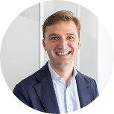

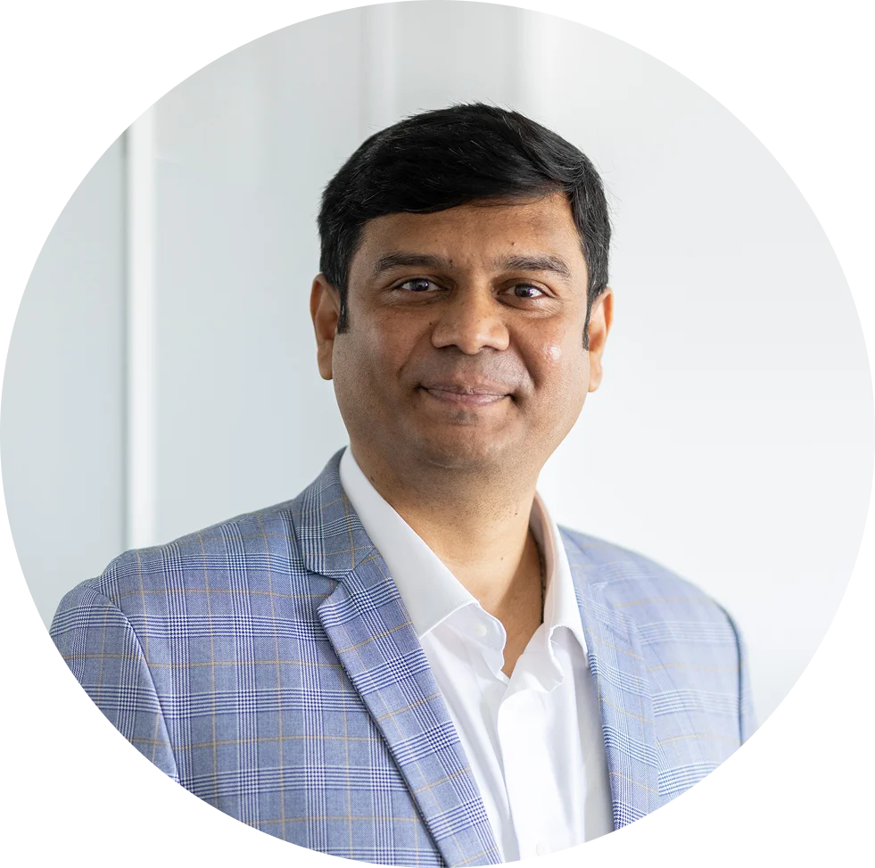

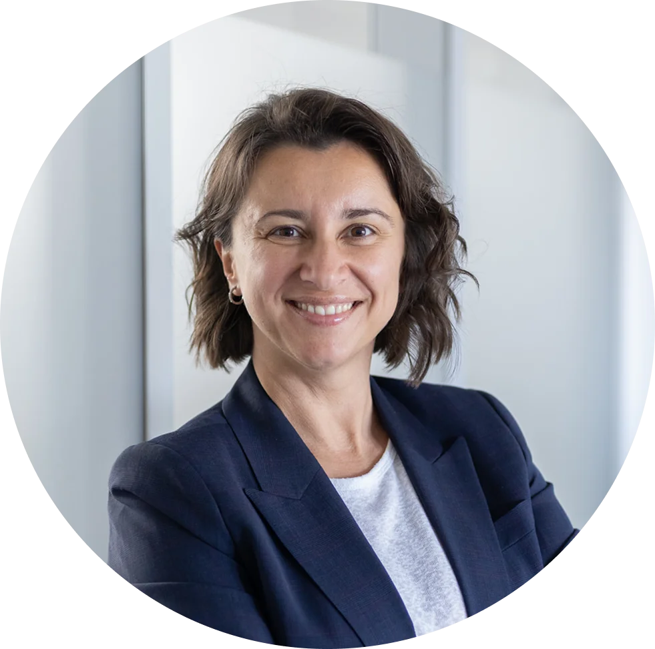
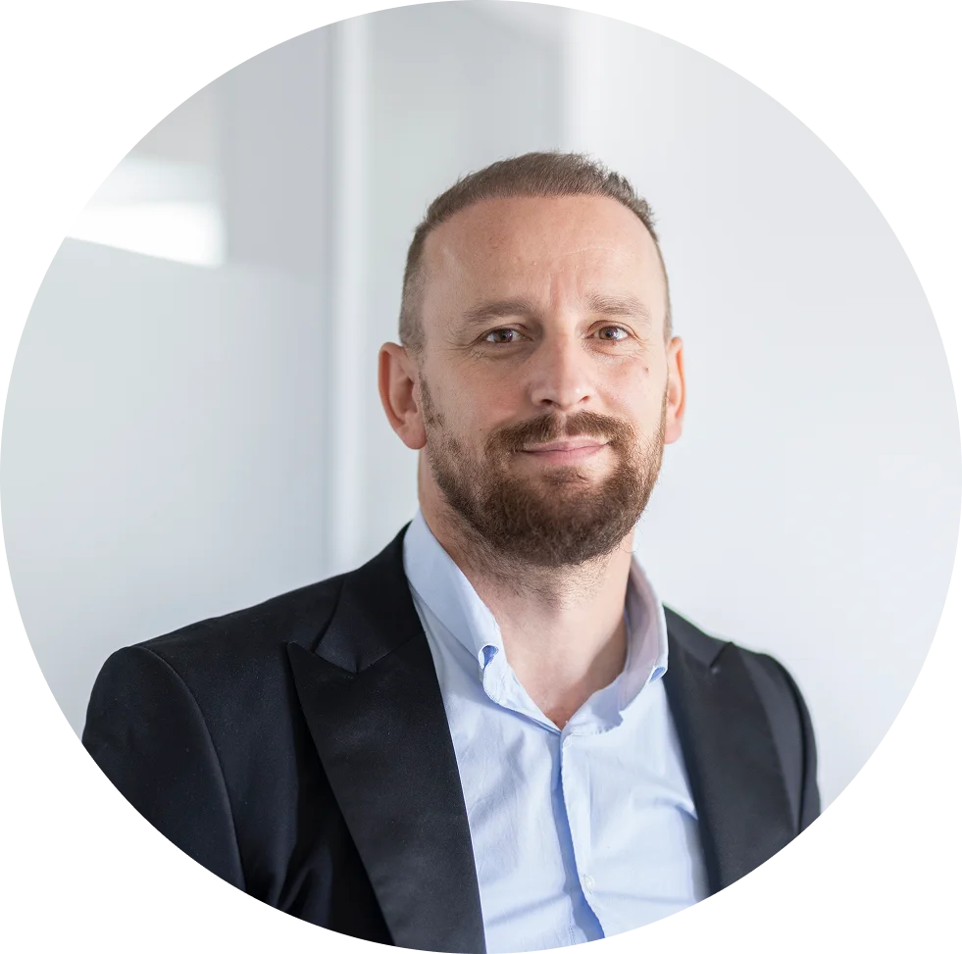
WHO WE ARE · OVERVIEW
History, locations and leadership
1781
1790
1920
1965
2014
2016
2021
2022
2023
2026
Pigge Druck und Service founded by Wilhelm E. Pigge
From newspaper printing to bookbinding in Bodenwerder
Move into printing of commercial and insurance forms
Leading forms printer in Northern Germany
Borek IT Sourcing Private Limited founded in India as a subsidiary of the printing company
Konstantin Borek (7th generation) joins · ISO 27001 for the Indian subsidiary
Printing business closed — focus on expanding Borek Solutions Group
Borek Solutions LLC founded in Prishtina, Kosovo
Focus on IT & AI services
Borek Solutions Bulgaria founded · launch of Borek AI Suite
LOCATIONS
MANAGEMENT TEAM
Konstantin Borek
Fiona Oldenburg
Kushal Rao
Group CEO
Group COO
Co-Founder & CEO India
Viktoria Schünemann
Elena Manovska
Muhamet Abdullahu
250+
Managing Partner & Co-CCO
Managing Partner & Co-CCO
CEO Kosovo
Employees at four locations
● Braunschweig · Headquarter, Germany
● Prishtina · AI-Hub
● Bulgaria · AI-Hub
● Vadodara · AI-Operations-Hub
BOREK SOLUTIONS GROUP · BOREKSOLUTIONS.DE
02 / 26
Notes:
1781 to today. Four locations, 250+ people. Layout per client reference: timeline, locations, management, client logos. Core areas removed.

Slide 3
WHY NOW
In three to five years your competitor is an autonomous company
Every company will have to automate large parts of its business — not because it's fashionable, but because it competes with firms that run entire processes without people.
ATTACKERS
INCUMBENTS
AI-native attackers
Established mid-size companies
—
Automated from day one — no legacy in the way
—
Processes built for a pre-AI world — run by people
—
Small teams, machine speed, almost no marginal cost
—
AI arrives in fragments: a chatbot here, a script there
—
They grow into your market — without your personnel costs
—
No central place to steer automation
—
Your price floor becomes their price ceiling
—
Deep expertise — but locked in people's heads
THE QUESTION
The question is not whether you automate. It’s how fast, at what cost — and on whose terms.
Autonomous means: the process runs without anyone triggering it — people only decide the exceptions.
BOREK SOLUTIONS GROUP · BOREKSOLUTIONS.DE
03 / 26
Notes:
AI-native attackers vs established Mittelstand. Autonomous = the process runs without a trigger; people decide exceptions.

Slide 4
THE PROBLEM
Everyone has recognised it. Almost nobody gets it done.
Mid-sized companies don’t need another roadmap. Real transformation starts where someone actually builds, runs and stands behind the automations.
Resource scarcity
Consultants deliver slides
Tools are bought, not used
The potential stays invisible
AI engineers are scarce and expensive worldwide — a single hire takes months and carries full employer risk.
You pay day rates for concepts and roadmaps. At project end the running automation is still missing.
A licence is not an automation. Someone has to specify, build, test and operate it — and nobody has the time.
Nobody has the complete map of what can be automated. It sits in the heads of the people doing the work.
THE USUAL OUTCOME
Weeks
A handful
1–2
per department, just for manual discovery
of ideas come to light — the rest stays hidden
pilots that never go into production
BOREK SOLUTIONS GROUP · BOREKSOLUTIONS.DE
04 / 26
Notes:
Messaging on this slide is pending revision by VS/EM.

Slide 5
THE GAP IN THE MARKET
Everyone delivers a piece. Nobody delivers the solution end to end.
Four types of provider work on the same problem. Each covers part of the chain — and leaves you the rest. The categories describe typical market offerings, not any single provider.
AI PLATFORMS
CONSULTANCIES
OFFSHORE STAFFING
AI BOUTIQUES
BOREK
Finds the potential across the whole company
✓
—
—
partly
✓
Builds the running automation
partly
—
✓
✓
✓
Operates it and measures the automation level
partly
—
—
partly
✓
Provides a permanent, trained team
—
—
✓
—
✓
German project management & documentation
—
✓
—
partly
✓
EU data residency, ISO 27001 & TISAX
partly
✓
—
partly
✓
Cost per unit of build capacity
low
very high
low
medium
low
We deliver end to end solution — people, system, governance and accountability in one package, at a price you can bear.
BOREK SOLUTIONS GROUP · BOREKSOLUTIONS.DE
05 / 26
Notes:
Categories describe typical market offerings, not a single provider.

Slide 6
THE ENTRY
Three ways in — one goal
Behind all three stand the same hub-trained developers, the same security standard and the same German project management. Almost every client starts with a fixed-price solution and grows into a permanent department.
01 / PRODUCT
02 / FIXED PRICE
03 / PERMANENT TEAM
Borek AI Suite
Borek AI Projects
Borek AI Department
The system the department works with — our own product.
A finished solution at a fixed price. You pay for the result, not the team.
The permanent team — your AI department, staffed from our hub.
·
Licence by company size
·
Fixed scope, price and date
·
Monthly rate per developer level
·
One-off setup, no build effort
·
Tier 1 to Tier 4 by complexity
·
Your backlog, your priorities
·
Maintenance, updates and hosting
·
Optional support and maintenance
·
Scale up or down, three months' notice
To Be Defined
€20,000 – €80,000+
from €8,600 / month
THE PATH
Easy to test — low risk, clear result. The goal is a team that keeps automating.
AI Suite: licence price depends on company size and number of sites, plus one-off setup.
BOREK SOLUTIONS GROUP · BOREKSOLUTIONS.DE
06 / 26
Notes:
Sequence: Suite, Projects, Department. More use-case detail is pending from VS/EM.

Slide 7
WHY US
The difference: we have the factory, not just the concept
Others sell consulting, licences or CVs. We run our own training and delivery organisation in Kosovo — that is the part you can't buy at short notice.
01
02
03
04
05
Our own AI Academy
Knowledge Hub
Our own domains
Global project management
Practical — and affordable
Every automation we build becomes a tested, reusable pattern. The second solution is faster than the first.
Document AI & OCR, conversational agents, RAG, workflow automation, data engineering, MLOps, QA and evaluation.
Three months of our own curriculum with a final exam — only then does anyone join a client team. We don't place people, we train them.
A dedicated project lead steers cadence, quality, escalation and reporting — the discipline behind impeccable delivery, every sprint.
Running automations instead of roadmaps — each with specification, test protocol and runbook. One unit of build capacity from €3,800 a month.
AND A SIXTH
And a sixth: verifiably secure — ISO 27001, TISAX, GDPR, EU hosting, no model training on your data.
BOREK SOLUTIONS GROUP · BOREKSOLUTIONS.DE
07 / 26
Notes:
We run our own training and delivery organisation — the part you can't buy at short notice.

Slide 8
SECTION 01 · PRODUCT
Borek AI Suite
Capture, build, operate — the system behind the department.
BOREK SOLUTIONS GROUP · BOREKSOLUTIONS.DE
08 / 26
Notes:
Section: Borek AI Suite.

Slide 9
BOREK AI SUITE
One system, three stages — a closed loop
Capture, build, operate: the Suite finds the automation potential across the whole company, hands every opportunity to the delivery team as a build-ready specification and shows in the cockpit what it is worth.
01
02
03
Capture
Build
Operate
An AI agent interviews every level — from management to the shop floor. Five to ten minutes per conversation, by voice or text. No workshops, no consultants.
Every approved specification goes to your expert team in the hub. Around four weeks per automation, IT sign-off in parallel, live on your go / no-go.
One cockpit for the whole company: automation level per department, hours saved, value contribution, exceptions and errors.
Result: a scored backlog with a business case per candidate.
Result: a running automation in production — with specification, test protocol and runbook.
Result: steering instead of gut feeling — the next wave becomes visible.
THE LOOP
A continuous loop: capture → build → operate → and the running automations show what comes next.
Our own product — monthly licence plus one-off setup. The capture approach already runs in our delivery projects.
BOREK SOLUTIONS GROUP · BOREKSOLUTIONS.DE
09 / 26
Notes:
One system, three stages. Closed loop: capture, build, operate.

Slide 10
CAPTURE
One AI that interviews everyone — and turns answers into automations
Nine tailored conversations, one per role and depth. Five to ten minutes, on any device, in German or English.
L1 Management
C1 Vision & priorities
Two scans, then one deep-dive
L2 Division heads
C2 Potential scan · C3 Process map
Everyone first names their manual tasks; we only go deep on the one that counts. Easy for employees, build-ready where it matters.
L3 Team leads
C4 Process walk-through
L4 Employees
C5 Everyday tasks · C6 Task deep-dive
Big ideas go to C9
L5 IT / Data
C7 Technology & data check
If an idea is a whole tool rather than a single task, it moves to the project track and becomes a staged plan with an MVP first.
All Everyone
C8 Review & confirm
BOREK SOLUTIONS GROUP · BOREKSOLUTIONS.DE
10 / 26
Notes:
Nine tailored conversations, one per role and depth.

Slide 11
CAPTURE · FROM OUR SYSTEM
Employees simply talk — and can share documents
BOREK AI SUITE — CAPTURE AGENT
C5 · MY EVERYDAY TASKS · VOICE
WHAT WE CAPTURE
Voice conversation · listening
00:42
Trigger
Invoice arrives in the accounts-payable inbox
LIVE TRANSCRIPT
Volume
~60 per day
Agent
Which task do you do almost daily and find routine?
Rule
Block if > 2 % deviation from the order
You
Matching invoices with purchase orders — about 60 a day.
Agent
Understood — can you share a recent invoice?
Steps
read → match → post
Systems
Outlook, SAP
Evidence
invoice_4711.pdf
Drag a document here — invoice, export, screenshot
→ becomes a build-ready requirement
BOREK SOLUTIONS GROUP · BOREKSOLUTIONS.DE
11 / 26
Notes:
Employees simply talk — and can share documents. Every conversation becomes a build-ready requirement.

Slide 12
CAPTURE · THE YIELD
For the first time, an objective view of your automation potential
No gut feeling, no workshop opinion: a map across the whole company — how many automations there are, where they sit, what they are worth and what they cost.
AUTOMATION MAP PER DEPARTMENT · EXAMPLE
DEPARTMENT
CANDIDATES
TIER 1 / 2 / 3
POTENTIAL H / MONTH
Every level interviewed
Finance
14
9 / 4 / 1
310 h
From leadership to the shop floor, including IT.
Customer service
12
7 / 4 / 1
260 h
Business case per line
Logistics
9
6 / 3 / 0
180 h
Benefit, effort, risk and payback — commercial, not technical.
Purchasing
8
5 / 2 / 1
140 h
HR
7
5 / 2 / 0
95 h
You prioritise
Management decides the order.
Sales
6
4 / 2 / 0
80 h
IT
5
3 / 1 / 1
70 h
Filled with your numbers, not estimated.
Total
61
candidates
~1,135 h
BOREK SOLUTIONS GROUP · BOREKSOLUTIONS.DE
12 / 26
Notes:
Example automation map. Filled with the client's numbers, not estimated.

Slide 13
YOUR DECISION
You decide how fast your company becomes autonomous
61 automations found are not fate but arithmetic: team size times time. You choose the lever — we show what each option costs and when it is done.
BACKLOG · EXAMPLE
TIME TO A FULLY AUTOMATED BACKLOG · ILLUSTRATIVE
61
Team S
~18 months
2 Junior + PM
Team M
~12 months
1 Mid + 2 Junior + PM
automations in the backlog
Team L
1 Senior + 1 Mid + 2 Junior + PM
~9 months
Same backlog, three speeds: more experts means autonomous sooner, fewer experts means longer — and correspondingly lower cost per month.
BOREK SOLUTIONS GROUP · BOREKSOLUTIONS.DE · CONFIDENTIAL
13 / 26
Notes:
Same backlog, three speeds. Team size times time.

Slide 14
BUILD
Your AI experts in Kosovo turn plans into running automations
Specifications flow from the cockpit — or from your own backlog — to our nearshore team. AI-assisted experts turn them into a working automation, align it with your IT and put it live on your go / no-go.
Specification
Build
IT sign-off
Go-live
Operate
~4 weeks
AI-assisted
EU nearshore
White-label
per automation and expert
experts, amplified by our tooling
daily direct flights, same time zone
can run as your own tower
A standard team of two developers plus PM delivers around one Tier-1 solution per quarter — Tier 2 and Tier 3 run in longer cycles.
BOREK SOLUTIONS GROUP · BOREKSOLUTIONS.DE
14 / 26
Notes:
Specification to operate. Around four weeks per automation and expert.

Slide 15
OPERATE
One cockpit: what runs, what it saves, what comes next
BOREK AI SUITE — STEERING COCKPIT
BACKLOG · AUTOMATION MAP · COVERAGE · ROLLOUT
58 %
23
~1,240 h
€ 55 k
Automation level
Automations live
saved / month
value / month
AUTOMATION LEVEL PER DEPARTMENT
RUNNING AUTOMATIONS
Customer service
72 %
Invoice check (3-way)
Finance
Finance
64 %
Logistics
58 %
Returns triage
Customer service
Purchasing
49 %
Delivery-date bot
Logistics
HR
41 %
Sales
33 %
Onboarding package
HR
IT
28 %
Example cockpit — every metric is configured with your own data.
BOREK SOLUTIONS GROUP · BOREKSOLUTIONS.DE
15 / 26
Notes:
Example cockpit — every metric is configured with the client's own data.

Slide 16
ACCEPTANCE
We automate tasks — not people
Automation only works if your teams help find it. That's why the message from leadership, managers and the agent itself is always the same: we take away the dull work and give the time back.
“Will I lose my job?”
“Is this surveillance?”
We automate tasks, not roles. Every automation is agreed with the affected department.
The agent asks about tasks and processes, never about people. We evaluate the conversation, never the person.
“Why should I take part?”
“I don't have time.”
Your ideas decide what gets built — and you get the hours back first.
Five to ten minutes, on your phone — pause any time and continue later.
You receive the works-council briefing, the employee FAQ and the communication plan — written for German companies.
BOREK SOLUTIONS GROUP · BOREKSOLUTIONS.DE
16 / 26
Notes:
We automate tasks, not people. Works-council briefing, FAQ and communication plan included.

Slide 17
SECTION 03 · PERMANENT TEAM
Borek AI Department
Your permanent AI team — staffed from our hub, working on your backlog.
BOREK SOLUTIONS GROUP · BOREKSOLUTIONS.DE
17 / 26
Notes:
Section: Borek AI Department.

Slide 18
BOREK AI DEPARTMENT
The permanent team — your AI department, staffed by us
You already know where it hurts? Then you don't need capture software — you need people who build. We give you your own AI team working on your backlog in your environment.
MODEL A
Your team, under your name
In your environment
Project model
The same experts every month — they know your systems.
Your repositories, your tooling, your security rules.
Fixed scope, fixed result, fixed date. Ideal for the first automation — with a 50 % money-back guarantee on the first one.
German project management
Switch to the Suite any time
German project lead steers cadence, reporting, escalation.
Once the obvious backlog is empty, the Suite finds the next wave.
MODEL B
Container model
Fixed monthly capacity of AI experts. You fill the backlog, we deliver continuously — priorities can change every sprint.
Junior €3,800 · Mid €5,500 · Senior €7,100 per month, plus PM flat fee €1,000–2,000 · three months' notice
BOREK SOLUTIONS GROUP · BOREKSOLUTIONS.DE
18 / 26
Notes:
Project model vs container model. Same experts every month.

Slide 19
SECTION 02 · FIXED PRICE
Borek AI Projects
A finished solution at a fixed price. You pay for the result, not the team.
BOREK SOLUTIONS GROUP · BOREKSOLUTIONS.DE
19 / 26
Notes:
Section: Borek AI Projects.

Slide 20
ONBOARDING
Your first automation live in 30 days
Onboarding is our job, not yours. Here is exactly what happens after signature — and the very short list of what we need from you.
DAY 1–5
DAY 6–15
DAY 16–25
DAY 26–30
Kick-off & access
Capture
First build
Live & measured
Contract, NDA and DPA in place. Your German project lead is named and introduced. Security checklist, system inventory and access requests start.
Option A: the Suite invites your teams, the first conversations run. Option B: joint backlog session — candidates scored, costed and prioritised.
The most impactful candidate goes into build with your expert team. IT sign-off runs in parallel so nothing waits at the end.
Go / no-go with you. First automation in production, hours saved measured, roadmap for the next quarter agreed.
WHAT WE NEED FROM YOU
A sponsor from management · one pilot department · IT access · around two hours of your time per week. We bring everything else.
BOREK SOLUTIONS GROUP · BOREKSOLUTIONS.DE
20 / 26
Notes:
First automation live in 30 days. Very short list of what we need.

Slide 21
PACKAGES
Three team sizes — you choose the pace
Same hub, same project management. The only difference is how much capacity runs in parallel and how complex the tasks may be.
Team S
Team M
POPULAR
Team L
2 Junior + PM
1 Mid + 2 Junior + PM
1 Senior + 1 Mid + 2 Junior + PM
€8,600
€14,600
€22,200
per month
per month
per month
·
~4 Tier-1 projects per year
·
~5–6 Tier-1 equivalents per year
·
Tier-3 capable
·
One department, then expand
·
Tier-2 initiatives in parallel
·
Architecture ownership on site
·
Cheaper than fixed price from 4 projects
·
Independent workstreams
·
Critical integrations
·
The standard entry team
·
The usual growth step
·
For company-wide programmes
FIXED PRICE ALTERNATIVE
Prefer a fixed price? A finished solution from €20,000 (Tier 1, 2–4 months) — and from around four projects a year your own team is the cheaper route.
BOREK SOLUTIONS GROUP · BOREKSOLUTIONS.DE
21 / 26
Notes:
Three team sizes. Sticker 'check either or' left open — confirm whether packages and fixed-price footnote should both appear.

Slide 22
OUR AI HUB
Our AI hub in Kosovo — our own company, not a partner network
Over 80 permanently employed software and automation developers in Prishtina. We recruit, train, certify and develop them ourselves — in one of the youngest and most digitally skilled talent markets in Europe.
Borek AI Academy
Knowledge Hub
Domains
Our own curriculum: Python, agent design, RAG, evaluation, secure deployment. Nobody joins a client team without passing the exam.
Every automation we build becomes a tested, reusable pattern. The second is faster than the first, the tenth faster still.
Document AI & OCR · conversational agents · RAG · workflow automation & RPA · data engineering · MLOps · QA and evaluation.
80+
2.5 hrs
CET
EU
DE / EN
own developers in Prishtina
direct flight — daily to several German airports
same working day, same time zone
data protection level
working languages
That's why cost-efficient doesn't mean inexperienced. It means European engineering without a German salary structure on top.
BOREK SOLUTIONS GROUP · BOREKSOLUTIONS.DE
22 / 26
Notes:
Our own company in Prishtina, not a partner network. 80+ permanent developers.

Slide 23
BOREK TRUST
Your data, your processes, your knowledge stay with you
We know what a German Mittelstand company needs at this point: no black box and no promises, but verifiable commitments — contractually agreed and technically anchored.
ISO 27001
TISAX
GDPR / DSGVO
ISMS
Information security
Automotive level (VDA)
EU data protection
Managed security system
EU hosting, your tenant
Encrypted end to end
Access control
Hosted in the EU — in your region or on your own infrastructure.
TLS 1.2+ in transit, AES-256 at rest — for everything.
SSO, MFA, role-based access and least privilege as standard.
No model training
Isolation & audit trail
Human in the approval
Your prompts and documents are never used for model training.
Separation per client, dedicated environments, complete audit trail.
Versioned changes and human approval before go-live.
BOREK SOLUTIONS GROUP · BOREKSOLUTIONS.DE
23 / 26
Notes:
Verifiable commitments — contractually agreed and technically anchored.

Slide 24
WHICH MODEL FITS
Same people, same standards — a different commercial frame
1 · AI Suite
2 · AI Projects
3 · AI Department
WHAT YOU BUY
A finished product
A result — a finished solution
Capacity — a team of your own
BILLING
Subscription + setup fee
Fixed price per project
Monthly rate per profile
ENTRY PRICE
€500 – €1,500 / month
€20,000 (Tier 1)
€8,600 / month (2 Junior + PM)
DELIVERY RISK
Product is finished
Entirely with us
Shared
TYPICAL DURATION
Ongoing subscription
2 to 12+ months per project
Ongoing, 3 months' notice
FITS IF
You want to make potential and steering visible across the whole company
You have a clearly defined problem and want to start with low risk
You have ongoing demand — around four projects a year or more
AVAILABILITY
COMING SOON
AVAILABLE NOW
AVAILABLE NOW
Not sure? Start with a fixed-price project — 50 % money back if the result doesn't convince.
BOREK SOLUTIONS GROUP · BOREKSOLUTIONS.DE
24 / 26
Notes:
Same people, same standards — a different commercial frame. Order: Suite, Projects, Department.

Slide 25
PRICING
One rate card, one tier table. That is the entire price list.
All figures are indicative pricing — the final quote depends on scope, integrations and team composition.
OWN AI TEAM — MONTHLY RATE PER PROFILE
AI PRODUCT DELIVERY — FIXED PRICE PER TIER
PROFILE
WHAT THE PROFILE DELIVERS
RATE / MONTH
TIER
STAFFING
LEAD TIME
FIXED PRICE
CHARACTERISTICS
AI Developer · Junior
Trained in the hub, 0–2 years, works under senior supervision
€3,800
Tier 1 · Simple
2 AI Dev + PM
2–4 months
€20,000 – 40,000
One clearly bounded process · 1–2 integrations
AI Developer · Mid-level
Delivers AI workstreams independently — agents and process automation
€5,500
Tier 2 · Medium
2 AI Dev + PM
5–9 months
€40,000 – 80,000
Multi-step across systems · 3–6 integrations
AI Developer · Senior-level
Owns workstreams, leads juniors, sets the technical direction
€7,100
Tier 3 · Complex
2–3 AI Dev + PM
9+ months
from €80,000
Multi-agent, company-wide · governance
PM flat fee
Fixed contact, delivery quality and team steering
€1,000 – 2,000
Tier 4 · Programme
scaled individually
individual
individual quote
Ongoing, managed AI operations across units
Standard team = 2 AI Developers + PM = €8,600 / month · tier price = team × duration · AI Suite €500 – €1,500 / month plus setup · all prices net, excl. VAT · indicative, subject to final quote.
BOREK SOLUTIONS GROUP · BOREKSOLUTIONS.DE
25 / 26
Notes:
Indicative pricing. One rate card, one tier table.

Slide 26
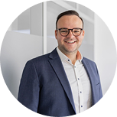
Let’s talk
Konstantin Borek
Viktoria Schünemann
Fiona Oldenburg
Max Fichtner
Group CEO
Managing Partner & Co-CCO
Group COO
Senior Strategic Partnership Manager
borek@boreksolutions.de
viktoria.schuenemann@boreksolutions.de
fiona.oldenburg@boreksolutions.de
max.fichtner@boreksolutions.de
+49 151 539 652 10
+49 151 223 06 286
+49 151 729 76084
+49 171 9994310
From first conversation to a deployable team in eight weeks.
Altewiekring 20A, 38102 Braunschweig, Germany
+49 531 28354 162
boreksolutions.de
26 / 26
Notes:
CI closing page. Next steps: 45-minute conversation, one guaranteed automation, choose the pace.

