Slide 1
VRELAX INVESTIGATION OF RELAXING
Görkem Narinoğlu & Umut Efiloğlu
Advisor: Dr. Faris Serdar Taşel
Co-Advisor: Asst. Prof. Dr. Murat Yılmaz

Slide 2
Contents
Company Information
Motivation
Problem
Analysis
Similar Applications
Solution
Technology Used
Conclusion
References

Slide 3

Company Information
Mebitech was founded in 2012
Data centers located in Ankara and Istanbul
Customer services and IT software

Slide 4
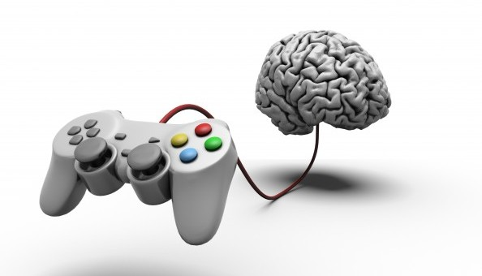
Motivation
Creating a virtual environment is motivating
Serious games are beneficial
Combining aspects of psychology and computer engineering (e.g. stress treatment, signal processing and virtual reality)

Slide 5
Problem
Intense anxiety problem
Troubles with psychological treatment
Handling stressful moments
Determining critical stress interval
Specifying stimuli for analysis

Slide 6
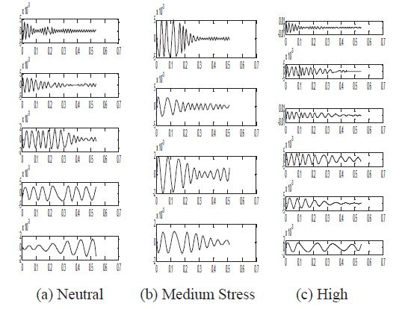
Analysis / Stress Analysis Structure
Level of stimuli = Person's emotion
SUSAS (Speech Under Stress Database)
Voice analysis with different algorithms

Slide 7
Analysis / How Is Stress Analyzed?
Can be analyzed with voice signal processing
8 – 12 Hz neutral voice range
There are different algorithms for analyze the voice signals (e.g. EMD, Teager Energy Operator, FFT)
Converting audio data into signal modules called Intrinsic Mode Functions (IMFs)
Comparing frequency with SUSAS (Speech Under Stress Database) voice samples

Slide 8

Analysis / VR Application
More effective than common treatments
Human – Computer Interaction
Two distinct scenarios
Creating realistic environment
HTC Vive compatible
Works as a desktop application

Slide 9
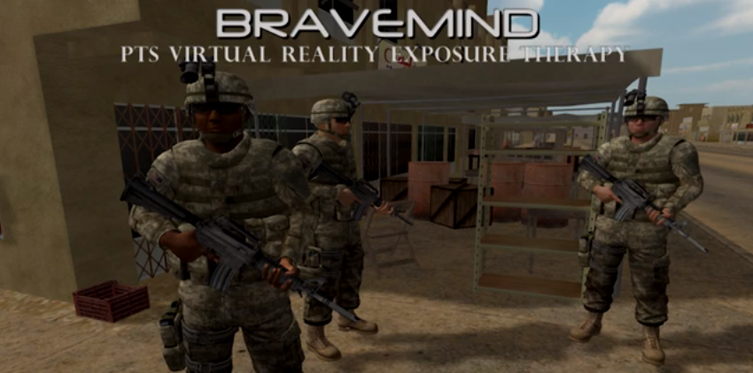

Similar Applications
Relax VR which uses 360-degree videos to relax users
MonarchVR is a mobile environmental and meditation application
Bravemind VR exposure therapy software

Slide 10
Solution / Planned Components
Voice Stress Analysis Structure
VR Environments/Scenarios with soothing music
Combine VR Application with Voice Stress Analysis Structure to operate them together

Slide 11
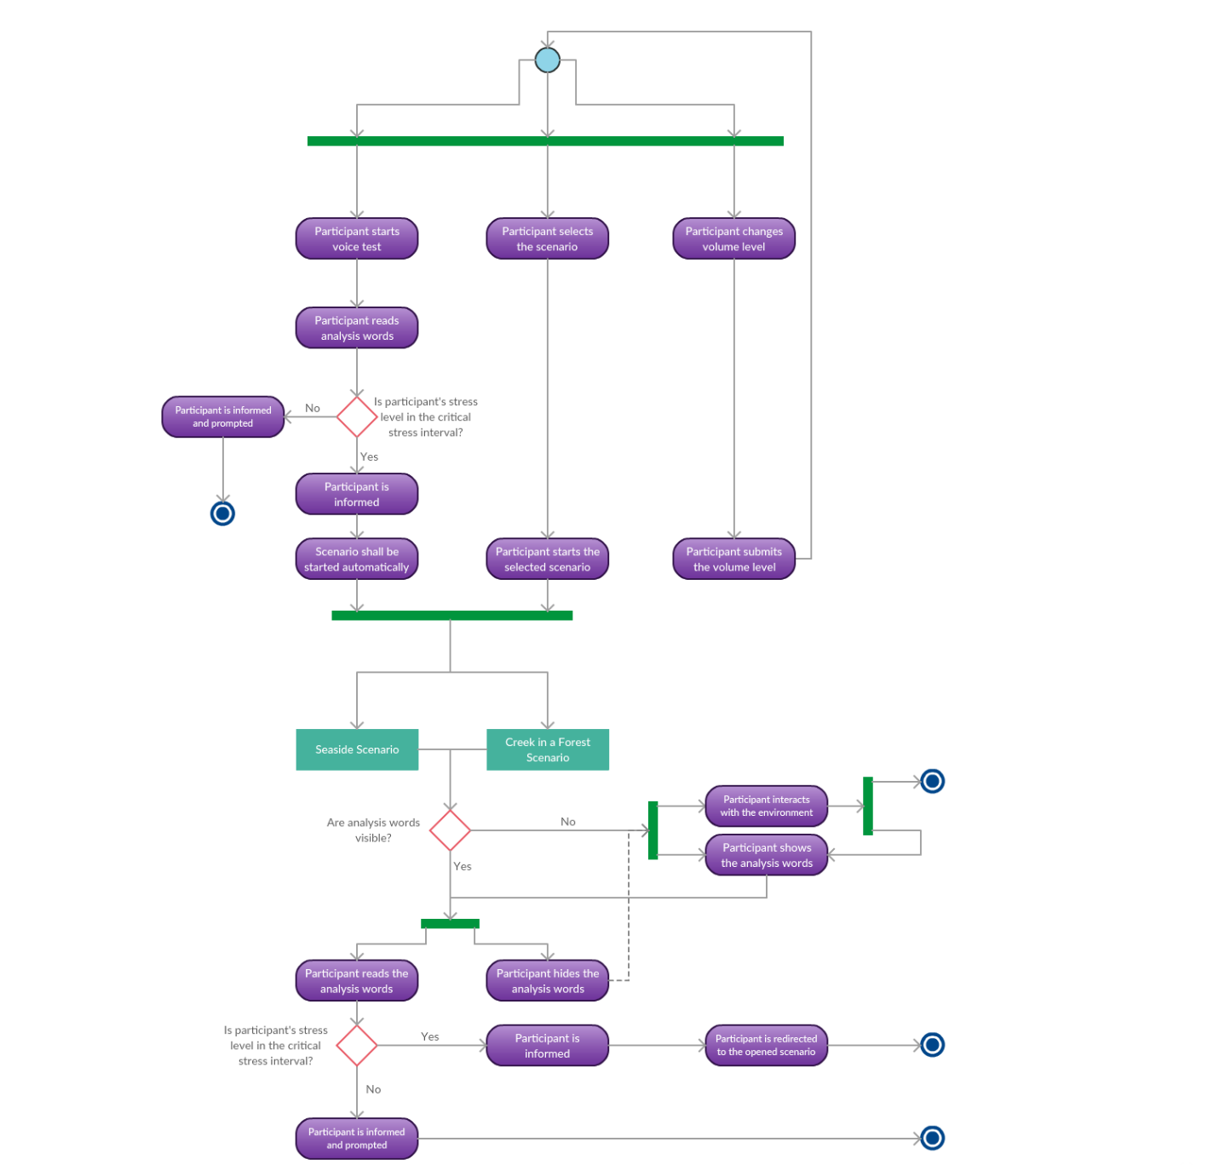
Solution / Activity Diagram

Slide 12
Solution / Activity Diagram (Cont.)

Slide 13
Solution / New Aspects
VRelax uses speech recognition and signal processing to measure stress level
VRelax combines stress analysis and virtual reality
VRelax makes relaxing easier and more meaningful with analyzed data

Slide 14


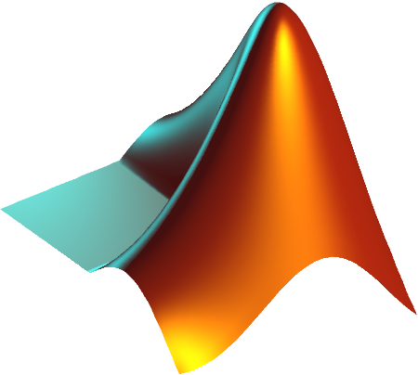


Technology Used
Here are the tools that we plan to use;
Unreal Engine
Blender
Substance Painter
MATLAB
Visual Studio

Slide 15
Conclusion
Analyze stress with voice signal processing and reduce it with relaxing scenarios
Virtual Reality System using HTC Vive
New way to handle stress
Currently in development

Slide 16
References
J. Zhang, N. Mbitiru, P. Tay and R. Adams, "Analysis of Stress in speech using adaptive Empirical Mode Decomposition", 2009 Conference Record of the Forty-Third Asilomar Conference on Signals, Systems and Computers, 2009.
Relaxvr.co. (2018). Relax VR - Rest, Relaxation & Meditation in Virtual Reality. [online] Available at: http://www.relaxvr.co/ [Accessed 10 Jan. 2018].
S. Ruzzo, "Bravemind: Virtual Reality Exposure Therapy", University of Southern California Institute, Los Angeles, 2005.
MonarchVR. (n.d.). Home. [online] Available at: http://monarchvr.org/ [Accessed 10 Jan. 2018].
C. Hopkins, R. Ratley, D. Benincasa and J. Grieco, "Evaluation of Voice Stress Analysis Technology", Proceedings of the 38th Annual Hawaii International Conference on System Sciences, 2005.
J. Hansen and S. Bou-Ghazale, "Getting Started with SUSAS: A Speech Under Simulated and Actual Stress Database", Fifth European Conference on Speech Communication and Technology, 1997.
"Ar-Ge | Mebitech Bilişim A.Ş.", KAYYEN, 2017. [Online]. Available: http://www.mebitech.com/arge?arge=17. [Accessed: 09- Dec- 2017].
A. M, C. Jorge and P. Couto, "Using a Game Engine for VR Simulations in Evacuation Planning", IEEE Computer Graphics and Applications, vol. 28, no. 3, pp. 6-12, 2008.
"Game Engine Technology by Unreal", Unrealengine.com, 2017. [Online]. Available: https://www.unrealengine.com/en-US/what-is-unreal-engine-4. [Accessed: 16- Dec- 2017].
B.Foundation, “About – blender.org”, blender.org, 2016. [Online]. Available: https://www.blender.org/about/. [Accessed: 16-Dec-2017].
"Substance Painter", allegorithmic, 2018. [Online]. Available: https://www.allegorithmic.com/products/substance-painter. [Accessed: 12- Jan- 2018].

Slide 17

Any Questions?

Slide 18
How Much is Stress Evaluation Successful?
Log Frequency Power Coefficients (LFPC) gives highest accuracy (87.8% for stress, 89.2% for emotion classification).
Detection of Stress and Emotion in Speech Using Traditional and FFT Based Log Energy Features (T L Nwe; S W Foo; L C De Silva)
EMD is better than Traditional Fast Fourier Transform (FFT) method in the detection of stress in voice.
Analysis of Stress in Speech Using Empirical Mode Decomposition (Nyaga Mbitiru, Peter Tay, James Z. Zhang, Robert D. Adams)
This stress evaluation process is also evaluated/approved by psychologist(s).

Slide 19
How Will The Product Be Tested?
Test group will be chosen by the psychologists.
This product will be tested under the supervision of psychologists.
Appropriate stimuli will be supplied to the patient(s).
After the occurred anxiety problem, VRelax will be tested.

Slide 20
Why HTC Vive?
Fully supports Unreal Engine
Has wide view angle and its technical features are better than its counterparts.
Proposer company has HTC Vive

