Slide 1
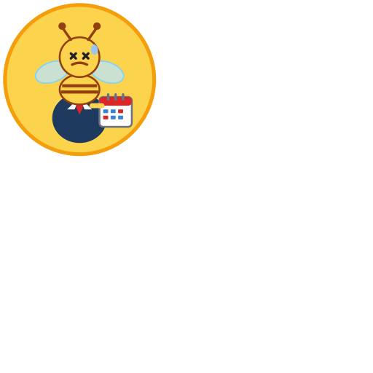

IBM
Keeping work and home in sync — without the secrets.
A native macOS menu bar app built by Daneyand & IBM’s Bob
HoneyDue
Calendar Sync
v 1.0.6
Daneyand "DJ" Singley
daneyand@ibm.com
802-598-6057

Slide 2
The Problem – The most impressive aspect of Bob is the building journey!
ORIGIN STORY
The Conflict
• IBM/Exchange calendar has all your work meetings
• Personal/family calendar is completely separate
• Family books events over your work hours — conflicts!
• But you can't share work calendar details with family
• Meeting titles, attendees, locations are all confidential
• There was no tool that solved this exact problem
The Key Insight
Family doesn't need to know WHAT you're doing — only THAT you're busy. Copy the time blocks. Strip every single detail. Share only the silence.
IBM Internal | HoneyDue Calendar Sync | Daneyand & Bob | 2025

Slide 3
How Should We Build It?
THE ARCHITECTURE JOURNEY | FROM SCRIPT TO NATIVE APP
🐍
🌐
🐳
🍎
Python Script
Web App
Container
Native Mac App
Started here
Considered next
Also explored
Where we landed
A simple Python script that pulled calendar data and wrote sanitized blocks. Fast to prototype. But — how does the user run it? Where does it live?
→
Host it as a web app — user logs in, connects calendars via OAuth. Now we need a server, a domain, auth flows, credentials in the cloud.
→
Run it in Docker — containerized, portable. But still needs a host, still needs OAuth tokens, still needs somewhere to run 24/7.
→
macOS already syncs both calendars via Calendar.app. EventKit reads them both locally — no server, no OAuth, no credentials. Just a bee in your tray.
"Swift? I've never written a line of Swift in my life." — Daneyand, Session 1

Slide 4
The Road Not Taken – Bob downloaded all compile tools locally
APPROACHES WE TRIED — AND ABANDONED
Outlook AppleScript
Google Calendar OAuth
Sanitizer.swift Module
❌ Broken in Outlook 16.80+
❌ Too complex, too much friction
✅ Simplified & inlined
Microsoft's new sync engine (HxStore) broke the 'calendar events' AppleScript property. Returns 0 events even when fully synced. A confirmed regression with no fix.
Required Google Cloud project setup, OAuth credentials, token refresh logic, and API rate limits. Overkill for a personal tool. Removed entirely.
Originally a standalone Swift module. Sanitization was so straightforward (just replace the title) that the whole module was folded into EventKitSync.swift.
"Wow, this thing has shell access!!." — Daneyand, Session 2
IBM Internal | HoneyDue Calendar Sync | Daneyand & Bob | 2025

Slide 5
The Breakthrough
EVENTKIT — THE ANSWER WAS IN macOS ALL ALONG
macOS Calendar.app is the hub.
IBM/Exchange Account
When you add your IBM/Exchange account to System Settings → Internet Accounts, macOS Calendar.app syncs your work calendar locally. Apple's EventKit framework can then read those events directly — no Outlook, no AppleScript, no Microsoft APIs, no Google OAuth, nothing. Both source (IBM) and target (iCloud/Google) are EventKit calendars. One API. Zero secrets.
↓ Internet Accounts
macOS Calendar.app
↓ Apple EventKit
HoneyDue reads events
↓ Sanitize & write
Personal/iCloud Calendar
IBM Internal | HoneyDue Calendar Sync | Daneyand & Bob | 2025

Slide 6
The Name & The Character
BRAND | IDENTITY | ARTWORK
"HoneyDue"
The work calendar dues get sanitized and sent home. Like a honeybee dutifully delivering — but keeping the hive's secrets. The bee mascot wears a suit jacket and a red tie, holds a calendar, and has stressed ✕ eyes — because work calendars are stressful. Custom SVG artwork, hand-crafted with Bob. The sweat drop sealed the deal.
IBM Internal | HoneyDue Calendar Sync | Daneyand & Bob | 2025

Slide 7
Built With Bob
AI-ASSISTED DEVELOPMENT | FROM IDEA TO APP IN HOURS
Session 1
Session 2
Session 3
Session 4
Problem framing, architecture decision (EventKit, not Outlook AppleScript)
Core Swift app scaffold, Models, CalendarReader, EventKitSync, DiffEngine, SyncEngine
SwiftUI SettingsView, tray icon (NSStatusItem), AppDelegate, Logger, config persistence
Bug fixes: recurring events crash, all-day events, multi-day events, back-to-back meetings
Session 5
Session 6
Session 7
Session 8
Ownership marker, duplicate guard, block-title rename sweep
State invalidation on calendar change, About window, author photo, bee icon SVG
Version bump checklist, build.sh release DMG
35 unit tests, sync interval options, v1.0.6 release
IBM Internal | HoneyDue Calendar Sync | Daneyand & Bob | 2025

Slide 8
How It Works
ARCHITECTURE | ZERO THIRD-PARTY DEPENDENCIES
📅
🔍
⚙️
✅
💾
EventKit Read
DiffEngine Compare
SyncEngine Orchestrate
EventKit Commit
state.json Save
→
→
→
→
CalendarReader fetchMeetings()
Current events vs state.json
Create / Update / Delete / Skip
Atomic batch Only on full success
Snapshot written Post-commit only
🔒 Zero Data Leakage
⚡ Atomic Commits
🐝 macOS Native
♻️ Change Tracking
Only block title, start, and end time cross over. Nothing else.
All EventKit changes roll back if any single operation fails.
Pure Swift + EventKit + SwiftUI. No Outlook. No OAuth. No APIs.
Moved meetings update their block. Cancelled meetings delete it.
IBM Internal | HoneyDue Calendar Sync | Daneyand & Bob | 2025

Slide 9
The Sanitization Principle
SECURITY | PRIVACY | BY DESIGN
SOURCE EVENT (IBM Calendar)
TARGET EVENT (Personal Calendar)
Title:
Q4 Strategy Review — Confidential
Title:
IBM - BLOCK
Attendees:
CEO, CFO, VP Engineering, ...
Attendees:
— (not written)
Location:
Board Room 4B, Austin TX
✦ SANITIZE ✦
Location:
— (not written)
→
Notes:
Link to confidential deck...
Notes:
honeyDue Calendar Sync (ownership marker)
Start:
2025-07-15 14:00
Start:
2025-07-15 14:00
End:
2025-07-15 15:30
End:
2025-07-15 15:30
IBM Internal | HoneyDue Calendar Sync | Daneyand & Bob | 2025

Slide 10
State Tracking & Diff Engine
SMART SYNC | NOT A FULL WIPE-AND-REWRITE EVERY TIME
NEW
CHANGED
DELETED
UNCHANGED
Event in source, not in snapshot
Event in both, hash differs
In snapshot, not in source
In both, hash matches
→ Create block on personal cal
→ Update block (time moved)
→ Delete block from personal cal
→ Skip (nothing to do)
Safety Features
• SHA-256 hash of event ID + start + end detects changes precisely
• Ownership marker ('honeyDue Calendar Sync' in notes) prevents touching user events
• Duplicate guard: scans target cal before creating — skips if block already exists
• Block-title rename sweep: if title changed, pre-pass renames all owned blocks first
• Calendar-change invalidation: changing source/target deletes state.json → full re-sync
• Atomic commit: if any write fails, all EventKit changes roll back, state is not saved
IBM Internal | HoneyDue Calendar Sync | Daneyand & Bob | 2025

Slide 11
The App Experience
macOS MENU BAR | SET IT AND FORGET IT
Tray Status Dots
Settings Window
Key Features
⚫
Grey
Running, no sync yet
• Source calendar picker (work/IBM)
✓ Regular, recurring, all-day, multi-day events all handled
• Target calendar picker (personal/iCloud)
✓ Auto-sync on configurable timer
🟡
Yellow
Sync in progress
• Block Title input (default: IBM - BLOCK)
✓ Run Now for immediate sync
🟢
Green
Last sync succeeded
• Lookahead Days (1–100, default 60)
✓ 10-day / 10 MB rotating log
• Sync Interval (15 min → 24 h)
🔴
Red
Last sync failed — check log
✓ Batch mode (--batch flag)
• Start at Login / Start Minimized
✓ Testing mode (-t flag)
• Save Config → Run Now
• Last Run / Status / Next Run
✓ Start at login support
• View Log File / Hide to Tray
✓ Zero third-party dependencies
IBM Internal | HoneyDue Calendar Sync | Daneyand & Bob | 2025

Slide 12
Quality & Release
35 UNIT TESTS | CI-GATED BUILD | SIGNED DMG
DiffEngineTests
AppConfigTests
ModelsTests
7 tests
12 tests
16 tests
Validates the diff logic that decides what to create, update, delete, or skip: • New event not in snapshot → create • Event in both, hash changed → update • Event in snapshot, gone from source → delete • Event in both, hash same → skip • ekEventID forwarding, mixed batch, empty set
Validates every config rule that guards bad input: • Source & target calendar ID must be non-empty • Source and target cannot be the same calendar • Lookahead days must be 1–100 • Block title must be non-empty • All 8 sync intervals are accepted (15 min–24 h) • Sub-60-min intervals rejected outside test mode
Validates data integrity across all model types: • JSON encode → decode round-trips for Meeting, SyncState, AppConfig, SyncResult • SyncResult summary strings are correct • AppPaths resolves log URL to Application Support • Nil fields survive JSON round-trip cleanly
Release Build Pipeline
$ swift test
$ swift build --configuration release
$ codesign --deep --force --sign -
$ hdiutil create
All 35 tests must pass — aborts on failure
Optimised ARM64 binary
Ad-hoc signed .app bundle
DMG drag-to-install disk image
IBM Internal | HoneyDue Calendar Sync | Daneyand & Bob | 2025

Slide 13
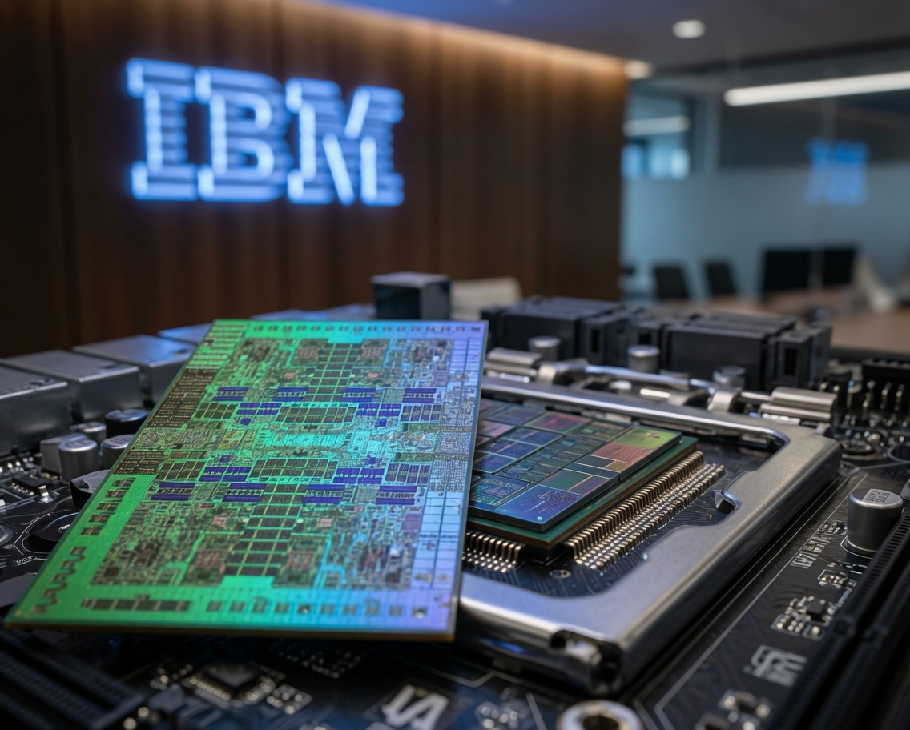
Surprise!
Bob built this entire presentation based on our chat history building the HoneyDue APP!!!
Crazy, right?
DEMO TIME
HoneyDue Calendar Sync — Live
Bee in the menu bar · Settings window · Run Now · Watch the blocks appear
⬇ Download: github.com/007Style/honeydue-cal-sync
IBM

