Slide 1

WELCOME
AI 101
The language. The models.
The machine.
Daneyand “DJ” Singley
IBM Technical Leader & Field CTO
DJ SINGLEY / AI 101
01
Notes:
DELIVERY
Suggested time: 29 seconds. Use the click builds to pace the explanation.
SPEAKER NARRATION
Welcome. This is a vocabulary session with a hardware payoff. We will begin with familiar examples, then connect the terminology to the models behind today's AI applications. By the end, we will follow a prompt all the way to the GPU and explain why fitting a model in memory is only the beginning. Some of you are using these tools every day, and some are still trying to untangle the acronyms. Both groups belong here. Experienced attendees should listen for the distinctions between training and inference, total and active parameters, and memory capacity and bandwidth. We will leave time for questions.
TRANSITION
Next: You thought you were getting:.
BACKGROUND ART SOURCE: Generated with the built-in OpenAI image-generation tool. Prompt: Create sophisticated abstract flowing electric cyan and faint violet luminous filaments converging into a computational lattice on the right third. Deep midnight navy background with quiet dark negative space across the left for white presentation typography. Premium scientific editorial artwork. No human figures, brains, robot faces, lettering, logos, UI, or watermarks.

Slide 2
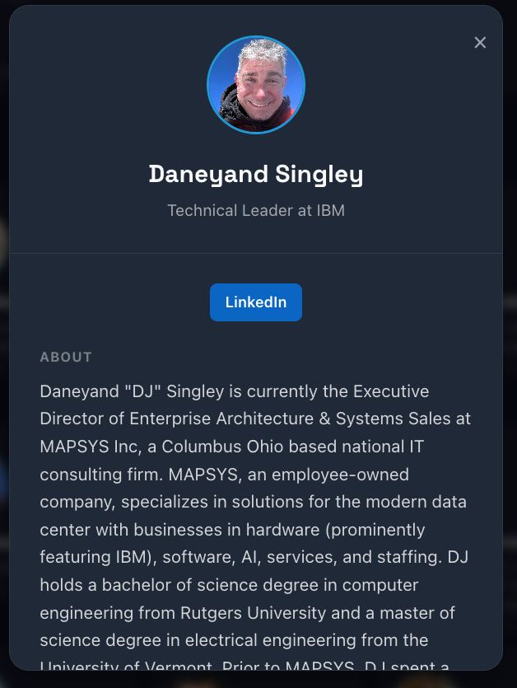
WELCOME
You thought you were getting:
MAPSYS Executive Director
Daneyand “DJ” Singley
Executive Director @ MAPSYS
DJ SINGLEY / AI 101
02
Notes:
DELIVERY
Suggested time: 17 seconds. Keep static. Pause for the joke before advancing.
SPEAKER NARRATION
Let the audience look at the old listing before you explain anything. This is the setup: “You thought you were getting the MAPSYS guy.” The screenshot is intentionally retained, including its mixed old and new information. Do not read the biography aloud. Give people a moment to recognize the mismatch. Then advance to the next slide for the reveal. The humor comes from the contrast between the advertised role and the person who has arrived, rather than from making a serious announcement about a résumé. Keep this short so the joke has room to land.
TRANSITION
Next: You’re actually getting:.
VISUAL SOURCE: Retained images from the user-supplied AI 101 presentation: image6.png. Full image proportions preserved. The TIFF diagram uses a pixel-identical PNG conversion for compatibility.

Slide 3
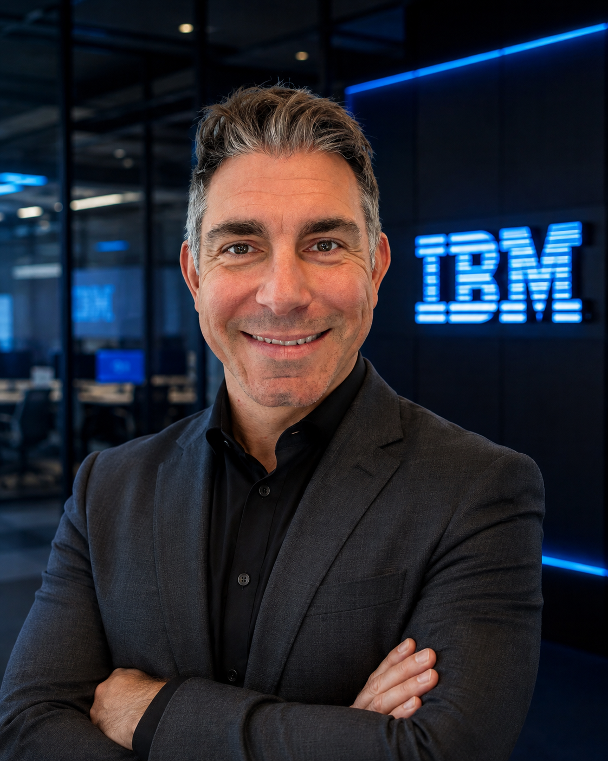
WELCOME
You’re actually getting:
Daneyand “DJ” Singley
Technical Leader &
Field CTO @ IBM
Same DJ. Different badge.
DJ SINGLEY / AI 101
03
Notes:
DELIVERY
Suggested time: 29 seconds. Keep static. Pause for the joke before advancing.
SPEAKER NARRATION
Pause for the laugh before talking over the reveal. “I recently moved back to IBM. Same DJ, different badge.” Adjust that line to your natural delivery. The new IBM portrait is the punch line, so let it do the work. If a brief introduction helps, explain that your path started in microprocessor design at IBM, moved through technical sales and 17 years at MAPSYS, and now returns to IBM. Your experience connecting architecture to business problems is why this AI vocabulary talk will eventually get down to hardware. The full biography belongs in notes and the closing reference slide, rather than competing with the joke.
TRANSITION
Next: Keep the conversation going.
VISUAL SOURCE: Retained images from the user-supplied AI 101 presentation: image7.png. Full image proportions preserved. The TIFF diagram uses a pixel-identical PNG conversion for compatibility.

Slide 4
WELCOME
Keep the
conversation going
Data, Cloud & AI in Columbus
meetup.com/Big-Data-Developers-in-Columbus/
DJ SINGLEY / AI 101
04
Notes:
DELIVERY
Suggested time: 17 seconds. Use the click builds to pace the explanation.
SPEAKER NARRATION
A quick invitation before the lesson: this conversation continues beyond the conference. If you are in the Columbus area, the local Data, Cloud & AI group is another way to meet practitioners and compare experiences. The group URL is retained from the supplied deck. Invite people to photograph the slide if they want it, rather than reading the link aloud. Keep this to a few seconds. Transition by saying that a mixed community needs a common language, which is exactly what the rest of this session is meant to provide.
TRANSITION
Next: What you’ll leave with.
BACKGROUND ART SOURCE: Generated with the built-in OpenAI image-generation tool. Prompt: Create sophisticated abstract flowing electric cyan and faint violet luminous filaments converging into a computational lattice on the right third. Deep midnight navy background with quiet dark negative space across the left for white presentation typography. Premium scientific editorial artwork. No human figures, brains, robot faces, lettering, logos, UI, or watermarks.

Slide 5
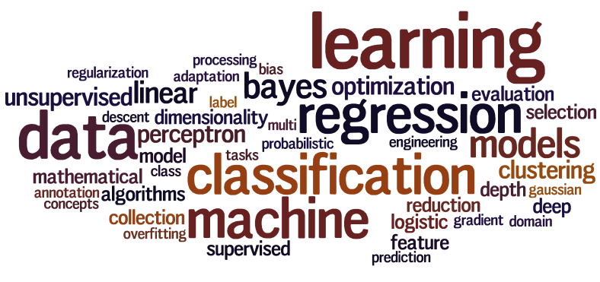
WELCOME
What you’ll leave with
The language
A vocabulary for AI conversations
The model
A mental model of how LLMs work
The machine
A way to read model and hardware specifications
DJ SINGLEY / AI 101
05
Notes:
DELIVERY
Suggested time: 34 seconds. Use the click builds to pace the explanation.
SPEAKER NARRATION
The goal is to make the terminology useful. You should be able to hear a discussion about supervised learning, a foundation model, a context window, or GPU bandwidth and understand what the speaker is describing. This is not a programming class. We will nevertheless go beneath the interface: a model is a collection of learned numerical parameters executed by software on hardware. We will build that understanding step by step, so nobody needs to arrive knowing the mathematics. Ask people to hold detailed architecture questions for the end, while welcoming quick clarifications when a term is unclear.
TRANSITION
Next: AI, machine learning, deep learning.

Slide 6
AI FOUNDATIONS
AI, machine learning, deep learning
ARTIFICIAL INTELLIGENCE
Theory for computers to perform tasks requiring human intelligence
MACHINE LEARNING
Give the computer the ability to learn without explicit programming
DEEP LEARNING
Brain like logical structure of algorithms: Artificial Neural Networks
DJ SINGLEY / AI 101
06
Notes:
DELIVERY
Suggested time: 51 seconds. Use the click builds to pace the explanation.
SPEAKER NARRATION
These terms overlap. Artificial intelligence is the broad umbrella. Machine learning is a family of approaches that learns from data rather than requiring a person to hand-code every rule. Deep learning is a family of machine-learning approaches based on multilayer neural networks. Today's generative language models sit within this broader history. AI also includes methods outside machine learning, and machine learning includes many useful methods outside deep learning. Avoid implying that the newest approach replaces every older one. The useful question is which method fits the problem, the data, and the operating constraints.
TRANSITION
Next: What do we use learning for?.

Slide 7
AI FOUNDATIONS
What do we use learning for?
Recognize
Identify an object or a pattern
Predict
Estimate an outcome from new inputs
Generate
Produce a useful new continuation
DJ SINGLEY / AI 101
07
Notes:
DELIVERY
Suggested time: 46 seconds. Use the click builds to pace the explanation.
SPEAKER NARRATION
Your original explanation is the right starting point: look for patterns and use them with new data. A house-price model relates property attributes to sale prices. An image classifier relates visual patterns to labels. A generative model learns statistical structure that lets it produce a continuation, an image, or another output. These examples differ in what we ask the model to return. The common thread is learning numerical relationships from examples. Statistical patterns can be useful without proving causation, and success on past examples does not guarantee success in a changed setting. We will return to that distinction when we discuss evaluation.
TRANSITION
Next: Data comes in different forms.

Slide 8
What is Machine Learning and Deep Learning used for?
AI FOUNDATIONS
01
Identifying patterns in data
02
Tools to help predict new values based on new data
03
Involves statistics – and lots of calculations to identify complex patterns
04
Ultimately build complex models to explore the data, generate new outputs
DJ SINGLEY / AI 101
09
Notes:
You can go to Wikipedia to find the detailed definition of Machine Learning (https://en.wikipedia.org/wiki/Machine_learning) and Deep Learning (https://en.wikipedia.org/wiki/Deep_learning). Most definitions are quite complicated for a novice user and that’s because the true definition of these terms usually involves “how” the learning works and can get very complicated.
To simplify this, let’s discuss more about “what it is used for”. In general ML and DL algorithms are used to find patterns in data. That’s it in a nutshell. Finding patterns is only of minimal use in and of itself, but where pattern recognition really becomes valuable is using prior patterns to predict new values. For example, if you can find a pattern in home price data based on home sales in your area, you can build algorithms to predict current home prices. Or if you can find patterns in images, you can predict if an image is a picture of a dog or a cat. Or predict if a tumor is benign or malignant, based on the patterns of cell images you have seen in the past.
How this is all done under the covers and the details behind machine learning and deep learning won’t be discussed in detail in this presentation. We will only go as far as to introduce the concepts in order for you to understand the language of AI, ML and DL.

Slide 9
Data Types
THE DATA
DJ SINGLEY / AI 101
10
Notes:
Before we get into the details behind the language of deep learning it’s important to have common vocabulary behind the data (where we are looking for the repeating patterns) that is used by the ML or DL programs. There are lots of types of data that can be used with ML and DL algorithms.

Slide 10
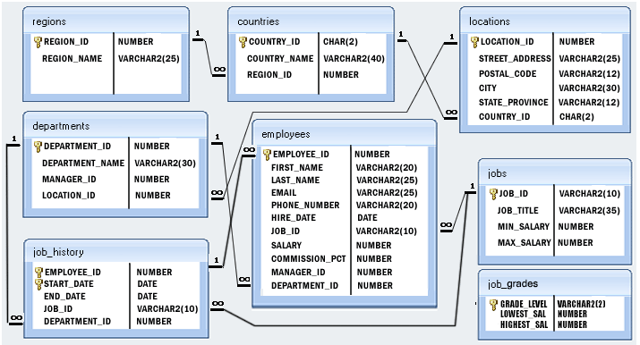
Structured Data
THE DATA
Data that has an enforced structure and values have defined data types
Relational databases contain mostly structured data
LIMIT_BAL | AGE | PAY_0 | BILL_AMT1 | BILL_AMT2 | BILL_AMT3 | PAY_AMT1 | PAY_AMT2 | PAY_AMT3
£20,000.00 | 24 | 2 | £3,913.00 | £3,102.00 | £689.00 | £0.00 | £689.00 | £0.00
£120,000.00 | 26 | -1 | £2,682.00 | £1,725.00 | £2,682.00 | £0.00 | £1,000.00 | £1,000.00
£90,000.00 | 34 | 0 | £29,239.00 | £14,027.00 | £13,559.00 | £1,518.00 | £1,500.00 | £1,000.00
£50,000.00 | 37 | 0 | £46,990.00 | £48,233.00 | £49,291.00 | £2,000.00 | £2,019.00 | £1,200.00
£50,000.00 | 57 | -1 | £8,617.00 | £5,670.00 | £35,835.00 | £2,000.00 | £36,681.00 | £10,000.00
£50,000.00 | 37 | 0 | £64,400.00 | £57,069.00 | £57,608.00 | £2,500.00 | £1,815.00 | £657.00
£500,000.00 | 29 | 0 | £367,965.00 | £412,023.00 | £445,007.00 | £55,000.00 | £40,000.00 | £38,000.00
£100,000.00 | 23 | 0 | £11,876.00 | £380.00 | £601.00 | £380.00 | £601.00 | £0.00
DJ SINGLEY / AI 101
11
Notes:
The first category of data is “structured data”. By structured data we mean that the type of data itself has some kind of structure and the data is typically grouped into a form of structure. In the simplest case think of an Excel spreadsheet. In there, you have rows and columns. A column typically represents some attribute of your data using a well defined data type. For example, if you have a spreadsheet of accounts, one column might be the account number, another might be the account balance, another might represent a debit or a credit into that account, another might be a description of that transaction, etc. In DL and ML we call these attributes “features”.
For example, the bank balance column will contain a currency value, while the description column will likely contain a string of characters and a date column will contain only valid dates. These are known as “data types” and form the structure for a given column.
Each row in a structured dataset is well defined in that all the column values for a given row are all related. For example, one row might represent an order from a store (purchase of something) and contain the price, tax, description, date, time, etc of that purchase. The row is structured because there is a column for every value that is put into that row and each row has the same set of well defined columns.
Relational databases (like Db2, Oracle, SQL Server, etc) are the primary source of structured data within a company and often used as the source for ML and DL. In the case of structured data, we are usually trying to find patterns within the rows in order to predict a given column within the data. For example, if I have a table of home sales, some of the columns might be home type, location, number of bedrooms, number of bathrooms, room sizes, etc. (the features) and one of the columns will be sold price. In a machine learning algorithm, you might ingest all of that structured data and have the model learn how to predict the sold price column from the other data in that table. Then you can build an application to take in the various values that define the home (any of the columns) and predict the sold price column value.

Slide 11
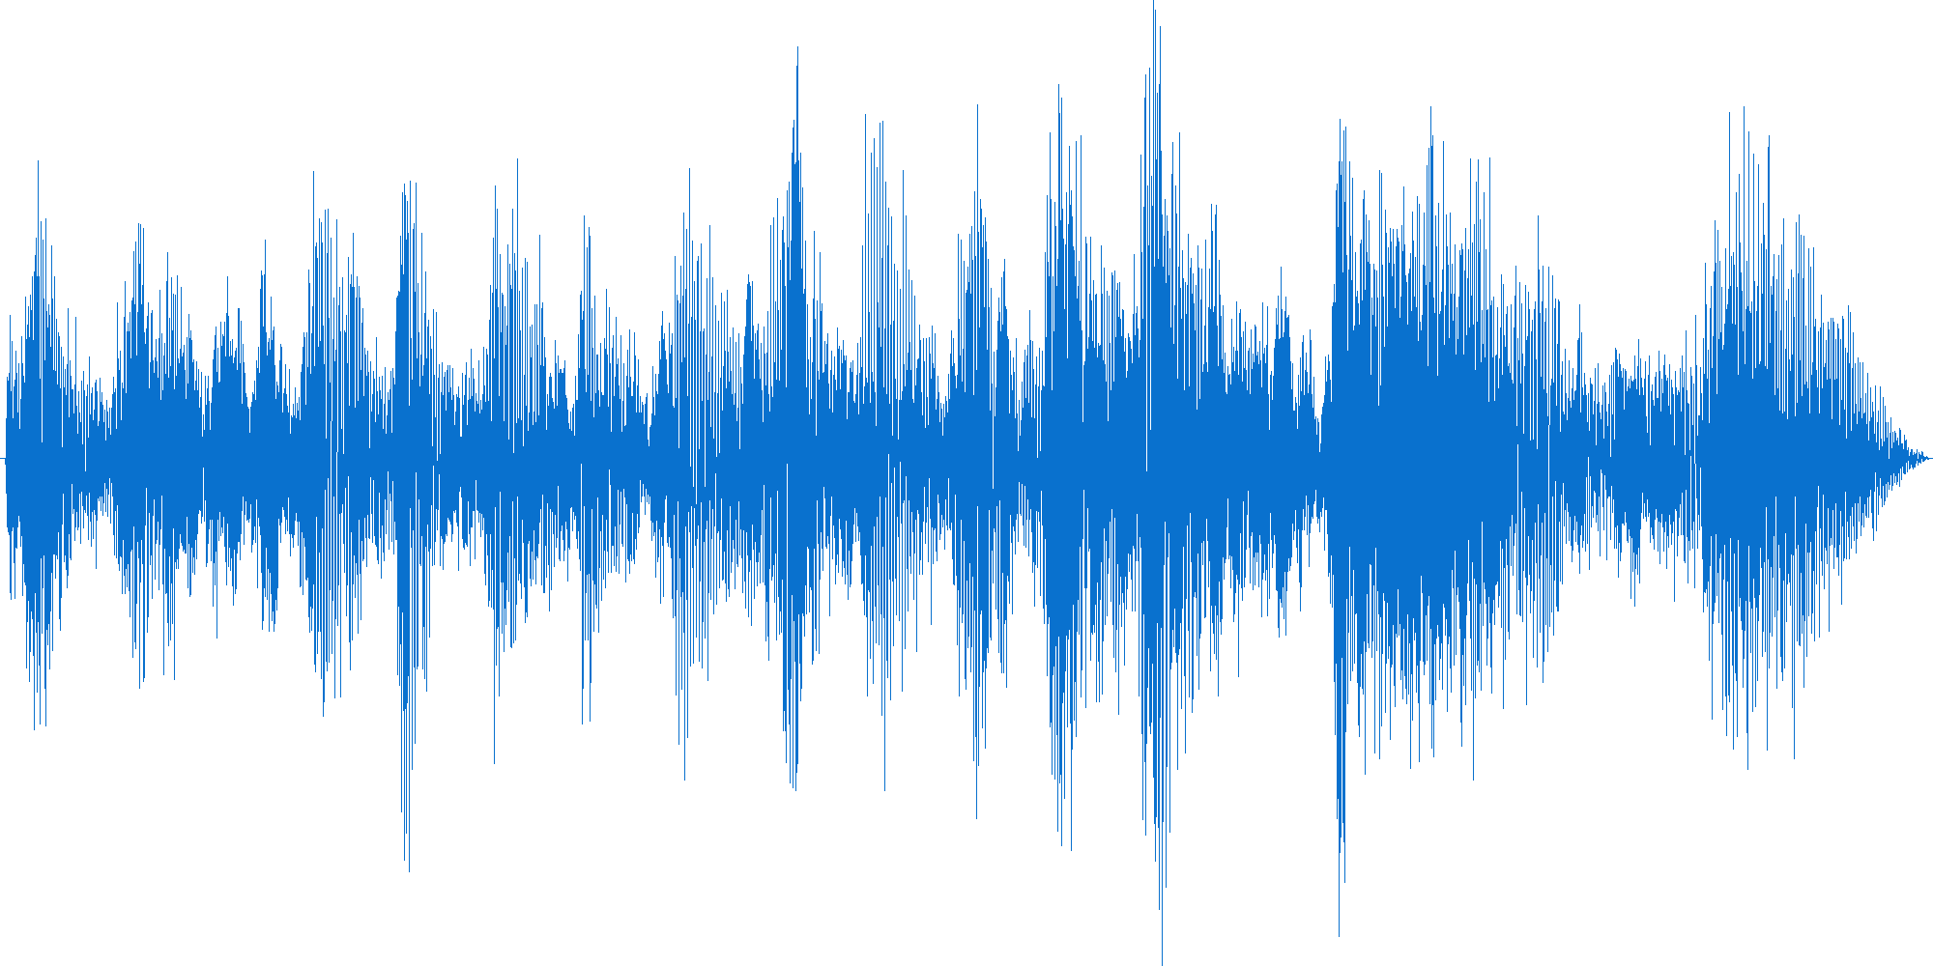
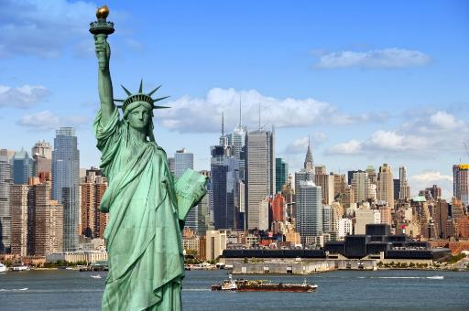


Unstructured Data
THE DATA
Data without an enforced pattern or type
Challenging to process using standard programming techniques
DJ SINGLEY / AI 101
12
Notes:
Unstructured data are things like images, sounds, videos, emails, tweets, etc. We refer to these as unstructured because the contents of the data do not have structure; however, the delivery mechanism does have some structure. For example, a picture may come in the form of a JPEG file which does have some structure which defines how to interpret the data and render the image on the screen. An email has some structure in that it has a sender, receiver, subject and then the body of the email. This kind of structure is often referred to as the metadata for the object (attributes that define the object) but the contents of the data (like the sentences in the email) could be anything and don’t have the same kind of structure as our previous example on structured data.
In the case of machine learning and deep learning, we are often looking for patterns within the unstructured data. For example, looking for patterns in an image file can help a system recognize if the image is a picture of a cat or a dog. Or we may be looking for the signature sound wave of a gun shot to be able to predict if a violent action has taken place in a neighborhood before it is even reported to police (or if the sound was simply a fire cracker or a car backfiring). Or with emails we may want to find patterns to indicate the authors sentiment (are they upset or happy or sad) or we may be looking for specific patterns of speech to understand a question and build a reply to the email without human intervention, or even identifying spam.
These are the types of problems ML and DL are typically used for with unstructured data.

Slide 12
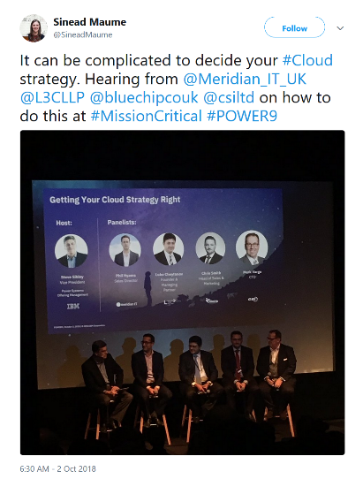
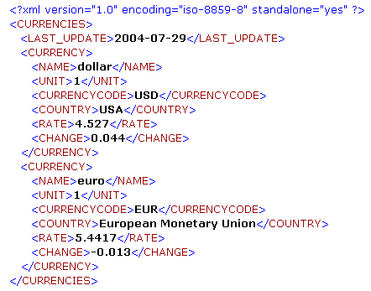
Semi-structured Data
THE DATA
{
"apiVersion": "v1",
"kind": "Service",
"metadata": {
"name": "powerai-vision-vision-ui",
"namespace": "gpu",
"resourceVersion": "483980",
"labels": {
"app": "powerai-vision-vision",
"chart": "ibm-powerai-vision-prod-1.1.0",
"component": "powerai-vision-vision-ui",
"release": "vision",
"run": "powerai-vision-vision-ui-svc“
}
},
"spec": {
"ports": [
{
"name": "ui-port",
"protocol": "TCP",
"port": 80,
"targetPort": 80
}
]
}
}
DJ SINGLEY / AI 101
© Copyright IBM Corporation 2018
13
Notes:
The final class of data is “semi-structured”. This data has a more rigid structure around it than unstructured data. For example, a JSON document has a well formed structure that describes each element within the document; like a person’s name, address, phone number, etc. much like a relational structured table has column headings. But the difference is that a structured relational table has fixed number of columns based on how it was defined (and changing that definition can be a lot of work), whereas a JSON document can have any number of data fields and a developer is free to add new fields whenever they see fit without worrying about the data structure.
Similarly, a tweet has a formed structure in that it has a fixed length and within the tweet certain symbols have specific meanings (like a hashtag or a persons @ handle). This gives the tweet some structure but again like unstructured data, the “payload” or the contents don’t have a defined structure.

Slide 13
AI FOUNDATIONS
Data comes in different forms
Structured
Semi-structured
Unstructured
Rows and columns
Named, flexible fields
Free-form content
A sales table
A JSON ticket
An email or recording
DJ SINGLEY / AI 101
08
Notes:
DELIVERY
Suggested time: 34 seconds. Use the click builds to pace the explanation.
SPEAKER NARRATION
Before we talk about learning, we need a shared language for what the system learns from. A spreadsheet is a useful mental picture for structured data. JSON is a familiar example of semi-structured data. Free-form text, recordings, and photographs are commonly called unstructured data. The last label does not mean that a file has no format or that language has no structure. It means the content does not arrive as a fixed set of database columns. Real applications often combine all three: a support ticket can contain structured metadata, a text description, and an attached image.
TRANSITION
Next: Structured data.

Slide 14
Training Types
HOW MODELS LEARN
DJ SINGLEY / AI 101
14
Notes:
Now let’s move onto machine learning and deep learning training. By training we mean that we are “teaching” the computer how to find patterns from. Not by telling it what patterns exist, but instead we feed in the data and let the algorithms find the patterns on their own. That is what training means … the computer is training a model to be able to detect patterns based on what it “sees” within the training runs.

Slide 15
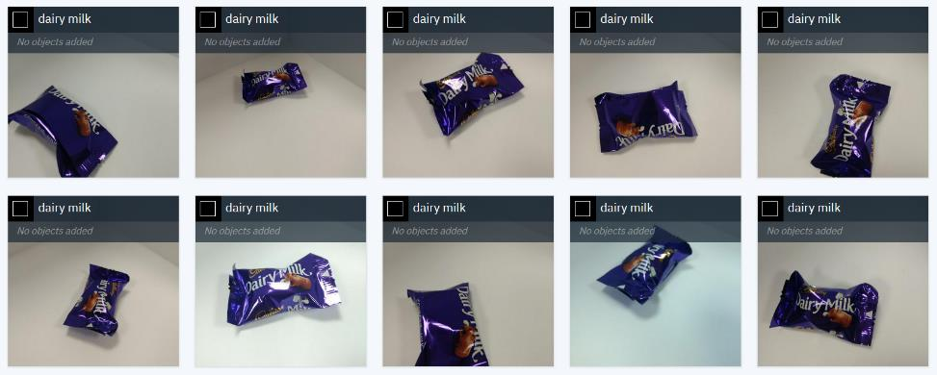
Supervised learning
HOW MODELS LEARN
Provide labelled data to the system
This is considered the ground truth
The system will find the patterns that determine your labels
4.849315 | 5.669982 | TRUE
5.548189 | 5.023918 | TRUE
5.449399 | 6.107647 | TRUE
4.138449 | 4.424792 | FALSE
4.407822 | 4.530602 | TRUE
3.212067 | 6.99535 | FALSE
4.036322 | 5.150239 | FALSE
4.17845 | 4.262555 | FALSE
3.949967 | 6.322179 | FALSE
4.68341 | 6.821367 | TRUE
3.569664 | 5.524142 | FALSE
2.366305 | 1.552303 | FALSE
3.430706 | 2.388652 | FALSE
2.438954 | 1.884384 | FALSE
4.526269 | 1.500568 | TRUE
2.826602 | 1.95353 | FALSE
4.184532 | 2.259855 | FALSE
DJ SINGLEY / AI 101
15
Notes:
The first type of training is called “Supervised Learning”. Think of this as how we teach our children to identify objects. We sit with them and open a book of animal pictures and we point to a picture of a dog and we say “dog” then we point to a picture of a cat and say “cat”. The child learns by doing this over and over until they can point to a dog and say the word dog. And if you are a parent, you will know that the first time they see a picture of a horse, they may point to it and say “dog”. Why? Because it has four legs, a tail and no big whiskers so it looks more like a dog than a cat and the child has not yet heard the word for horse. In our supervised learning model, we say “no Sophia that is a horse … can you say horse?”
That’s what supervised machine learning is. We pass in data to an algorithm and tell it what the expected outcome is. For example, with structured data we pass in the table of values and include the expected outcome (in the home sales example we pass in all the attributes of the home AND we pass in the sold price column that the home sold for). For images, we pass in images of chocolate bars AND we pass in the name of those chocolate bars. The learning model then has the facts it needs to discover patterns so it carry out predictions: like what chocolate bars are in an image.

Slide 16

Unsupervised learning
HOW MODELS LEARN
Provide unlabelled data to the system
You do not have a clear understanding of what you are looking for
Interested in patterns within the data
Can identify correlations between data
BILL_AMT1 | BILL_AMT2 | BILL_AMT3 | PAY_AMT1 | PAY_AMT2 | PAY_AMT3
£3,913.00 | £3,102.00 | £689.00 | £0.00 | £689.00 | £0.00
£2,682.00 | £1,725.00 | £2,682.00 | £0.00 | £1,000.00 | £1,000.00
£29,239.00 | £14,027.00 | £13,559.00 | £1,518.00 | £1,500.00 | £1,000.00
£46,990.00 | £48,233.00 | £49,291.00 | £2,000.00 | £2,019.00 | £1,200.00
£8,617.00 | £5,670.00 | £35,835.00 | £2,000.00 | £36,681.00 | £10,000.00
£64,400.00 | £57,069.00 | £57,608.00 | £2,500.00 | £1,815.00 | £657.00
£367,965.00 | £412,023.00 | £445,007.00 | £55,000.00 | £40,000.00 | £38,000.00
£11,876.00 | £380.00 | £601.00 | £380.00 | £601.00 | £0.00
DJ SINGLEY / AI 101
16
Notes:
“Unsupervised learning” is really more like putting a child in a room full of toys without any parent in the room and then they learn on their own. For example, if you put a child in front of a set of Lego blocks they may have no idea what they are for. And the first thing they will likely do is try to eat them ☺ but they will quickly find that they don’t taste good and they will likely notice that two Lego blocks actually connect together (they find the pattern of bumps on a block that fit into the holes on another block). This may actually happen by accident, but once discovered the child will notice that other blocks have the same pattern and they then start to connect many blocks together (without supervision).
Quite simply, with unsupervised learning, a set of data is provided and ML or DL algorithms look for patterns within the data. This is often used for clustering like objects together. That is, looking for things in the data that are like other things in the data and grouping them together (more on clustering and classification later).
In the examples above, you might be looking for patterns in a table of structured data (without a target column to “supervise” the result). Or you might, for example, look at flickr images and group them together into similar images as in the graphic on the right.

Slide 17
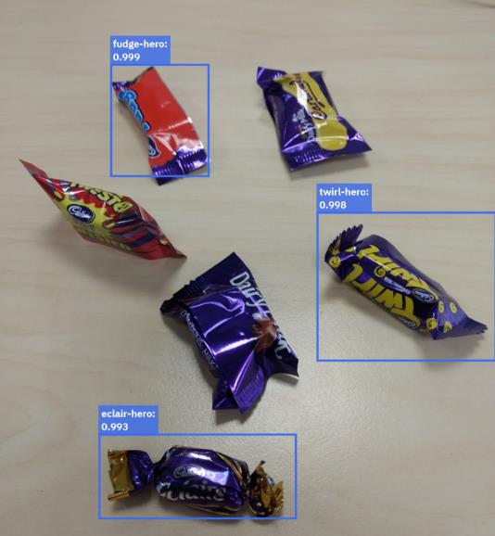
Reinforcement Learning
HOW MODELS LEARN
Provide feedback to a system using rewards for correct results
Often implemented for gaming tasks
Aim of the model is to maximise the reward it gets
User provides feedback rather than labels
+3
-3
=0
DJ SINGLEY / AI 101
17
Notes:
Reinforcement learning is much like a reward system you might have with a pet (or a child). For example, one way to train a dog is to teach them how to perform a task, and when the task is performed correctly, the dog is given a treat. This tells the dog that their behaviour was correct so they should do it again to get another treat.
With machine learning, reinforcement is providing by way of a goal or score. When a task finds a pattern correctly, it is rewarded with a higher score and the goal is to find something that improves the score. As noted on this slide, this is often used with gaming tasks.
As an example, think of the old computer game of pong where you have two “paddles” (one on each side of the screen) that simply move up and down and a “ball” that bounces around the screen from side to side. If the ball hits the paddle it bounces back towards the other side of the screen. If the ball does not hit the paddle it will fall off the screen and that player loses a point. If I start with the computer not knowing how to play pong at all, but given them a “penalty” when they miss the ball, the computer will eventually just hit the ball at random and realize there is a reward for performing that task. Subsequently, the computer will start moving the paddle and eventually understand how to track the ball and hit the paddle repeatedly in order to receive the reward (and eventually learn how to hit the ball to make it harder for the opponent to hit it back). In the above example, the “goal” is to increase the score as much as possible and the score is calculated as the number of correctly identified objects gives you a plus 1 and the number of objects missed subtracts 1 from your overall score. The goal is to get the highest score. That is reinforcement learning in a nut shell.

Slide 18
Data splitting
EVALUATION
DJ SINGLEY / AI 101
18
Notes:
Another important concept to understand is not only “how” a learning model can take a set of data and find patterns but we also need to make sure that the patterns it is finding are “correct” or not. To do that we need a set of data to “train” the model and another set of data to “test” the model against to see how well the predictions match to reality.
This takes us to the topic of data splitting.

Slide 19
Data preparation
EVALUATION
Data is split into smaller sets before training
  Training data is used to train the model
  Validation data is used to test the performance of the model and make refinements
  Test data is used to measure the accuracy of the final model
Validate
Train
Test
DJ SINGLEY / AI 101
19
Notes:
Of course to train a model to find patterns in data, you need a large set of data for it to learn from. However, the training of the model is only one step in the process. In order to know if the model is good, you need to take some additional data and test the model for accuracy.
Often you only have one data set to work with and so a data scientist will split the data (randomly) into 3 sets. The first set is the training data set and is typically made up of 70% - 80% of the data you have to work with. This is the data that will be used to train the model.
The second set of data is called the validation set and is used to look at how the model is performing while the data scientist is training the model. That is, after a model is created a data scientist will run the model against the validation set of data and may then go back to retrain the model using a different set of hyperparameters (more on hyperparameters later in this deck). By doing this they are refining the model over many iterations. However, by doing this they are also tuning the model to “fit” both the training data and the validation set of data (although not directly training the data on the validation set, it does influence the final model indirectly because it was used to make the model better based on the results of the predictions in the validation set).
The third set of data is the test data set. This is data that the model has never seen before in any of the training runs and is used to measure the accuracy of the final model. The model will be used against the Test data set and you will see how well (or how accurate) the predictions are to the real outcomes (which are in the test data set). For example, in a Kaggle competition (https://www.kaggle.com/) you are given a data set to train on and then a data set to test on which you will use for your final submissions to the contest (you don’t know the correct predictions in the test data set but Kaggle will take your test results and score them and let you know how well your model performs).

Slide 20
Dimensionality / Complexity
THE MATH
DJ SINGLEY / AI 101
20
Notes:
In this next section we will discuss the concept of dimensionality and how it relates to the complexity of building a machine learning or deep learning model.

Slide 21
Some mathematics
THE MATH
There are different terms and representations for different dimensions of data
Scalar
Vector
Matrix
Tensor
17
12
24
36
42
12 27 78
24 14 11
36 78 16
42 33 59
12 27 78
24 14 11
78 16
33 59
14 52 16
18 02 83
17 62 55
36 75 40
11 94
17 47
62 99 03
12 05 87
DJ SINGLEY / AI 101
21
Notes:
Another term you will come across in data science is a Tensor. So what is a Tensor? Before we get there let’s look at more primitive dimensions of data.
The first is a scalar. The definition of which is a quantity that has only a magnitude but no direction. That’s a complicated way of just saying it’s a number ☺ If I ask you how is the car moving and you say 17 that doesn’t tell me much (because you only gave me a scalar).
If instead you say 17 miles per hour due east then I know how fast you are going and in what direction. That description is actually a vector which is defined as a quantity having both magnitude and direction. In mathematics, this may be represented as an X and a Y coordinate (and then the line drawn from 0,0 to x,y represents the vector of a car’s motion where the length of the line is the magnitude and the angle of the line represents the direction. As discussed on the previous slide, it gets more complicated when you go beyond 2 or 3 dimensions. In the example shown on the slide, we have a vector in 4 dimensions, which is represented by 4 numbers inside of a set of parenthesis, like (12,24,36,42). This is known as a vector.
A matrix is a two dimensional vector (which in itself is a multidimensional type…confused yet?). It is often referred to as a rectangular array of scalar elements. There may be M rows and N columns in the M x N (pronounced m by n) matrix. Just like there are mathematical rules for multiplying, dividing, adding and subtracting scalars, there are also mathematical rules that define how you multiply, divide, add and subtract two matrices (which is the plural of matrix) together. The interesting thing about matrices is that a graphics processing unit (GPU) is very good at doing matrix mathematics (they were specially designed for doing math on graphical data which themselves are represented by a set of matrices). This is why GPUs are so useful when doing deep learning as they are very good at matrix math.
Finally this brings us to a tensor. A tensor can be defined as a multi-dimensional array of matrices as shown above. These are simple for a computational system to store and manipulate (and input and output). And as mentioned above, GPUs make it very easy to accelerate the manipulation of matrices (and therefore tensors). Note that a tensor is not limited to the dimensions that we have shown on the slide above. It can be a nested set of matrices to any depth.

Slide 22
Machine Learning
MACHINE LEARNING
Finding patterns in data to make predictions
DJ SINGLEY / AI 101
22
Notes:
Now let’s jump into what machine learning algorithms mean and what they are trying to do for us in terms of pattern detection or pattern recognition.

Slide 23
MACHINE LEARNING
Common machine-learning tasks
CLASSIFICATION
REGRESSION
Which category?
What number?
Fraud or not fraud? Spam or not spam?
Predict a home’s sale price from its features.
CLUSTERING
ANOMALY DETECTION
What groups exist?
What looks unusual?
Segment customers who behave alike.
Flag an odd transaction or sensor reading.
The task describes the answer you need, not the algorithm you must use.
DJ SINGLEY / AI 101
23
Notes:
DELIVERY
About one minute. One example per box.
SPEAKER NARRATION
Most machine-learning problems fall into a handful of task types, and the task is defined by the kind of answer you want back. Classification answers 'which category?': fraud or not fraud, spam or not spam. Regression answers 'what number?': the sale price of a home, which ties back to our structured-data example. Clustering answers 'what groups exist?' without labels, which is the unsupervised learning we just saw. Anomaly detection answers 'what looks unusual?': an odd transaction or a sensor reading that doesn't fit.
The task tells you what you need. Many different algorithms can do each one, and choosing among them is the data scientist's job.
TRANSITION
Next: deep learning.

Slide 24
Deep Learning
DEEP LEARNING
Many layers of learned transformations: neural networks
DJ SINGLEY / AI 101
24
Notes:
Now that we have covered machine learning lets dive into deep learning to understand what it means and what is the difference to machine learning.

Slide 25
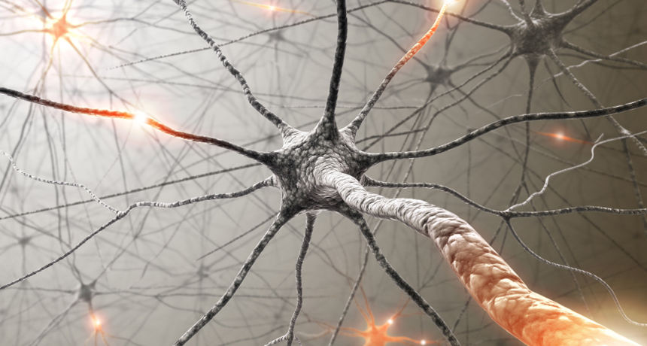
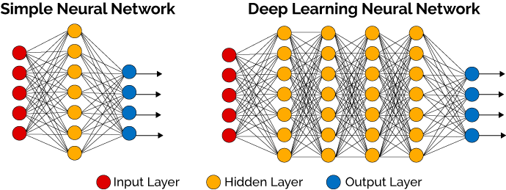
Neural Networks
DEEP LEARNING
Neural networks are systems designed to “loosely” mimic the human brain
They involve a lot of processing to identify patterns in data
Calculations are encapsulated in layers
Multiple layers are connected together in a network
7 | 6
8 | 2
0.18
0.04
0.79
0.00
4 | 4
3 | 8
DJ SINGLEY / AI 101
25
Notes:
Before we jump into what is deep learning we first have to mention neural networks (and you will see shortly the often cited relation between deep learning and neural networks). The idea behind a neural network is to have a computer system that “mimics” the way a human brain works. And in fact, mimic the way neurons communicate inside the brain. A neuron contains 3 parts; the dendrite which receives messages from other neurons, the cell body which processes the input “message” and the axon which distributes the output of the cell to other neurons. The other important property of the brain is that the use of certain neurons strengthens those neuron connections (so the more you think about something the stronger that memory encoded in those neurons).
A simple neural network takes a set of inputs (think dimensions of data or matrices of pixel values in an image), then pass that information on to what is called a hidden layer. In a computational neural network that is analysing images for example that hidden layer may take pixel values and find things like lines, curves, etc in a picture and pass that on to the next layer. In a simple Neural network there is one input layer, one hidden layer and one output layer that gives a result.
Deep learning neural networks are those neural networks that have several hidden layers. In our example on image recognition to distinguish between dogs and cats, the first hidden layer my detect lines, shapes, arcs, circles, etc which then get passed on to the next hidden layer which might be using those shapes to identify features like nose, tail, whiskers, etc which are then passed on to the next layer, etc. etc.
In the end the output layer may determine if the image is a dog or a cat. In training of a deep learning model if the model output was “dog” and the image was actually a cat, then those branches within the neural network that favoured the output of dog would be weakened (weights of those connections would be reduced) and connections and nodes which favoured the image being a cat would be strengthened (weights of those predictions would be increased). This is much like the case of the brain where neural networks are strengthened by their repeated use.
There are many public architectures for various neural networks that have been developed in recent years (like Imagenet, googleNet, Inception (v3, v4 etc), YOLO). If you want to get a deeper understanding of these, they are described further here: https://medium.com/@sidereal/cnns-architectures-lenet-alexnet-vgg-googlenet-resnet-and-more-666091488df5
There are also some good examples at Quora.com (where many of these network images have been taken from) here https://www.quora.com/What-is-the-difference-between-Neural-Networks-and-Deep-Learning

Slide 26
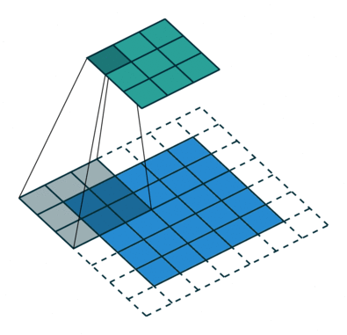
Neural Networks
DEEP LEARNING
Different types depending on the use case
Convolutional Neural Networks (CNNs)
  Performs the same processing over multiple subsets of the data
  Heavily used in Image Classification use cases
Recurrent Neural Networks (RNNs)
  Pass output of some layers back into the input of same layer
  Often used in Text to Speech as the model has ‘memory’
Transformers (Self-Attention)
  Use attention to identify relationships between parts of the input, even when far apart
  Excel at language tasks such as summarization, translation, Q&A, and text generation, Multimodal
DJ SINGLEY / AI 101
26
Notes:
As mentioned on the previous slide, there are a number of different types of neural networks. If you really want to spend more time on the details of neural networks, you can find a very detailed list of network types and what they are useful for here: https://towardsdatascience.com/the-mostly-complete-chart-of-neural-networks-explained-3fb6f2367464
Two very common neural networks are shown on this slide. The first is known as a convolutional neural network (CNN) which is used frequently in image processing. A CNN is looking at sections of an image at a time and essentially is looking for patterns across the sets of data (lines, edges, curves, etc.). This is why CNNs excels at classifying images and detecting objects within an image (as it is looking for similar patterns across sets of data). The second common network is known as a recurrent neural network (RNN) which takes the output of some layers and uses them as input for the same layer. This is often used for text recognition because it learns from what it found in the past. For example, an RNN is a good method to know that a “dog” is different when you put the word “hot” in front of it. RNNs are also frequently used for speech recognition as it is often needed for understanding the context of a sentence (looking at the entire sentence and not just each individual word is important to understand the context).
As well, if you want to dive deeper into convolutional neural networks, there is a good guide by Vincent Dumoulin and Francesco Visin here (https://arxiv.org/abs/1603.07285).

Slide 27
Building a model – and what’s a hyperparameter
DEEP LEARNING
Each layer has a series of weights and biases
These are modified as the model is trained to produce higher accuracy
These weights and biases are held in matrices
The amount of change each iteration is called the learning rate
DJ SINGLEY / AI 101
27
Notes:
As previously mentioned, a neural network in your brain is “strengthened” when a given neural path is used frequently. Similarly, in a computational neural network, there are aspects called weights and biases that perform similar functions. As a model is trained, the network is “learning” how to predict and model the correct outcome. The way this happens is that any path within the neural network that predicts the correct answer will have its weights increased such that similar patterns found in the future will be biased towards the correct outcome.
As shown on this slide, weights are associated with each edge that connect one neuron to every other neuron. Each line has its own weight (in the above diagram labeled as W x,y … where y is the input neuron and x is the output neuron). The function of the neuron takes the input values of the previous layer and the weights of those lines to determine the value of the output of that cell. Bias is added at each cell before the output is sent on to the next layer. At the end of the network, when we notice that the model accurately or inaccurately made a prediction, we go back through the network and adjust the weights and the biases in order to strengthen the connections that were making correct predictions and weaken the connections (lower the values) that were leading us to the incorrect prediction (more on this in a bit … but this process is known as back propagation). By adjusting these weights during the training the model evolves into being able to make accurate predictions.
As you may be able to imagine, if you only change the weights by very small amounts in each pass, it may take a very long time to converge on an optimal prediction. Likewise, if you change these values by a large amount, you may easily overshoot the optimal values and never converge on the best solution for a given model. The amount of change of these values is called the learning rate and is one kind of “hyperparameter”.
A hyperparameter is a configuration parameter, when building a neural network, that describes how the learning will happen within the network. There are many other hyperparameters and data scientists spend a significant amount of time building models, changing hyperparameters and iterating over and over again tweaking these parameters and re-training models to find the optimal model.

Slide 28


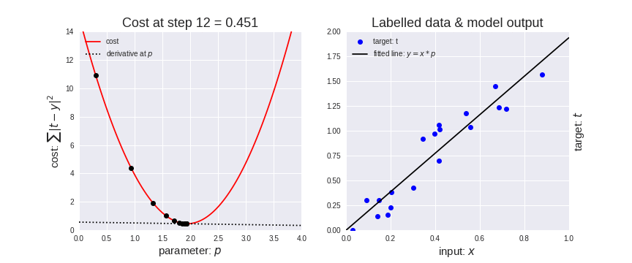
Building a model – and what’s a hyperparameter
DEEP LEARNING
Deep Learning training requires the system to learn from the data
This requires multiple iterations or epochs
Over each iteration or epoch the system looks at all of the training data
The model is refined based on the loss from previous run
Iteration 1
Refine model
Iteration 2
Refine model
Iteration 3
Refine model
. . .
Iteration 2000
Final
model
DJ SINGLEY / AI 101
28
Notes:
When training a deep learning model, you need to iterate many times over the data to find the optimal result. The way this works is that the model is generated and the error rate is found. For example, in the lower right graph, a linear regression finds some line to fit the data and you can measure how far away from the line each dot on the graph is. This would be considered a loss function (how far away the prediction is from the truth). The algorithm will then go through another iteration in an attempt to minimise the errors (i.e. minimise the loss function).
The number of iterations (also known in deep learning as epochs) that a training run will go through is also a typical hyperparameter that a data scientist will tweak as they iterate over building their model.

Slide 29
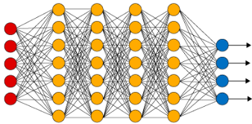
Building a model
DEEP LEARNING
The model is refined based on loss which is a measure of error
This is based on a loss function and the difference between predicted and actual results
This step is called feed forward as we pass through the model forwards
This loss can be calculated per layer moving backwards through the network
This is called back propagation and is key to Deep Learning training
Training Data
Refine Model
Calculate Loss
Loss
DJ SINGLEY / AI 101
29
Notes:
How do these iterations and loss functions interact with weights? Here we will combine the 3 previous concepts. During the forward portion of an iteration, the algorithm will produce some output. That output will have a measurable loss. That loss is used to adjust the weights between the layers before the next iteration. This application of loss information to the weights is known as “back propagation”.
The model will continue to be refined in this manner for N iterations or epochs (defined as a hyperparameter).
If you want to dive a lot deeper into how weights and biases are leveraged and modified during a training run, there is a detailed explanation here: https://medium.com/@neuralnets/back-propagation-algorithm-and-bias-neural-networks-fcf68b5153

Slide 30
Building a model
DEEP LEARNING
A trained model includes:
  A network definition file that describes the layers
  Weights and biases for each layer within that network
7 | 6
8 | 2
4 | 4
3 | 8
7 | 6
8 | 2
4 | 4
3 | 8
Trained model
weights
7
2
4
0
7
2
4
0
7
2
4
0
network definition
biases
DJ SINGLEY / AI 101
30
Notes:
To summarize, deep learning is a method in which a network (with many hidden layers) is used to create a trained model which can take some input, apply weights and biases throughout the layers, and produce an output (prediction).
This trained model is often simply referred to as a deep learning algorithm … or simply a deep learning model.

Slide 31
Deep Learning frameworks
SOFTWARE
DJ SINGLEY / AI 101
31
Notes:
To make it easier for data scientists and developers to build these deep learning models, frameworks have evolved to simplify the creation and programming of deep learning models. In this section we will discuss some of the more common frameworks.

Slide 32




Frameworks
SOFTWARE
Frameworks are also known as libraries
They contain common functions to simplify model building
Most of the common frameworks are Open Source
DJ SINGLEY / AI 101
32
Notes:
Like many application development environments, a framework is a set of libraries that simplify the common functions that are needed by data scientists to build models. Most of these frameworks are open source and as such they have evolved rapidly.
Four of the most common are:
TensorFlow - developed by the Google Brain team for internal Google use. It was released under the Apache 2.0 open-source license on November 9, 2015. TensorFlow provides libraries for Python, C, C++, Go, Java, JavaScript and Swift. In TensorFlow, multi-dimensional matrices of data are known as tensors and are manipulated by built-in functions. Developers can create graphs (networks) to process tensors.
PyTorch - pronounced “pie torch” – is an open source machine learning library for Python, used for applications such as natural language processing. It is primarily developed by Facebook's artificial-intelligence research group but is open source so there are many other contributors including IBM.
Caffe - From the Berkeley Vision Learning Center (BVLC) and alternative versions have been produced by NVIDIA and IBM with optimizations for their hardware. With Caffe you create models using networks of layers and build training iterations. Pre-trained models are often shared in a what is known as a Model Zoo (which makes it easier for various developers to collaborate and extend each others works). Rather than working on tensors like with TensorFlow, data is passed between layers in Blobs (binary large objects) within Caffe.
Keras - An open source neural network library written in Python. It runs on top of TensorFlow, and has been designed to enable fast experimentation with deep neural networks, it focuses on being user-friendly, modular, and extensible. In fact, it is part of TensorFlow today, but people will still refer to it on its own so we put it here.

Slide 33
Making use of trained models
INFERENCE
DJ SINGLEY / AI 101
33
Notes:
Now that you have a model created, how is it used?

Slide 34
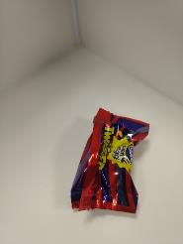
Deployment
INFERENCE
Trained models can be used to predict outcomes based on new data
Models can be deployed for inference – also known as scoring
This generally uses a cut down version of the framework
A common method is to create an Application Programming Interface (API)
API
{
result: "success",
imageUrl: "http:/ibm/test.jpg",
classified:
{
creme-egg: "0.94855"
}
}
Model
DJ SINGLEY / AI 101
34
Notes:
Once you have a model, you then take some input (which would be the same kind of data you used in the training) and passing it into the model to have it produce a prediction. The prediction is often referred to as an inference (we are inferring a result based on the model and the input) or sometimes it is called scoring (we are producing a score as output that someone can make a decision on).
To use the model there is usually an application programming interface (API) that is called with the input data (the input data could be a structured row of data or it could be an image or whatever was used as input data when the model was trained). The API will use the model to run the data through and produce an output that can be used within an application to make some decision on. Most often this is a REST API which makes it easily invokable from a web application.
Note that we have said that we will generally use a cut down version of the framework and by this we mean that the input is the same as what was done during the training and the output will be the same but there is no learning going on during the inferencing. As such, there are no iterations or back propagation or weight/bias changes. We simply execute the model to come up with a prediction or a score. This may mean that GPUs are less critical for inferencing (but in some high volume cases like video stream object detection, GPUs may be a critical success factor). There is also inferencing possible on other servers that are not where the model was trained. In fact inferencing can often benefit by being closer to the actual source of the input (like next to the cameras or attached directly to the sensors used to collect input).
Update for LLMs: large language models are the exception to 'GPUs may be less critical for inference.' Generating every token reads the model weights and the KV cache, so memory capacity and bandwidth matter a lot. That is the payoff in the model-to-memory section.

Slide 35
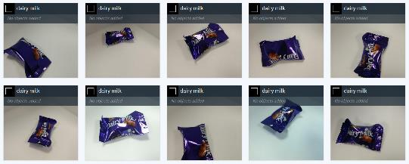
Quality of results
INFERENCE
Each inference event will provide a confidence value
  This value relates to that prediction only
The accuracy of a model is determined through:
  Correct predictions of data within the Test data set or the validation data set described previously
Accuracy relates to the model, confidence relates to the prediction
{
result: "success",
imageUrl: "http:/ibm/test.jpg",
classified:
{
creme-egg: "0.94855"
}
}
80% Accurate
95% Confident
DJ SINGLEY / AI 101
35
Notes:
Along with the prediction that the model produces for a given single input, the model will also produce a confidence value. That is, how sure is the model that its prediction is accurate. In the above example on the right, we have a model that can identify types of chocolates. The output on the right is saying that the model predicts this image is of type “cream-egg” chocolate and it is 95% sure (confident) that its prediction is correct. Confidence is related to a given prediction.
Another quality measure is a measure of the model itself. That is, how often does the model make the correct prediction. If the model is given 100 chocolates and it correctly categorizes 80 of those 100 then it is said to have an accuracy of 80%. The key metric that data scientists look for is how accurate the model is and so accuracy is a very important quality metric (they often refer to it as performance, as in “performance of the model”).
In fact, the most common goal is to increase Accuracy of a model which is often achieved by providing more labelled data to train, run training over a larger number of iterations, or provide higher quality data.
Caution: a model's output score is not always calibrated. A 0.95 score does not guarantee the answer is right 95% of the time. If you plan to act on the score, check calibration on held-out test data.

Slide 36
Working with LLMs &
Running Models
LLMs
DJ SINGLEY / AI 101
36
Notes:
One final area of terminology we want to discuss is some of the language used when working with LLMs and running models.

Slide 37
LLMs
LLMs
WHAT IS AN LLM
MODELS
WORKING WITH THEM
An LLM - computational model notable for its ability to achieve general-purpose language generation and other natural language processing tasks such as classification, extraction, text generation, summarization, Q&A, etc
Meta Llama
OpenAI GPT
XAI Grok
Qwen
IBM Granite & Slate
Prompt Engineering
zero-shot, one-shot, few-shot prompting
Run locally with
Ollama => open-source software platform and runtime
Foundational Models
*** Inferencing ***
DJ SINGLEY / AI 101
37
Notes:
SPEAKER NARRATION
A large language model is a neural network trained on a huge amount of text to predict what comes next. That one skill turns out to cover classification, extraction, generation, summarization and question answering. The model families on the slide include closed models you call through an API and open-weight models you can download. Prompt engineering is how you steer them: zero-shot gives just the instruction, one-shot and few-shot add examples. Ollama lets you run open-weight models on your own machine, which is what we'll size in a few minutes.
TRANSITION
Next: what a model actually reads, tokens.

Slide 38
LLMs
Tokens and the context window
THE MODEL READS TOKENS, NOT WORDS
Col
umbus
is
the
capital
of
Ohio
.
8 tokens
Illustrative split. Each model family has its own tokenizer.
CONTEXT WINDOW = PROMPT + ANSWER
Example: Qwen3-8B, 32,768 tokens
PROMPT · 24,576 input tokens
ANSWER · 8,192
Fill the window with the prompt and there is no room left for the answer. Every token in the window takes KV-cache memory.
DJ SINGLEY / AI 101
38
Notes:
DELIVERY
About one minute. This sets up the memory math later in the talk.
SPEAKER NARRATION
LLMs don't read words. They read tokens: chunks of text that might be a whole word, part of a word, or punctuation. In English a token averages a bit less than a word. The split on the slide is illustrative; every model family ships its own tokenizer, so the same sentence can be a different number of tokens on different models.
The context window is the model's working budget, and it covers both the prompt and the answer. Qwen3-8B, the model we'll size later, has a native 32,768-token window. If the prompt uses 24,576 tokens, there are 8,192 left for the answer. Fill the whole window with the prompt and the model has no room to respond.
Hold on to this idea: every token in that window costs memory. We'll put a number on it in a few slides.
TRANSITION
Next: how the model uses all those earlier tokens.

Slide 39
LLMs
Attention and the KV cache
EARLIER TOKENS · keys + values already cached
The
cat
sat
on
the
KV CACHE
mat
NEW TOKEN
ATTENTION
KV CACHE
THE COST
Each new token looks back at the earlier tokens to decide which ones matter.
Keys and values for earlier tokens are stored, so they are not recomputed for every new token.
The cache grows with every token in the context. That is the memory math on slides 45–46.
DJ SINGLEY / AI 101
39
Notes:
DELIVERY
About one minute. Point at the gold token, then trace the lines back.
SPEAKER NARRATION
Attention is how a transformer uses context. When the model produces a new token, here 'mat', it looks back at every earlier token and weighs how relevant each one is. That's how 'it' can refer to something three sentences back.
To do that, each earlier token contributes a key and a value at every layer. Recomputing those for the whole conversation on every new token would be wasteful, so inference engines store them. That store is the KV cache.
The cache is stored data, not another neural network. It grows by a fixed amount with every token, which is why long context costs memory. In a few slides we'll calculate exactly how much for Qwen3-8B.
TRANSITION
Next: how the hardware side fits in.

Slide 40
LLMs
Generative AI, agentic AI, encoders & decoders
GENERATIVE AI
AGENTIC AI
ENCODER / DECODER
Capable of generating text, images, videos, or other data using generative models, often in response to prompts.
Agentic AI is artificial intelligence that can take a goal, break it into steps, make decisions, use tools or data sources, and act with some level of autonomy to complete a task.
An encoder builds a representation of the input.
A decoder generates what comes next.
DJ SINGLEY / AI 101
40
Notes:
SPEAKER NARRATION
Generative AI produces new content. Agentic AI wraps a model in a loop with goals and tools so it can take several steps on its own; not every chatbot is an agent. Encoders and decoders are two halves of the original transformer design: the encoder builds a representation of the input, the decoder generates what comes next. Most chat LLMs today are decoder-only.
TRANSITION
Next: the hardware that runs them.

Slide 41
How to understand models and hardware needed to run them:
HARDWARE
Unified Memory Compute vs GPU
GPU
UNIFIED MEMORY COMPUTE
GPUs are highly parallel compute engines perfectly suited to handling tensors and other deep learning data types
Nvidia GPU
AMD GPU
Intel GPU
CPU and GPU share one memory pool
Apple M-series
AMD Ryzen AI Max
Nvidia DGX Spark
DJ SINGLEY / AI 101
41
Notes:
SPEAKER NARRATION
Two hardware shapes come up in every local-AI conversation. A dedicated GPU from NVIDIA, AMD or Intel has its own fast VRAM, separate from system RAM. Unified-memory systems such as Apple M-series, AMD Ryzen AI Max (codename Strix Halo) and NVIDIA DGX Spark let the CPU and GPU share one large pool. Unified memory can hold bigger models than a typical GPU's VRAM; dedicated GPUs usually have more memory bandwidth. Keep both capacity and bandwidth in mind for the next section.
TRANSITION
Next: reading a real model page.

Slide 42
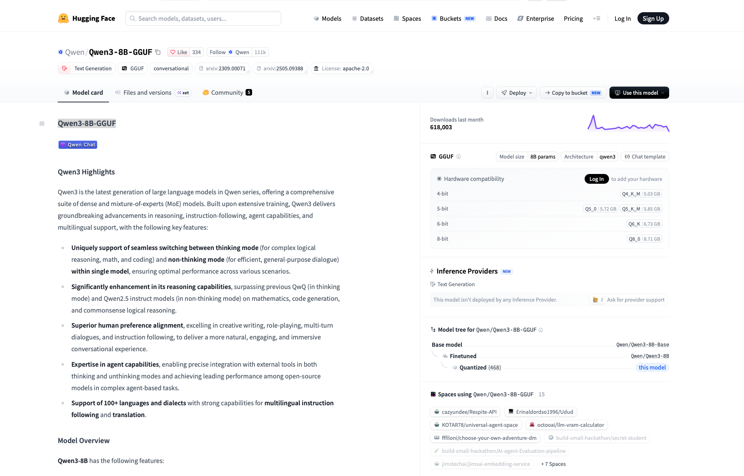
FROM MODEL TO MEMORY
Reading a model repository
DJ SINGLEY / AI 101
42
Notes:
SPEAKER NARRATION
This is the Hugging Face page for Qwen3-8B in GGUF format. Point out the model name, the parameter count, and the list of quantized files with their sizes. We'll use the Q4_K_M file for the memory math on the next slides.
TRANSITION
Next: where each number comes from.

Slide 43
FROM MODEL TO MEMORY
One model, two source repositories
A. CHOSEN DOWNLOAD: GGUF REPOSITORY
Q4_K_M file: 5.03 GB
huggingface.co/Qwen/Qwen3-8B-GGUF/tree/main
B. ARCHITECTURE: ORIGINAL MODEL REPOSITORY
8.2B parameters, 32K native context: model card
36 layers, 8 KV heads, 128 dimensions: config.json
huggingface.co/Qwen/Qwen3-8B
Architecture file: /blob/main/config.json in repository B
DJ SINGLEY / AI 101
43
Notes:
SOURCE KEY
A: https://huggingface.co/Qwen/Qwen3-8B-GGUF/tree/main (chosen weight file and size).
B: https://huggingface.co/Qwen/Qwen3-8B (original model card); https://huggingface.co/Qwen/Qwen3-8B/blob/main/config.json (architecture).
Cache setting: assumed 16-bit values, 2 bytes each. This is independent of the chosen Q4_K_M weights.
All arithmetic results are calculated estimates, not measured peak memory.
DELIVERY
Use after the Hugging Face screenshot. Click to reveal the calculations.
SPEAKER NARRATION
Use this slide immediately after the user's Hugging Face screenshot. Read the repository name first: Qwen is the publisher, Qwen3 is the family, and 8B is a rounded parameter-count label. The original Qwen3-8B card reports 8.2 billion learned numerical values. Those values are the weights. This count does not say how many gigabytes the chosen representation requires. Next read the native context limit, 32,768 tokens, on the original model card. That budget includes both input and generated continuation, so a full 32K input leaves no room for a response within a 32K limit. An illustrative split is 24,576 input tokens and 8,192 output tokens. Finally inspect the selected file in the official GGUF repository. Q4_K_M is the roughly four-bit option in our example and its listed download size is 5.03 GB. Q8_0 is listed at 8.71 GB. These names describe alternative weight representations of the same underlying model. Choose one file, not all the variants. The 32 GB repository total is not this model's required memory. The original model card and GGUF Files tab are separate sources. Use the card for the model's characteristics and the file listing for the chosen artifact's actual size.
SOURCES
https://huggingface.co/Qwen/Qwen3-8B
https://huggingface.co/Qwen/Qwen3-8B-GGUF/tree/main

Slide 44
FROM MODEL TO MEMORY
How much memory do the weights need?
Weight bytes ≈ parameters × bits per weight ÷ 8
8.2B parameters: original model card (B). Results below are calculated.
8 bits
8.2B × 8 ÷ 8
8.2 GB
5 bits
8.2B × 5 ÷ 8
5.13 GB
4 bits
8.2B × 4 ÷ 8
4.1 GB
GGUF Files page (A): Q4_K_M = 5.03 GB
Formats add overhead and can mix precisions. Use the actual file for the budget.
DJ SINGLEY / AI 101
44
Notes:
SOURCE KEY
A: https://huggingface.co/Qwen/Qwen3-8B-GGUF/tree/main (chosen weight file and size).
B: https://huggingface.co/Qwen/Qwen3-8B (original model card); https://huggingface.co/Qwen/Qwen3-8B/blob/main/config.json (architecture).
Cache setting: assumed 16-bit values, 2 bytes each. This is independent of the chosen Q4_K_M weights.
All arithmetic results are calculated estimates, not measured peak memory.
DELIVERY
Use after the Hugging Face screenshot. Click to reveal the calculations.
SPEAKER NARRATION
Each learned weight needs storage. Eight bits make a byte. Multiply the number of weights by bits per weight and divide by eight to estimate bytes. With the rounded 8.2 billion parameter count, eight bits per weight gives 8.2 billion bytes, or 8.2 decimal GB. Five bits gives 5.125 GB, rounded to 5.13 GB, and four bits gives 4.1 GB. These are ideal weight payload calculations. They are useful for understanding the relationship without teaching floating-point format names. Actual quantized files also contain scales, metadata, and some values at different precisions. That is why the chosen Q4_K_M file is 5.03 GB rather than the ideal 4.1 GB and Q8_0 is 8.71 GB rather than 8.2 GB. The Q5_K_M file is 5.85 GB rather than the ideal 5.13 GB. Quantization retains the parameter count while changing the numerical representation, and may change quality or performance. Use the actual selected file as the next budgeting input when the engine keeps that compressed representation in memory. The file size is still an estimate of loaded weight storage, not a measurement of peak inference memory. Runtime conversion can change it. The slide uses decimal GB throughout.
SOURCES
https://huggingface.co/Qwen/Qwen3-8B-GGUF/tree/main

Slide 45
FROM MODEL TO MEMORY
Where the KV-cache numbers come from
Factor | What it means | Where it comes from
2 | Keys AND values | KV-cache structure
36 | Transformer layers | B config: num_hidden_layers
8 | KV heads per layer | B config: num_key_value_heads
128 | Values in each head vector | B config: head_dim
2 bytes | Storage per cached value | ASSUMPTION: 16-bit cache
2 × 36 × 8 × 128 × 2 = 147,456 bytes per token
B: huggingface.co/Qwen/Qwen3-8B/blob/main/config.json
DJ SINGLEY / AI 101
45
Notes:
SOURCE KEY
A: https://huggingface.co/Qwen/Qwen3-8B-GGUF/tree/main (chosen weight file and size).
B: https://huggingface.co/Qwen/Qwen3-8B (original model card); https://huggingface.co/Qwen/Qwen3-8B/blob/main/config.json (architecture).
Cache setting: assumed 16-bit values, 2 bytes each. This is independent of the chosen Q4_K_M weights.
All arithmetic results are calculated estimates, not measured peak memory.
DELIVERY
Use after the Hugging Face screenshot. Click to reveal the calculations.
SPEAKER NARRATION
This table makes every factor in the KV-cache calculation explicit. The first factor of two means keys and values. The architecture configuration specifies 36 transformer layers, 8 key/value heads per layer, and 128 values in each head's vector. The final factor of two means two bytes per cached numerical value, which is our chosen 16-bit cache assumption. It is not two bytes per token. A token needs 2 × 36 × 8 × 128 = 73,728 numerical values across the cache. At two bytes each, this is 147,456 bytes per cached token. The first two is structural, and the last two is a precision setting. The Q4_K_M filename describes weight quantization and does not specify cache precision. The memory rate is specific to this architecture and our cache setting. The architecture fields come from the original Qwen3-8B config.json. With GGUF, the converted model's metadata and runtime should reflect the architecture and selected cache representation. No part of this arithmetic establishes runtime overhead.
SOURCES
https://huggingface.co/Qwen/Qwen3-8B/blob/main/config.json
https://huggingface.co/docs/transformers/cache_explanation

Slide 46
FROM MODEL TO MEMORY
More context needs more KV memory
32,768 tokens × 147,456 bytes ≈ 4.83 GB
Context per conversation | KV cache at 2 bytes per value
8,192 tokens | 1.21 GB
32,768 tokens | 4.83 GB
65,536 tokens (extended) | 9.66 GB
Model card (B): native 32K; YaRN extension for 64K.
Calculated from slide 45. One conversation, input + answer. Decimal GB.
DJ SINGLEY / AI 101
46
Notes:
SOURCE KEY
A: https://huggingface.co/Qwen/Qwen3-8B-GGUF/tree/main (chosen weight file and size).
B: https://huggingface.co/Qwen/Qwen3-8B (original model card); https://huggingface.co/Qwen/Qwen3-8B/blob/main/config.json (architecture).
Cache setting: assumed 16-bit values, 2 bytes each. This is independent of the chosen Q4_K_M weights.
All arithmetic results are calculated estimates, not measured peak memory.
DELIVERY
Use after the Hugging Face screenshot. Click to reveal the calculations.
SPEAKER NARRATION
Choose a context budget for one conversation. It includes the prompt and generated continuation. For a 32,768-token sequence multiply 147,456 bytes per token by 32,768 to obtain 4,831,838,208 bytes, or 4.83 decimal GB. The same calculation gives approximately 1.21 GB at 8,192 tokens and 9.66 GB at 65,536 tokens. These are KV payload calculations using the assumed two-byte cache values. Qwen documents 32,768 as the native context and validates extension to 131,072 with YaRN, which stands for Yet another RoPE extensioN. RoPE means Rotary Position Embedding, a method for representing token positions. YaRN adjusts positional scaling to support longer sequences. For 64K Qwen recommends factor two. Changing a runtime context setting alone does not establish reliable long-context behavior. Correct model configuration and sufficient memory are separate requirements. At 128K the cache payload would be approximately 19.33 GB. An engine can allocate for its configured capacity instead of only the currently used tokens. Multiple independent active conversations multiply cache needs, while model weights can be shared.
SOURCES
https://huggingface.co/Qwen/Qwen3-8B#processing-long-texts

Slide 47
FROM MODEL TO MEMORY
9.86 GB before runtime overhead
5.03 GB file (A) + 4.83 GB calculated cache
Then add runtime memory, measured on the target system.
DEDICATED GPU
UNIFIED MEMORY
VRAM: model, cache, GPU buffers
System RAM: OS and host apps
Model, cache, and runtime share
memory with the OS and other apps.
Assumes 32K context and 2-byte cache values. Measure runtime overhead.
DJ SINGLEY / AI 101
47
Notes:
SOURCE KEY
A: https://huggingface.co/Qwen/Qwen3-8B-GGUF/tree/main (chosen weight file and size).
B: https://huggingface.co/Qwen/Qwen3-8B (original model card); https://huggingface.co/Qwen/Qwen3-8B/blob/main/config.json (architecture).
Cache setting: assumed 16-bit values, 2 bytes each. This is independent of the chosen Q4_K_M weights.
All arithmetic results are calculated estimates, not measured peak memory.
DELIVERY
Use after the Hugging Face screenshot. Click to reveal the calculations.
SPEAKER NARRATION
Use the selected Q4_K_M download, 5.03 GB, as the approximate model-storage term if the runtime retains that quantized representation. Add the calculated 4.83 GB KV payload for a full 32K conversation. The subtotal is 9.86 GB before runtime overhead. It is not a measured minimum hardware requirement. Do not add a made-up fixed working-room number. Ollama's inference engine needs temporary calculation buffers, activations, and other allocations, which depend on hardware, backend, configured context, parallel requests, and prompt processing. Measure peak memory for the selected model and runtime. For a dedicated NVIDIA GPU, the GPU-resident weights, cache and GPU execution buffers consume VRAM. The OS, Ollama host process and most other apps use system RAM; GPU-using apps may also consume VRAM. On Apple M-series, DGX Spark, and Ryzen AI Max unified-memory systems, CPU and GPU compete for a shared pool, so leave room for OS and applications as well as inference. Some backends split work between CPU and GPU; that changes the placement and performance. Capacity says whether a workload can fit. It does not promise useful speed. Compare time to first token and per-request generated tokens per second on the target hardware. Small-batch decoding is often bandwidth-sensitive, whereas prompt processing can be compute-intensive. The previous arbitrary 3 GB allowance has been removed.
SOURCES
https://docs.ollama.com/faq
https://developer.nvidia.com/blog/mastering-llm-techniques-inference-optimization/

Slide 48
FROM MEMORY TO PERFORMANCE
How long until it starts? How fast does it write?
Each new token takes a pass through the model’s layers,
using cached attention information from earlier tokens.
TTFT
TPS
Time to first token
Tokens per second, per user
Initial wait. Lower is better.
Prompt processing + queueing
Generation pace. Higher is better.
Often limited by memory bandwidth
Compute performs the calculations. Memory bandwidth feeds
the model weights and KV-cache data.
DJ SINGLEY / AI 101
48
Notes:
DELIVERY
About one minute. Click 1 explains a decode step. Click 2 covers initial wait. Click 3 covers streaming speed. Click 4 connects generation to memory traffic.
SPEAKER NARRATION
Use the two questions in the title to make performance concrete. Time to first token measures the delay from submitting a request until its first output token arrives. It includes queueing and prompt processing, and may include network delay or model loading. With a warm model, processing a long prompt often makes substantial use of compute. Tokens per second here means the generation rate experienced by one user after output begins. Aggregate TPS across many users measures server throughput and should be labeled separately. An ordinary autoregressive decode step processes the current token through the model's layers and reads previous keys and values during attention. The cache is stored state, not a second neural network. A dense model uses its dense layers; an MoE model activates selected experts rather than every expert. Ordinary inference does not update weights. The new token's attention state is appended to the cache. For one or a few simultaneous sequences, weight and cache traffic can make decode sensitive to memory bandwidth. Long context increases attention work and cache traffic. Compute, optimized kernels, batching, and offloading also affect speed. Capacity determines whether the workload can fit; a larger memory pool does not automatically deliver faster generation. Compare the same model file, prompt length, output length, runtime settings, and concurrency. No speed benchmark is claimed on this slide.
SOURCES
https://developer.nvidia.com/blog/mastering-llm-techniques-inference-optimization/
https://huggingface.co/docs/transformers/cache_explanation
https://www.nvidia.com/en-us/glossary/mixture-of-experts/

Slide 49
Play with it @ home!
Download open weight models from huggingface.com
Run with ollama from ollama.com
Or play with it via open source projects:
- https://github.com/007Style/deepThink
- https://github.com/007Style/deepThinkER
DJ SINGLEY / AI 101
49
Notes:
SPEAKER NARRATION
If you want to try this yourself: download open-weight models from Hugging Face and run them with Ollama. The two GitHub projects are open-source examples you can explore. A good first experiment is to run the same model at two quantization levels and compare time to first token and tokens per second.

Slide 50
Stay Curious
IBM’s A Mixture of Experts Podcast:
https://www.ibm.com/think/podcasts/mixture-of-experts
DJ SINGLEY / AI 101
50
Notes:
SPEAKER NARRATION
To keep up with how fast this field moves, IBM's Mixture of Experts podcast is a good weekly listen.

Slide 51
Summary
WRAP-UP
Feel confident with the vocabulary of Deep Learning & AI
DJ SINGLEY / AI 101
51
Notes:
After going through this session, you have hopefully learned something about the various terms used in deep learning and machine learning and feel more comfortable having a conversation with someone on this subject.

Slide 52
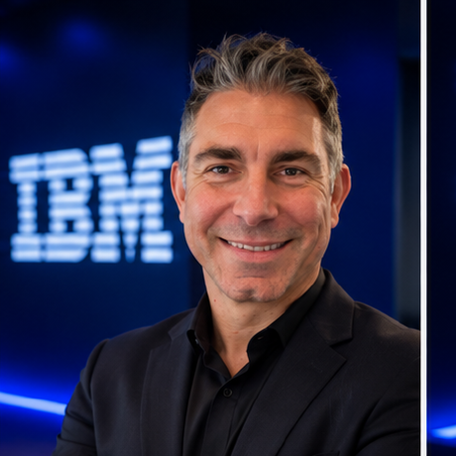
About the speaker:
  Daneyand@IBM.com
  802-598-6057
Daneyand "DJ" Singley is a Technical Leader & Field CTO at IBM, helping clients solve complex business challenges through technology strategy, architecture, and innovation.
Prior to returning to IBM, DJ spent 17 years at MAPSYS, a premier IBM Business Partner based in Columbus, Ohio. As Executive Director & Chief Architect, he led the company’s reseller business for a decade, delivering sustained year-over-year revenue growth and guiding clients through the evolution of enterprise infrastructure.
DJ began his career at IBM as a microprocessor design engineer, developing processor logic for Apple G5 Macs, Nintendo Wii and Wii U consoles, and IBM Power servers before transitioning into technical sales. He holds six patents and has authored several published papers.
DJ earned a Bachelor of Science in Computer Engineering from Rutgers University and a Master of Science in Electrical Engineering from the University of Vermont. Throughout his career, his passion has remained the same: bringing together exceptional people and technology to solve customer problems.
DJ SINGLEY / AI 101
52
Notes:
SPEAKER NARRATION
Thank the audience, share contact details, and open for questions.

