Slide 1
Synchronization Methods for Supporting Distributed 3D Virtual Environments in Java
Kevin Gorman
Daneyand Singley
Yuichi Motai
University of Vermont
Burlington, Vermont, USA
Notes:
The title of this paper is “Synchronization Methods for Supporting Distributed 3D Virtual Environments in Java”
The authors of this paper are Kevin Gorman, Daneyand Singley, and Yuichi Motai of the University of Vermont in the USA

Slide 2
Project Overview
Distributed Virtual Environment created using Java
  Supported a 3D Flight Simulator application for exploring Digital Elevation Maps (DEMs)
  Took advantage of Java3D and NIO.Channels API’s
Focus of work on network synchronization using Java
  Three methods explored in detail
    Server based synchronization using threads
    Server based synchronization using non-blocking I/O
    “Transparent” synchronization using non-blocking I/O
  Objective and Subjective experimental results
    Non-blocking I/O much superior to threaded methods
    “Transparent” method best overall
Notes:
A distributed virtual environment was created using Java. The environment supported the creation of a 3D Flight Simulator application that allowed users to explore Digital Elevation Maps (or DEMs)
Much of the effort in creating the virtual environment was expended to create robust networking support
Methods for maintaining synchronization between client and server applications using Java was explored in detail
Three methods for maintaining synchronization were created and tested
Server based synchronization using threads
Threads were used to access data that was being transmitted between the server and the client
The server issued periodic commands to the clients instructing them to “re-sync” and start updating their environment with the latest data (discarding old data)
Server based synchronization using non-blocking I/O
Non-blocking I/O (available via the NIO.channels API) were used to access data that was being transmitted between the server and the client
The server issued periodic commands to the clients instructing them to “re-sync” and start updating their environment with the latest data (discarding old data)
Transparent synchronization using non-blocking I/O
Non-blocking I/O (available via Java 1.4’s NIO.channels API) were used to access data that was being transmitted between the server and the client
Clients would automatically discard old, un-processed, data whenever new data arrived
Objective and subjective experiments were run using all three synchronization methods.
Non-blocking I/O was found to be much superior to thread based techniques
The method using “transparent” synchronization maintained the most smoothly operating local environments while also maintaining the most synchronization between the client and server environments

Slide 3
Architecture
APPLICATION
Network Interface
I/O Handler
Flight Engine
Graphical
Engine
Networking Support
Control System
User Comm.
Notes:
The distributed virtual environment provided many important features that were used to create the flight simulator application:
Graphical Engine
3D Graphics (created using the Java3D API and VRML97 models)
Control System
A responsive control system was created
Allowed users to control their airplane avatars using a keyboard/mouse and/or other input devices
User Communications
Highly useful communications systems
Users can interact in real-time two way voice chat over network
Users can also instant message one another individually or interact in chat rooms created as needed
Networking Support
Robust and configurable, supporting easy access to multiple synchronization methods
Allows for a tradeoff between client-server synchronization and more smoothly operating local environments
In addition, an update thread (not shown) is used to control/limit screen updates and simulation progression

Slide 4
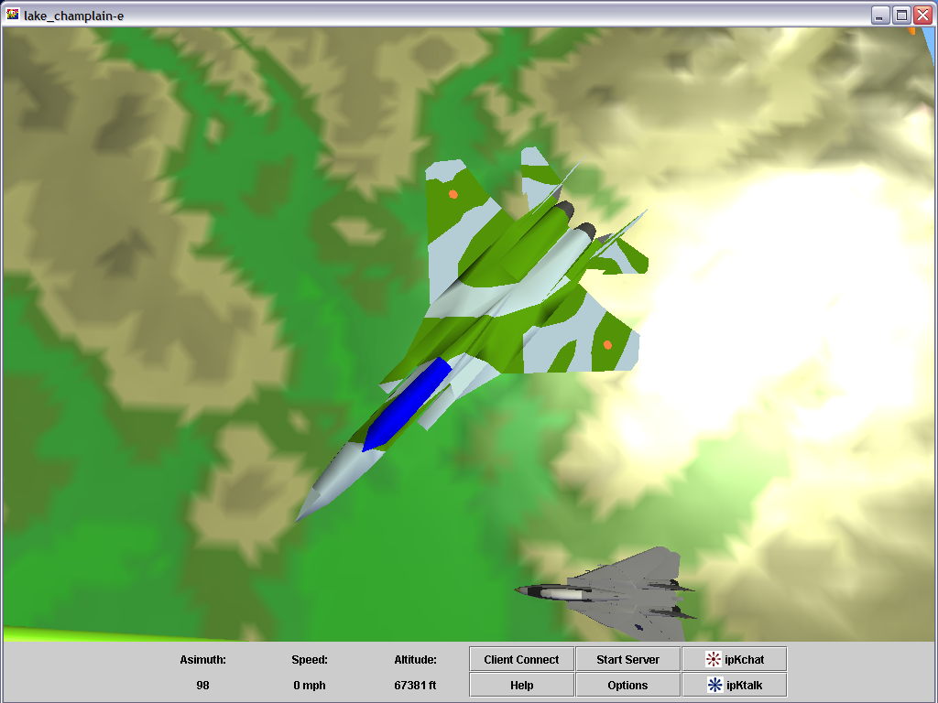
Application Screenshot
Notes:
Screenshot of application running on Windows 2000 Pentium 3 class machine
3D models created using VRML97
Surface generated from DEM (Digital Elevation Map)
Allows flight simulation to occur over detailed representation of a variety of real landmasses
New DEM’s can be downloaded. DEM’s for nearly any part of the world are available.
GUI supplies avatar information (direction/speed of travel) and allows access to:
Options
Communications (voice and instant messaging between users)
Networking controls

Slide 5
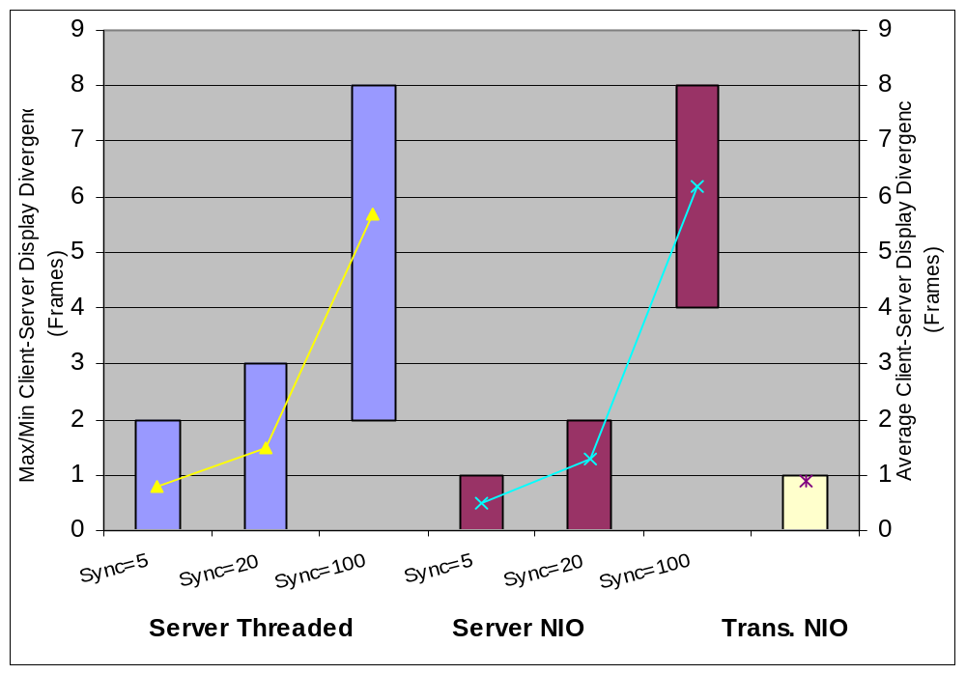
Client-Server Divergence
Client-Server divergence, in frames, for a variety of synchronization methods and re-sync intervals.
Notes:
Client-Server synchronization was studied first.
In the server based synchronization methods (the blue and purple bars), the server would periodically instruct the client machine to re-sync
Depending on how much the client had diverged from the server a number of frames would be discarded
Re-sync intervals of 5, 20, and 100 frames were examined
As the re-sync interval increases the client-server divergence increases (the client has more time to become out of sync)
The chart displays the minimum/maximum and average amount of divergence (in frames) the client was found to have at each re-sync interval
Clearly, shorter re-sync intervals allow the client and server to maintain more synchronization
Note that the non-blocking I/O method was slightly better than the threaded method (lower average divergence)
Non-blocking I/O with a re-sync interval of 5 frames actually had the lowest average divergence
In the transparent synchronization method (the tan bar on the right) the client simply discards any un-displayed frames as soon as new data arrives
The client had to discard an average of slightly less than 1 frames at all times
This method allowed the client to maintain excellent synchronization with the server
Experiment specs:
Server or control machine: AMD Athlon 700, AMD 751 North Bridge, 256mb ram, ATI Radeon 7200 graphics
Client or display machine: Dual Intel Pentium III 700, Intel 440BX North Bridge, 1024mb ram, Nvidia Geforce 3 graphics

Slide 6
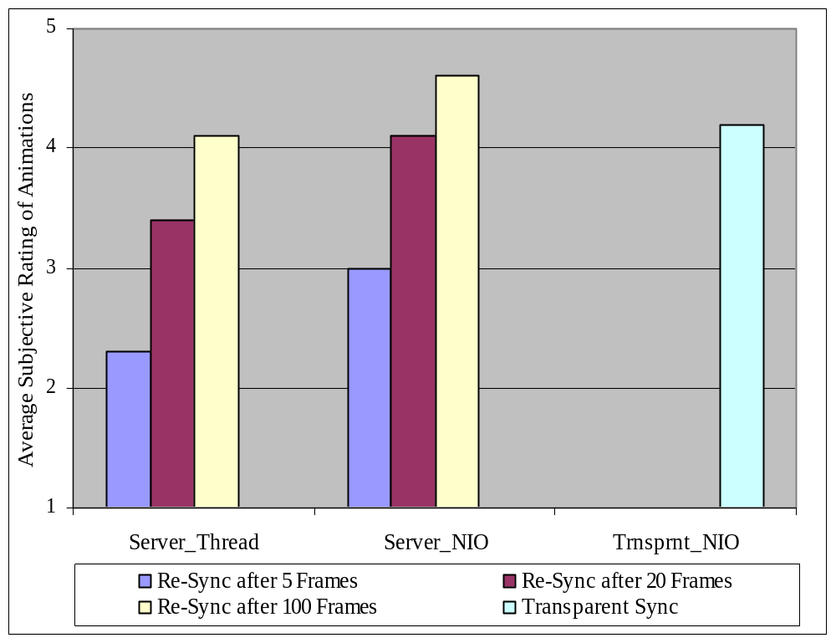
Subjective Ratings
Subjective rating of fluidness of animations for a variety of synchronization methods and re-sync intervals.
Notes:
Next, users of the application were asked to supply subjective ratings on a scale of 1 to 5 (with 5 being better).
Users were asked to rate the fluidness of the animations (how well the application seemed to be running for them)
The server based synchronization methods that used longer re-sync intervals were preferred over the shorter re-sync intervals
There would be less frequent “jumps” in the image being displayed on the client
The divergence would be bigger so the animations would jump a larger amount, but the jumps would occur at much less frequent intervals, so the users found this to be better
The transparent based synchronization method (the light green bar on the right) was found to produce very fluid animations
The animations would only jump if/when the client became out of sync (remember the server based method forces a re-sync whether the client needs it or not)
The divergence was kept to a minimum so the animation jumps were very small

Slide 7
Server Based Synchronization with Threads
SERVER
Network Interface
TCP Connection
User Input
Flight Data sent via object I/O stream
I/O Handler
Flight Engine
Screen Redraw
TCP Connection
TCP Connection
Flight Data read via object I/O stream using a blocking thread
Flight Data read via object I/O stream using a blocking thread
CLIENT0
CLIENT1
Re-sync?
Yes
Re-sync?
Yes
No
Clear syncQ
No
Clear syncQ
Add data to buffer
Add data to buffer
syncQ Buffer
syncQ Buffer
User Input
I/O Handler
User Input
I/O Handler
Screen Redraw
Network Interface
Screen Redraw
Network Interface
Flight Engine
Flight Engine
Notes:
This image illustrates the application running on the server and on two clients. When the networking method using server based synchronization with threads was selected the following happens:
The Flight data is sent to the client over a TCP connection via the object I/O stream
The client reads the flight data via the object I/O stream using a blocking thread
If the re-sync command is asserted the syncQ buffer is cleared of data and the newly arrived data is immediately used for updating the environment
If the re-sync command is not asserted the data is simply added to the syncQ buffer, which is operating in a FIFO manner. The oldest data in the syncQ buffer is simply the next data used to update the client environment.

Slide 8
Server Based Synchronization with Non-Blocking I/O
SERVER
Network Interface
TCP Connection
User Input
I/O Handler
Flight Engine
Screen Redraw
Flight Data converted to string, string encoded in bytes (Marshalling)
TCP Connection
Multicast Transmission
TCP Connection
CLIENT0
Flight Data read via non-blocking I/O
CLIENT1
Flight Data read via non-blocking I/O
dst Byte Buffer
Un-marshalling of data
dst Byte Buffer
Un-marshalling of data
String decoded
String decoded
String buffer
String buffer
Re-sync?
String parsed
Re-sync?
String parsed
Yes
Yes
No
Clear syncQ
No
Clear syncQ
Add data to buffer
Add data to buffer
User Input
syncQ Buffer
User Input
syncQ Buffer
I/O Handler
I/O Handler
Screen Redraw
Network Interface
Screen Redraw
Network Interface
Flight Engine
Flight Engine
Notes:
This image illustrates the application running on the server and on two clients. When the networking method using server based synchronization with non-blocking I/O was selected the following happens:
The Flight data is sent to the client over a TCP connection after it is marshalled into a byte stream format by the server
The client reads the flight data into a byte buffer via a non-blocking I/O call, this buffer is then converted into a string and the string is parsed back into the normal flight data object format (completing the un-marshalling on the client end)
The flight data is then parsed. If the re-sync command is asserted the syncQ buffer is cleared of data and the newly arrived data is immediately used for updating the environment
If the re-sync command is not asserted the data is simply added to the syncQ buffer, which is operating in a FIFO manner. The oldest data in the syncQ buffer is simply the next data used to update the client environment.
The non-blocking I/O allows the client to check for new data on the socket. If no data is available it immediately returns (unlike in the threaded version) and the application keeps running smoothly. The price for this improved socket interface is the requirement to marshal and un-marshal the data.

Slide 9
Transparent Synchronization with Non-Blocking I/O (Client Only)
TCP Connection
CLIENT0
Flight Data read via non-blocking I/O
Un-marshalling of data
dst Byte Buffer
String decoded
String buffer
String parsed
syncQ empty?
No
Yes
Clear syncQ
Add data to buffer
syncQ Buffer
User Input
I/O Handler
Screen Redraw
Network Interface
Flight Engine
Notes:
This image illustrates just the client application. When the networking method using transparent synchronization with non-blocking I/O was selected the following happens:
The Flight data is sent to the client over a TCP connection after it is marshalled into a byte stream format by the server (this step is the same as that in the previous method)
The client reads the flight data into a byte buffer via a non-blocking I/O call, this buffer is then converted into a string and the string is parsed back into the normal flight data object format (completing the un-marshalling on the client end)
If the syncQ buffer is empty, the new data is simply added to the buffer and processing of the new data begins immediately.
If the syncQ buffer is not empty, the syncQ buffer is cleared and processing of the new data also begins immediately.
This immediate use of newly arrived data allows this method to maintain better synchronization between the client and the server than the other methods that use the enforced re-sync.

Slide 10
Conclusion
A 3D Distributed Virtual Environment was created using Java and it’s various API’s
The project demonstrated that Java could be used to successfully implement all important features
  Graphical engine, communications, controls, and networking support
The non-blocking I/O provided in the Java NIO.channels API is key to enabling Java’s use in the creation of real-time distributed environments
  Numerous synchronization methods were examined
  Synchronization methods that use non-blocking I/O (particularly when coupled with the “transparent” synchronization flow) were found to be the best both qualitatively and quantitatively
Notes:
A 3D Distributed Virtual Environment was created using Java
The project demonstrated that Java could be used to successfully implement all important features necessary for creating such a distributed virtual environment
Graphical engine, communications, controls, and networking support were all easily implemented using Java
The non-blocking I/O provided in the Java NIO.channels API is key to enabling Java use in the creation of real-time distributed environments
Numerous synchronization methods were examined
Synchronization methods that use non-blocking I/O (particularly when coupled with the “transparent” synchronization flow) were found to be the best both qualitatively and quantitatively

Slide 11
Acknowledgements
The authors would like to thank:
Sergei Grichine and Soji Yamakawa for their contributions to the 3D graphical engine and the 3D models
Notes:
The authors would like to thank Sergei Grichine and Soji Yamakawa for their contributions to the 3D graphical engine and the 3D models
Thank you.

