Slide 1
Methods for Supporting Networked 3D Virtual Environments in Java
Gorman, Singley

Slide 2
Abstract
Java
  Allows for cost effective, portable, maintainable and extensible virtual environments (VE’s)
Important feature of VE’s:
  Graphics, controls, communications, and networking support
Paper describes a project that uses Java to build a VE and deals with issues related to implementing networking features using Java

Slide 3
Introduction
Java SDK 1.4.1, Java 3D 1.3.1, VRML97 used
A VE (called Whiskey) that enables flight simulator-like applications was developed
  Primary focus of paper is on application that allows for collaborative geo-exploration of DEM’s via flying a 3D plane avatar

Slide 4
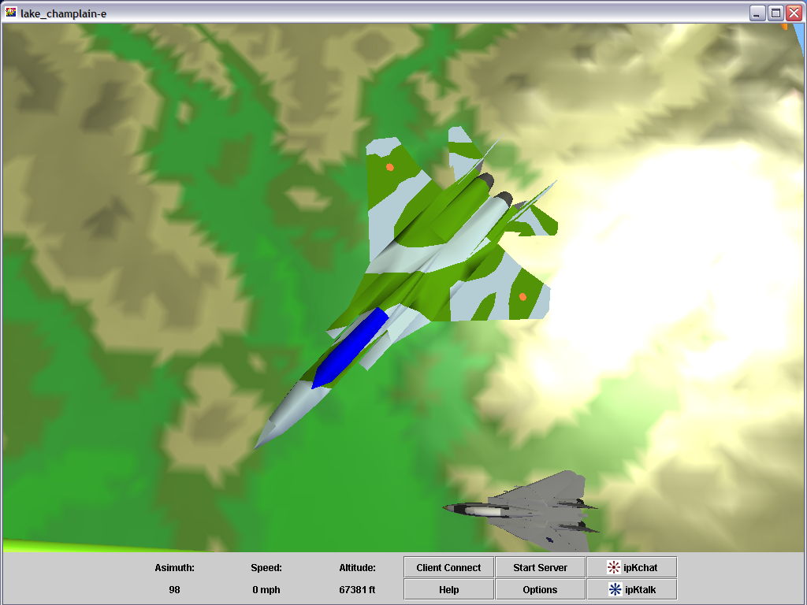
Design of Virtual Environment
Graphical engine
  Based on tweaked open source code

Slide 5
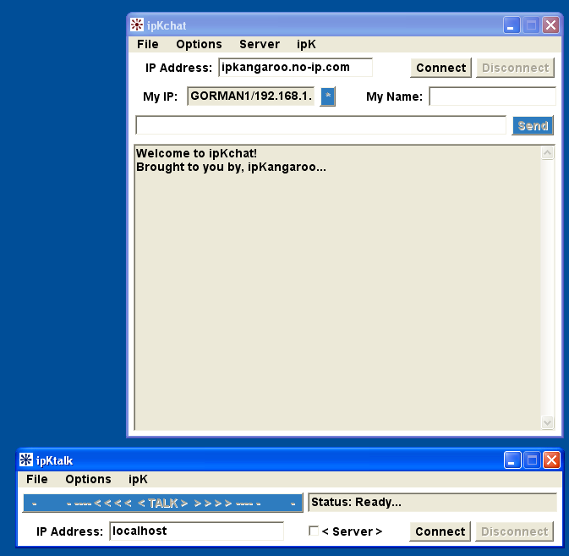
Design of Virtual Environment Continued
Controls
  Basic keyboard and
  mouse setup, but
  extendable to other
  devices
Communications
  ipKchat and ipKtalk
  Developed by Singley

Slide 6
Design of Virtual Environment Continued
Networking
  4 Methods
    Server based synchronization with threads
    Client based synchronization with threads
    Server based synchronization with non-blocking I/O
    Transparent synchronization with non-blocking I/O

Slide 7
Networking Details
while(true)
{
syncer = cRecv(); // Read flightPacket from socket
if(syncer.sync==true) //If sync is set, initialize buffer clear routine
{ fPacket = syncer; syncUp(); }
else
{syncQ.addLast(syncer); } //Otherwise we add the packet to the buffer
}
Figure 4. Thread for performing a read from a socket.
//non-blocking I/O read
status = sc.read(dst);
//If status is >0, parse out packets and put in buffer.
if(status >0) {/* Data processing code here */}
Figure 6. Non-blocking I/O performing a read from a socket.
Socket
String decode
String parser
Packet of avatar data
dst byte buffer
string buffer
syncQ linked list of strings
Figure 7. Non-blocking I/O data processing.

Slide 8
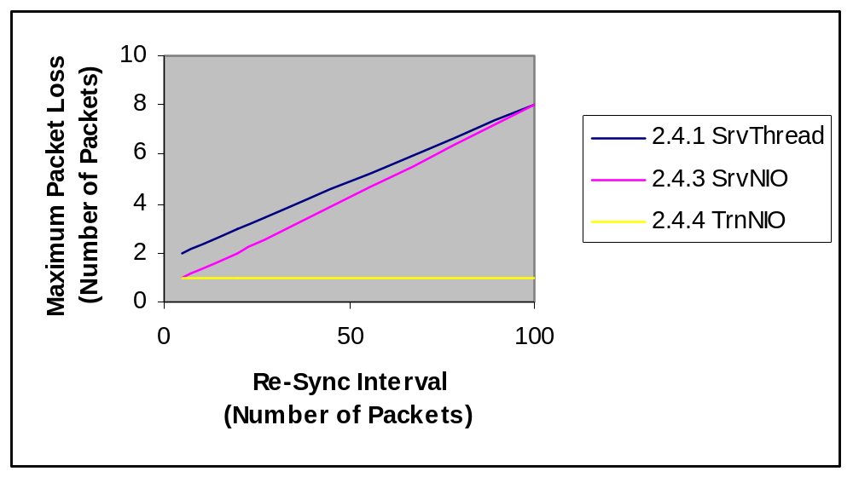
Comparison of Networking Methods

Slide 9
Comparison of Networking Methods Continued
Sync. Method
Re-Sync Interval
Average Rating
2.4.1 Server Based with Threads
5
X1
20
X2
100
X3
2.4.3 Server Based with Non-blocking I/O
5
Y1
20
Y2
100
Y3
2.4.4 Transparent with Non-blocking I/O
N/A
Z

Slide 10
Conclusion
Transparent synchronization with non-blocking I/O is best method qualitatively and quantitatively
  Allows Java to be realistically used to create real-time networked VE
  Java good choice for other reasons
    Open source support
    Knowledge base in academia
    Object oriented
  Allows for creation of VE that is cost effective, portable, maintainable and extensible
  Allows for creation of VE that provides graphic/control/communication/networking support

Slide 11
Thanks
Sergei Grichine for his open source graphical engine
Soji Yamakawa for his VRML97 airplane models
Whiskey VE is open source!

