Slide 1
SEMESTER- 5 PRESENTATION
ON
Data Aggregation in
Wireless Sensor Network
Team :
Atul Pandey
Sumit singh chauhan
Yash Bansal
Srijan Baranwal
Vaibhaw
ravi

Slide 2
Wireless Sensor Network
WSN is a wireless network consisting of spatially distributed autonomous device using sensor to monitor physical or environmental conditions.
In WSN sensor nodes are deployed in a region to sense the information.
Aggregation can be simply defined as “ the ability to summarize information ”.
Data aggregation is a process in which intermediate node receives multiple input packets perform aggregation and produce single output packet in the network.

Slide 3
Contd..
Data aggregation usually involves the integration of data many sensor nodes and the aggregator data to the base station
The main goal of data aggregation is to gather and aggregate data in an energy efficient manner so that network lifetime is enhanced .
Data aggregation technique removes data redundancy from wireless sensor network in order to enhance the lifetime of WSN

Slide 4
Advantages
Enhance robustness and accuracy of information.
Reduce traffic load and conserve energy of sensors

Slide 5
Disadvantages
Malicious attacker
Cannot ensure correctness
Increase power consumption

Slide 6
Data Aggregation Strategies
There are four strategies for data aggregation
Centralized Approach
In-Network Aggregation
Tree-Based Approach
Cluster-Based Approach

Slide 7
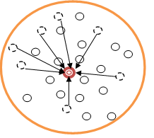
Centralized approach
In this approach each node sends data to a central node via the shortest possible route.
All the sensor nodes simply sends the data packets to a node, which is the powerful among all other nodes.
It cannot be used for continuous data delivery
It extends the network lifetime
Simple in nature.

Slide 8
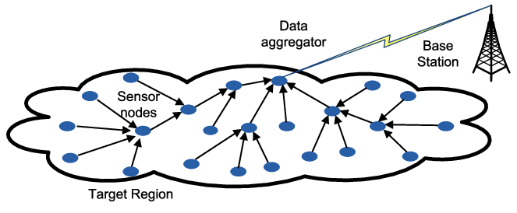
In-Network
Aggregation
The aggregation is the global process of gathering and routing information through a multi-hop network and processing data at intermediate nodes with the objective of reducing power consumption.
There are two types of approach in-network aggregation : with size reduction and without size reduction
Not applicable for large network.
Data security, Low energy.

Slide 9
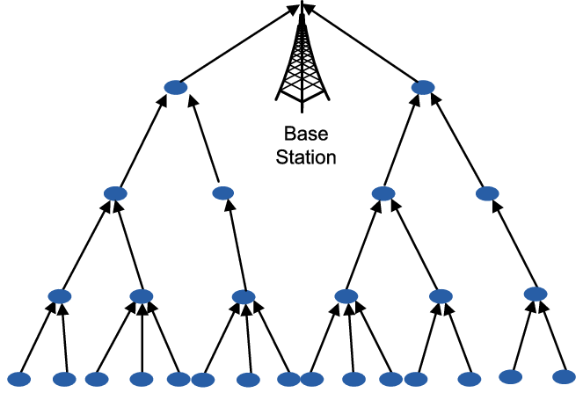
Tree-Based
Approach
In the tree based approach at first data integration tree is formed
For each data transmission minimum spanning tree is created.
Each node has a parent node to forward its data
Ability to tolerate disconnections and loss.
Network lifetime is limited

Slide 10
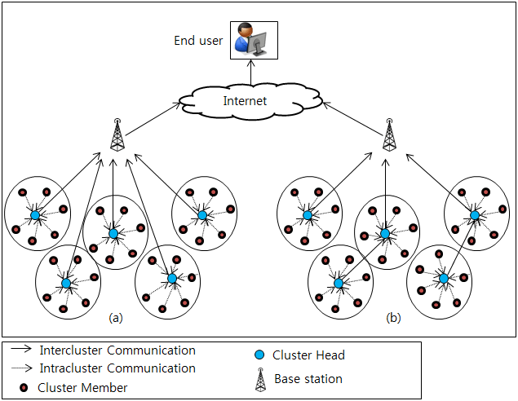
Cluster-Based
Approach
In Cluster-Based Approach, whole network is divided into several clusters. Each clusters is consisting of many sensor nodes
Low energy, increased lifetime of network
Improved energy efficiency.
It is not used for large network region.
Lifetime of sensor node is limited

Slide 11
Future Plan
In future various issues of data aggregation will be investigated in detail. •
Redundancy Elimination
Delay
Accuracy
Traffic load

Slide 12
Project Idea
Forest Fire area
prediction

Slide 13
PROJECT SUMMARY
AIM : To predict the area covered by forest fire
PROMPT : The dataset contains 517 fires from the Montesinho natural park in Portugal. For each incident weekday, month, coordinates, and the burnt area are recorded, as well as several meteorological data such as rain, temperature, humidity, and wind. The workflow reads the data and trains a regression model based on the spatial, temporal, and weather variables.

Slide 14
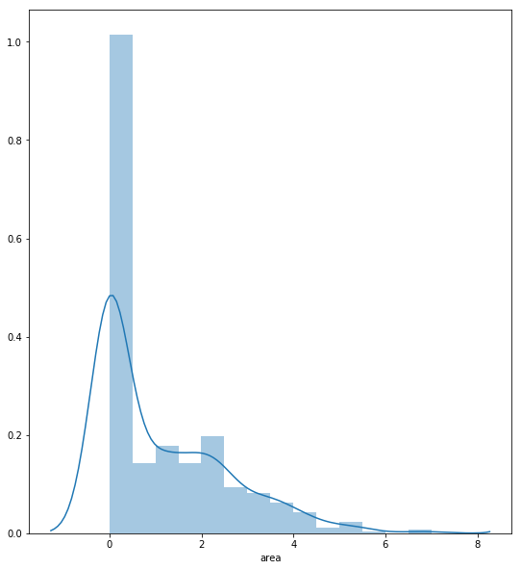
ANALYSIS

Slide 15
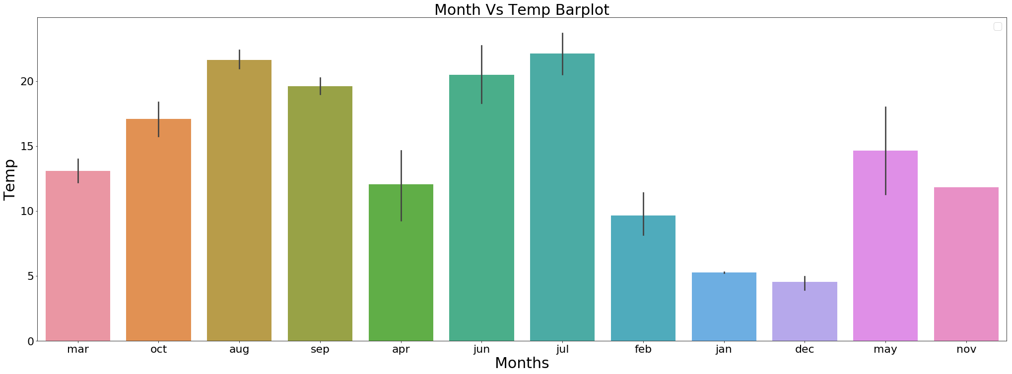
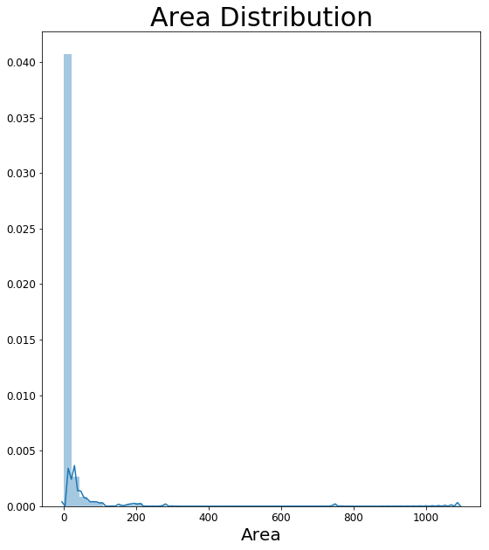

Slide 16
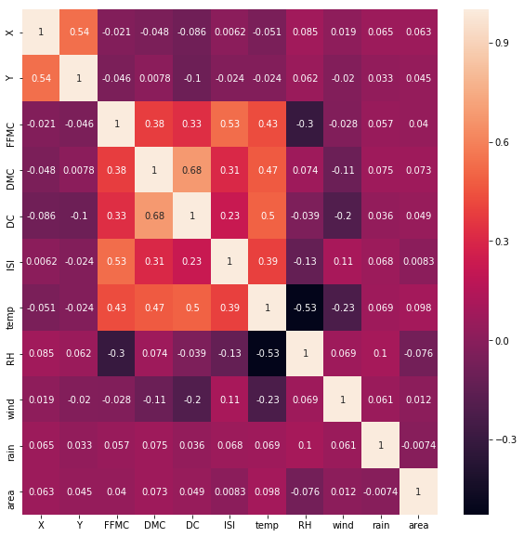
HEAT MAP

