Slide 1

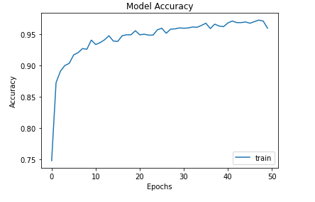
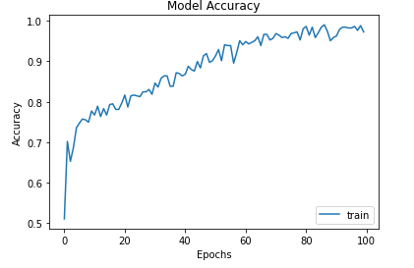
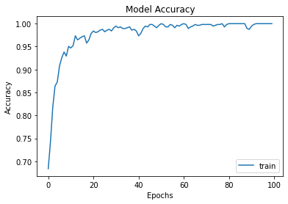
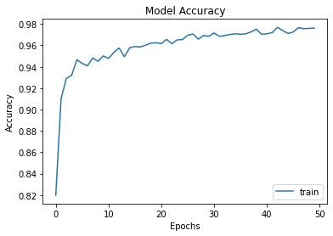
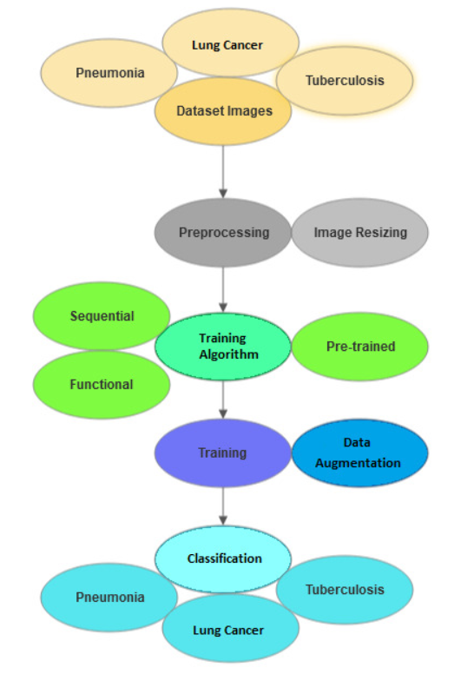
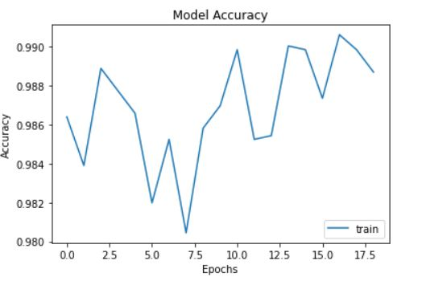
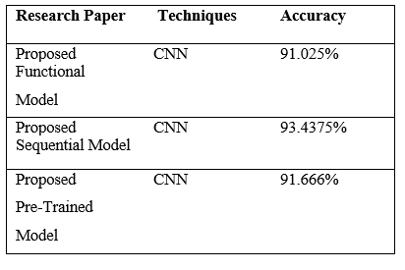

Title of project (Calibri 24pts)
Student 1, Student 2, and Student 3 | (Calibri 21pts)
Prof. X. Xxxxxxxxxxxx xxxxxxx| SENSE
Motivation/ Introduction
Header : Calibri 18 pts
Results
Deep learning currently drives unprecedented breakthroughs across domains ranging from scientific discovery to pervasive consumer technologies, yet the field is continually challenged by issues of computational efficiency, model opacity, and the need for vast labeled datasets. While specialized architectural innovations have yielded state-of-the-art results in isolated tasks, the underlying principles governing optimal learning, generalization, and scaling remain areas of active and critical investigation. (Calibri 12 pts)
SCOPE of the Project
Fig. 2 Model accuracy vs Epochs for Pneumonia (Sequential).
(Calibri 10 pts)
Fig. 3 Model accuracy vs Epochs for Tuberculosis.
In this paper, we aim to detect various Lung diseases (Pneumonia, Tuberculosis and Lung Cancer) from X-ray and CT scan images using volume datasets with more than thousand samples. We implemented three deep learning models (Sequential, Functional, and Transfer) and trained them on publicly available datasets. Deep learning is used as a tool for machine learning, where the CNNs are capable of automatically extracting and learning features from medical images. We also validated our models on the datasets and compared their performance with other existing models. Our models were able to reach the same or higher levels of accuracy as the best performing models.
Methodology
The datasets used, the preprocessing and data augmentation methods and the various algorithms used are discussed in detail in the next subsections. The workflow for the work is presented in a flowchart form in Fig 1.
Dataset - All the datasets used in this work are from publicly available datasets published on the website “Kaggle". The Pneumonia dataset published by Paul Mooney contains 5856 frontal chest x ray images. The Tuberculosis dataset published by Scott Mader has 662 frontal x rays. The Cancer dataset published by Mohamed Hany has 907 lung CT scan images.
Algorithms - Three different model algorithms were used in this work.
Sequential
Functional
Pre-trained
Fig, 4 Model accuracy vs Epochs for Cancer.
Fig. 5 Model accuracy vs Epochs for Pneumonia (Functional).
Fig. 6 Model accuracy vs Epochs for Pneumonia (Pre-trained).
Table. 1 Comparison of accuracies of different proposed models for Pneumonia dataset.
SDGs Addressed:
Fig. 1
Conclusion/ Summary
a) Sequential
  The sequential model is a model in which layers are stacked to form a sequential order. The input is passed through all the layers in the order in which the layers were stacked. Features are learnt at each and every layer and as we go deeper into the layer, the model becomes able to distinguish the infected areas and non-infected areas from the chest x rays. The model is trained from scratch in this method unlike the pre-trained model.
In this paper, we have proposed three different models of Convolutional Neural Networks (CNN) which were used to train on various lung disease datasets that are publicly available. The trained model was used to predict the labels of some test images which have not been seen by the model. The results of the proposed models indicated that it performed better than other related works. In future, changing the optimizers, learning rate and introduction of more data augmentation could potentially lead to further improvements in classification accuracy of the proposed CNN models. Early stopping technique can also be used to avoid overfitting.
b) Functional
  The functional model has more flexibility than the other algorithms. It can form connections between any two layers contrary to the others which progress only in a linear fashion. This allows us to create more complicated and sophisticated networks. Input goes through the first layer and then proceeds along the designed architecture. This method also trains from scratch contrary to the pre-trained model.
Contact Details : hariharan.2017@vitstudent.ac.in utkarsh.raj2017@vitstudent.ac.in , bhargav.ram2017@vitstudent.ac.in
Pre-trained
  This is the easiest and most commonly used model for image classification. Instead of training a model from scratch, this technique uses already trained weights on a large dataset of images to classify the required images. This technique is also called transfer learning as previously learnt weights are transferred and used for classification. Generally, this model takes lesser time to train and hence produces the lowest accuracy.
faculty_email@vit.ac.in
Acknowledgments/ References
Indolia, S., Goswami, A. K., Mishra, S. P., & Asopa, P. (2018). Conceptual understanding of a convolutional neural network, a deep learning approach. Procedia Computer Science, 132, 679-688.
Indolia, S., Goswami, A. K., Mishra, S. P., & Asopa, P. (2018). Conceptual understanding of a convolutional neural network, a deep learning approach. Procedia Computer Science, 132, 679-688.
Indolia, S., Goswami, A. K., Mishra, S. P., & Asopa, P. (2018). Conceptual understanding of a convolutional neural network, a deep learning approach. Procedia Computer Science, 132, 679-688. (APA Style citation)
This is the formula we used to calculate accuracy for our models.
Where, TP stands for True Positive, TN for True Negative, FP for False Positive and FN for False Negative.

