Slide 1

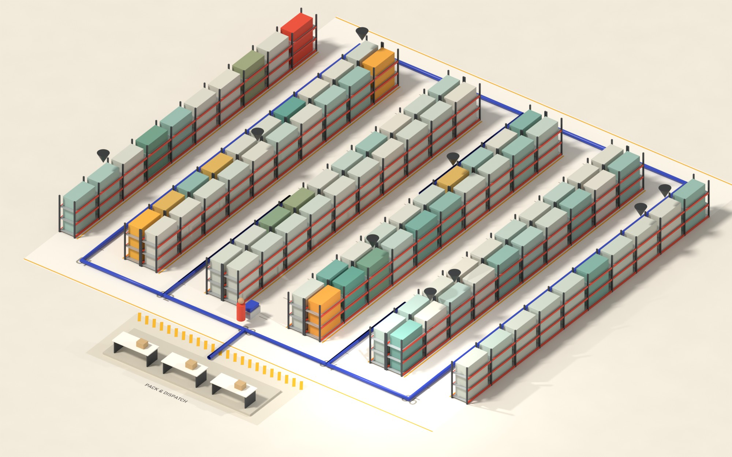
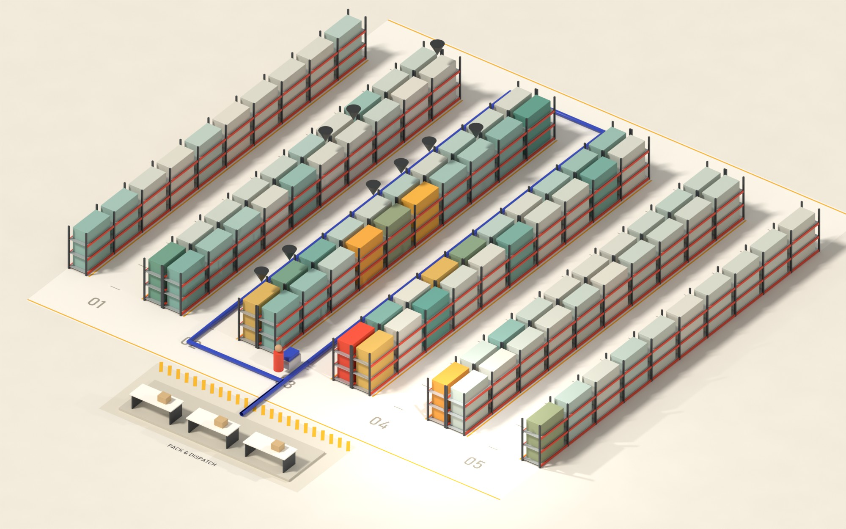
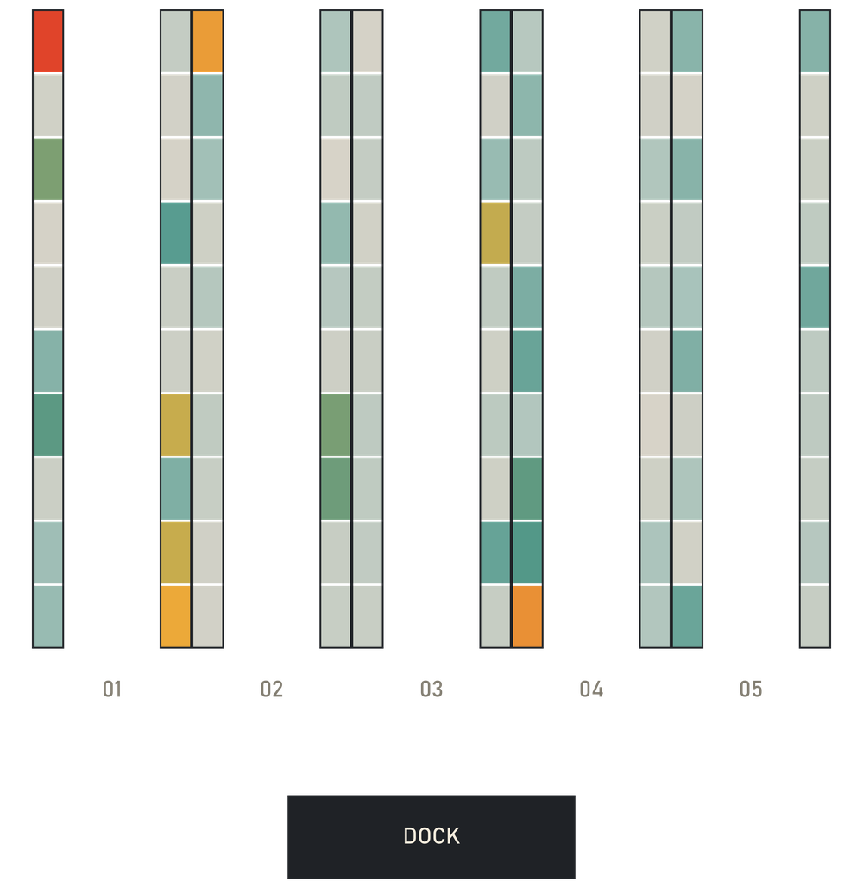
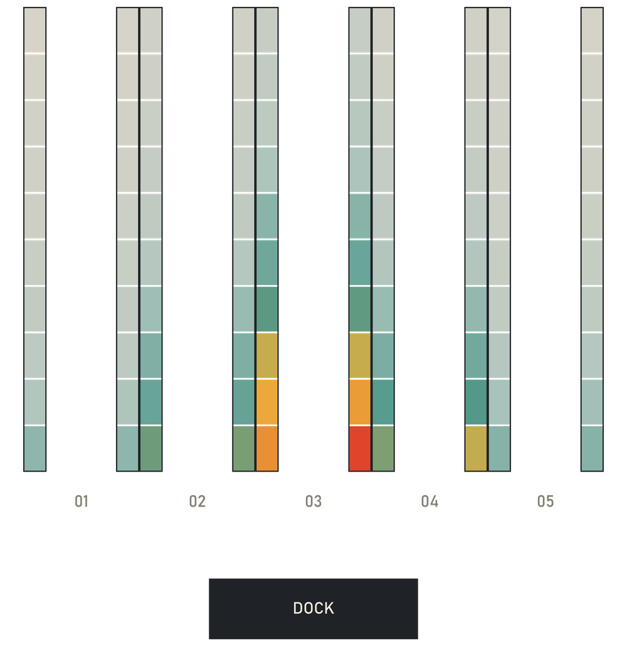
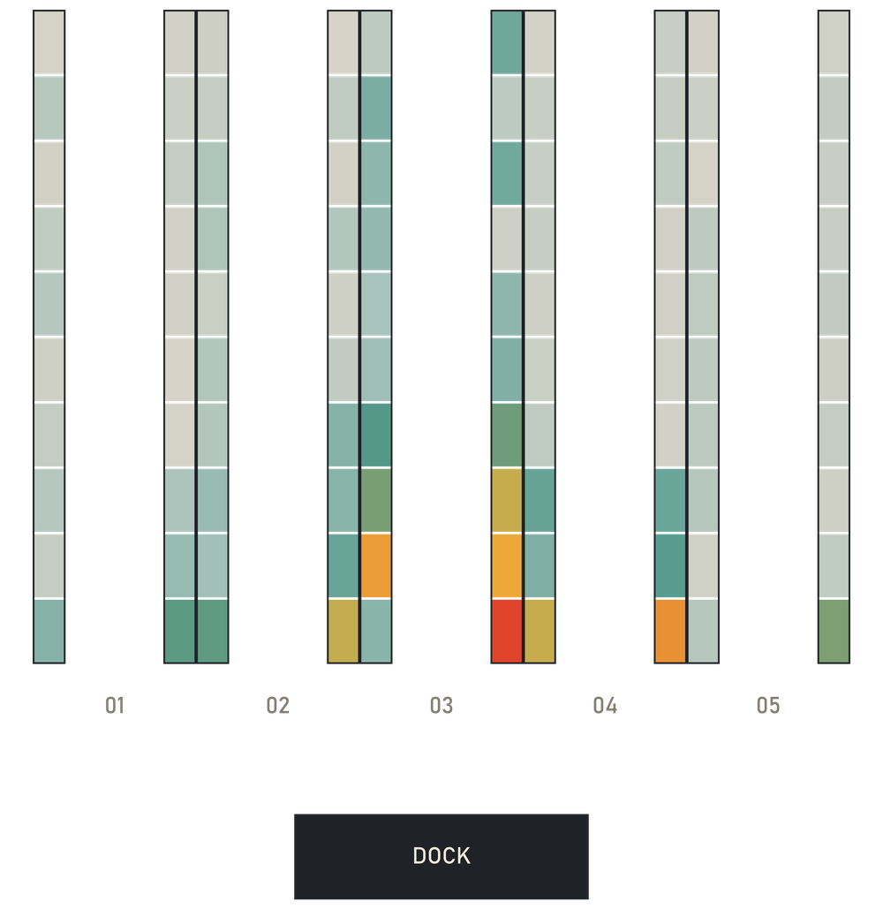
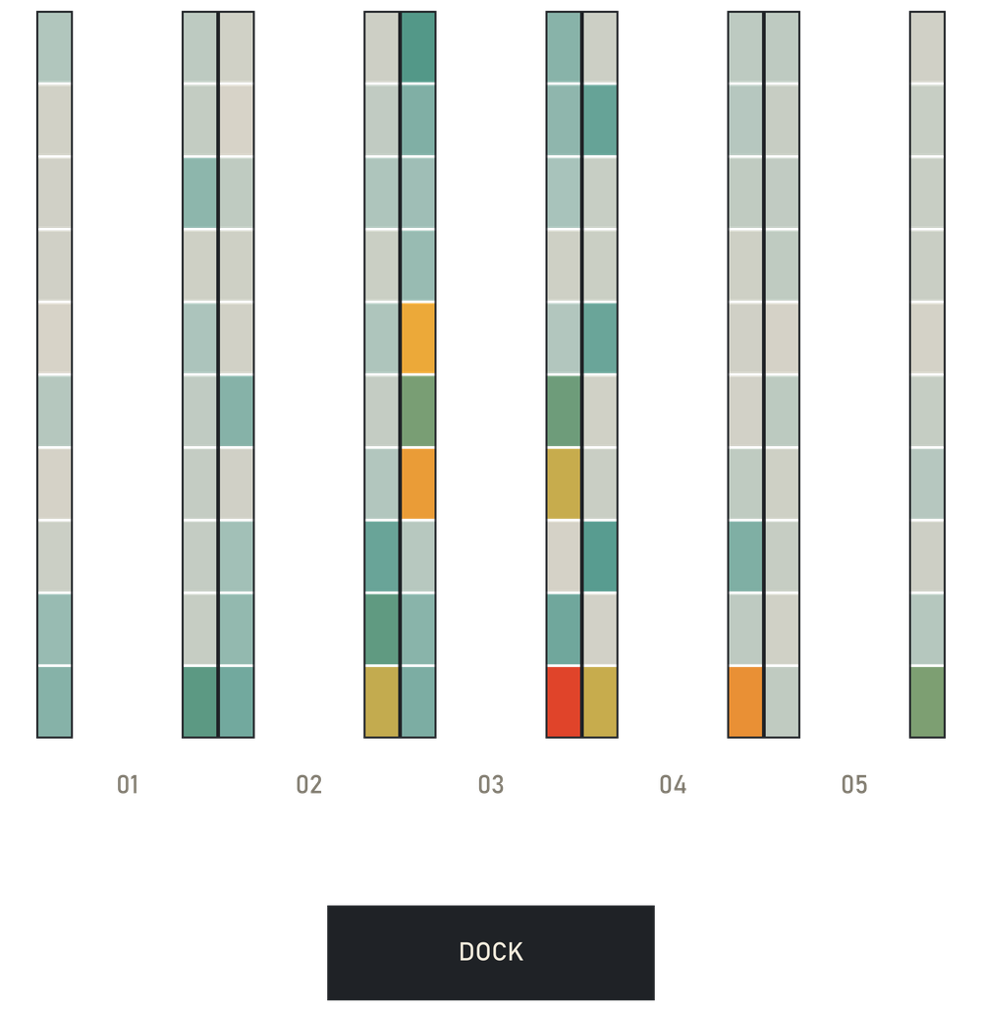
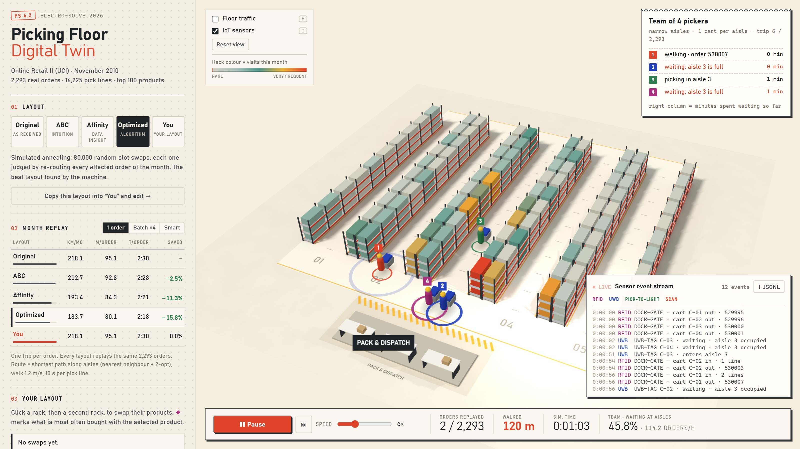

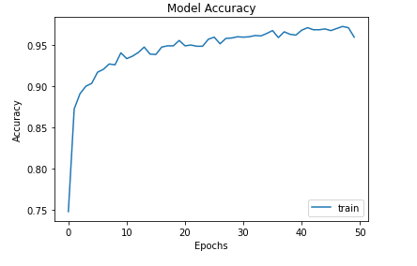
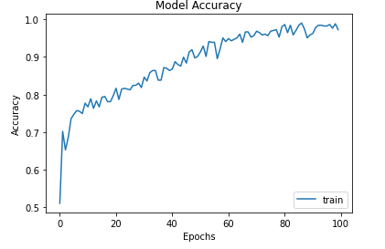
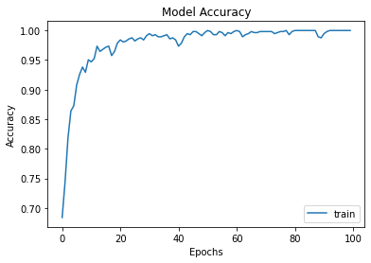
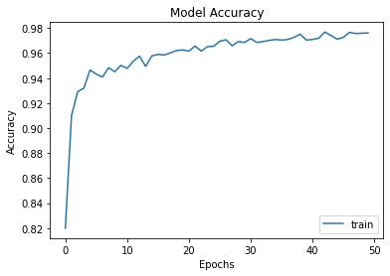
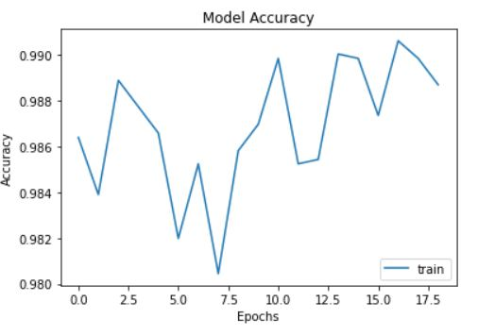
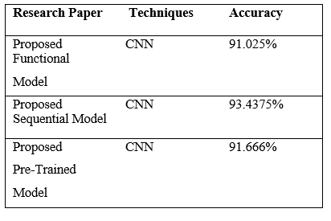
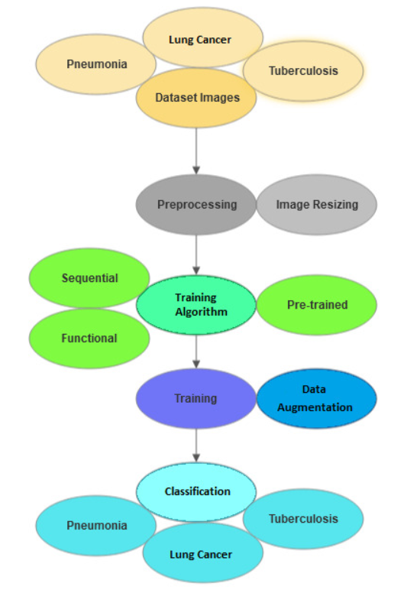
Picking Floor Digital Twin: Data-Driven Warehouse Slotting
Rohith Krishna A K (25BCE2027) and Jaidev A (25BCE0971) | Team GitHappens
Dr. Jaffino | SENSE
Motivation/ Introduction
Results
In a warehouse, an order picker spends more time walking than picking: in our model 79 s of every 150 s order is walking. Where each product sits on the shelves (slotting) decides that distance, yet it is usually set by habit. We built a digital twin of a picking floor that replays real customer orders, so any shelf arrangement can be measured before anyone moves a carton.
SCOPE of the Project
A 100-slot pick zone (5 aisles, racks on both sides) is driven by 2,293 real orders from the UCI Online Retail II dataset (Nov 2010). We compare four slotting strategies, batch and smart-batch picking, and a team of up to six pickers with aisle congestion. The twin runs in a browser as a 3D game where users swap racks against an optimizer, and it emits the events real sensors would stream: RFID dock gate, UWB cart tags, pick-to-light modules and barcode scans.
Fig. 2 One real order (invoice 532964, 9 lines): 143 m through 5 aisles on Original (left) vs 62 m through 2 on Optimized.
Layout | km / month | m / order | Walking saved | Unseen week
Original | 218.1 | 95.1 | – | –
ABC (intuition) | 212.7 | 92.8 | 2.5% | 1.9%
Affinity (data) | 193.4 | 84.3 | 11.3% | 11.2%
Optimized (SA) | 183.7 | 80.1 | 15.8% | 13.9%
Smart batch + Optimized | 70.1 | 30.6 | 67.9% | –
Methodology
Real orders
UCI Online Retail II
76,584 lines
Clean (pandas)
2,293 orders
top 100 products
Floor graph
61 nodes, 64 edges
Floyd–Warshall
Route each trip
nearest neighbour
+ 2-opt
Table 1 Same 2,293 orders on every layout, one picker. Unseen week: layouts built before 22 Nov, tested on the last 766 orders.
4 pickers, narrow aisles
23% of team capacity lost; pickers wait 23% of the time.
6 pickers
month cleared in 22.6 h (narrow) vs 15.7 h (wide aisles).
Slotting vs congestion
Optimized beats Original by +9% with 1 picker, +5% with 6.
IoT event stream
RFID · UWB · PTL
barcode, JSONL
3D twin + game
Three.js, Web Worker
Blender-baked floor
Team of pickers
aisle capacity
queueing sim
Slotting
ABC · Affinity
simulated annealing
Fig. 1 System pipeline: one simulation core, used offline (Node) and live (browser).
a) Data. Cancelled invoices, postage/fee codes and invalid rows are removed (76,584 → 74,757 lines). The top 100 products by pick lines (3% of the range, 22% of picks) fill the 100 slots; 2,293 orders remain, 7.1 lines each.
b) Floor and routing. The floor is a graph whose edges follow aisles, so no route can cut through a rack. Floyd–Warshall gives all shortest paths; each trip (dock → picks → dock) is ordered by nearest neighbour and improved by 2-opt. Walking 1.2 m/s, 10 s per order line.
c) Slotting. Original (stock-code order); ABC (most-picked nearest the dock); Affinity (slot score = picks + w × co-orders with products already in that aisle); Optimized (simulated annealing over slot swaps, 80,000 iterations, accepting a worse swap with probability P = e^(−Δd / T); only orders touching the two swapped products are re-routed).
d) Team of pickers. N pickers (1–6) clear the month's backlog from one queue. An aisle holds at most c carts (narrow: c = 1, wide: c = 2); a picker reaching a full aisle waits at its entrance. Time-stepped (0.5 s) and deterministic, so the browser and Node give identical results. Congestion loss = 1 − throughput / (N × single-picker throughput).
e) Validation. Layouts were also built from orders before 22 Nov only and tested on the 766 orders of the final week.
f) IoT layer. Every replay emits the events real devices would publish: RFID gate at the dock (cart out/in), UWB tag position at every aisle node, pick-to-light ON/OFF per slot, barcode pick confirmation and aisle-blocked alerts, exported as JSON Lines. An ESP32 publishing the same messages (e.g. over MQTT) could replace the replay feed.
Fig. 3 Throughput vs team size on the Optimized layout.
Original 218.1 km
ABC −2.5%
Affinity −11.3%
Optimized −15.8%
Fig. 4 Rack visits per month (grey = rare, red = very frequent); dock at the bottom.
SDGs Addressed:
SDG 8
Decent work: less walking, less fatigue
SDG 9
Industry & innovation: digital twin + IoT
SDG 12
Responsible production: leaner logistics
Conclusion/ Summary
The textbook ABC rule saves only 2.5% because orders average 7 lines spread across the floor. Using what customers buy together saves 11.3%, and simulated annealing 15.8% (34 km ≈ 8 picker-hours a month); the gains hold on unseen orders (13.9%). Smart batching plus the optimized layout cuts walking by 68%. With a team, narrow aisles lose 23–35% of capacity to queueing, which erodes about half the slotting gain: aisle width and batching matter as much as slotting. Next: live sensor input and dynamic re-slotting.
Contact Details : rohithkrishna.a2025@vitstudent.ac.in
jaidev.a2025@vitstudent.ac.in · jaffino.g@vit.ac.in (guide)
Acknowledgments/ References
Chen, D. (2019). Online Retail II [Dataset]. UCI Machine Learning Repository. https://doi.org/10.24432/C5CG6D
de Koster, R., Le-Duc, T., & Roodbergen, K. J. (2007). Design and control of warehouse order picking: A literature review. European Journal of Operational Research, 182(2), 481–501.
Kirkpatrick, S., Gelatt, C. D., & Vecchi, M. P. (1983). Optimization by simulated annealing. Science, 220(4598), 671–680.
Gue, K. R., Meller, R. D., & Skufca, J. D. (2006). The effects of pick density on order picking areas with narrow aisles. IIE Transactions, 38(10), 859–868.
Fig. 5 3D twin in team mode: two of four pickers queue at a full aisle.

