Slide 1
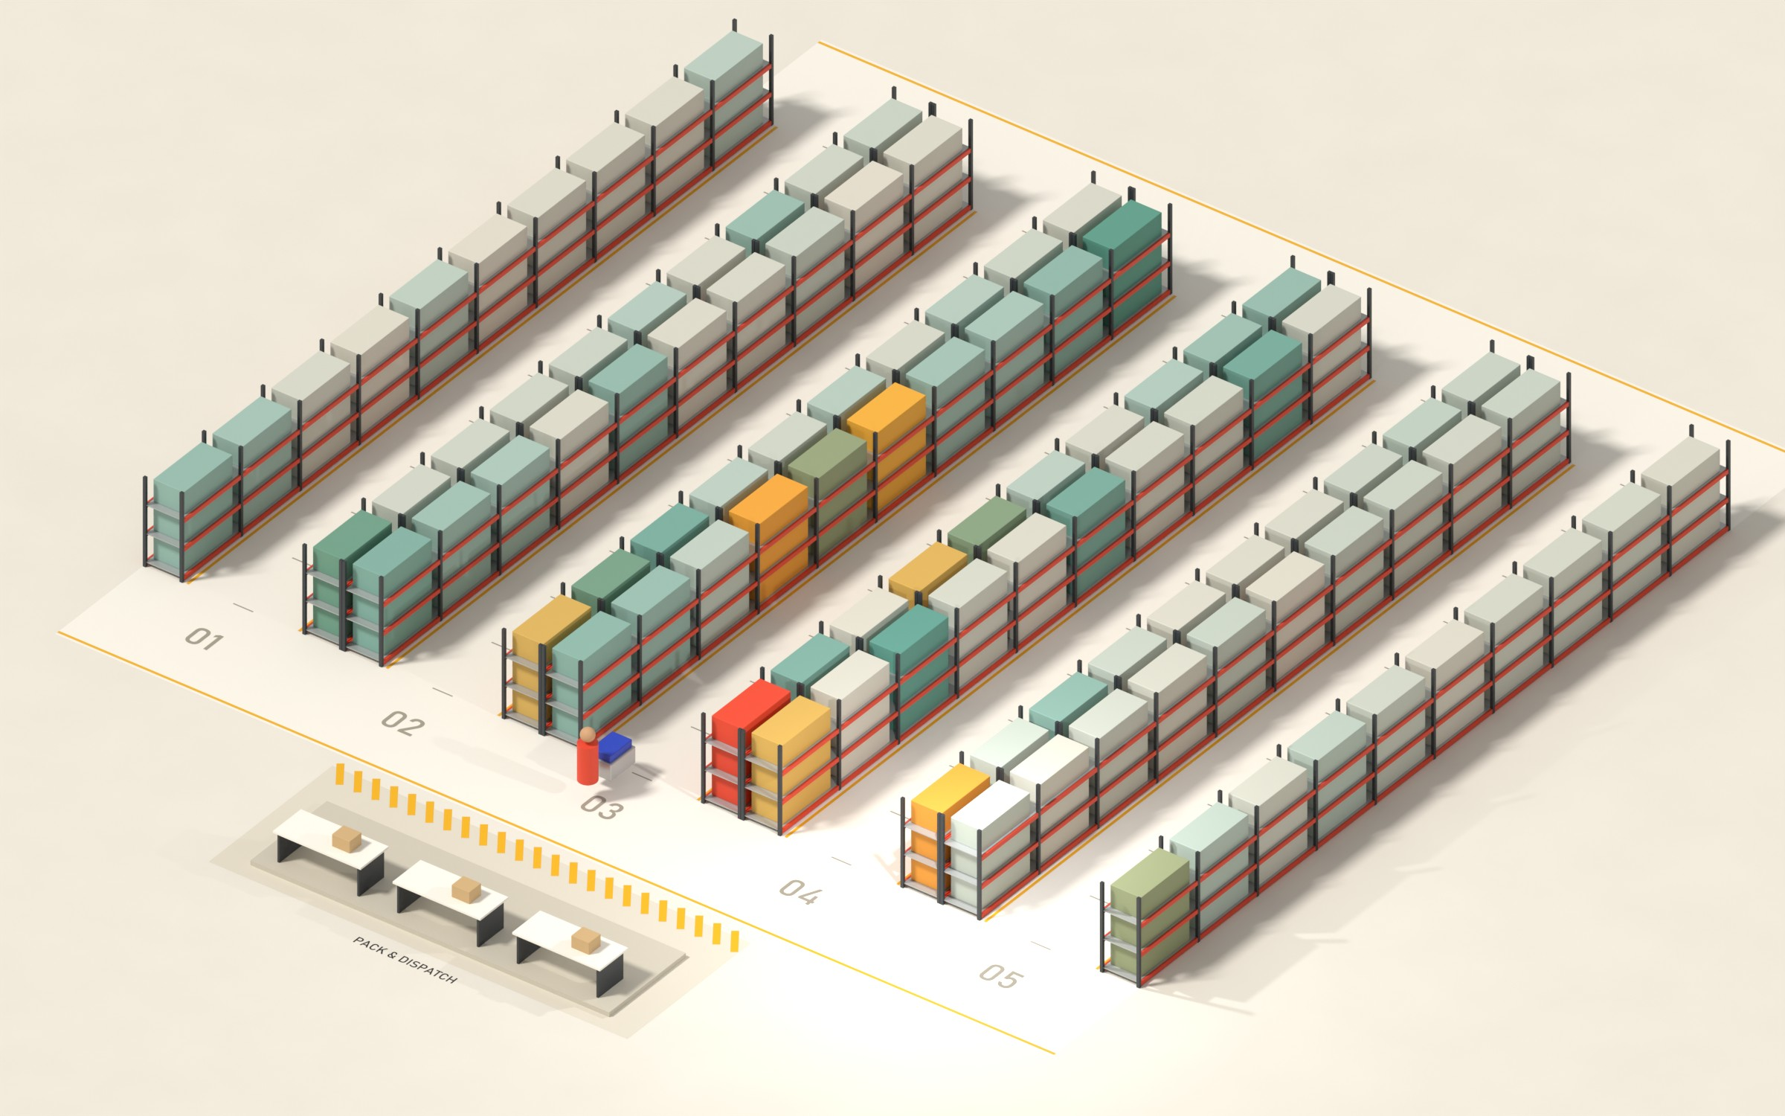
PICKING FLOOR DIGITAL TWIN
01 / 12
PS 4.2
ELECTRO-SOLVE 2026 · PROJECT EXPO
Picking Floor
Digital Twin
A 3D twin of a warehouse picking floor, driven by 2,293 real customer orders. Re-shelve the products and it replays the same month to measure the walking saved.
2,293
−15.8%
−68%
real orders replayed
walking, optimized layout
with smart batching
Team GitHappens · SENSE, VIT
Rohith Krishna A K (25BCE2027) · Jaidev A (25BCE0971)
Guide: Dr. Jaffino
ELECTRO-SOLVE 2026 · PS 4.2 · SENSE, VIT
DATA: ONLINE RETAIL II (UCI, CC BY 4.0)
Notes:
Hook: pickers in a warehouse spend more time walking than picking, and where each product sits decides how far they walk. We built a 3D digital twin of a picking floor, driven by 2,293 real customer orders. Rearrange the shelves and the twin replays exactly the same orders to measure the walking saved, instead of just claiming it.

Slide 2
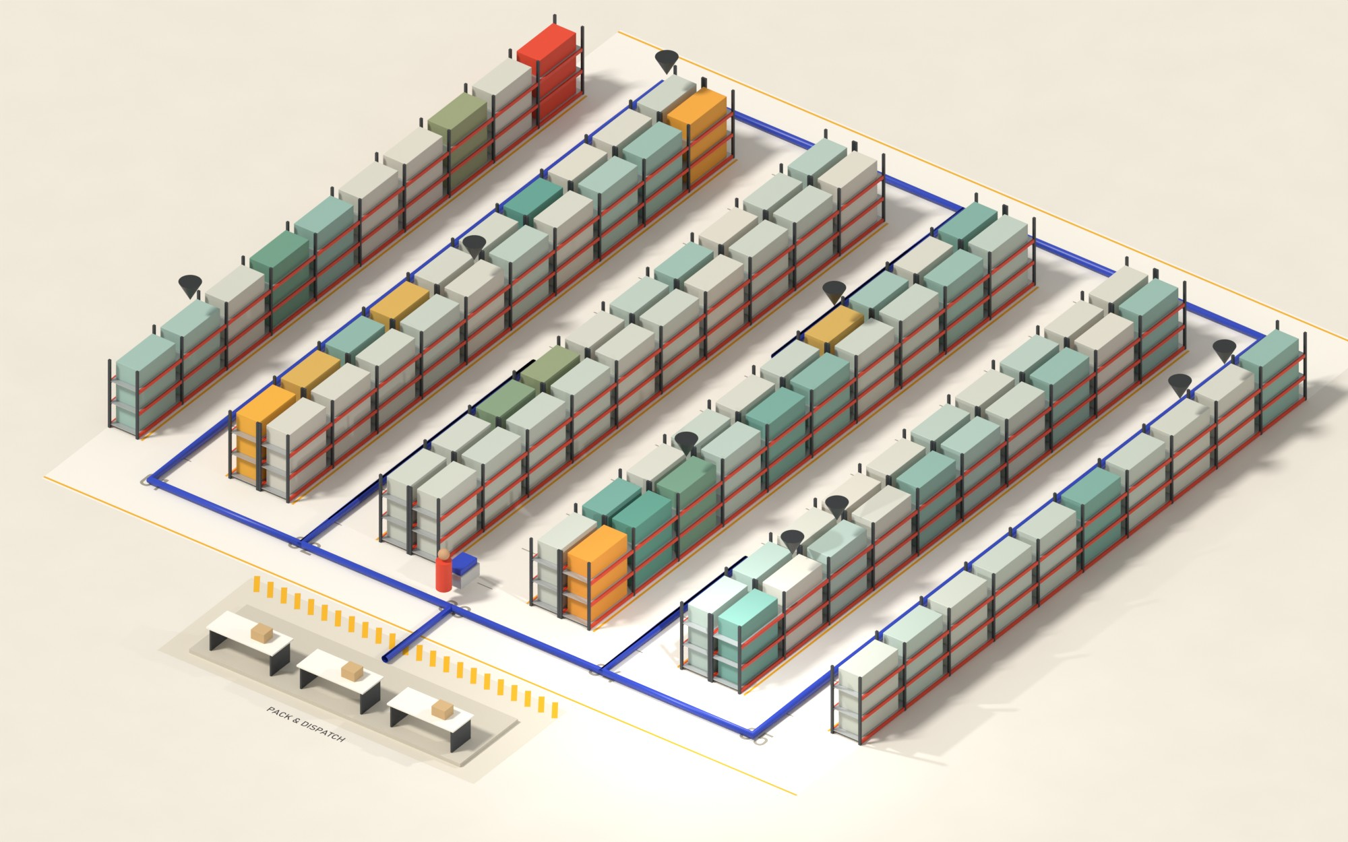
PICKING FLOOR DIGITAL TWIN
02 / 12
§02 THE PROBLEM
Pickers walk more
than they pick.
53%
of every order’s time is walking
79 s walking
71 s picking
Per order, 1.2 m/s walking, 10 s per line
218 km walked in one month by a single picker in a 100-slot zone.
Invoice 532964 · 9 lines on the as-received layout: 143 m through all 5 aisles
ELECTRO-SOLVE 2026 · PS 4.2 · SENSE, VIT
DATA: ONLINE RETAIL II (UCI, CC BY 4.0)
Notes:
In our model one order costs about 79 s of walking and 71 s of picking, so 53% of the time is walking. Over the month one picker walks 218 km in a 100-slot zone. The picture is one real order, invoice 532964: 9 lines, and on the as-received layout the picker walks 143 m through all 5 aisles.

Slide 3
PICKING FLOOR DIGITAL TWIN
03 / 12
§03 THE DATA
Built on 2,293 real customer orders
Online Retail II (UCI, CC BY 4.0): a UK gift wholesaler, November 2010, the pre-Christmas peak.
2,293
Raw order lines
76,584
−1,192 cancelled
Clean pick lines
74,757
real orders, replayed line by line
−282 postage & fees · −353 invalid
Lines on the top 100 products
16,225
3% of the product range carries 22% of all picks. A pick is one order line: walking depends on visits, not on quantity.
top 100 of 3,018 products
Real orders replayed
2,293
7.1 lines per order
ELECTRO-SOLVE 2026 · PS 4.2 · SENSE, VIT
DATA: ONLINE RETAIL II (UCI, CC BY 4.0)
Notes:
Dataset: UCI Online Retail II, a UK gift wholesaler, November 2010, the pre-Christmas peak. We remove cancellations, postage and fees, and invalid rows: 76,584 lines become 74,757. We keep the top 100 products by pick lines: 3% of the range but 22% of picks. Result: 2,293 real orders, 7.1 lines per order. A pick is one order line, because walking depends on visits, not quantity.

Slide 4
PICKING FLOOR DIGITAL TWIN
04 / 12
§04 HOW IT WORKS
One simulation core, used twice
The optimizer and the live game run the same routing code, so every number on screen is measured, not claimed.
01
02
03
04
Clean
Floor graph
Route & score
Optimize & play
pandas turns 76,584 raw lines into 2,293 orders on the top 100 products.
61 nodes, 64 edges. No edge crosses a rack: walking follows the aisles.
Shortest paths + nearest-neighbour and 2-opt per trip. A month replays in milliseconds.
Simulated annealing offline and in a Web Worker; Three.js twin in the browser.
Same deterministic code in Node and in the browser → both agree to the metre: 218.1 km for Original.
ELECTRO-SOLVE 2026 · PS 4.2 · SENSE, VIT
DATA: ONLINE RETAIL II (UCI, CC BY 4.0)
Notes:
Architecture: Python cleans the data once; one shared JavaScript simulation core routes and scores any layout. The same code runs offline in Node for the optimizer and live in the browser for the game, so the numbers are identical. The floor is a graph of 61 nodes and 64 edges, and no edge passes through a rack. The 3D floor itself is baked in Blender from the same geometry.

Slide 5
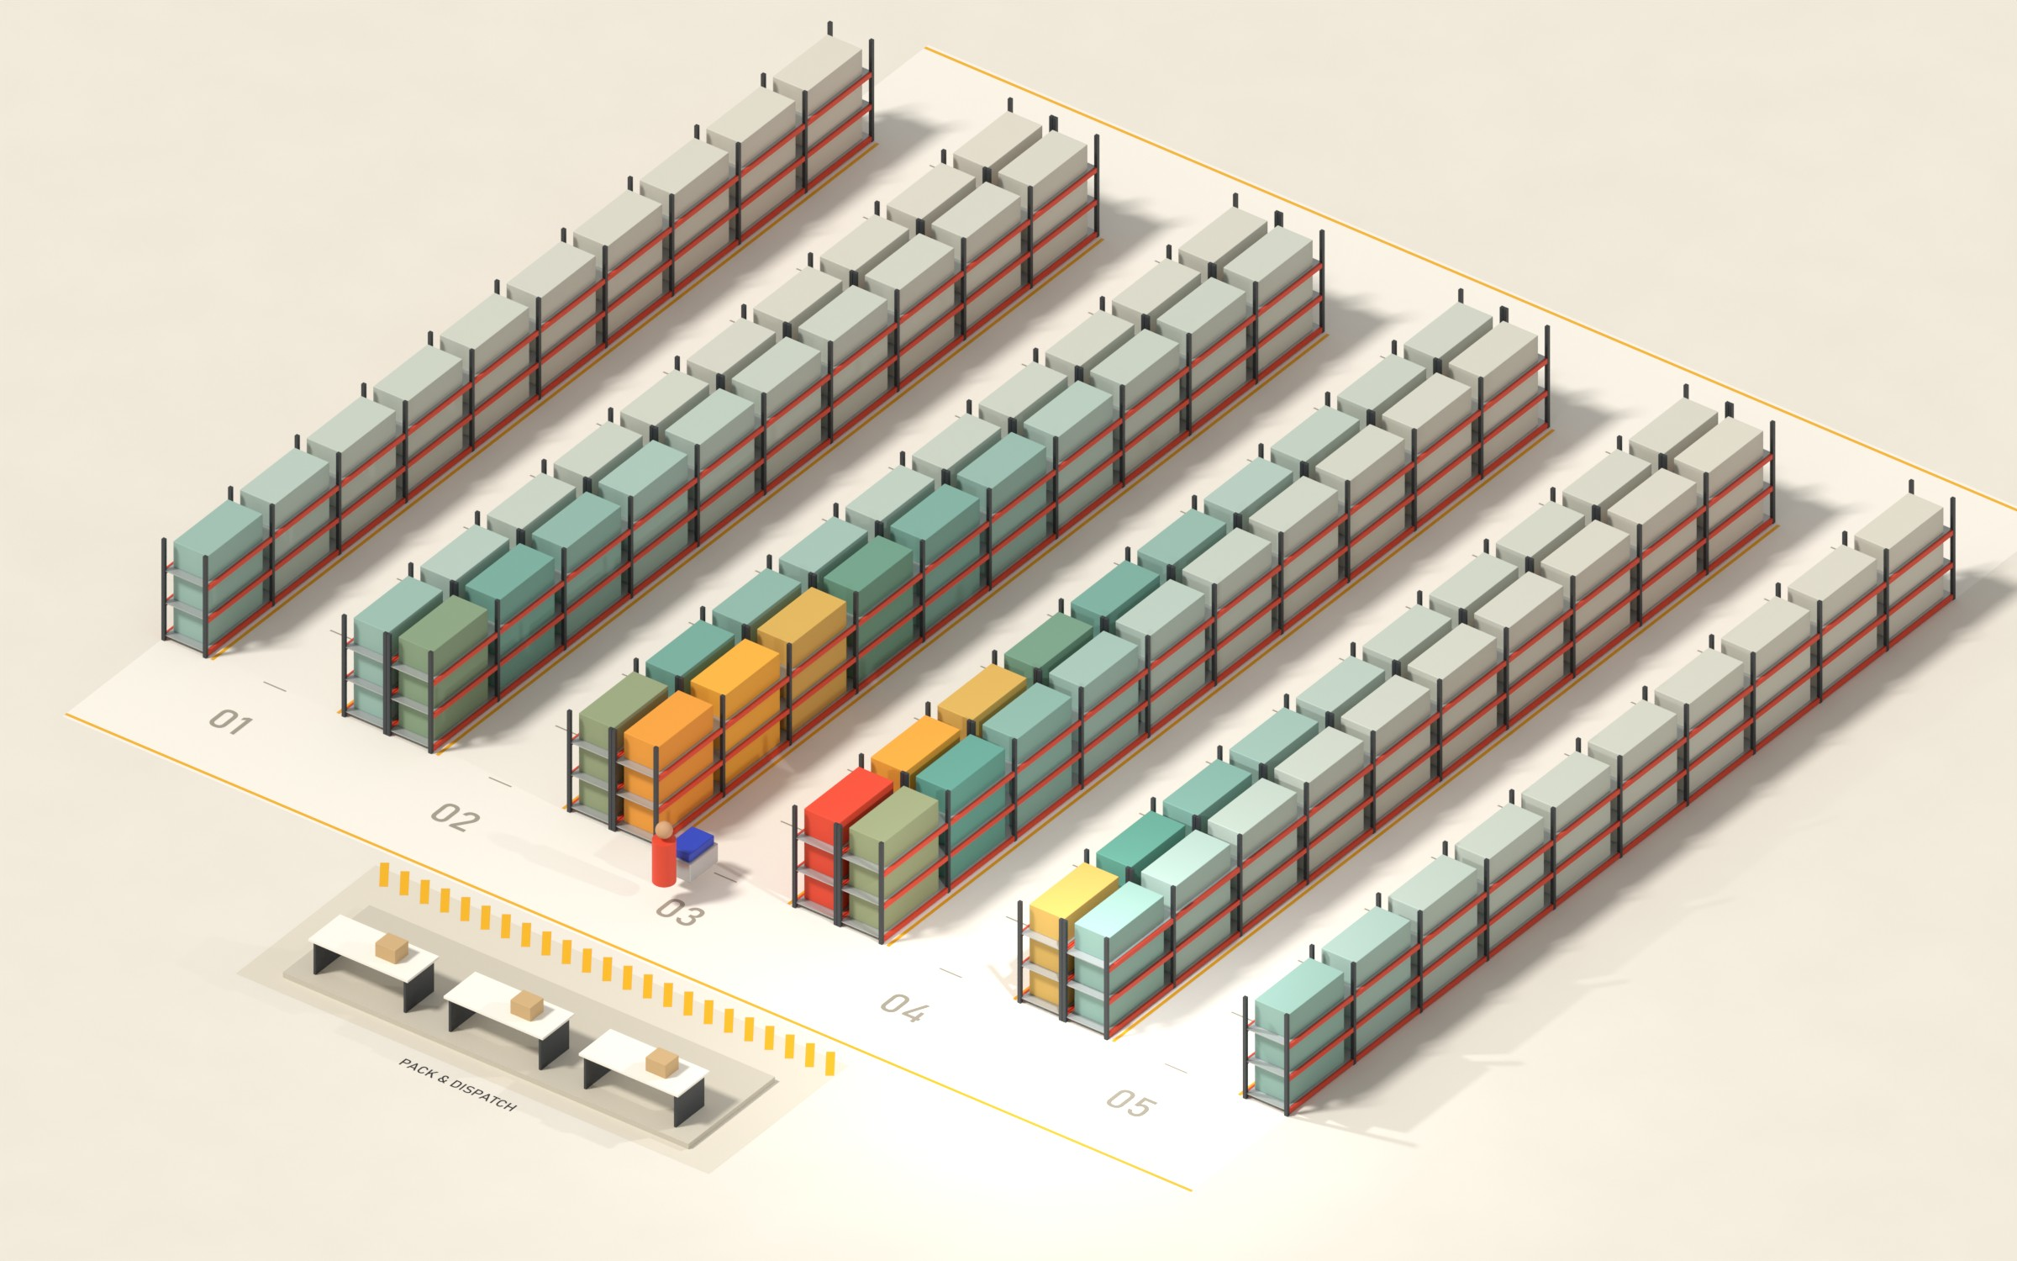
PICKING FLOOR DIGITAL TWIN
05 / 12
§05 LAYOUT 1 · INTUITION
The textbook fix
saves only 2.5%
ABC slotting puts the most-picked products nearest the dock. Orders average 7 lines, so the picker still visits most aisles.
−2.5%
218.1 → 212.7 km a month
Original
218.1 km
ABC
−2.5%
Affinity
−11.3%
Optimized
−15.8%
Rack colour = visits per month: rare → very frequent
ELECTRO-SOLVE 2026 · PS 4.2 · SENSE, VIT
DATA: ONLINE RETAIL II (UCI, CC BY 4.0)
Notes:
The textbook fix is ABC slotting: most-picked products nearest the dock. On the same 2,293 orders it saves only 2.5%. Why: an average order has 7 lines spread over many products, so the picker still enters most aisles. Rack colour is how often each slot is visited.

Slide 6
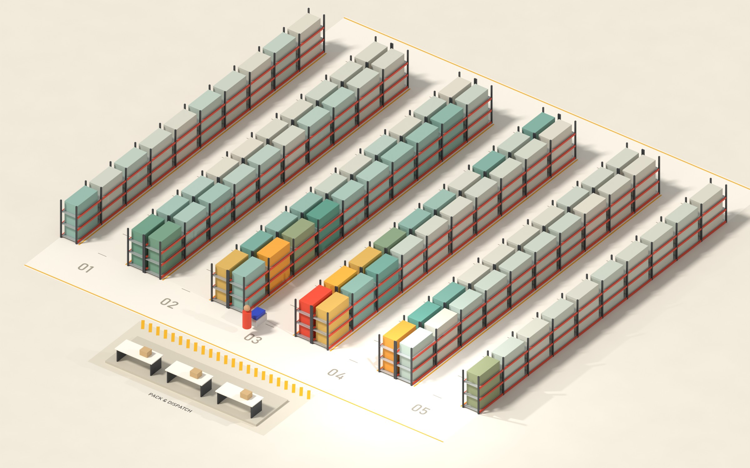
PICKING FLOOR DIGITAL TWIN
06 / 12
§06 LAYOUT 2 · DATA INSIGHT
What customers buy
together wins
Affinity slotting pulls co-ordered products into the same aisle, while fast movers still sit near the dock.
−11.3%
218.1 → 193.4 km · 4–5× the ABC saving
Original
218.1 km
ABC
−2.5%
Affinity
−11.3%
Optimized
−15.8%
Rack colour = visits per month: rare → very frequent
ELECTRO-SOLVE 2026 · PS 4.2 · SENSE, VIT
DATA: ONLINE RETAIL II (UCI, CC BY 4.0)
Notes:
Affinity slotting uses what customers buy together: products that share orders are pulled into the same aisle, while fast movers still sit near the dock. Same orders: 218.1 to 193.4 km, 11.3% less walking, four to five times the ABC saving.

Slide 7
PICKING FLOOR DIGITAL TWIN
07 / 12
§07 LAYOUT 3 · ALGORITHM
80,000 swaps later:
15.8% less walking
Simulated annealing tries random slot swaps; each is judged by re-routing every affected order of the month.
−15.8%
218.1 → 183.7 km · 34 km ≈ 8 h of picker time
Original
218.1 km
ABC
−2.5%
Affinity
−11.3%
Optimized
−15.8%
Rack colour = visits per month: rare → very frequent
ELECTRO-SOLVE 2026 · PS 4.2 · SENSE, VIT
DATA: ONLINE RETAIL II (UCI, CC BY 4.0)
Notes:
Our optimizer is simulated annealing over slot swaps: 80,000 swaps, each judged by re-routing every affected order of the month. 462 were accepted, in about 44 seconds on a laptop. Result: 183.7 km, 15.8% less walking. That is 34 km, about 8 hours of picker time a month.

Slide 8
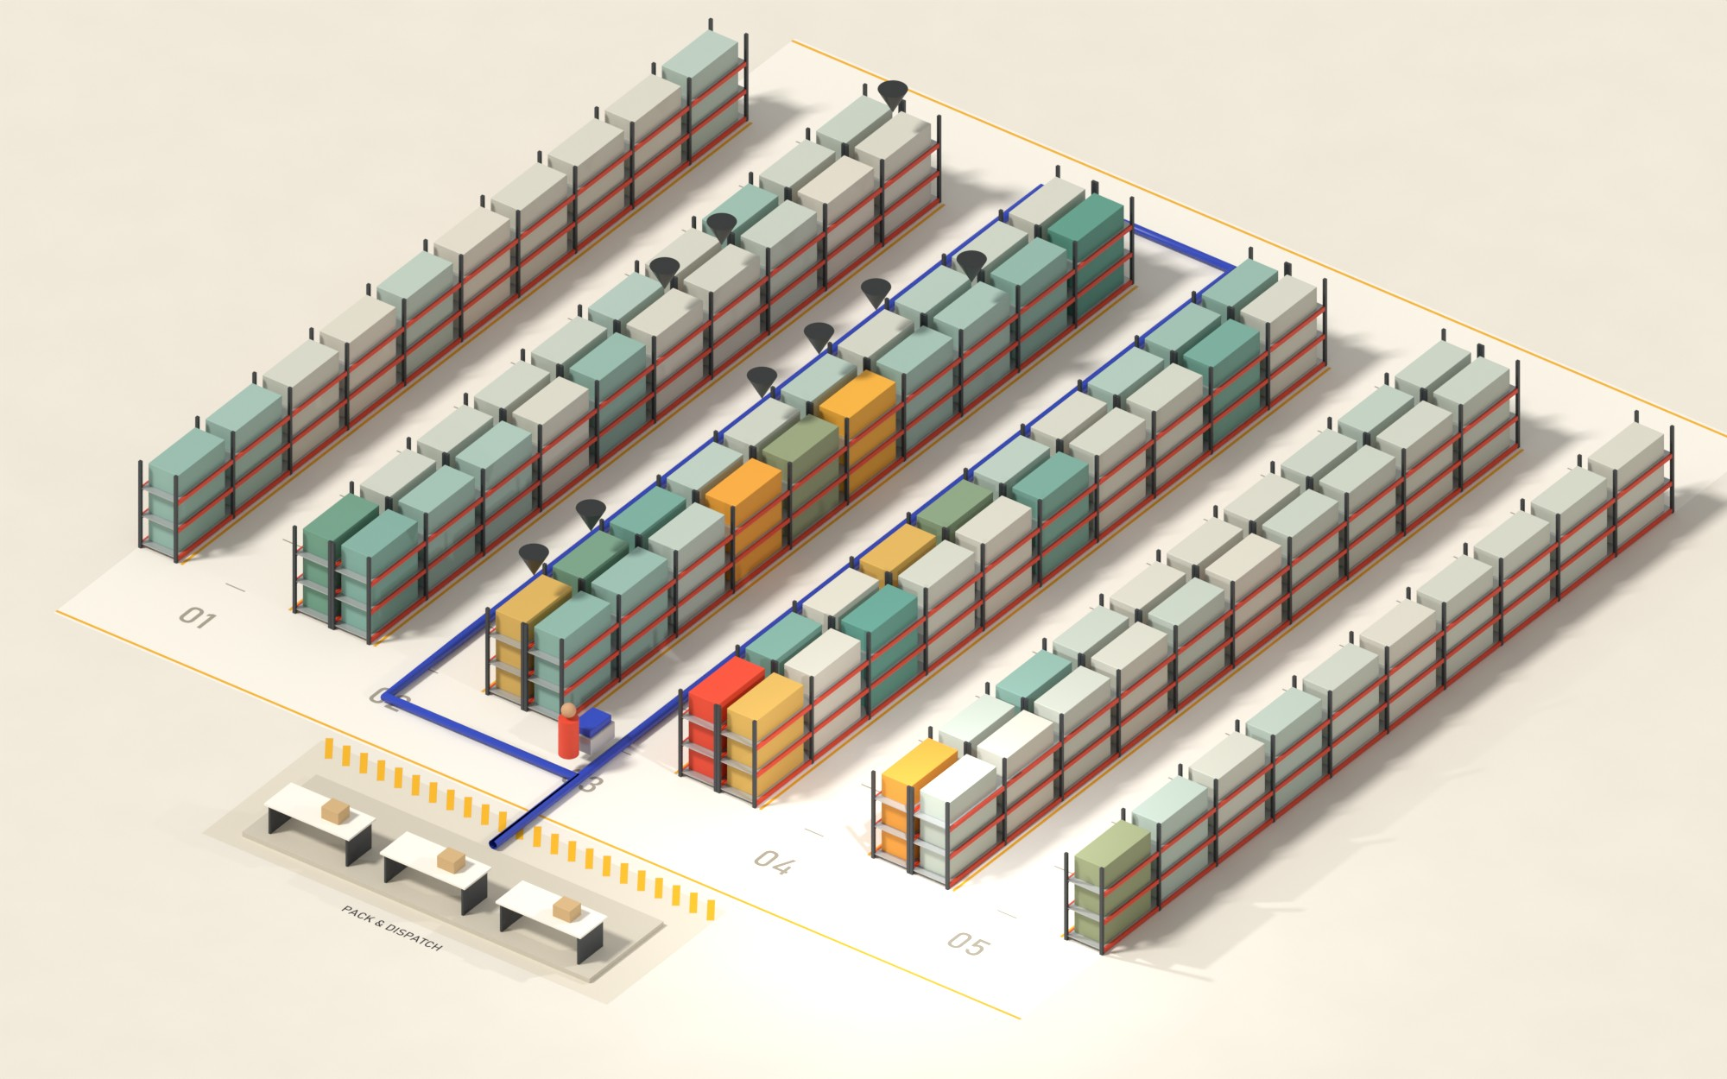
PICKING FLOOR DIGITAL TWIN
08 / 12
§08 ONE REAL ORDER
Same order, two floors
Invoice 532964: 9 lines, the same picker, routed along the aisles on each layout.
ORIGINAL
143 m 5 aisles
OPTIMIZED
62 m 2 aisles
One of the month’s biggest single-order wins. Averaged over all 2,293 orders: 95.1 → 80.1 m per order.
ELECTRO-SOLVE 2026 · PS 4.2 · SENSE, VIT
DATA: ONLINE RETAIL II (UCI, CC BY 4.0)
Notes:
Here is what that means for one order. Invoice 532964, 9 lines. Original layout: 143 m through 5 aisles. Optimized: 62 m through 2. To be fair, this is one of the biggest single-order wins of the month; on average an order goes from 95 to 80 m.

Slide 9
PICKING FLOOR DIGITAL TWIN
09 / 12
§09 PROOF · UNSEEN ORDERS
It holds on orders it never saw,
and stacks with batching
WALKING SAVED VS ORIGINAL
full month
unseen week
KM WALKED IN THE MONTH
2.5%
Original, 1 order / trip
218.1
ABC
1.9%
Optimized layout
183.7
11.3%
Affinity
11.2%
Batch of 4 orders
88.2
15.8%
Smart batch + optimized
70.1
Optimized
−68%
13.9%
walking: the best layout plus layout-aware smart batching, on the same orders.
Layouts built on orders before 22 Nov (1,527), tested on the final week (766 orders).
ELECTRO-SOLVE 2026 · PS 4.2 · SENSE, VIT
DATA: ONLINE RETAIL II (UCI, CC BY 4.0)
Notes:
Is it memorising the month? No. We built the layouts only from orders before 22 November and tested on the final week, 766 orders they never saw: ABC 1.9%, Affinity 11.2%, Optimized 13.9%. And slotting stacks with process: batching 4 orders per trip cuts the month to 88 km; layout-aware smart batching plus the optimized layout gets to 70 km, 68% less than where we started.

Slide 10
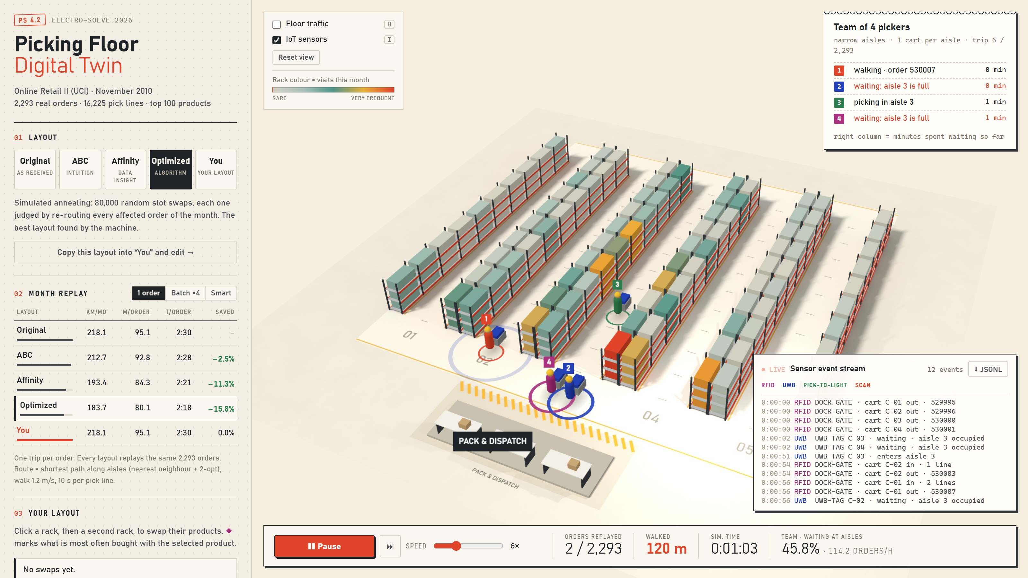
PICKING FLOOR DIGITAL TWIN
10 / 12
§10 A TEAM OF PICKERS
More pickers,
more queueing
Up to six pickers clear the month's backlog together. A narrow aisle fits one cart, so the next picker waits at the entrance.
In the app: numbered pickers, a pulsing ring while queued, live waiting share and aisle-blocked IoT events.
23%
Backlog model. Same 2,293 orders, one queue; each picker takes the next trip at the dock. Deterministic, 0.5 s steps.
of a 4-picker team's capacity lost in narrow aisles
6 pickers
35% lost; month in 22.6 h vs 15.7 h with wide aisles
Slotting vs people
Optimized leads by +9% with 1 picker, +5% with 6
ELECTRO-SOLVE 2026 · PS 4.2 · SENSE, VIT
DATA: ONLINE RETAIL II (UCI, CC BY 4.0)
Notes:
Real floors have more than one picker. We simulate a team of 1 to 6 pickers clearing the month's backlog. In a narrow aisle only one cart fits, so the next picker waits at the entrance. With 4 pickers the team loses about 23% of its capacity to queueing; with 6, about 35%. Wide aisles almost remove it. And the optimized layout's lead shrinks from 9% to 5%, because concentrating picks also concentrates people. Aisle width and batching matter as much as slotting once you have a team.

Slide 11
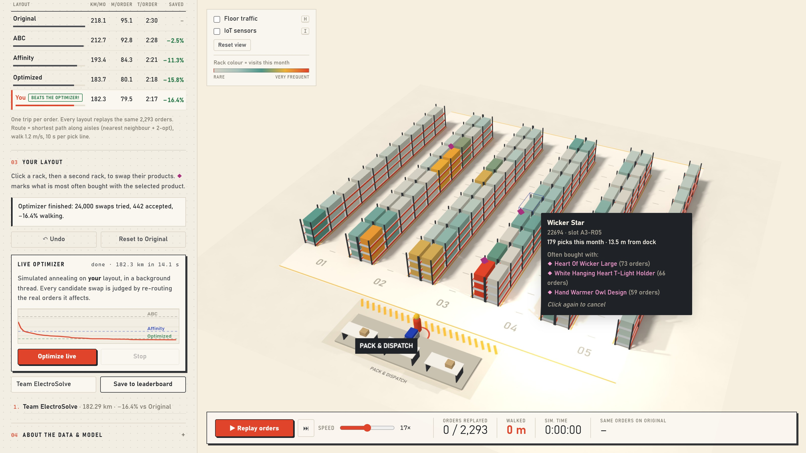
PICKING FLOOR DIGITAL TWIN
11 / 12
§11 PLAY IT
Can you beat
the optimizer?
01
Swap racks
The month re-scores instantly; ◆ marks what is bought together.
02
Live optimizer
Annealing in a Web Worker on your layout. Here: 182.3 km in 14 s.
03
Team mode
1–6 pickers with aisle congestion; watch them queue.
04
IoT sensor mode
RFID, UWB, pick-to-light and scan events, exported as JSON Lines.
Space replay · 1–5 layouts · H heat · B batch · I IoT · O optimize
ELECTRO-SOLVE 2026 · PS 4.2 · SENSE, VIT
DATA: ONLINE RETAIL II (UCI, CC BY 4.0)
Notes:
Demo. Click one rack, then another, to swap; the whole month re-scores instantly. Diamonds show products bought together. The live optimizer runs the same annealing in a background thread on your layout; in this screenshot it beat the offline optimizer, 182.3 km. Space to replay, 1 to 5 layouts, H heatmap, B batching, I IoT mode, O optimizer.

Slide 12
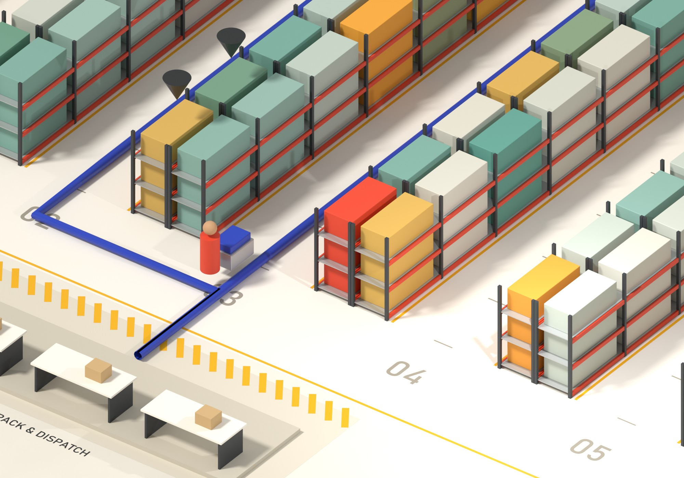
PICKING FLOOR DIGITAL TWIN
12 / 12
§12 WHAT'S NEXT
From replay
to a live twin
A twin needs sensors. The replay already emits the events real devices would stream, so hardware can replace it one feed at a time.
Thank you. Questions?
Next: live sensor input and dynamic re-slotting.
RFID Dock gate
UWB Cart tag
PICK-TO-LIGHT Every slot
BARCODE Picker scanner
cart_out C-01 · 4 totes
x 12.5 z 1.0 · aisle 3
light_on A3-R05 · qty 6
pick_confirmed 22694 ✓
ELECTRO-SOLVE 2026 · PS 4.2 · SENSE, VIT
DATA: ONLINE RETAIL II (UCI, CC BY 4.0)
Notes:
ECE angle: a digital twin needs sensors. The replay already emits the events real devices would stream: an RFID gate at the dock, a UWB tag on the cart, pick-to-light modules on every slot, and barcode confirmations. It downloads as JSON Lines, so real hardware can replace the replay. Next: live sensor input and dynamic re-slotting. Thank you, questions welcome.

