Slide 1
Customer Churn Prediction in Telecom Industry

Slide 2
Team 4
Krushna Jawanjal
Aditya Naidu
Pranay Rajesh Agarwal
Vaishali Agarwal
Afan Nazir Ahmed Boblai
Arun T J
Divya MahendraPratap Singh

Slide 3
Index
SR NO. | TITLE
01 | Project Synopsis
02 | Introduction
03 | Data Insights
04 | EDA
05 | Visualization
06 | Feature Engineering
07 | Treating Imbalanced Data
08 | Model Building
09 | Hyperparameter Tuning
10 | Deployment

Slide 4
Project Synopsis
Business objective:
Customer churn is a big problem for telecommunications companies. Indeed, their annual churn rates are usually higher than 10%. For that reason, they develop strategies to keep as many clients as possible. This is a classification project since the variable to be predicted is binary (churn or loyal customer). The goal here is to model churn probability, conditioned on the customer features.

Slide 5

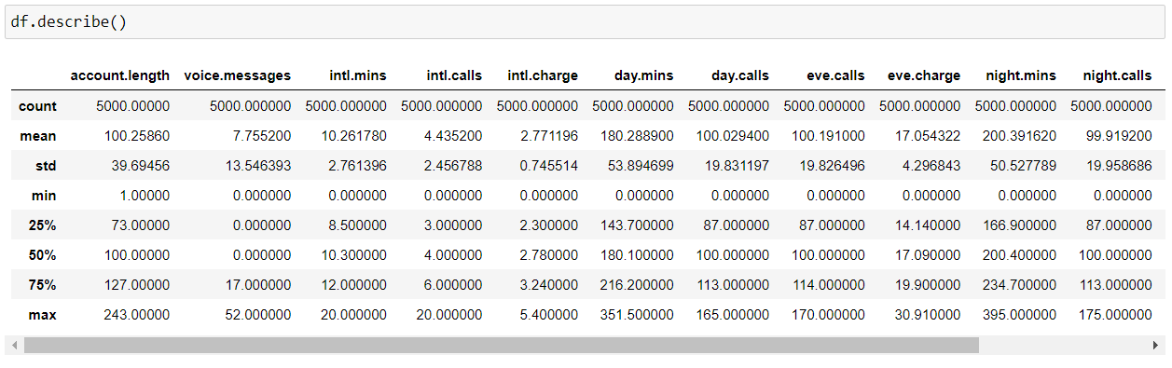
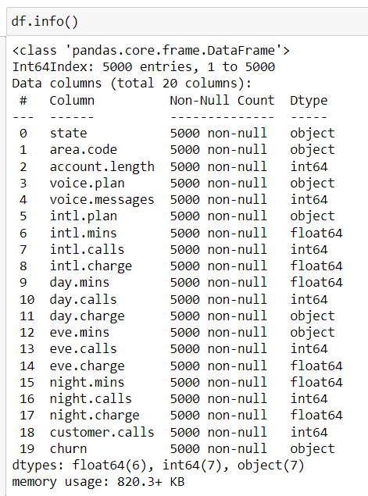
Data Insights
Less number of people call the customer care.
Call duration during night is double than daytime.

Slide 6
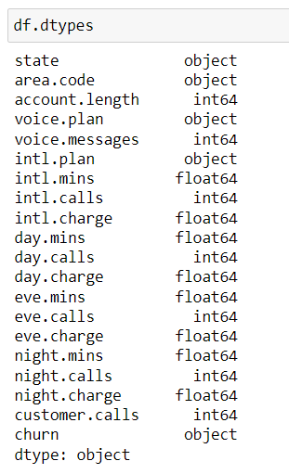

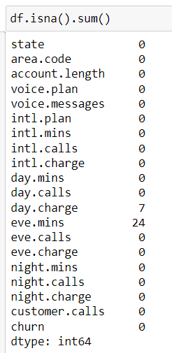
EDA
1. No Duplicated records found.
2. Columns 'eve.mins' and 'day.charge' are showing dtypes as object.
Null values present are dropped.
Dtype converted from object to float.

Slide 7
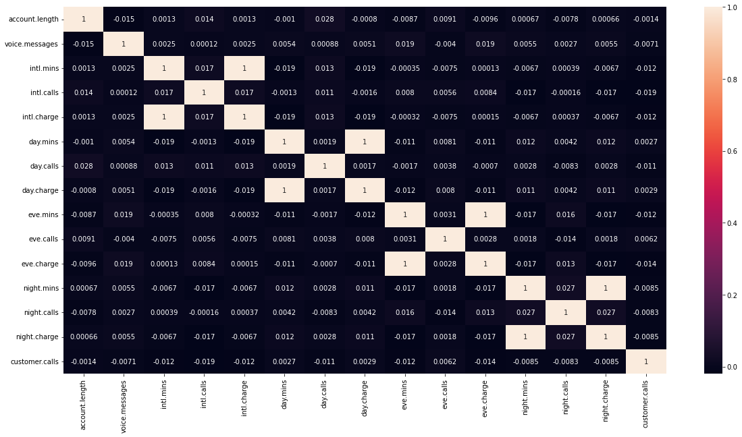
Correlation
Columns day.mins - day.charge and eve.mins - eve.charge show 100% correlation.
Hence, one of them can be removed.

Slide 8
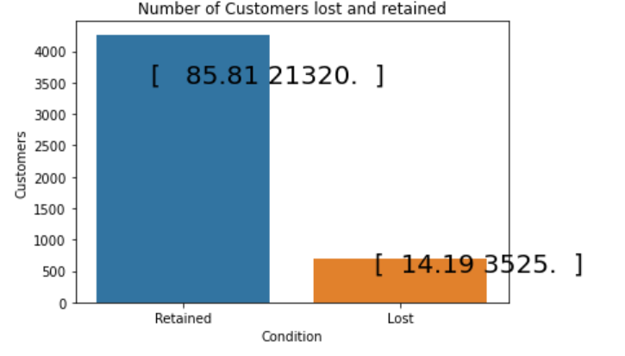

Slide 9
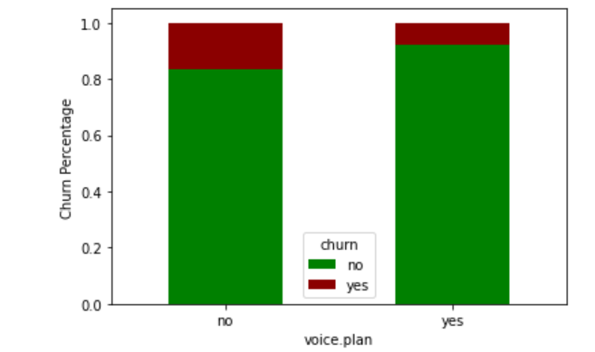
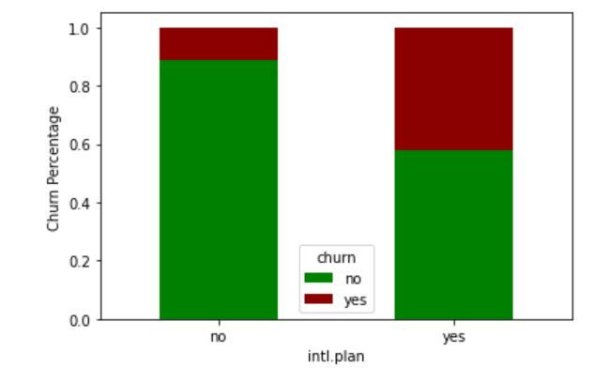
Visualization
A customer is likely to churn out who has subscribed to an international plan.
A customer is likely to churn out who has not subscribed to voice plan.

Slide 10
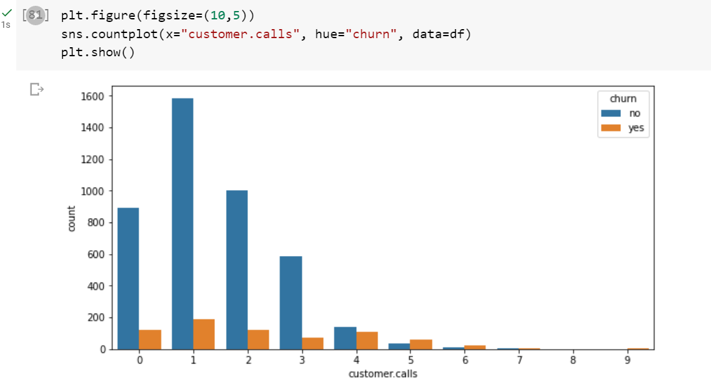

Slide 11
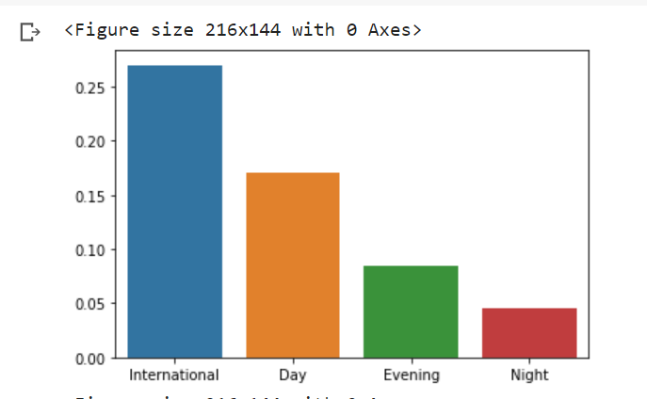
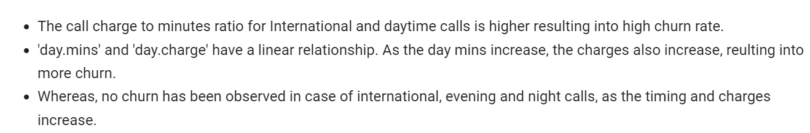

Slide 12
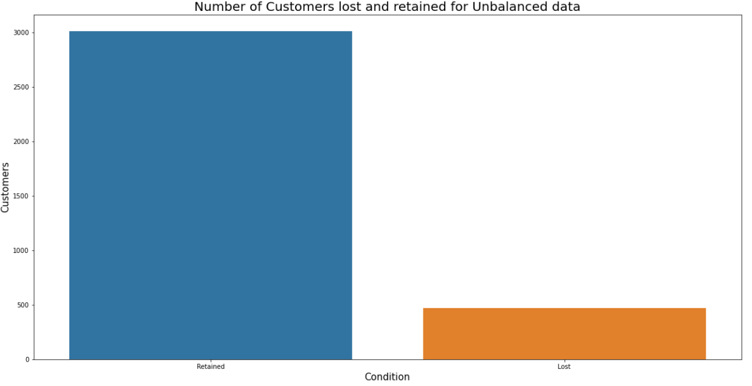
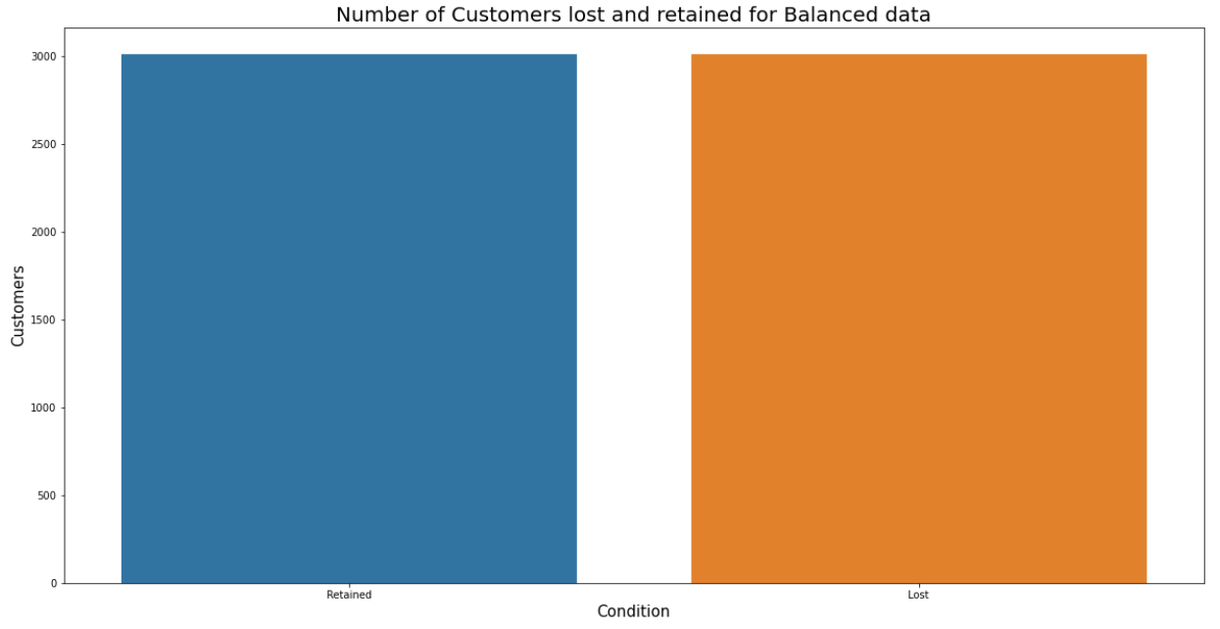
Treating Imbalance Data using SMOTE
Imbalanced data might cause predicting no churn as it is in the majority.
By using SMOTE (oversampling technique), the imbalanced churn column data has been balanced.
Before using SMOTE
After using SMOTE

Slide 13

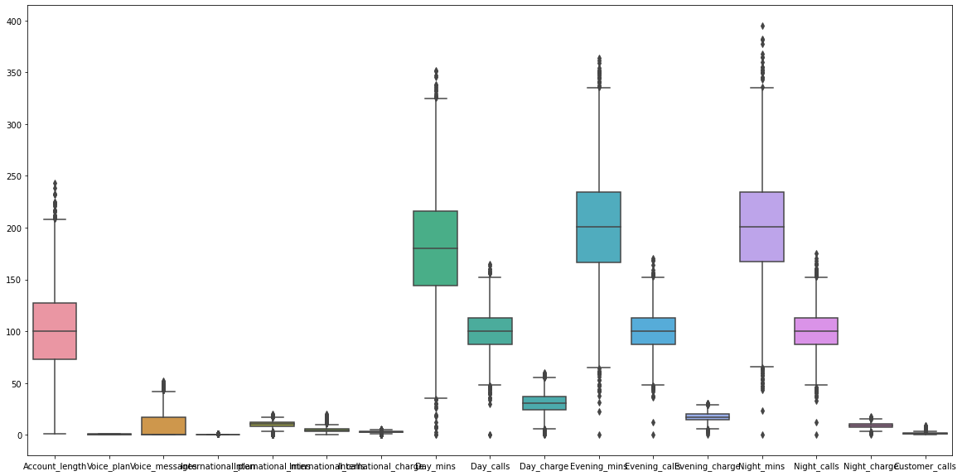
Outliers

Slide 14
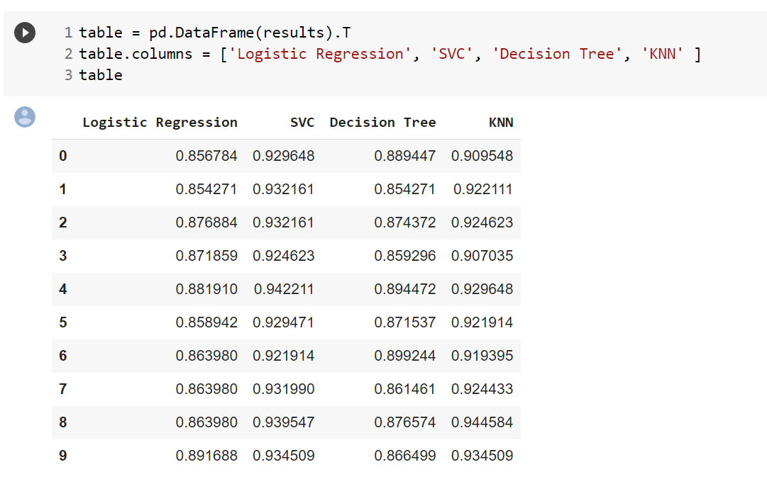
Model Building
Following functions have been used for Model building, with and without SMOTE.
LogisticRegression
KNeighborsClassifier
SVM
DecisionTreeClassifier
AdaBoostClassifier
GradientBoostingClassifier
RandomForestClassifier
XGBClassifier
Function defined for creating different algorithm models.

Slide 15
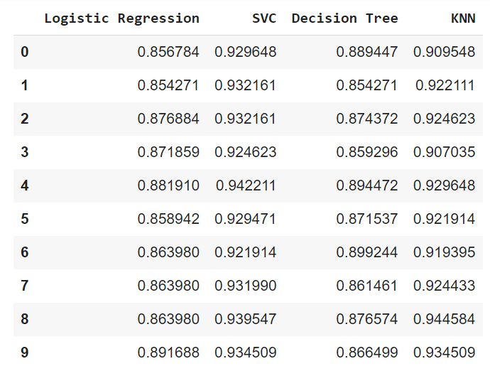
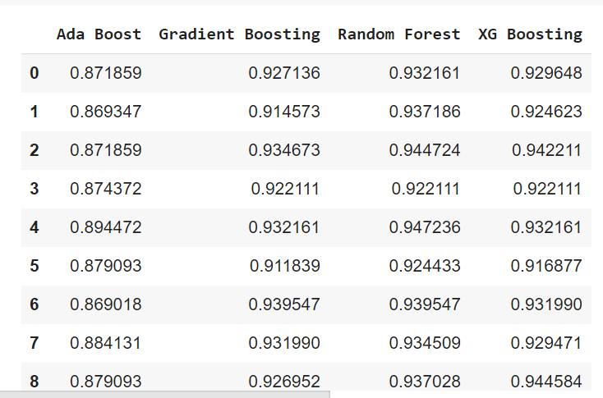

Slide 16
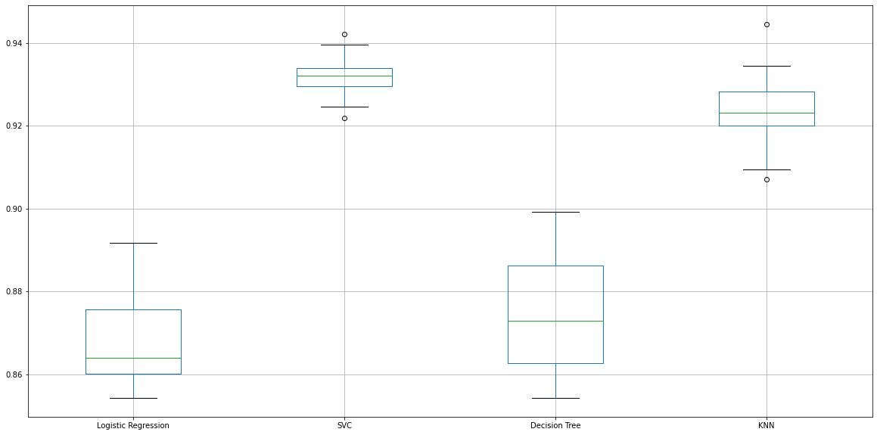

Slide 17
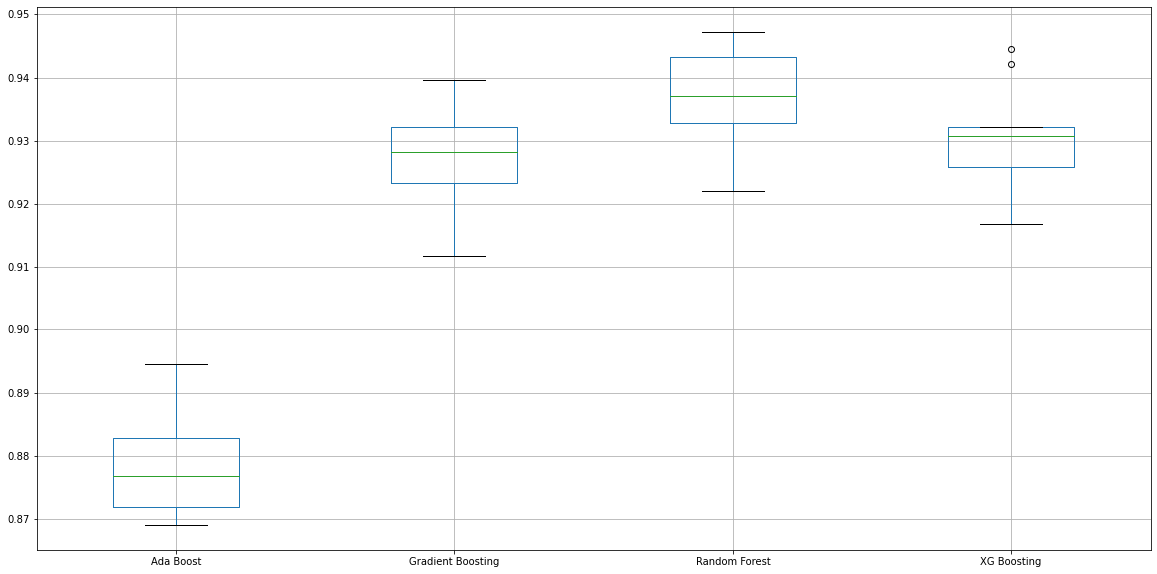

Slide 18
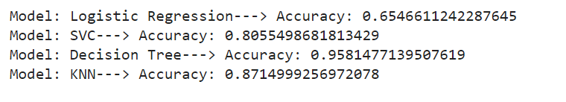
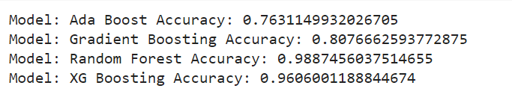
Finding Accuracy
Final Model : From above Accuracy : Random Forest Model

Slide 19
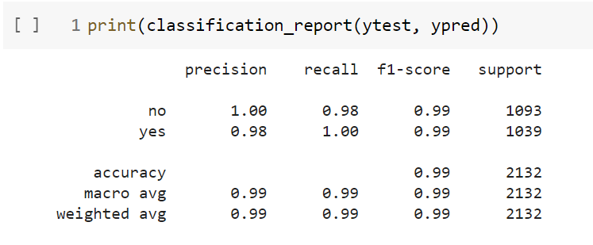
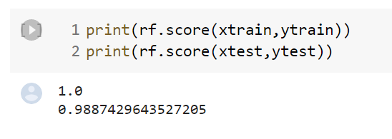

Slide 20
Observations -
- Algorithms when implemented with SMOTE technique, show good results in terms of accuracy score than without SMOTE algorithms. This is due to the balancing of data.
- Highest accuracy values obtained are with Random Forest (with SMOTE) - 0.98
Conclusion -
Based on the above observations Random Forest is the best model.

Slide 21
Thank you!

