Slide 1
ST3236: Stochastic Process
Tutorial 9
TA: Mar Choong Hock
Email: g0301492@nus.edu.sg
Exercises: 10

Slide 2
Question 1
Messages arrive at a telegraph office as a Poisson
process with mean rate 3 messages per hour
what is the probability that no message arrive
during the morning hours 8:00am to
noon?
(b) what is the distribution of the time at which the
first afternoon message arrives?

Slide 3
Question 1a
P(X(12) - X(8) = 0) = e^{-4λ} = e⁻¹²
Note that only the duration of the time is required,
property of stationary process.
Is Poisson Process a Markov Process?

Slide 4
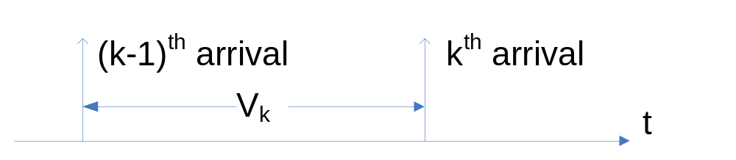
Question 1b
Let U₁ be the time for the first afternoon message
P(U₁ ≥ t) = P(X(t) - X(12) = 0) = e^{-λ(t-12)}; t > 12
Thus
F_{U1}(t) = 1 - e^{-λ(t-12)}; t > 12
The time distribution is exponentially distributed with mean time = 1/λ.
In general, the inter-arrival time between two events for Poisson process is exponentially distributed, F(V_{k}) = 1 - e^{-λ(V}k⁾

Slide 5
Question 2
Suppose that customers arrive at a facilities according to a Poisson process having rate λ = 2.
Let X(t) be the number of customers that have arrived up to time t. Determine the following
probabilities and conditional probabilities and expectations
(a) P(X(1) = 2,X(3) = 6)
(b) P(X(1) = 2|X(3) = 6)
(c) P(X(3) = 6|X(1) = 2)
(d) E{X(1)X(5)[X(3) - X(2)]}

Slide 6
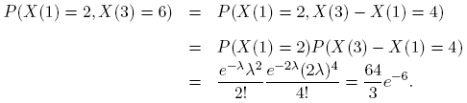
Question 2a
Let λ = 2. Make use of the properties of the counting process and the independent of disjoint time intervals.

Slide 7
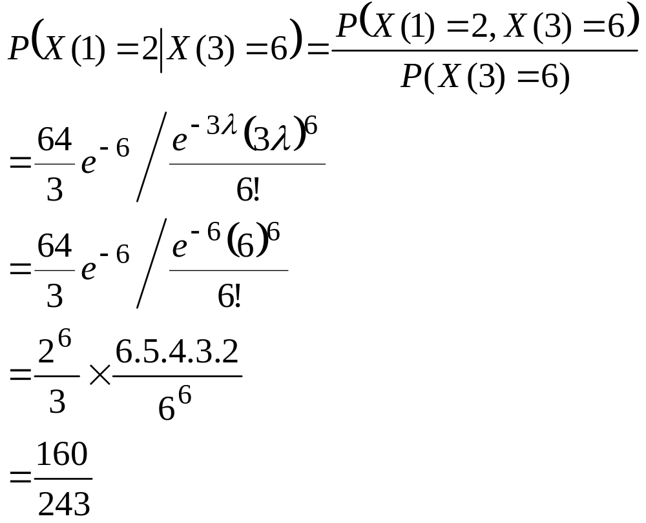
Question 2b

Slide 8
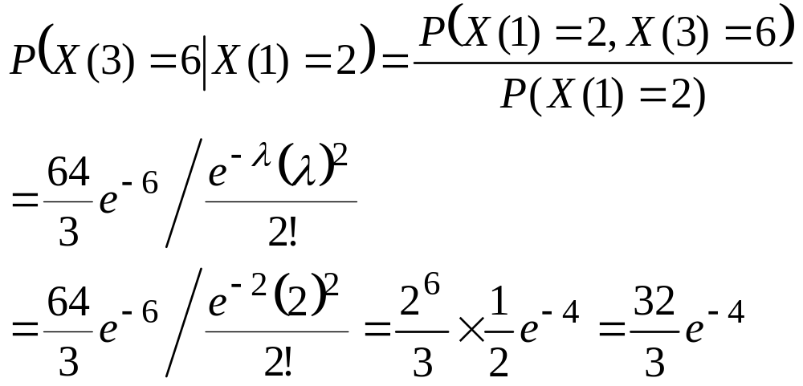
Question 2c
Or by counting property,
P(X(3)=6|X(1)=2) = P(X(3)-X(1)=4)

Slide 9
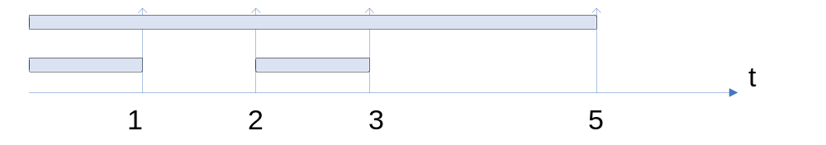
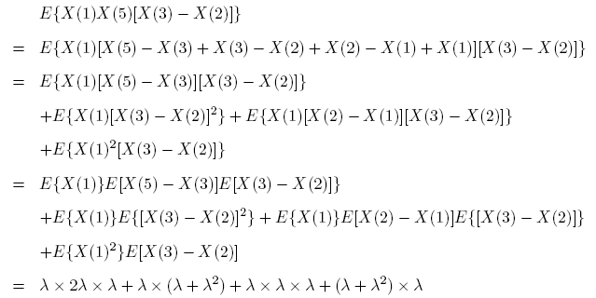
Question 2d

Slide 10
Question 3
Let X(t) be a Poisson process of rate λ = 3 per hour.
Find the conditional probability that there are two events in the first hour, given that there are five events in the first three hours.

Slide 11

Question 3
Use Theorem in Lecture notes,
Since we know there are 5 customers in the three hour interval, we want to know probability of any 2 customers in the 1-hour interval (and 3 customers in the 2-interval).
Note that where the customers are distributed uniformly over the time interval, even though the arrival process is Poisson.

Slide 12
Question 3
From Bayes’ Theorem,
P(X(1)=2|X(3)=5) P(X(3)=5) = P(X(3)=5|X(1)=2) P(X(1)=2) =
But, by counting property,
P(X(3)=5|X(1)=2)= P(X(3)-X(1) = 3)

Slide 13
Question 4
Customers arrive at a service facility according to a poisson process of rate λ customers/hour.
Let X(t) be the number of customers that have arrived up to time t. Let W₁,W₂, … be the
successive arrival times of the customers. Determine the conditional means E[W₅ | X(t) = 4]
and E[W₃ | X(t) = 4]

Slide 14
Question 4
Case E[W₅ | X(t) = 4]?
In this case, we know that up to time t, the 4th customer has arrived, what is the average waiting time s for the 5 customers to arrive?

Slide 15
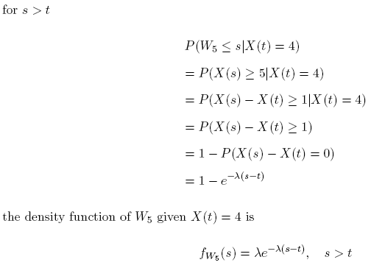
Question 4

Slide 16
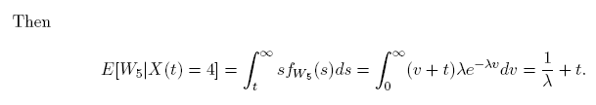
Question 4
Average waiting time for five customer = average waiting time for four customer + average inter-arrival time between the fourth and the fifth customer. (See Q1b)

Slide 17
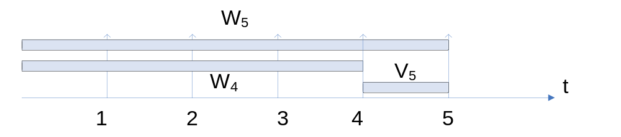
Question 4 - Optional
E[W₅ | X(t) = 4] = E[V₅+W₄ | W₄ = t]
= E[V₅+t]
= E[V₅] + t
=…
Can try this on the lecture notes problem and split intervals to W₃ + V₄ + V₅

Slide 18
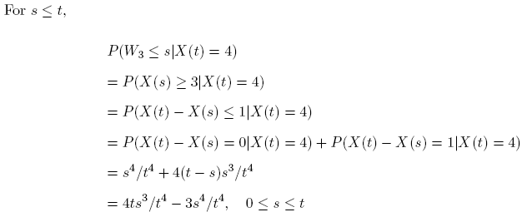
Question 4
Case E[W₃ | X(t) = 4]?
Note: To say the waiting time for 3 customer is less than s is same as at time s, there is 3 or more customers arrivals. Because, if at time s there is 3, then s = W_{3,} if more than 3, s > W₃.

Slide 19
Question 4
Case E[W₃ | X(t) = 4]?
Note: To say the waiting time for 3 customer is less than s is same as at time s, there is 3 or more customers arrivals. Because, if at time s there is 3, then s = W_{3,} if more than 3, s > W₃.

Slide 20
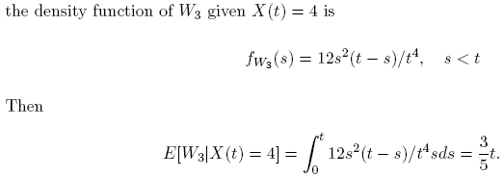
Question 4

Slide 21
Question 5
Let X₁(t) and X₂(t) be independent Poisson process
having parameters λ₁ and λ₂ respectively.
What is the probability that X₁(t) = 1 before X₂(t) =
1?
That is , what is the probability that first arrival for
process 1 happened earlier than the first arrival for
process 2.

Slide 22
Question 5
Let W₁ and W’₁ be the waiting time for the first event in Poisson process 1 and 2 respectively.
Then W₁ and W’₁ follow exponential distributions with parameters 1/λ₁ and 1/λ₂ respectively and are independent of each other. The probability is

Slide 23
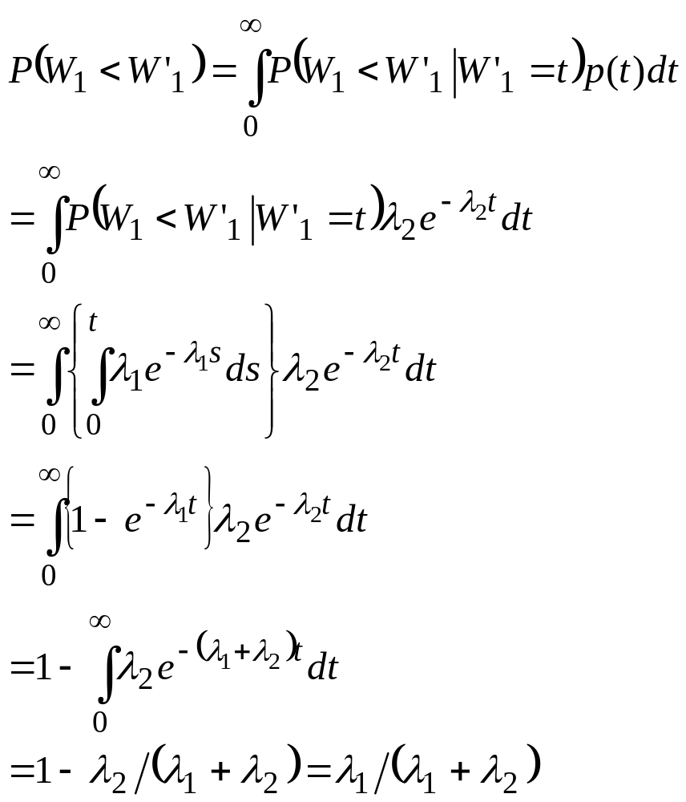
Question 5

