Slide 1
Spring Data Repositories
Naveen VK
May 21st & 22nd, 2013

Slide 2
About myself
Naveen VK
Principal Architect at NVISIA
http://www.nvisia.com
14 years of software development experience

Slide 3
Spring One, October 2012
Most Interesting Topics
Spring Data Repositories
Oliver Gierke
Spring REST
From “What’s new in Spring MVC 3.2?” by Rossen Stoyanchev

Slide 4
Spring Data Repositories

Slide 5
Spring Data Repositories
Traditional N-Tiered Architecture
User Interface
Data Objects
Services
Data Access
Database

Slide 6
Spring Data Repositories
N-Tiered Architecture with NoSQL Datastores
User Interface
Data Objects
Services
NoSQL Datastore
MongoDB
Neo4J
GemFire
Redis

Slide 7
Spring Data Repositories
SQL Example
Save
insert into person (id, firstname, lastname)
values (1, “JOHN”, “DOE”);
Retrieve
select * from person where id = 1;

Slide 8
Spring Data Repositories
NoSQL Example
Save
Person person = new Person(1, “JOHN”, “DOE”);
region.put(person.getId(), person);
Retrieve
Person person = region.get(1);

Slide 9
Spring Data Repositories
Complex Heterogeneous Data Architecture
User Interface
Data Objects
Services
Data Access
Neo4J
GemFire
Database
MongoDB

Slide 10
Spring Data Repositories
What is it?
A SpringSource umbrella project
Abstracts data access layer code for CRUD operations for various data stores
Data access layer consists of interfaces with finder methods
Appropriate implementation of interface used at runtime
Uses convention over configuration for finder methods in the interface

Slide 11
Spring Data Repositories
What is it? - Continued
Provides a familiar and consistent Spring-based model
Retains datastore-specific features and capabilities
Reduces amount of boiler-plate code to implement DAOs for various datastores
SpringData subprojects are associated with specific datastores
Website:
http://www.springsource.org/spring-data

Slide 12
Spring Data Repositories
N-Tier Architecture with SpringData Repositories
User Interface
Data Objects
Services
SpringData Repository
Database
Neo4J
MongoDB
GemFire

Slide 13
Spring Data Repositories
Repository
Mediates between the data stores, the data mapping layer and the data objects
Uses a collection-like interface for accessing data objects
Reduces the amount of boiler-plate code required to implement data access layer for various data stores
Uses Java Persistence API (JPA)

Slide 14
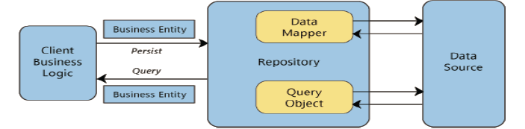
Spring Data Repositories
Repository – From Oliver Gierke’s presentation

Slide 15
Spring Data Repositories
Core Concepts
Main interface is called
Repository
Interface for CRUD functionality is called
CrudRepository
Extends Repository
Another notable interface
PagingAndSortingRepository
Extends CrudRepository

Slide 16
Spring Data Repositories
CrudRepository
Generic methods in CrudRepository
count()
delete() methods
Delete by ID, collection of IDs, Entity, deleteAll()
exists()
find() methods
Find by ID, collection of IDs, findAll()
save() methods
Save one entity, collection of entities

Slide 17
Spring Data Repositories
API & Demo
Spring Data API
file:///C:/Installs/Spring/spring-data-commons-1.5.0.RELEASE/docs/api/index.html
Demo

Slide 18
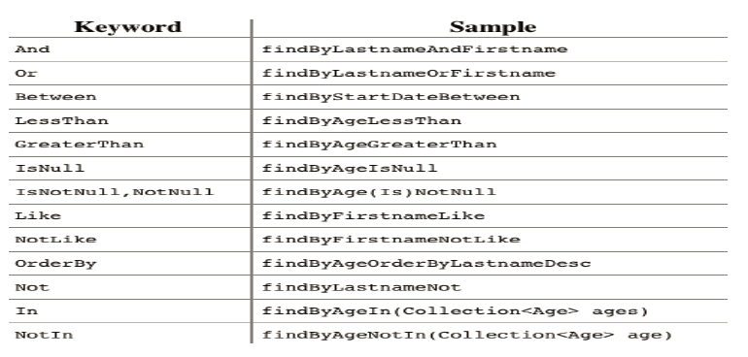
Spring Data Repositories
Query Methods

Slide 19
Spring Data Repositories
Wrap Up
Any questions or comments?
Code in Github
https://github.com/navnoon23/SpringDataDemo
Contact info:
LinkedIn: Naveen VK
naveen@nvisia.com, naveenvkm@gmail.com

