Slide 1
Introduction to Julia: Why are we doing this to you? (Spring 2017)
Steven G. Johnson, MIT Applied Math
MIT classes 18.06, 18.303, 18.330, 18.08[56],
18.335, 18.337, …

Slide 2
What language for teaching scientific computing?
For the most part, these are not hard-core programming courses,
and we only need little “throw-away” scripts and toy numerical experiments.
Almost any high-level, interactive (dynamic) language with easy facilities for linear algebra (Ax=b, Ax=λx), plotting, mathematical functions, and working with large arrays of data would be fine.
And there are lots of choices…

Slide 3
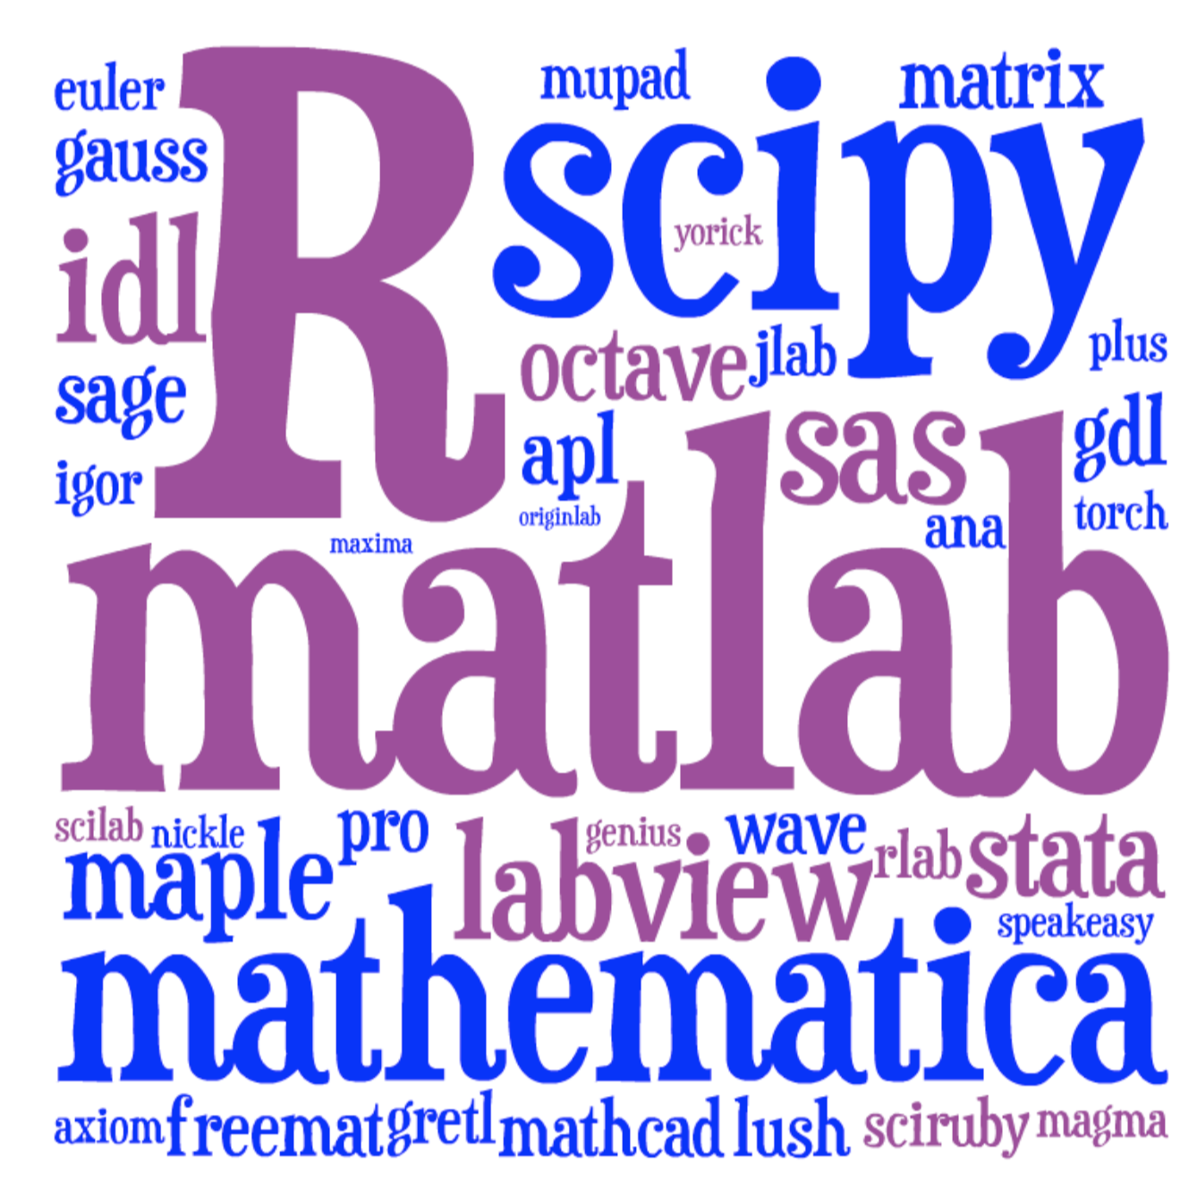
Lots of choices for interactive math…
[ image: Viral Shah ]

Slide 4
Just pick the most popular? Matlab or Python or R?
We feel guilty pushing a language on you that we
are starting to abandon ourselves.
Traditional HL computing languages
hit a performance wall in “real” work
… eventually force you to C, Cython, …

Slide 5





A new programming language?
Viral Shah
Jeff Bezanson
Alan Edelman
[ MIT ]
julialang.org
Stefan Karpinski
[begun 2009, “0.1” in 2013, ~35k commits,
“0.5” release in Fall 2016 ]
[ 30+ developers with 100+ commits,
1000+ external packages, 3rd JuliaCon in 2016 ]
As high-level and interactive as Matlab or Python+IPython,
as general-purpose as Python,
as productive for technical work as Matlab or Python+SciPy,
but as fast as C.

Slide 6
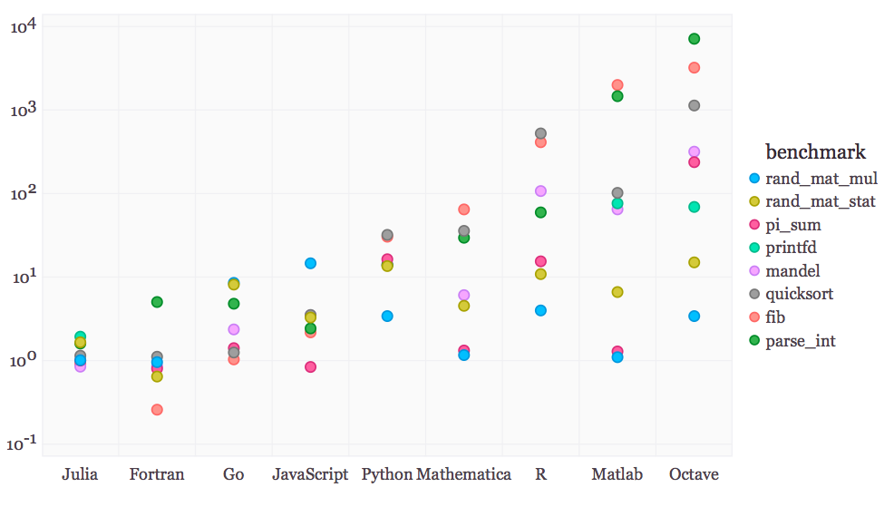
Performance on synthetic benchmarks
[ loops, recursion, etc., implemented in most straightforward style ]
(normalized so that C speed = 1)

Slide 7
Special Functions in Julia
Special functions s(x): classic case that cannot be vectorized well
… switch between various polynomials depending on x
Many of Julia’s special functions come from the usual C/Fortran libraries,
but some are written in pure Julia code.
Pure Julia erfinv(x) [ = erf^{–1}(x) ]
3–4× faster than Matlab’s and 2–3× faster than SciPy’s (Fortran Cephes).
Pure Julia polygamma(m, z) [ = (m+1)^{th} derivative of the ln Γ function ]
~ 2× faster than SciPy’s (C/Fortran) for real z
… and unlike SciPy’s, same code supports complex argument z
Julia code can actually be faster than typical “optimized”
C/Fortran code, by using techniques [metaprogramming/code generation] that are hard in a low-level language.

Slide 8
Pure-Julia FFT performance
(FFTW, MKL: “unfair” factor of ~2 from manual SIMD)
already comparable to FFTPACK
[ probably some tweaks to
inlining will make it better ]
FFTPACK
Julia
FFTW w/o SIMD
FFTW 1.0-like code generation
+ recursion in Julia
~ 1/3 lines of code compared to
FFTPACK, more functionality

Slide 9
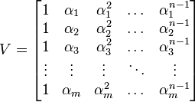
Generating Vandermonde matrices
given x = [α₁, α₂, …], generate:
NumPy (numpy.vander): [follow links]
Python code …wraps C code
… wraps generated C code
type-generic at high-level, but
low level limited to small set of types.
Writing fast code “in” Python or Matlab = mining the standard library
for pre-written functions (implemented in C or Fortran).
If the problem doesn’t “vectorize” into built-in functions,
if you have to write your own inner loops … sucks for you.

Slide 10
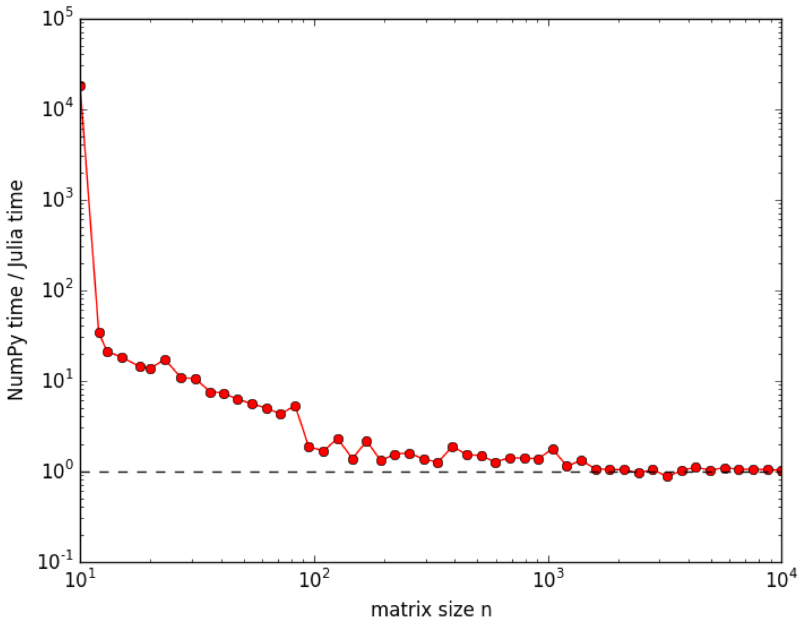
Generating Vandermonde matrices
given x = [α₁, α₂, …], generate:
NumPy (numpy.vander): [follow links]
Python code …wraps C code
… wraps generated C code
type-generic at high-level, but
low level limited to small set of types.
Julia (type-generic code):
function vander{T}(x::AbstractVector{T}, n=length(x))
m = length(x)
V = Array(T, m, n)
for j = 1:m
V[j,1] = one(x[j])
end
for i = 2:n
for j = 1:m
V[j,i] = x[j] * V[j,i-1]
end
end
return V
end

Slide 11
Generating Vandermonde matrices
function vander{T}(x::AbstractVector{T}, n=length(x))
m = length(x)
V = Array(T, m, n)
for j = 1:m
V[j,1] = one(x[j])
end
for i = 2:n
for j = 1:m
V[j,i] = x[j] * V[j,i-1]
end
end
return V
end
note: works for any container
of any type with “*” operation
… performance ≠ inflexibility

Slide 12
But I don’t “need” performance!
For lots of problems, especially “toy” problems in courses, Matlab/Python performance is good enough.
But if use those languages for all of your “easy” problems, then you won’t be prepared to switch when you hit a hard problem. When you need performance, it is too late.
You don’t want to learn a new language at the same time that you are solving your first truly difficult computational problem.

Slide 13
Just vectorize your code? = rely on mature external libraries, operating on large blocks of data, for performance-critical code
Good advice! But…
• Someone has to write those libraries.
• Eventually that person will be you.
— some problems are impossible or
just very awkward to vectorize.

Slide 14
But everyone else is using Matlab/Python/R/…
Julia is still a young, niche language. That imposes real costs — lack of familiarity, rough edges, continual language changes. These are real obstacles.
But it also gives you advantages that Matlab/Python users don’t have.

Slide 15
But I lose access to all the libraries available for other languages?
Very easy to call C/Fortran libraries from Julia, and also to call Python…

Slide 16

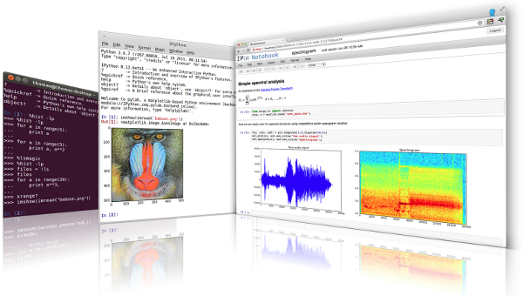
Julia leverages Python…
Directly call Python libraries (PyCall package),
e.g. to plot with Matplotlib (PyPlot package)
via IPython/Jupyter:
Modern multimedia
interactive notebooks
mixing code, results,
graphics, rich text, equations, interaction
“IJulia”
[ ipython.org ]

Slide 17
goto live IJulia notebook demo…
Go to juliabox.org for install-free IJulia on the Amazon cloud
See also julialang.org for more tutorial materials…

