Slide 1
What Do the Textbooks Say?
“Data mining is defined as the process of discovering patterns in data.”
—Data Mining: Practical Machine Learning Tools and Techniques,
3rd Edition (Witten, Frank & Hall)
“Data mining refers to extracting or ‘mining’ knowledge from large amounts of data.”
—Data Mining: Concepts and Techniques, 2nd Edition (Han & Kambler)
Text?

Slide 2
What Do More Textbooks Say?
“Data mining is the process of automatically discovering useful information in large repositories of data.
—Introduction to Data Mining (Tan, Kumar, & Steinbach)
“Data mining is the analysis of (often large) observational data sets to find unsuspected relationships and to summarize the data in novel ways that are both understandable and useful to the data owner.”
—Principles of Data Mining (Hand, Mannila, & Smyth)
Text?

Slide 3
Even More Textbooks?
“Data mining is the set of methods and techniques for exploring and analysing data sets (which are often large), in an automatic or semi-automatic way, in order to find among these data certain unknown or hidden rules, associations or tendencies; special systems output the essentials of the useful information while reducing the quantity of data.”
—Data Mining and Statistics for Decision Making (Tuffery)
Text?

Slide 4
Our Definition
Data mining is the art of extracting knowledge from large bodies of structured data.
Text?

Slide 5

Preliminaries
Bullet
Sub bullet
Bullet 2
Bullet 3
Bullet 4
Please fill out these bullets. We will have some introduction to you before this point. (so feel free to concentrate on the content)

Slide 6
Two Key Features
1
Extracting Knowledge
2
Large Bodies of Data
Notes:
Previously unknown patterns, descriptions, or relations—potentially useful information—are being extracted from data. Discovering this knowledge often requires some form of learning.
Datasets are structured, often as a database. They are also typically larger than those encountered other domains. In fact, the datasets are so large that the process of extracting knowledge must be automated—or at least augmented—by computer.

Slide 7
It’s a Confluence of Many Domains
PROBABILITY & STATISTICS
PATTERN RECOGNITION
MACHINE LEARNING
DATA MINING
DATABASES
INFORMATION THEORY
DATA VISUALIZATION
Notes:
While we often come across various definitions for “Data mining”, it’s also difficult to discern it from other concepts that somewhat overlap with it. While Data Mining evolved from various research initiatives in the field of databases, today it has grown to influence a variety of other areas (depictured above). All of these different areas also provided numerous contributions to what “data mining” is today. In this course we spend a good amount of time covering Machine Learning, while we also touch upon these other aspects.

Slide 8
What Isn’t Data Mining?
Looking up a record in a database.
No pattern is revealed by this lookup.
Searching for a term on Google.
This is simply a “match” or “non-match”.
Testing a two-sample hypothesis in a clinical trial.
The dataset is often not large.

Slide 9
What’s Almost Data Mining
Noting that some last names occur in certain geographical areas.
Taking all query results from Google and discovering that they can be grouped or categorized.
When doing multiple tests across many different genes, identifying very strongly significant genes.

Slide 10



Let’s look at a basic example of data mining.
Rock, Paper, Scissors

Slide 11












Rock, Paper, Scissors
1
Rock-it:
Males have the tendency to produce rock on their first throw. If you are playing against one, try using paper.
2
Double on the Rocks:
When you see a two-Rock run, it is highly likely that your opponent’s next move will be Scissors or Paper. People dislike being predicable. Counter with rock.
vs.
vs.
3
Paper Please:
Paper is thrown the least in a match. Use it as an unexpected options.
4
Spock & Roll:
When in doubt, and all seems lost, go for the Spock. It is unexpected and highly illegal, but also impossible to counter.
Paper is thrown 29.6% of the time.
Rock is thrown 35.4% of the time.
Okay, this part is not really data mining.
Scissors is thrown 35% of the time.
Based on: http://flowingdata.com/2010/07/30/how-to-win-rock-paper-scissors-every-time/

Slide 12
Rock, Paper, Scissors
1
2
Rock-it:
Males have the tendency to produce rock on their first throw. If you are playing against one, try using paper
1
vs.
Based on: http://flowingdata.com/2010/07/30/how-to-win-rock-paper-scissors-every-time/

Slide 13
Rock, Paper, Scissors
1
2
Double on the Rocks:
When you see a two-Rock run, it is highly likely that your opponent’s next move will be Scissors or Paper. People dislike being predicable. Counter with rock.
2
vs.
Based on: http://flowingdata.com/2010/07/30/how-to-win-rock-paper-scissors-every-time/

Slide 14
Rock, Paper, Scissors
1
2
Paper Please:
Paper is thrown the least in a match. Use it as an unexpected options.
Paper is thrown 29.6% of the time.
3
Rock is thrown 35.4% of the time.
Scissors is thrown 35% of the time.
Based on: http://flowingdata.com/2010/07/30/how-to-win-rock-paper-scissors-every-time/

Slide 15
Rock, Paper, Scissors
1
2
Spock & Roll:
When in doubt, and all seems lost, go for the Spock. It is unexpected and highly illegal, but also impossible to counter.
4
Okay, this part is not really data mining.
Based on: http://flowingdata.com/2010/07/30/how-to-win-rock-paper-scissors-every-time/

Slide 16
So maybe you’re thinking, “That’s kind of neat. But what about some real examples.”
Because we are breaking up the content this slide may not fit.
Notes:
Because we are breaking up the content this slide may not fit.

Slide 17
Data Mining Tasks
1
Descriptive Tasks
Here, the objective is to derive patterns (correlations, trends, clusters, trajectories, and anomalies)
2
Predictive Tasks
The objective of these tasks is to predict the value of a particular attribute based on the values of other attributes.
Notes:
Descriptive Tasks
Here, the objective is to derive patterns (correlations, trends, clusters, trajectories, and anomalies) that are able to summarize the underlying relationships in data. Descriptive data mining tasks are often exploratory in nature and frequently require postprocessing techniques to validate and explain the results.
Predictive Tasks
The objective of these tasks is to predict the value of a particular attribute based on the values of other attributes. The attribute to be predicted is commonly known as the target or dependent variable, while the attributes used for making the prediction are known as the explanatory or independent variables

Slide 18
ININ
M G
DATA
AND WHY IT MATTERS
I feel like this entire section can be delivered on the web site as a image. Do you want to talk over this or do you feel like the image and text speak for themselves?
FROM POLITICS TO BIOLOGY TO BIG DATA, THE EFFECTS OF DATA MINING ARE EVERYWHERE
ONE WAY DATA MINING CAN INFLUENCE OUR LIVES IS THROUGH PREDICTIONS

Slide 19
Politics
Genomics
Various school districts, colleges and universities today, leverage data collected as students progress through their education. That data helps identifying students that are in need of individual attention or who could benefit from teaching methods that are tailored to them, helping maximize their chance of succeeding.
Data mining has provided massive insights to understanding the human genome, illuminating the causes of ADHD (attention deficit/hyperactivity disorder), obesity, asthma, colorectal cancer, Crohn’s disease, and providing clues to factors that have influenced human evolution.
Political campaigns are very early adopters of data mining techniques. Today, most campaigns make vast use of voter data to identify particular areas or demographics that need to be targeted. Fund raising has also greatly benefited by a deeper understanding of how effective different approaches to that are, a knowledge directly derived from detailed data analysis.
Education
Notes:
Justin: You mentioned potentially using a different, potentially more accessible example here.
Everaldo: I simplified the Genomics example in this slide, and included a couple of additional ones.

Slide 20
E G
XPLODIN
DATA
THE POTENTIAL OF BIG DATA
The amount of digital data in our world has been exponentially growing in just a few short years. Big data has the potential to become the next frontier for innovation, competition, and profit.
WHAT IS BIG DATA?
“Big Data” refers to sets of data whose size surpasses that of what data storage tools can typically handle. It’s something that grows concurrently with the development of technology and something that helps continued innovation.
A GROWING TORRENT
Just how big is big data? Huge; and with the potential to expand even more in the future.
4
Billion
235
Terabytes
40%
5%
PIECES OF CONTENT ARE SHARED EVERYDAY ON FACEBOOK
OF DATA HAS BEEN COLLECTED BY THE US LIBRARY OF CONGRESS IN APRIL 2011
THE PROJECTED GROWTH OF GLOBAL DATA PER YEAR
THE PROJECTED GROWTH OF GLOBAL IT SPENDING PER YEAR

Slide 21

















DATA SECTORS
15
17
SECTORS IN THE UNITED STATES HAVE MORE DATA PER COMPANY THAN THE US LIBRARY OF CONGRESS
OUT
OF
PROCESS
MANUFACTURING
AMOUNT OF STORED STATE BY SECTOR: (IN PETABYTES, 2009)
966
848
715
694
619
434
429
DISCRETE
MANUFACTURING
GOVERNMENT
COMMUNICATIONS
PROCESS MANUFACTURING
BANK
HEALTHCARE
SECURITIES &
INVESTMENTS
411
364
269
243
227
202
194
PROFESSIONAL SERVICES
RETAIL
EDUCATION
INSURANCE
TRANSPORTATION
WHOLESALE
UTILITIES
3.8
PETABYTES
ON AVERAGE, A SECURITIES AND INVESTMENT FIRM WITH UNDER 1,000 EMPLOYEES WILL HAVE 3.8 PETABYTES OF DATA STORED.
116
106
51
RESOURCE INDUSTRIES
CONSUMER RECREATIONAL
CONSTRUCTION

Slide 22

WHAT IS THIS DATA WORTH?
Simply knowing that all this data is out there is one thing. Utilizing this data to turn a profit is another issue. Using big data has the potential to increase profitability across all sectors. However there are five sectors that stand to benefit the most.
HEALTH
Healthcare has lagged behind many other industries when it comes to improving operational performance and adopting technology-enabled process improvements.
$300
Billion
AND BRING CURRENT HEALTHCARE EXPENDITURES BY THE US GOVERNMENT DOWN 8%
17%
9%
IN TEN YEARS, THE IMPLEMENTATION OF BIG DATA IN THE HEALTH INDUSTRY COULD CAPTURE $300 BILLION ANNUALLY
2010
2020
HEALTHCARE EXPENDITURES AS A PERCENTAGE OF THE GDP
AREAS WHERE BIG DATA COULD BE UTILIZED
R&D
CLINICAL
ACCOUNTING
PUBLIC HEALTH
NEW BUSINESS MODEL
POTENTIAL WORTH OF DATA
Research and development; clinical trail design; personalized medicine
Transparency in clinical data and clinical decision support
Advanced fraud detection; performance-based drug pricing
Public health surveillance and response systems
Aggregation of patient records; online platforms and communities.
$108
$65
$47
$9
$5
BILLION
BILLION
BILLION
BILLION
BILLION

Slide 23
GOVERNMENT
RETAIL
Governments in many parts of the world need to increase their productivity through digital means. Examining the public sector of the European Union, we can where the utilization of big data can create value through efficiency.
The use of technology and digital data in the retail industry has allowed for a boost in profitability and productivity over the decade. The continued adoption of big data has the potential for further profitability.
€300
BILLION
60%
THE POTENTIAL INCREASE IN RETAILERS’ OPERATING MARGINS FROM BIG DATA COULD BE 60%
UTILIZING BIG DATA, EUROPE’S PUBLIC SECTOR COULD REDUCE COSTS BY 20% OR 300 BILLION EUROS
MANUFACTURING
AREAS WHERE BIG DATA COULD BE UTILIZED
The manufacturing sector has adopted data in the use of information technology and automation. Continued adoption of big data could lead to increased production and decreased costs.
OPERATIONAL EFFICIENCY SAVINGS
REDUCTION IN FRAUD AND ERROR
INCREASE IN TAX COLLECTION
POTENTIAL WORTH OF DATA
50%
BIG DATA HAS THE POTENTIAL TO CUT OPERATING COSTS BY NEARLY 50% ACROSS ALL SECTORS OF MANUFACTURING
€200
€30
€110
BILLION
BILLION
BILLION

Slide 24

PERSONAL LOCATION TECHNOLOGY
Personal location data volumes has increased rapidly with the adoption of mobile phones. The potential for this data is far greater than any other, because it is not confined to a single sector, but cuts across all industries.
$600
BILLION
AREAS WHERE BIG DATA COULD BE UTILIZED
GPS
Navigation including smart routing based on real-time traffic
$500
THE POTENTIAL ANNUAL CONSUMER SURPLUS FROM GLOBAL PERSONAL LOCATION DATA IS $600 BILLION
1
Petabyte
BILLION
MARKETING
POTENTIAL WORTH OF DATA
Geo-targeted mobile advertising (advertising platform providers)
$100
BILLION
SOCIAL
People tracking location sharing and entertainment
$57
BILLION

Slide 25




CAN WE CAPTURE THE FULL POTENTIAL OF BIG DATA?
There are several issues that must be dealt with before all industry sectors can access the full potential of this big data.
DATA POLICIES
TECHNOLOGY
Big data raises several legal issues due to the fact that data is fundamentally different from other assets. Since data can be so easily copied, intellectual property becomes an urgent consideration to policy makers. Also, there is an issue of culpability. Who is liable for an inaccurate piece of data when it leads to negative consequences?
Local systems and inferior standards/formats prevents the integration of big data in many sectors, especially the public sector. Making use of large datasets requires both adequate storage and compatible technology. These investment costs are sometimes far too large.
DATA ACCESS
TALENT
In order to create the most broad data available, companies will need to increasingly rely on third-party data sources and integrate external information with their own. Currently, there are not completely efficient markets that allow for this transfer and sharing of data..
In many instances, there is a lack of skilled personnel needed to mine big data, create the necessary structures, and make use of big data through informed decisions.
Sources:
“Big Data: The Next Frontier for Innovation, Competition and Productivity.”
US Bureau of Labor Statistics | McKinsey Global Institute Analysis
Column Five Infographic

Slide 26
General Overview
Bullet
Sub bullet
Bullet 2
Bullet 3
Bullet 4
Please fill in bullets

Slide 27






Course Topics
Preliminaries
Data Understanding
Data Preprocessing
Clustering
Classification
& Regression
Validation & Interpretation
Advanced Topics
Preliminaries
Data Understanding
Data Preprocessing
Data Modeling
Validation & Interpretation
Advanced Topics
Preliminaries
Data Understanding
Data Preprocessing
Clustering & Association
Classification & Regression
Validation & Interpretation
Advanced Topics

Slide 28
Course Topics
Data Understanding
Types of data; information and uncertainty; classes and attributes; interactions among attributes; relative distributions; summary statistics; data visualization

Slide 29
Course Topics
Data Preprocessing
Standardizing data; sampling data; using principal components to eliminate attributes

Slide 30
Course Topics
Clustering and Association
Dissimilarity and scatter; k-means clustering; hierarchical clustering; determining the number of clusters

Slide 31
Course Topics
Classification and Regression
Nearest neighbor; decision trees; Bayesian learners; regression

Slide 32
Course Topics
Validation and Interpretation
Concept of validation and testing data; comparing benchmarking techniques; performance metrics (error, ROC curves, lift curves)

Slide 33
Course Topics
Data Understanding
1
Types of data; information and uncertainty; classes and attributes; interactions among attributes; relative distributions; summary statistics; data visualization
Data Preprocessing
2
Standardizing data; sampling data; using principal components to eliminate attributes
Clustering and Association
3
Dissimilarity and scatter; k-means clustering; hierarchical clustering; determining the number of clusters

Slide 34
Course Topics
Classification and Regression
4
Nearest neighbor; decision trees; Bayesian learners; regression
Validation and Interpretation
5
Concept of validation and testing data; comparing benchmarking techniques; performance metrics (error, ROC curves, lift curves)

Slide 35




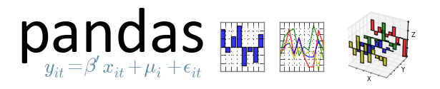


Tools and Modules
SciPy
Static Demo

Slide 36
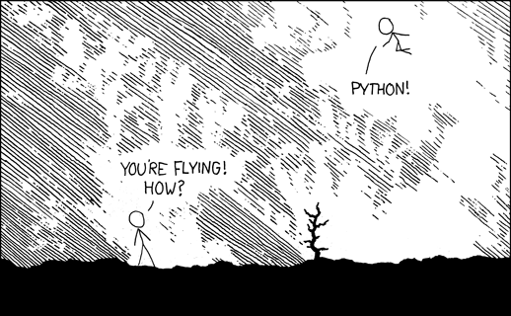
Source: xkcd

Slide 37
What’s in Data?
Instance:
Thing to be classified, associated, or clustered.
Individual, independent example of target concept.
Characterized by a predetermined set of features or attributes.
Notes:
Moved from Mod2.

Slide 38
What’s in Data?
Input to learning scheme: set of instances
Usually represented as a single relation.
Traditional form for data mining.
Advanced methods now exist for relational data.
Notes:
Moved from Mod2.

Slide 39
What’s in an Instance?
Each instance is described by a set of “features.”
A feature is a property or characteristic of an instance.
A feature can take several values (feature values).
Can be categorical (nominal or ordinal)
Can be numeric (interval or ratio)
Features can discrete or continuous.
Notes:
Moved from Mod2.

Slide 40
Discrete Features
Qualitative features.
Has only a reasonable set of values.
Often represented as integer variables.
Note: binary attributes are a special case of discrete features.
Notes:
Qualitative features.
Enough information to distinguish one object from another.
Has only a reasonable set of values.
Thumb-rule: count with your fingers.
Often represented as integer variables.
For example: 0 for red; 1 for blue; etc.
Note: binary attributes are a special case of discrete features.

Slide 41
Continuous Features
Most numeric properties hold.
Can be integer or real number.
Examples: temperature, height, weight, age, counts.
Practically, real values can only be measured and represented using a finite number of digits.
Notes:
Moved from Mod2.

Slide 42
Real World Example
Bullet
Sub bullet
Bullet 2
Bullet 3
Bullet 4
Please fill in bullets

Slide 43
Data Mining
The art of extracting knowledge from large bodies of structured data.
Intro Text?
Let’s put it to use!
Notes:
Everaldo: I simplified the earlier “Genomics” example. And I believe this example here on recommendations is fine as is, since students should be mostly familiar by the concept of recommendation systems from having used them personally.

Slide 44
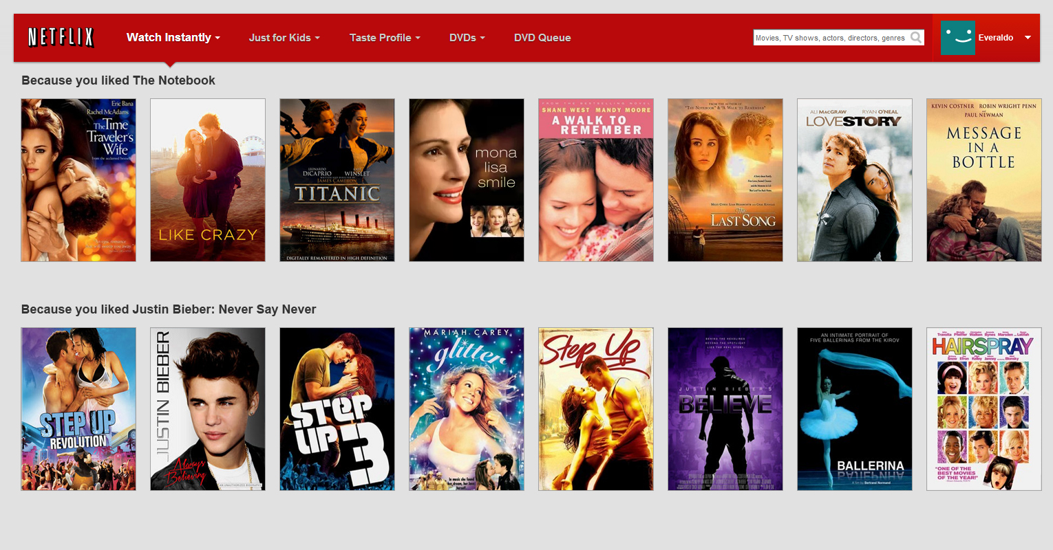
Recommendations
This could look visually interesting in the web version.

Slide 45
Basic Recommendations with Collaborative Filtering

Slide 46













Making Recommendations

Slide 47
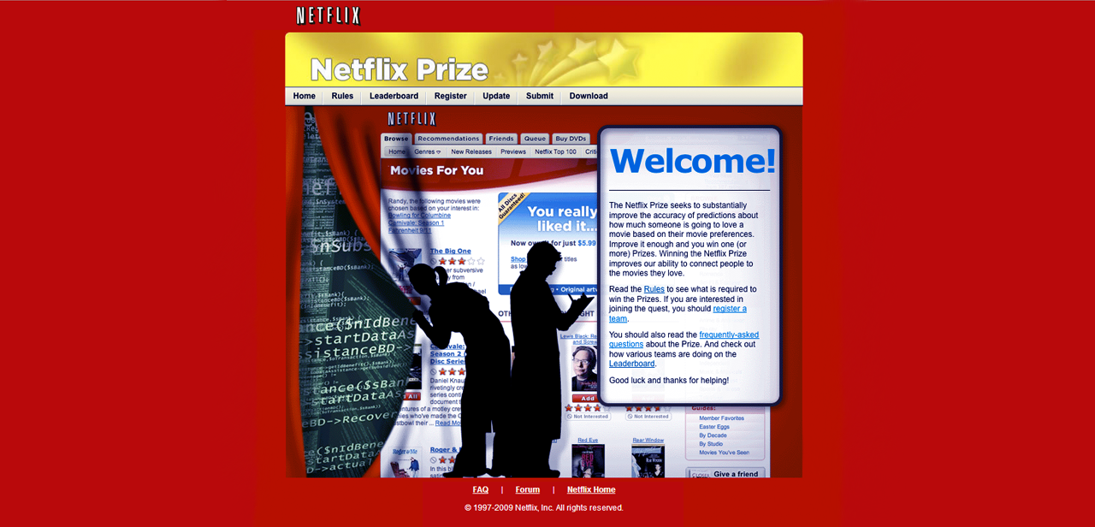
The Netflix Prize (2006-2009)

Slide 48
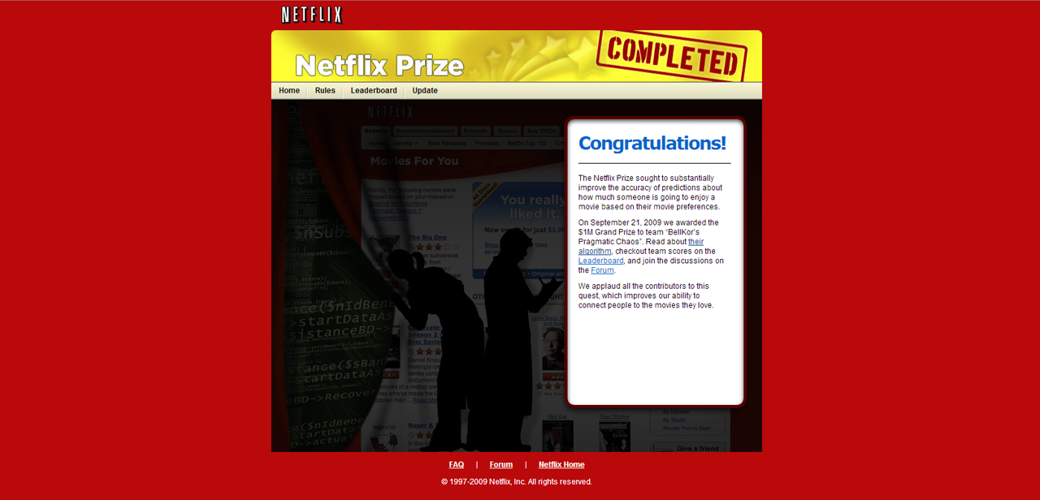
The Netflix Prize (2006-2009)

Slide 49
What was the Netflix Prize?
An open competition for the best collaborative filtering algorithm to predict user ratings for films, solely based on previous ratings without any other information about the users or films.
Notes:
In October, 2006 Netflix released a dataset containing 100 million anonymous movie ratings and challenged the data mining, machine learning, and computer science communities to develop systems that could beat the accuracy of its recommendation system, Cinematch.
Thus began the Netflix Prize, an open competition for the best collaborative filtering algorithm to predict user ratings for films, solely based on previous ratings without any other information about the users or films.

Slide 50
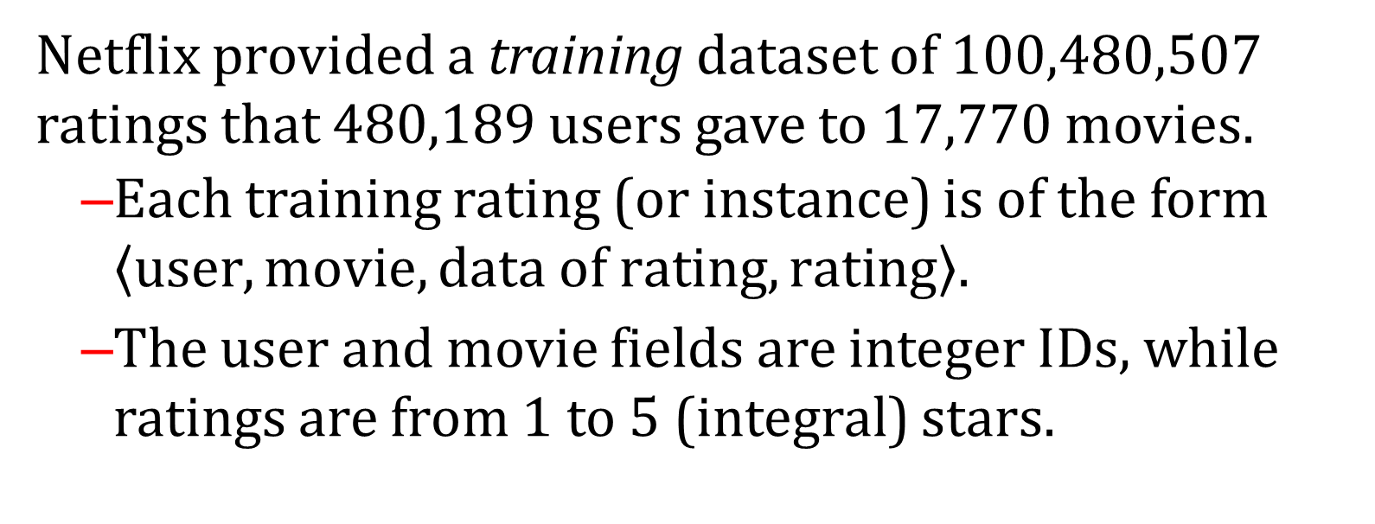
The Netflix Prize Datasets
Netflix provided a training dataset of 100,480,507 ratings that 480,189 users gave to 17,770 movies.
Each training rating (or instance) is of the form $\left\langle user, movie, data of rating, rating\right\rangle$.
The user and movie fields are integer IDs, while ratings are from 1 to 5 (integral) stars.

Slide 51
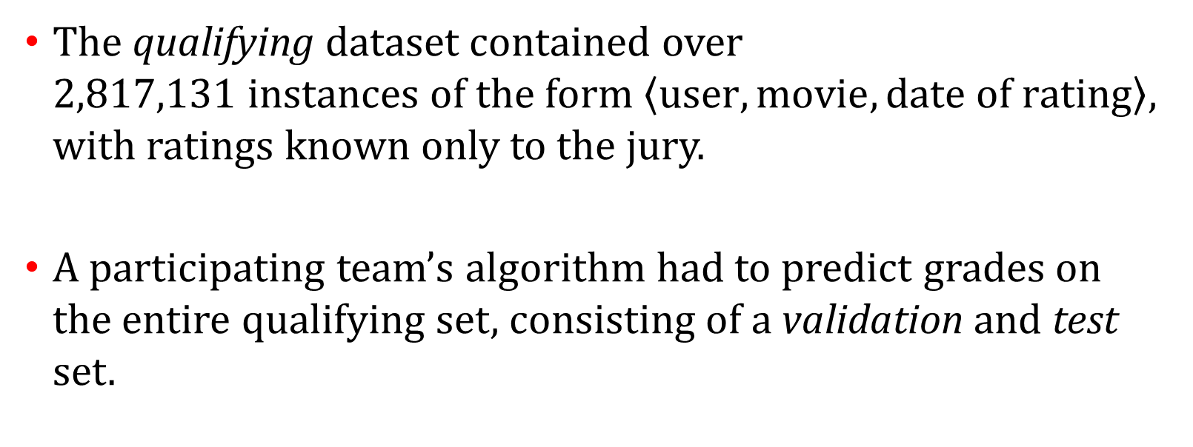
The Netflix Prize Datasets
The qualifying dataset contained over 2,817,131 instances of the form $\left\langle user, movie, date of rating\right\rangle$, with ratings known only to the jury.
A participating team’s algorithm had to predict grades on the entire qualifying set, consisting of a validation and test set.
Notes:
During the competition, teams were only informed of the score for a validation or quiz set of 1,408,342 ratings.
The jury used a test set of 1,408,789 ratings to determine potential prize winners.

Slide 52
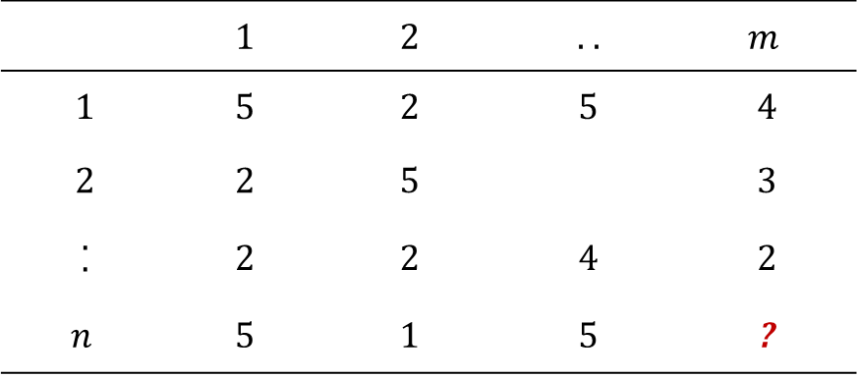
The Netflix Prize Data
Movie Ratings
 | 1 | 2 | . . | $$m$$
1 | 5 | 2 | 5 | 4
2 | 2 | 5 |  | 3
. . | 2 | 2 | 4 | 2
$$n$$ | 5 | 1 | 5 | ?
Users

Slide 53
The Netflix Prize Data
Movie Ratings
 | 1 | 2 | . . | $$m$$
1 | 5 | 2 | 5 | 4
2 | 2 | 5 |  | 3
. . | 2 | 2 | 4 | 2
$$n$$ | 5 | 1 | 5 | ?
Instances
(samples,
examples,
observations)

Slide 54
The Netflix Prize Data
Features (attributes, dimensions)
 | 1 | 2 | . . | $$m$$
1 | 5 | 2 | 5 | 4
2 | 2 | 5 |  | 3
. . | 2 | 2 | 4 | 2
$$n$$ | 5 | 1 | 5 | ?
Users

Slide 55
The Netflix Prize Goal
Movie Ratings
 | Star Wars | Hoop Dreams | Contact | Titanic
Joe | 5 | 2 | 5 | 4
John | 2 | 5 |  | 3
Al | 2 | 2 | 4 | 2
Everaldo | 5 | 1 | 5 | ?
Users
Goal: Predict ? (a move rating) for a user

Slide 56
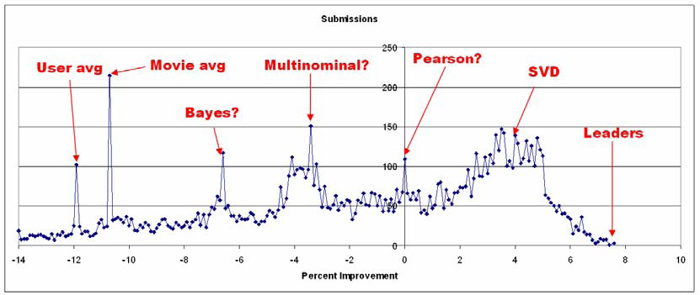
The Netflix Prize Methods
Bennett, James, and Stan Lanning. "The Netflix Prize." Proceedings of KDD Cup and Workshop. Vol. 2007. 2007.

Slide 57
Collaborative Filtering
Bullet
Sub bullet
Bullet 2
Bullet 3
Bullet 4

Slide 58
Key to Collaborative Filtering
Common insight: personal tastes are correlated
If Alice and Bob both like X and Alice likes Y, then Bob is more likely to like Y, especially (perhaps) if Bob knows Alice.
Notes:
There is an IPython Notebook with a collaborative filtering example here: http://nbviewer.jupyter.org/github/cse40647/cse40647/blob/sp.14/02.1%20-%20Collaborative%20Filtering.ipynb
That particular example is covered in detail at the beginning of the following book: Programming Collective Intelligence by Toby Segaran
I’ve replaced the slides that covered many other aspects of “collaborative filtering”, which will be revisited at the end of the course by that practical example.

Slide 59
Collaborative Filtering
Collaborative filtering (CF) systems work by collecting user feedback in the form of ratings for items in a given domain and exploiting similarities in rating behavior amongst several users in determining how to recommend an item
Text?

Slide 60

Collaborative Filtering Dataset
Items
 | 1 | 2 | . . | $$m$$
1 | 5 | 2 | 5 | 4
2 | 2 | 5 |  | 3
. . | 2 | 2 | 4 | 2
$$n$$ | 5 | 1 | 5 | ?
Users
Goal: Predict ? (an item) for $n$ (a user)

Slide 61
Collaborative Filtering Example
Creating a simple collaborative filtering (recommendation) method requires us to address a handful of challenges:
Collecting ratings for each user
Finding similar users
Generating a recommendation based on that information.
Notes:
We’ll walk through a simple example that is fully covered in Chapter 2 of Programming Collective Intelligence by Toby Segaran.

Slide 62
Collaborative Filtering Example
An IPython Notebook with details on how that can be achieved and comments can be found here.

