Slide 1


Bank Marketing Campaign: A Data-Driven Roadmap to Success
Presented By:
Hameez Ahmad,
Sajal Vatsayan,
Ashritha Shreedhara
Udupa, Sanjida Kohinur Oni

Slide 2
Our Journey Today
Problem : Why do campaigns succeed or fail?
A look inside a Portuguese bank's telemarketing efforts.
The six questions that guided our analysis.
Deep Dive Analysis
Economic Climate & Client Jobs
Contact Strategy
Demographics & Finances
Past Engagements
Age & Seasonality
A new, smarter strategy.

Slide 3
The Core Problem
Bank marketing can be expensive with low returns.
Why do some clients subscribe to a term deposit, while others don't?
Our goal is to move from guesswork to a data-driven strategy.
We transform complex data into a clear, practical guide for success.

Slide 4

Dataset Overview
This dataset is related to direct marketing campaigns (via telephone calls) of a Portuguese banking institution
Campaign Goal
Predict whether a client will subscribe to a term deposit
Dataset Details
File: bank-additional-full.csv
41,188 records
21 variables
Time range: May 2008 – Nov 2010

Slide 5
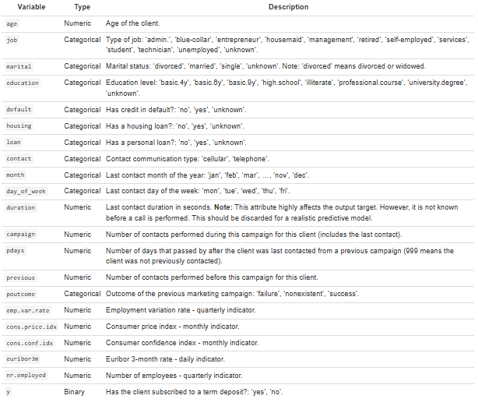
Key Variables in the Dataset

Slide 6

Research Questions
Our analysis is guided by six key questions:
Economic Context & Profession How do economic indicators (e.g., consumer confidence, Euribor rate) and job type affect subscription decisions?
Contact Strategy Effectiveness What is the impact of call duration and number of contacts on success? Does this differ for cellular vs. telephone?
Demographics & Financial Commitments How do marital status, education, and housing loan status relate to subscription rates?
Impact of Past Engagement For previously contacted clients, how do past outcomes and time since last contact affect current success?
Age, Job, and Subscription Patterns How does the age distribution of subscribers vary across different job categories?
Seasonal Trends & Campaign Fatigue Are there seasonal patterns in campaign success? How does this interact with campaign fatigue (contact frequency)?

Slide 7
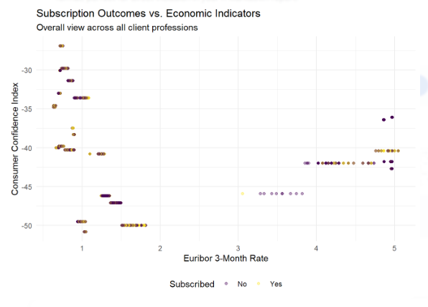
RQ1: Economic Context & Client Profession
Research Question How do consumer confidence (cons.conf.idx) and Euribor rate (euribor3m) interact with a client’s job type to influence term deposit subscription?
Initial Observation
Scatter plots showed general trends
But suffered from overplotting in dense areas
Solution: Faceted Heatmap
Economic indicators binned into grid cells
Each cell = subscription rate
Color intensity = success “hotspot”
Why This Works
Eliminates overplotting
Reveals actionable “hot zones”
Enables clear comparisons across job types

Slide 8
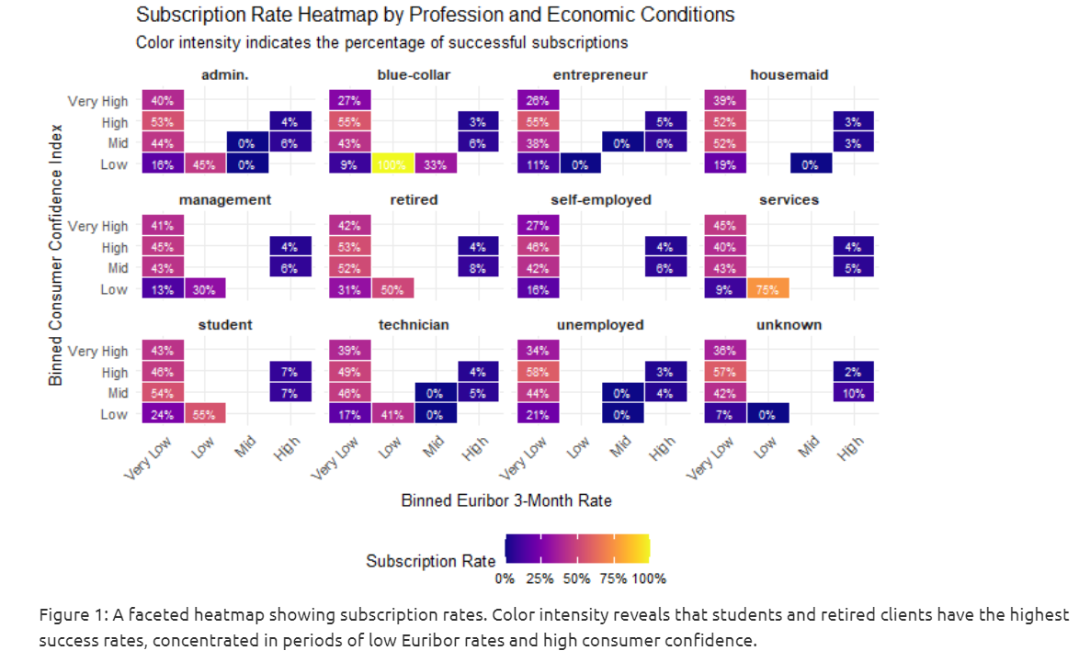
RQ1: Economic Context & Client Profession – Visualization
Faceted heatmap: subscription rate by job and economic bins

Slide 9
Dominant Trend
Highest success rates in “Very Low” Euribor bin
Especially strong for:
Admin., Management, Retired, Students
Success rates often 40–50%+
Indicates low interest rates boost campaign performance
Unexpected Hotspots
Blue-Collar:
100% success when both Euribor and confidence are Low
Services:
75% success under the same “Low-Low” economic conditions
Sensitivity Analysis
High-Sensitivity Groups:
Students & Retirees
Success closely tied to favorable economic signals
Complex-Sensitivity Groups:
Blue-Collar & Services
Not always responsive, but extremely receptive under specific conditions
RQ1 – Heatmap Insights: Economic Context & Profession

Slide 10
Conclusion: Economic Context & Profession
Key Takeaway
Economic climate (Euribor + consumer confidence) is a strong predictor of subscription success
→ Client profession significantly shapes this effect
Actionable Insight
Students & Retired clients are highly sensitive to economic signals → Target them during low-interest, high-confidence periods
Strategic Recommendation
For less sensitive groups (e.g., blue-collar):→ Focus messaging on non-economic value propositions

Slide 11
RQ2: Contact Strategy Effectiveness
Research Question
What is the combined effect of call duration and number of contacts on subscription success? Does this differ by contact method (cellular vs. telephone)?
Why This Matters
Helps identify the optimal number of contacts
Finds the ideal call duration
Aims to improve marketing efficiency
Hypothesis
Cellular may be more effective than telephone
Call length and frequency likely influence success

Slide 12
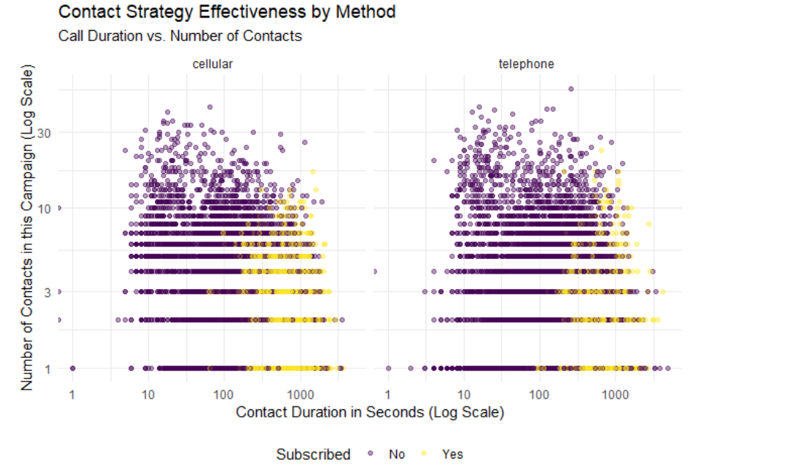
RQ2: Contact Strategy Effectiveness – Visualization
Scatter plot (duration vs. campaign)

Slide 13

Initial Findings from Scatter Plot
Key Observations
Successful calls (yellow dots) cluster at:
Low campaign count (< 10 contacts)
Longer durations (> 100 seconds)
Cellular contacts
More frequent
Higher concentration of success than telephone
Critical Limitations
Duration is not predictive:
A long call reflects client interest, not call strategy
Analogy: “Patients who recover spend longer in the recovery room” — not helpful for prediction
Over plotting persists:
Hard to judge success rates from dense scatter data

Slide 14
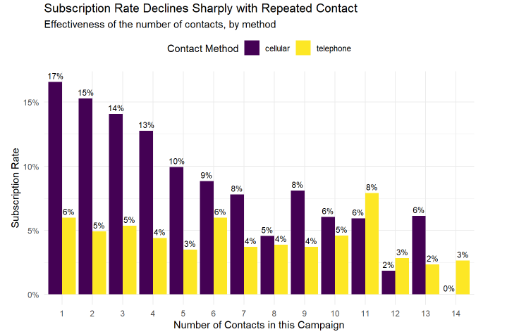
RQ2: Contact Strategy Effectiveness – Visualization
Bar chart for campaign success by contact type

Slide 15
RQ2 – Insights
Cellular is Superior
17% success on the first contact (vs. 6% for telephone)
Best results within the first 3 calls
Effectiveness drops to 5% by the 8th contact
Telephone is Weaker
Lower and less predictable success rates
Spike at 11th contact likely due to small sample noise
Actionable Strategy
Front-load campaigns with 1–3 cellular contacts
Avoid excessive follow-ups beyond 5–6 attempts
Deprioritize telephone channel due to low ROI

Slide 16
Conclusion: The First Call is Golden
Cellular is King: Calling a mobile is nearly 3 times more effective than a landline.
The First Call is Everything: Success rates drop sharply after the first contact.
Diminishing Returns: Pursuing clients beyond 4-5 calls is highly inefficient.
Actionable Insight: Focus your energy on making the *first call* count.

Slide 17
RQ3: Demographics & Financial Commitments
Why It Matters
Demographic and financial traits strongly influence client behavior
Helps refine target audience segments
Visualization Approach
Use a faceted bar chart:
X-axis: Marital status
Grid facets: Education level × Housing loan status
Y-axis: Subscription rate
Data Preparation
Combined all “basic.*y” levels into a single “Basic Education” category → Makes comparisons clearer and cleaner
How do a client’s marital status, education level, and housing loan status relate to their likelihood of subscribing to a term deposit?

Slide 18
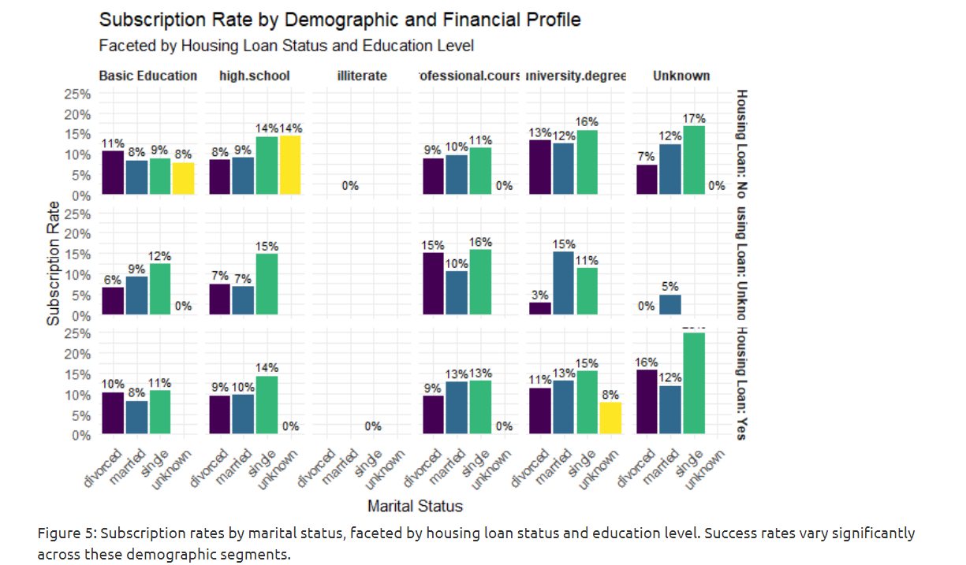
RQ3: Insights from Demographic Bar Charts
Highest-Converting Groups
Single clients, especially:
Unknown education + no housing loan → 17%
University degree → 16%
High school → 14%
Housing Loan Impact
Clients without housing loans consistently have higher success rates
Suggests mortgage burden may reduce term deposit interest
Education Matters
Higher education = higher subscription likelihood
"Illiterate" group shows no subscriptions (likely due to low sample size
Marital Status Trends
Single > Divorced > Married in most education and loan categories
Married clients generally least likely to subscribe

Slide 19
Conclusion: Demographics & Financial Factors
Key Takeaway
A client’s demographic and financial profile is a strong predictor of term deposit subscription
Ideal Client Profile
Single
No housing loan
Education: University degree, Professional course, or even Unknown
Lower Priority Segment
Married clients with housing loans → Significantly lower conversion potential
Actionable Insight
Focus marketing on high-probability profiles
Avoid spending resources on low-return segments

Slide 20

For clients who have been contacted before, how does the outcome of the previous campaign (poutcome) and the number of days since the last contact (pdays) jointly predict the success of the current campaign?
RQ4 – Impact of Past Engagement

Slide 21
RQ4 – Impact of Past Engagement
Focus Group
Excludes clients with no prior contact (pdays = 999)
Target: Clients with contact history
Goal
Determine whether:
A successful past campaign boosts current success
Recency of contact matters
Visualization Method
Violin + Box Plot combo:
X-axis: pout come (past outcome)
Y-axis: pdays (recency)
Color: Current outcome (y)

Slide 22
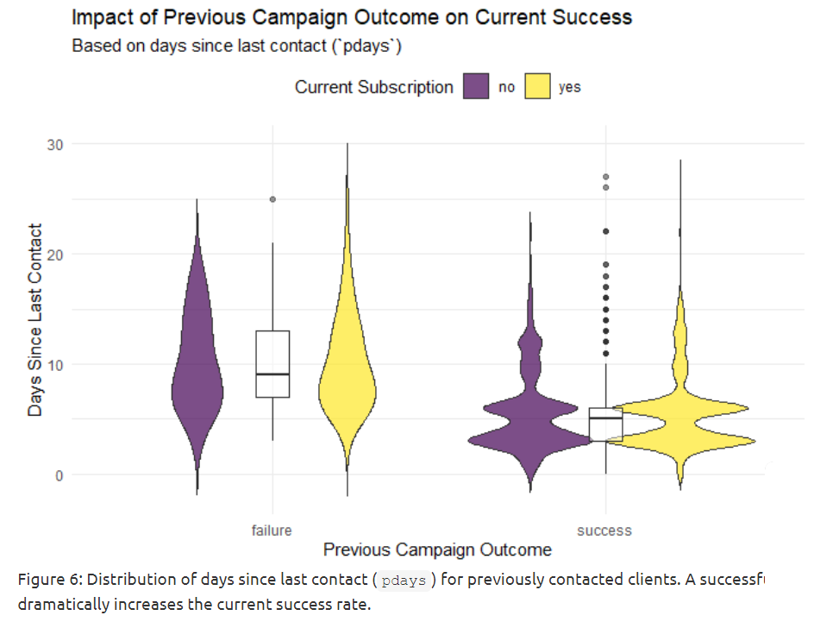
RQ4: Impact of Past Engagement – Visualization

Slide 23
Insight 4: Past Success is a Goldmine
This is our most powerful predictor!
Clients who subscribed before are extremely likely to do so again (a massive 65% success rate).
Even those who said "no" before are still a good audience (14% success).
Actionable Insight:
Your best future customers are your past customers. Make retargeting them your #1 priority.

Slide 24
How does the age distribution of clients who subscribe to a term deposit differ from those who do not, and how do these patterns vary across different job categories?
RQ5: Age, Job, and Subscription Patterns

Slide 25
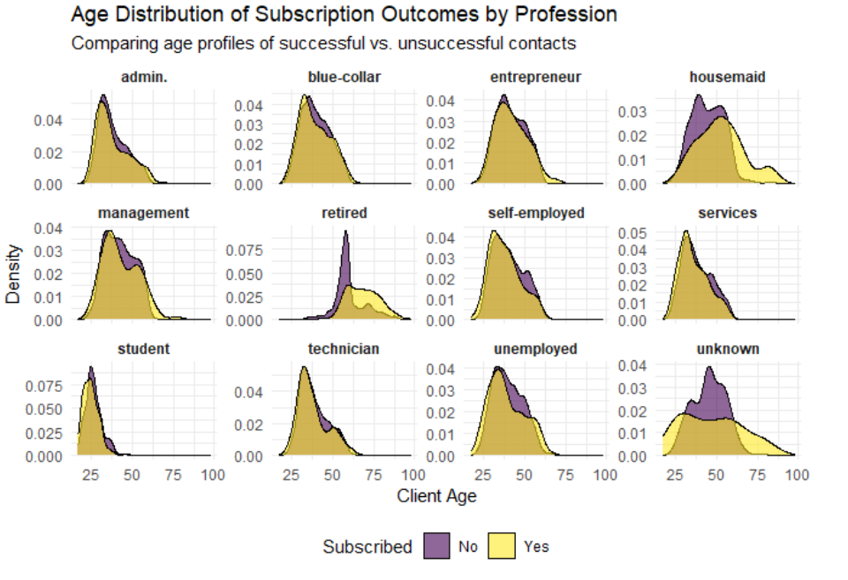
RQ5: Age, Job, and Subscription Patterns – Visualization
Faceted density plots by job with overlaid curves for subscription outcome

Slide 26
Insight 5: Targeting by Generation
Age isn't just a number—it's a strategy. We found key age windows for success:
Students: Early 20s
Admin & Management: Two key groups—young professionals (30s) and those nearing retirement (55-60).
Retired: A strong peak between 60 and 70.
Actionable Insight: Don't use a one-size-fits-all age strategy. Target by generation and profession.

Slide 27

Is there a seasonal effect on campaign success by month? Furthermore, how does this seasonality interact with campaign fatigue, as measured by the number of contacts (campaign) made to a client?
RQ6: Seasonal Trends and Campaign Fatigue

Slide 28
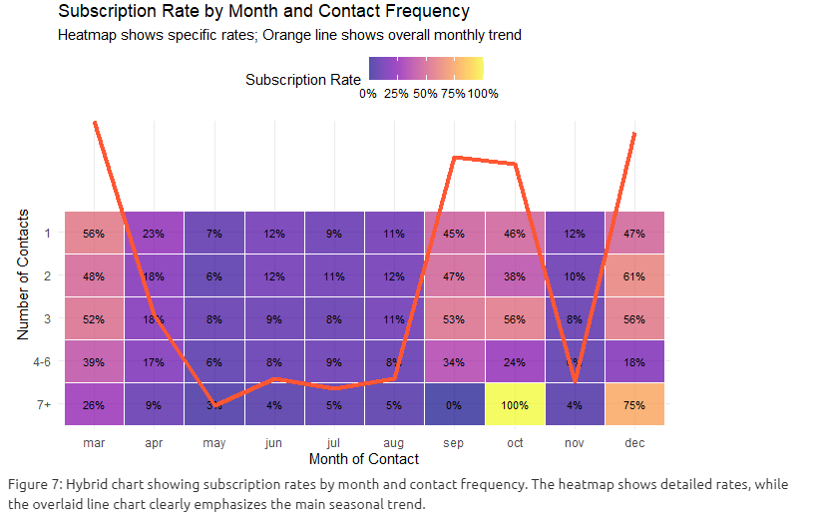
RQ6: Seasonal Trends and Campaign Fatigue

Slide 29

How Do Seasons Change Our Strategy?
Prime Seasons:
Campaigns thrive in two key windows: early Spring (March) and a strong Autumn/Winter peak (Sept, Oct, Dec).
The Data:
First-contact success rates are exceptional in these months, hitting 56% in March and over 45% in the Autumn/Winter period.
The December Anomaly:
Unlike other months, persistence pays off in December. The 2nd and 3rd calls were even more successful than the first, suggesting a different client mindset during the holiday season.
Actionable Insight:
Concentrate your budget in the peak seasons. Follow the "first contact is best" rule generally, but adapt the strategy to allow for more persistence in December.

Slide 30
The Big Picture: The Story of "Yes"
Success is not random. It's a simple formula:
WHEN:
Call during peak seasons (Spring/Autumn).
WHO:
Call past subscribers or those with the "Golden Profile.“
HOW:
Use a single, well-timed call to a cellular phone.

Slide 31
Our Recommendation: A Tiered Strategy
Tier 1: Highest Priority
Immediately retarget past subscribers.
Target "golden profile" clients during prime seasons with a single cellular call.
Tier 2: High Potential
Target high-potential age groups (e.g., retirees 60-70, young managers).
Focus on clients sensitive to economic conditions when timing is right.
Tier 3: General Outreach
Run broader campaigns only during prime seasons.
Deprioritize summer months and married clients with housing loans.

Slide 32
The Future: From Data to Decisions
This analysis is just the beginning.
We can embed these rules into our CRM for automated lead scoring.
We can continuously track results to refine our strategy over time.
This is how we build a smarter, more profitable bank.

Slide 33
Your 30-Second Takeaway
1.Focus on the First Call: Make it count.
2. Target Your Best Bets: Past customers and "golden profiles."
3. Timing is Everything: Call during the spring and fall.

Slide 34

Visual Tools Used
All visualizations created in R using:
ggplot2
dplyr
viridis
Faceting, heatmaps, violin plots, density plots, bar charts used to reveal insights.

Slide 35
Thank You
Any Questions ?

