Slide 1
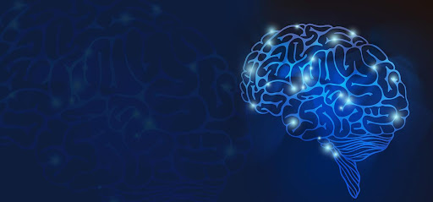
Brain Tumor Detection and Segmenting
Group members :
Mishi MAKADE
KGOSI Katlego
Capstone Project Coordinator’s name(s):
Mr Kudakwashe MADZIMA

Slide 2

Project Layout
Introduction
Problem description
Aims of the project
Objectives of the project
Relevance
Significance of Study
Limitation of Study
Methodology
Method of data collection
Ethical Consideration
System specifications
Network Selection
FinalModel
Results
Challenges
References

Slide 3
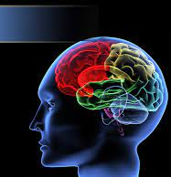
Introduction
A brain tumor is the growth of abnormal cells in the brain. There are many types of brain tumors, but this study will focus on meningioma, pituitary, and glioma tumor.
Meningiomas start from the membranes that surrounds the brain and surrounds the central nervous system (Badža et al.2020:1).
Pituitary tumors are lumps that are inside the skull(Badža et al.2020:1).
Gliomas are a general term for tumors that arise from brain tissues other than nerve cells and blood vessels (Badža et al.2020:1).
Deep learning algorithms and Machine learning techniques have been and are still playing a big role in detection of brain tumors.
The deep learning models previously used to classify brain tumors are slow and consist of many parameters.

Slide 4
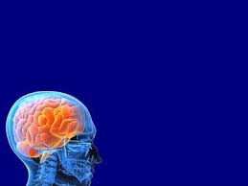
Introduction
As a result, training these models is time consuming and requires a lot of memory.
This poses a great challenge when it comes to deploying these models on resource-restricted mobile devices.
Mobile intelligence needs faster mobile processors, more storage space, smaller but more accurate models, and even the assistance of other network nodes.

Slide 5
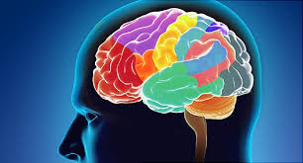
Problem description
Accurate and fast diagnosis of brain tumor is crucial as it involves the selection of the most appropriate treatment method for saving a patient’s life (Irmak, 2021:2).
Previously implemented deep learning models on brain tumor classification like vgg16,Resnet etc are complex and slow (Badža et al.2020:9).
Performing real-time performance with these models requires dedicated hardware (Badža et al.2020:9).
This may result in delayed diagnosis, treatment and therefore may increase the chances of a patient’s death.
The models are also difficult and impossible to deploy on mobile devices due to their complexity(Anon 2021).
The proposed Capstone project will address the problem of complexity by using pre-trained EfficientNetB7 model.
EfficientNetB7 is 8.4 times smaller than the best existing ConvNet (Tan & Le 2020:1)

Slide 6
Aims
The aims of this project are to:
Develop and compare pre-trained models on brain tumors detection.
Segment brain tumors using image processing techniques.

Slide 7
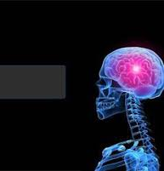
Objectives
Gather and perform
Gather and perform pre-processing on the dataset.
Develop
Develop an EfficientNetB7 and compare it to vgg16 for classification of brain tumors. Compare the models based on accuracy and complexity.
Segment
Segment the brain tumor using image processing techniques.

Slide 8
Relevance
This project implements deep learning models to classify images.
The use of deep learning models relates this project to the Data Science 2A and Data Science 2B modules.
The project also implements image processing and that relates it to the Image Processing module taken by third years.

Slide 9
Business Case
Healthcare industry is a very important industry where best accuracies need to be achieved.
As brain tumor is one of top cancers in men and women, early and low-cost detection is what is targeted.

Slide 10
Business Case
The app developed in this project can be implemented by less experienced medical practitioners or low levelled practitioners, example nurses and parents or individuals who have access to MRI scanners.
This app will provide a second opinion when diagnosis of brain tumor is carried out in hospitals.
Due to the reduced complexity of EfficientNetB7 the app can be deployed on mobile devices therefore providing easy access to the app’s services.

Slide 11
Significance of study
The development of smaller networks is important as it is linked to the possibility of deploying the models on mobile platforms and fast .
This study’s findings will help medical practitioners generate fast and reliable diagnosis of brain tumor through the implementation of EfficientNetB7.

Slide 12

Literature Review
Numerous techniques have been applied to brain tumor classification. One of those techniques is machine learning (Irmak, 2021:2). Deep learning and artificial intelligence have made a big impact in the field of medical image analysis, more specifically in the field of disease diagnosis((Mehmood et al. 2020, 2021; Yaqub et al. 2020 cited in Irmak, 2021:2).
Kang, Ullah and Gwak (2021:6) proposed a system that used pretrained deep learning models to extract features and then fed those features to machine learning models. They used many pretrained deep learning models including vgg-16, Resnet and others and they also used many machine learning models. They then studied the performance of each of those machine learning models.
The results showed that DenseNet-169 deep feature alone is a good choice when the size of the MRI dataset is very small and the number of classes is 2, the ensemble of DenseNet-169, Inception V3, and ResNeXt-50 deep features is a good choice when the size of MR images dataset is large and the number of classes is 2, and the ensemble of DenseNet-169, ShuffleNet V2, and MnasNet deep features is a good choice when the size of MRI dataset is large and there are four classes (normal, glioma tumor, meningioma tumor, and pituitary tumor). They also discovered that in most cases, SVM with RBF kernel outperforms other ML classifiers for the MRI-based brain tumor classification task.

Slide 13
Literature Review cont.
Then Badža and Barjaktarovi´c (2020:4) proposed a new CNN architecture and the classification was performed using a T1-weighted contrast-enhanced MRI image database which contains three tumor types. The CNN model created is simpler and it is possible to run it on conventional modern personal computers. The performance of their network was evaluated using the four approaches: combinations of two 10-fold cross-validation methods and two databases. The generalization capability of their network was tested with one of the 10-fold methods, subject-wise cross-validation, and the improvement was tested by using an augmented image database. The best results for the 10-fold cross-validation method was obtained for the record-wise cross-validation for the augmented data set, and the accuracy was 96.56%.
From all the techniques implemeneted we discovered that the EfficientNetB7 hasn’t been implemented to classify brain tumors. So, this study will develop the model in brain tumor classification along with vgg-16 then compare the results based on accuracy and complexity.

Slide 14

Limitations of study
Time
Data

Slide 15
Methodology: Method of data collection
The dataset was downloaded from Kaggle.

Slide 16
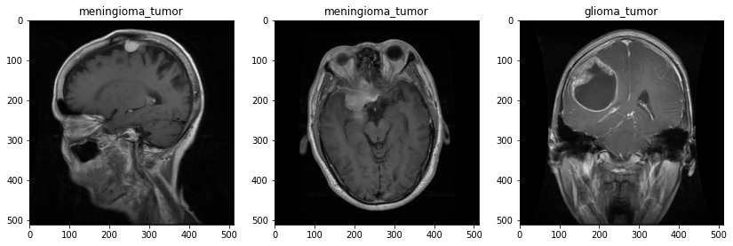
Dataset Sample

Slide 17
Methodology: System specifications
Programming language :
Python
Libraries:
Keras & tensorflow
Sklearn
Matplotlib
Pandas
Models:
vgg16
EfficientNetB7

Slide 18
Methodology: Image Pre-processing
The MRIs came in different sizes and were therefore resized as per requirement of the different models presented in this study.
The “preprocess_input” function was used for pre-processing the images along with “ImageDataGenerator”.
The “ImageDataGenerator” takes the original image and replaces it with a new pre-processed image.

Slide 19
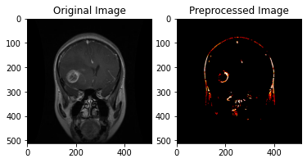
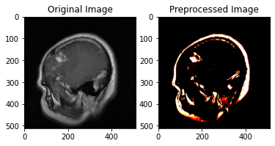
Image Pre-processing Results

Slide 20
Methodology: model development and fine-tuning
All models were fine-tuned on the same parameters.
They were fine tuned on the following parameters namely, optimizers, dropout, number of epochs and batch size.
The goal of fine tuning was to get the optimum hyper-parameters for the final models.

Slide 21
Methodology: MRI Segmentation
Segmentation is the division of an image into significant structures.
Segmentation divides an image into its essential regions or objects, and it is an important step in image analysis, object representation, visualization and numerous other image processing tasks.
This study uses image processing to segment a tumor.

Slide 22
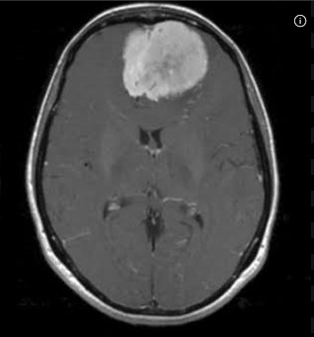
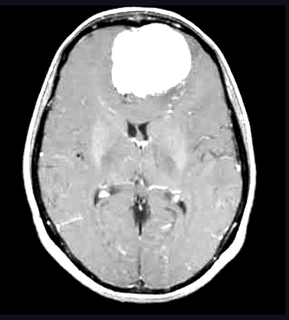
Segmented Image Example

Slide 23
Ethical Considerations
The dataset for this study was obtained from Kaggle and is therefore publicly available.
Navoneel Chakrabarty and Swati Kanchan along with the team members Sartaj Bhuvaji, Ankita Kadam, Prajakta Bhumkar and Sameer Dedge(2020) collected the dataset.
The dataset is called Brain Tumor Classification (MRI). The dataset consists of 2227 training MRIs and 429 test MRIs.
There are 826 glioma tumor, 247 meningioma tumor, 827 pituitary tumor and 327 no tumor MRIs in the train dataset. The test dataset consists of 98 pituitary, 100 glioma, 127 meningioma, and 104 no tumor MRIs.

Slide 24
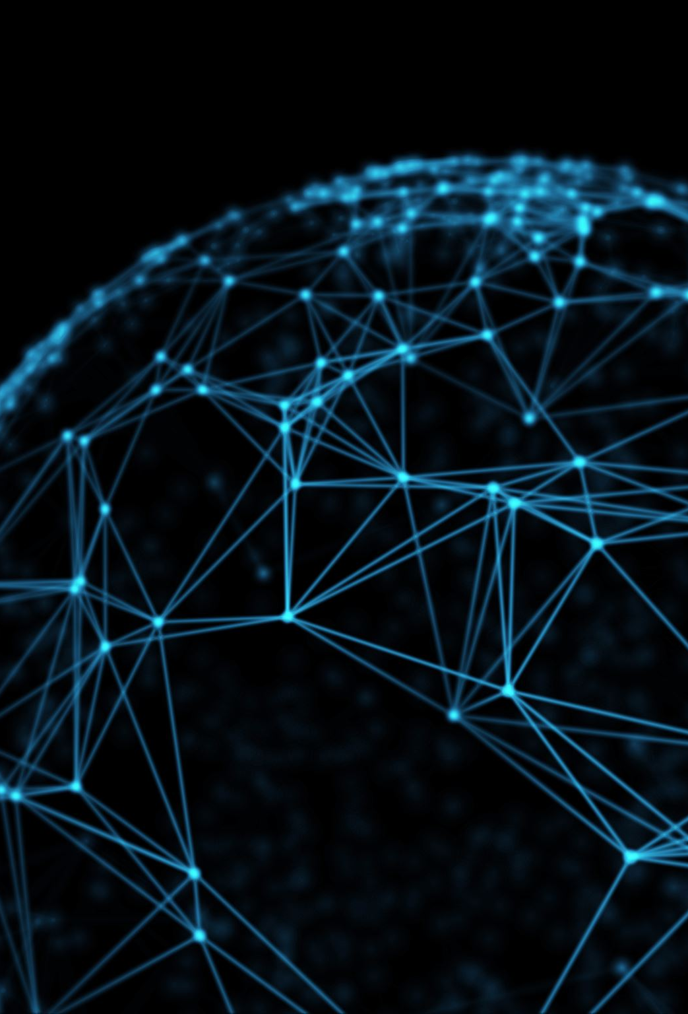
Network Selection
For our project a good model was one with few training parameters which indicates the complexity of the model, and one with high accuracy.
We used two models namely, vgg-16 and Resnet pre-trained networks.
Both models were fine tuned through hyper-parameters.
Then the final models were trained with the optimum hyper-parameters.

Slide 25
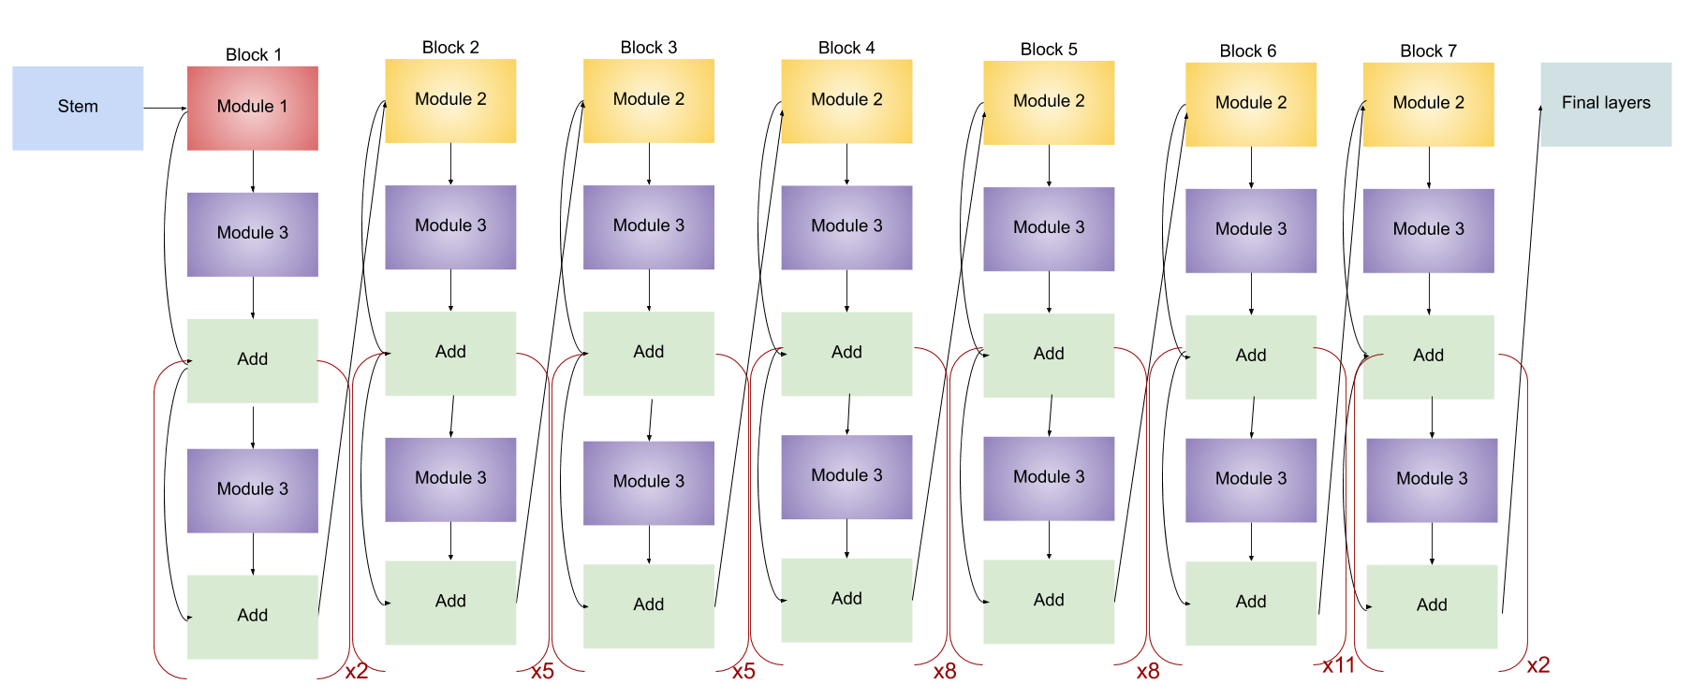
Final Model
EffcientNetB7 Architecture
We found that EfficientNetB7 gave best results for the chosen parameters of interest, namely accuracy in terms of number of trainable parameters and accuracy.
EfficientNetB7 has a total of 66 million trainable parameters while VGG-16 has 138 million trainable parameters, and EfficientNetB7 gave the highest accuracy.

Slide 26
Results
Model | Trainable Parameters | Training Accuracy | Validation Accuracy
Vgg-16 | 138M | 88% | 92%
EfficientNetB7 | 66M | 96% | 98%

Slide 27
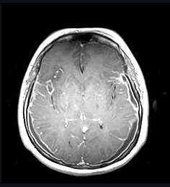
Challenges and Areas of Future Research
Improve our segmentation techniques as for other images it shows there exist a tumor where there is none(in the image on the side it shows as if there is a small tumor it can be misinterpreted as an early stage of a tumor)
Improve and add more performance measurement techniques of our models

Slide 28
References
Badza,M & Barjaktarovi´,M.2020. Classification of Brain Tumors from MRI Images Using a Convolutional Neural Network.applied sciences 13:1-13.
Kang,J & Ullah,Z &Gwak,J.2021. MRI-Based Brain Tumor Classification Using Ensemble of Deep Features and Machine Learning Classifiers.applied sciences 13:1-21.
Irmak,E.2021. Multi-Classification of Brain Tumor MRI Images Using Deep Convolutional Neural Network with Fully Optimized Framework. Iranian Journal of Science and Technology, Transactions of Electrical Engineering 22:1-22.
Magadza,T.2021. Deep Learning for Brain Tumor Segmentation : A Survey of State-of-the-Art. Journal of Imaging 22:1-22
Anon.2021. Deployment of AI model in mobile devices(consulted 02 September 2021): https://developpaper.com/deployment-of-ai-model-in-mobile-devices/
Tan,M & Le,Q. 2019. EfficientNet: Rethinking Model Scaling for Convolutional Neural Networks. Proceedings of the 36 th International Conference on Machine Learning 7:1-11.

