Slide 1
TECHNICAL SEMINAR
“ INTRODUCTION TO UNSUPERVISED LEARNING ”
SUBMITTED BY :
OMJI SHUKLA
ROLL NO : R271222037
SAP ID : 500100963

Slide 2
MOTIVATION
In the rapidly evolving field of artificial intelligence and machine learning, we are witnessing groundbreaking advancements that are transforming the way we live, work, and interact with technology.
The motivation behind this presentation is to shed light on the fascinating world of unsupervised learning and highlight its immense value in addressing real-world challenges across various domains.

Slide 3
INTRODUCTION
Unsupervised learning is a machine learning technique. It is used to identify patterns and relationships in data. It does not require explicit guidance or supervision from humans.
In unsupervised learning, the algorithm is given a dataset without any labeled output. The algorithm must find structure or underlying patterns on its own.

Slide 4
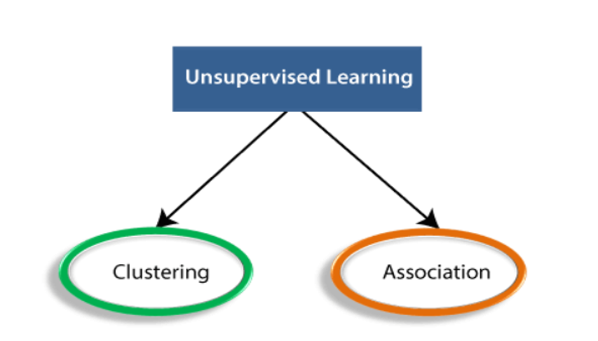

Slide 5
Clustering :
Clustering is a method of grouping the objects into clusters such that objects with most similarities remains into a group and has less or no similarities with the objects of another group. Cluster analysis finds the commonalities between the data objects and categorizes them as per the presence and absence of those commonalities.

Slide 6
Association :
An association rule is an unsupervised learning method which is used for finding the relationships between variables in the large database. It determines the set of items that occurs together in the dataset. Association rule makes marketing strategy more effective. Such as people who buy X item (suppose a bread) are also tend to purchase Y (Butter/Jam) item. A typical example of Association rule is Market Basket Analysis.

Slide 7
TYPES OF CLUSTERING ALGORITHM
K-Means Clustering :
K-Means clustering is a popular unsupervised learning technique used to group similar data points into K clusters.
The algorithm works by iteratively assigning each data point to the nearest cluster center and then updating the cluster centers based on the newly assigned data points.

Slide 8
Hierarchical Clustering :
Hierarchical clustering is a popular unsupervised learning technique used to group similar data points into a hierarchy of clusters.
The algorithm works by iteratively merging or splitting clusters based on their similarity or dissimilarity, creating a tree-like structure called a dendrogram.
Density-Based Clustering :
Density-based clustering is a popular unsupervised learning technique used to group similar data points together based on their density in the data space.
The algorithm works by identifying areas of high density as clusters and separating them from areas of low density or noise.

Slide 9
TYPES OF ASSOCIATION ALGORITHM
Apriori Algorithm :
The Apriori algorithm is a popular algorithm used in unsupervised learning for association rule mining. The algorithm is used to identify frequent item sets or groups of items that frequently co-occur in a given dataset.

Slide 10
“G7 calls for 'responsible' use of generative AI ”
The world must urgently assess the impact of generative artificial intelligence, G7 leaders said , announcing they will launch discussions this year on "responsible" use of the technology.
A working group will be set up to tackle issues from copyright to disinformation, the seven leading economies said in a final communique released during a summit in Hiroshima, Japan.

Slide 11
CONCLUSION
Unsupervised learning has the potential to identify hidden patterns and structures in data that may not be immediately apparent through manual inspection or supervised learning.
This learning can be used for exploratory data analysis, allowing researchers and practitioners to gain a better understanding of the data and its underlying distribution.

Slide 12
THANK YOU

