Slide 1
POWER BI PORTFOLIO PROJECT
Insurance Analytics
Dashboard
Turning premium, customer and policy data into business decisions.
Customer
Revenue
Settlement
Prepared by Abhishek Singh Chauhan
Data Modelling • DAX • Power BI
Notes:
[Sources]
Source: Insurance Analytics Dashboard project and PBIP model supplied by the user.
[/Sources]

Slide 2
THE BUSINESS NEED
The team needed one view of insurance performance
The work began with a reporting problem, not a chart requirement.
Without a single dashboard
What the dashboard needed to answer
•
Customer and revenue performance was hard to track
•
How many customers do we have?
•
City, age and sales-mode analysis was fragmented
•
Where is revenue coming from?
•
Policy change was not visible month over month
•
Which customer groups create value and exposure?
•
Settlement exposure was not linked to customer segments
•
Where should the business take action next?
Insurance Analytics Dashboard | 02
Notes:
[Sources]
Source: Client project requirements supplied by the user.
[/Sources]

Slide 3
DATA PREPARATION
A simple model made analysis responsive to filters
The dashboard combines five connected business areas.
Customer
Premiums
Policies
Settlements
Date
Customer code, DOB, city
Date, policy, sales mode, premium
Base premium and coverage
Age-based settlement percentage
Month, week and day analysis
Relationships allow filters such as City, Month, Age Group and Policy ID to update the same measures consistently.
Insurance Analytics Dashboard | 03
Notes:
[Sources]
Source: PBIP semantic model tables: dim_customer, fact_premiums, dim_policies, fact_settlements and dim_date.
[/Sources]

Slide 4
ANALYSIS APPROACH
The dashboard uses business measures—not raw columns
Each KPI answers a direct business question.
01
Total Customers
Distinct customers who purchased a policy
02
Total Revenue
Sum of final premium amount
03
Daily Growth %
Current day versus previous day
04
Policy MoM Growth %
Policy sales versus prior month
05
Expected Settlement
Base coverage × settlement percentage
Insurance Analytics Dashboard | 04
Notes:
[Sources]
Source: key_metrics table in the supplied Power BI semantic model.
[/Sources]

Slide 5
DASHBOARD SOLUTION
Two report pages turn analysis into decisions
The report was designed so a stakeholder can start broad, then move to age-specific decisions.
01 Insurance Performance Overview
02 Age Group Analysis
•
KPI cards for customers, revenue and growth
•
Expected settlement by age group
•
Revenue/customer trend and policy MoM movement
•
Revenue and customers on separate scales
•
City summary and age-group performance
•
Sales-mode and policy preference by age
Insurance Analytics Dashboard | 05
Notes:
[Sources]
Source: Redesigned Insurance Analytics PBIP report pages created from the supplied project.
[/Sources]

Slide 6
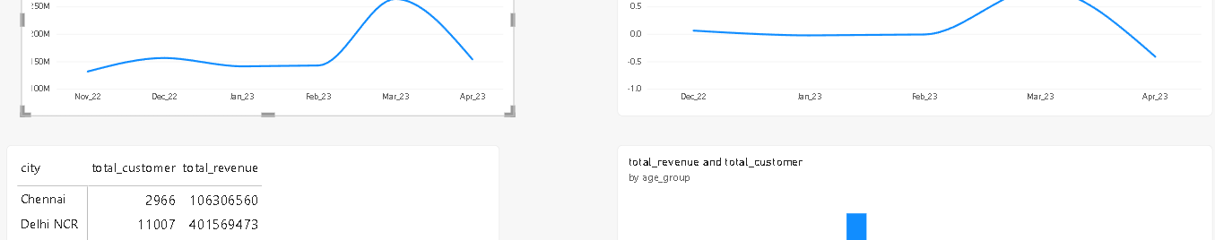
PERFORMANCE SNAPSHOT
26,841 customers and INR 989.3M revenue
The dashboard gives leaders a quick starting point before they drill down.
TOTAL CUSTOMERS
TOTAL REVENUE
TOP CITY
26,841
INR 989.3M
Delhi NCR
Insurance Analytics Dashboard | 06
Notes:
[Sources]
Source: Dashboard screenshot supplied by the user. Total customers and total revenue are visible in the city summary.
[/Sources]

Slide 7
CITY PERFORMANCE
Delhi NCR is the clear revenue leader
It generates about 41% of total revenue, so it should be protected and understood.
What this tells us
•
Delhi NCR: INR 401.6M
•
Mumbai: INR 239.5M
•
Top two cities = 64.8% of revenue
Insurance Analytics Dashboard | 07
Notes:
[Sources]
Source: City summary visible in the user-supplied dashboard screenshot. Revenue values converted from INR to INR M.
[/Sources]

Slide 8
TREND INSIGHT
March revenue was the high point; April needs attention
The revenue movement highlights a question for the business—not a conclusion to assume.
Business question
What changed between March and April?
Check sales mode, policy mix, city contribution and campaign activity before making a decision.
Insurance Analytics Dashboard | 08
Notes:
[Sources]
Source: Monthly revenue trend visible in the user-supplied dashboard screenshot. Values are approximate read-offs from the plotted monthly trend.
[/Sources]

Slide 9
AGE SEGMENT ACTIONS
Age analysis connects growth with settlement exposure
The age page helps the business avoid treating all customers the same.
Key observations
Recommended next actions
•
31–40 is the strongest revenue age group
•
Protect Delhi NCR with channel and policy analysis
•
Revenue and customer counts need separate axes
•
Investigate the March-to-April revenue drop
•
Settlement exposure should be reviewed alongside policy preference
•
Create age-specific offers using policy and sales-mode preference
•
Review lower-revenue cities for local opportunity
Insurance Analytics Dashboard | 09
Notes:
[Sources]
Source: Age group charts and expected settlement measure in the user-supplied dashboard and semantic model.
[/Sources]

Slide 10
INSURANCE ANALYTICS DASHBOARD
Better visibility leads
to better decisions.
The dashboard gives the business one place to monitor performance, identify changes and act on customer segments.
Thank you
Abhishek Singh Chauhan | Power BI Portfolio Project
Notes:
[Sources]
Source: Summary of the dashboard project analysis.
[/Sources]

