Slide 1
FINAL PROJECT PRESENTATION
426K
Goodcabs: reading six months of trips
trips analysed
₹254
average fare per trip
What the data says about growth, loyalty and targets, and what to do next
7.66
Presented
by Abhishek | SQL + Power BI analysis
average passenger rating
Notes:
[0:00 - 0:30] Hello Bruce, I'm Abhishek. Over the next 15 minutes I'll walk you through the Goodcabs project in five parts: the business problem, the top insights, the SQL behind them, a live tour of the Power BI dashboard, and my recommendations. The three numbers on the right are the headline: about 426 thousand trips, a 254 rupee average fare and a 7.66 average passenger rating.

Slide 2





What I will walk you through
01
02
03
04
05
Business problem
Top insights
SQL highlights
Dashboard demo
Recommendations
What leadership needs to know
Four findings from the data
How the numbers were built
A tour of all three pages
Where to act next
2 min
4 min
2.5 min
3.5 min
1.5 min
Notes:
[0:30 - 1:00] Here is the plan. Two minutes on the problem, four on the insights, two and a half on SQL, three and a half for the dashboard demo, and a short set of recommendations. I'll keep each section tight so you can ask questions at the end.

Slide 3


Growth now depends on winning riders and keeping them
Goodcabs operates cab services across ten Indian cities.
Every city has targets for trips, new passengers and passenger rating, but until now there was no single view showing who is on track, where revenue comes from, and whether riders come back.
Are we on target?
Trips, new passengers and ratings, city by city and month by month
Where does revenue come from?
City mix, fare per trip and fare per km
Do passengers come back?
New vs repeat riders and how often repeat riders travel
Notes:
[1:00 - 2:00] Goodcabs runs in ten cities, and each city has targets for trips, new passengers and passenger rating. Leadership had no single place to see three things: are we on target, where does revenue come from, and do passengers come back. That is the problem I set out to solve with SQL for the analysis and Power BI for the dashboard.

Slide 4



The business at a glance
426K
₹254
₹13.28
Total trips
Average fare per trip
Average fare per km
19.1 km
7.66
25.7%
Average trip distance
Average passenger rating
Repeat passenger rate
Notes:
[2:00 - 3:00] Before the insights, the baseline. 426 thousand trips, an average fare of 254 rupees, 13.28 rupees per kilometre on trips of about 19 kilometres. Passengers rate us 7.66 on average, and about one in four passengers is a repeat rider. Keep that 25.7 percent in mind because it matters in the third insight.

Slide 5
Jaipur earns more than twice what any other city does
₹37.2M
Jaipur revenue, about 2.2x second-placed Kochi (₹17.0M)
So what: one city carries a large share of revenue. A dip in Jaipur moves the whole business, and the smaller cities have room to grow.
Notes:
[3:00 - 4:00] Insight one is concentration. Jaipur generated about 37 million rupees in revenue, which is more than twice Kochi, the next city at 17 million. That is good news for Jaipur, but it also means the company is exposed. If Jaipur slows down, the whole picture changes. And the cities at the bottom, like Mysore at about 4 million, are where there is the most room to grow.

Slide 6
New-passenger inflow has shrunk by about a third
35K → 23K
New passengers per month, January to June
So what: repeat riders held between 8K and 12K a month, so the decline is an acquisition problem, not a loyalty problem.
Notes:
[4:00 - 5:00] Insight two is about acquisition. New passengers started at about 35 thousand a month and fell to about 23 thousand by June, a drop of roughly a third. Repeat riders, in purple, stayed in a steady 8 to 12 thousand band. So riders who join are staying. The pipeline of new riders is what is thinning.

Slide 7
One in four passengers drives nearly six in ten trips
0.71 : 1
New to repeat passenger trips ratio. Repeat riders take the larger share of trips.
So what: a repeat rider is worth several new riders in trip volume, so moving riders from first trip to second trip pays off.
Notes:
[5:00 - 6:00] Insight three is why loyalty matters. Repeat passengers are only 25.7 percent of our passengers, but they take 58.4 percent of all trips. The new to repeat trips ratio is 0.71 to 1. Put simply, a repeat rider is worth several new riders in trip volume. Combined with insight two, we are bringing in fewer new riders and the ones we do bring in are the most valuable ones to keep.

Slide 8
Revenue growth fell in three of the last four months
-14.6%
Revenue change in June versus May, the steepest fall in the period
So what: shrinking new-passenger inflow shows up in revenue. June needs a city-level look before it becomes a trend.
Notes:
[6:00 - 7:00] Insight four is momentum. February grew 7.6 percent, then March, April and June all fell, with June down 14.6 percent. Teal bars are growth, amber bars are decline. This links to insight two: fewer new riders is starting to show up in revenue. I would want a city-level look at June before calling it a trend.

Slide 9

SQL: six business requests, one consistent set of tables
REQUEST 1
REQUEST 2
REQUEST 3
City-level fare and trip summary
Monthly trips vs target
Repeat passenger trip frequency
Trips, average fare per km and per trip, and each city's share of total trips
Actual trips against target by city and month, with a performance status
How many repeat passengers took 2, 3, up to 10 trips, per city
REQUEST 4
REQUEST 5
REQUEST 6
Cities by new passengers
Peak demand month by city
Monthly repeat passenger rate
Top and bottom cities ranked by new passengers
The month each city hit its highest trip count
Repeat passenger rate by city and month, plus an overall city rate
Notes:
[7:00 - 8:30] On the SQL side I answered six business requests: a city-level fare and trip summary, monthly trips against target, repeat passenger trip frequency, the highest and lowest cities for new passengers, peak demand month by city, and the monthly repeat passenger rate. They all run on the same set of tables, so the numbers in SQL and in the dashboard reconcile. Please adjust this slide to match the exact requests in your own SQL file.

Slide 10

Example: how the city summary was built
SELECT c.city_name,
COUNT(t.trip_id) AS total_trips,
ROUND(SUM(t.fare_amount)
/ SUM(t.`distance_travelled(km)`), 2)
AS avg_fare_per_km,
ROUND(SUM(t.fare_amount)
/ COUNT(t.trip_id), 2) AS avg_fare_per_trip,
ROUND(100.0 * COUNT(t.trip_id)
/ SUM(COUNT(t.trip_id)) OVER (), 2)
AS pct_of_trips
FROM fact_trips t
JOIN dim_city c ON c.city_id = t.city_id
GROUP BY c.city_name
ORDER BY total_trips DESC;
Joins on shared keys
Trips link to city and date through city_id and date
Aggregate once, divide safely
Ratios are sums divided by sums, not averages of averages
Window functions
Percent-of-total and rankings without extra subqueries
Notes:
[8:30 - 9:30] Here is one example, the city summary. It joins trips to cities, counts trips, and works out average fare per kilometre and per trip by dividing total fare by total distance and trip count. That matters: the ratio is sum divided by sum, not an average of averages, which would give wrong numbers. A window function gives each city's percentage of total trips without a second query. The Power BI measures follow the same logic, so SQL and dashboard agree. Replace this query with your own best query before recording.

Slide 11
Dashboard: one data model, three pages, four filters
DATA MODEL
Same filters everywhere
dim_date
dim_city
dim_month
City, Month, Day Type and Passenger Type, synced across pages
Targets you can read at a glance
Triangles up and down plus teal and amber, never red and green alone
fact_trips
fact_passenger_summary
Targets: trips, new pax, rating
Honest interactions
Teal outline: dimension tables. Amber outline: fact and target tables.
Filters only touch tables they relate to, so targets are never mixed with filtered actuals
Notes:
[9:30 - 10:30] Now the dashboard. Underneath is one data model: city, month and date dimensions feed the trips, passenger and target tables. The same four filters, city, month, day type and passenger type, work across pages. Targets show with up and down triangles in addition to colour, so the page reads clearly for everyone. And I limited filters to related tables so targets are never compared against filtered actuals. Switch to Power BI Desktop for the live demo on the next three slides.

Slide 12
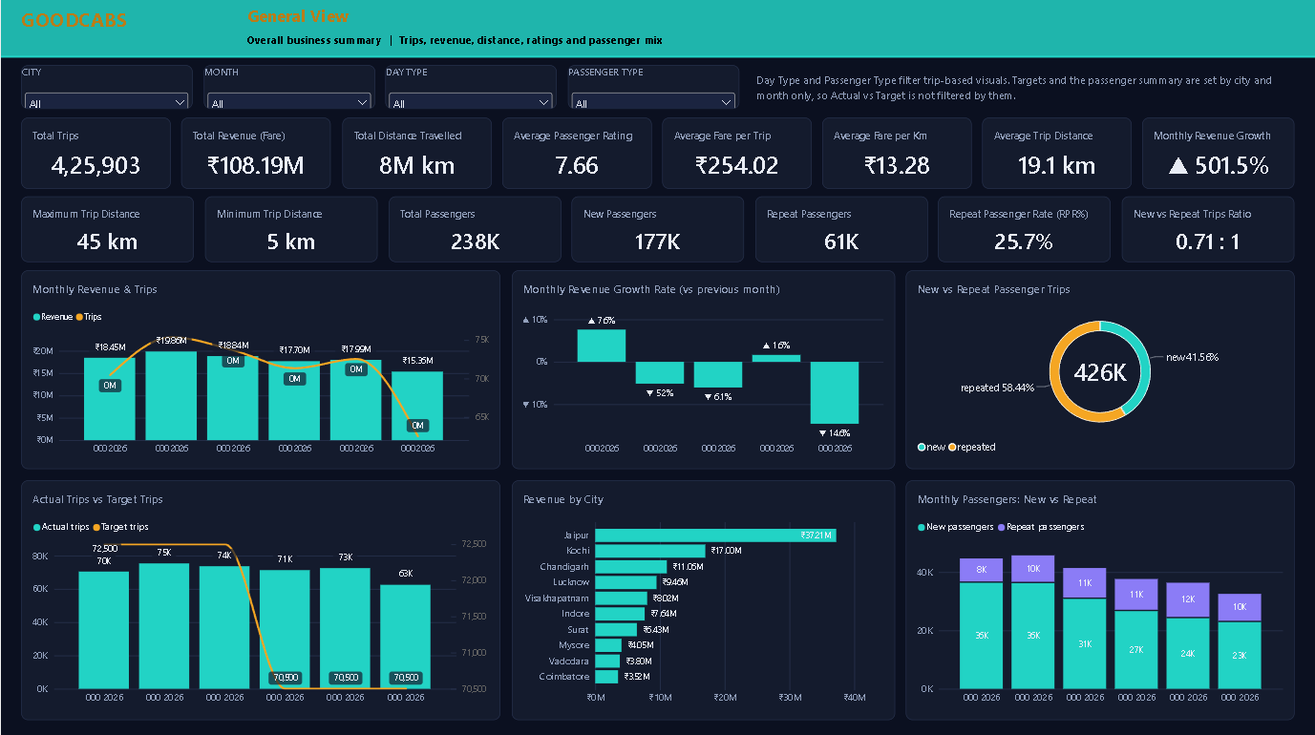
Demo 1: General View, the whole business on one page
GOODCABS | General View
Start with the KPI rows
Trips, revenue, distance, rating, fares, passenger counts and RPR%
Then the trends
Monthly revenue & trips
Revenue growth
New vs repeat trips
Monthly revenue and trips, growth rate and actual vs target trips
Finish with the mix
Actual vs target trips
Revenue by city
New vs repeat passengers
New vs repeat trips and revenue by city
Try a filter
Pick Day Type to see weekday vs weekend; note targets stay unfiltered
Notes:
[10:30 - 11:30] Page one is General View. Top two rows are the KPIs: trips, revenue, distance, rating, average fares, passenger counts, repeat passenger rate and monthly revenue growth. Below that, monthly revenue and trips, the growth rate, the new versus repeat trips donut, actual versus target trips, revenue by city, and monthly new versus repeat passengers. Demo: pick a city, then a month, and watch everything update.

Slide 13
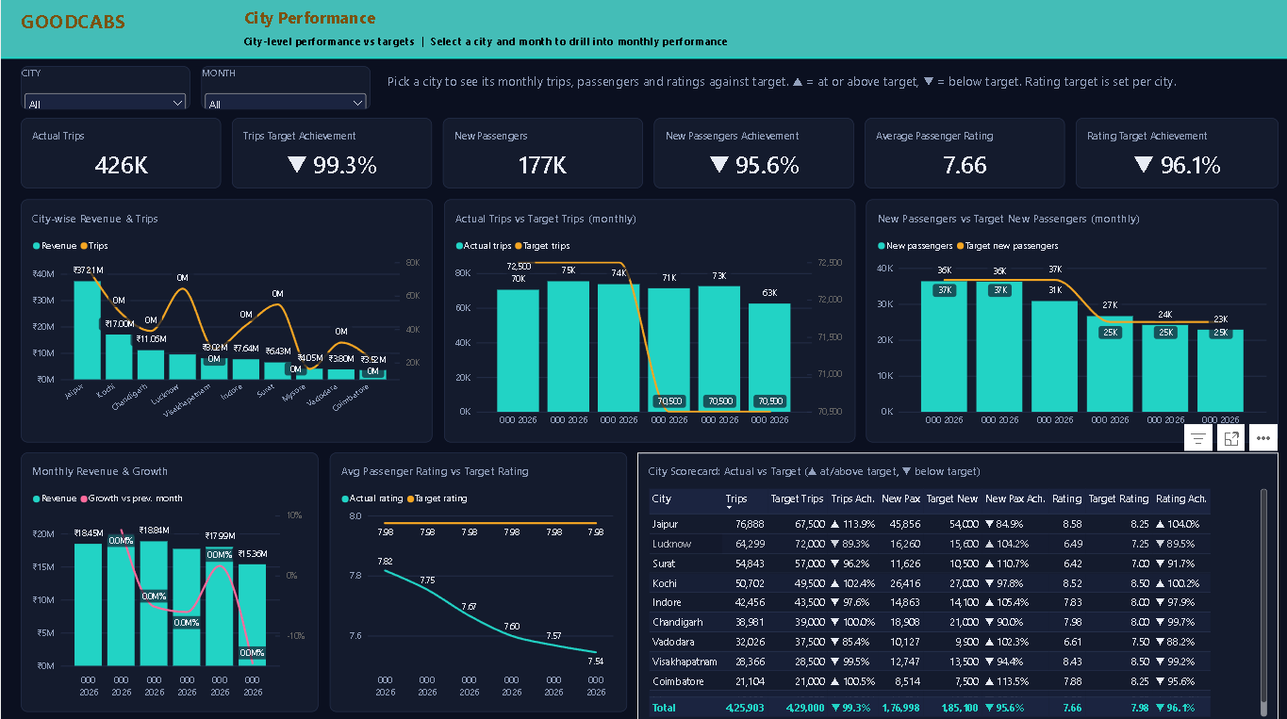
Demo 2: City Performance, pick a city and see the months
GOODCABS | City Performance
Pick one city
The city slicer drives every monthly chart on the page
Revenue & trips by city
Actual vs target trips
New pax vs target
Read the targets
Trips, new passengers and rating against target, each with an achievement rate
Use the scorecard
Monthly revenue & growth
Rating vs target
City scorecard: ▲ at or above target, ▼ below
Ten cities side by side with ▲ and ▼ against target
Compare months
Month slicer isolates a single month for any city
Notes:
[11:30 - 12:30] Page two is City Performance. Choose a city and the monthly charts show its actual trips against target, new passengers against target, and rating against target. The three KPI cards show achievement with an up or down triangle. The scorecard at the bottom right lines up all ten cities, so you can see in seconds who is above or below target. Demo: select a city that missed its new passenger target.

Slide 14
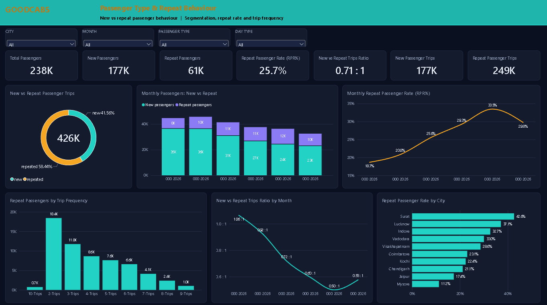
Demo 3: Passenger & Repeat Behaviour, who comes back
GOODCABS | Passenger Type & Repeat Behaviour
Segment the riders
New vs repeat passengers, trips and the trip ratio
New vs repeat trips
New vs repeat passengers
Monthly RPR%
Watch the rate
Monthly repeat passenger rate and RPR% by city
See the frequency
Repeat passengers by trip frequency
New : repeat trip ratio
RPR% by city
How many repeat riders took 2, 3 and up to 10 trips
Mind the scope
Passenger Type and Day Type filter trip visuals only; the page says so
Notes:
[12:30 - 13:30] Page three is Passenger Type and Repeat Behaviour. Left to right: new versus repeat trips, monthly passenger mix, and the monthly repeat passenger rate. Bottom row: how many repeat passengers took two, three and up to ten trips, the new to repeat trips ratio by month, and the repeat rate by city. A note on the page explains that Passenger Type and Day Type filter trip-based visuals only, because the passenger summary is monthly.

Slide 15
Four moves for the next quarter
Rebuild new-passenger acquisition
Turn first rides into second rides
Start with cities below their new-passenger target on the City Performance page.
Offer a follow-up incentive after a rider's first trip to lift the repeat rate above 25.7%.
Track: new passengers vs target
Track: RPR% and trip ratio
Protect Jaipur, grow the middle
Investigate the June dip
Keep service quality high in Jaipur and Kochi while testing growth plays in mid-revenue cities.
Break June revenue down by city and day type before deciding it is a trend.
Track: revenue share by city
Track: monthly revenue growth
Notes:
[13:30 - 14:30] Four recommendations. One, rebuild new-passenger acquisition, starting with cities below target. Two, turn first rides into second rides, for example with a follow-up offer, because repeat riders carry most trips. Three, protect Jaipur and Kochi while growing the middle cities. Four, look at June by city and day type before calling it a trend. Each has a metric on the dashboard that tells us whether it is working.

Slide 16
Thank you
SQL analysis
Six business requests answered
Happy to take questions and walk through any city in more detail.
Power BI dashboard
Three pages, four synced filters
Insights and actions
Four findings, four recommendations
Abhishek | Goodcabs final project
Notes:
[14:30 - 15:00] To close: you now have SQL analysis, a three-page Power BI dashboard, and four findings with four recommendations. Thank you for your time, Bruce. I'm happy to take questions.

