Slide 1


WAVECON
5G Launch Business Impact
Revenue • Customer KPIs • Plan Portfolio • Actions
PRE VS POST 5G | JAN–APR VS JUN–SEP 2022
STRATEGY: MONETIZE + RETAIN
Executive takeaway: 5G improved value per user.

Slide 2
The 5G story is a monetisation win — with a retention leak
₹15.9bn
₹211.3
Total Revenue
ARPU
↓ 0.50% vs pre-5G
↑ 11.05% — premium signal
77.4M
6.96M
Active Users
Unsubscribed
↓ 8.28% — core risk
↑ 23.5% — critical
What changed
Management Priority
1
Revenue held up
Protect premiumisation while rebuilding the active-user base.
Only a ₹80M decline despite a major technology transition.
MONETIZE
RETAIN
2
Mix shifted premium
Higher ARPU signals customers who stayed are spending more.
3
Scale weakened
Fewer active users and more unsubscribes are the core risk.
WAVECON • 5G BUSINESS IMPACT
2

Slide 3
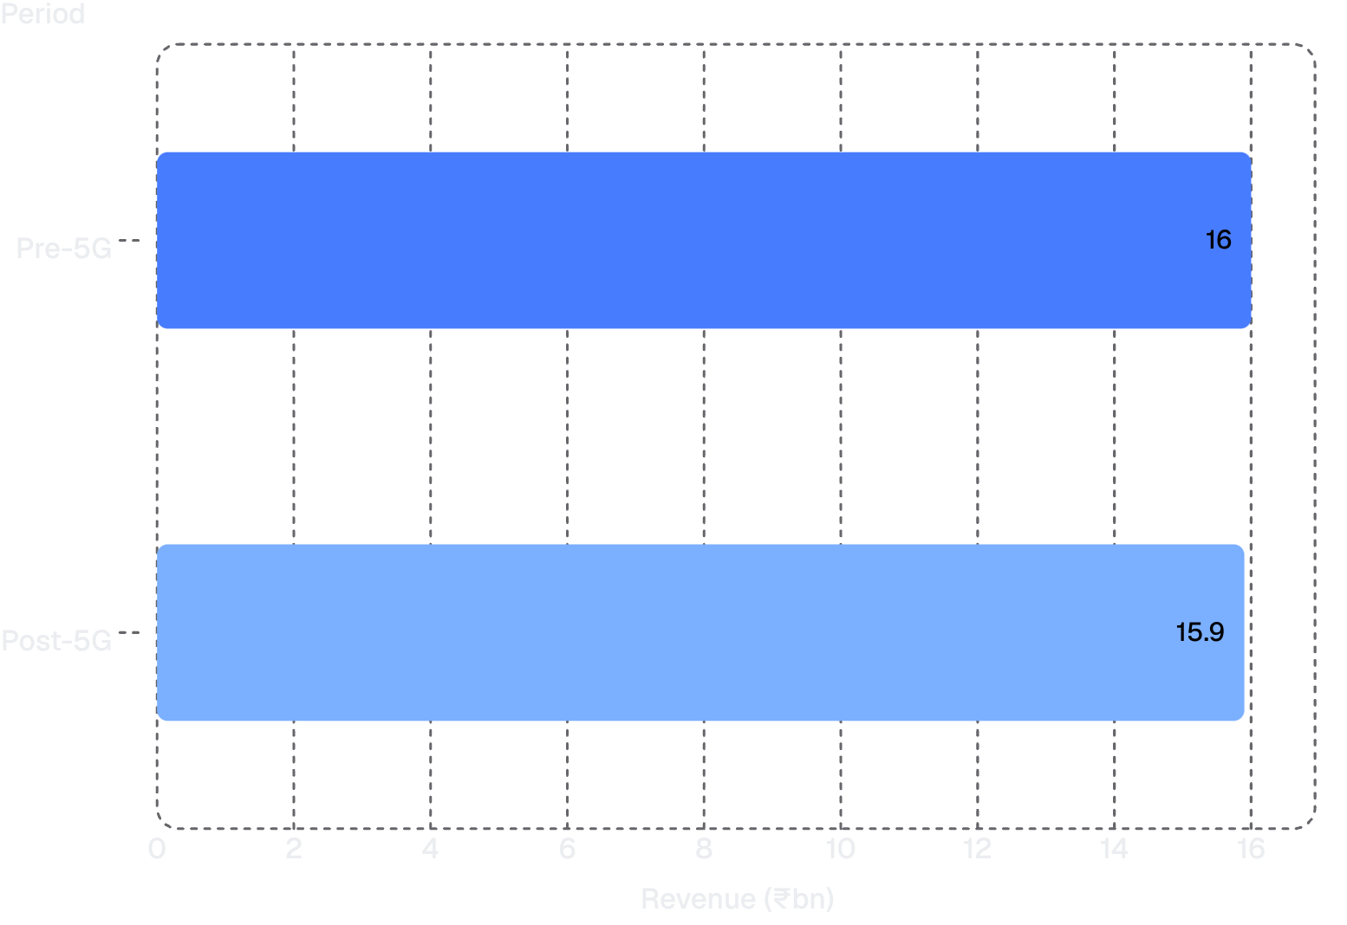
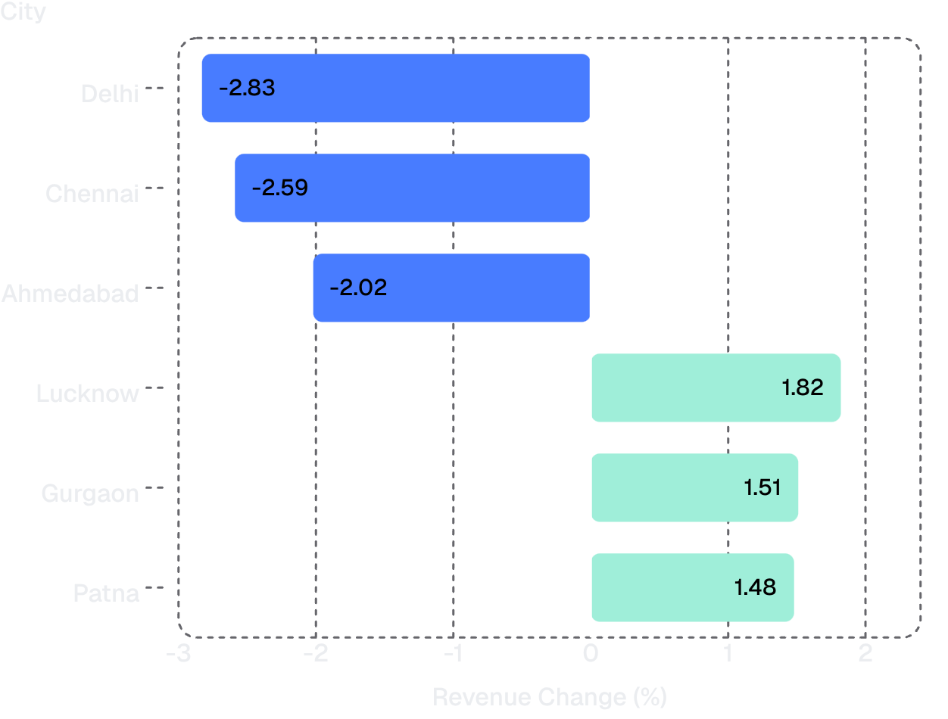
5G did not lift total revenue immediately
National Revenue
City Performance
Metro softness is masking growth in selected Tier-2/3 markets.
Overall revenue change: -0.50% | Absolute decline: ≈ ₹80M
WAVECON • 5G BUSINESS IMPACT
3

Slide 4
Customer retention is the KPI problem — not monetisation
Metric
Pre-5G
Post-5G
Change
ARPU
₹190.2
₹211.3
+11.05% ✓ Healthy
Total Active Users (TAU)
84.4M
77.4M
-8.28% ⚠ Underperforming
Total Unsubscribed (TUSU)
5.63M
6.96M
+23.5% ✗ Critical
The Revenue Paradox
Higher spend per user + fewer active users = flat / lower revenue. 5G is attracting higher-value usage, but migration friction and/or pricing is pushing too many users out.
WAVECON • 5G BUSINESS IMPACT
4

Slide 5




Post-5G winners are data-heavy; legacy packs are losing relevance
WINNERS
LOSERS / REVIEW
P1 — Smart Recharge Pack
P5
P6
Strongest established plan post-5G; revenue accelerated.
Legacy / low-value mix
Low-data proposition
P11 — Ultra Fast Mega Pack
P7
P13
New 5G plan with strong traction and premium-data fit.
Severe structural decline
New plan, weaker traction
P12 — Ultra Duo Data Pack
Healthy post-launch contribution; aligned to higher data use.
Portfolio signal: Demand is shifting from talk-time and low-data packs toward high-data 5G bundles.
WAVECON • 5G BUSINESS IMPACT
5

Slide 6
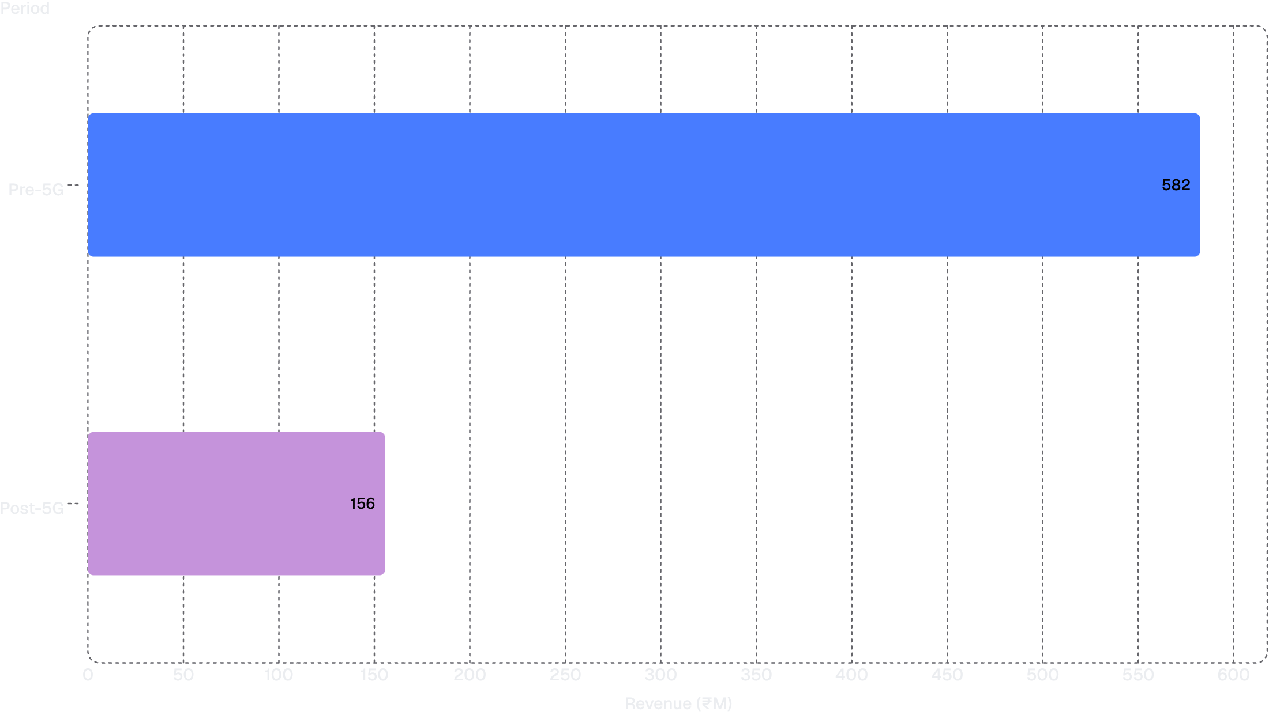
P7 is the clearest casualty of the 5G transition
P7 — 25GB Combo 3G/4G Data Pack
₹582M
₹156M
Pre-5G Revenue
Post-5G Revenue
-73.3%
Revenue lost: ₹426.8M
RECOMMENDATION: SUNSET P7
Obsolete 3G/4G positioning
Weak fit for 5G behaviour
Structural revenue collapse
MIGRATION: Move users to P1/P11 with a time-bound incentive.
WAVECON • 5G BUSINESS IMPACT
6

Slide 7
P8, P9 and P10 were discontinued after 5G
P8
P9
P10
Low data + 1-day validity
≈ 5% pre-launch revenue share
Minimal data / talk-time value
≈ 2.5% pre-launch revenue share
High data but only 3-day validity
≈ 1.5% pre-launch revenue share
Strategic Logic
Caution
Simplify the portfolio and move customers toward longer-validity, higher-data 5G offers.
Forced migration can raise churn. Replace abrupt removal with upgrade incentives and a 5G Lite bridge plan.
WAVECON • 5G BUSINESS IMPACT
7

Slide 8
Turn 5G premiumisation into sustainable growth
Retain
Scale
Migrate
Launch a 5G Lite/value tier for price-sensitive users.
Outcome: Reduce churn.
Put marketing weight behind P1, P11 and P12.
Outcome: Grow 5G mix.
Sunset P7 with targeted upgrade credits, not forced exits.
Outcome: Protect the base.
Localise
Measure
Fix conversion in Delhi, Chennai and Ahmedabad; replicate the Lucknow/Gurgaon playbook.
Outcome: Recover cities.
Track ARPU, TAU and churn together — not revenue alone.
Outcome: Avoid false wins.
North Star
Grow revenue without sacrificing the active-user base.
WAVECON • 5G BUSINESS IMPACT
8

Slide 9
Dashboard snapshot and source basis
Data Basis
Validated Insights
Dashboard: Wavecon 5G impact analysis supplied with the task
Power BI report pages: Main KPI, Market and Plan
Metric
Result
Revenue
-0.50%
ARPU
+11.05%
Decision Lens
Total Active Users (TAU)
-8.28%
Monetisation improved, but retention weakened. Portfolio and migration strategy should address both.
Unsubscribes
+23.5%
P7 Revenue
-73.3%
PREPARED FOR WAVECON MANAGEMENT REVIEW
P8–P10
Discontinued
WAVECON • 5G BUSINESS IMPACT
9

