Slide 1
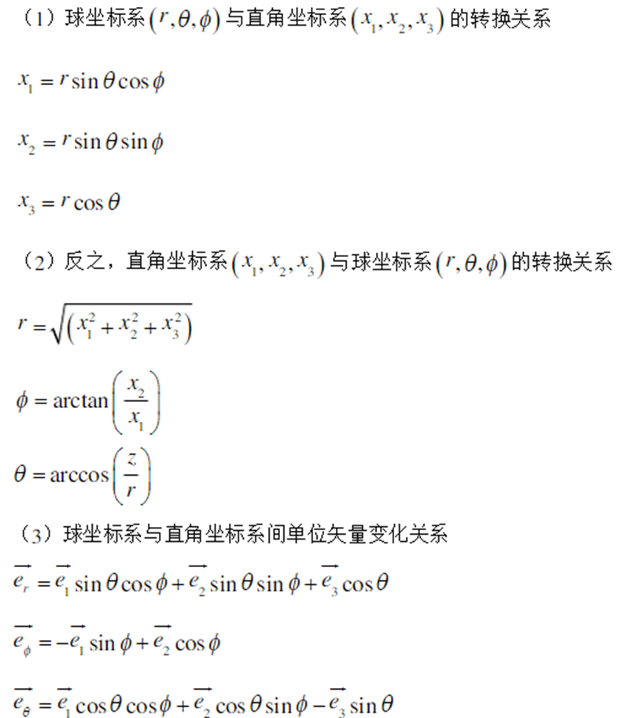
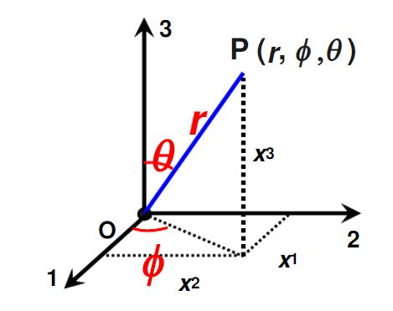

Slide 2
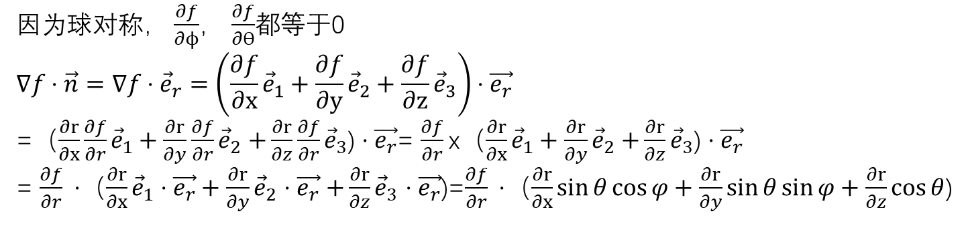
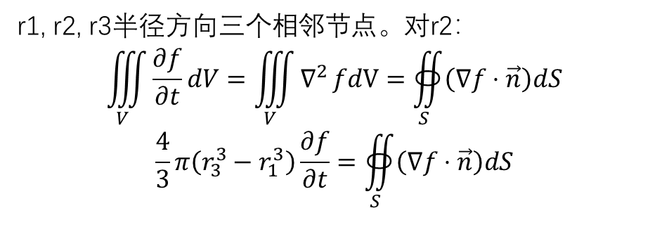
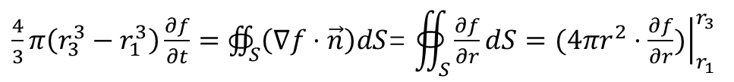
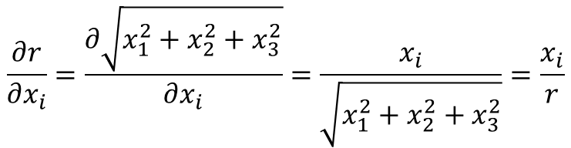
r1, r2, r3半径方向三个相邻节点。对r2：
$$\iiint_{V}{\frac{∂f}{∂t}dV}=\iiint_{V}{∇^{2}}fdV=∯_{S}{\left(∇f⋅\vec{n}\right)dS}$$
$$\frac{4}{3}π\left(r_{3}^{3}−r_{1}^{3}\right)\frac{∂f}{∂t}=∯_{S}{\left(∇f⋅\vec{n}\right)dS}$$
r1
r2
r3
因为球对称， $\frac{∂f}{∂ϕ}$， $\frac{∂f}{∂ϴ}$都等于0
$$∇f⋅\vec{n}=∇f⋅{\vec{e}}_{r}=\left(\frac{∂f}{∂x}{\vec{e}}_{1}+\frac{∂f}{∂y}{\vec{e}}_{2}+\frac{∂f}{∂z}{\vec{e}}_{3}\right)⋅\vec{e_{r}}$$
=（$\frac{∂r}{∂x}\frac{∂f}{∂r}{\vec{e}}_{1}+\frac{∂r}{∂y}\frac{∂f}{∂r}{\vec{e}}_{2}$ $+\frac{∂r}{∂z}\frac{∂f}{∂r}{\vec{e}}_{3}$) $⋅\vec{e_{r}}$= $\frac{∂f}{∂r}$x（$\frac{∂r}{∂x}{\vec{e}}_{1}+\frac{∂r}{∂y}{\vec{e}}_{2}$ $+\frac{∂r}{∂z}{\vec{e}}_{3}$) $⋅\vec{e_{r}}$
= $\frac{∂f}{∂r} ⋅$（$\frac{∂r}{∂x}{\vec{e}}_{1}⋅\vec{e_{r}}+\frac{∂r}{∂y}{\vec{e}}_{2}$ $⋅\vec{e_{r}}$ $+\frac{∂r}{∂z}{\vec{e}}_{3}$ $⋅\vec{e_{r}}$)=$\frac{∂f}{∂r} ⋅$（$\frac{∂r}{∂x}\sin{θ\cos{φ}}+\frac{∂r}{∂y}\sin{θ\sin{φ}}+\frac{∂r}{∂z}\cos{θ}$)
$$\frac{∂r}{∂x_{i}}=\frac{∂\sqrt{x_{1}^{2}+x_{2}^{2}+x_{3}^{2}}}{∂x_{i}}=\frac{x_{i}}{\sqrt{x_{1}^{2}+x_{2}^{2}+x_{3}^{2}}}=\frac{x_{i}}{r}$$
$∇f⋅\vec{n}=\frac{∂f}{∂r}⋅\left(\frac{x}{r}\sin{θ\cos{φ}}+\frac{y}{r}\sin{θ\sin{φ}}+\frac{z}{r}\cos{θ}\right)=\frac{∂f}{∂r}⋅\left(\sin^{2}{θ\cos^{2}{φ}}+\sin^{2}{θ\sin^{2}{φ}}+\cos^{2}{θ}\right)$ $=\frac{∂f}{∂r}$
$\frac{4}{3}π\left(r_{3}^{3}−r_{1}^{3}\right)\frac{∂f}{∂t}=∯_{S}{\left(∇f⋅\vec{n}\right)dS}$= $∯_{S}{\frac{∂f}{∂r}dS=(4πr^{2}⋅{\left.\frac{∂f}{∂r})\right|}_{r_{1}}^{r_{3}}}$

