Slide 1
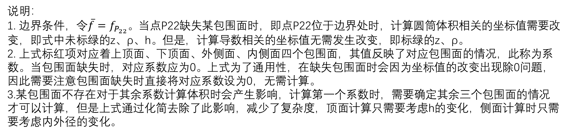
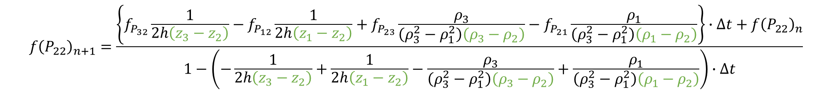
最终可得点P22在n+1时刻的值为：
$${f\left(P_{22}\right)}_{n+1}=\frac{\left\{f_{P_{32}}\frac{1}{2h\left(z_{3}−z_{2}\right)}−f_{P_{12}}\frac{1}{2h\left(z_{1}−z_{2}\right)}+f_{P_{23}}\frac{ρ_{3}}{\left(ρ_{3}^{2}−ρ_{1}^{2}\right)\left(ρ_{3}−ρ_{2}\right)}−f_{P_{21}}\frac{ρ_{1}}{\left(ρ_{3}^{2}−ρ_{1}^{2}\right)\left(ρ_{1}−ρ_{2}\right)}\right\}∙∆t+{f\left(P_{22}\right)}_{n}}{1−\left(−\frac{1}{2h\left(z_{3}−z_{2}\right)}+\frac{1}{2h\left(z_{1}−z_{2}\right)}−\frac{ρ_{3}}{\left(ρ_{3}^{2}−ρ_{1}^{2}\right)\left(ρ_{3}−ρ_{2}\right)}+\frac{ρ_{1}}{\left(ρ_{3}^{2}−ρ_{1}^{2}\right)\left(ρ_{1}−ρ_{2}\right)}\right)∙∆t}$$
更一般地，
$${f\left(P_{22}\right)}_{n+1}=\frac{D_{ca}\left\{f_{P_{32}}\frac{1}{2h\left(z_{3}−z_{2}\right)}−f_{P_{12}}\frac{1}{2h\left(z_{1}−z_{2}\right)}+f_{P_{23}}\frac{ρ_{3}}{\left(ρ_{3}^{2}−ρ_{1}^{2}\right)\left(ρ_{3}−ρ_{2}\right)}−f_{P_{21}}\frac{ρ_{1}}{\left(ρ_{3}^{2}−ρ_{1}^{2}\right)\left(ρ_{1}−ρ_{2}\right)}\right\}∙∆t+\left(J_{Gdye}+J_{Fdye}+J_{buffers}\right)∙∆t+\frac{K_{ryr}}{V}{\left[{Ca}^{2+}\right]}_{jSR}∙∆t+{f\left(P_{22}\right)}_{n}}{1−D_{ca}\left(−\frac{1}{2h\left(z_{3}−z_{2}\right)}+\frac{1}{2h\left(z_{1}−z_{2}\right)}−\frac{ρ_{3}}{\left(ρ_{3}^{2}−ρ_{1}^{2}\right)\left(ρ_{3}−ρ_{2}\right)}+\frac{ρ_{1}}{\left(ρ_{3}^{2}−ρ_{1}^{2}\right)\left(ρ_{1}−ρ_{2}\right)}\right)∙∆t+\frac{K_{ryr}}{V}∙∆t}$$
说明：
1. 边界条件，令$\overline{f}=f_{P_{22}}。$当点P22缺失某包围面时，即点P22位于边界处时，计算圆筒体积相关的坐标值需要改变，即式中未标绿的z、ρ、h。但是，计算导数相关的坐标值无需发生改变，即标绿的z、ρ。
2. 上式标红项对应着上顶面、下顶面、外侧面、内侧面四个包围面，其值反映了对应包围面的情况，此称为系数。当包围面缺失时，对应系数应为0。上式为了通用性，在缺失包围面时会因为坐标值的改变出现除0问题，因此需要注意包围面缺失时直接将对应系数设为0，无需计算。
3.某包围面不存在对于其余系数计算体积时会产生影响，计算第一个系数时，需要确定其余三个包围面的情况才可以计算，但是上式通过化简去除了此影响，减少了复杂度，顶面计算只需要考虑h的变化，侧面计算时只需要考虑内外径的变化。

Slide 2
$${g2\left(P_{22}\right)}_{n+1}=\frac{D_{F}\left\{{g2}_{P_{32}}\frac{1}{2h\left(z_{3}−z_{2}\right)}−{g2}_{P_{12}}\frac{1}{2h\left(z_{1}−z_{2}\right)}+{g2}_{P_{23}}\frac{ρ_{3}}{\left(ρ_{3}^{2}−ρ_{1}^{2}\right)\left(ρ_{3}−ρ_{2}\right)}−{g2}_{P_{21}}\frac{ρ_{1}}{\left(ρ_{3}^{2}−ρ_{1}^{2}\right)\left(ρ_{1}−ρ_{2}\right)}\right\}∙∆t−J_{Fdye}∙∆t+{g2\left(P_{22}\right)}_{n}}{1−D_{F}\left(−\frac{1}{2h\left(z_{3}−z_{2}\right)}+\frac{1}{2h\left(z_{1}−z_{2}\right)}−\frac{ρ_{3}}{\left(ρ_{3}^{2}−ρ_{1}^{2}\right)\left(ρ_{3}−ρ_{2}\right)}+\frac{ρ_{1}}{\left(ρ_{3}^{2}−ρ_{1}^{2}\right)\left(ρ_{1}−ρ_{2}\right)}\right)∙∆t}$$

Slide 3
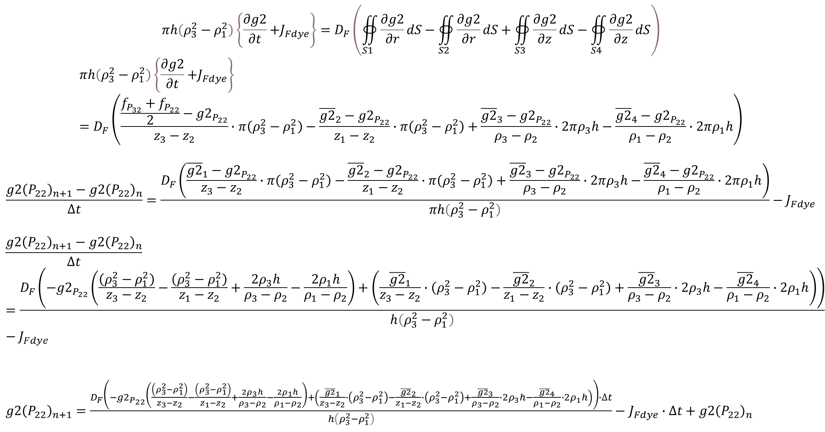
$$πh\left(ρ_{3}^{2}−ρ_{1}^{2}\right)\left\{\frac{∂g2}{∂t}{+J}_{Fdye}\right\}=D_{F}\left(∯_{S1}{\frac{∂g2}{∂r}dS}−∯_{S2}{\frac{∂g2}{∂r}dS}+∯_{S3}{\frac{∂g2}{∂z}dS}−∯_{S4}{\frac{∂g2}{∂z}dS}\right)$$
$$πh\left(ρ_{3}^{2}−ρ_{1}^{2}\right)\left\{\frac{∂g2}{∂t}{+J}_{Fdye}\right\}=D_{F}\left(\frac{\frac{f_{P_{32}}+f_{P_{22}}}{2}−{g2}_{P_{22}}}{z_{3}−z_{2}}∙π\left(ρ_{3}^{2}−ρ_{1}^{2}\right)−\frac{{\overline{g2}}_{2}−{g2}_{P_{22}}}{z_{1}−z_{2}}∙π\left(ρ_{3}^{2}−ρ_{1}^{2}\right)+\frac{{\overline{g2}}_{3}−{g2}_{P_{22}}}{ρ_{3}−ρ_{2}}∙2πρ_{3}h−\frac{{\overline{g2}}_{4}−{g2}_{P_{22}}}{ρ_{1}−ρ_{2}}∙2πρ_{1}h\right)$$
$$\frac{{g2\left(P_{22}\right)}_{n+1}−{g2\left(P_{22}\right)}_{n}}{∆t}=\frac{D_{F}\left(\frac{{\overline{g2}}_{1}−{g2}_{P_{22}}}{z_{3}−z_{2}}∙π\left(ρ_{3}^{2}−ρ_{1}^{2}\right)−\frac{{\overline{g2}}_{2}−{g2}_{P_{22}}}{z_{1}−z_{2}}∙π\left(ρ_{3}^{2}−ρ_{1}^{2}\right)+\frac{{\overline{g2}}_{3}−{g2}_{P_{22}}}{ρ_{3}−ρ_{2}}∙2πρ_{3}h−\frac{{\overline{g2}}_{4}−{g2}_{P_{22}}}{ρ_{1}−ρ_{2}}∙2πρ_{1}h\right)}{πh\left(ρ_{3}^{2}−ρ_{1}^{2}\right)}−J_{Fdye}$$
$$\frac{{g2\left(P_{22}\right)}_{n+1}−{g2\left(P_{22}\right)}_{n}}{∆t}=\frac{D_{F}\left({−g2}_{P_{22}}\left(\frac{\left(ρ_{3}^{2}−ρ_{1}^{2}\right)}{z_{3}−z_{2}}−\frac{\left(ρ_{3}^{2}−ρ_{1}^{2}\right)}{z_{1}−z_{2}}+\frac{2ρ_{3}h}{ρ_{3}−ρ_{2}}−\frac{2ρ_{1}h}{ρ_{1}−ρ_{2}}\right)+\left(\frac{{\overline{g2}}_{1}}{z_{3}−z_{2}}∙\left(ρ_{3}^{2}−ρ_{1}^{2}\right)−\frac{{\overline{g2}}_{2}}{z_{1}−z_{2}}∙\left(ρ_{3}^{2}−ρ_{1}^{2}\right)+\frac{{\overline{g2}}_{3}}{ρ_{3}−ρ_{2}}∙2ρ_{3}h−\frac{{\overline{g2}}_{4}}{ρ_{1}−ρ_{2}}∙2ρ_{1}h\right)\right)}{h\left(ρ_{3}^{2}−ρ_{1}^{2}\right)}−J_{Fdye}$$
${g2\left(P_{22}\right)}_{n+1}=\frac{D_{F}\left({−g2}_{P_{22}}\left(\frac{\left(ρ_{3}^{2}−ρ_{1}^{2}\right)}{z_{3}−z_{2}}−\frac{\left(ρ_{3}^{2}−ρ_{1}^{2}\right)}{z_{1}−z_{2}}+\frac{2ρ_{3}h}{ρ_{3}−ρ_{2}}−\frac{2ρ_{1}h}{ρ_{1}−ρ_{2}}\right)+\left(\frac{{\overline{g2}}_{1}}{z_{3}−z_{2}}∙\left(ρ_{3}^{2}−ρ_{1}^{2}\right)−\frac{{\overline{g2}}_{2}}{z_{1}−z_{2}}∙\left(ρ_{3}^{2}−ρ_{1}^{2}\right)+\frac{{\overline{g2}}_{3}}{ρ_{3}−ρ_{2}}∙2ρ_{3}h−\frac{{\overline{g2}}_{4}}{ρ_{1}−ρ_{2}}∙2ρ_{1}h\right)\right)∙∆t}{h\left(ρ_{3}^{2}−ρ_{1}^{2}\right)}−$ $J_{Fdye}∙∆t+{g2\left(P_{22}\right)}_{n}$

Slide 4
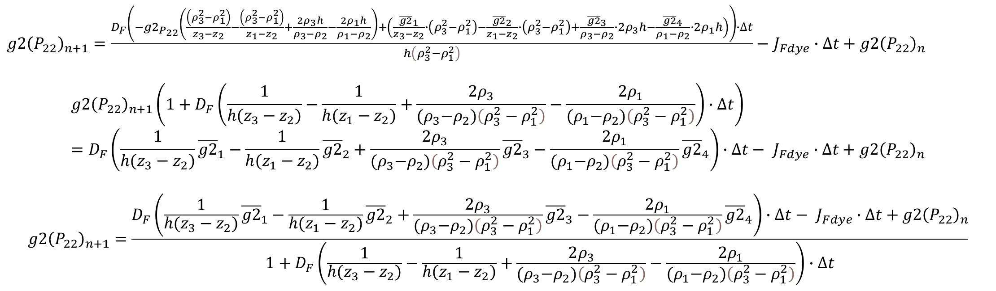
${g2\left(P_{22}\right)}_{n+1}=\frac{D_{F}\left({−g2}_{P_{22}}\left(\frac{\left(ρ_{3}^{2}−ρ_{1}^{2}\right)}{z_{3}−z_{2}}−\frac{\left(ρ_{3}^{2}−ρ_{1}^{2}\right)}{z_{1}−z_{2}}+\frac{2ρ_{3}h}{ρ_{3}−ρ_{2}}−\frac{2ρ_{1}h}{ρ_{1}−ρ_{2}}\right)+\left(\frac{{\overline{g2}}_{1}}{z_{3}−z_{2}}∙\left(ρ_{3}^{2}−ρ_{1}^{2}\right)−\frac{{\overline{g2}}_{2}}{z_{1}−z_{2}}∙\left(ρ_{3}^{2}−ρ_{1}^{2}\right)+\frac{{\overline{g2}}_{3}}{ρ_{3}−ρ_{2}}∙2ρ_{3}h−\frac{{\overline{g2}}_{4}}{ρ_{1}−ρ_{2}}∙2ρ_{1}h\right)\right)∙∆t}{h\left(ρ_{3}^{2}−ρ_{1}^{2}\right)}−$ $J_{Fdye}∙∆t+{g2\left(P_{22}\right)}_{n}$
$${g2\left(P_{22}\right)}_{n+1}\left(1+D_{F}\left(\frac{1}{{h(z}_{3}−z_{2})}−\frac{1}{{h(z}_{1}−z_{2})}+\frac{2ρ_{3}}{{(ρ}_{3}−ρ_{2})\left(ρ_{3}^{2}−ρ_{1}^{2}\right)}−\frac{2ρ_{1}}{{(ρ}_{1}−ρ_{2})\left(ρ_{3}^{2}−ρ_{1}^{2}\right)}\right)∙∆t\right)=D_{F}\left(\frac{1}{{h(z}_{3}−z_{2})}{\overline{g2}}_{1}−\frac{1}{{h(z}_{1}−z_{2})}{\overline{g2}}_{2}+\frac{2ρ_{3}}{{(ρ}_{3}−ρ_{2})\left(ρ_{3}^{2}−ρ_{1}^{2}\right)}{\overline{g2}}_{3}−\frac{2ρ_{1}}{{(ρ}_{1}−ρ_{2})\left(ρ_{3}^{2}−ρ_{1}^{2}\right)}{\overline{g2}}_{4}\right)∙∆t− J_{Fdye}∙∆t+{g2\left(P_{22}\right)}_{n}$$
$${g2\left(P_{22}\right)}_{n+1}=\frac{D_{F}\left(\frac{1}{{h(z}_{3}−z_{2})}{\overline{g2}}_{1}−\frac{1}{{h(z}_{1}−z_{2})}{\overline{g2}}_{2}+\frac{2ρ_{3}}{{(ρ}_{3}−ρ_{2})\left(ρ_{3}^{2}−ρ_{1}^{2}\right)}{\overline{g2}}_{3}−\frac{2ρ_{1}}{{(ρ}_{1}−ρ_{2})\left(ρ_{3}^{2}−ρ_{1}^{2}\right)}{\overline{g2}}_{4}\right)∙∆t− J_{Fdye}∙∆t+{g2\left(P_{22}\right)}_{n}}{1+D_{F}\left(\frac{1}{{h(z}_{3}−z_{2})}−\frac{1}{{h(z}_{1}−z_{2})}+\frac{2ρ_{3}}{{(ρ}_{3}−ρ_{2})\left(ρ_{3}^{2}−ρ_{1}^{2}\right)}−\frac{2ρ_{1}}{{(ρ}_{1}−ρ_{2})\left(ρ_{3}^{2}−ρ_{1}^{2}\right)}\right)∙∆t}$$

