Slide 1
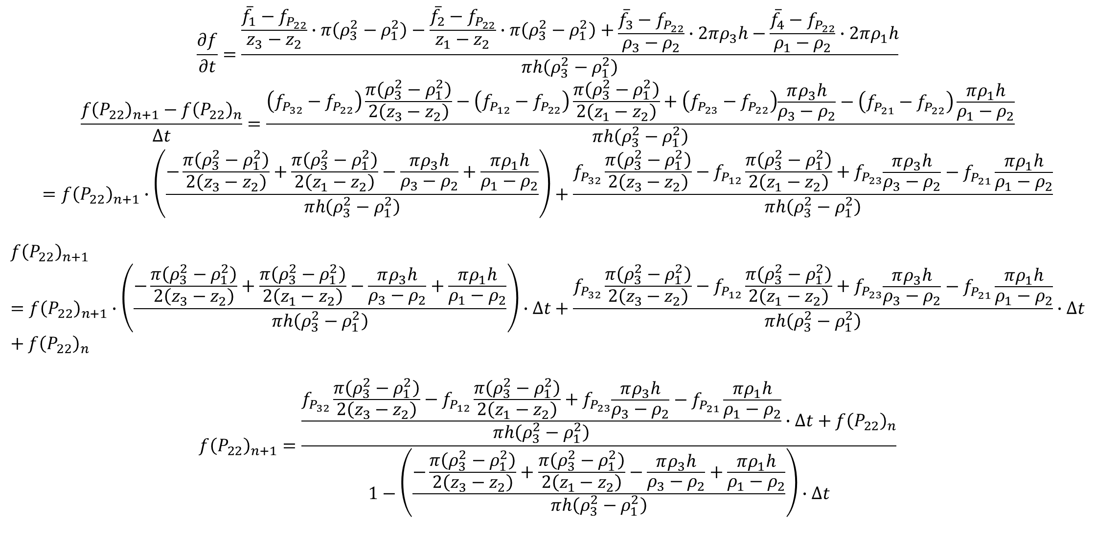
$$\frac{∂f}{∂t}=\frac{\frac{{\overline{f}}_{1}−f_{P_{22}}}{z_{3}−z_{2}}∙π\left(ρ_{3}^{2}−ρ_{1}^{2}\right)−\frac{{\overline{f}}_{2}−f_{P_{22}}}{z_{1}−z_{2}}∙π\left(ρ_{3}^{2}−ρ_{1}^{2}\right)+\begin{aligned}\begin{aligned}\frac{{\overline{f}}_{3}−f_{P_{22}}}{ρ_{3}−ρ_{2}}∙2πρ_{3}h−\frac{{\overline{f}}_{4}−f_{P_{22}}}{ρ_{1}−ρ_{2}}∙2πρ_{1}h\end{aligned}\#\end{aligned}}{πh\left(ρ_{3}^{2}−ρ_{1}^{2}\right)}$$
$$\frac{{f\left(P_{22}\right)}_{n+1}−{f\left(P_{22}\right)}_{n}}{∆t}=\frac{\left(f_{P_{32}}−f_{P_{22}}\right)\frac{π\left(ρ_{3}^{2}−ρ_{1}^{2}\right)}{2\left(z_{3}−z_{2}\right)}−\left(f_{P_{12}}−f_{P_{22}}\right)\frac{π\left(ρ_{3}^{2}−ρ_{1}^{2}\right)}{2\left(z_{1}−z_{2}\right)}+\left(f_{P_{23}}−f_{P_{22}}\right)\begin{aligned}\begin{aligned}\frac{πρ_{3}h}{ρ_{3}−ρ_{2}}−\left(f_{P_{21}}−f_{P_{22}}\right)\frac{πρ_{1}h}{ρ_{1}−ρ_{2}}\end{aligned}\#\end{aligned}}{πh\left(ρ_{3}^{2}−ρ_{1}^{2}\right)}$$
$$={f\left(P_{22}\right)}_{n+1}∙\left(\frac{−\frac{π\left(ρ_{3}^{2}−ρ_{1}^{2}\right)}{2\left(z_{3}−z_{2}\right)}+\frac{π\left(ρ_{3}^{2}−ρ_{1}^{2}\right)}{2\left(z_{1}−z_{2}\right)}−\frac{πρ_{3}h}{ρ_{3}−ρ_{2}}+\frac{πρ_{1}h}{ρ_{1}−ρ_{2}}}{πh\left(ρ_{3}^{2}−ρ_{1}^{2}\right)}\right)+\frac{f_{P_{32}}\frac{π\left(ρ_{3}^{2}−ρ_{1}^{2}\right)}{2\left(z_{3}−z_{2}\right)}−f_{P_{12}}\frac{π\left(ρ_{3}^{2}−ρ_{1}^{2}\right)}{2\left(z_{1}−z_{2}\right)}+f_{P_{23}}\begin{aligned}\begin{aligned}\frac{πρ_{3}h}{ρ_{3}−ρ_{2}}−f_{P_{21}}\frac{πρ_{1}h}{ρ_{1}−ρ_{2}}\end{aligned}\#\end{aligned}}{πh\left(ρ_{3}^{2}−ρ_{1}^{2}\right)}$$
$${f\left(P_{22}\right)}_{n+1}={f\left(P_{22}\right)}_{n+1}∙\left(\frac{−\frac{π\left(ρ_{3}^{2}−ρ_{1}^{2}\right)}{2\left(z_{3}−z_{2}\right)}+\frac{π\left(ρ_{3}^{2}−ρ_{1}^{2}\right)}{2\left(z_{1}−z_{2}\right)}−\frac{πρ_{3}h}{ρ_{3}−ρ_{2}}+\frac{πρ_{1}h}{ρ_{1}−ρ_{2}}}{πh\left(ρ_{3}^{2}−ρ_{1}^{2}\right)}\right)∙∆t+\frac{f_{P_{32}}\frac{π\left(ρ_{3}^{2}−ρ_{1}^{2}\right)}{2\left(z_{3}−z_{2}\right)}−f_{P_{12}}\frac{π\left(ρ_{3}^{2}−ρ_{1}^{2}\right)}{2\left(z_{1}−z_{2}\right)}+f_{P_{23}}\begin{aligned}\begin{aligned}\frac{πρ_{3}h}{ρ_{3}−ρ_{2}}−f_{P_{21}}\frac{πρ_{1}h}{ρ_{1}−ρ_{2}}\end{aligned}\#\end{aligned}}{πh\left(ρ_{3}^{2}−ρ_{1}^{2}\right)}∙∆t+{f\left(P_{22}\right)}_{n}$$
$${f\left(P_{22}\right)}_{n+1}=\frac{\frac{f_{P_{32}}\frac{π\left(ρ_{3}^{2}−ρ_{1}^{2}\right)}{2\left(z_{3}−z_{2}\right)}−f_{P_{12}}\frac{π\left(ρ_{3}^{2}−ρ_{1}^{2}\right)}{2\left(z_{1}−z_{2}\right)}+f_{P_{23}}\begin{aligned}\begin{aligned}\frac{πρ_{3}h}{ρ_{3}−ρ_{2}}−f_{P_{21}}\frac{πρ_{1}h}{ρ_{1}−ρ_{2}}\end{aligned}\#\end{aligned}}{πh\left(ρ_{3}^{2}−ρ_{1}^{2}\right)}∙∆t+{f\left(P_{22}\right)}_{n}}{1−\left(\frac{−\frac{π\left(ρ_{3}^{2}−ρ_{1}^{2}\right)}{2\left(z_{3}−z_{2}\right)}+\frac{π\left(ρ_{3}^{2}−ρ_{1}^{2}\right)}{2\left(z_{1}−z_{2}\right)}−\frac{πρ_{3}h}{ρ_{3}−ρ_{2}}+\frac{πρ_{1}h}{ρ_{1}−ρ_{2}}}{πh\left(ρ_{3}^{2}−ρ_{1}^{2}\right)}\right)∙∆t}$$

Slide 2
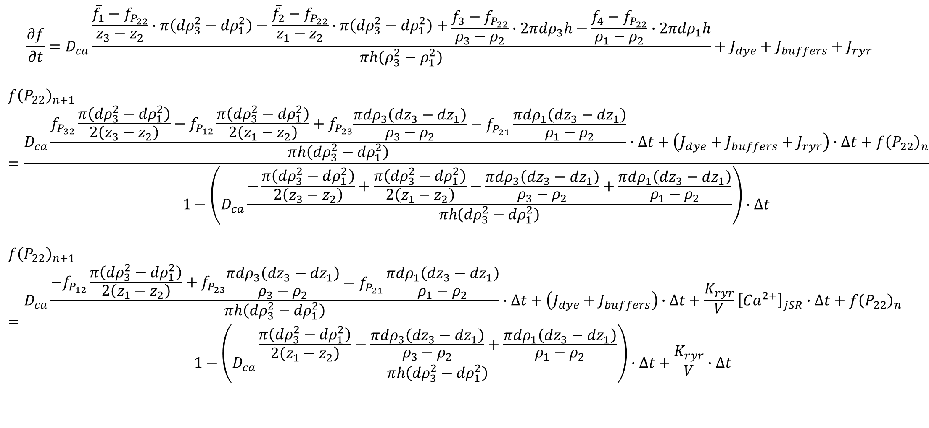
$$\frac{∂f}{∂t}=D_{ca}\frac{\frac{{\overline{f}}_{1}−f_{P_{22}}}{z_{3}−z_{2}}∙π\left({dρ}_{3}^{2}−{dρ}_{1}^{2}\right)−\frac{{\overline{f}}_{2}−f_{P_{22}}}{z_{1}−z_{2}}∙π\left({dρ}_{3}^{2}−{dρ}_{1}^{2}\right)+\begin{aligned}\begin{aligned}\frac{{\overline{f}}_{3}−f_{P_{22}}}{ρ_{3}−ρ_{2}}∙2π{dρ}_{3}h−\frac{{\overline{f}}_{4}−f_{P_{22}}}{ρ_{1}−ρ_{2}}∙2π{dρ}_{1}h\end{aligned}\#\end{aligned}}{πh\left(ρ_{3}^{2}−ρ_{1}^{2}\right)}+J_{dye}+J_{buffers}+J_{ryr}$$
$${f\left(P_{22}\right)}_{n+1}=\frac{D_{ca}\frac{f_{P_{32}}\frac{π\left({dρ}_{3}^{2}−{dρ}_{1}^{2}\right)}{2\left(z_{3}−z_{2}\right)}−f_{P_{12}}\frac{π\left({dρ}_{3}^{2}−{dρ}_{1}^{2}\right)}{2\left(z_{1}−z_{2}\right)}+f_{P_{23}}\begin{aligned}\begin{aligned}\frac{π{dρ}_{3}\left(dz_{3}−{dz}_{1}\right)}{ρ_{3}−ρ_{2}}−f_{P_{21}}\frac{π{dρ}_{1}\left(dz_{3}−{dz}_{1}\right)}{ρ_{1}−ρ_{2}}\end{aligned}\#\end{aligned}}{πh\left({dρ}_{3}^{2}−{dρ}_{1}^{2}\right)}∙∆t+\left(J_{dye}+J_{buffers}+J_{ryr}\right)∙∆t+{f\left(P_{22}\right)}_{n}}{1−\left(D_{ca}\frac{−\frac{π\left({dρ}_{3}^{2}−dρ_{1}^{2}\right)}{2\left(z_{3}−z_{2}\right)}+\frac{π\left({dρ}_{3}^{2}−{dρ}_{1}^{2}\right)}{2\left(z_{1}−z_{2}\right)}−\frac{πdρ_{3}\left(dz_{3}−{dz}_{1}\right)}{ρ_{3}−ρ_{2}}+\frac{π{dρ}_{1}\left(dz_{3}−{dz}_{1}\right)}{ρ_{1}−ρ_{2}}}{πh\left({dρ}_{3}^{2}−{dρ}_{1}^{2}\right)}\right)∙∆t}$$
$${f\left(P_{22}\right)}_{n+1}=\frac{D_{ca}\frac{−f_{P_{12}}\frac{π\left({dρ}_{3}^{2}−{dρ}_{1}^{2}\right)}{2\left(z_{1}−z_{2}\right)}+f_{P_{23}}\begin{aligned}\begin{aligned}\frac{π{dρ}_{3}\left(dz_{3}−{dz}_{1}\right)}{ρ_{3}−ρ_{2}}−f_{P_{21}}\frac{π{dρ}_{1}\left(dz_{3}−{dz}_{1}\right)}{ρ_{1}−ρ_{2}}\end{aligned}\#\end{aligned}}{πh\left({dρ}_{3}^{2}−{dρ}_{1}^{2}\right)}∙∆t+\left(J_{dye}+J_{buffers}\right)∙∆t+\frac{K_{ryr}}{V}{\left[{Ca}^{2+}\right]}_{jSR}∙∆t+{f\left(P_{22}\right)}_{n}}{1−\left(D_{ca}\frac{\frac{π\left({dρ}_{3}^{2}−{dρ}_{1}^{2}\right)}{2\left(z_{1}−z_{2}\right)}−\frac{πdρ_{3}\left(dz_{3}−{dz}_{1}\right)}{ρ_{3}−ρ_{2}}+\frac{π{dρ}_{1}\left(dz_{3}−{dz}_{1}\right)}{ρ_{1}−ρ_{2}}}{πh\left({dρ}_{3}^{2}−{dρ}_{1}^{2}\right)}\right)∙∆t+\frac{K_{ryr}}{V}∙∆t}$$

Slide 3
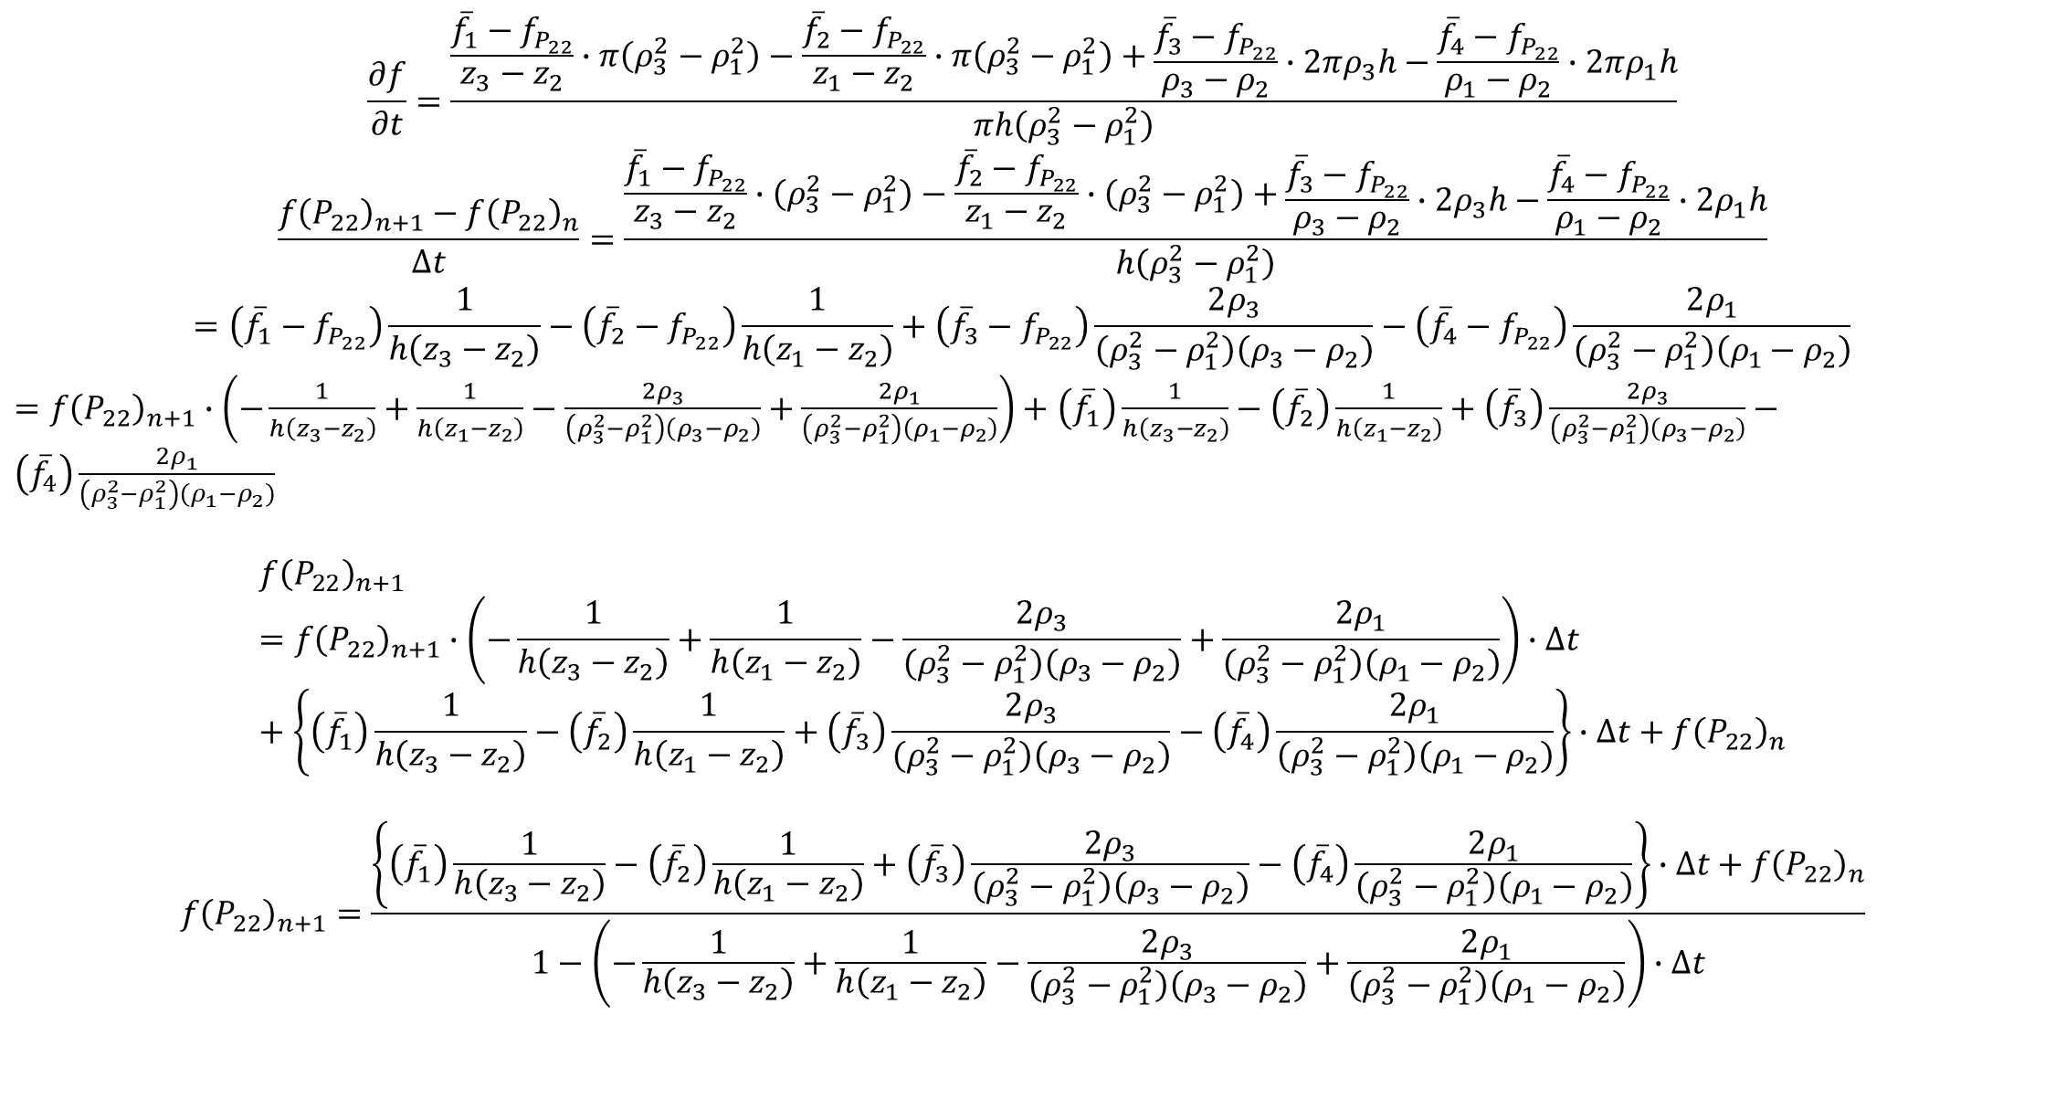
$$\frac{∂f}{∂t}=\frac{\frac{{\overline{f}}_{1}−f_{P_{22}}}{z_{3}−z_{2}}∙π\left(ρ_{3}^{2}−ρ_{1}^{2}\right)−\frac{{\overline{f}}_{2}−f_{P_{22}}}{z_{1}−z_{2}}∙π\left(ρ_{3}^{2}−ρ_{1}^{2}\right)+\begin{aligned}\begin{aligned}\frac{{\overline{f}}_{3}−f_{P_{22}}}{ρ_{3}−ρ_{2}}∙2πρ_{3}h−\frac{{\overline{f}}_{4}−f_{P_{22}}}{ρ_{1}−ρ_{2}}∙2πρ_{1}h\end{aligned}\#\end{aligned}}{πh\left(ρ_{3}^{2}−ρ_{1}^{2}\right)}$$
$$\frac{{f\left(P_{22}\right)}_{n+1}−{f\left(P_{22}\right)}_{n}}{∆t}=\frac{\frac{{\overline{f}}_{1}−f_{P_{22}}}{z_{3}−z_{2}}∙\left(ρ_{3}^{2}−ρ_{1}^{2}\right)−\frac{{\overline{f}}_{2}−f_{P_{22}}}{z_{1}−z_{2}}∙\left(ρ_{3}^{2}−ρ_{1}^{2}\right)+\begin{aligned}\begin{aligned}\frac{{\overline{f}}_{3}−f_{P_{22}}}{ρ_{3}−ρ_{2}}∙2ρ_{3}h−\frac{{\overline{f}}_{4}−f_{P_{22}}}{ρ_{1}−ρ_{2}}∙2ρ_{1}h\end{aligned}\#\end{aligned}}{h\left(ρ_{3}^{2}−ρ_{1}^{2}\right)}$$
$$=\left({\overline{f}}_{1}−f_{P_{22}}\right)\frac{1}{h\left(z_{3}−z_{2}\right)}−\left({\overline{f}}_{2}−f_{P_{22}}\right)\frac{1}{h\left(z_{1}−z_{2}\right)}+\left({\overline{f}}_{3}−f_{P_{22}}\right)\frac{2ρ_{3}}{\left(ρ_{3}^{2}−ρ_{1}^{2}\right)\left(ρ_{3}−ρ_{2}\right)}−\left({\overline{f}}_{4}−f_{P_{22}}\right)\frac{2ρ_{1}}{\left(ρ_{3}^{2}−ρ_{1}^{2}\right)\left(ρ_{1}−ρ_{2}\right)}$$
$={f\left(P_{22}\right)}_{n+1}∙\left(−\frac{1}{h\left(z_{3}−z_{2}\right)}+\frac{1}{h\left(z_{1}−z_{2}\right)}−\frac{2ρ_{3}}{\left(ρ_{3}^{2}−ρ_{1}^{2}\right)\left(ρ_{3}−ρ_{2}\right)}+\frac{2ρ_{1}}{\left(ρ_{3}^{2}−ρ_{1}^{2}\right)\left(ρ_{1}−ρ_{2}\right)}\right)+$ $\left({\overline{f}}_{1}\right)\frac{1}{h\left(z_{3}−z_{2}\right)}−\left({\overline{f}}_{2}\right)\frac{1}{h\left(z_{1}−z_{2}\right)}+\left({\overline{f}}_{3}\right)\frac{2ρ_{3}}{\left(ρ_{3}^{2}−ρ_{1}^{2}\right)\left(ρ_{3}−ρ_{2}\right)}−\left({\overline{f}}_{4}\right)\frac{2ρ_{1}}{\left(ρ_{3}^{2}−ρ_{1}^{2}\right)\left(ρ_{1}−ρ_{2}\right)}$
$${f\left(P_{22}\right)}_{n+1}={f\left(P_{22}\right)}_{n+1}∙\left(−\frac{1}{h\left(z_{3}−z_{2}\right)}+\frac{1}{h\left(z_{1}−z_{2}\right)}−\frac{2ρ_{3}}{\left(ρ_{3}^{2}−ρ_{1}^{2}\right)\left(ρ_{3}−ρ_{2}\right)}+\frac{2ρ_{1}}{\left(ρ_{3}^{2}−ρ_{1}^{2}\right)\left(ρ_{1}−ρ_{2}\right)}\right)∙∆t+\left\{\left({\overline{f}}_{1}\right)\frac{1}{h\left(z_{3}−z_{2}\right)}−\left({\overline{f}}_{2}\right)\frac{1}{h\left(z_{1}−z_{2}\right)}+\left({\overline{f}}_{3}\right)\frac{2ρ_{3}}{\left(ρ_{3}^{2}−ρ_{1}^{2}\right)\left(ρ_{3}−ρ_{2}\right)}−\left({\overline{f}}_{4}\right)\frac{2ρ_{1}}{\left(ρ_{3}^{2}−ρ_{1}^{2}\right)\left(ρ_{1}−ρ_{2}\right)}\right\}∙∆t+{f\left(P_{22}\right)}_{n}$$
$${f\left(P_{22}\right)}_{n+1}=\frac{\left\{\left({\overline{f}}_{1}\right)\frac{1}{h\left(z_{3}−z_{2}\right)}−\left({\overline{f}}_{2}\right)\frac{1}{h\left(z_{1}−z_{2}\right)}+\left({\overline{f}}_{3}\right)\frac{2ρ_{3}}{\left(ρ_{3}^{2}−ρ_{1}^{2}\right)\left(ρ_{3}−ρ_{2}\right)}−\left({\overline{f}}_{4}\right)\frac{2ρ_{1}}{\left(ρ_{3}^{2}−ρ_{1}^{2}\right)\left(ρ_{1}−ρ_{2}\right)}\right\}∙∆t+{f\left(P_{22}\right)}_{n}}{1−\left(−\frac{1}{h\left(z_{3}−z_{2}\right)}+\frac{1}{h\left(z_{1}−z_{2}\right)}−\frac{2ρ_{3}}{\left(ρ_{3}^{2}−ρ_{1}^{2}\right)\left(ρ_{3}−ρ_{2}\right)}+\frac{2ρ_{1}}{\left(ρ_{3}^{2}−ρ_{1}^{2}\right)\left(ρ_{1}−ρ_{2}\right)}\right)∙∆t}$$

Slide 4
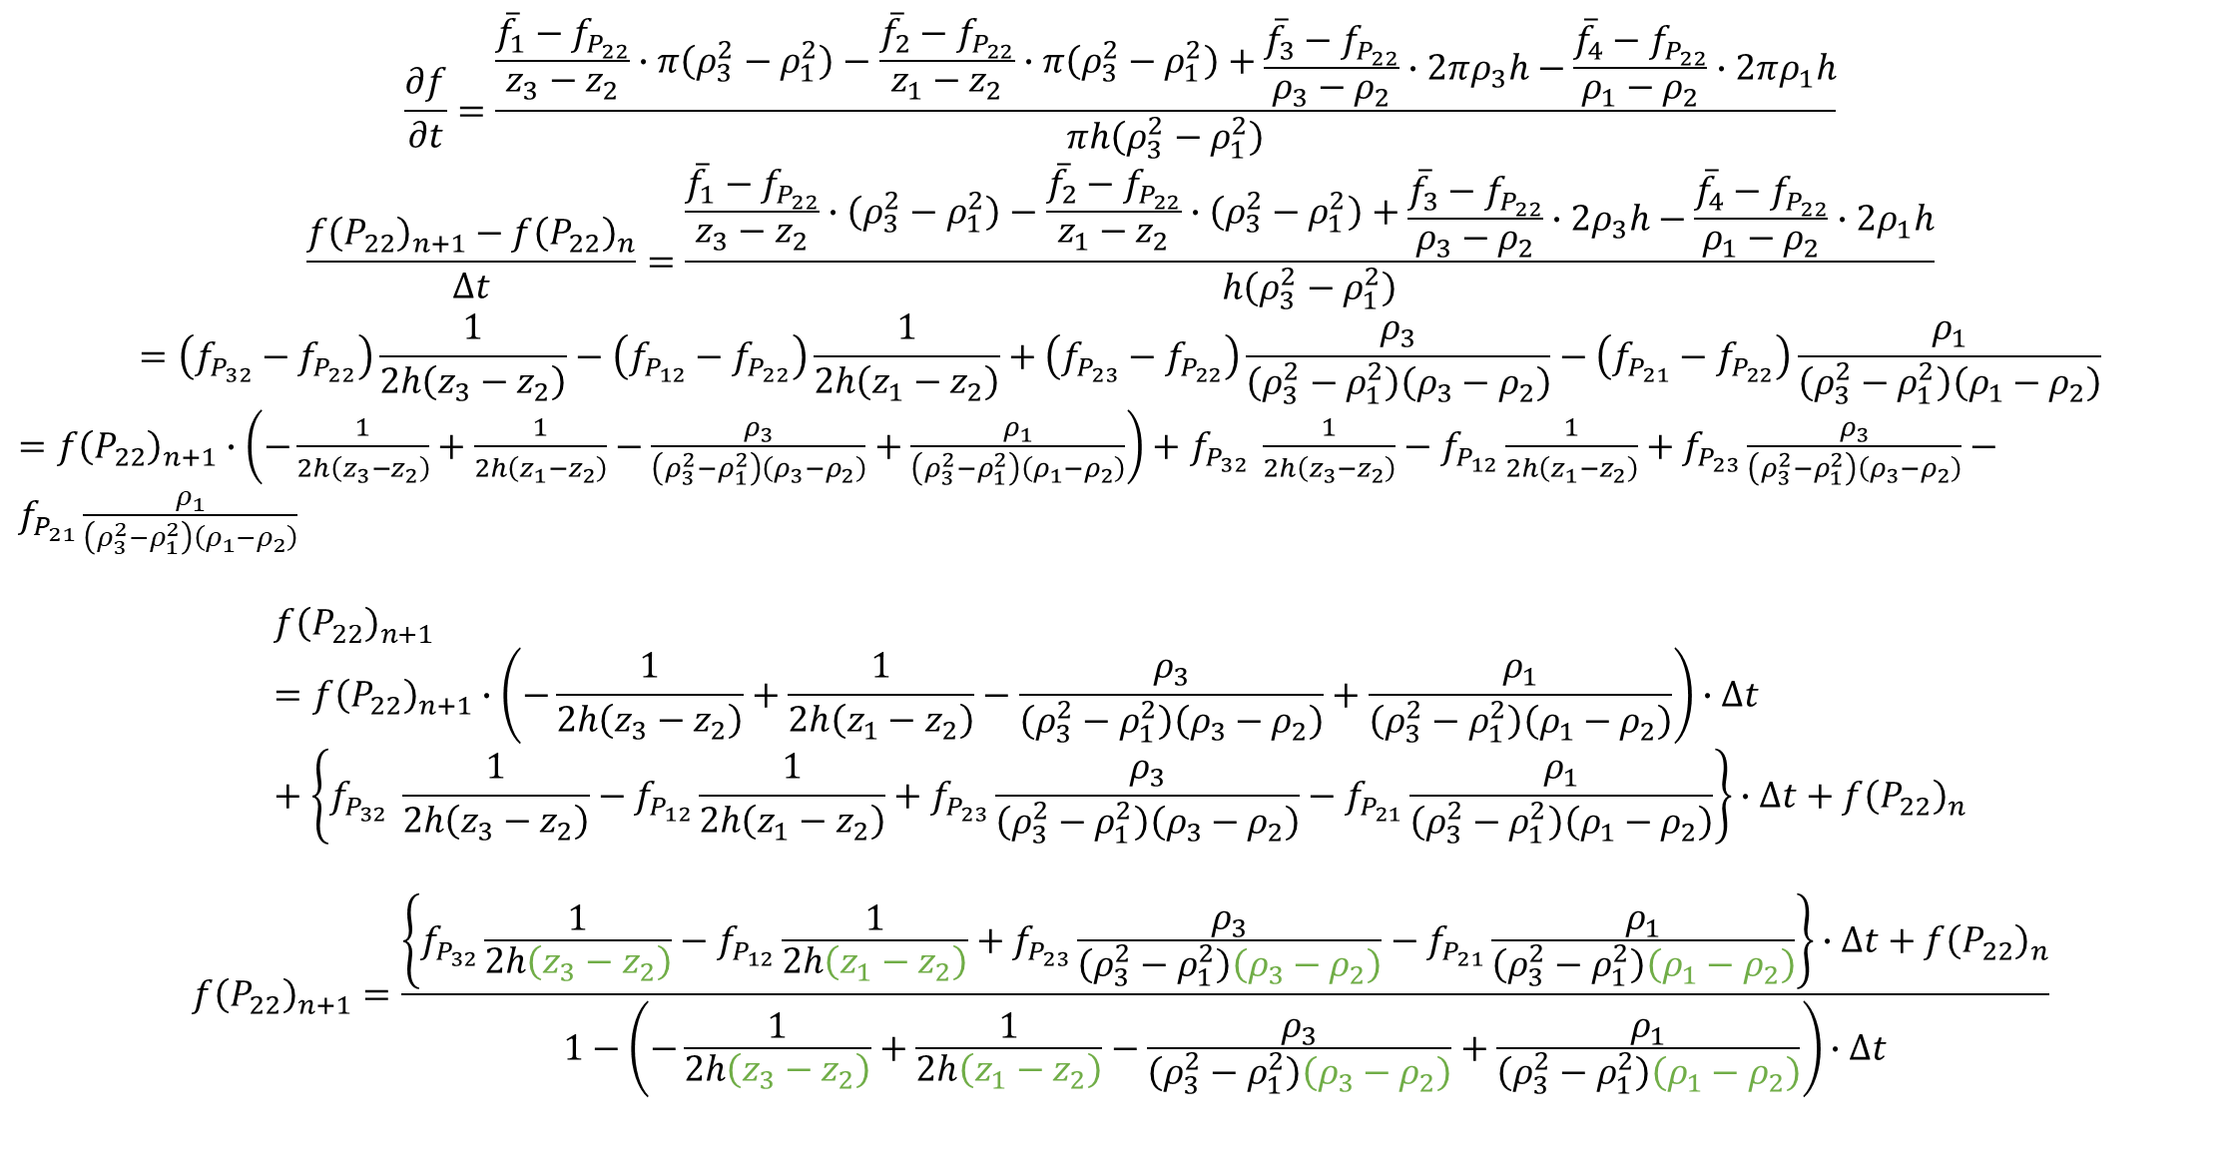
$$\frac{∂f}{∂t}=\frac{\frac{{\overline{f}}_{1}−f_{P_{22}}}{z_{3}−z_{2}}∙π\left(ρ_{3}^{2}−ρ_{1}^{2}\right)−\frac{{\overline{f}}_{2}−f_{P_{22}}}{z_{1}−z_{2}}∙π\left(ρ_{3}^{2}−ρ_{1}^{2}\right)+\begin{aligned}\begin{aligned}\frac{{\overline{f}}_{3}−f_{P_{22}}}{ρ_{3}−ρ_{2}}∙2πρ_{3}h−\frac{{\overline{f}}_{4}−f_{P_{22}}}{ρ_{1}−ρ_{2}}∙2πρ_{1}h\end{aligned}\#\end{aligned}}{πh\left(ρ_{3}^{2}−ρ_{1}^{2}\right)}$$
$$\frac{{f\left(P_{22}\right)}_{n+1}−{f\left(P_{22}\right)}_{n}}{∆t}=\frac{\frac{{\overline{f}}_{1}−f_{P_{22}}}{z_{3}−z_{2}}∙\left(ρ_{3}^{2}−ρ_{1}^{2}\right)−\frac{{\overline{f}}_{2}−f_{P_{22}}}{z_{1}−z_{2}}∙\left(ρ_{3}^{2}−ρ_{1}^{2}\right)+\begin{aligned}\begin{aligned}\frac{{\overline{f}}_{3}−f_{P_{22}}}{ρ_{3}−ρ_{2}}∙2ρ_{3}h−\frac{{\overline{f}}_{4}−f_{P_{22}}}{ρ_{1}−ρ_{2}}∙2ρ_{1}h\end{aligned}\#\end{aligned}}{h\left(ρ_{3}^{2}−ρ_{1}^{2}\right)}$$
$$=\left(f_{P_{32}}−f_{P_{22}}\right)\frac{1}{2h\left(z_{3}−z_{2}\right)}−\left(f_{P_{12}}−f_{P_{22}}\right)\frac{1}{2h\left(z_{1}−z_{2}\right)}+\left(f_{P_{23}}−f_{P_{22}}\right)\frac{ρ_{3}}{\left(ρ_{3}^{2}−ρ_{1}^{2}\right)\left(ρ_{3}−ρ_{2}\right)}−\left(f_{P_{21}}−f_{P_{22}}\right)\frac{ρ_{1}}{\left(ρ_{3}^{2}−ρ_{1}^{2}\right)\left(ρ_{1}−ρ_{2}\right)}$$
$={f\left(P_{22}\right)}_{n+1}∙\left(−\frac{1}{2h\left(z_{3}−z_{2}\right)}+\frac{1}{2h\left(z_{1}−z_{2}\right)}−\frac{ρ_{3}}{\left(ρ_{3}^{2}−ρ_{1}^{2}\right)\left(ρ_{3}−ρ_{2}\right)}+\frac{ρ_{1}}{\left(ρ_{3}^{2}−ρ_{1}^{2}\right)\left(ρ_{1}−ρ_{2}\right)}\right)+$ $f_{P_{32}} \frac{1}{2h\left(z_{3}−z_{2}\right)}−f_{P_{12}}\frac{1}{2h\left(z_{1}−z_{2}\right)}+f_{P_{23}}\frac{ρ_{3}}{\left(ρ_{3}^{2}−ρ_{1}^{2}\right)\left(ρ_{3}−ρ_{2}\right)}−f_{P_{21}}\frac{ρ_{1}}{\left(ρ_{3}^{2}−ρ_{1}^{2}\right)\left(ρ_{1}−ρ_{2}\right)}$
$${f\left(P_{22}\right)}_{n+1}={f\left(P_{22}\right)}_{n+1}∙\left(−\frac{1}{2h\left(z_{3}−z_{2}\right)}+\frac{1}{2h\left(z_{1}−z_{2}\right)}−\frac{ρ_{3}}{\left(ρ_{3}^{2}−ρ_{1}^{2}\right)\left(ρ_{3}−ρ_{2}\right)}+\frac{ρ_{1}}{\left(ρ_{3}^{2}−ρ_{1}^{2}\right)\left(ρ_{1}−ρ_{2}\right)}\right)∙∆t+\left\{f_{P_{32}} \frac{1}{2h\left(z_{3}−z_{2}\right)}−f_{P_{12}}\frac{1}{2h\left(z_{1}−z_{2}\right)}+f_{P_{23}}\frac{ρ_{3}}{\left(ρ_{3}^{2}−ρ_{1}^{2}\right)\left(ρ_{3}−ρ_{2}\right)}−f_{P_{21}}\frac{ρ_{1}}{\left(ρ_{3}^{2}−ρ_{1}^{2}\right)\left(ρ_{1}−ρ_{2}\right)}\right\}∙∆t+{f\left(P_{22}\right)}_{n}$$
$${f\left(P_{22}\right)}_{n+1}=\frac{\left\{f_{P_{32}}\frac{1}{2h\left(z_{3}−z_{2}\right)}−f_{P_{12}}\frac{1}{2h\left(z_{1}−z_{2}\right)}+f_{P_{23}}\frac{ρ_{3}}{\left(ρ_{3}^{2}−ρ_{1}^{2}\right)\left(ρ_{3}−ρ_{2}\right)}−f_{P_{21}}\frac{ρ_{1}}{\left(ρ_{3}^{2}−ρ_{1}^{2}\right)\left(ρ_{1}−ρ_{2}\right)}\right\}∙∆t+{f\left(P_{22}\right)}_{n}}{1−\left(−\frac{1}{2h\left(z_{3}−z_{2}\right)}+\frac{1}{2h\left(z_{1}−z_{2}\right)}−\frac{ρ_{3}}{\left(ρ_{3}^{2}−ρ_{1}^{2}\right)\left(ρ_{3}−ρ_{2}\right)}+\frac{ρ_{1}}{\left(ρ_{3}^{2}−ρ_{1}^{2}\right)\left(ρ_{1}−ρ_{2}\right)}\right)∙∆t}$$
Notes:
边界情况：令边界点浓度值=fP22，在求距离上相应坐标换成P22的坐标(不包括绿色)

