Slide 1
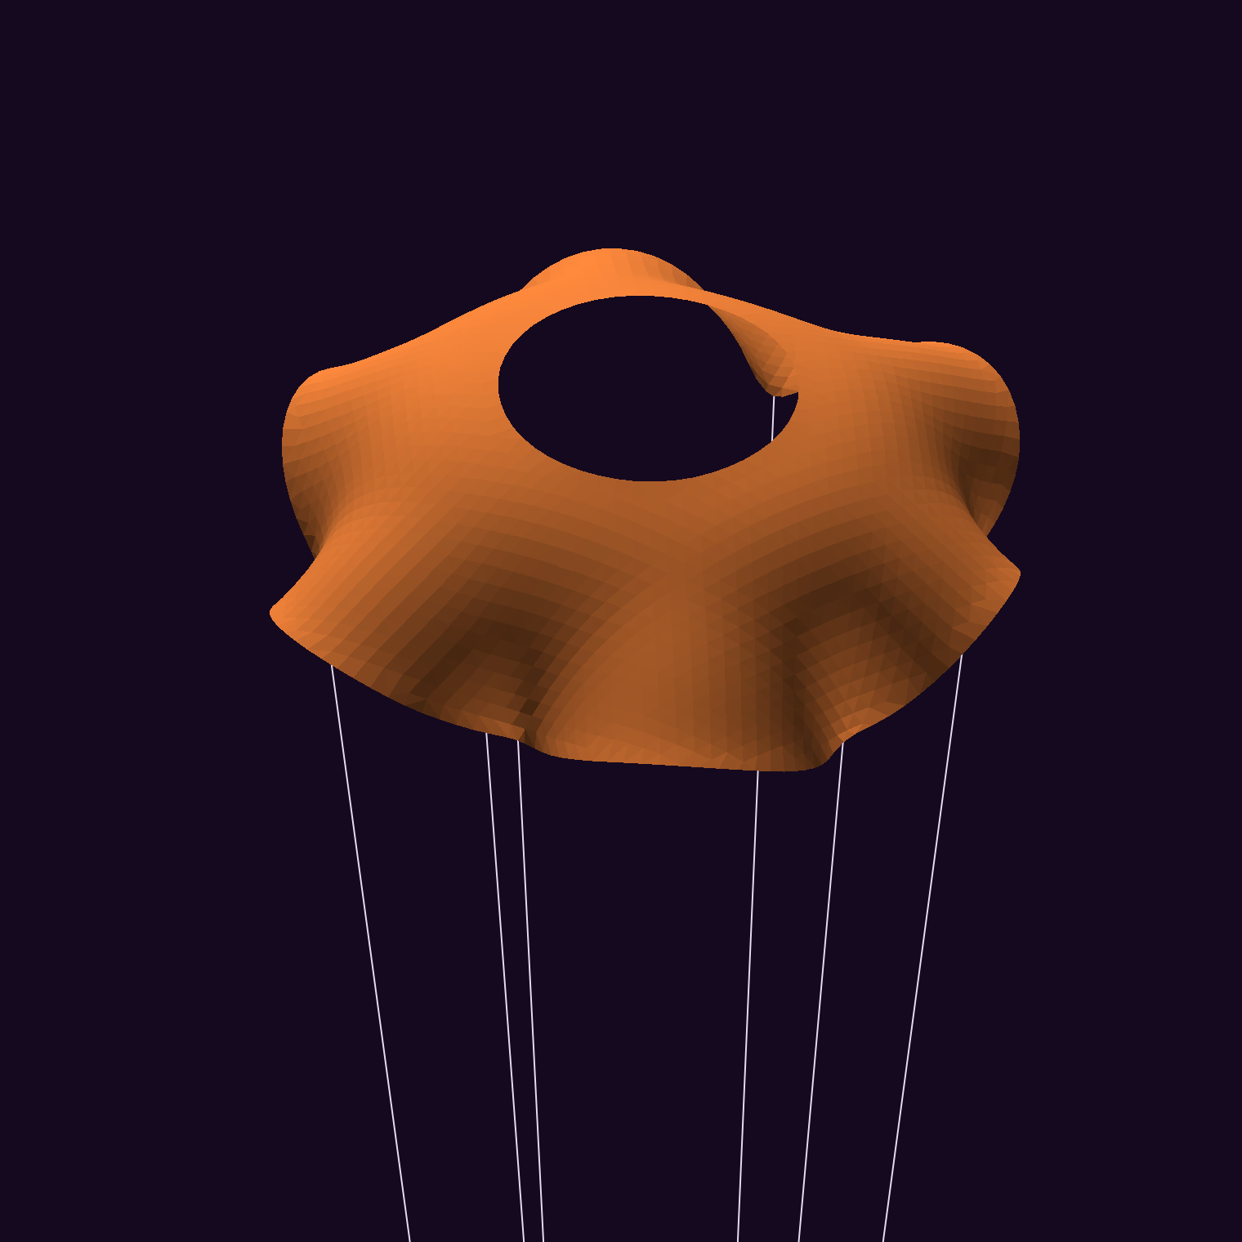
Can a data-driven search beat a hole in the middle?
Comparative evaluation of data-driven design methods for parachute shape and slit optimization
Prabal, Pranav, Walter
ROB-GY 7863B, NYU Tandon
Notes:
SPEAKER 1 · 6 s
SAY
• Hi, we're Prabal, Pranav and Walter.
• Can a data-driven search beat a simple hole in the middle?
IF ASKED
• Project questions? Which canopy lands slowest with fixed plastic and OK stability. Which course methods find good designs best.

Slide 2
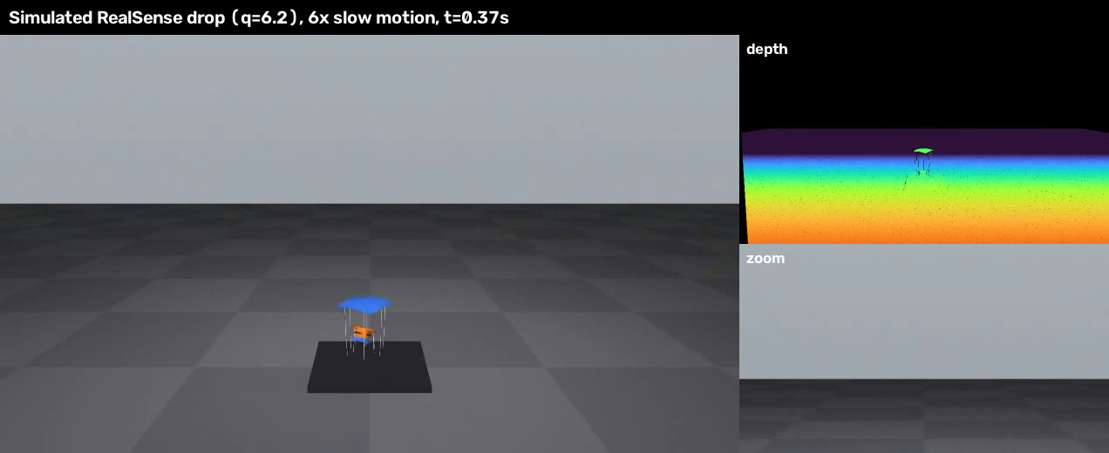
250 cm² of plastic. How slowly can it land?
8.9 m/s
free fall from 4 m
6.3 m/s
best estimate so far
Simulated drop, slow motion
Objectives: lowest landing speed, plus pitch stability
Setup: 250 cm² of plastic in any 2D shape, 4 m drop, 6 lines, 95 g payload (assumed)
Simulation estimates; physical validation pending
Drop simulator: MuJoCo (Todorov et al., 2012)
Notes:
SPEAKER 1 · 25 s · CLICK VIDEO
SAY
• This is a simulated drop.
• Same 250 cm² of plastic, any 2D shape.
• 4 m drop, 6 lines.
• Goal: lowest landing speed, plus pitch stability.
• Free fall: 8.9 m/s. Best so far: 6.3.
• Payload mass is assumed until we weigh it.
IF ASKED
• Why landing speed? Measured the same way in simulated and real drops.
• Why 250 cm²? Same material for every design, so it's fair.
• Why 4 m? At 2.5 m no design stood out, in all 27 assumption sets.
• 8.9 m/s? Free fall with no drag: √(2·g·h).
• 6.3 m/s? The vent's CFD estimate, not a measurement. 95 g payload and 3 g canopy assumed.

Slide 3
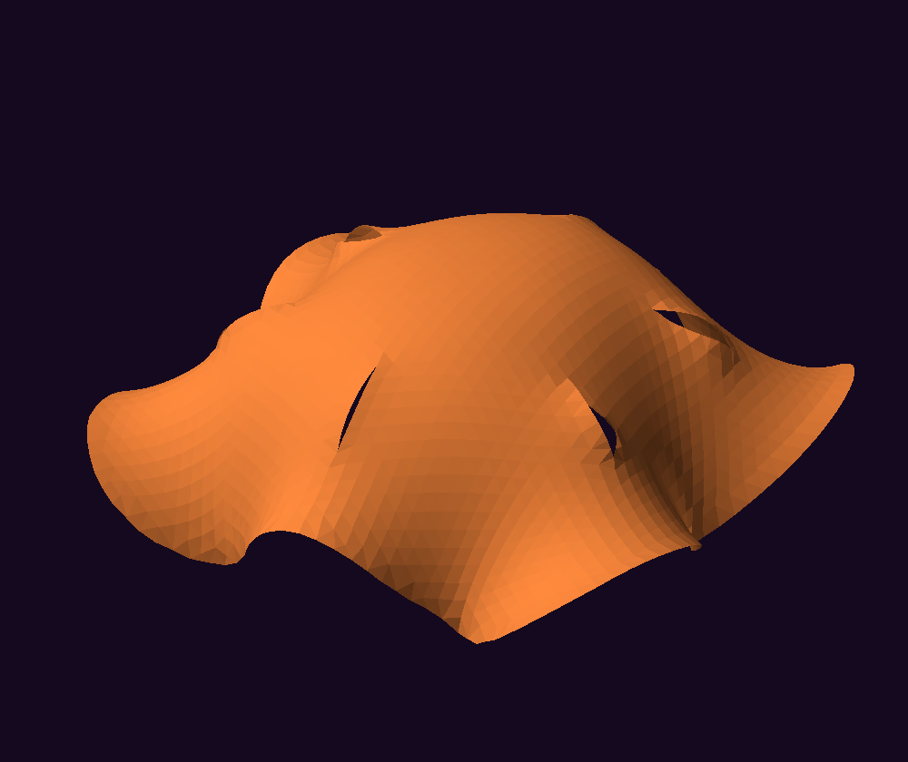
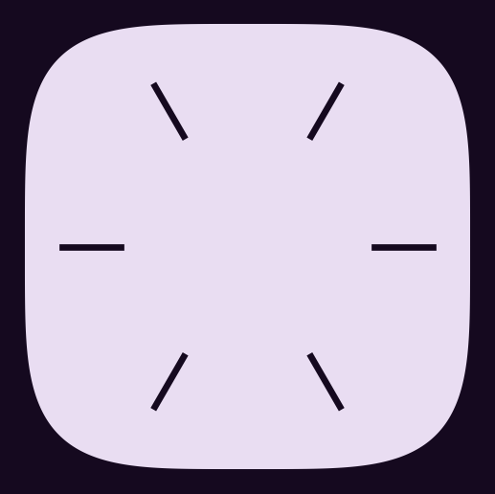



Slits barely opened in our model
→
3 variables
7 variables
9 variables
< 1 mm
Outline, slit length, slit position
Vent size; side hole count, size, place, shape
Heights of 61 smooth bumps, in 9 symmetric groups. Centre weight 0 → −1.6: a hole opens.
slit opening, 36 form-found designs
Every design must be cuttable: 78% of free-form samples pass.
Form-finding: dynamic relaxation (Day, 1965)
Notes:
SPEAKER 1 · 15 s
SAY
• We started with slits.
• In our model they opened under 1 mm, so almost no effect.
• So we changed the encoding: 3 7 → 9 variables.
• Changing only the centre weight opens a hole.
• 78% of free-form shapes can be cut.
IF ASKED
• 3 variables? Outline q (2 = circle), slit length, slit position.
• 7 variables? Vent size, side-hole area, count, distance, stretch, shape, rotation. Outline q still applies.
• 9 variables? 61 Gaussian bumps on a hill. 6-fold symmetry groups them into 9 weights.
• Do slits fail for real? That's our model's result, not tested on real canopies.
• Which weights matter? Sobol: the outer edge weights. That's the surrogate, not CFD.

Slide 4
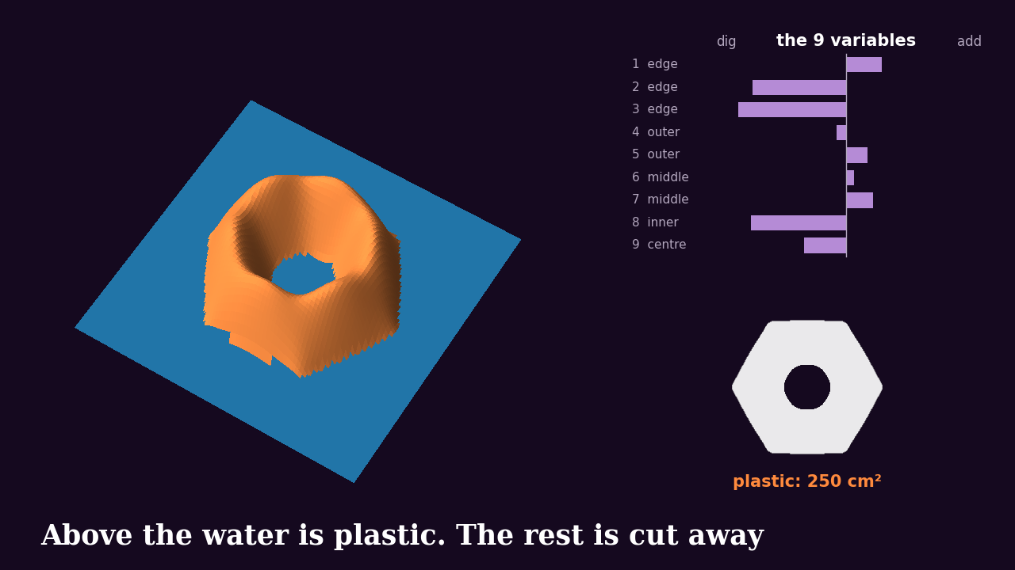
How 9 variables make a canopy
Notes:
SPEAKER 1 · 20 s · CLICK VIDEO
SAY
• Think of a sandcastle.
• Smooth hill, 61 spots, grouped into 9.
• Each variable adds or digs sand at its group.
• Raise the water until exactly 250 cm² sticks out.
• Above the water is plastic. The rest is cut away.
• New numbers, new shape, same plastic.
IF ASKED
• The math? height = 1 − (r/R)² + Σ w × Gaussian. Plastic where height > t.
• The water level? Found by bisection for every design, so area is never a variable.
• Why 9, not 61? Symmetry matches the 6 lines and shrinks the search.
• Why this encoding? Outline and holes come from one field. We never place holes by hand.
• Is it novel? No. Standard level-set / RBF shape method plus symmetry linking.
• Which designs? Real CFD designs, free56 then free07.

Slide 5
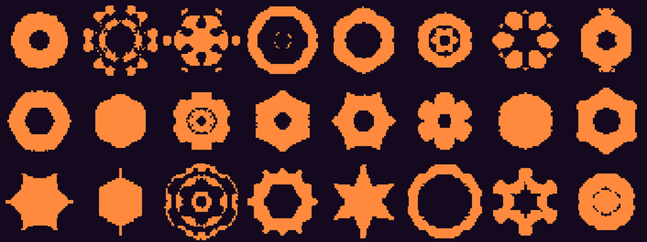
Dimensionality reduction on sampled shapes
Shapes the VAE invented
0.97
autoencoder IoU at 9-D, on shapes it never trained on
IoU: overlap ÷ union of two shapes. 1.0 is a perfect match.
VAE: Kingma & Welling (2014)
Notes:
SPEAKER 1 · 20 s · THEN HAND TO SPEAKER 2
SAY
• PCA, autoencoder and VAE on 1,883 shapes.
• Scored on shapes they never trained on.
• IoU = overlap ÷ union.
• At 9 dimensions: autoencoder 0.97, PCA 0.94.
• We still search the 9 weights directly.
IF ASKED
• Why three methods? PCA = linear baseline. Autoencoder = nonlinear. VAE also makes new shapes.
• The data? 48 × 48 masks, held-out test shapes.
• Why not search with the VAE? Only 66% of its shapes were one piece.
• Does this prove 9 weights are best? No. Latent codes and field weights are separate.

Slide 6

CFD trains a surrogate model for design search
Encoding
Cuttable design
DOE + CFD training data
Surrogate model (GP)
GA, PSO, BO search
Fresh CFD check
Measurement: simulated and future real drops
Camera + IMU
Pose filter
Landing speed
CFD check on reference shapes
1.235
1.516
disc Cd, reference 1.17
cup Cd, reference 1.42
Form-finding: flat pattern to inflated shape
Reference Cd: Hoerner, Fluid-Dynamic Drag (1965) · CFD: OpenFOAM v2406, k-ω SST (Menter, 1994)
Notes:
SPEAKER 2 · 30 s · CLICK VIDEO
SAY
• This is the whole workflow, left to right.
• Latin hypercube sampling picks training shapes.
• Each is inflated, then CFD at 0° and 10°.
• CFD is too slow for every candidate, so it trains a Gaussian process surrogate.
• The optimizer searches the surrogate. Winners get fresh CFD.
• Camera + IMU: same code for simulated and real drops.
• Disc and cup are within 7% of published drag.
IF ASKED
• Why a surrogate? One CFD run is 30+ min. 200 evals × 10 runs per method is impossible.
• CFD setup? OpenFOAM, k-ω SST, 7 m/s.
• How does search judge a shape? GP score from shape features, plus cut check and inflation classifier. It never sees physics.
• Stability? Cm_alpha = moment slope from 0° and 10°. Positive = a tilt grows.
• Limits? Shape from uniform pressure, no CFD feedback. Disc +5.6%, cup +6.8%.
• Reference values? Hoerner, Fluid-Dynamic Drag (1965).

Slide 7
What we ran so far
130
45
780
CFD runs on form-found canopies
converged designs with both angles
shapes in the inflation scan, 64% stable
1,883
200 × 10
5
sampled shapes for dimensionality reduction
evaluations × runs for each search method
search winners re-checked with fresh CFD
Notes:
SPEAKER 2 · 15 s
SAY
• Here's the scale of the work.
• 130 CFD runs 45 converged designs.
• 780 shapes scanned for inflation.
• 1,883 shapes for dimensionality reduction.
• 200 evaluations × 10 runs per method.
• 5 winners re-checked with fresh CFD.
IF ASKED
• 130 vs 45? 51 inflated stably, 6 didn't converge. Each design needs 2 angles.
• Inflation classifier? Random forest, 77% accuracy. Our addition, not a course method.
• Real drops? None yet. Everything here is simulation.

Slide 8




A central vent gave the lowest estimate
30% open
Plain canopy
12% vent
49% open
6.40 m/s
6.45 m/s
6.31 m/s
7.20 m/s
Vent against plain: 0.14 m/s slower, 54% less pitch instability, not yet self-righting
Simulation estimates; physical validation pending
Notes:
SPEAKER 2 · 18 s
SAY
• All four use exactly 250 cm².
• Central vent: 6.31 m/s.
• 0.14 slower than plain, 54% less pitch instability.
• Not yet self-righting.
• Big hole is worst: 7.20.
• CFD estimates, not measurements.
IF ASKED
• What is 12%? Hole = 12% of plastic area (10.7% of the outline).
• Numbers? Drag area 243.6 vs 219.5 cm². Cm_alpha +2.25 vs +4.89 (×1e-3 per °).
• Why does a hole help? Bigger drag area, less unstable. Venting is the likely reason, untested.
• Self-righting designs? Only 4 of 45. The best of those lands at 6.91 m/s.

Slide 9
Small holes gave the lowest estimates
~10%
open gave the best results
> 30%
drag falls away, and speed rises
Each dot is one design, all with 250 cm² of plastic.
Simulation estimates; physical validation pending
Notes:
SPEAKER 2 · 12 s
SAY
• Each dot is one CFD design.
• Best results around 10% open.
• Past 30% open, drag falls and speed climbs.
IF ASKED
• No-hole designs? 19 at 0% open, median 6.50 m/s.
• Is 10% exact? No. Only 13 designs between 1–15%, median 6.43. A region, not an optimum.

Slide 10
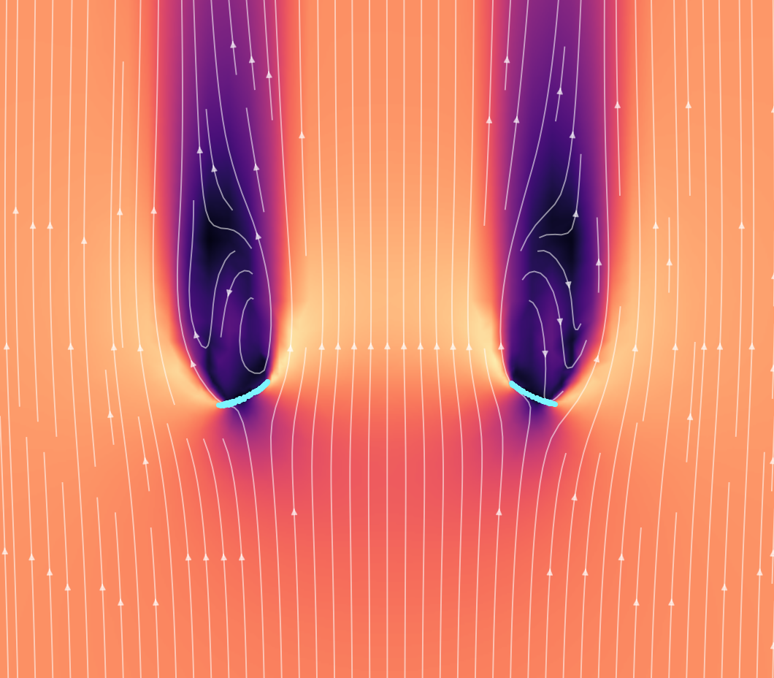
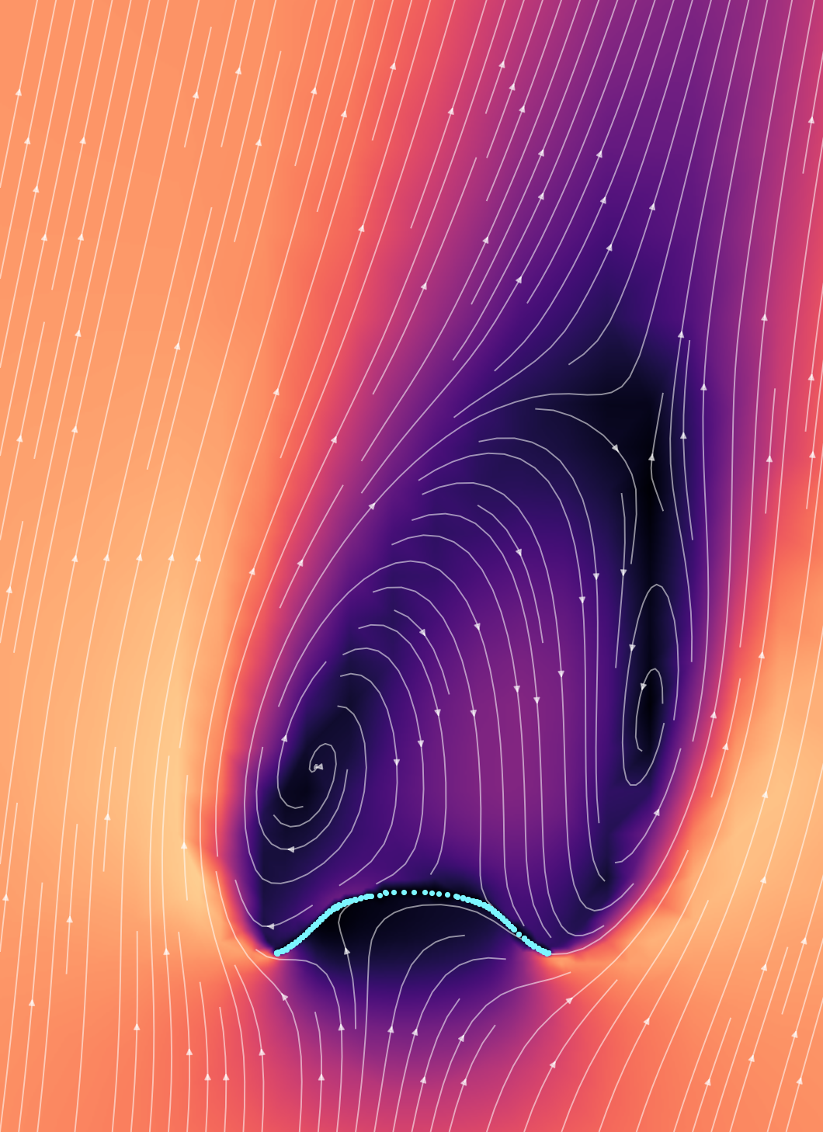
What the air is doing
Big hole: air runs straight through
Tilted 10°: lopsided wake (coarse mesh)
CFD: OpenFOAM v2406, k-ω SST turbulence model (Menter, 1994)
Notes:
SPEAKER 2 · 10 s · THEN HAND TO SPEAKER 3
SAY
• Left: big opening, air runs straight through.
• Right: tilted 10°, the wake goes lopsided.
• That's why stability is hard.
IF ASKED
• Left design? free03, ~26% open, self-righting, 6.91 m/s.
• Right image? Older slit canopy, coarse mesh. Shows the idea only.
• Why not show the vent? Its flow fields were lost when the rented machines shut down. Forces were saved.

Slide 11
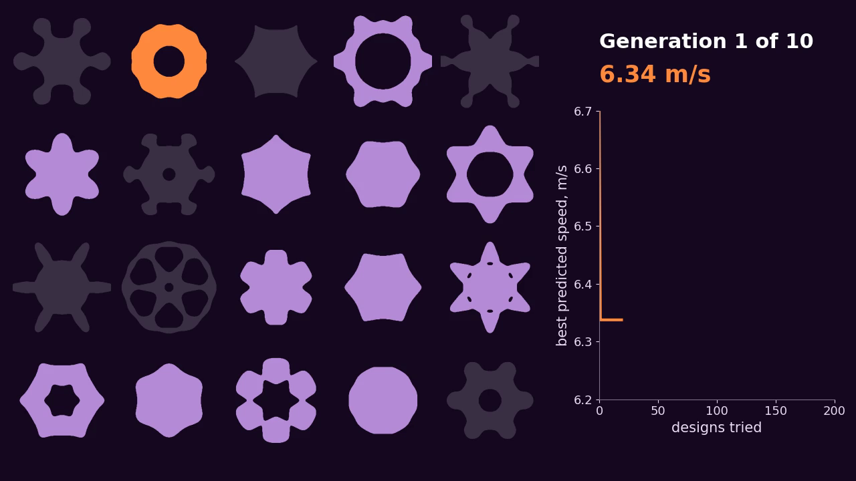
Nine design variables, 200 evaluations
1
GA evolves a population
2
Surrogate model scores fitness
3
Best designs get fresh CFD
Grey shapes: infeasible, could not be cut or predicted not to inflate
GA: pymoo (Blank & Deb, 2020)
Notes:
SPEAKER 3 · 30 s · CLICK VIDEO
SAY
• The GA evolves a population of designs.
• The surrogate scores each one's fitness.
• Grey = rejected: can't be cut or won't inflate.
• Budget: 200 evaluations.
• The best designs then get fresh CFD.
IF ASKED
• Why a GA? Handles 9 variables, needs no gradients.
• How? 20 designs per generation. Keep the best, crossover, mutation. This is a real run, 10 generations.
• Fitness? Lowest predicted speed + 0.03 m/s test noise. Rejected = marked penalty.
• Speed on screen? A noisy surrogate score, not a real speed.

Slide 12
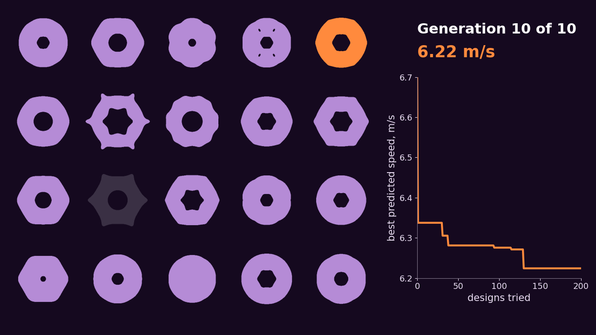
It reinvented the central hole
Notes:
SPEAKER 3 · 6 s
SAY
• No rule told it to do this.
IF ASKED
• Did it really invent it? It learned from CFD data that included holed designs. Open area is one of its features.

Slide 13
Fresh CFD exposed the surrogate's optimism
Design | Predicted (m/s) | CFD (m/s)
GA winner 1 | 6.27 | 6.33
GA winner 2 | 6.27 | 6.44
GA winner 3 | 6.27 | 6.36
Optimising on a model also finds the model's mistakes.
All five checked winners inflated stably.
Simulation estimates; physical validation pending
Notes:
SPEAKER 3 · 15 s
SAY
• This is the check.
• GA winners predicted ~6.27 m/s.
• Fresh CFD: 0.06 to 0.17 slower.
• Optimise on a model and you find its mistakes.
• All five winners inflated stably.
IF ASKED
• All five in CFD? 6.33, 6.36, 6.41, 6.41, 6.44. The 3 GA ones are shown.
• The other two? Other methods, predicted within 0.01, but both ~6.40. Error grew with how hard the search pushed. Only 5 designs, so a clue.
• Why optimistic? Only ~40 training designs. Search hunts where the errors look good.

Slide 14
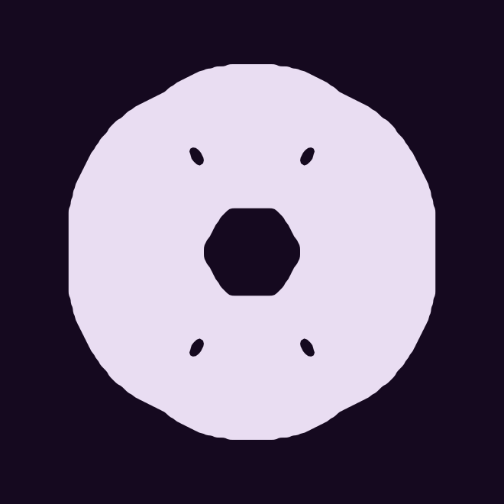
The vent keeps the lowest checked estimate
Search winner
12% vent
Surrogate predicted 6.27 m/s
CFD check: 6.33 m/s
CFD: 6.31 m/s
A 0.02 m/s gap, with no uncertainty estimate yet
Simulation estimates; physical validation pending
Notes:
SPEAKER 3 · 15 s
SAY
• Best search winner: 6.33 in CFD.
• Hand-made vent: 6.31.
• Gap of 0.02, no uncertainty yet.
• So the vent has the lowest checked estimate.
• The search got close, starting from random shapes.
DON'T SAY
• The vent is clearly better.
IF ASKED
• Stability? Cm_alpha +2.53 winner vs +2.25 vent (×1e-3 per °). Neither self-righting.

Slide 15
GA and PSO led; tabu search trailed
Method | Median (m/s) | IQR (m/s)
GA | 6.260 | 0.020
PSO | 6.271 | 0.018
Multi-objective GA | 6.288 | 0.041
Bayesian optimization | 6.293 | 0.023
Simulated annealing | 6.303 | 0.043
Random search | 6.312 | 0.016
Tabu search | 6.475 | 0.248
200 evaluations × 10 runs. Objective: best surrogate speed found, with 0.03 m/s test noise. IQR: spread across runs.
Simulation estimates; physical validation pending
GA, multi-objective GA: pymoo (Blank & Deb, 2020) · GP: scikit-learn (Pedregosa et al., 2011)
Notes:
SPEAKER 3 · 20 s
SAY
• Each method: 200 evaluations × 10 runs.
• Score = best surrogate speed with noise. It ranks methods, not real speeds.
• Median, and IQR = spread across runs.
• GA and PSO led.
• Tabu trailed, with the widest spread.
IF ASKED (reasons are likely, not tested)
• Why so many methods? Comparing them is the project.
• Why none beat the vent? All searched the surrogate. The surrogate is the limit.
• Tabu 6.475? Fixed steps, poor fit for 9 continuous variables.
• Random 6.312? Many designs score well on the surrogate.
• SA 6.303? One design at a time. 200 evals is few in 9-D.
• BO 6.293? Noise and rejected designs hurt its model. Untuned.
• Multi-objective GA 6.288? Also optimises stability, so not a loser.
• GA 6.260, PSO 6.271? Population-based, cope better with noise.
• What is PSO? A swarm of designs; each moves toward its own best and the swarm's best.
• Is GA best in general? No. One surrogate, one budget, our settings.

Slide 16
Next: a better surrogate, then real drops decide
1
Bayesian optimization
0.14 m/s
Feed the CFD checks back into the surrogate
vent gain over the plain canopy
2
Multi-objective GA (NSGA-II)
0.139 m/s
Find the Pareto front of speed against stability
smallest gap 3 repeats can detect, assuming 0.06 m/s drop noise
3
Real drops, more repeats
Weigh the payload and test the hole designs
So 3 repeats per design is not enough.
Simulation estimates; physical validation pending
NSGA-II: Deb et al. (2002)
Notes:
SPEAKER 3 · 20 s · END
SAY
• Same goal: lowest speed, plus stability.
• 1. Feed CFD checks back with Bayesian optimization.
• 2. Multi-objective GA (NSGA-II): Pareto front, speed vs stability.
• 3. Real drops decide.
• Vent's 0.14 gain ≈ what 3 repeats can detect, so we need more repeats.
• Thank you. Questions?
IF ASKED
• Why these steps? More CFD = less surrogate error. BO picks the next runs. Speed and stability conflict.
• 0.139 m/s? 4 standard errors, 0.06 m/s noise per drop, 3 repeats. Noise is assumed.
• Still needed? Weigh payload, IMU wiring, RealSense model, recorder, hole stencils.
• Is NSGA-II in the course? Not by name. It's the multi-objective GA (week 4).

