Slide 1
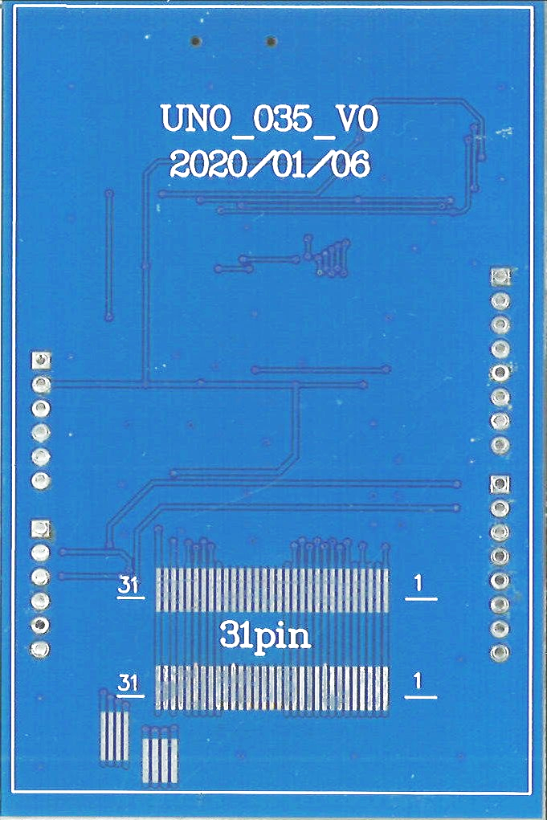
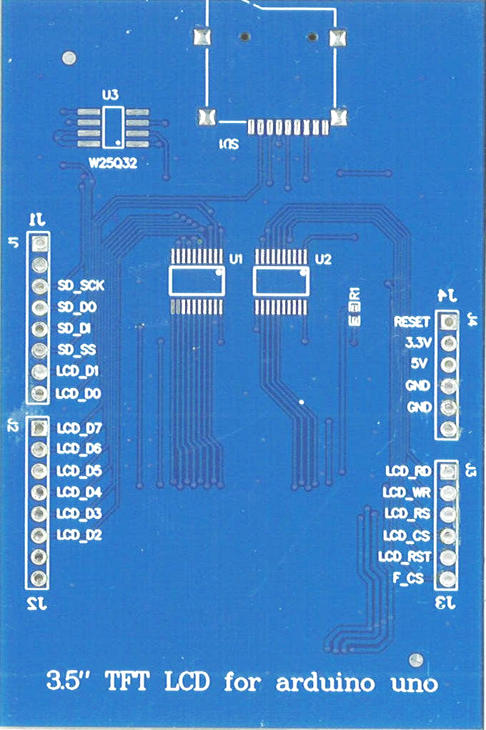
3v3
LCD_RD

Slide 2
LCD_WR
LCD_RS

Slide 3
LCD_CS
LCD_RST

Slide 4
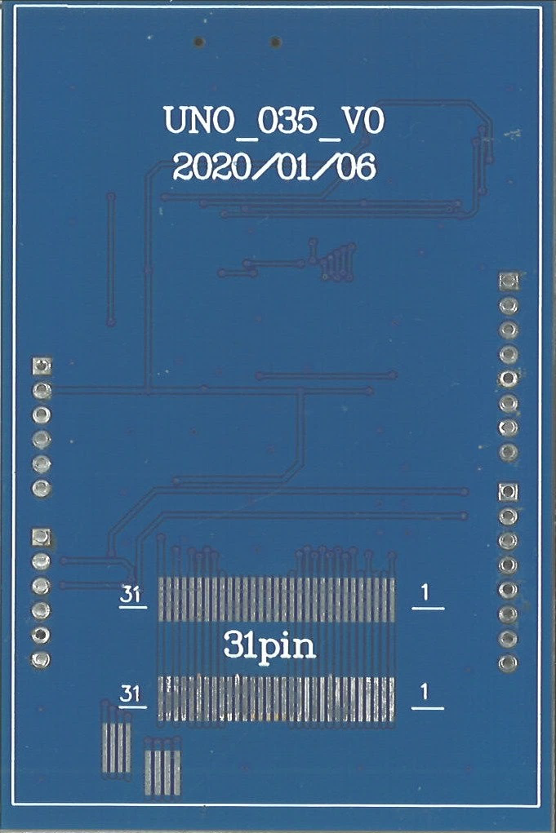
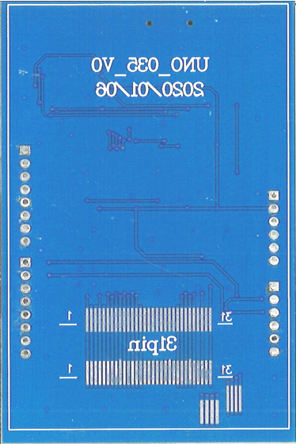
F_CS
LCD_ D2

Slide 5
LCD_D3
LCD_ D4

Slide 6
LCD_D5
LCD_ D6

Slide 7
LCD_D7
LCD_ D0

Slide 8
LCD_D1
SD_ SS

Slide 9
SD_DI
SD_ DO

Slide 10
SD_SCK
GND

