Slide 1
The OverWatch
A security system that can think

Slide 2
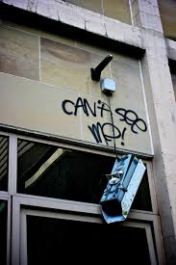
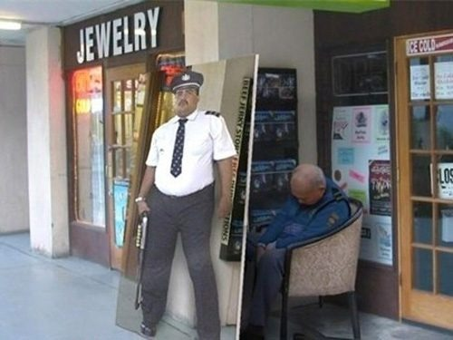
What We have

Slide 3

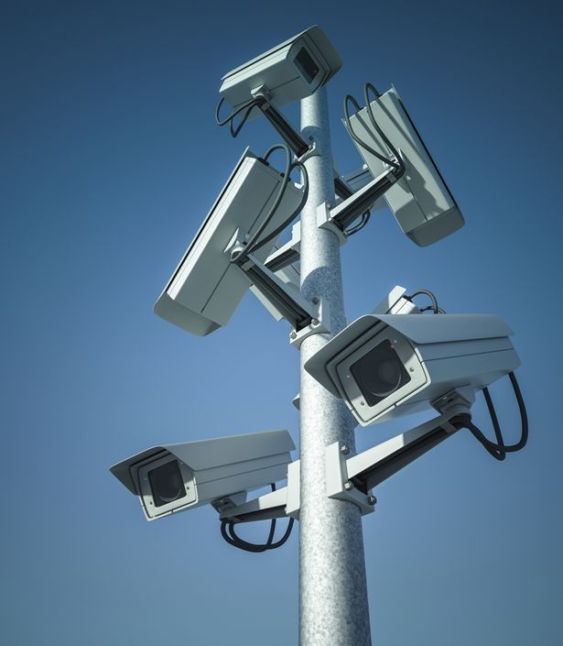
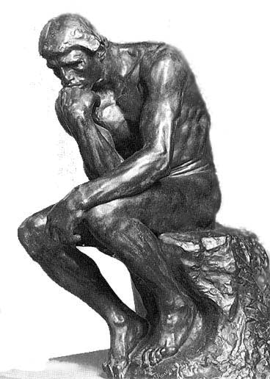
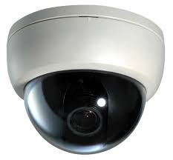
What We NEED
+
=
Smart Surveillance

Slide 4
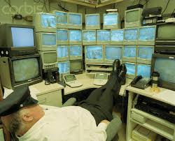
A bank is a place where we keep our money and many expensive items so shouldn’t we have a Security System that can handle the security of such a place.
I am not saying we don’t have Security but many times human errors occurs like Guards falling asleep on duty or in the security room . In such a case who is watching the monitors or guarding the bank?
There are many cases of robberies which could have been stopped with our Solution.

Slide 5
Different Robberies in Banks

Slide 6
Chelambra bank robbery
The Chelambra bank robbery in the Malappuram district of Kerala, India
The bank was in the second floor of a building. The ground floor had a restaurant that was up for rent. The four-member gang rented the restaurant by giving an advance payment of about Rs. 50,000. They shut down the front door and placed a board saying that it was under renovation and would reopen on 8 January 2008. To make things more convincing, they even bought new furniture for the restaurant and much construction material for the site.
Those who were watching the scene would have thought that repairs were going on. But they were cracking the first floor open, where the strong room was kept. They cracked it and made a big enough hole in the ceiling to the strong room. All the money they took was from some iron safes in the strong room which they cut open using a gas cutting machine. They took away gold and cash kept inside the safe.
They Got away with got away with 80 kilograms of gold and 5,000,000 rupees !

Slide 7
Near Delhi, Gang Bored Into Concrete Wall To Raid Bank Lockers
The Ghaziabad branch of Punjab National Bank confronts crores of losses after 26 lockers were raided; most of them were left empty.
The police found that the gang entered the bank by boring through a concrete wall. A dense cover of bushes concealed them as they demolished the wall.
26 lockers were raided; most of them were left empty.

Slide 8

Our Solution
A complete surveillance System using IoT, cameras and machine learning to identify faces and circumstances and report if any unusual activity happens.

Slide 9
A brief Summery of Solution
We will make use of already present cameras in the banks to get the feed and then apply our Software to Provide security.
We will do so by:-
1) If someone is steeling or present in unauthorised areas (Motion Detection ) then the camera can alarm without needing any supervision or someone watching the camera feed:- Done using motion detection and heat signatures and facial recognition.
2) Security in Banks (Detecting if a known criminal is present or if some one has a gone):- Done by:-checking the faces of people in the bank getting a facial image if face present in database raise an alarm. If some one takes out a gun to rob the bank it will detect the gun and automatically call the police. During an emergencies any button won't be needed to be pushed the cameras will detect and act accordingly.
3) Who Enters the Bank :- With our System the person entering the bank will have to Get their Photo taken at the entrance and enter their name and adhar card number. Photo will be taken Automatically by the camera the person will only have to enter their name and adhar. So we will Know who enters and who leaves . Any unauthorized entry can be traced.
These Systems can also be used in an ATM in the similar manner.

Slide 10
Other Feature (Not Implemented yet)
We can use heat and various IR sensors to better this whole Solution but at the moment we have not added those in the System.
We can use heat sensing in vaults and IR sensors to count the number of people entering in the ATM to prevent robbery as more then one people will be needed for any robbery in ATM and more then one person should not be allowed anyway inside an ATM.

Slide 11
Effects of Our System
Alarms reported can be sent directly to the security teams on their phones using android apps.
This can very easily reduce the work load of the surveillance team and let them know of many situations which may go unnoticed because someone did not see it on time on the monitor.
The guard who had to watch the monitor the whole day can now provide better security by patrolling the campus or standing guard at various places as needed and as soon as any alarm is raised they can report on the scene as told by the Software.

Slide 12
How we could have stopped those robberies
Chelambra bank robbery :-
Usnig Motion Detection we could have easily detected if the floor of the Room was in any way harmed as it would have caused a lot of movement (THE WHOLE FLOOR JUST DROPED there will be motion).
When the robbers were in the Storage Room we could have easily detected their motion and may be get their faces.
Near Delhi, Gang Bored Into Concrete Wall To Raid Bank Lockers :-
Usnig Motion Detection we could have easily detected if the Walls of the Room was in any way harmed as it would have caused a lot of movement (they boring through a concrete wall so the motion could easily be detected).
When the robbers were in the Room we could have easily detected their motion and may be get their faces.

Slide 13
What We Used
Python and various libraries
PIL
Tkinter
imutils
time
datetime
tkMessageBox
os
glob
Httplib
urllib
Base64
json
Thread and threading
OpenCV
Microsoft Cognitive Services
Object detection Training and Detection (Custom Vision API)

