Slide 1

Enhancing Crop Yield with Artificial Intelligence-Based Leaf Disease Diagnosis
Ayush Singh
1

Slide 2

Outline
Introduction
Literature Review
Key Gaps
Problem Statement
Objectives
Architecture Diagram
Use Case Diagram
System Design
Project Pl
Dataset Overview
Code
Deliverables/Benefits
Real Life Applications
Limitations
Result
Future Work
References
2

Slide 3
Introduction
Apple is a vital source of vital nutrients and important crop for billions of consumers. Apple crop face major impact on its agricultural output due to various diseases affecting them, particularly leaf diseases.
Recent advancements in deep learning and machine learning have enabled efficient disease classification using methods like SVM, PCA, Random Forest, K-NN, and Genetic Algorithms. Techniques such as ANN, CNN, and YOLOv5 have further enhanced disease detection accuracy and precision..
We used SVM for classification, VIT for image feature extraction via patch embedding and transformer encoding, and PCA to reduce dimensionality and prevent overfitting. Our study on apple disease detection includes apple rust, apple scab, and healthy leaves, utilizing techniques like image pre-processing and augmentation. We fine-tuned deep learning models using transfer learning and compared our hybrid model's performance to the VGG19 architecture.
3

Slide 4
Literature Review
AUTHOR/ YEAR | JOURNAL | CROP | OBJECTIVE | DATASET | ACCURACY | METHOD | LIMITATIONS
Chongke Bi/2020 | Nature Springer | Apple Leaf | Apple Leaf Diseases Identification | Orchards in shaanxi Province | Mobile Net - 0.735 InceptionV3 - 0.7559 Res Net 152 - 0.7765 | Detection using three kinds of deep learning models, including Mobile Net, InceptionV3 and ResNet152 and comparing their accuracies. | The images were required from the upper leaf surface and by avoiding direct sun light reflection.
Haiping Si/2024 | MDPI/Agriculture | Apple Leaf | Deep Learning powered apple leaf disease detection with MobileNetV2 model. | “Plant Pathology 2021 - FGVC8” dataset sourced from Kaggle, which comprises of 18,632 high-quality images with dimensions of 4000 × 2672 pixels | ResNet18 - 93.75% Swin Tiny - 95.91% Proposed - 97.32% | The DBCoST model is constructed by integrating two branches: a CNN branch for local feature extraction and a Swin Transformer branch for capturing global information and long-range dependencies. | The images were required from the upper leaf surface and by avoiding direct sun light reflection.
Vibhor Kumar Vishnoi/ 2023 | Journal | Apple Leaf | Detection of Apple Plant Diseases Using Leaf Images Through CNN | 3171 images from village dataset | D-CNN -98% | The method involves creating a unique CNN called Conv-3 DCNN to detect diseases in apple plants from leaf images. | collecting more leaf images from various geographical areas with varying conditions is resource-intensive and time-consuming
4

Slide 5
Literature Review
AUTHOR/ YEAR | JOURNAL | CROP | OBJECTIVE | DATASET | ACCURACY | METHOD | LIMITATIONS
Yong Zhong/2020 |  | Apple Leaf | Research on deep learning in apple leaf disease recognition | Data set of 2462 apple leaf image | DenseNet-121 Deep convolution network and the accuracy is 92.29% | Validation and exploration are needed to address issues related to dataset biases, evaluation metrics, and model performance in unbalanced datasets. | The images were required from the upper leaf surface and by avoiding direct sun light reflection.
Munish Khanna/2023 | Springer | Plant Leaves | A robust deep convolutional neural network model for plant leaves disease recognition | Plant Village dataset of 54,306 images of 38 classes and 14 different species, another Kaggle dataset of 24,916 images of 30 classes | VGG16 + InceptionResNetV2 +EfficientNetB5+EfficientNetB4 + EfficientNetB3 (Ensemble Model) gives the accuracy of 97.52%. While proposed model gives accuracy of 97.95% | utilization of deep convolutional neural network architectures DCNN architectures such as VGG-16, VGG-19, MobileNet, Inception ResNetV2, InceptionV3, EfficientNet,ResNet 50V2,Xception,DenseNet169, NASNetLarge a new DCNN model named "PlaNet" is proposed and implemented for this task | the model has not been tested in a variety of situations, such as lighting, occlusion, lighting changes, etc. In some situations, the system may not work as well
Hebing Cheng/2023 | Frontiers in plant Science | Apple Leaf | Identification of apple leaf disease via novel attention mechanism based convolutional neural network | Plant Village, PPCD2020, PPCD2021 ATLDSD datasets. Total sample size is 15250 | Accuracy Of Mobile Net-MFS is maximum of 98.7% at 75 Epoch | We have improved MobileNet v3 by modifying its attention mechanism, taking into account the influence of dimension and space. | The images were required from the upper leaf surface and by avoiding direct sun light reflection.
5

Slide 6
Limited Data
The optimization of speed and computational complexity
Unbalanced dataset
Transferability and adaptability
Evaluation measures and Model Comparison
Key Gaps

Slide 7
Problem Statement
Manual monitoring of affected disease leaves for large yield is
not time and cost effective.
There are existing mechanisms for leaf disease detection however they still lack capabilities to offer solutions for diseases.
Apple serves as major cash crop for farmers in hilly regions
India and due to lack of effective disease management measures
livelihood of farmers in Himachal, Kashmir are severely effected.

Slide 8
Objectives
• Performing Data augmentation for increasing the number of images in dataset to prevent overfitting and Increasing features.
• Create and implement a Deep learning-based Hybrid model comprising of SVM, ViT and PCA for effective disease recognition with higher accuracy.
• Evaluating the performance of our model based on matrices like accuracy, confusion matrix, precision and F-1 score and recall, weighted and macro average.

Slide 9
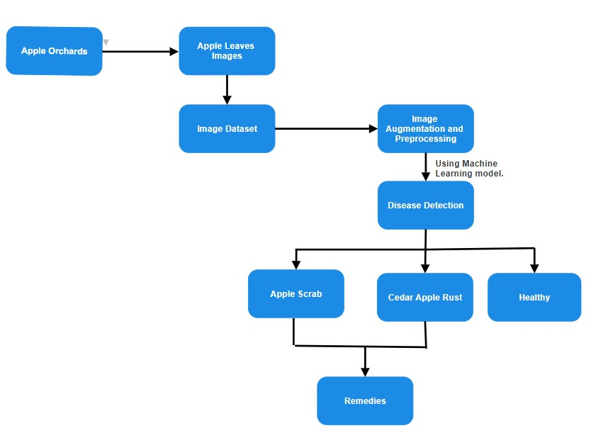
Architecture Diagram
Fig 1: Project Synthesis

Slide 10
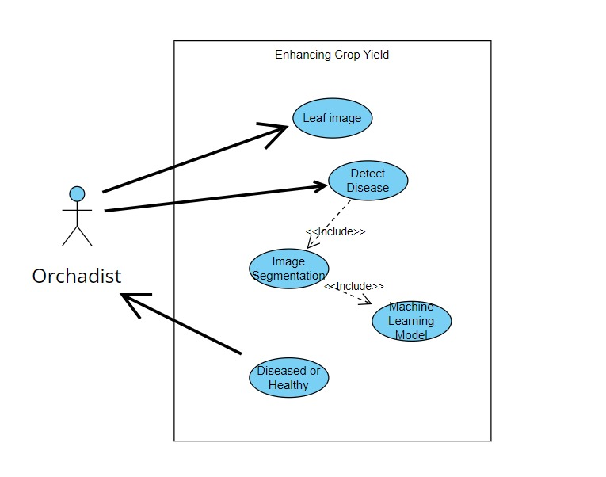
Use Case Diagram
Fig 2: Usage of our model by an orchardist to improve production.

Slide 11
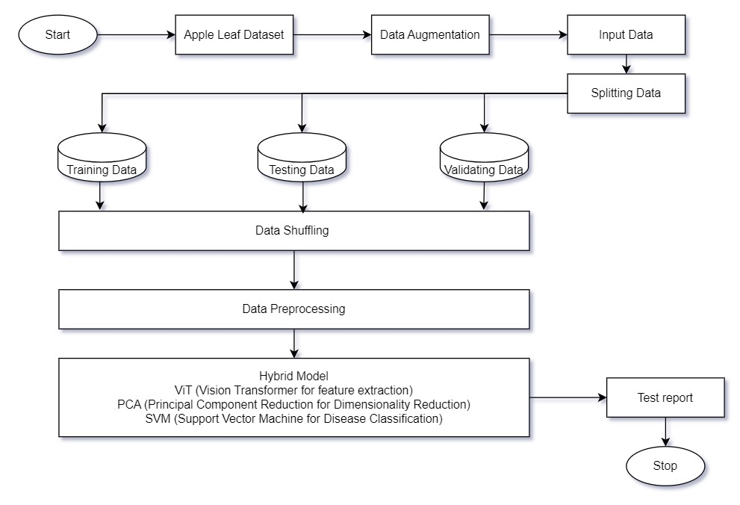
System Design

Slide 12
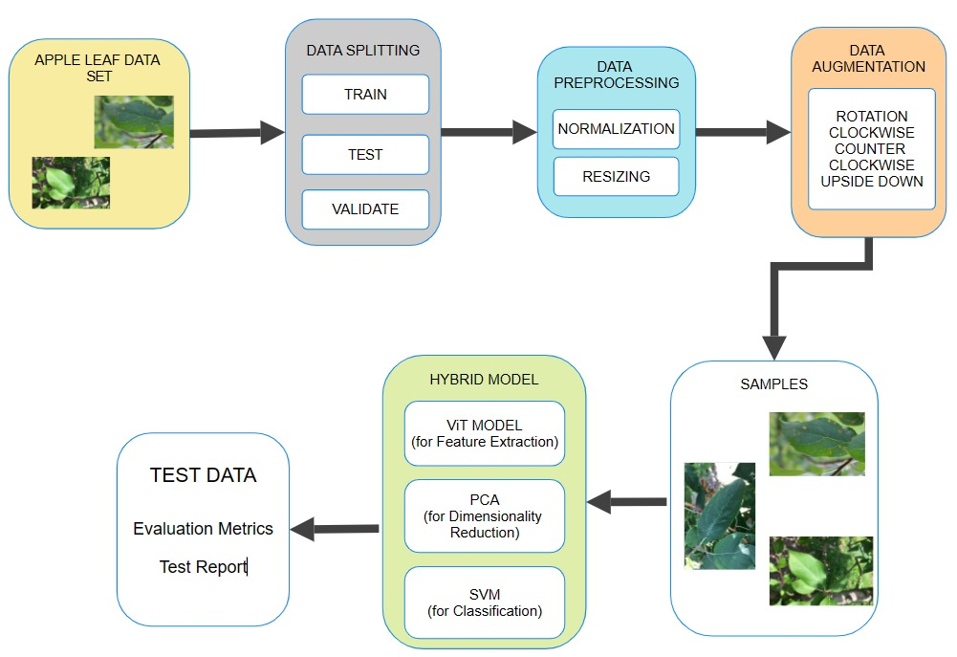
Project Plan

Slide 13
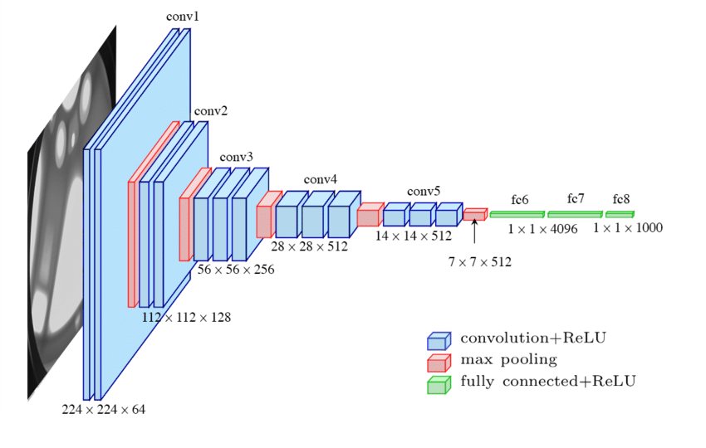
VGG-19 Architecture

Slide 14
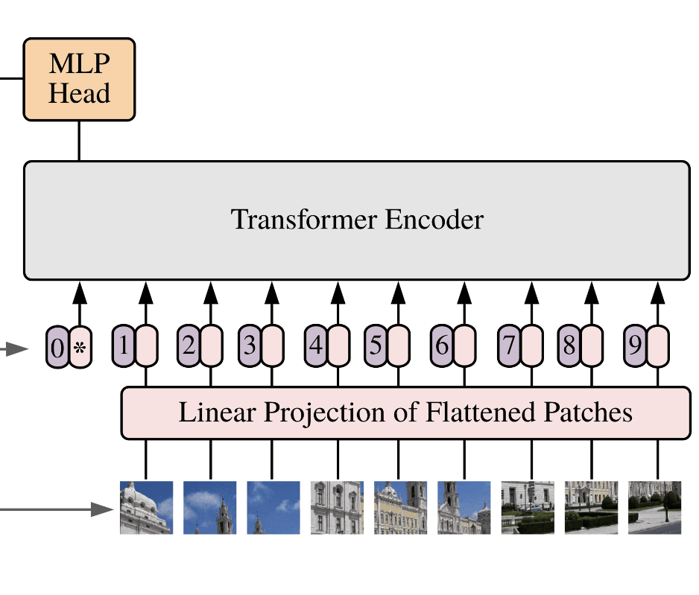
ViT Architecture

Slide 15
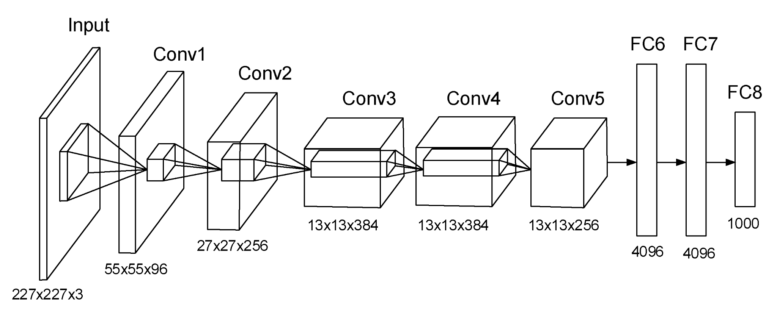
SVM Architecture

Slide 16
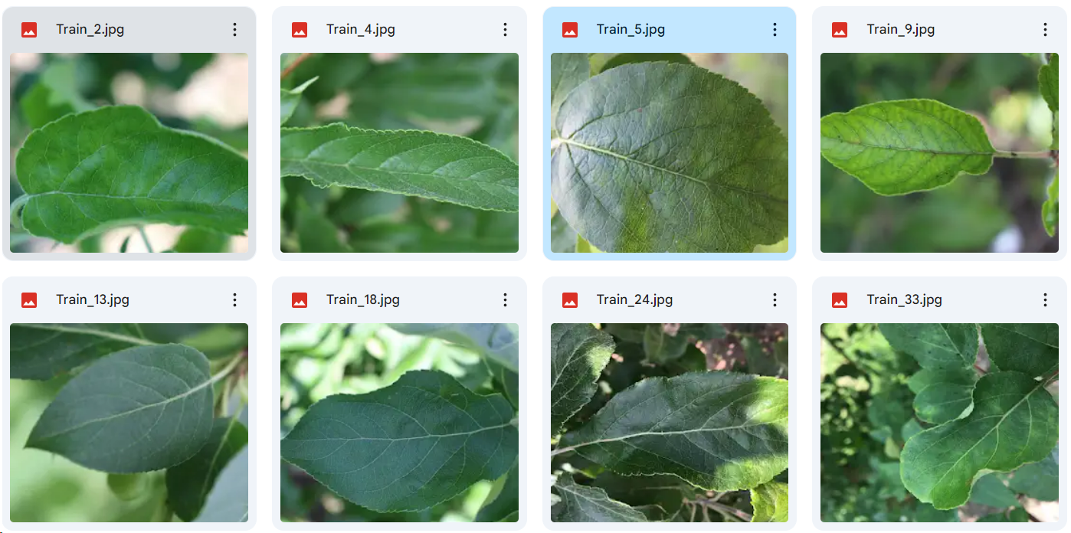
Dataset Overview
The dataset contains 1730 images which belongs to three classes, Apple Scrab, Cedar Apple Rust and Healthy respectively. This dataset is derived from the Kaggle Plant Pathology Challenge competition for the FGVC7 workshop at CVPR 2020 in Seattle, Washington State. For training complete dataset is used at each epoch.
Fig 5 : Images from the Apple leaf dataset

Slide 17
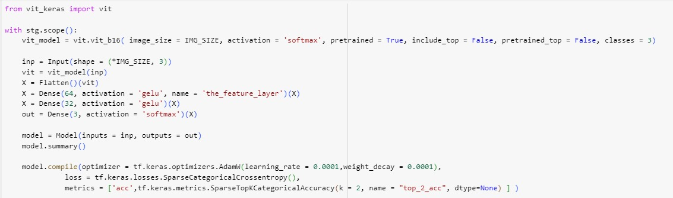
Code

Slide 18

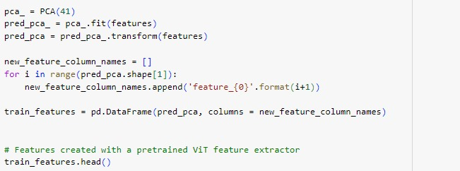

Code

Slide 19
Deliverables/benefits
Fully functional, AI-based sap (red spot and cedar sap rust) disease identification system with the help of deep learning models.
Explain the entire process in detail, including custom planning before imaging, normalization, resizing, data segmentation, data enhancement, and model training.
Compare studies to evaluate the accuracy, precision, etc., between the advanced CNN architecture VGG19 and our SVM/VIT/PCA hybrid model.
After increasing the dataset size through image enhancement, train the model to achieve the desired results effectively.

Slide 20
Real life applications
Early Disease Detection: AI-based leaf disease diagnosis can help farmers detect diseases in crops at an early stage.
Data-driven Insights: By analyzing historical data on crop diseases and their impact on yield, AI can provide valuable insights into disease patterns and trends
Crop Monitoring: Continuous monitoring of crop health using AI can help farmers stay vigilant against potential disease outbreaks.

Slide 21
Limitations
Generalization: Models trained on specific conditions or limited datasets
Multiple Diseases: Plants can suffer from multiple diseases simultaneously, which can complicate diagnosis since symptoms may overlap or influence each other.
Data Scarcity: High-quality, annotated datasets for training AI models are often scarce, especially for less common diseases or crops.
Dynamic Nature of Symptoms: Symptoms can evolve, requiring continuous updating of datasets to reflect current conditions.
Data Ownership: Clarifying who owns the data collected from farms and how it can be used is essential to protect farmers' interests.
Disease Stage Detection: AI models may struggle to identify diseases at very early or very late stages, reducing the effectiveness of timely interventions.

Slide 22
Results
The below confusion matrix represents metrics results of the Hybrid model consisting of Vit, PCA and SVM testing and training results. The training and testing accuracy and loss obtained using a dataset of around 7000 images. Remarkably, 97.85% of accuracy score is achieved by the model. While the same hybrid model is giving the accuracy of 95.7% when our dataset is applied without data augmentation In comparison to approx 75% accuracy in case of VGG19 model application.

Slide 23
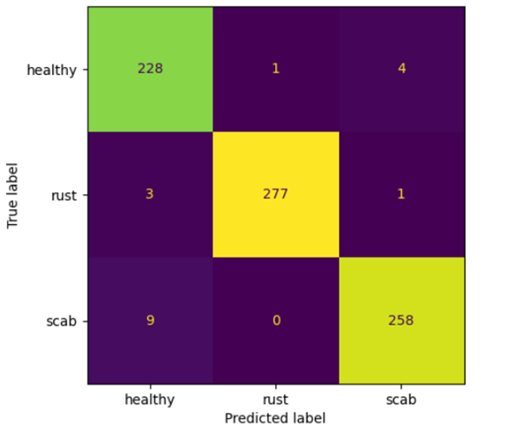
Confusion matrix

Slide 24
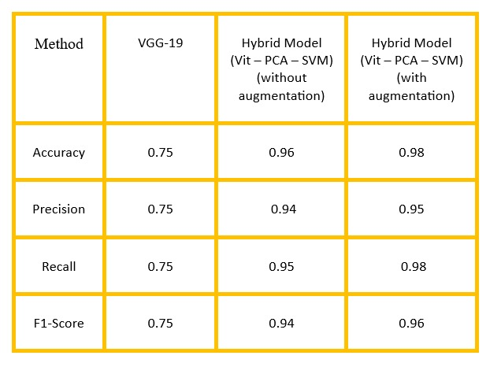
Performance of our hybrid and VGG-19 model

Slide 25
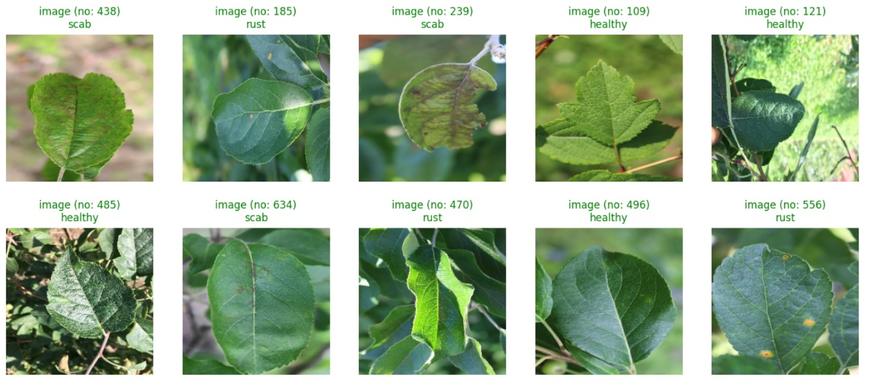

Slide 26
Future Work
1. We will create a powerful AI system that can accurately spot and identify different apple leaf diseases by looking at picture in an app or on a website and learning from them.
2. The AI system will provide real-time analysis of apple leaf diseases.
3. The AI system will be extended to diagnose a wider range of diseases affecting not only apples but also other crops such as mangoes.
4. Collaborations with agricultural research institutions, government agencies, and farming cooperatives will be pursued to facilitate the development and dissemination of the AI system..
5.We will apply U2-Net for image background removal and ESRAGAN for image enhancement for getting better accuracy.

Slide 27
Conclusion
This study successfully demonstrates the efficacy of a hybrid model combining ViT, PCA, and SVM for identifying apple leaf diseases with high accuracy. By leveraging the strengths of each component—ViT for feature extraction, PCA for dimensionality reduction, and SVM for classification—we achieved significant improvements in diagnostic precision, reaching an accuracy of 97.695%. Despite challenges such as image quality and data limitations, this model offers a practical, low-power, and cost-effective solution for real-world agricultural applications. The results highlight the potential of advanced AI techniques in enhancing crop management and minimizing financial losses in apple cultivation.

Slide 28
References
K. Frederick, B.A. Isaac, K.T. Theophilus, Leaf spot disease of groundnut: a review of existing research on management strategies, Cogent Food Agric. 8 (2022).
Jiang P, Chen Y, Liu BIN (2019) Real-time detection of apple leaf diseases using deep learning approach based on improved convolutional neural networks. IEEE Access 7:59069–59080.
B. Liu, Y. Zhang, D. He and Y. Li, “Identification of apple leaf diseases based on deep convolutional neural networks,” Symmetry, vol. 10, no. 1, pp. 11, 2017.
Wang, P.; Niu, T.; Mao, Y.; Zhang, Z.; Liu, B.; He, D. Identification of apple leaf diseases by improved deep convolutional neural networks with an attention mechanism. Front. Plant Sci. 2021, 12, 723294.

Slide 29
References(contd…)
M. Snehal, J. Banarase, S.D. Shirbahadurkar. A Review on Plant Leaf Diseases Detection and Classification. International Journal of All Research Education and Scientific Methods (IJARESM). 2021, pp 2455–6211.
L. Li, B. Wang, Y. Li, H. Yang. Diagnosis and Mobile Application of Apple Leaf Disease Degree Based on a Small-Sample Dataset. Plants 2023, 12 (4), 786.
P. Jiang, Y. Chen, B. Liu, D. He and C. Liang, “Real-time detection of apple leaf diseases using deep learning approach based on improved convolutional neural networks,” IEEE Access, vol. 7, pp. 59069–59080, 2019.

Slide 30
Thank You.

