Slide 1
Computer Abstractions & technology
1.5
Technologies for building processors & memory

Slide 2
“The whole is greater than the sum of its parts.”
- Aristotle (?)

Slide 3
A bit of history
“Computer” originally referred to humans; “one who computes”
Abacus
ENIAC

Slide 4
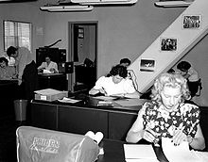
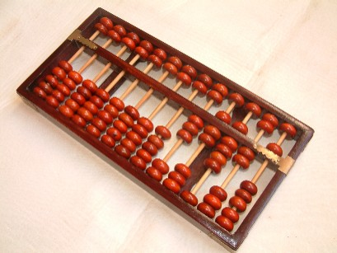
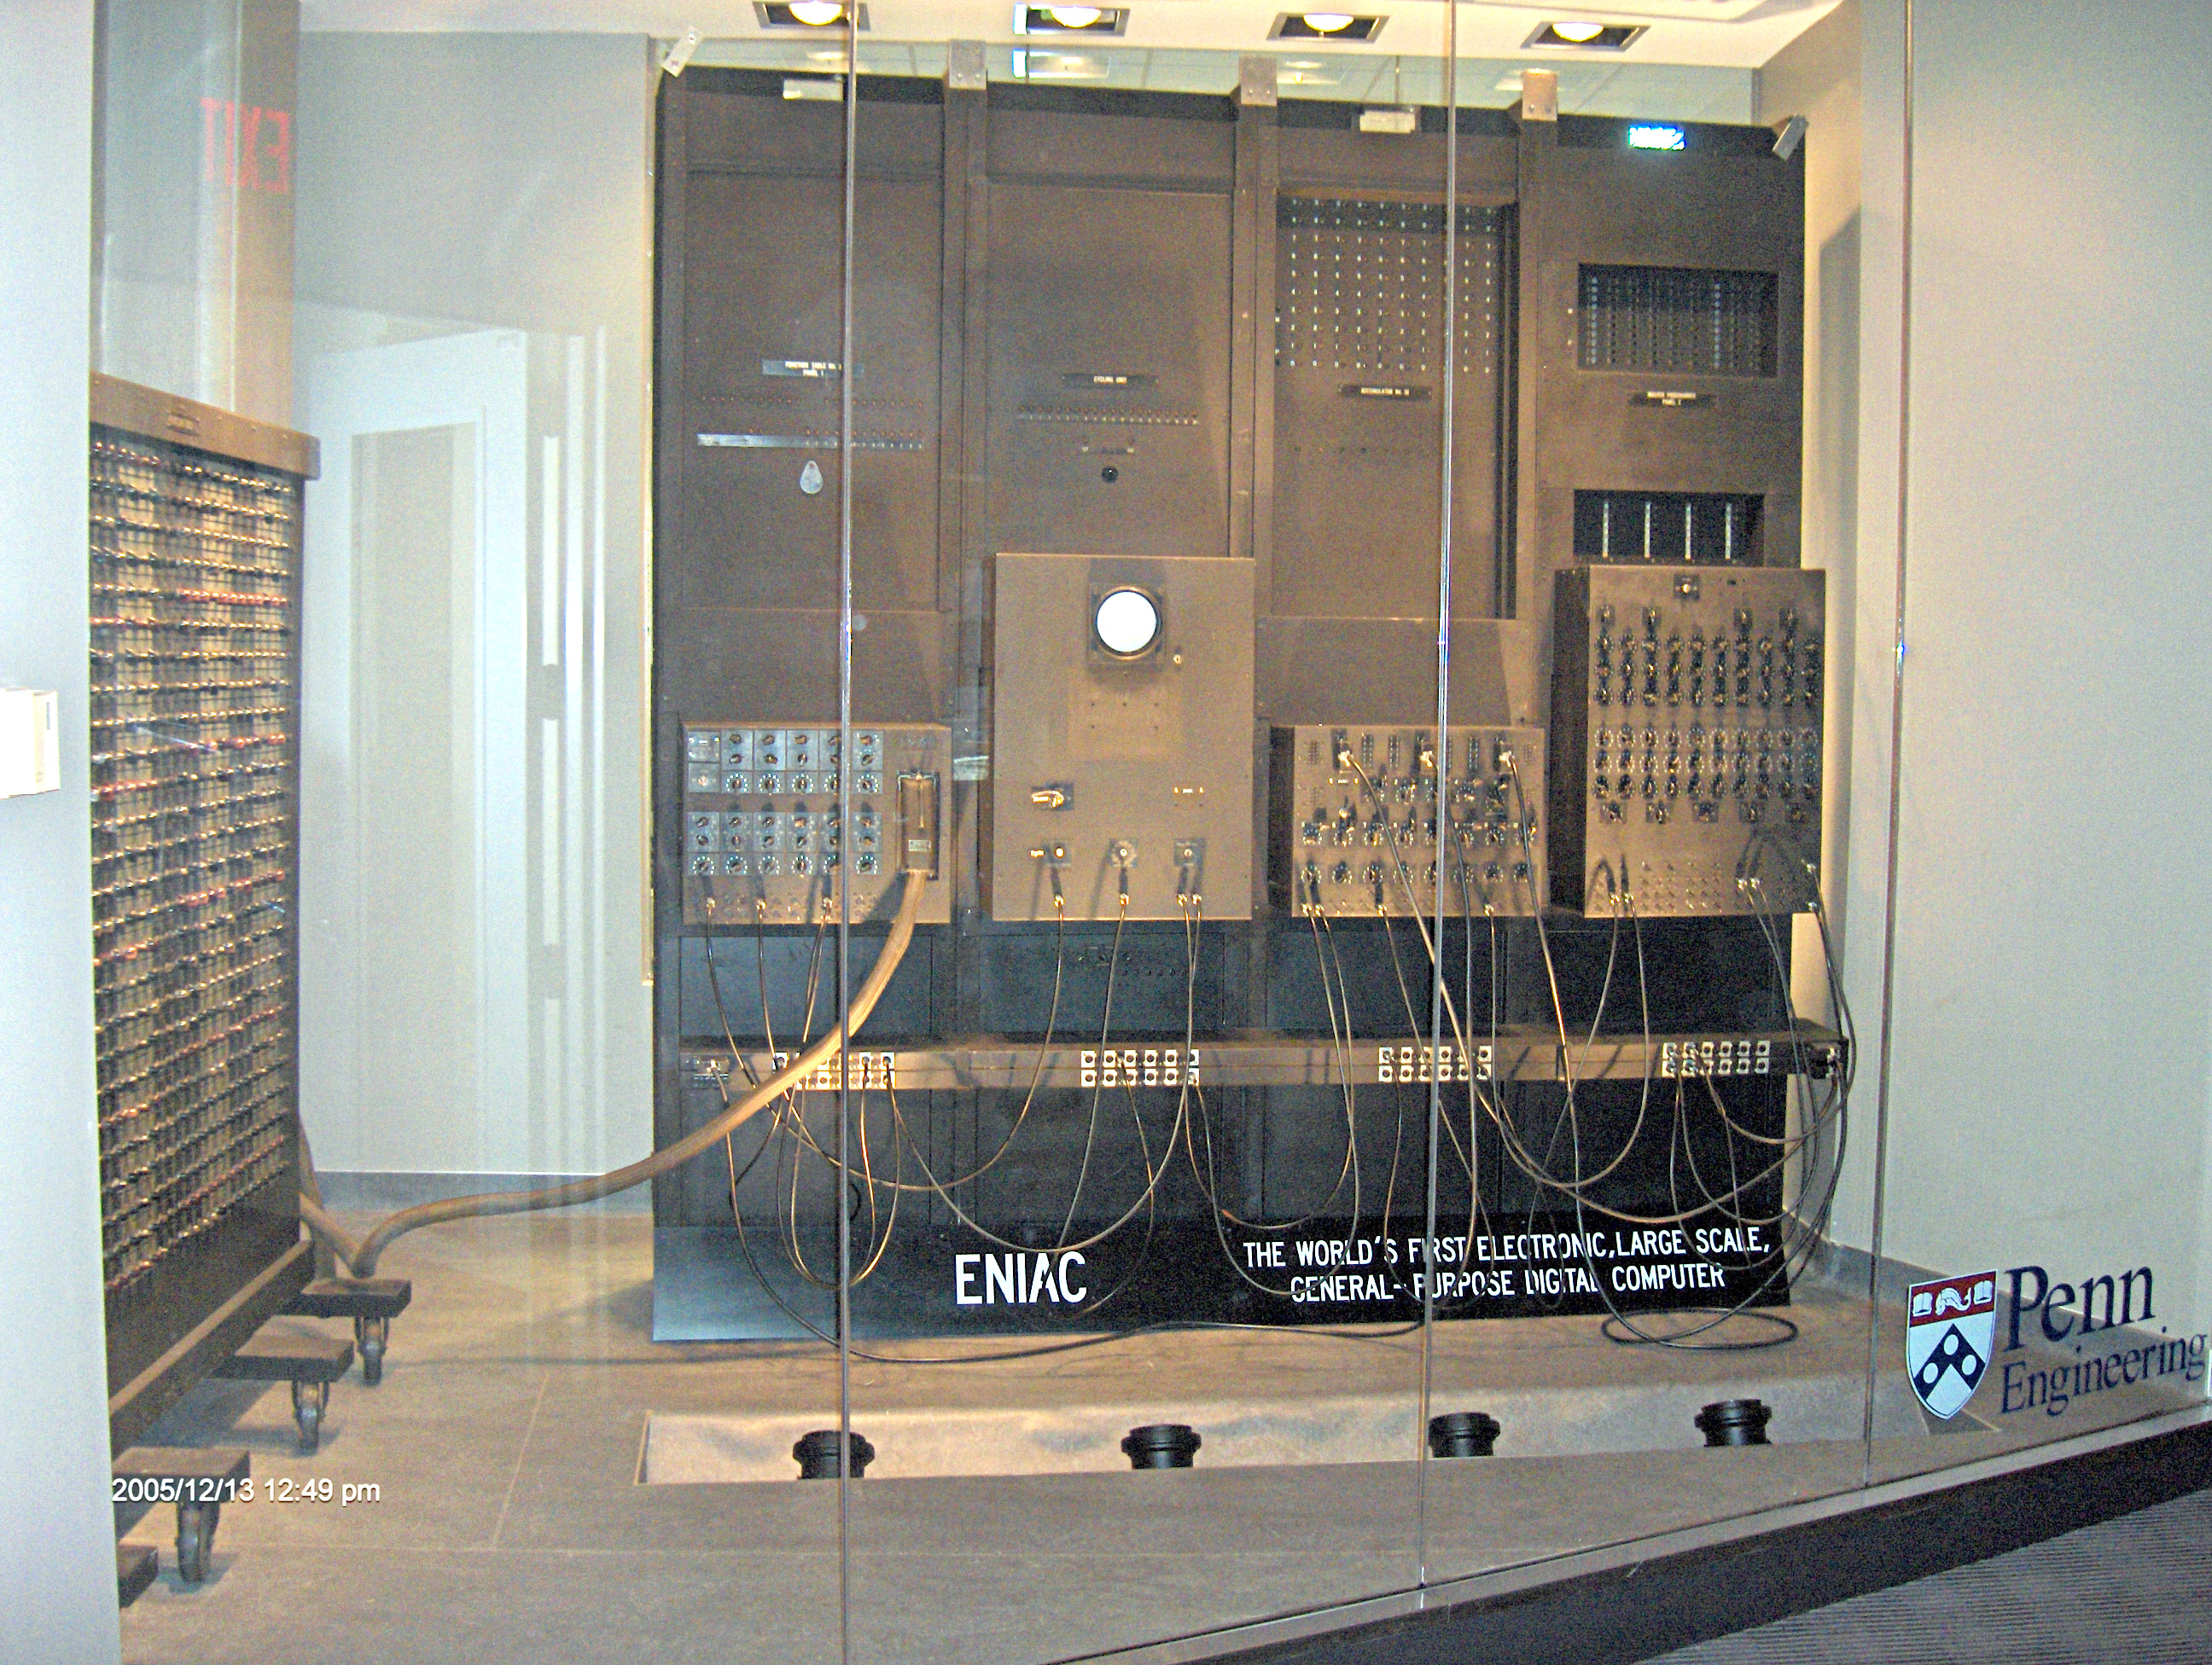
A bit of history

Slide 5
Progress
Year | Technology | Performance / Unit Cost
1951 | Vacuum Tube | 1
1965 | Transistor | 35
1975 | Integrated Circuit (IC) | 900
1995 | Very Large-Scale IC (VLSI) | 2,400,000
2013 | Ultra Large-Scale IC | 250,000,000,000

Slide 6
Progress
Number of Years | Performance / Unit Cost
1951 – 1965 (14) | 35x
1965 – 1975 (10) | ~ 26x
1975 – 1995 (20) | ~2667x
1995 – 2013 (18) | ~ 104167x

Slide 7
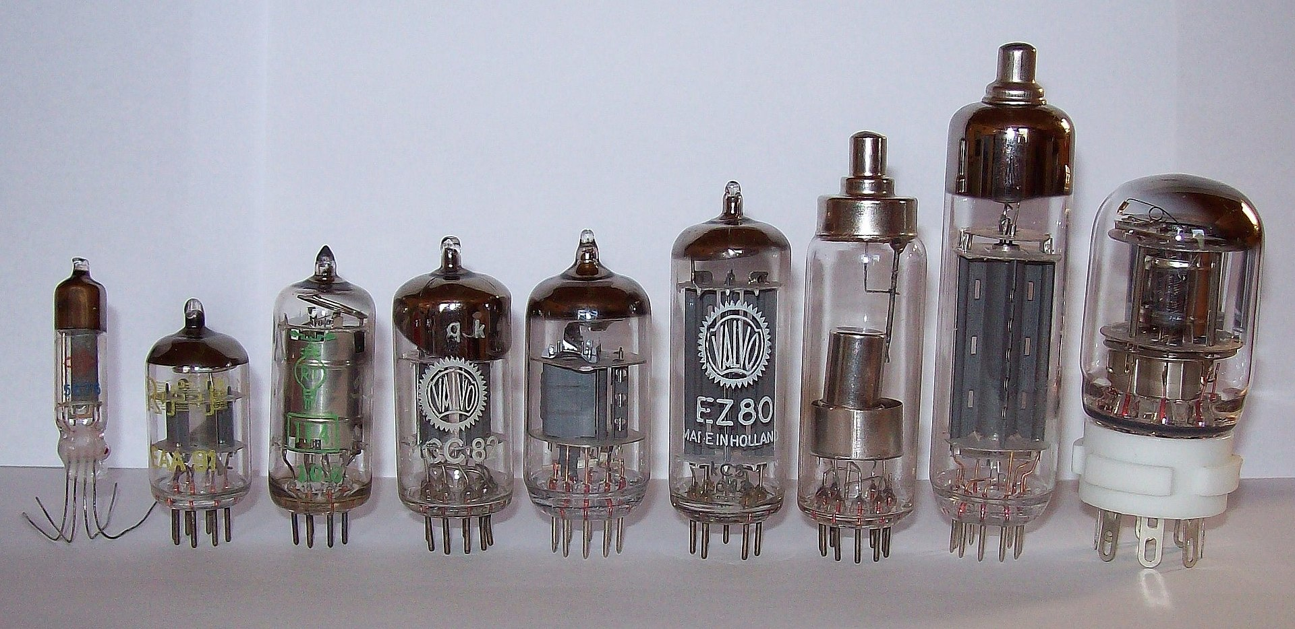
Vacuum Tubes
Thermionic valves
Vacuums are created within the tubes to allow electricity to flow
Results in gargantuan machines

Slide 8
Transistors
“Brain cells” of modern computers
Semiconductor device (Silicon)
Apply current at or above a certain threshold to get current flowing
Building blocks of integrated circuits

Slide 9
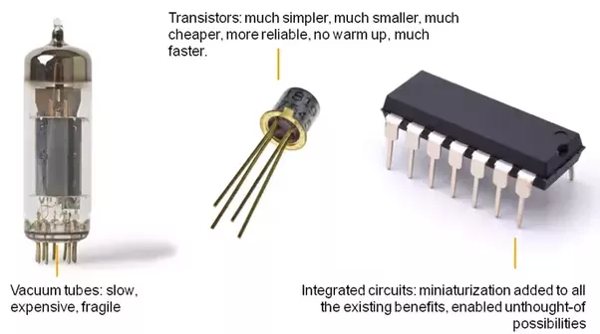
Integrated Circuits (ICs)
Combination of transistors into a single chip
Moore’s Law (section 1.2)
Predict increase in number of transistors per chip
Silicon (semiconductor)

Slide 10
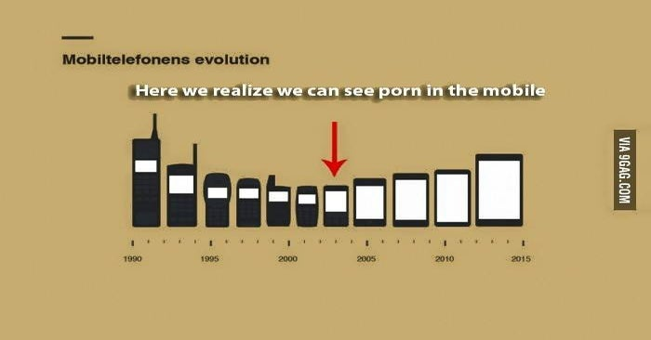
Integrated Circuits (ICs)
Evidence of Moore’s Law
I hope this humor is appreciated in class

Slide 11
Food for thought: Future
Quantum computers
Qubits

Slide 12
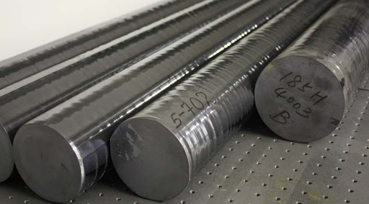
Silicon Crystal Ingot
A rod composed of a silicon crystal between 8 to 12 inches in diameter and approximately 12 to 24 inches long, used as the start of the manufacturing process for Integrated Circuits.
These ingots, in the manufacturing process for IC’s, are finely sliced into wafers <= 0.1 inches thick.

Slide 13
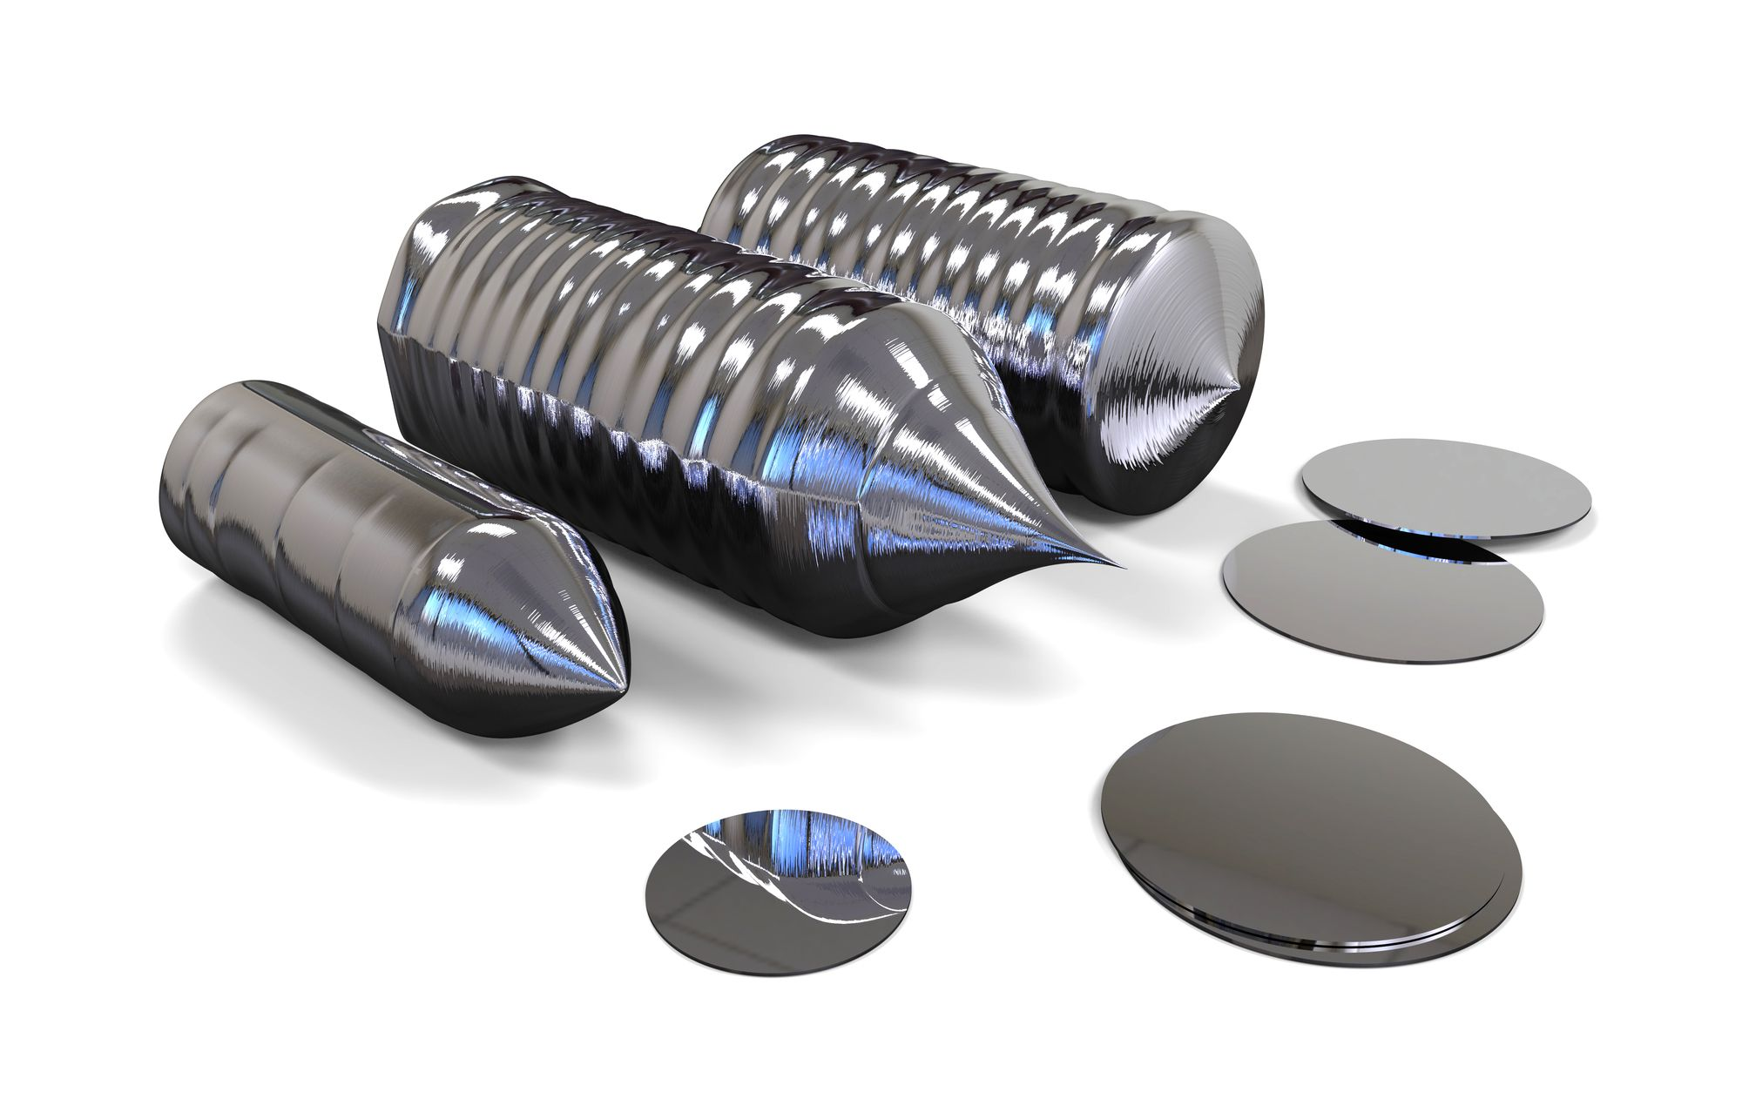
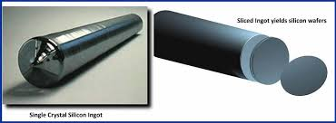
Wafer
A slice from a silicon ingot, that is no more then 0.1 inches in thickness.
Used to create chips via a series of processing steps (20-40 average steps) from blank wafers to patterned wafers.

Slide 14
Defect
During the processing steps between blank wafers and patterned wafers, a microscopic flaw in the original wafer or the processing steps can cause the die to fail.
These types of flaws, called defects, make it virtually impossible to produce a perfect wafer.
One way to cope with possible imperfections can be to place many independent components on a single wafer (Prompting the patterned wafer to be chopped into these components.

Slide 15
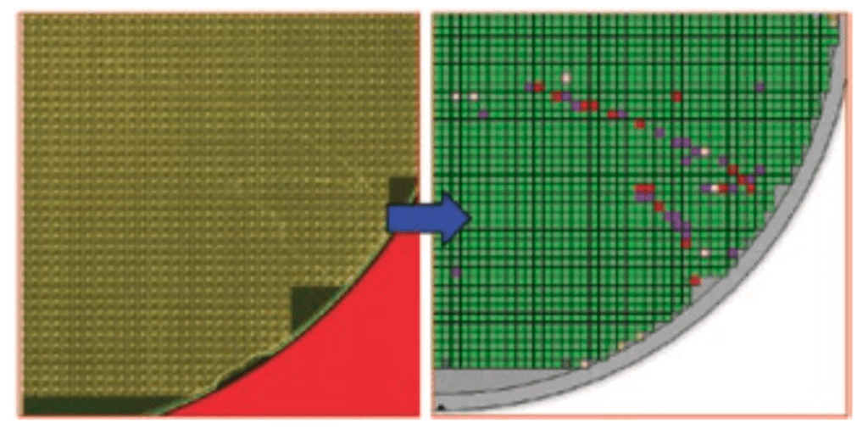
Representation -> Wafer Defect

Slide 16
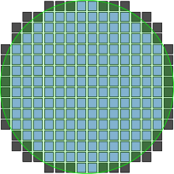
Die (Informally known as Chips)
When the patterned wafer is chopped, it can also be referred to as being diced.
The resulting rectangular sections that are cut from the wafer are known as dies, otherwise known as chips.

Slide 17
Yield
From dicing, doing so enables you to discard the imperfect/flawed dies instead of the entire wafer.
The comparison between the dies can also be referred to as the yield of a process, defined as the percentage/ratio between the good dies from the total dies on the wafer originally.

Slide 18
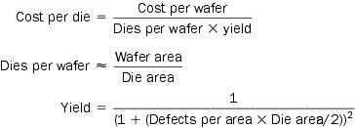
Food for Thought: Costs
Fluctuating Costs of an Integrated Circuit
Yield
Dies per wafer
Cost Reduction
The cost can be determined from three different equations
First: Derive
Second: Approximation
Third: Empirical observations of yields
Generally NOT linear

