Slide 1
Computer Abstractions & technology
1.5
Technologies for building processors & memory

Slide 2
Introduction
<…>

Slide 4
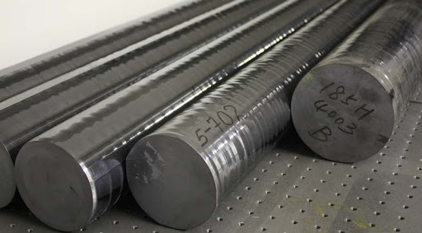
Silicon Crystal Ingot
A rod composed of a silicon crystal between 8 to 12 inches in diameter and approximately 12 to 24 inches long, used as the start of the manufacturing process for Integrated Circuits.
These ingots, in the manufacturing process for IC’s, are finely sliced into wafers <= 0.1 inches thick.

Slide 5
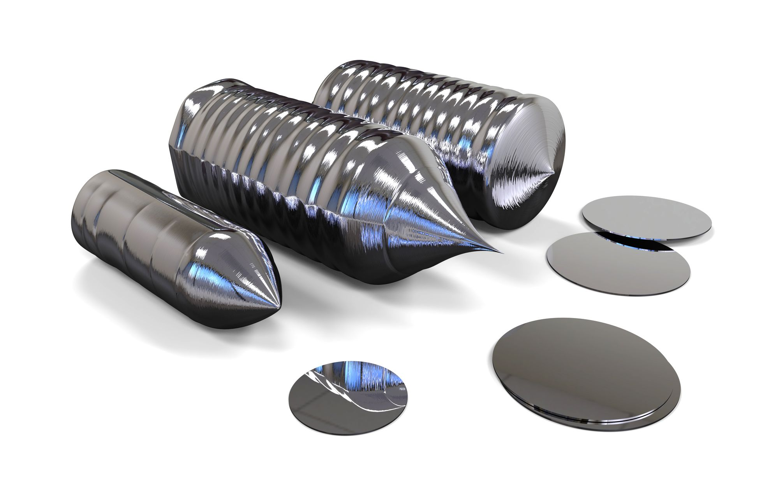
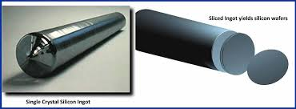
Wafer
A slice from a silicon ingot, that is no more then 0.1 inches in thickness.
Used to create chips via a series of processing steps (20-40 average steps) from blank wafers to patterned wafers.

Slide 6
Defect
During the processing steps between blank wafers and patterned wafers, a microscopic flaw in the original wafer or the processing steps can cause the die to fail.
These types of flaws, called defects, make it virtually impossible to produce a perfect wafer.
One way to cope with possible imperfections can be to place many independent components on a single wafer (Prompting the patterned wafer to be chopped into these components.

Slide 7
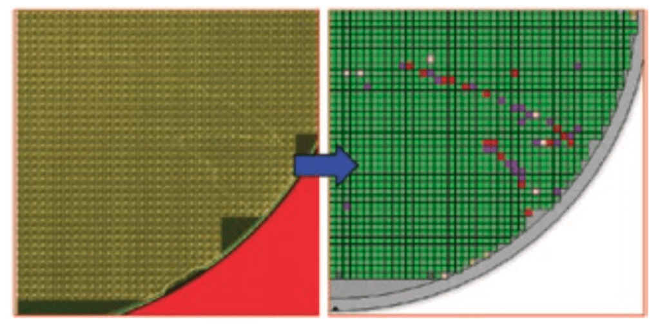
Representation -> Wafer Defect

Slide 8
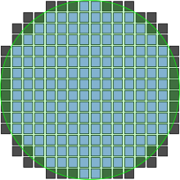
Die (Informally known as Chips)
When the patterned wafer is chopped, it can also be referred to as being diced.
The resulting rectangular sections that are cut from the wafer are known as dies, otherwise known as chips.

Slide 9
Yield
From dicing, doing so enables you to discard the imperfect/flawed dies instead of the entire wafer.
The comparison between the dies can also be referred to as the yield of a process, defined as the percentage/ratio between the good dies from the total dies on the wafer originally.

Slide 10
Conclusion
<…>

