Slide 1
Better recommendations with RAG and LLMs
Sushant Karki
skarki@umd.edu
University of Maryland
Dec 11, 2023

Slide 2
Agenda
Project Overview
Motivation
Objectives
Methodology
Architecture
Results and Demonstrations
Challenges and Learnings:
Q&A

Slide 3
Project Overview
Combining Retrieval Augmented Generation and LLMs:
Using Retrieval Augmented Generation with Large Language Models to improve local business recommendations.
Personalization:
Creating a chatbot that makes recommendations based on individual user queries and preferences.

Slide 4
Motivation
Addressing Search Limitations:
Tackling the challenge of standard search engines' inability to provide highly personalized and context-specific results.
Evolving Search Trends:
Responding to the shift in user search behavior, with a growing preference for AI-driven, conversational interfaces like ChatGPT.
Potential of LLMs:
Inspired by the advancements in Large Language Models, leveraging their capacity to significantly enhance the accuracy and relevance of business recommendations.

Slide 5
Objective
To create a chatbot that, based on its interactions with the user, refines its recommendations and responds with tailored recommendations for the user’s query.

Slide 6
Methodology
Dataset
Data processing
Knowledge Base
Chatbot Implementation

Slide 7
Dataset
Google Reviews (5 Million reviews, 1M used)
Business Metadata (78,000 businesses)
{
"user_id": "116210082545550472083",
"name": "Brian A",
"time": 1528719383671,
"rating": 5,
"text": "Every time I have been to this place I am in and
out and the customer service is outstanding. Every
staff member I have interacted with was extremely
nice and professional.",
"pics": null,
"resp": null,
"gmap_id": "0x89b7a76096bdad0b:0x66e4be0af3dc1720"
}
{
"name": "My Express Care Pharmacy",
"address": "My Express Care Pharmacy, 4453 Crain Hwy,
White Plains, MD 20695",
"gmap_id": "0x89b7a76096bdad0b:0x66e4be0af3dc1720",
"description": null,
"latitude": 38.5908611,
"longitude": -76.9429746,
"category": ["Pharmacy"],
"avg_rating": 4.6,
"num_of_reviews": 32,
"price": null,
………………………………………………………………….
…………………………………………………………………..
}

Slide 8
Data Processing
Platform: Databricks
Engine: Apache Spark
Cloud Provider: AWS
Details:
Augmented reviews data with the corresponding business data
Created appropriately formatted documents for storage
Build knowledge base using the documents by generating embeddings and storing them in a vector database

Slide 9
Data Processing
Sample document:
### Address: Pisces Crab & Seafood, 1448 Martin Blvd, Middle River, MD 21220
### Name: Pisces Crab & Seafood
### Review: First i called and someone picked up the phone but didn't say hello or anything and left me on the phone. I called again at 245pm and ordered 1 med male and 2 med female and was told my order will be ready at 3:30. I then get a call at 315 telling me they didn't have no more med female but small. So I said give me two small females then and was told that my order will now be ready 30min later than the original time. So now its so suppose to be ready at 4pm. So now I get another call at 3:45 saying I'm calling to let you know we out of med female and I said someone already called me a half hour ago. Then a girl said oh someone told her they didn't call to explain about the med female. So now its 4pm I go get the crabs and was told there not ready probably about 10 to 15min. So over this. Also while I was in there someone ordered shrimp before I came in and the guy was sitting waiting then was told they was sold out of the shrimp. Lol i waited because I drove 30 min to try this place out and was not driving all over.I went back in at 4:17pm they know longer have med males.. they tried to offer me something. I just got my money back.. Horrible This was my first time and will not be back. Hey you have to see for yourself but this was my personal review and experience. You might just have a better experience than I had.
### Average Rating: 4.40
### Hours: [['Thursday', '11AM–9PM'], ['Friday', '11AM–9PM'], ['Saturday', '11AM–9PM'], ['Sunday', '11AM–9PM'], ['Monday', 'Closed'], ['Tuesday', '11AM–9PM'], ['Wednesday', '11AM–9PM']]
### URL: https://www.google.com/maps/place//data=!4m2!3m1!1s0x89c7fdc2fef23149:0xe285d99a76b16ca1?authuser=-1&hl=en&gl=us
### Description: N/A
### Categories: Seafood restaurant
### Latitude/Longitude: 39.3343099, -76.4454445
### Hours: [['Thursday', '11AM–9PM'], ['Friday', '11AM–9PM'], ['Saturday', '11AM–9PM'], ['Sunday', '11AM–9PM'], ['Monday', 'Closed'], ['Tuesday', '11AM–9PM'], ['Wednesday', '11AM–9PM']]
### Misc: {"Accessibility": ["Wheelchair accessible entrance"], "Amenities": ["Good for kids"], "Atmosphere": ["Casual"], "Dining options": ["Dessert"], "Health & safety": ["Mask required", "Staff required to disinfect surfaces between visits"], "Offerings": ["Comfort food", "Quick bite"], "Popular for": ["Dinner", "Solo dining"], "Service options": ["Takeout", "Dine-in"]}

Slide 10
Knowledge Base
Used Pinecone as the Knowledge Base for storing document embeddings because of its ease of use
A spark connector is provided by Pinecone that makes it easy to ingest embeddings into Pinecone database in a Spark workflow.

Slide 11
Chatbot Implementation
Used Llama2-7B-chat as choice of LLM
Used Langchain with Llama-2 to build a Retrieval-augmented generation (RAG) chatbot
2 Approaches:
LLM Chain
For any user query, looks it up in the knowledge base and responds based on the retrieved documents
Agent
A LLM equipped with tools (in our case, the Pinecone knowledge base)
Based on the query, the LLM first decides whether or not it needs a tool to respond to the query, and only uses the tool if it decides that it needs to use the tool to respond to the query
Eg. For a user query of “Hi there”, the agent doesn’t need to search the knowledge base, so it decides not to use the knowledge base

Slide 12
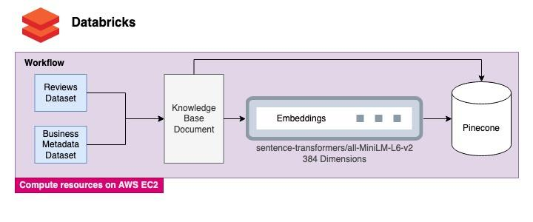
Architecture

Slide 13
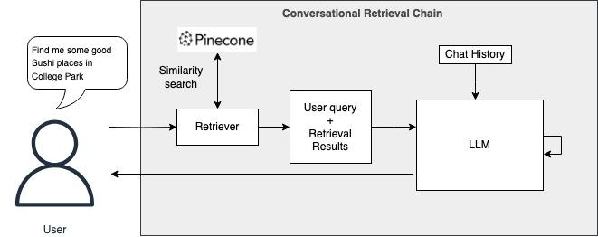
Architecture

Slide 14
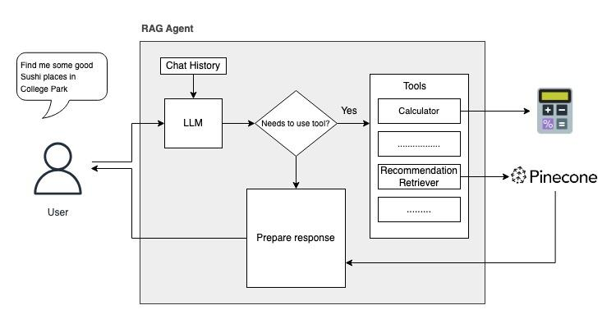
Architecture

Slide 15

Results and Demonstrations

Slide 16
Challenges and Learnings
Prompt Engineering is not easy
Could get LLM chain to work but failed to use retrieval as a tool for a LLM agent
Spent most of my time on finding the right prompt to make the LLM consistently respond with a specific format
Langchain support for local LLMs is limited at the moment
Learned a lot about Langchain and its ecosystem

Slide 17
Future work
Use RAG as a tool for an agent
Build a Web UI
Add more data
Add more tools
Replace Llama-2 with a more powerful LLM
Use a stronger embedding model

Slide 18
Q&A
Any questions?

Slide 19
References
1. Apache Spark: Used for data processing.
URL: https://spark.apache.org/
2. AWS EC2: Used for compute resources
URL: https://aws.amazon.com/ec2/
3. Google Local Data (2021): Dataset used for the chatbot’s knowledge base.
URL: https://datarepo.eng.ucsd.edu/mcauley_group/gdrive/googlelocal/#subsets
4. Langchain: Application of Retrieval Augmented Generation (RAG) with LLMs.
URL: https://www.langchain.com/
5. LLaMA-2-7B-chat Model: Used as the Large Language Model for chatbot development.
Hugo Touvron et al. "Llama 2: Open Foundation and Fine-Tuned Chat Models." arXiv:2307.09288 [cs.CL].
Available at: https://doi.org/10.48550/arXiv.2307.09288
6. Pinecone: Vector Database
URL: https://www.pinecone.io/

