Slide 1
Collision Avoidance in Formation Control
Mike Reynolds

Slide 2

Abstract
Task: Path Planning for a formation with collision avoidance
Challenges:
Avoidance
Feasibility
Computational Efficiency
Solution: Motion planning to “best spot” to minimize formation deviation
Future Work:
Exploration of dynamic obstacles
Control Barrier Function
Online planning
Path Planning Used: Hybrid A* planner

Slide 3
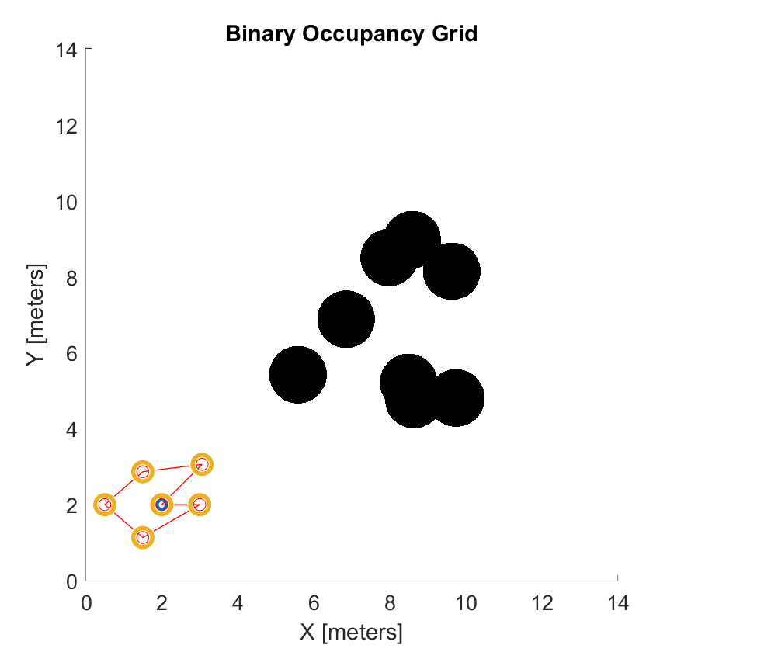
Problem Formulation
Assumptions:
-Single Integrator Dynamics
- All obstacles have the same safety radius
-All agents have the same safety radii
-Every agent is stationary except for the agent moving
-Each agent has knowledge of each other agent and the obstacles
-The formation will in general follow a predetermined path
-Formation is initially safe

Slide 4
Formation Construction
Agent
𝜃* = Angle w.r.t Formation Heading
Heading of formation
r* = Distance from Formation Center
𝛾 = Heading w.r.t global x
y
x₀= Formation Center
x
Global Inertial Coordinate System

Slide 5
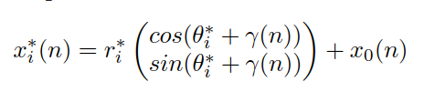
Ideal Location

Slide 6
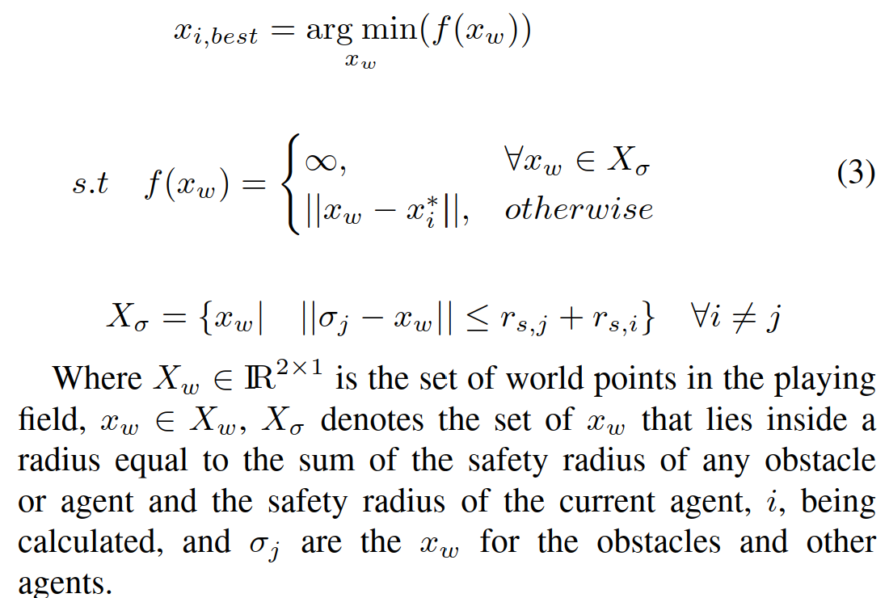
Best Point

Slide 7
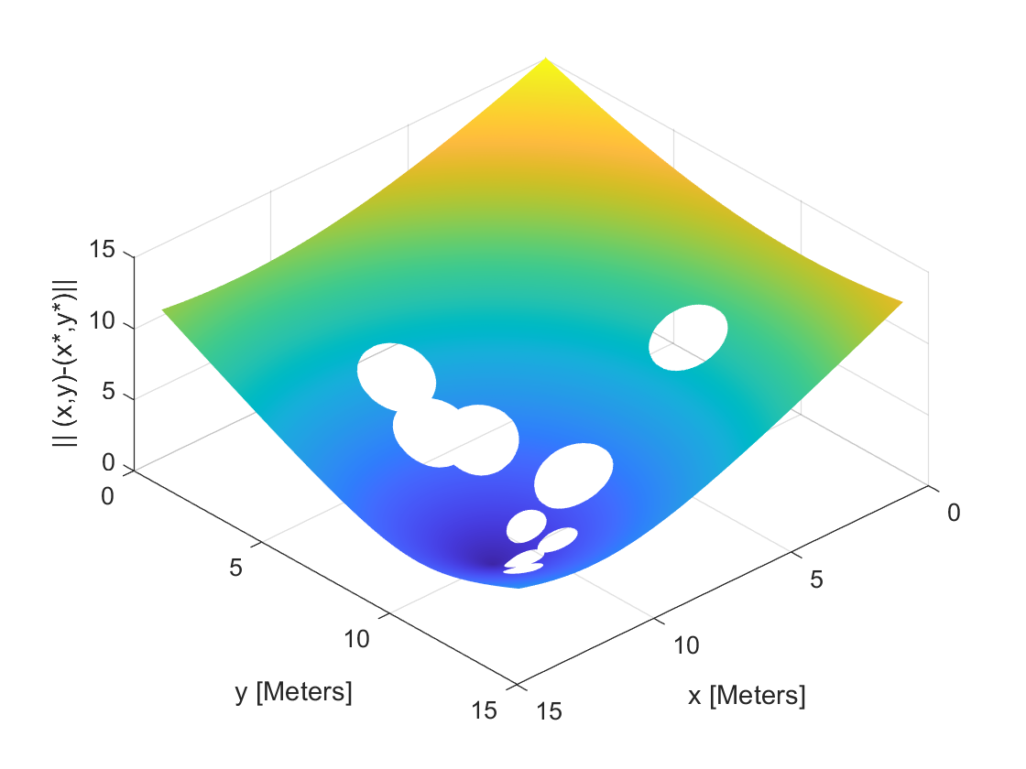
Sample Best Point Calculation
“Best Point”

Slide 8
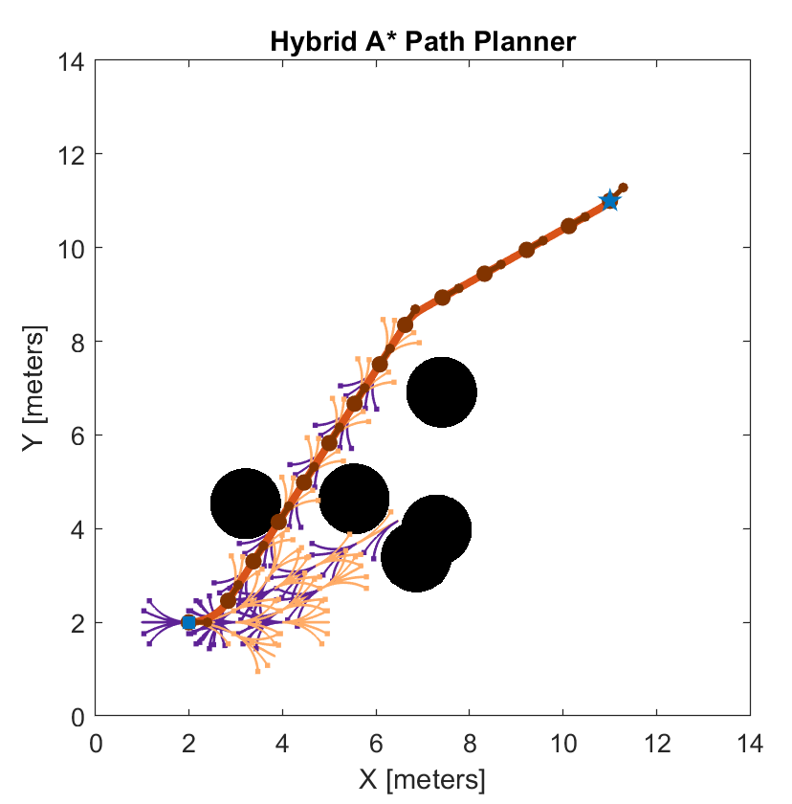
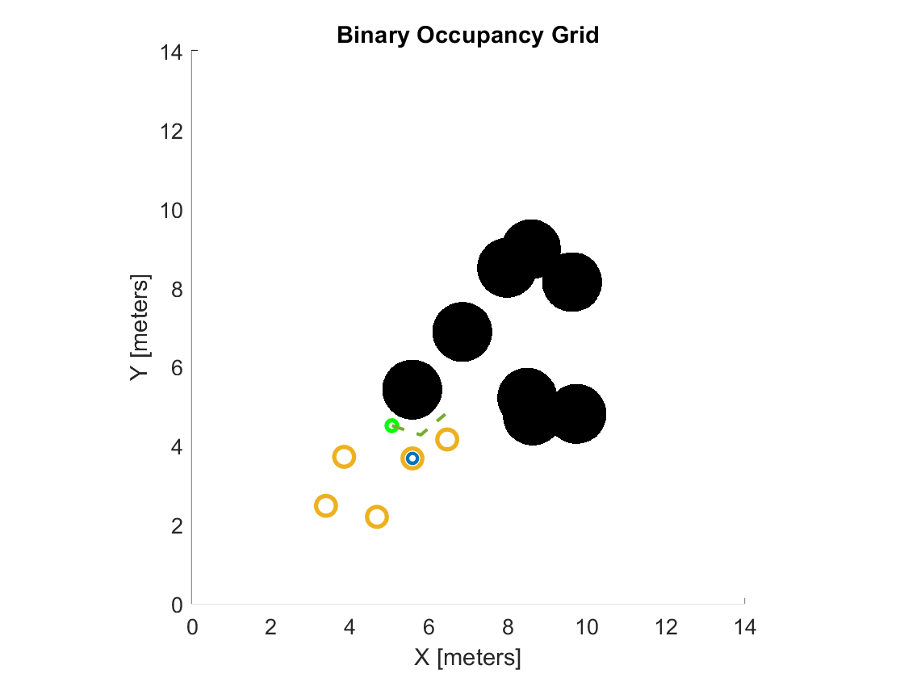
Path Planning

Slide 9
Method Workflow
Start
End
Step = 0, Agent = 1
Yes
Step = K?
Agent = 1
Yes
No
Get next point for Formation center
Agent = N?
Calculate Ideal location, x*,based on r*,𝜃*, 𝛾, and x₀
Step = Step + 1
No
For all unoccupied points, x, find ||x-x*||
“Best Spot” = arg min ||x-x*||
Find path to “Best Spot”
Agent = Agent + 1
Move to “Best Spot”

Slide 10
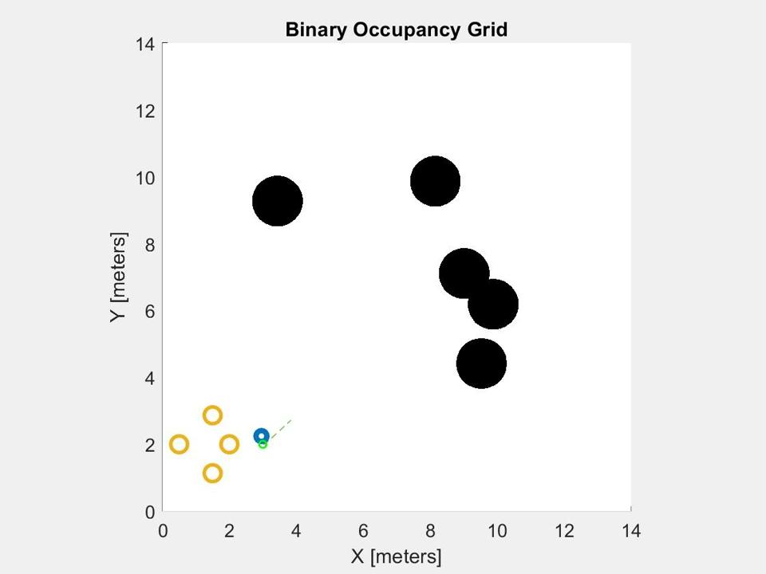
Results

Slide 11
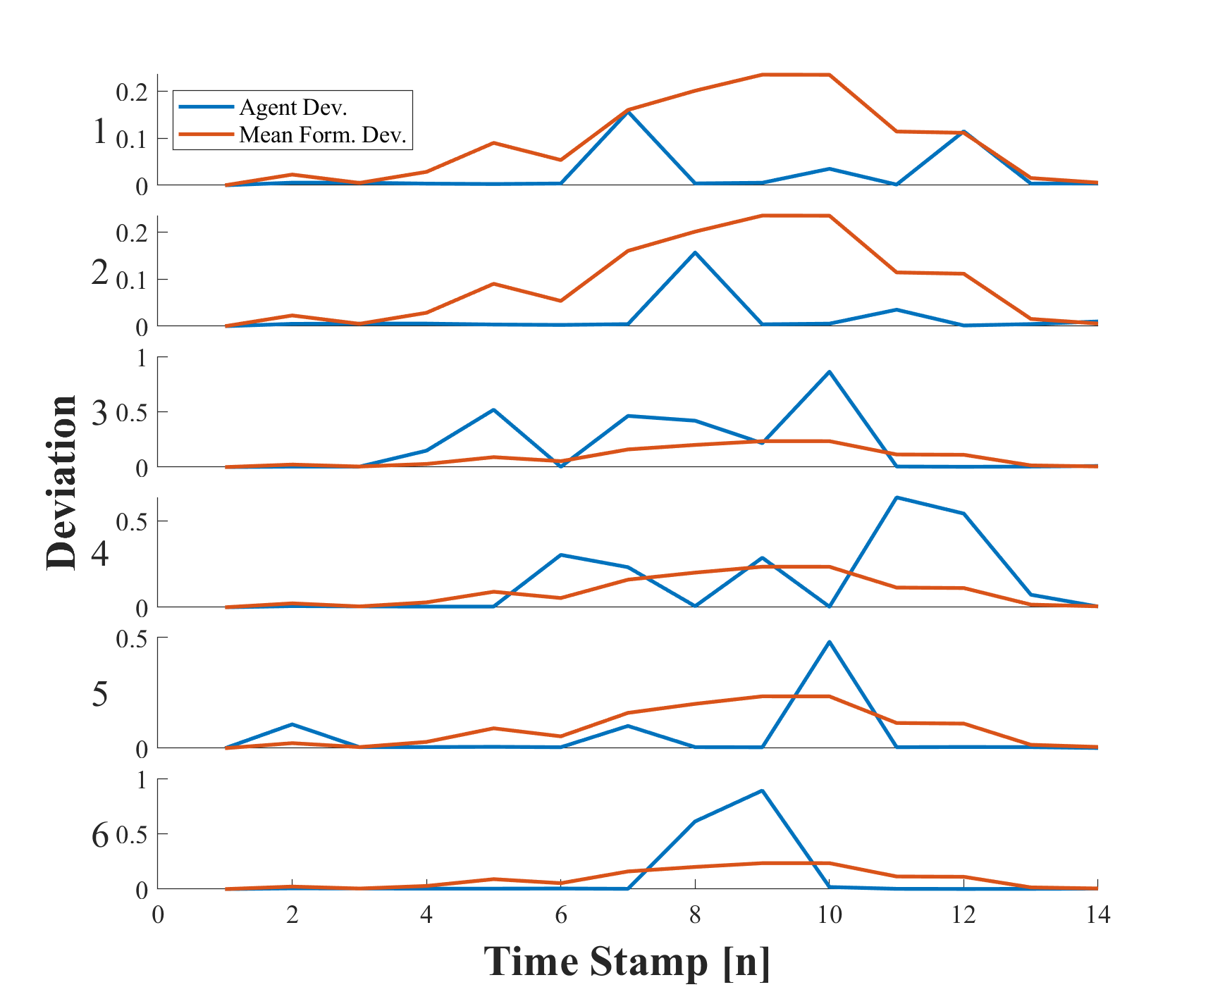
Deviation
Shows reasonable deviation for individual agents
Expected deviation for whole formation (i.e. deviation gets large while in obstacle field, and drops after the formation passes through)

Slide 12
Computationally Expensive
Clear drawback to this method
Mitigation:
-Implement A* if nonholonomic constraints can be ignored
-RRT*?
-Local best point may be faster to compute than a global best point
WARNING: make sure local region has a feasible path to best point

Slide 13
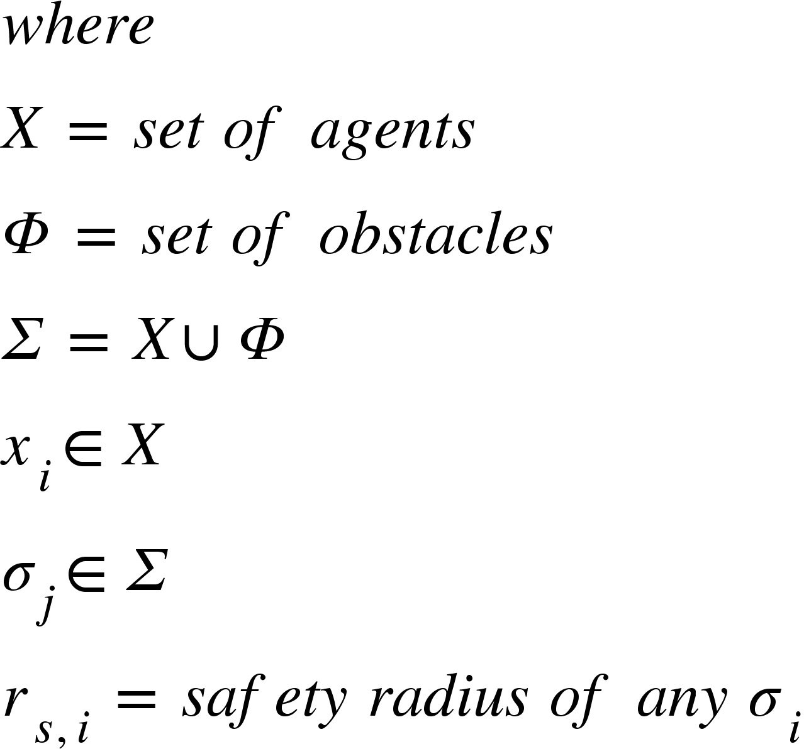
Discussion: Zeroing Control Barrier Function
-Smooth Max for Lipschitz Continuity
-Issues with miscalculation since smooth max is upper bound of actual max
[1] A. D. Ames, X. Xu, J. W. Grizzle and P. Tabuada, "Control Barrier Function Based Quadratic Programs for Safety Critical Systems," in IEEE Transactions on Automatic Control, vol. 62, no. 8, pp. 3861-3876, Aug. 2017, doi: 10.1109/TAC.2016.2638961. keywords: {Safety;Lyapunov methods;Cruise control;Electronic mail;Automotive engineering;Electrical engineering;Barrier function;control Lyapunov function;nonlinear control;quadratic program;safety;set invariance},

Slide 14
QP with Square Constraints
Maximum Safe Circle
Safe Square
Agent
Problems:
Safe set constricts when close to other agents or obstacles

Slide 15
Future Work
A better formulation of a Control Barrier Function may improve computation time and safety
Relaxation of the assumption that the positions of the obstacles and agents are known
Implementation of an online planner

Slide 16
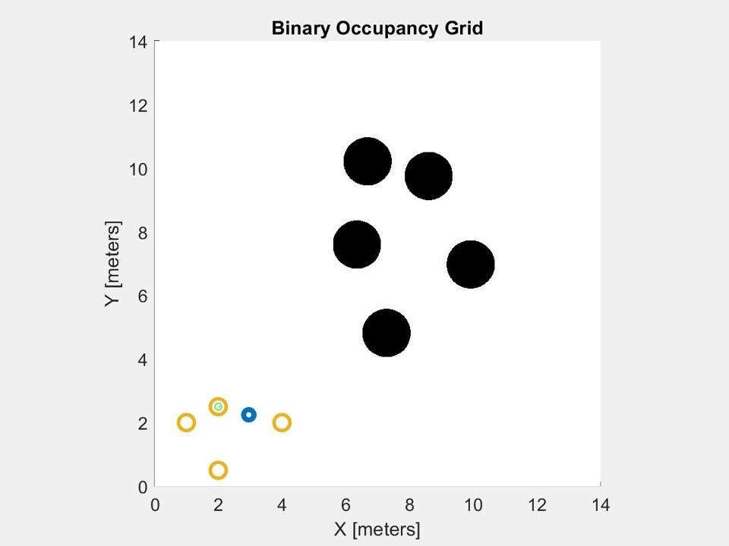
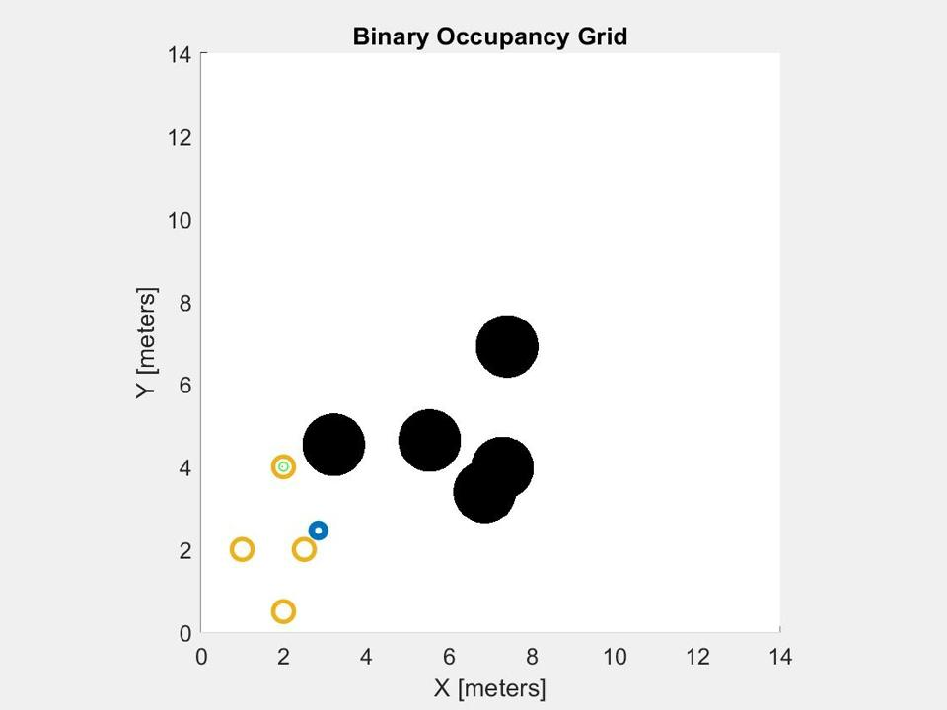
More Examples
Git Repository

