Slide 1
IETF Hackathon
IETF 111
19-23 July 2021
Online

Slide 2
Why Are We Here
Advance pace and relevance of IETF standards
Bring speed and collaborative spirit of open source community into IETF
Flush out ideas, feed into working group sessions
Produce sample code, reference implementations, utilities
Attract developers, new people to IETF
Match new, skillful developers with IETF veterans
University engagement around hackathon projects

Slide 3
Note Well
This is a reminder of IETF policies in effect on various topics such as patents or code of conduct. It is only meant to point you in the right direction. Exceptions may apply. The IETF's patent policy and the definition of an IETF "contribution" and "participation" are set forth in BCP 79; please read it carefully.
As a reminder:
By participating in the IETF, you agree to follow IETF processes and policies.
If you are aware that any IETF contribution is covered by patents or patent applications that are owned or controlled by you or your sponsor, you must disclose that fact, or not participate in the discussion.
As a participant in or attendee to any IETF activity you acknowledge that written, audio, video, and photographic records of meetings may be made public.
Personal information that you provide to IETF will be handled in accordance with the IETF Privacy Statement.
As a participant or attendee, you agree to work respectfully with other participants; please contact the ombudsteam (https://www.ietf.org/contact/ombudsteam/) if you have questions or concerns about this.
Definitive information is in the documents listed below and other IETF BCPs. For advice, please talk to WG chairs or ADs:
BCP 9 (Internet Standards Process)
BCP 25 (Working Group processes)
BCP 25 (Anti-Harassment Procedures)
BCP 54 (Code of Conduct)
BCP 78 (Copyright)
BCP 79 (Patents, Participation)
https://www.ietf.org/privacy-policy/ (Privacy Policy)

Slide 4
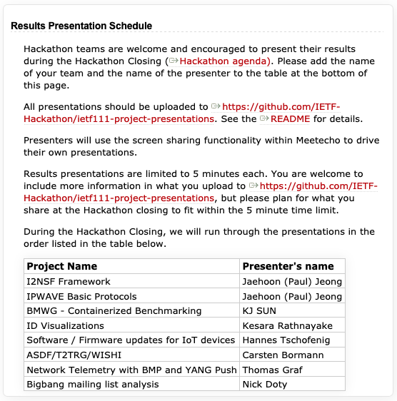
Agenda
Monday, 19 July 2021
Hackathon Kickoff - 12:00 - 14:00 PDT (19:00 - 21:00 UTC) ​Meetecho
Monday, 19 July - Friday, 23 July
Teams work on projects, see ​Team Schedule
Friday, 23 July 2021
Hackathon Closing - 12:00 - 14:00 PDT (19:00 - 21:00 UTC) Results Presentation Schedule Meetecho

Slide 5
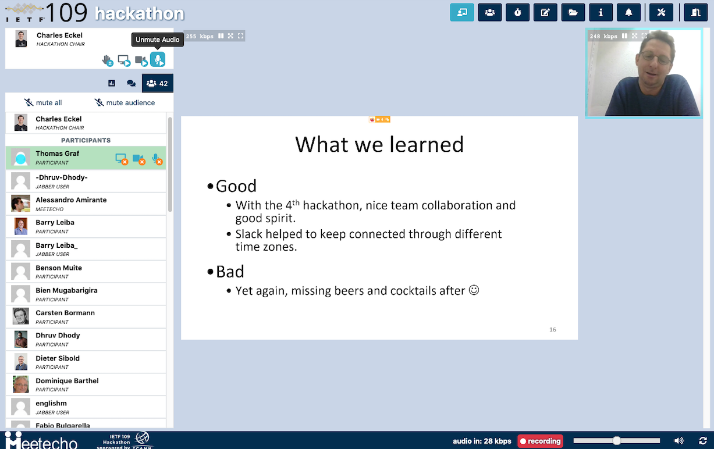
Project Presentations
What problem you tried to solve?
What you achieved?
Highlights
Lessons learned
Feedback to working group
Open source, other SDOs
5 minutes max

Slide 6
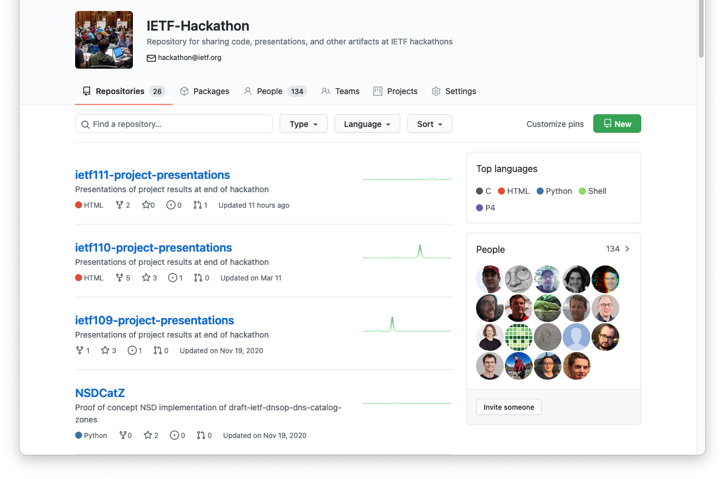
https://github.com/ietf-hackathon

Slide 7
Results Presentation Schedule

Slide 8

THANK YOU!

Slide 9

See you next time, in Madrid hopefully!

