Slide 1

BMP & YANG GROW and NETCONF WG
IETF 111
July 19-23th, 2021
Virtual Hackathon

Slide 2
BMP Hackathon - Plan
Performance
Measure CPU and memory consumption of BGP process when BMP Adj-RIB IN, OUT and Local-RIB with path-marking TLV is enabled.
draft-ietf-grow-bmp-local-rib (BGP Local RIB)
draft-grow-bmp-tlv (TLV support for BMP Route Monitoring and Peer Down Messages)
draft-cppy-grow-bmp-path-marking-tlv (Path Marking TLV)
Measure impact of BMP when session is stable, unstable, and when BGP peer is flapping.
Verify the completeness of information sent by BMP route-monitoring about BGP RIB state when BGP is congested.
Verify possible BGP route-propagation delay impact when BMP is enabled on a transit node.

Slide 3
Hackathon – Software
Software
pmacct nfacctd for IPFIX and BMP data collection
Apache Kafka as message broker
Apache Druid as timeseries DB
Pivot as user interface
Wireshark BMP dissector for packet analysis
ExaBGP for BGP VPnv4/6 route generation
Tutorial
https://imply.io/post/add-bgp-analytics-to-your-imply-netflow-analysis

Slide 4
Hackathon - Network
VPNv4 1'000'000 path's route generation with ExaBGP.
VPNv4 route-reflector BMP Adj-RIB IN pre-policy and Adj-RIB Out post-policy. with draft-ietf-grow-bmp-tlv and draft-cppy-grow-bmp-path-marking-tlv on Huawei VRP V800R013.
VPNv4 route-reflector BMP Adj-RIB Out post-policy on Juniper JunOS 21.1R1.11.
MPLS PE BMP Adj-RIB IN pre-policy on IOS XR 7.4.1 and IOS XE 17.6.1 EFT.

Slide 5
Lab Environment
Achievements
Test automation contains ExaBGP for sequenced BGP VPNv4 unicast route generation, BMP state initialization, BMP metric and YANG push cpu and memory process usage data collection.
BMP route-monitoring prefix loss and delay can be automatically measured.
CPU and memory usage now monitored on BGP process level.
Comparison between 4 different operating systems.
Next Steps
Redo same tests with higher scale and Cisco IOS XR being the route-reflector, Cisco IOS XE being the MPLS PE and improved timestamping on Huawei VRP.

Slide 6
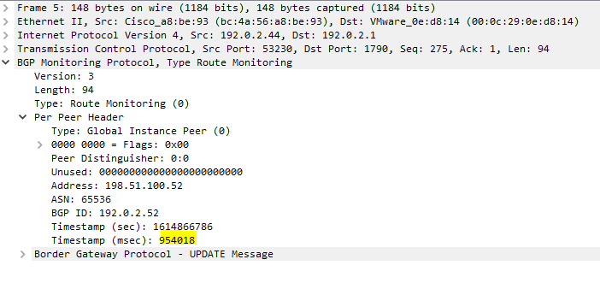
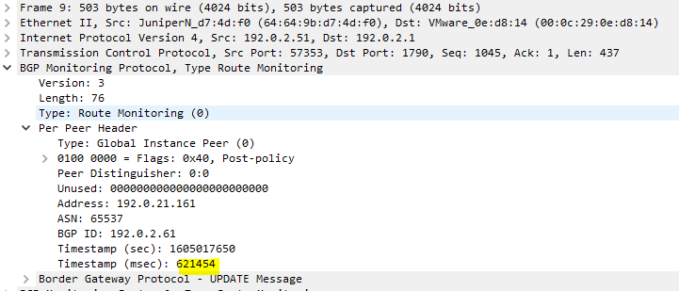
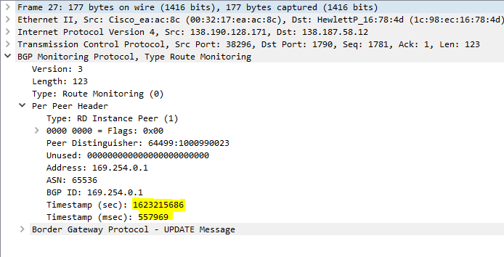
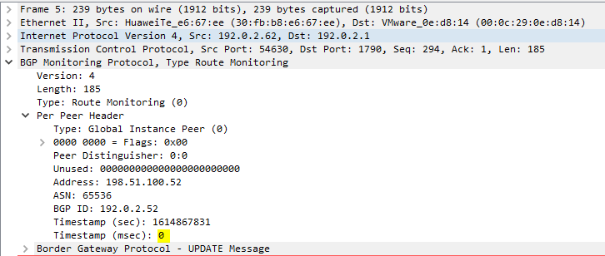
BMP Timestamping
Cisco IOS XR
Juniper JunOS
Huawei VRP
Cisco IOS XE
(msec in 17.6)

Slide 7
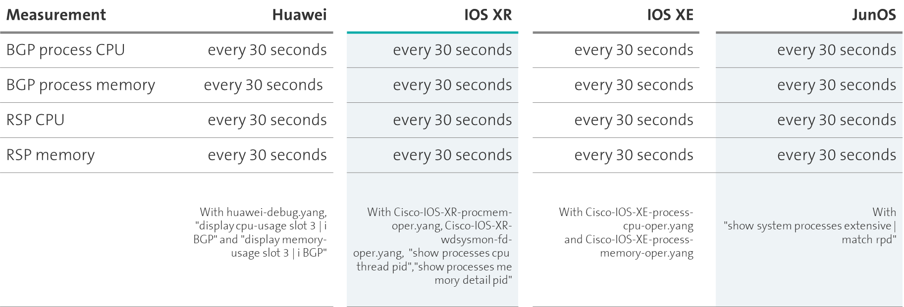
Device Measurement

Slide 8
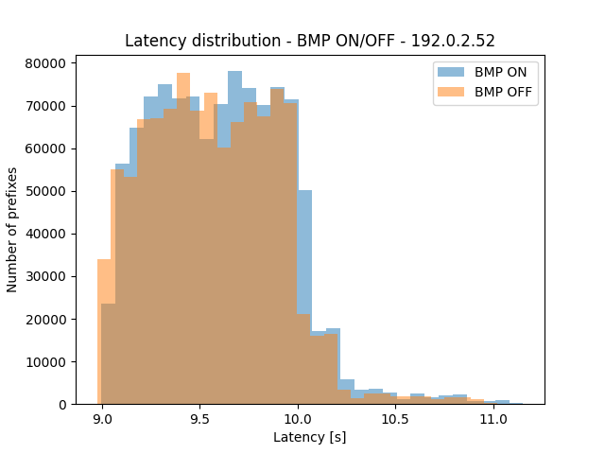
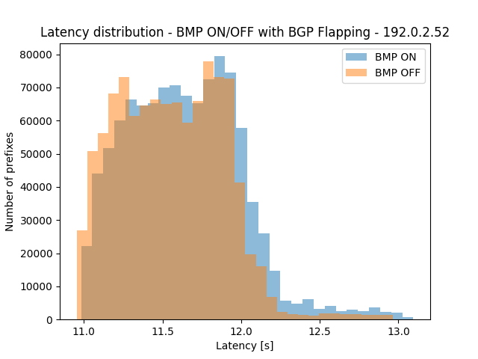
Huawei VPNv4 route-reflector Impact of BMP on BGP Propagation Delay
1'000'000 BGP VPNv4 unicast paths advertised as fast as possible to 10 peers. BMP session on/off - Stable vs. Flapped BGP.

Slide 9
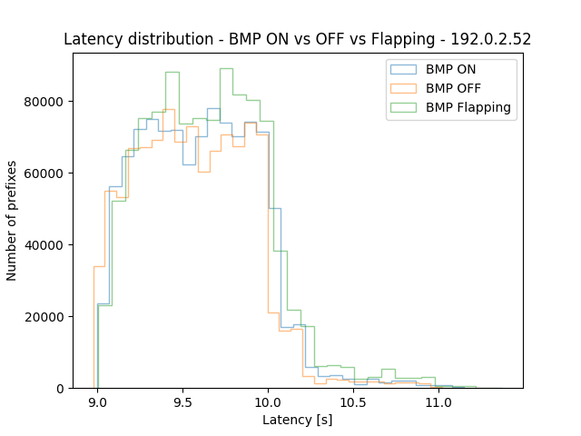
Huawei VPNv4 route-reflector Impact of BMP on BGP Propagation Delay
1'000'000 BGP VPNv4 unicast paths advertised as fast as possible to 10 peers. Delay comparison between BMP enabled, disabled and BMP session flapping

Slide 10
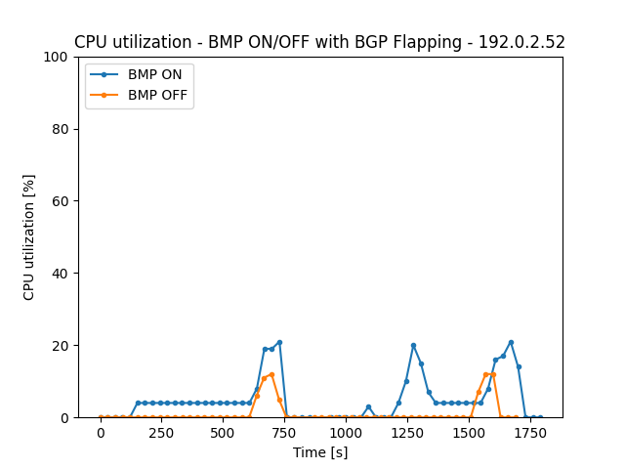
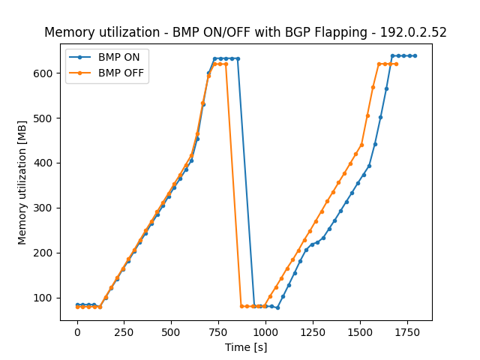
Huawei VPNv4 route-reflector Memory and CPU impact before and after BGP Flap
BGP Flap
BGP Flap
1'000'000 BGP VPNv4 unicast paths advertised as fast as possible to 10 peers. Memory and CPU comparison between BMP enabled and disabled

Slide 11
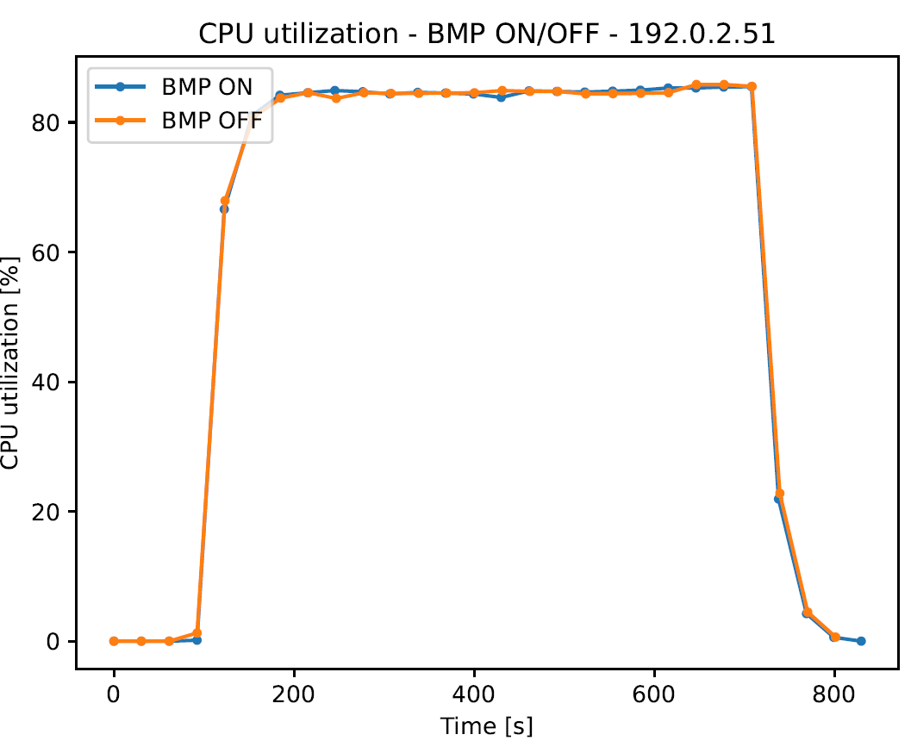
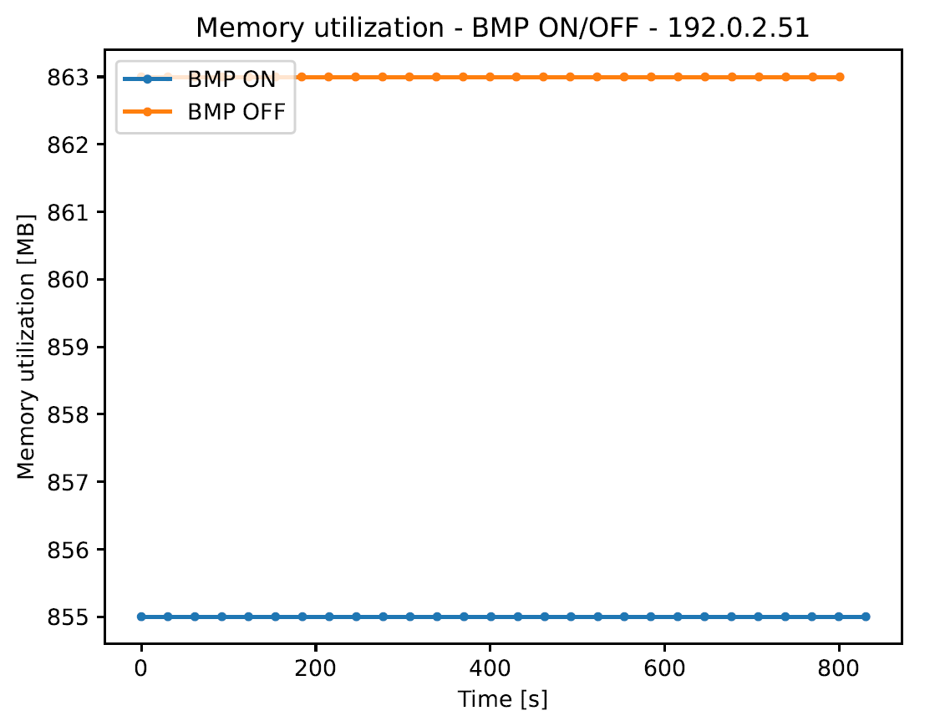
Juniper VPNv4 route-reflector Memory and CPU impact
1'000'000 BGP VPNv4 unicast paths advertised as fast as possible to 10 peers. Memory and CPU comparison between BMP enabled and disabled on Huawei RR

Slide 12
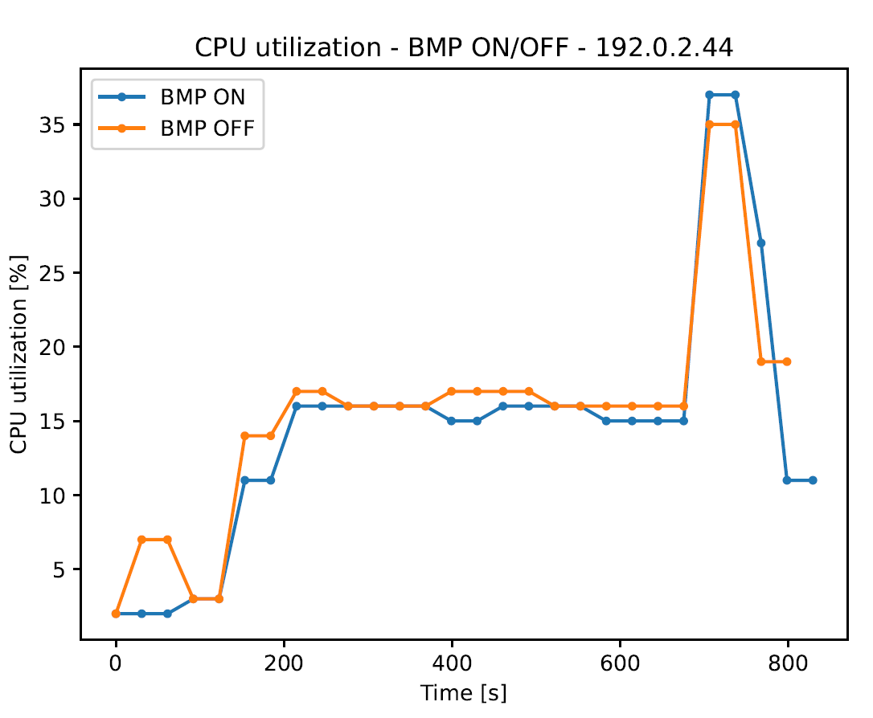
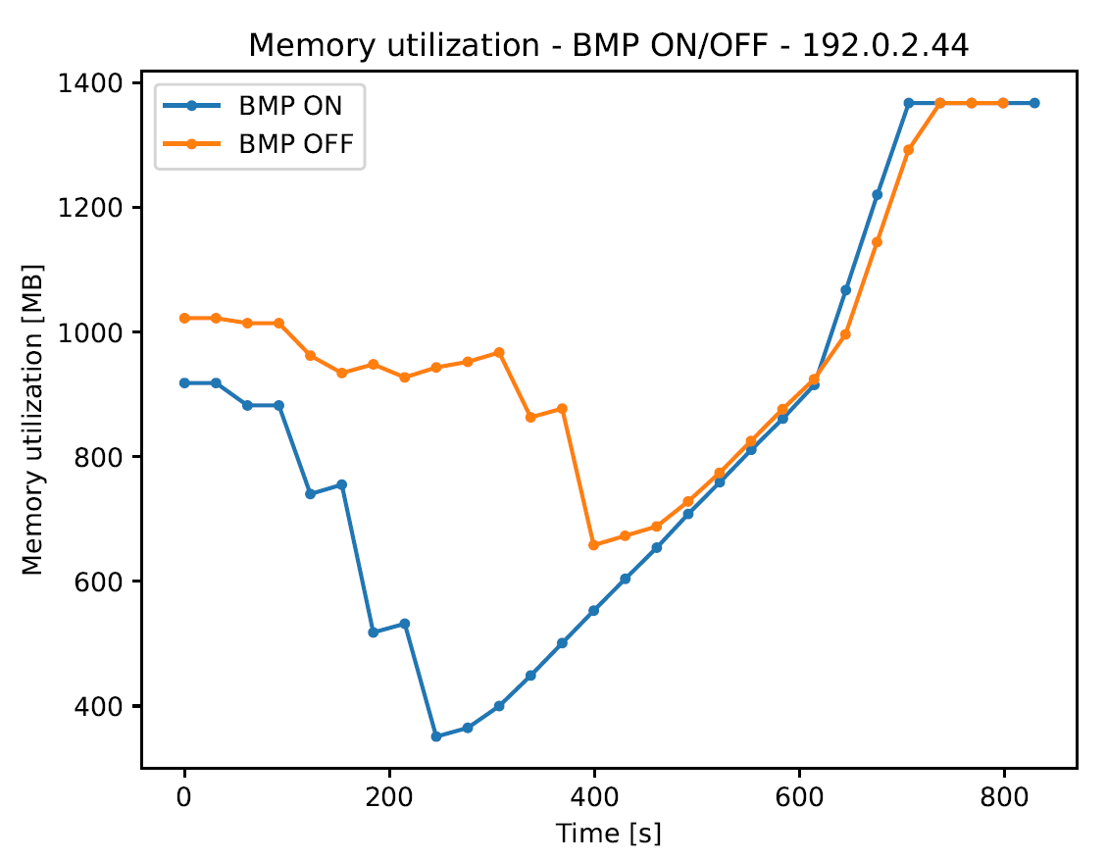
Cisco IOS XR MPLS PE Memory and CPU impact
1'000'000 BGP VPNv4 unicast paths advertised as fast as possible to 10 peers. Memory and CPU comparison between BMP enabled and disabled on Huawei RR

Slide 13
What we learned (again)
Good
With the 6th hackathon, we know the drill. Consistency more and more pays off.
Good preparation, planning with test automation was gold.
Bad
Testbed getting instable with 4'000'000 routes. Need to increase performance and stability.
Yet again, missing beers and cocktails after ☺

Slide 14
Thanks to…
Alex Huang Feng – INSA
Pierre Francois – INSA
Paolo Lucente – NTT
Marco Tollini - Swisscom
Matthias Arnold - Swisscom
Thomas Graf - Swisscom
…Imply for providing us the big data,
Huawei for the network environment and support,
and Cisco for Software and the test cases.

