Slide 1

Predicting NBA Game Outcomes
Exploring Supervised Machine Learning
Kevin Pickelman, Dr. Armstrong

Slide 2

Problem Description
Can NBA games be correctly predicted using supervised machine learning trained on historical team data?

Slide 3
Topics to Discuss
NBA Statistics
Data Acquisition
Supervised ML
Random Forest Classifier
Features Used
Hyperparameter Tuning
Results & Analysis – Post & Pre Game Statistics

Slide 4
NBA Statistics — Feature Selection
Overview of The Statistics Used
Focusing on team data
Points Per Game (PPG) — average points scored over n games
Win % (PCT) — wins / total games played
Effective Field Goal % (eFG) — metric to measure shooting efficiency
Player Impact Estimate Rating (PIE) — advanced formula to measure a team’s performance
Defensive Rating (DRTG) — number of points allowed per 100 possessions
Offensive Rating (ORTG) — measures a team's points scored per 100 possessions
Net Rating (NRTG) — measures a team's point differential per 100 possessions

Slide 5

NBA Statistics — Feature Selection
How Are They Measured?
eFG%: $\frac{FGM+(0.5x3PM)}{FGA}$
PIE Rating:
ORTG: $(\frac{PointsScored}{Possessions})x100$
DRTG: $(\frac{PointsAllowed}{Possessions})x100$
(PTS + FGM + FTM – FGA – FTA + Deff.REB + Off.REB/2 + AST + STL + BLK/2 – PF – TO) /
(Game.PTS + Game.FGM + Game.FTM – Game.FGA – Game.FTA +
Game.Deff.REB + Game.Off.REB/2 + Game.AST + Game.STL + Game.BLK/2 – Game.PF – Game.TO)

Slide 6
NBA Statistics — Feature Selection
Continued
In addition to the statistics previously noted:
Cumulative win percentage
Rebounds
Turnovers / TOV%
Possibility of adding removing features throughout the process

Slide 7
Supervised Machine Learning
What is it
Supervised means that the ML model can be trained & can “learn”
Model learns by being given human-labeled data, e.g. a picture of a cat labeled “cat” — this is the training data
The input is the picture, output is the label
The goal is that after training, the model can predict the label for unseen input
Predicting win / loss is a binary classification problem

Slide 8
Algorithms
Which Algorithms Will Be Utilized?
Random Forest Classifier

Slide 9

Random Forest Classifier
Ensemble method, made up of decision trees
Each decision tree is trained on a samples from random subset of the feature data (w/ replacement), this is Bootstrap Sampling
Roughly 37% of samples will not be chosen $(1−1/n)^{n}$ where n is num of samples — OOB (out-of-bag) samples
Calculate parent node impurity
Node impurity is measured before splitting (making a decision), Gini Impurity is used
Gini impurity measures the probability a feature is classified incorrectly, 0 is pure (good), 1 is impure (bad)

Slide 10

Random Forest Classifier
Randomly select subset of features (num of features), if 15 features, randomly select $\sqrt{1}5$ of them
Sort feature values & identify split points by finding midpoints between unique values
For each potential split point — we will calculate total Gini impurity, split on highest impurity reduction (gain) — lowest Gini value
After n rounds — a majority vote amongst the trees is casted
The result that appears the most is chosen

Slide 11
Random Forest Classifier
Parameters
n_estimators: controls the number of decision trees built in the random forest
oob_score: out-of-bag sample validation (boolean)
bootstrap: decides whether each tree learns from a random sample or all the data — true for random, false for all
n_jobs: controls number of processor cores to use during training, -1 sets to all available cores.

Slide 12
Primary Objective
Can supervised machine learning algorithms trained on historical team data predict game outcomes better than 60% of the time?
Limitations: 3-person weeks over one semester (120 hours, 14 weeks)

Slide 13
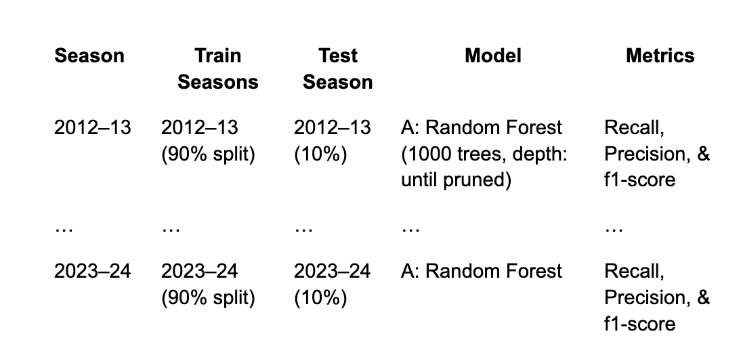
Experiment Block Design

Slide 14
Experiment Design
Gather, clean, and label data
Split between testing and training data using cross validation
Build up random forest
Check results using various metrics such as precision, recall, & f1score
Fine-tune, use various combinations of features & hyperparameters

Slide 15

Hypothesis
$H_{1}$ = A machine learning algorithm trained on team performance metrics will predict game outcomes with accuracy significantly greater than 50%, outperforming randomly guessing.
$H_{0}$ = This model does not perform significantly better than randomly guessing and does not show accuracy equal to 50%.

Slide 16
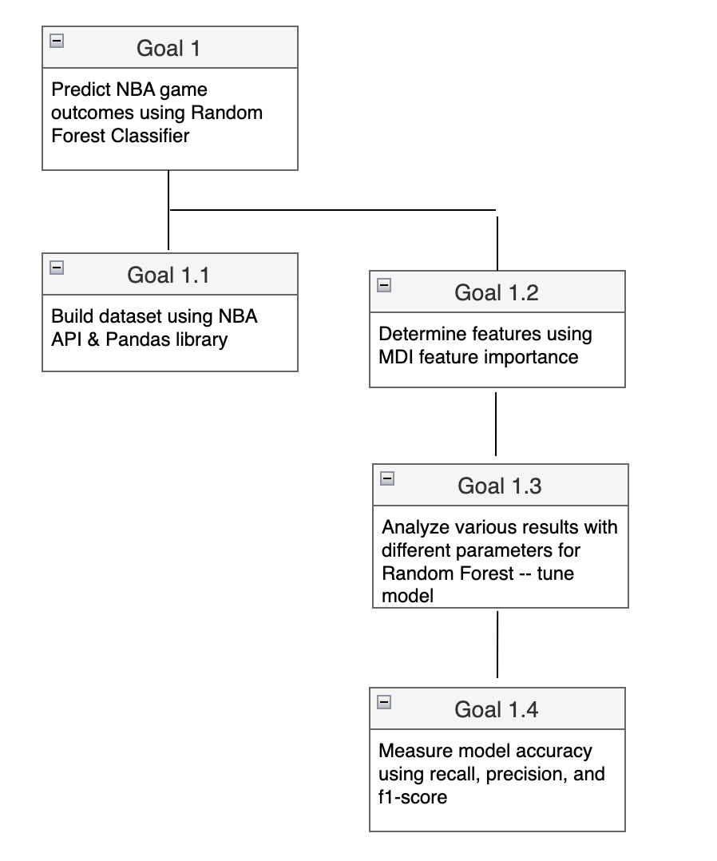
Goal Tree

Slide 17
Solution Description
Tools: Python w/ use of libraries & packages, mentor assistance
nba_api library for historical & live statistical data
pandas library & NumPy for manipulating data
Scikit-learn library for feature selection & model evaluation

Slide 18
Data Acquisition
Used NumPy/Pandas & an NBA API to create my own data set
Used data from 2012-2024
Included shortened COVID seasons
Had to collect game info in batches due to API rate limiting

Slide 19
Data Acquisition
Once basic data was collected, it was mutated into advanced statistics
31,340 rows with 27 columns
Uploaded to Kaggle with MIT license & 10.0 usability

Slide 20
Features Used
Had to discard PIE rating & PTS – caused data leakage and revealed the result
Used a rolling PIE, all games leading up to the current one

Slide 21
Hyperparameter Tuning
n_estimators set to 1,000 – minimal difference however when set above 500
criterion = ‘gini’ – this uses the gini impurity index mention earlier
max_depth set to none, trees grow until they are pure or until all samples are used
oob_score & bootstrapping are both set to True (I found when these are set to True the accuracy is improved, however only slightly – leads to a more verbose model)
n_jobs was set to -1, this utilizes all cores on the computer to speed up training

Slide 22
Result Analysis
Conducted experiments using pre-game and post-game statistics
Pre-game statistics used the statistics up-to the game being predicted
Post-game statistics used the statistics from the finished game
This was done to show the difference in prediction power – pre-game prediction is more accurate in terms of actual predictions
Used a 10/90 split for training and testing (this had the best results)
Results were measured using recall, precision, and f1-score accuracy. Added a confusion matrix plot for easier interpretation

Slide 23
Result Analysis – Measurements
Recall: true positives / true positives + false positives
Precision: true positives / true positives + true negatives
F1Score: recall * precision / recall + precision
Notes:
Recall – measured by taking true positives / true positives + false positives
Precision – measured by taking true positives / true positives + true negatives
F1 – recall * precision / recall + precision

Slide 24
Feature Importance
Used Mean Decrease Impurity for feature importance, shows how well a feature led to a pure split (reducing impurity). Higher MDI indicates more important features

Slide 25
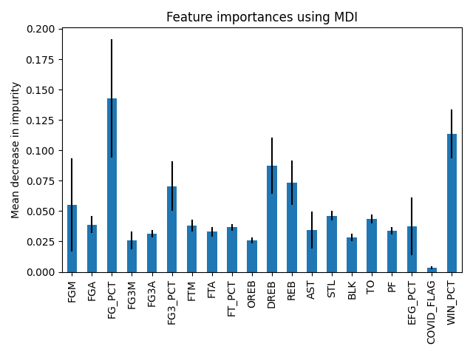
Feature Importance – Post Game Stats

Slide 26
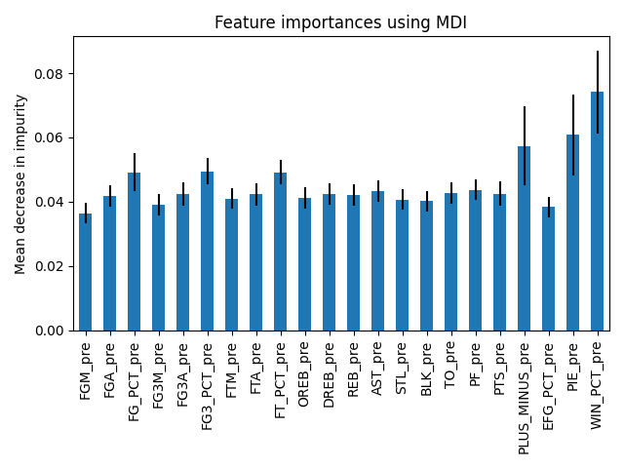
Feature Importance – Pre Game Stats

Slide 27
Result Analysis – Post Game Stats
Model consistently scored 80-85% accuracy using post-game statistics

Slide 28
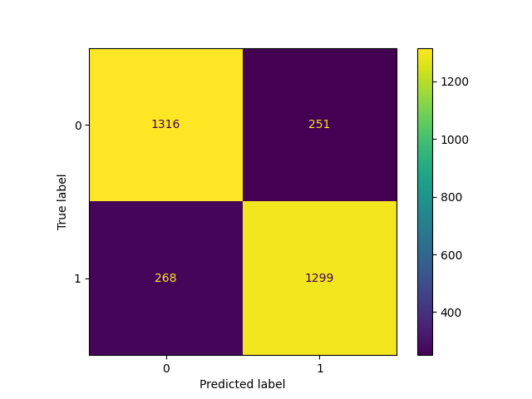
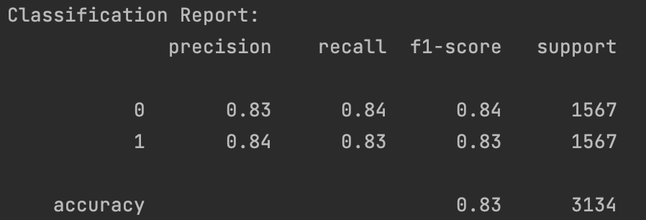
Result Analysis – Post Game Stats

Slide 29
Result Analysis – Pre Game Stats
Model scored 58.1% accuracy using pre-game statistics
Based on research – this is a slightly above average prediction rating

Slide 30
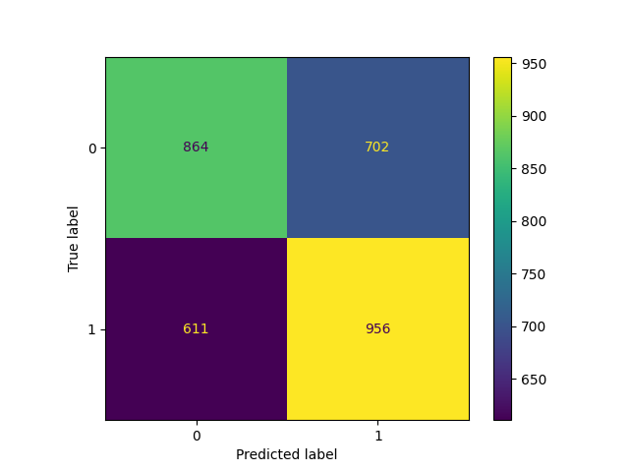
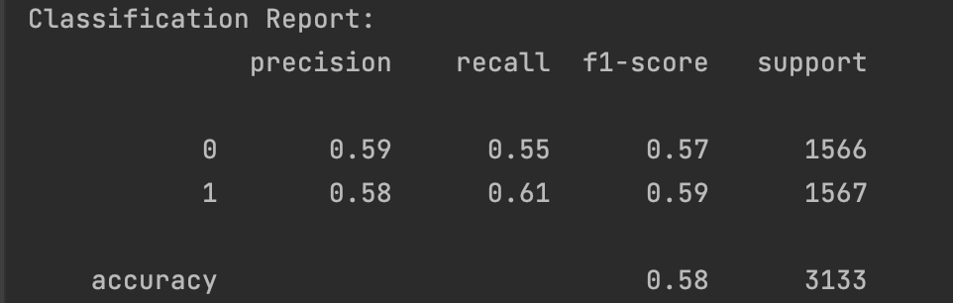
Result Analysis – Pre Game Stats

Slide 31
Future Work
Connect model to live games using NBA API to make current + future predictions
Utilize a different ML model (XGBoost) to analyze result differences
Make into a website, monetize?

Slide 32
Wrap Up
Turns out, it’s hard to predict future results in the NBA
Very happy with my outcome, almost hit my primary objective of 60% accuracy
Gained a lot of experience using Pandas and ML models
This project helped me land a job at IBM
Received over 900 downloads on Kaggle within two weeks, very cool to see other people use my dataset

Slide 33
Thanks!

Slide 34
Extra Slides

Slide 35
Training Models on Features
k-fold cross validation
k-1 folds for training
1 fold used for testing
Training on 90% & testing on 10%
Given, [0.1, 0.2, 0.3, 0.4, 0.5, 0.6]
Fold1: [0.5, 0.2]
Fold2: [0.1, 0.3]
Fold3: [0.4, 0.6]
Model1: trained on fold 1 & fold 2 — tested on fold 3

Slide 36

Random Forest Classifier
OOB Validation
Say tree 6, 9, and 12 did not use sample #23, this is our OOB for these trees
After forest training, gather tree’s predictions based on OOB sample
Compare OOB results to true class label
Compute error score: $errorRate=1−OOBAccuracy$
Output is model.oob_score & gives the accuracy rating.

Slide 37

Random Forest Classifier
Gini Impurity Information
Gini Impurity Equation, same for parent & child nodes $G=1−\overset{C}{\underset{i=1}{∑}}p_{i}^{2}$ where C = total number of classes (2) & $p_{i}$ = proportion of number of samples belonging to class $i$ at that node. $i=win||lose$.
Calculate parent node impurity, this will be used later when deciding splits
After parent node calculated, find thresholds in the randomly chosen feature values
Then, find the Gini of the left & right group(s), split to which side had the lowest Gini (highest Gain)

Slide 38

Random Forest Classifier
Gini Impurity — Example
Given FG% feature as our random subset, values are: [.45, .43, .47, .41, .49]
With the corresponding class label as: [W, L, W, L, W]
Find parent impurity:
$p(Win)=\frac{3}{5}=0.6$, $p(Lose)=\frac{2}{5}=0.4$
$G_{parent}=1−(0.6)^{2}−(0.4)^{2}=1−.36−.16=.48$
Now sort feature values, find possible thresholds, typically midway points BETWEEN values

Slide 39

Random Forest Classifier
Gini Impurity — Example Continued
Sorted FG% = [.41, .43, .45, .47, .49]
Possibilities: FG% —> .42, .44, .48
FG% for .44 threshold, Left = ≤ .44 (Index 0 & 1, .41 & .43), Right = > .44 (.45, .47, & .49)
Calculate Gini = $\frac{2}{5}∗0+\frac{3}{5}∗0=0$ (pure split)
A .48 threshold would be L = [.41, .43, .45, .47], C = [L, L, W, W] , R = [.49], C = [W]
G for threshold $.48=\frac{4}{5}∗0.5+\frac{1}{5}∗0=0.4$—> worse split than .44 threshold
Now, find Gain and split on highest gain (lowest Gini)
$Gain=G_{parent}−G_{split}$

