Slide 1
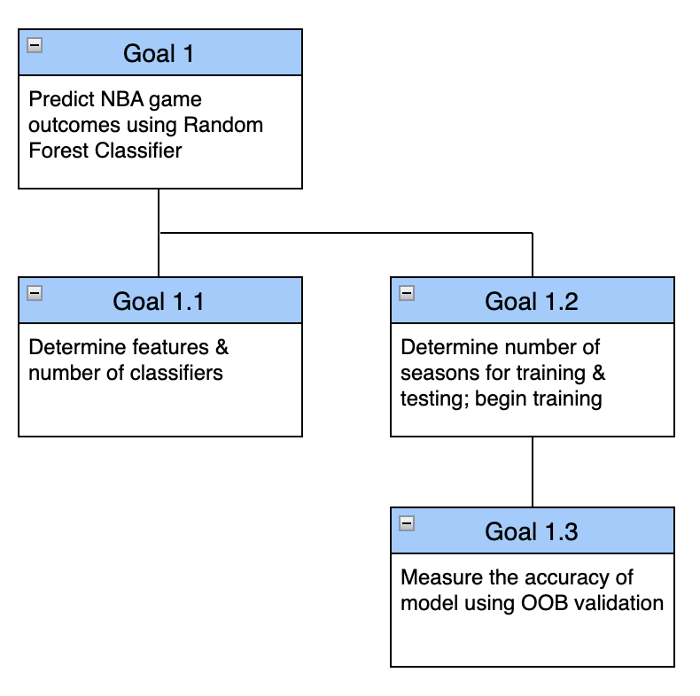
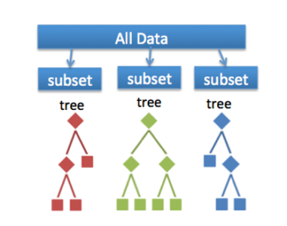


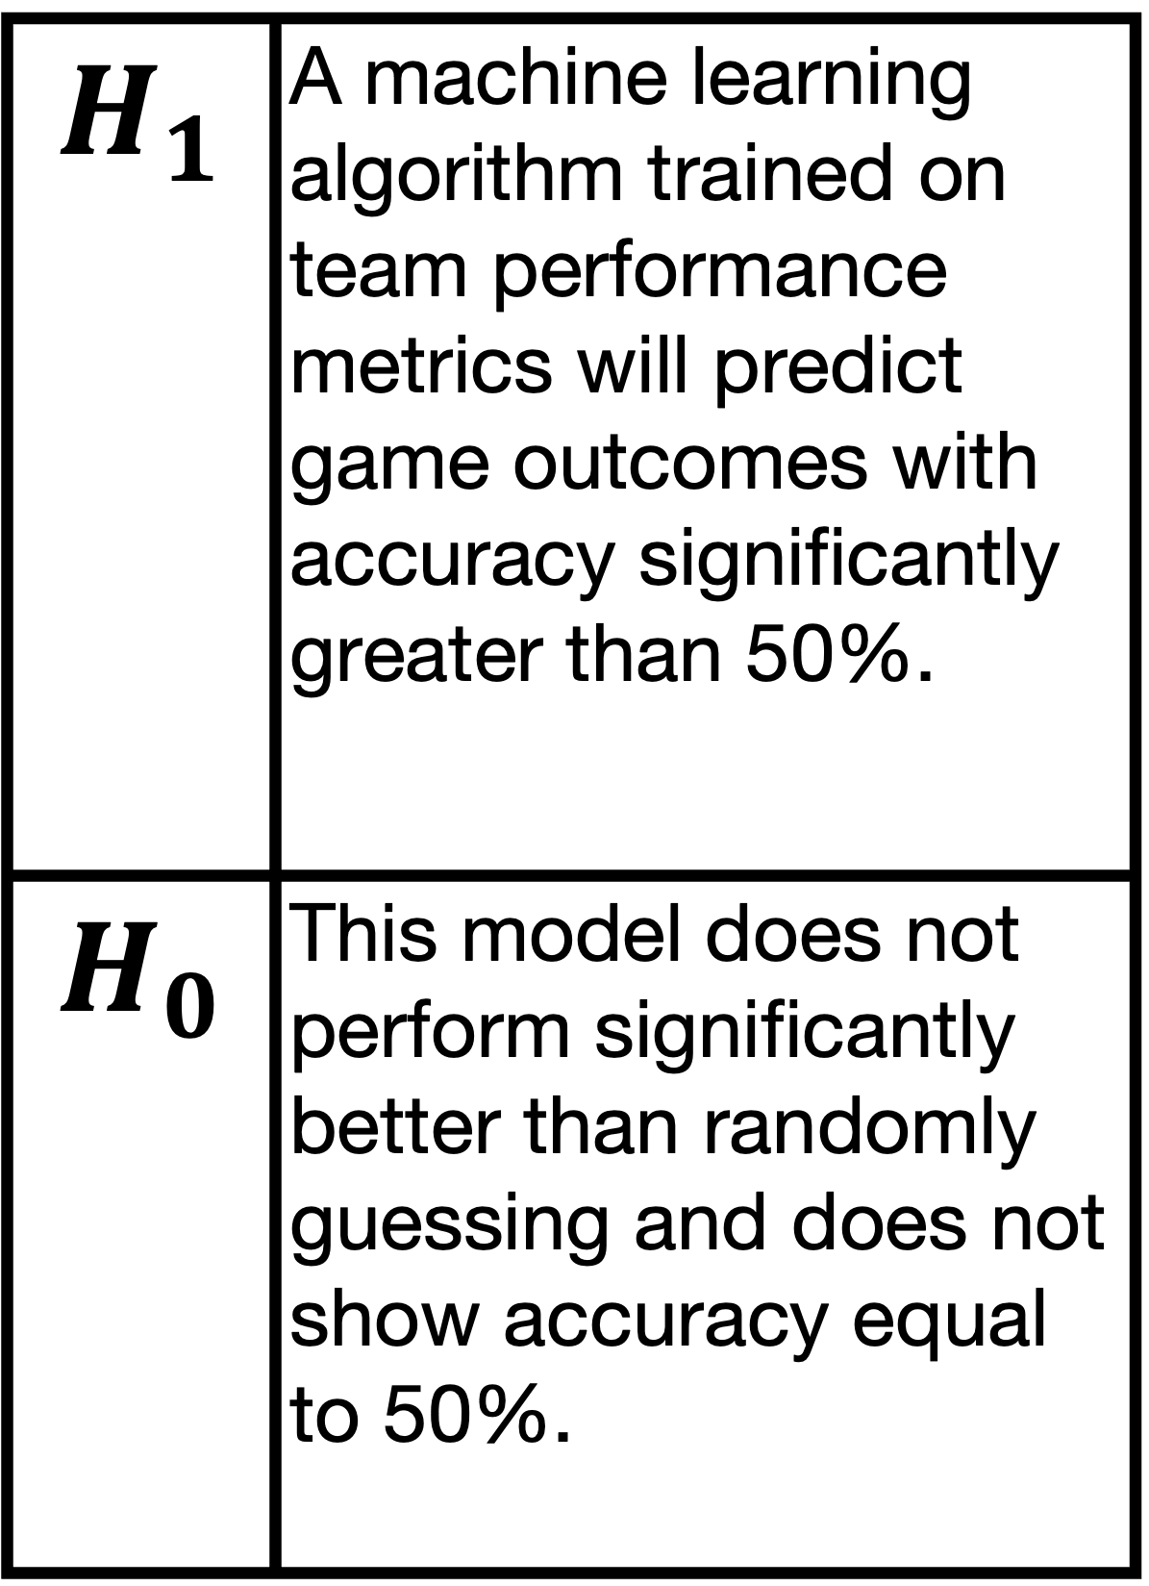
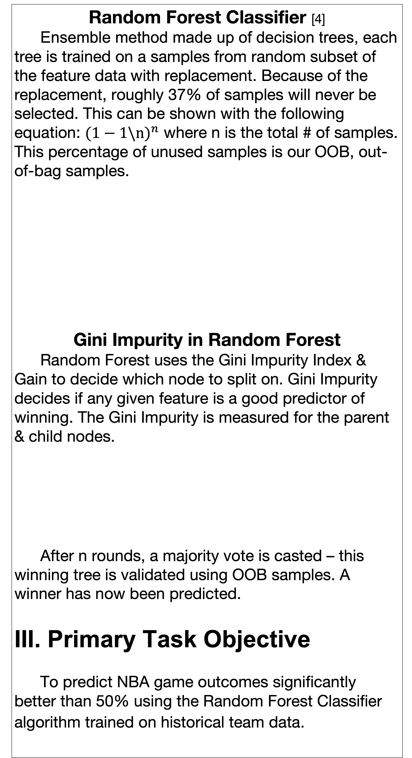
Predicting NBA Game Outcomes Using Supervised Machine Learning
By: Kevin Pickelman
Mentor: Dr. Armstrong
Problem Statement
Can NBA game outcomes be accurately predicted using supervised machine learning trained on historical team data?
II. Background
NBA Statistics Used [1]
Points per Game (PPG)
Win % (PCT) & Win % in Last 10 Games
Effective Field Goal % (eFG)
PIE Rating
Defensive Rating (DRTG)
Offensive Rating (ORTG)
Net Rating (NRTG)
Data Acquisition [2][3]
Data is acquired through nba_api package & processed using pandas library, 10 seasons will be used. The 2019-2020 season will be omitted due to COVID-19 causing a shortened season.
Supervised ML
Supervised means that the ML model can be trained & can “learn”. Model learns by being given human-labeled data, e.g. a picture of a cat labeled “cat” — this is the training data. The input is the picture, output is the label. The goal is that after training, the model can predict the label for unseen input.
Random Forest Classifier [4]
Ensemble method made up of decision trees, each tree is trained on a samples from random subset of the feature data with replacement. Because of the replacement, roughly 37% of samples will never be selected. This can be shown with the following equation: ${(1−1\backslash n)}^{n}$ where n is the total # of samples. This percentage of unused samples is our OOB, out-of-bag samples.
Gini Impurity in Random Forest
Random Forest uses the Gini Impurity Index & Gain to decide which node to split on. Gini Impurity decides if any given feature is a good predictor of winning. The Gini Impurity is measured for the parent & child nodes.
After n rounds, a majority vote is casted – this winning tree is validated using OOB samples. A winner has now been predicted.
III. Primary Task Objective
To predict NBA game outcomes significantly better than 50% using the Random Forest Classifier algorithm trained on historical team data.
IV. Hypothesis & Goal Tree
V. Experimental Design
Consists of 10 seasons of data, 9 will be used for training & the remainder will be used for testing. For any given two teams, the winner will be accurately predicted.
Block Diagram
VI. Solution Description
Tools: Python with use of nba_api library for historical data & pandas library for preprocessing data. Sci-kit learn for supervised ML algorithm
$$H_{1}$$ | A machine learning algorithm trained on team performance metrics will predict game outcomes with accuracy significantly greater than 50%.
$$H_{0}$$ | This model does not perform significantly better than randomly guessing and does not show accuracy equal to 50%.
Number of Classifiers | 50 | 75 | 100
Prediction error | X | X | X
Sources: [1] https://www.nba.com/ [2] https://nba-apidocumentation.knowledgeowl.com/help [3] https://pandas.pydata.org/docs/user_guide/index.html [4] https://scikit-learn.org/stable/modules/ensemble.html#random-forests-and-other-randomized-tree-ensembles [5] https://digitalcommons.bryant.edu/cgi/viewcontent.cgi?article=1000&context=honors_data_science

