Slide 1
Predicting NBA Games Using Random Forest Classifier Progress Report 2
Kevin Pickelman
Mentor: Dr. Armstrong

Slide 2
Primary Objective
Can a supervised machine learning algorithm trained on historical team data predict game outcomes better than 60% of the time?
Limitation: 120 person-hours over 10 weeks

Slide 3
Actively Working On
Currently developing features on current data-set
Mutating data frame using current statistics to create advanced metrics
Adding penalty flag to COVID-season data

Slide 4
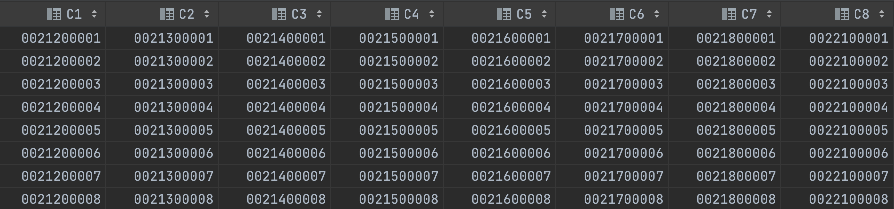
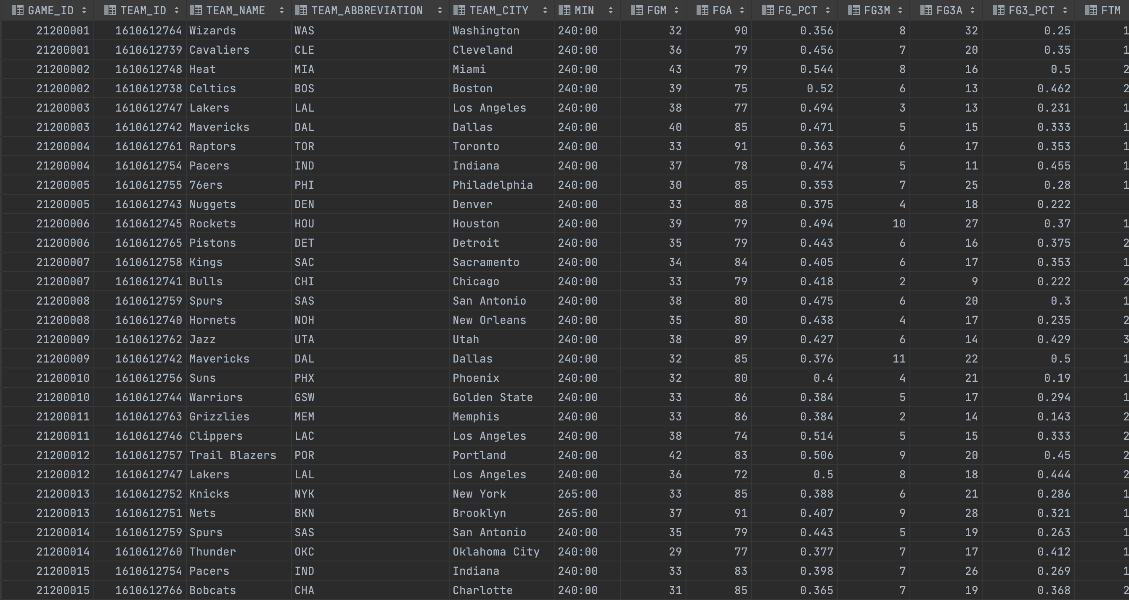

Slide 5
Future Work
Begin rough drafts of training/testing random forest classifier
Optimizing feature selection
Run metric tests to observe significance of features
Tweak model parameters

Slide 6
Schedule Update
Slightly behind schedule due to 72 games missing from my data set – currently working to recover these

Slide 7
End
Any Questions

