Slide 1
Predicting NBA Games Using Random Forest Classifier Progress Report 3
Kevin Pickelman
Mentor: Dr. Armstrong

Slide 2
Primary Objective
Can a supervised machine learning algorithm trained on historical team data predict game outcomes better than 60% of the time?
Limitation: 120 person-hours over 10 weeks

Slide 3
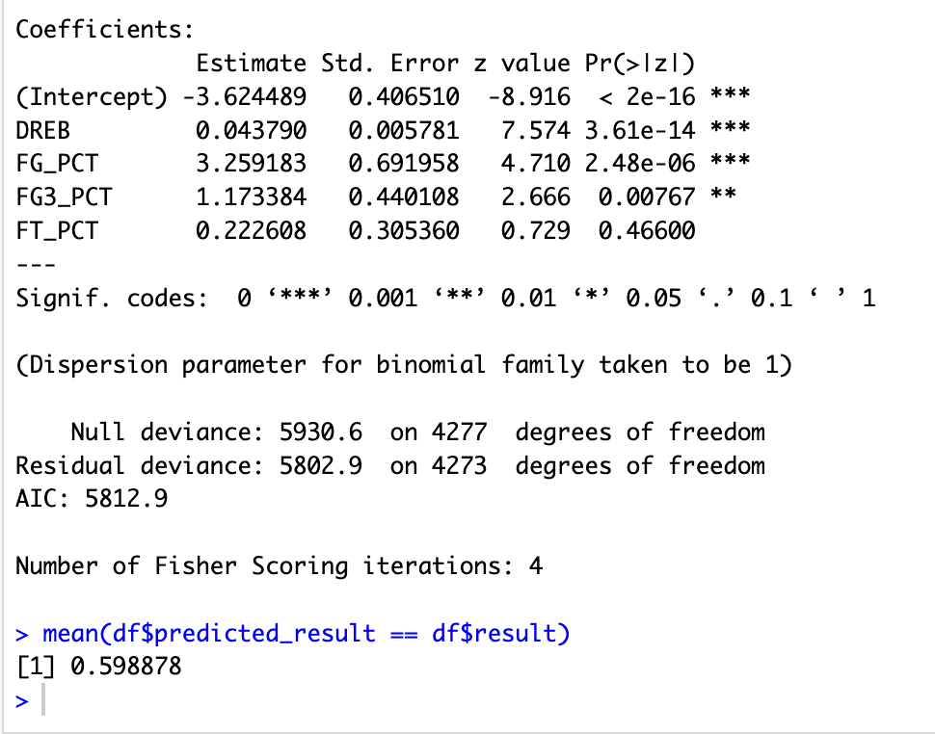
Actively Working On
Adding advanced metrics to data set (some nasty formulas)
Began rough modeling, switched to R for this

Slide 4
Future Work
Finish adding advanced metrics
Begin final stage of modeling and interpreting results using various accuracy measurements
Add some visualization in form of a GUI

Slide 5
Schedule Update
Slightly behind schedule

Slide 6
End
Any Questions

