Slide 1
Sentiment Analysis on Dating App Reviews
Data Science II Final Presentation
Carlie Cann, Nolan Dermigny, Kevin Pickelman

Slide 2
Topics to Discuss
Data Acquisition
Data Pre-processing
Sentiment Analysis
Exploring the Data
Modeling
Results & Analysis

Slide 3
Explaining the Data
Dataset was found on Kaggle
Contains data from three dating apps (Tinder, Bumble, Hinge)
Includes Reviews and how many people found them useful
Data was gathered from numerous regions throughout the world

Slide 4
Data Pre-Processing
Over 600k rows of data to process
Had to clean up the reviews column, contained numerous languages and curse words
We separated reviews based on language (focused on English reviews)

Slide 5
Sentiment Analysis
Sentiment Analysis encapsulates how positive or negative words or sentences are
Various libraries exist to conduct this, we used the afinn sentiment score, it is measured on an integer scale from -5 to 5
Nearly negative 5 is a “bad” review, nearly positive 5 is a “good” review
For example, “I am happy” would get an afinn score of nearly 5

Slide 6
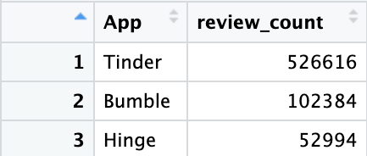
Exploring the Data
Tinder had over 500k reviews
Bumble had ~ 100k
Hinge had ~ 50k

Slide 7
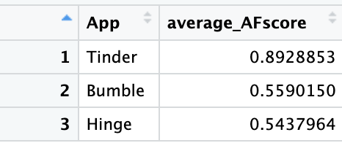
Exploring the Data (Continued)
On average, these apps do not have highly positive reviews. Mostly neutral
Tinder had the highest average afinn score of 0.89
In fact, the top 20 highest afinn scores all came from Tinder reviews

Slide 8
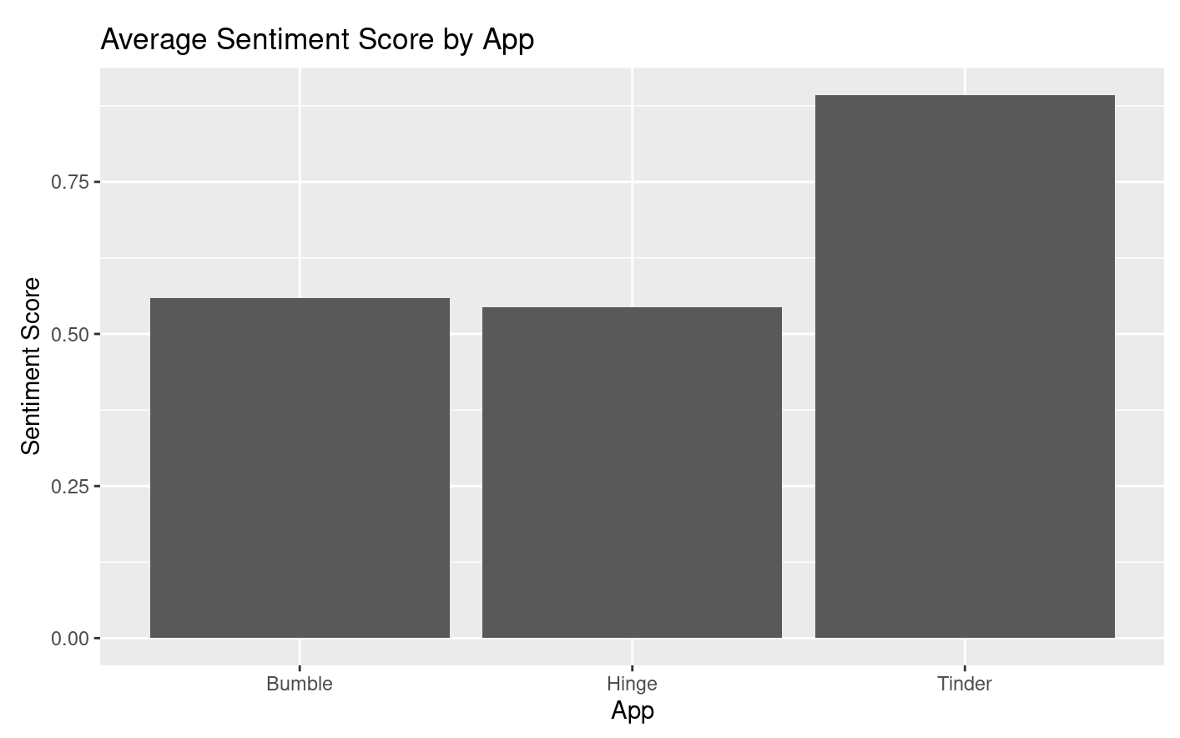

Slide 9
Modeling
We used a Support Vector Machine (SVM) to predict afinn scores
Due to the immense size of our data, we modeled on 1000 entries
We followed the tidymodels method for modeling, making a recipe, workflow, and then fitting
Because afinn predicts on a decimal scale, we rounded the results to 1, 2, 3, 4,and 5

Slide 10
How SVM Works
SVMs are supervised ML models
Supervised ML means they learn, training on the data
****ADD MORE TO THIS SLIDE*****

Slide 11
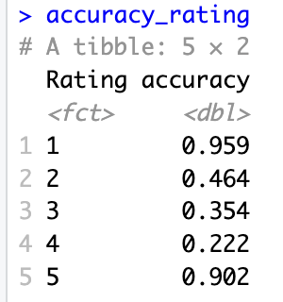
Results & Analysis
Our model did great at predicting sentiment scores of 1, 2 and 5
It struggled with accurately predicting ratings within the middle
We can view this better with a plot (next slide)

Slide 12
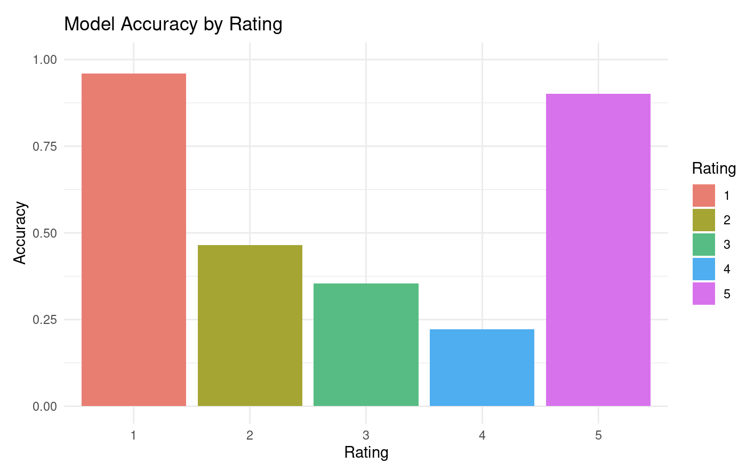
Results & Analysis

Slide 13
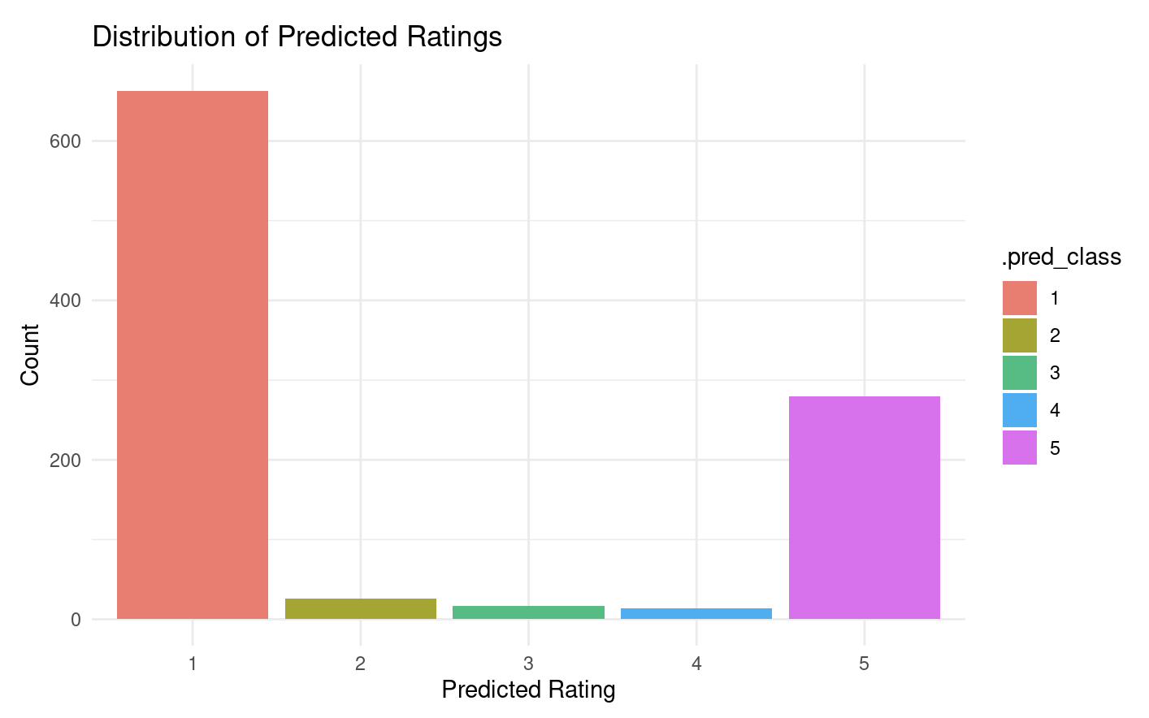
Results & Analysis
We can see most of the predicted ratings were low

