Slide 1
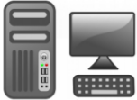
Stream Graph API
Network programming
I/O stream
Event-driven reactor
Resource control
Serialization
DtCraft Programming Environment
…

