Slide 1





Ansible
Reporter Andranik Barseghyan

Slide 2





Process Diagram
What is Ansible
Why Ansible
Ansible Use Cases
Example
Configuration Management With Ansible
Architecture of Ansible

Slide 3




What is Ansible
Ansible is an open-source configuration management and provisioning tool, similar to Chef, Puppet or Salt
Free. Ansible is an open-source tool.
It uses SSH to connect to servers and run the configured Tasks. Ansible lets you control and configure nodes from a single machine
Very simple to set up and use
Powerful. Ansible lets you model even highly complex IT workflows.
What makes it different from other management software is that Ansible uses SSH infrastructure. The project was founded in 2013 and bought by Red Hat in 2015.
Flexible and Agentless
Efficient

Slide 4
Why Ansible
Other configuration tools tend to be procedural do this and then do that and so on. Ansible works by you writing a description of the state of the machine that you want and then it takes steps to fulfill that description.
No Agent
As long as the box can be ssh’d into and it has python, it can be configured with Ansible.
Declarative Not Procedural
Idempotent
Ansible’s whole architecture is structured around the concept of idempotency. The core idea here is that you only do things if they are needed and that things are repeatable without side effects.
Ansible is quite easy to learn. It doesn’t require any extra knowledge.
Tiny Learning Curve

Slide 5




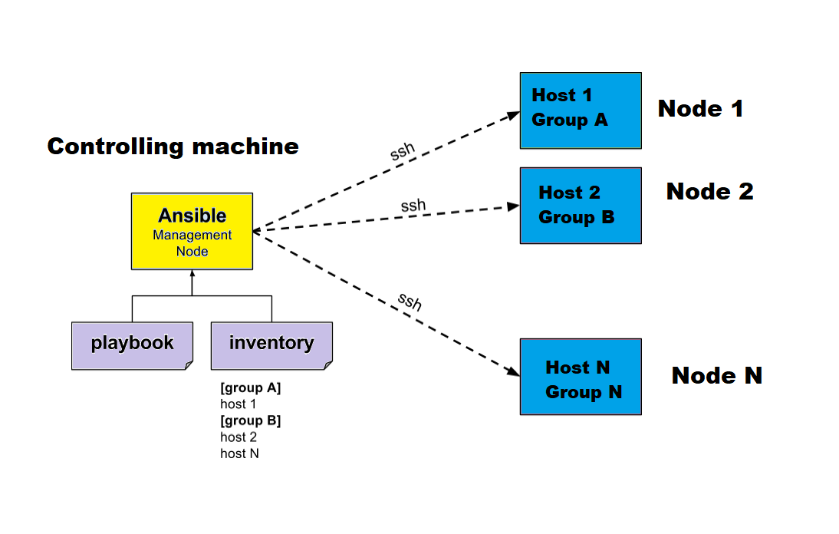
Difference
Push
Pull
Controler Server - Master Server
Linux Only (RedHat, Debian, CentOS, OS X)
Python 2.6+ or Python 3.5+
Controlled Server - Managed Server
Linux: Root Username/Password or SSH Key Python 2.6+. SSH port 22
Windows: Admin Username/Password, PowerShell 3.0 (ConfigureRemotingForAnsible.ps1). WinRM Port 5986

Slide 6
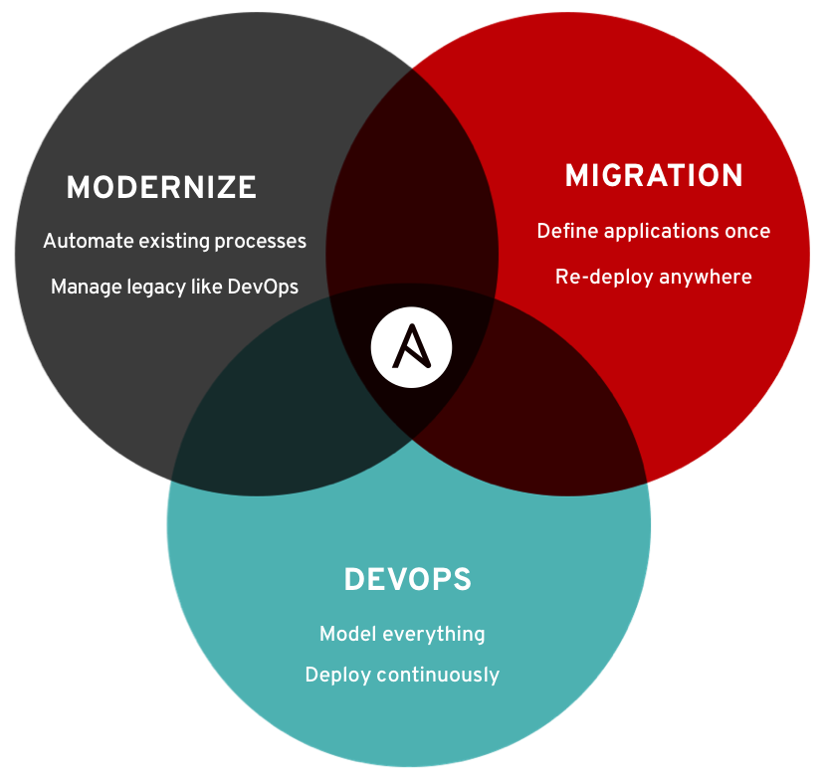
Ansible Use Cases
There’s nothing worse than doing the same thing for 8 hours a day! Eliminate repetitive, manual processes with automation.
Weekly system reboot
Enforce security guidelines
Rules are rules. It’s best to automate in an effort to achieve strict security standards.
Use check mode with Ansible tasks to enforce desired settings and see if your configuration has drifted.
Monitor configuration drift
Disaster recovery can involve a wide range of components. Act across different variables of the technology stack to identify problems and eliminate cross team dependencies.
Disaster recovery
Command blaster
Remarkably easy to write, you can run commands across your environment for any number of servers.
Database binary patching
Several databases use outdated binary sets. Patch the binaries in accordance with the release of the latest patch.
Instance provisioning
Use modules for several cloud providers to create new instances and tailor their configuration.
Service license agreements
Mistakes cost time and money. Eliminate errors that can crop up in detailed software contracts.

Slide 7
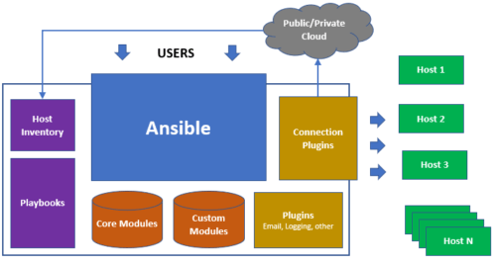
Architecture of Ansible

Slide 8
Host Inventory
Playbook
Modules
Roles
The Inventory is a description of the nodes that can be accessed by Ansible. By default, the Inventory is described by a configuration file, whose default location is in./etc/ansible/hosts The configuration file lists either the IP address or hostname of each node that is accessible by Ansible. Every host is assigned to a group such as web servers, db servers etc. The inventory file can be in one of many formats such as yaml, INI etc
Playbooks are simple YAML files. These files are descriptions of the desired state of your systems. Ansible then does the hard work of getting your systems to that state no matter what state they are currently in. Playbooks make your installations, upgrades and day-to-day management repeatable and reliable. Playbooks are simple to write and maintain. Playbooks are written in a natural language so they are very easy to evolve and edit.
.
There are over 1000 modules provided by Ansible to automate every part of the environment. Modules are like plugins that do the actual work in Ansible, they are what gets executed in each playbook task. Each module is mostly standalone and can be written in a standard scripting language (such as Python, Perl, Ruby, Bash, etc.). One of the guiding properties of modules is idempotency, which means that even if an operation is repeated multiple times, it will always place the system into the same state.
Roles are a way to group tasks together into one container. We could have a role for setting up MySQL, another one for configuring iptables etc. Roles makes it easy to configure hosts. Any role can be performed on any host or group of hosts such as:

Slide 9
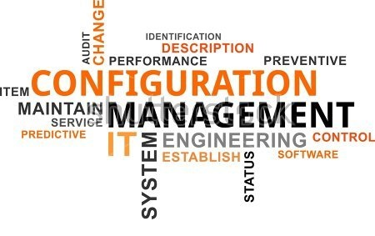
Configuration Management With Ansible
Ansible is the simplest solution for configuring the nodes. It’s designed to be minimal in nature, consistent, secure and highly reliable. Any developer, tester or IT manager can easily configure nodes. Any IT person can write playbooks easily. Ansible configurations are simple data descriptions of your infrastructure (human readable) ensuring everyone on your team will be able to understand the meaning of each configuration task. Ansible requires nothing more than a password or SSH key in order to start managing systems and can start managing them without installing any agent software.
Example

Slide 10






References
Companies that are using Ansible
www.digitalocean.com/community/tutorials/configuration-management-101-writing-ansible-playbooks
www.ansible.com
docs.ansible.com
docs.ansible.com/ansible/latest/installation_guide/intro_configuration.html

Slide 11
Th
nk You

