Slide 1
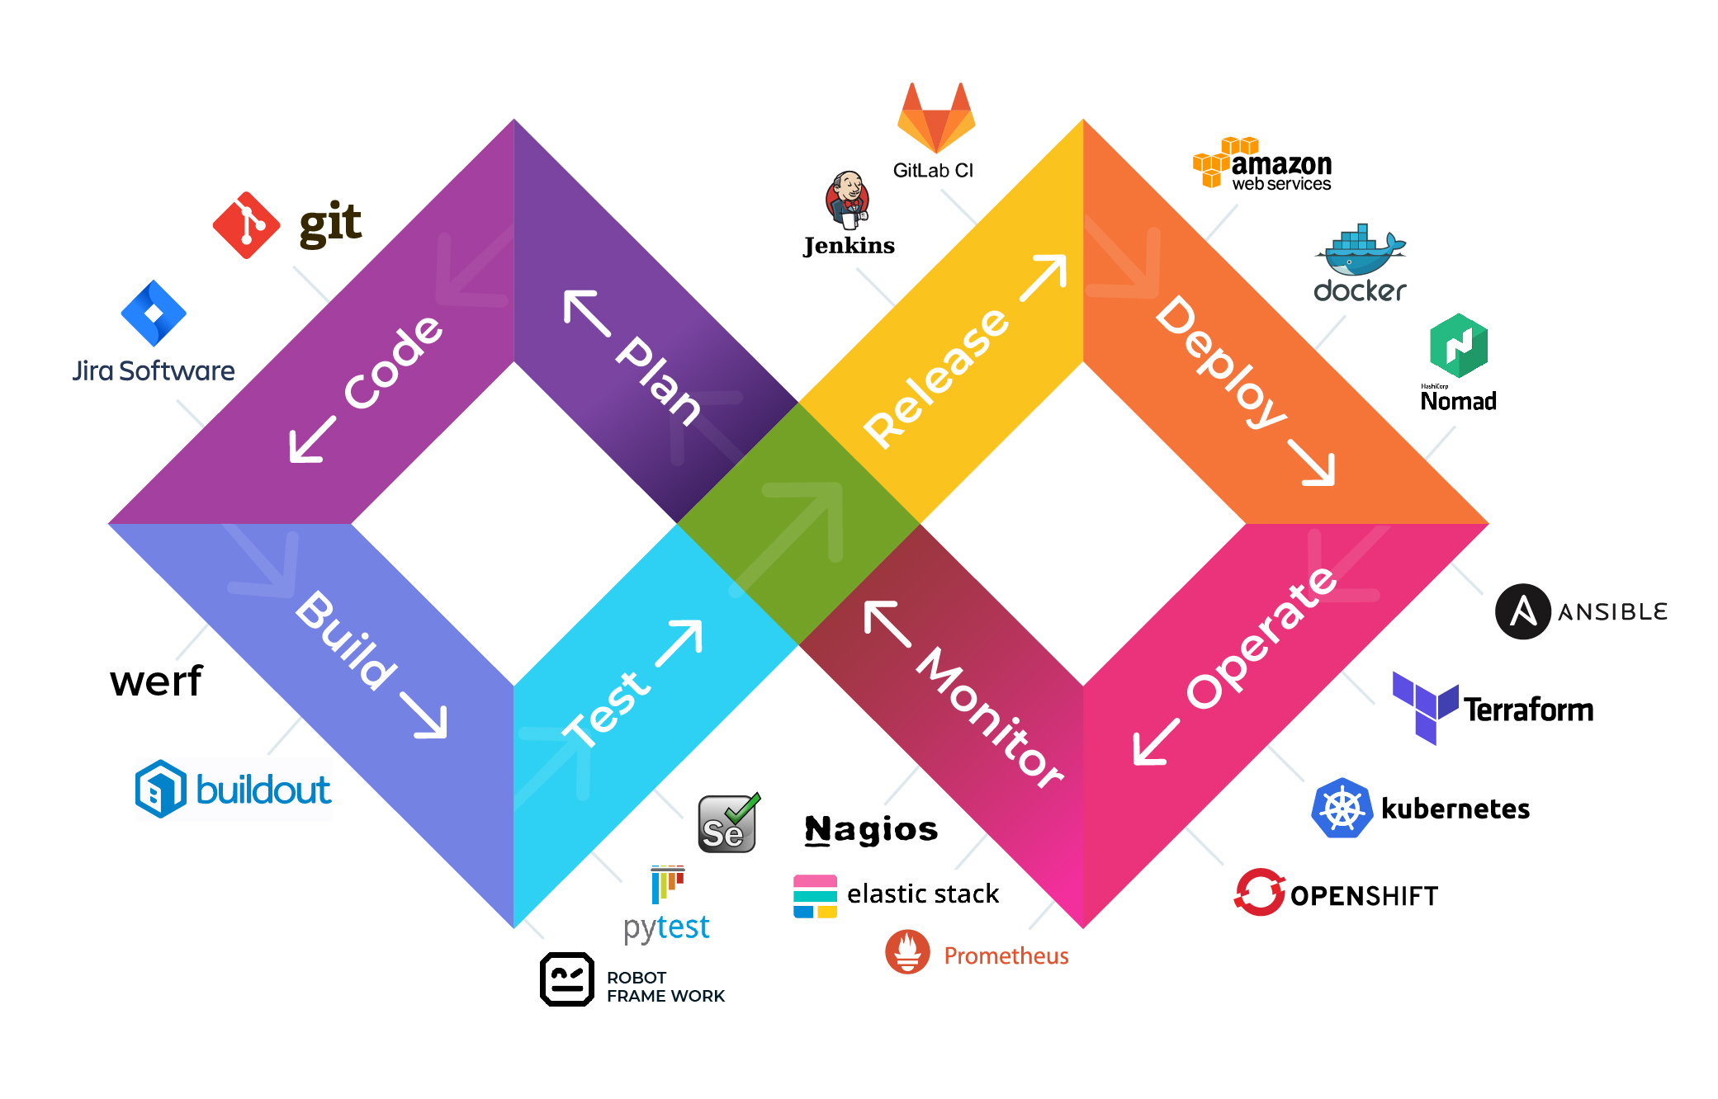
DevOps
Concepts
Andranik Barseghyan
https://github.com/Rebiss/Presentation

Slide 2
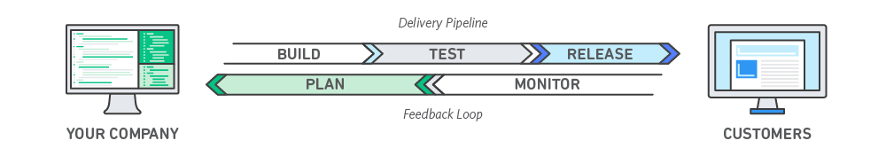
Introduction
DevOps is the combination of cultural philosophies, practices, and tools that increases an organization’s ability to deliver applications and services at high velocity: evolving and improving products at a faster pace than organizations using traditional software development and infrastructure management processes. This speed enables organizations to better serve their customers and compete more effectively in the market.
General Manager

Slide 3
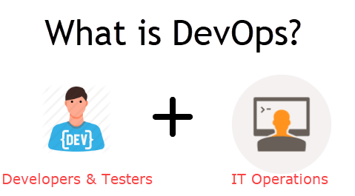
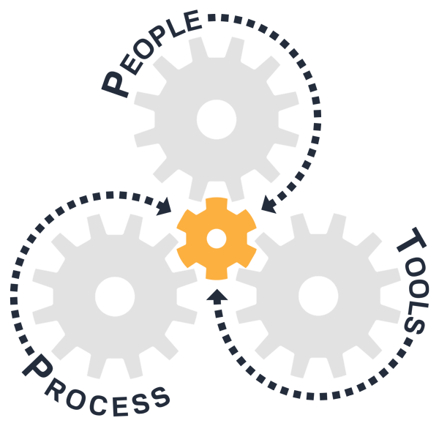
DevOps is software development methodology that combines software development with information technology operations.
DevOps is the union of people, process, and products to enable continuous delivery of value to our end users.
DevOps is a set of practices that combines software development (Dev) and information-technology operations (Ops) which aims to shorten the systems development life cycle and provide continuous delivery with high software quality.
DevOps is the practice of operations and development engineers participating together in the entire service the development process to production support.

Slide 4
Goal
What is the Primary Goal of DevOps?
The primary DevOps goal is to optimize the flow of value from idea to end user. Obviously, there’s a cultural change that must happen for a company to be successful with DevOps, so culture is a big focus, but the DevOps goal is to make the delivery of value more efficient and effective.
To do this, we must first be able to assign value to any changes that we’re trying to make in an organization. This is something that we have been very focused on at VersionOne. As we are rolling out new strategies and programs, we assign a value to those ideas and break them down along with the value into work items so that our developers or our team members can work on them.
To optimize the flow of value from idea to end user.
Improve deployment frequency
Lower failure rate of new releases
Shortened lead time between fixes
To make faster development.

Slide 5
Principles
Iterative
Continuous
Self-service
Holistic
Incremental
Automated
Collaborative

Slide 6
Practices
5
Self-service configuration
4
Automated provisioing
3
Continuous build
2
Continuous integration | Continuous delivery
Automated release managment
1
Incemental testing

Slide 7
DevOps Lifecycle
Deployment
In this phase, the deployment process takes place continuously. It is performed in such a manner that any changes made any time in the code, should not affect the functioning of high traffic website.
Monitoring
Testing
Integration
In this phase, operation team will tack care of the inappropriate system behavior or bugs which are found in production
In this phase, QA team use tools like Selenium to identify and fix bugs in the new piece of code. Unit and
integration testing help increase the efficincy and speed of the development.
In the phase, new functionality is integrated with the prevailing code, and testing takes place.
Development
In this phase, the entire development process is separated into small development cycles. This benefits DevOps team to speed up software development and delivery process.
Customer Feedback and Optimization
In this phase, customer gives feedback and from that modification is done.

Slide 8
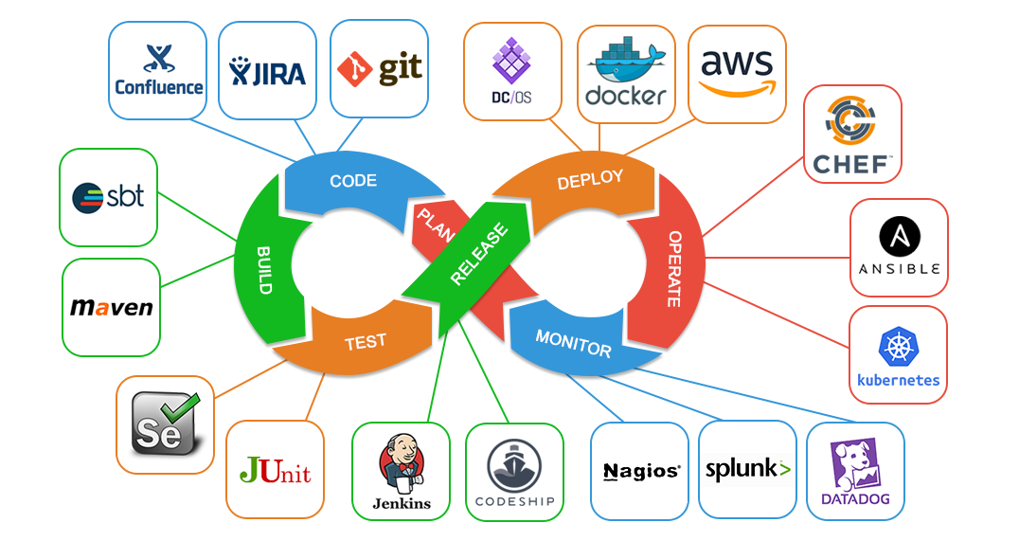
Skils
As DevOps is intended to be a cross-functional mode of working, those that practice the methodology use different sets of tools—referred to as "toolchains"—rather than a single one. These toolchains are expected to fit into one or more of the following categories, reflective of key aspects of the development and delivery process:
Coding, Building, Testing, Packaging, Releasing, Configuring, Monitoring .
A DevOps toolchain is a set or combination of tools that aid in the delivery, development, and management of software applications throughout the systems development life cycle, as coordinated by an organisation that uses DevOps practices.
Generally, DevOps tools fit into one or more activities, which supports specific DevOps initiatives: Plan, Create, Verify, Package, Release, Configure, and Monitor.
Etc...

Slide 9
Books
The DevOps Handbook: How to Create World-Class Agility, Reliability, and Security in Technology Organizations
The DevOps Handbook
The DevOps Adoption Playbook: A Guide to Adopting DevOps in a Multi-Speed IT Enterprise
The DevOps Adoption Playbook
Accelerate: The Science of Lean Software and DevOps: Building and Scaling High Performing Technology Organizations
The Science of Lean Software and DevOps
The Phoenix Project
The Phoenix Project

Slide 10
THANK YOU

