Slide 1
Docker
Reporter
Andranik Barseghyan
https://github.com/Rebiss/Presentation

Slide 2


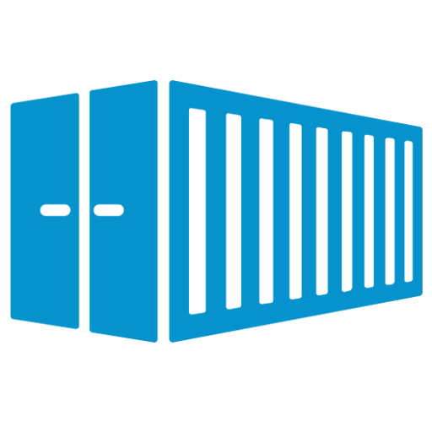


What is Docker-Compose?
When is it used?
What is Container?
Example
What is Image?
What is Docker?
Containers vs Virtual Machines What’s the Difference?

Slide 3
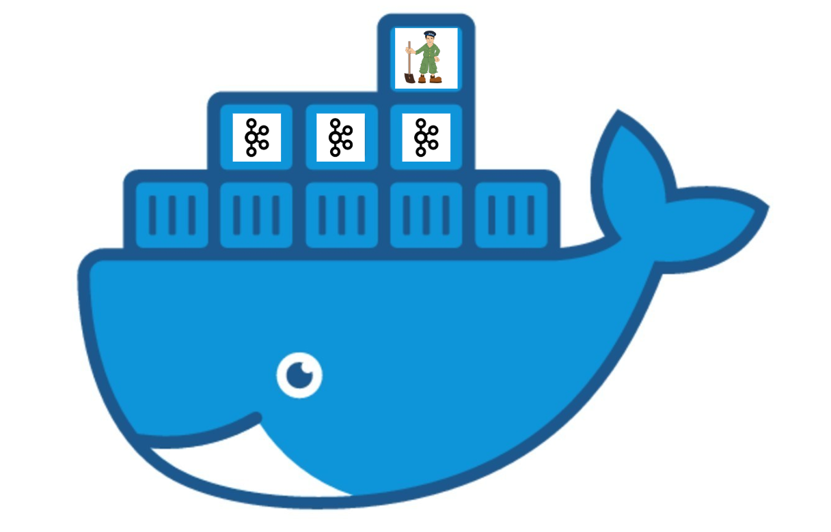
What is Docker?
Docker is a tool designed to make
it easier to create, deploy, and
run applications by using containers. Containers allow a developer to
package up an application with all of
the parts it needs, such as libraries and other dependencies, and deploy it as one package. By doing so, thanks
to the container, the developer can
rest assured that the application
will run on any other Linux machine
regardless of any customized settings that machine might have that could
differ from the machine used for
writing and testing the code.
Docker allows applications to use the
same Linux kernel as the system that they're
running on and only requires applications be
shipped with things not already running on the host computer. This gives a significant
performance boost and reduces the size of the
application.
And importantly, Docker is open source. This means that anyone can contribute to Docker and extend it to meet their own
needs if they need additional features
that aren't available out of the box.

Slide 4
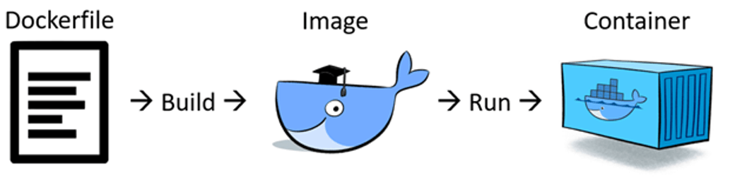
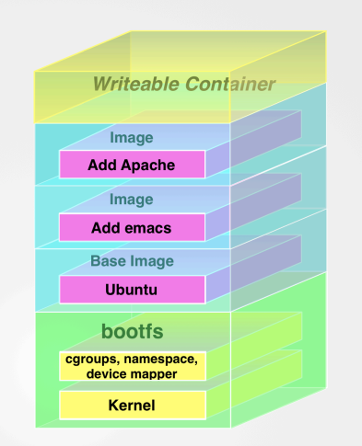
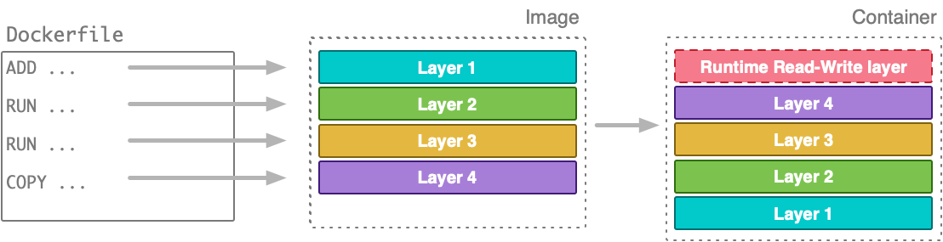
Image
Image is a file, comprised of multiple layers, that is used to execute code in a Docker
container. An image is essentially built from the instructions for a complete and executable
version of an application, which relies on the host OS kernel. When the Docker user runs an
image, it can become one or multiple instances of that container.
not monolith
Union File System

Slide 5
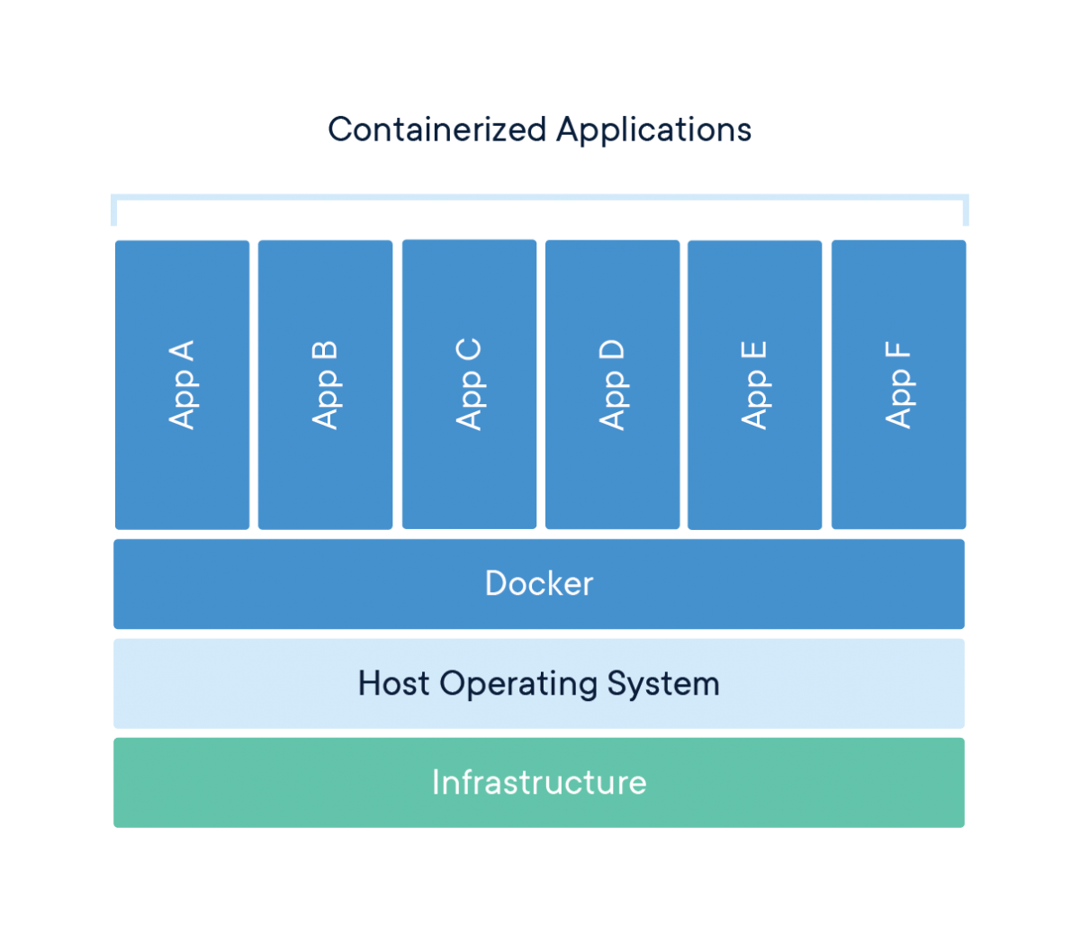
Container
A container is a standard unit of software that
packages up code and all its dependencies so the
application runs quickly and reliably from one
computing environment to another. A Docker
container image is a lightweight, standalone,
executable package of software that includes
everything needed to run an application: code,
runtime, system tools, system libraries and settings.
Container images become containers at runtime and in the case of Docker containers - images become
containers when they run on Docker Engine. Available for both Linux and Windows-based applications,
containerized software will always run the same,
regardless of the infrastructure. Containers isolate software from its environment and ensure that it
works uniformly despite differences for instance
between development and staging.
Docker containers that run on Docker Engine:
Containers are an abstraction at the app layer that packages code and dependencies
together. Multiple containers can run on the same machine and share the OS kernel with
other containers, each running as isolated processes in user space. Containers take up
less space than VMs (container images are typically tens of MBs in size), can handle more
applications and require fewer VMs and Operating systems.

Slide 6
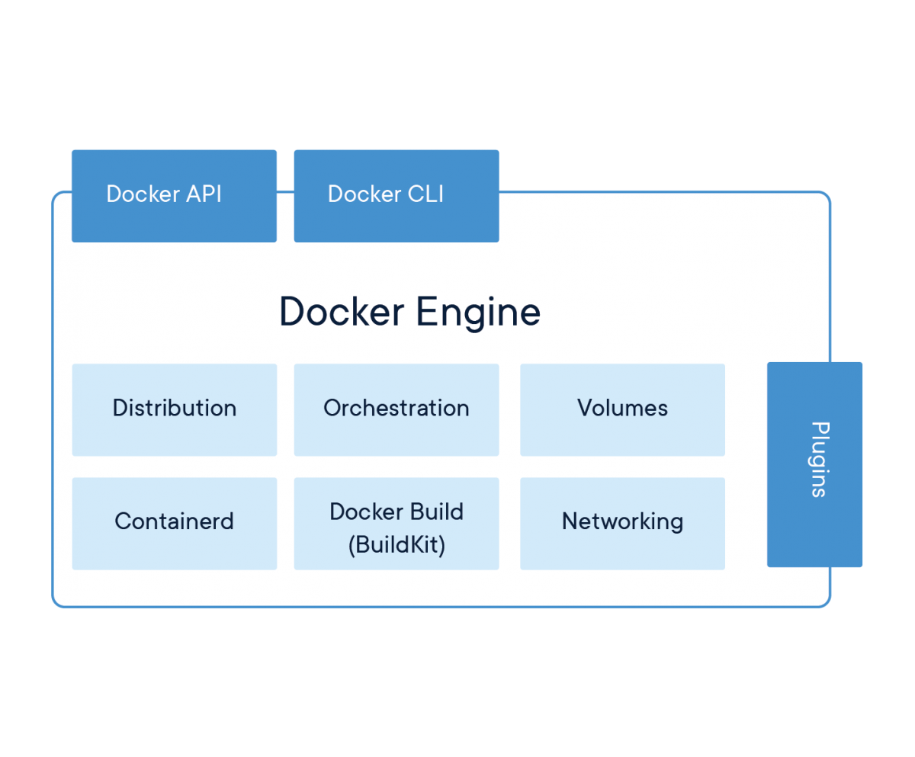
Docker Engine
Docker Engine is the industry’s
de facto container runtime that
runs on various Linux (CentOS,
Debian, Fedora, Oracle Linux, RHEL, SUSE, and Ubuntu) and Windows
Server operating systems. Docker
creates simple tooling and a
universal packaging approach that bundles up all application
dependencies inside a container
which is then run on Docker Engine. Docker Engine enables containerized applications to run anywhere
consistently on any infrastructure, solving “dependency hell” for
developers and operations teams,
and eliminating the “it works on
my laptop!” problem.

Slide 7
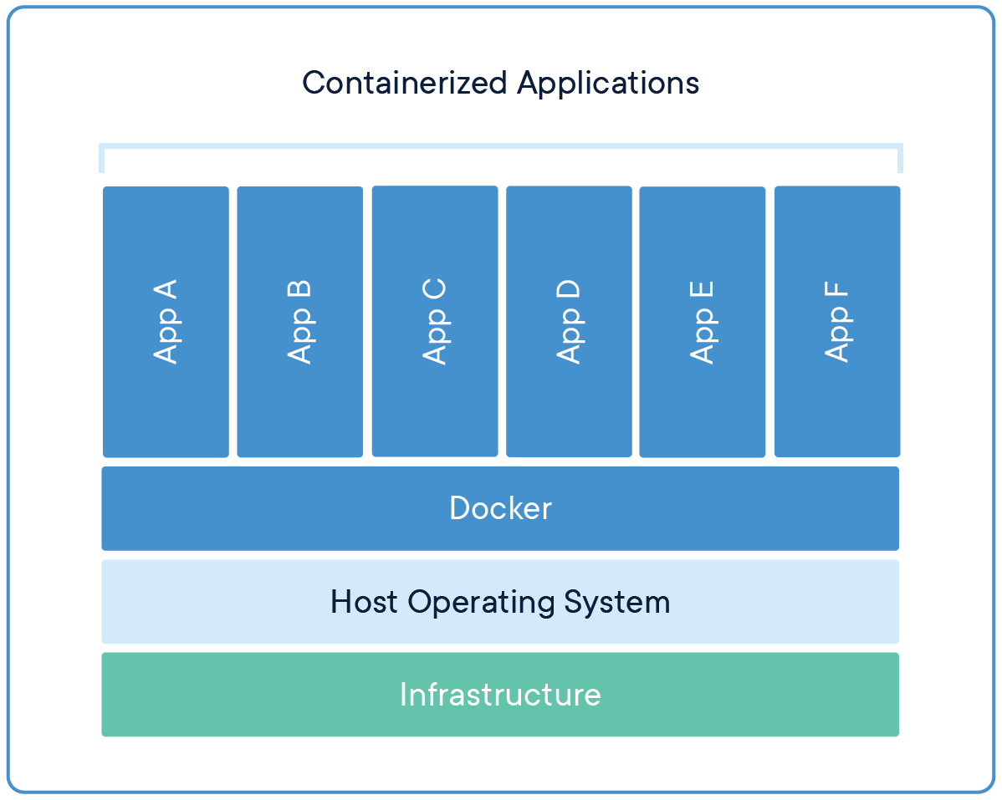
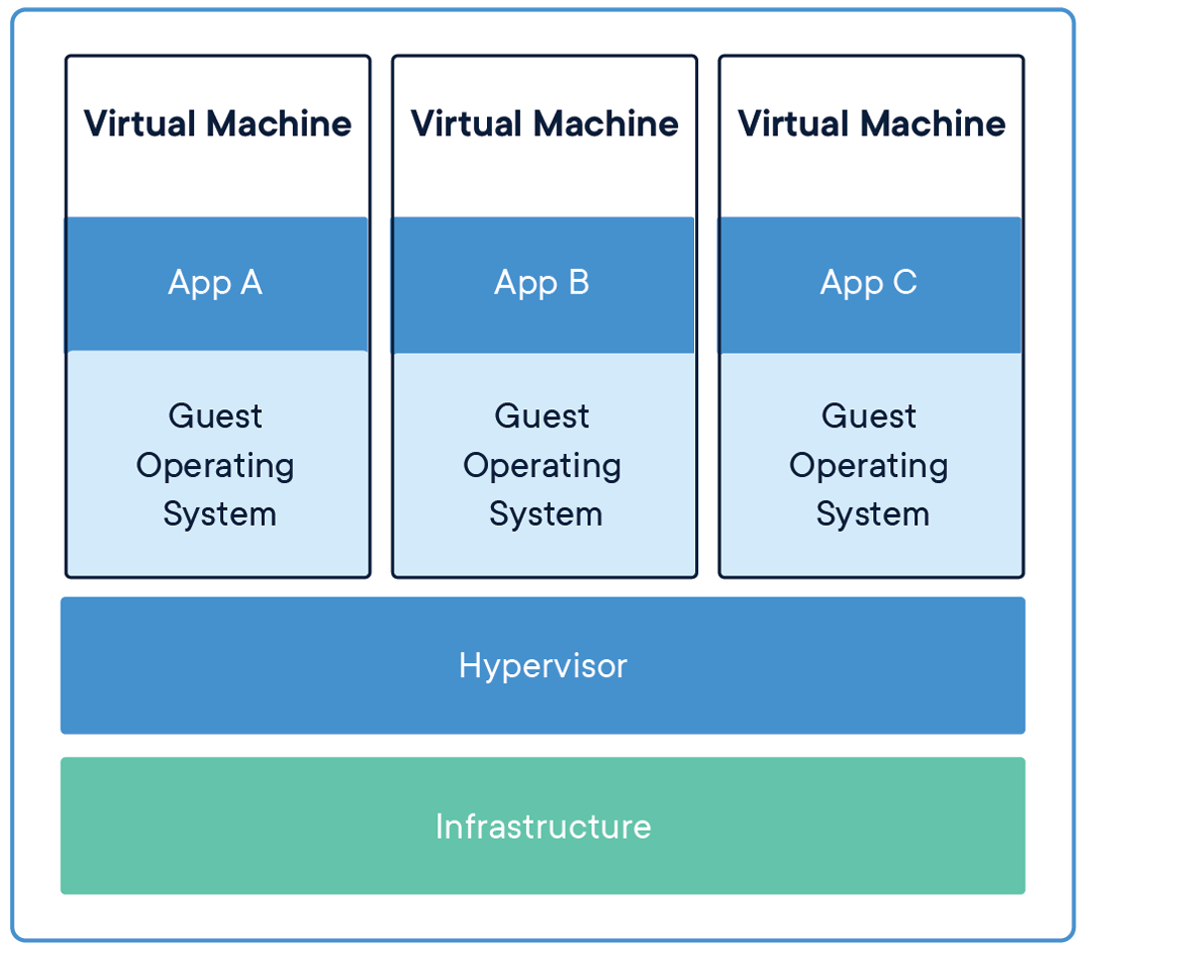
Difference
VIRTUAL MACHINES
Virtual machines (VMs) are an abstraction of physical hardware turning one server into
many servers. The hypervisor allows multiple VMs to run on a single machine. Each VM
includes a full copy of an operating system, the application, necessary binaries and
libraries - taking up tens of GBs. VMs can also be slow to boot.

Slide 8
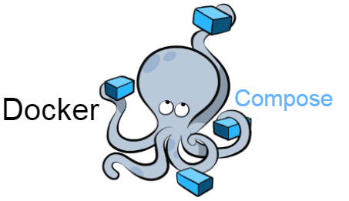
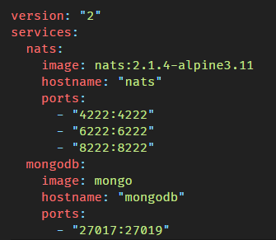
Docker-Compose
Compose is a tool for defining and running
multi-container Docker applications. With
Compose, you use a YAML file to configure your application’s services. Then, with a single
command, you create and start all the services from your configuration. To learn more about
all the features of Compose, see the list of
features.
Compose works in all environments: production, staging, development, testing, as well as CI
workflows. You can learn more about each case
in Common Use Cases.
docker-compose.yml

Slide 9
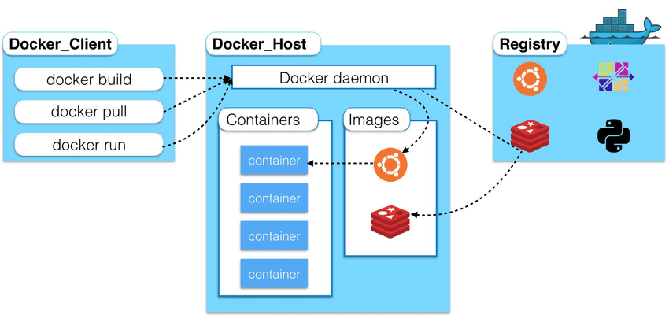
Docker architecture
Docker daemon
The Docker daemon listens for
Docker API requests and manages
Docker objects such as images,
containers, networks, and volumes. A daemon can also communicate
with other daemons to manage
Docker services.
Docker client
The Docker client (docker) is the primary way that many Docker users interact with Docker. When you
use commands such as docker run, the client sends
these commands to dockerd, which carries them out. The docker command uses the Docker API. The Docker client can communicate with more than one daemon.
Docker registries
A Docker registry stores Docker images. Docker Hub is a public registry that anyone can use, and Docker is configured to look for images on Docker Hub by default. You can even run your own private registry. If you use Docker Datacenter (DDC), it includes Docker Trusted
Registry (DTR).

Slide 10
When is it used?
Use Docker as version control system for your entire app's operating system.
Use Docker when you want to distribute/collaborate on your app's operating system with a team.
Use Docker to run your code on your laptop in the same environment as you have on your server.
Use Docker whenever your app needs to go through multiple phases of development (dev/test/qa/prod, try Drone or Shippable, both do Docker CI/CD).
Use Docker with your Chef Cookbooks and Puppet Manifests (Docker doesn't do
configuration management).
https://hub.docker.com
https://www.docker.com
Example ...

Slide 11
THANK YOU

