Slide 1


Node.js
Reporter
Andenaik Barseghyan
https://github.com/Rebiss/Presentation

Slide 2




1.1
Content
Whot is Node.js
Libuv. Event Loop. Threads
Core Modules. C++ Bindings
C-ares. ZLib. HTTP Parser. OpenSSL
V8 Engin. WebAssembly
Microtask and Macrotask

Slide 3

Whot is Node.js
®
Node.js is a JavaScript runtime built on Chrome's V8 JavaScript engine.
Node.js uses an event-driven(Reactor Pattern), non-blocking I/O model that mastes is lightweight and efficient.

Slide 4
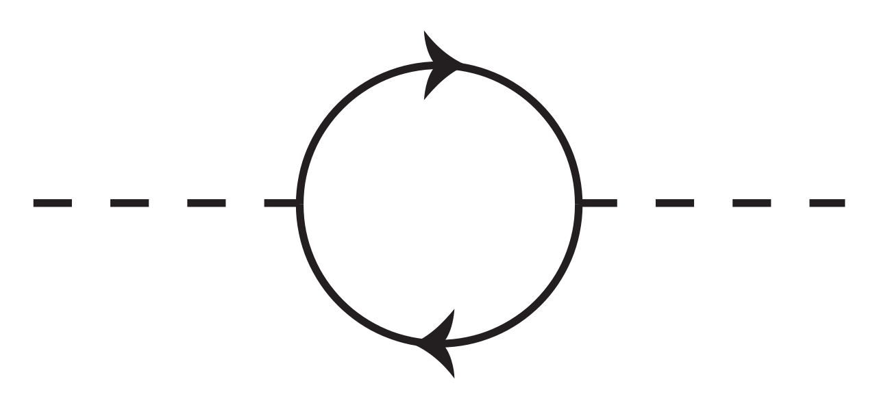
4.2
Reactor Pattern
I/O reques
Synchronous Event Demultiplexer
Event Queue
Event Loop
Hardware I/O
The reactor design pattern is an event handling pattern for handling service requests delivered concurrently to a service handler by one or more inputs. The service handler then demultiplexes the incoming requests and dispatches them synchronously to the associated request handlers
Structure: Synchronous Event Demultiplexer, Dispatcher, Request Handler

Slide 5
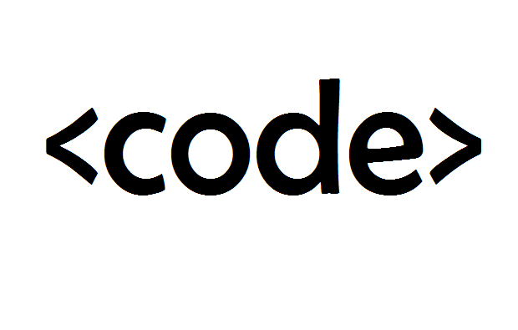









Node.js Architecture
Addons
Core Modules

Slide 6

Libuv
Written in
Event Loop
C
Operating system
Libuv (Unicorn Velociraptor Library) is a multi-platform C library that provides support for asynchronous I/O based on event loops.
Type
I/O abstraction library
Cross-platform
Features
Full-featured event loop backed by epoll, kqueue, IOCP, event ports.
Asynchronous
TCP and UDP sockets.
DNS resolution.
Asynchronous
file and file system
operations.
File system
events.
ANSI escape code controlled TTY.
Child processes.
IPC with
socket sharing, using Unix domain sockets or named
pipes.
Thread pool.
Signal handling.
High resolution clock.

Slide 7
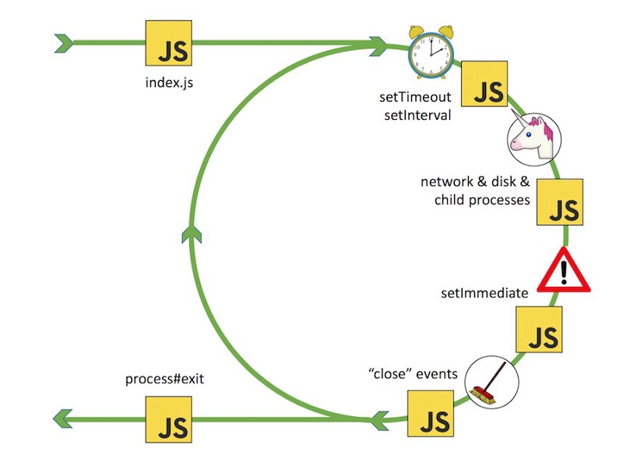


Event Loop or Semi-infinite Loop
refs++
refs=0
Timer. setTimeout,setInterval
Add your title
refs--
I/O.
Collback,network...
Add your title
Immediate.
setImmediate
refs>0
Add your title
Closee events.
DB close conection
while loop
Add your title
refs==0

Slide 8
4.2
Libuv
Non-Blocking I/O
Blocking I/O
File I/O
DNS
etc...
Network I/O
Thread Pool
IOCP
epoll
kqueue
Windows
Linux
BSD

Slide 9
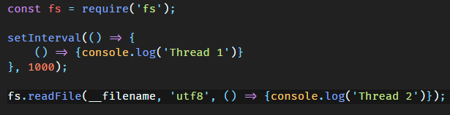
Threads
Blocking I/O
CPU intensive
Thread Pool
UV_THREADPOOL_SIZE = 8 SIZE <= 128
Web Workers

Slide 10
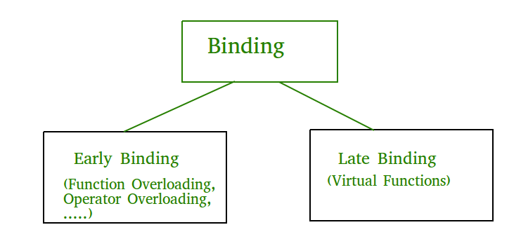


C++ Bindings
2.2
Binding refers to the process of converting identifiers (such as variable and performance names) into addresses. Binding is done for each variable and functions. For functions, it means that matching the call with the right function definition by the compiler. It takes place either at compile time or at runtime.
arly Binding (compile-time time polymorphism)
As the name indicates, compiler (or linker) directly associate an address to the function call. It replaces the call with a machine language instruction that tells the mainframe to leap to the address of the function.
ate Binding
In this, the compiler adds code that identifies the kind of object at runtime then matches the call with the right function definition (Refer this for details). This can be achieved by declaring a virtual function.

Slide 11






Core Modules
Module in Node.js is a simple or complex functionality organized in single or multiple JavaScript files which can be reused throughout the Node.js application.
Each module in Node.js has its own context, so it cannot interfere with other modules or pollute global scope.
Http
Path
Http module includes classes, methods and events to create Node.js http server
Path module includes methods to deal with file paths.
Url
Fs
url module includes methods for URL resolution and parsing.
Path module includes methods to deal with file paths.
Querystring
Util
Querystring module includes methods to deal with query string.
Util module includes utility functions useful for programmers.
Also, each module can be placed in a separate .js file under a separate folder.
Node.js implements CommonJS modules standard. CommonJS is a group of volunteers who define JavaScript standards for web server, desktop, and console application.

Slide 12
C-ares
ZLib
HTTP Parser. OpenSSL
C-ares
HTTP Parser
is a C library for asynchronous DNS requests (including name resolves).
C89 compatibility, MIT licensed, builds for and runs on POSIX, Windows, Netware, Android and many more operating systems
This is a parser for HTTP messages written in C. It parses both requests and responses. The parser is designed to be used in performance HTTP applications. It does not make any syscalls nor allocations, it does not buffer data, it can be interrupted at anytime. Depending on your architecture, it only requires about 40 bytes of data per message stream (in a web server that is per connection).
ZLib
zlib is a software library used for data copression. zlib was written by Jean-loup Gailly and Mark Adler and is an abstraction of the DEFLATE compression algorithm used in their gzip file compression program. zlib is also a crucial component of many software platforms, including Linux, OSX, and iOS.
OpenSSL
OpenSSL is an open-source command line tool that is commonly used to generate private keys, create CSRs, install your SSL/TLS certificate, and identify certificate information. We designed this quick reference guide to help you understand the most common OpenSSL commands and how to use them.

Slide 13
Javascript V8 engin
What is javascript engin ?
V8 is Google’s open source high-performance JavaScript and WebAssembly engine, written in C++. It is used in Chrome and in Node.js, among others.
This documentation is aimed at C++ developers who want to use V8 in their applications, as well as anyone interested in V8’s design and performance. This document introduces you to V8, while the remaining documentation shows you how to use V8 in your code and describes some of its design details, as well as providing a set of JavaScript benchmarks for measuring V8’s performance.
V8 implements ECMAScript and WebAssembly, and runs on Windows 7 or later, macOS 10.12+, and Linux systems that use x64, IA-32, ARM, or MIPS processors. V8 can run standalone, or can be embedded into any C++ application.
V8 compiles and executes JavaScript source code, handles memory allocation for objects, and garbage collects objects it no longer needs.
Keywords

Slide 14








Javascript engin
Add your words here,according to your need to draw the text box size
Add your words here,according to your need to draw the text box size
Add your words here,according to your need to draw the text box size

Slide 15
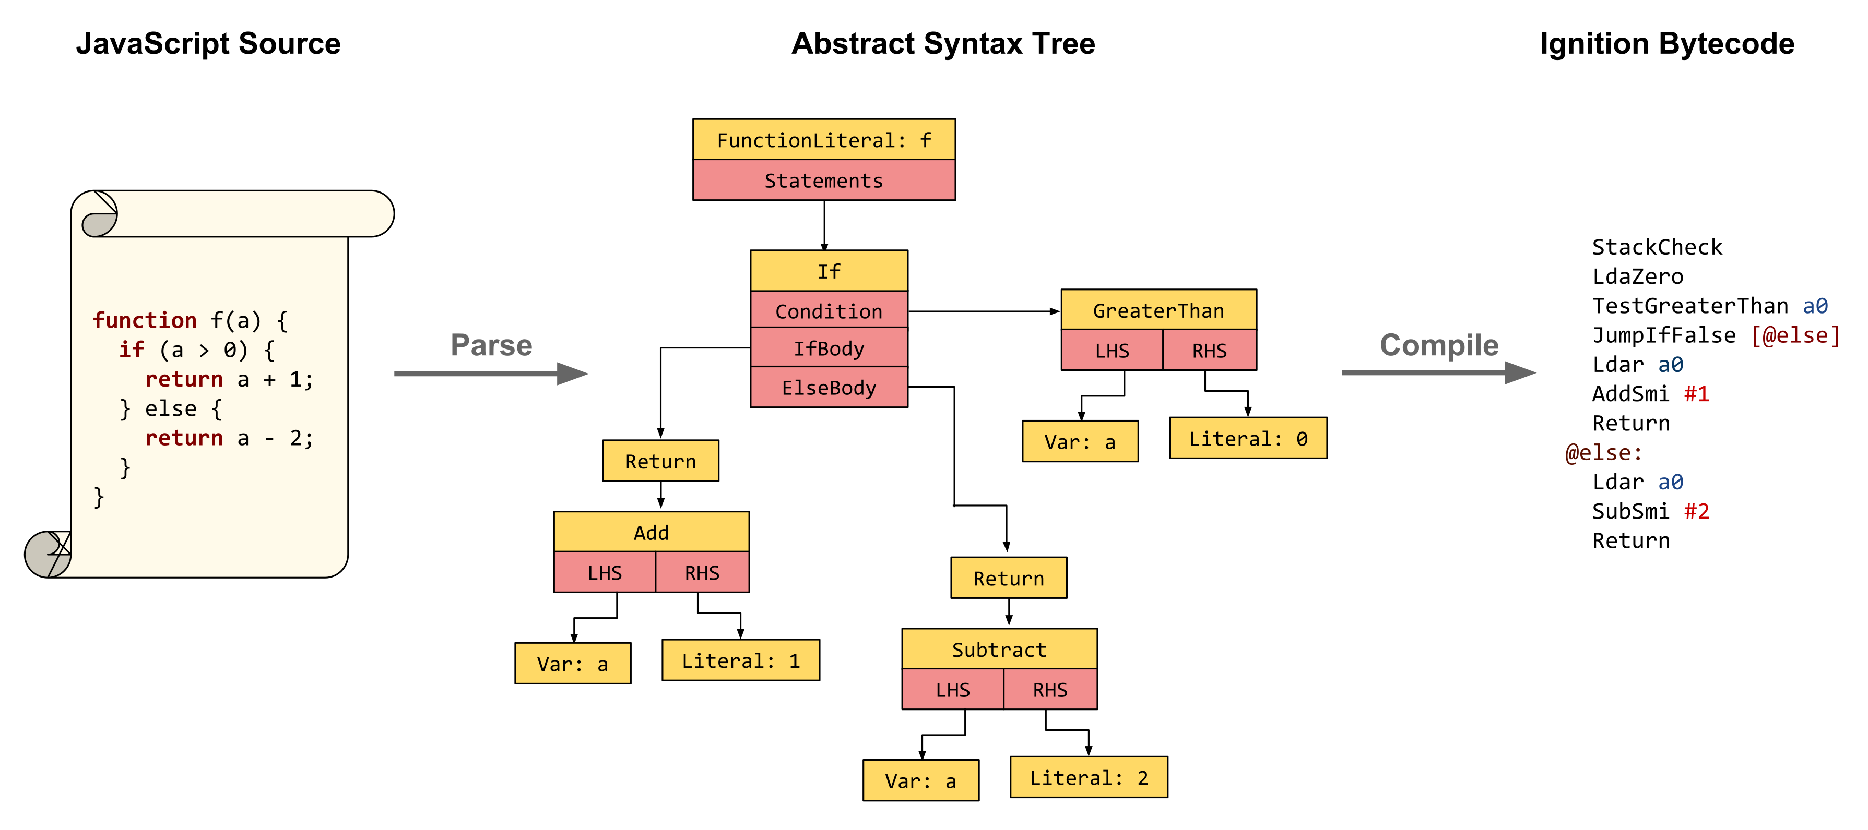
4.2
2008
Source code
Parser
Compiler Fullcodegen
Optimized code
Parser
Abstract syntax tree
Lexical(scanner) Analyzer
Syntax(parser) Analyzer

Slide 16
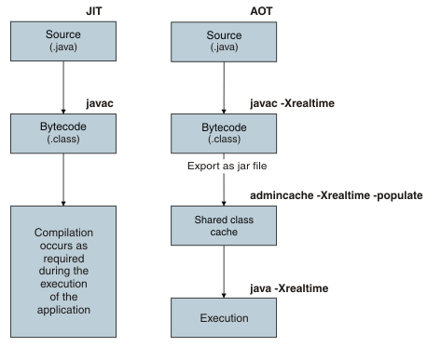
Compilation
4.2
Ahead of Time
Static translation
AOT is the act of compiling a higher-level programming language such as C or C++, or an intermediate representation such as Java bytecode or .NET Framework Common Intermediate Language (CIL) code, into a native (system-dependent) machine code so that the resulting binary file can execute natively.
AOT produces machine optimized code, just like a standard native compiler. The difference is that AOT transforms the bytecode of an extant virtual machine (VM) into machine code.

Slide 17

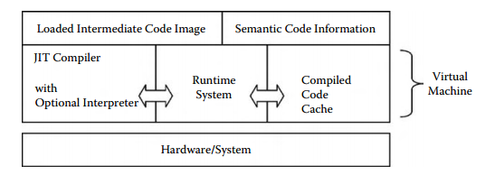
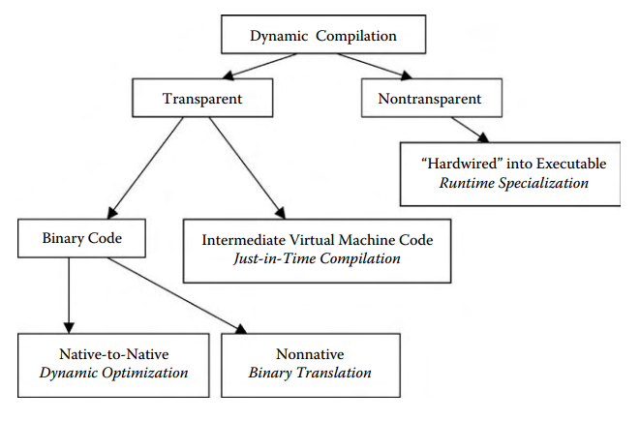
Compilation
4.2
Just in Time
Dynamic translation or Run-time compilations
JIT is a way of executing computer code that involves compilation during execution of a program – at run time – rather than prior to execution. Most often, this consists of source code or more commonly bytecode translation to machine code, which is then executed directly. A system implementing a JIT compiler typically continuously analyses the code being executed and identifies parts of the code where the speedup gained from compilation or recompilation would outweigh the overhead of compiling that code.

Slide 18
4.2
2010
Source code
Parser
Fullcodegen
Non-Optimized code
Parser
Crankshaft
Optimized code

Slide 19

4.2
2015
Source code
Parser
Fullcodegen
Non-Optimized code
Parser
urboFan is one of V8’s optimizing compilers leveraging a concept called “Sea of Nodes”.
One of V8’s blog posts offers a high-level overview of TurboFan. More details can be found in the following resources.
Crankshaft
Optimized code
Tirbofun

Slide 20




4.2
2015

Slide 21

4.2
2016
Source code
Parser
Fullcodegen
Non-Optimized code
Parser
Crankshaft
Optimized code
Interpretator Ignition
Tirbofun
V8 features an interpreter called Ignition. Ignition is a fast low-level register-based interpreter written using the backend of TurboFan. The V8 blog post presents a high-level overview of the Ignition interpreter. More details can be found in the following resources
Source Code
AST
Byte code

Slide 22
4.2
2017
Source code
Parser
Ignition
Tirbofun
Optimized Code

Slide 23
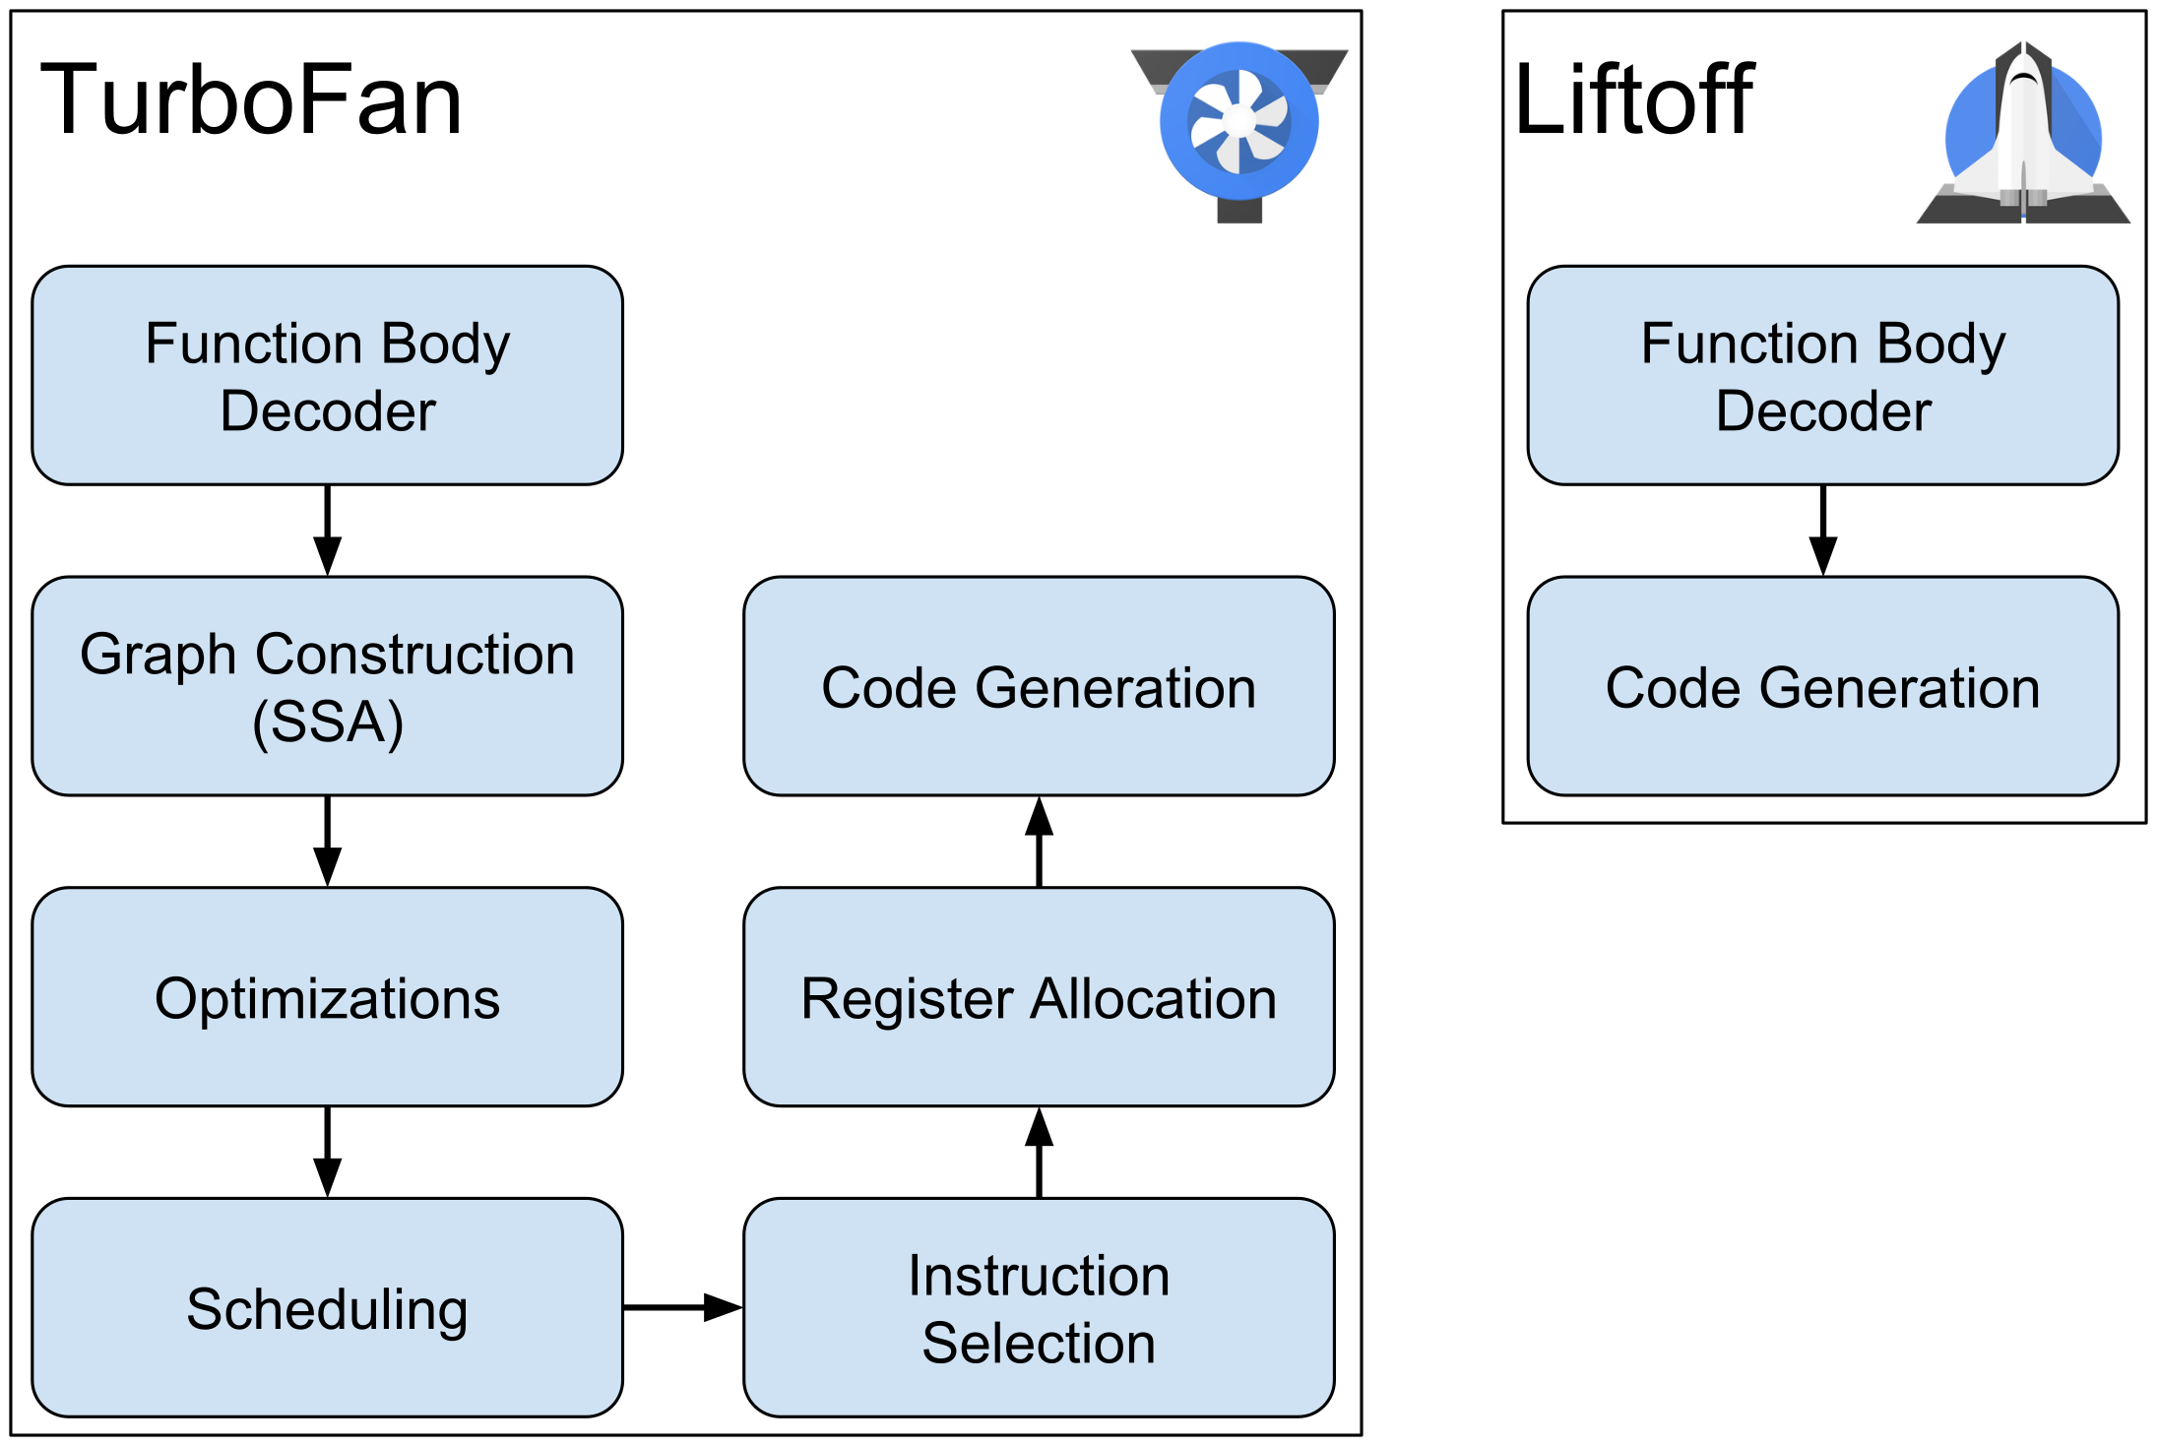
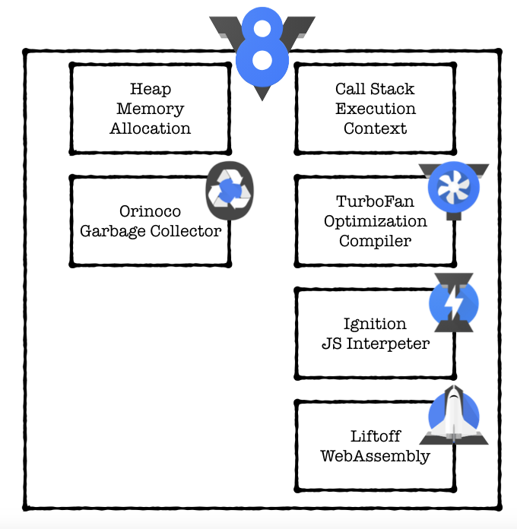


4.2
2018

Slide 24
4.2
Liftoff
V8 v6.9 includes Liftoff, a new baseline compiler for WebAssembly. Liftoff is now enabled by default on desktop systems. This article details the motivation to add another compilation tier and describes the implementation and performance of Liftoff.
But why does it take this long to start up a WebAssembly app, if similar JS apps start up much faster? The reason is that WebAssembly promises to deliver predictable performance, so once the app is running, you can be sure to consistently meet your performance goals (e.g. rendering 60 frames per second, no audio lag or artifacts…). In order to achieve this, WebAssembly code is compiled ahead of time in V8, to avoid any compilation pause introduced by a just-in-time compiler that could result in visible jank in the app.
Orinoco
Running over the memory heap, looking for disconnected memory allocations is the Orinoco. Implementing a generational garbage collector, moving objects within the young generation, from the young to the old generation, and within the old generation. These moves leave holes, and Orinoco performs both evacuation and compaction to free space for more objects.
Another optimization performed by Orinoco is in the way it searches through the heap to find all pointers that contain the old location of the objects moved and update them with the new location. This is made using a data structure called remembered set.
On top of these, black allocation is added, which basically means the garbage collection process automatically marks living objects in black in order to speed up the iterative marking process.
https://v8.dev/blog/liftoff
https://v8.dev/blog/trash-talk

Slide 25

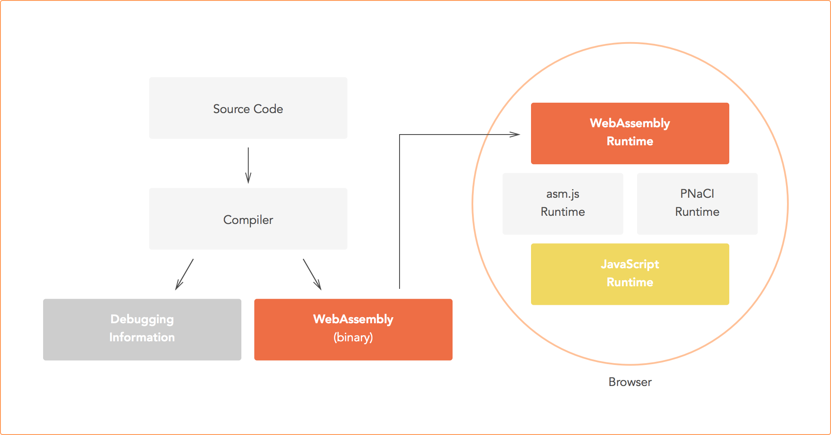
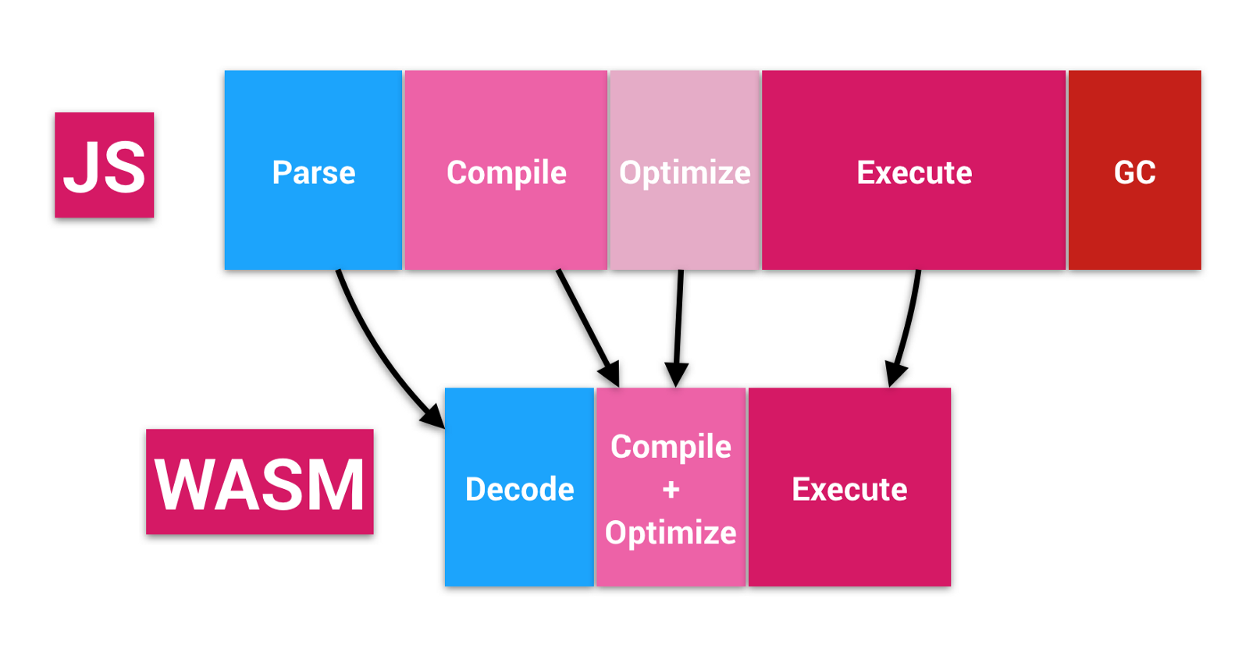



4.2
WebAssembly (WASM)
WebAssembly (abbreviated Wasm) is a binary instruction format for a stack-based virtual machine. Wasm is designed as a portable target for compilation of high-level languages like C/C++/Rust, enabling deployment on the web for client and server applications.
https://webassembly.org

Slide 26


4.2
Sendbox
Parser
Decode
Optimize
JIT
APIs
Machine Code

Slide 27

Microtask and Macrotask
Example

Slide 28
Thank you！

