Slide 1
CSC 455: Database Processing for Large-Scale Analytics Lecture 2
Dragoş Vişan
College of CDM, DePaul University
September 22nd, 2015

Slide 2
Tonight
Relational schema
Functional dependencies
Normalization and normal forms
SQL
Python

Slide 3
Redundancy
Redundancy occurs when more than one record in a table stores the same information
Wastes space
Allows modification, deletion, and insertion anomalies
Normalization removes redundancy by identifying and removing functional dependencies

Slide 4
Redundancy
AdCampaignID | AdCampaignName | StartDate | Duration | CampaignMgrID | CampaignMgrName | ModeID | Media | Range | BudgetPctg
111 | SummerFun16 | 6/6/2016 | 12 days | CM100 | Roberta | 1 | TV | Local | 50%
111 | SummerFun16 | 6/6/2016 | 12 days | CM100 | Roberta | 2 | TV | National | 50%
222 | SummerZing16 | 6/8/2016 | 30 days | CM101 | Sue | 1 | TV | Local | 60%
222 | SummerZing16 | 6/8/2016 | 30 days | CM101 | Sue | 3 | Radio | Local | 30%
222 | SummerZing16 | 6/8/2016 | 30 days | CM101 | Sue | 5 | Print | Local | 10%
333 | FallBall16 | 9/9/2016 | 12 days | CM102 | John | 3 | Radio | Local | 80%
333 | FallBall16 | 9/9/2016 | 12 days | CM102 | John | 4 | Radio | National | 20%
444 | WinterStyle16 | 12/1/2016 | 5 days | CM103 | Nancy | 6 | Print | National | 100%
555 | WinterColors16 | 12/2/2016 | 5 days | CM100 | Roberta | 3 | Radio | Local | 100%
The name, start date and
duration of the campaign
222 repeated three times
The media and range values
for campaign mode 1 repeated twice
The name of the campaign
manager CM100 repeated
three times
Database Systems, Jukic, Vrbsky, Warehouse

Slide 5
Redundancy
AdCampaignID | AdCampaignName | StartDate | Duration | CampaignMgrID | CampaignMgrName | ModeID | Media | Range | BudgetPctg
111 | SummerFun16 | 6/6/2016 | 12 days | CM100 | Roberta | 1 | TV | Local | 50%
111 | SummerFun16 | 6/6/2016 | 12 days | CM100 | Roberta | 2 | TV | National | 50%
222 | SummerZing16 | 6/8/2016 | 30 days | CM101 | Sue | 1 | TV | Local | 60%
222 | SummerZing16 | 6/8/2016 | 30 days | CM101 | Sue | 3 | Radio | Local | 30%
222 | SummerZing16 | 6/8/2016 | 30 days | CM101 | Sue | 5 | Print | Local | 10%
333 | FallBall16 | 9/9/2016 | 12 days | CM102 | John | 3 | Radio | Local | 80%
333 | FallBall16 | 9/9/2016 | 12 days | CM102 | John | 4 | Radio | National | 20%
444 | WinterStyle16 | 9/1/2016 | 5 days | CM103 | Nancy | 6 | Print | National | 100%
555 | WinterColors16 | 12/2/2016 | 5 days | CM100 | Roberta | 3 | Radio | Local | 100%
????? | ????? | ????? | ???? | ???? | ???? | 7 | Intertubes | National | ????
Deletion Anomaly
Can’t delete campaign 444
without deleting all data about
campaign manager Nancy
Modification Anomaly
To change the duration,
you have to modify three
records
Insertion Anomaly
Can’t insert new campaign
Mode 7 without inserting an actual campaign using the new mode
Database Systems, Jukic, Vrbsky, Warehouse

Slide 6
Functional Dependencies
Attribute Y is functionally dependent on attribute X if and only if the value of X uniquely determines the value of Y
Also “X determines Y”, “X → Y”
X is called the determinant
May need more than one attribute: X,Y →Z
May determine more than one: X → Y,Z

Slide 7
Finding a Primary Key
1. Find all functional dependencies among the attributes
2. Find all sets of attributes that together determine all of the others, and from which no attributes can be removed (candidate keys)
3. If there is more than one candidate key, choose one to be the primary key

Slide 8
Functional Dependencies
AdCampaignID | AdCampaignName | StartDate | Duration | CampaignMgrID | CampaignMgrName | ModeID | Media | Range | BudgetPctg
111 | SummerFun16 | 6/6/2016 | 12 days | CM100 | Roberta | 1 | TV | Local | 50%
111 | SummerFun16 | 6/6/2016 | 12 days | CM100 | Roberta | 2 | TV | National | 50%
222 | SummerZing16 | 6/8/2016 | 30 days | CM101 | Sue | 1 | TV | Local | 60%
222 | SummerZing16 | 6/8/2016 | 30 days | CM101 | Sue | 3 | Radio | Local | 30%
222 | SummerZing16 | 6/8/2016 | 30 days | CM101 | Sue | 5 | Print | Local | 10%
333 | FallBall16 | 9/9/2016 | 12 days | CM102 | John | 3 | Radio | Local | 80%
333 | FallBall16 | 9/9/2016 | 12 days | CM102 | John | 4 | Radio | National | 20%
444 | WinterStyle16 | 12/1/2016 | 5 days | CM103 | Nancy | 6 | Print | National | 100%
555 | WinterColors16 | 12/2/2016 | 5 days | CM100 | Roberta | 3 | Radio | Local | 100%
CampaignMgrID → CampaignMgrName
ModeID → Media, Range
AdCampaignID → AdCampaignName, StartDate, Duration, CampaignMgrID, CampaignMgrName
AdCampaignName → AdCampaignID, StartDate, Duration, CampaignMgrID, CampaignMgrName

Slide 9
Functional Dependencies
AdCampaignID | AdCampaignName | StartDate | Duration | CampaignMgrID | CampaignMgrName | ModeID | Media | Range | BudgetPctg
111 | SummerFun16 | 6/6/2016 | 12 days | CM100 | Roberta | 1 | TV | Local | 50%
111 | SummerFun16 | 6/6/2016 | 12 days | CM100 | Roberta | 2 | TV | National | 50%
222 | SummerZing16 | 6/8/2016 | 30 days | CM101 | Sue | 1 | TV | Local | 60%
222 | SummerZing16 | 6/8/2016 | 30 days | CM101 | Sue | 3 | Radio | Local | 30%
222 | SummerZing16 | 6/8/2016 | 30 days | CM101 | Sue | 5 | Print | Local | 10%
333 | FallBall16 | 9/9/2016 | 12 days | CM102 | John | 3 | Radio | Local | 80%
333 | FallBall16 | 9/9/2016 | 12 days | CM102 | John | 4 | Radio | National | 20%
444 | WinterStyle16 | 12/1/2016 | 5 days | CM103 | Nancy | 6 | Print | National | 100%
555 | WinterColors16 | 12/2/2016 | 5 days | CM100 | Roberta | 3 | Radio | Local | 100%
AdCampaignID, ModeID → AdCampaignName, StartDate, Duration, CampaignMgrID, CampaignMgrName, Media, Range, BudgetPctg
AdCampaignName, ModeID → AdCampaignID, StartDate, Duration, CampaignMgrID, CampaignMgrName, Media, Range, BudgetPctg

Slide 10
Functional Dependency Types
Partial FD
ModeID → Media, Range
Full key FD
AdCampaignID, ModeID → BudgetPctg
Transitive FD
If X → Y and Y → Z then X → Z
CampaignMgrID → CampaignMgrName

Slide 11
Functional Dependency Rules
Union
If X → Y, X → Z then X → YZ
Decomposition
If X → YZ then X → Y and X → Z
BUT NOT XY → Z, then X → Z and Y → Z
Pseudo-transitivity
If X → Y and WY → Z then WX → Z

Slide 12
Example
(StudentID, Name, School, Location)
StudentID → Name
Name → School
School → Location

Slide 13
Example
StudentID → School (Transitivity)
StudentID → Location (Transitivity)
StudentID → StudentID (Reflexivity)
Trivial FD
StudentID → Name (given)
StudentID → StudentID, Name, School, Location (Union)

Slide 14
Goals of Decomposition
Want to be able to reconstruct what you started with (lossless)
Dependency preservation
Minimize the cost of integrity constrains
Redundancy avoidance
Avoid any unnecessary data duplication

Slide 15
Decomposing a Schema
Name | Age | Salary
J. Smith | 35 | 90K
B. Doe | 38 | 135K
K. Parks | 35 | 93K
S. Jones | 41 | 115K
1
2
Name | Age
J. Smith | 35
B. Doe | 38
K. Parks | 35
S. Jones | 41
Age | Salary
35 | 90K
38 | 135K
35 | 93K
41 | 115K
Name | Age
J. Smith | 35
B. Doe | 38
K. Parks | 35
S. Jones | 41
Name | Salary
J. Smith | 90K
B. Doe | 135K
K. Parks | 93K
S. Jones | 115K

Slide 16
Decomposing a Schema: Option 1
Name | Age
J. Smith | 35
B. Doe | 38
K. Parks | 35
S. Jones | 41
Age | Salary
35 | 90K
38 | 135K
35 | 93K
41 | 115K
Name | Age | Salary
J. Smith | 35 | 90K
J. Smith | 35 | 93K
B. Doe | 38 | 135K
K. Parks | 35 | 90K
K. Parks | 35 | 93K
S. Jones | 41 | 115K

Slide 17
Decomposing a Schema: Option 2
Name | Age
J. Smith | 35
B. Doe | 38
K. Parks | 35
S. Jones | 41
Name | Salary
J. Smith | 90K
B. Doe | 135K
K. Parks | 93K
S. Jones | 115K
Name | Age | Salary
J. Smith | 35 | 90K
B. Doe | 38 | 135K
K. Parks | 35 | 93K
S. Jones | 41 | 115K

Slide 18
Decomposing a Schema
Gate | ArrivalIn | Destination
A1 | 10 | Paris
A2 | 15 | Berlin
A3 | 15 | Boston
A4 | 25 | Chicago
1
2
Gate | ArrivalIn
A1 | 10
A2 | 15
A3 | 15
A4 | 25
ArrivalIn | Destination
10 | Paris
15 | Berlin
15 | Boston
25 | Chicago
Gate | ArrivalIn
A1 | 10
A2 | 15
A3 | 15
A4 | 25
Gate | Destination
A1 | Paris
A2 | Berlin
A3 | Boston
A4 | Chicago

Slide 19
Normalization
Process used to improve the design of relational databases that contain redundant data
Normal Forms;
First normal form - 1NF
Second – 2NF
Third – 3NF

Slide 20
First Normal Form (1NF)
First Normal Form: Each domain of a column must contain only atomic values, and each column in a record must have at most one value from its domain
1NF is typically our starting point

Slide 21
Second Normal Form (2NF)
Second Normal Form: 1NF, plus every attribute in the table is determined by the entire primary key (but not by any subset)
To get 2NF, eliminate partial dependencies
A partial dependency is a functional dependency where the determinant is a subset of the primary key

Slide 22
Removing Partial Dependencies
Find all dependencies where the determinant is a subset of the primary key
Starting with the smallest subset, do the following:
1. Remove all attributes on the right-hand side from the table and put them in a new table
2. Add the attributes in the determinant to the new table; make them the primary key, and make them a foreign key in the original table or in an additional bridge table linked to the new table
3. Remove from the remaining partial dependencies any attributes removed from the original table

Slide 23
Removing Partial Dependencies
Full key FD
AdCampaignID | AdCampaignName | StartDate | Duration | CampaignMgrID | CampaignMgrName | ModeID | Media | Range | BudgetPctg
Partial FDs

Slide 24
Converting 1NF to 2NF
AdCampaignID → AdCampaignName, StartDate, Duration, CampaignMgrID, CampaignMgrName
ModeID → Media, Range
AD CAMPAIGN
AdCampaignID | AdCampaignName | StartDate | Duration | CampaignMgrID | CampaignMgrName
MODE
ModeID | Media | Range
AD CAMPAIGN MIX
AdCampaignID | ModeID | BudgetPctg

Slide 25
Converting 1NF to 2NF
(EmpID, EmpLName, EmpFName, Dept, ProjCode, Hours)
Two FDs are given:
EmpID →EmpLName, EmpFName, Dept
EmpID, ProjCode →Hours

Slide 26
1NF vs 2NF Data
EmpID | EmpLName | EmpFName | Dept | ProjCode | Hours
550 | Smith | Winston | Accounting | 101 | 20
550 | Smith | Winston | Accounting | 252 | 10
601 | Smith | Barney | Finance | 252 | 5
390 | Hammond | Evey | Personnel | 995 | 25
001 | Preston | Bill | Special Events | 995 | 5
100 | Logan | Ted | Special Events | 995 | 5
007 | Bond | James | Personnel | 252 | 20
505 | Lane | Lois | Media Relations | 101 | 10
505 | Lane | Lois | Media Relations | 252 | 10
505 | Lane | Lois | Media Relations | 995 | 10
Notes:
VALUES ( '550', 'Smith', 'Winston', 'Accounting', 101, 20 );
VALUES ( '550', 'Smith', 'Winston', 'Accounting', 252, 10 );
VALUES ( '601', 'Smith', 'Barney', 'Finance', 252, 5 );
VALUES ( '390', 'Hammond', 'Evey', 'Personnel', 995, 25 );
VALUES ( '001', 'Preston', 'Bill', 'Special Events', 995, 5 );
VALUES ( '100', 'Logan', 'Ted', 'Special Events', 995, 5 );
VALUES ( '007', 'Bond', 'James', 'Personnel', 252, 20 );
VALUES ( '505', 'Lane', 'Lois', 'Media Relations', 101, 10 );
VALUES ( '505', 'Lane', 'Lois', 'Media Relations', 252, 10 );
VALUES ( '505', 'Lane', 'Lois', 'Media Relations', 995, 10 );

Slide 27
Converting 1NF to 2NF
Decompose (EmpID, EmpLName, EmpFName, Dept, ProjCode, Hours)
Remove the offending FD
EmpID →EmpLName, EmpFName, Dept
Two tables
(EmpID, EmpLName, EmpFName, Dept)
(EmpID, ProjCode, Hours)

Slide 28
Towards 2NF
EmpID | EmpLName | EmpFName | Dept
550 | Smith | Winston | Accounting
550 | Smith | Winston | Accounting
601 | Smith | Barney | Finance
390 | Hammond | Evey | Personnel
001 | Preston | Bill | Special Events
100 | Logan | Ted | Special Events
007 | Bond | James | Personnel
505 | Lane | Lois | Media Relations
505 | Lane | Lois | Media Relations
505 | Lane | Lois | Media Relations
EmpID | ProjCode | Hours
550 | 101 | 20
550 | 252 | 10
601 | 252 | 5
390 | 995 | 25
001 | 995 | 5
100 | 995 | 5
007 | 252 | 20
505 | 101 | 10
505 | 252 | 10
505 | 995 | 10

Slide 29
Towards 2NF
EmpID | EmpLName | EmpFName | Dept
550 | Smith | Winston | Accounting
601 | Smith | Barney | Finance
390 | Hammond | Evey | Personnel
001 | Preston | Bill | Special Events
100 | Logan | Ted | Special Events
007 | Bond | James | Personnel
505 | Lane | Lois | Media Relations
EmpID | ProjCode | Hours
550 | 101 | 20
550 | 252 | 10
601 | 252 | 5
390 | 995 | 25
001 | 995 | 5
100 | 995 | 5
007 | 252 | 20
505 | 101 | 10
505 | 252 | 10
505 | 995 | 10

Slide 30
Third Normal Form (3NF)
Third Normal Form: 2NF, plus every attribute in the table is determined only by the primary key of the table.
To get 3NF, eliminate transitive dependencies
A transitive dependency is a functional dependency where the determinant is not part of the primary key

Slide 31
Removing Transitive Dependencies
Find all dependencies where the determinant is not part of the primary key
Starting with the smallest subset, do the following:
1. Remove all attributes on the right-hand side from the table and put them in a new table
2. Add the attributes in the determinant to the new table; make them the primary key, and make them a foreign key in the original table or in an additional bridge table linked to the new table
3. Remove from the remaining transitive dependencies any attributes removed from the original table

Slide 32
Removing Transitive Dependencies
Full key FD
AdCampaignID | AdCampaignName | StartDate | Duration | CampaignMgrID | CampaignMgrName | ModeID | Media | Range | BudgetPctg
Transitive FD
Partial FDs

Slide 33
Converting 1NF to 2NF
AdCampaignID → AdCampaignName, StartDate, Duration, CampaignMgrID, CampaignMgrName
ModeID → Media, Range
CampaignMgrID → CampaingMgrName
AD CAMPAIGN
AdCampaignID | AdCampaignName | StartDate | Duration | CampaignMgrID
MODE
ModeID | Media | Range
CAMPAIGN MANAGER
CampaignMgrID | CampaignMgrName
AD CAMPAIGN MIX
AdCampaignID | ModeID | BudgetPctg

Slide 34
Towards 3NF
(First , Last, Address, City, State, Zip)
First, Last → First, Last, Address, City, State, Zip
Given FD:
Zip → City, State

Slide 35
2NF Data Table
First | Last | Address | City | State | ZipCode
Henry | Bienen | 2145 Sheridan Rd | Evanston | IL | 60202
Helmut | Epp | 55 E. Jackson St | Chicago | IL | 60604
Denis | Stein | 55 E. Jackson St. | Chicago | IL | 60604
David | Miller | 243 S. Wabash Av. | Chicago | IL | 60604
Gary | Miller | 5000 Forbes Av. | Pittsburgh | PA | 15213
Gary | Leighton | 77 Beacon St | Cambridge | MA | 02139

Slide 36
Decompose the Tables
First | Last | Address | ZipCode
Henry | Bienen | 2145 Sheridan Rd | 60202
Helmut | Epp | 55 E. Jackson St | 60604
Denis | Stein | 55 E. Jackson St. | 60604
David | Miller | 243 S. Wabash Av. | 60604
Gary | Miller | 5000 Forbes Av. | 15213
Gary | Leighton | 77 Beacon St | 02139
City | State | ZipCode
Evanston | IL | 60202
Chicago | IL | 60604
Chicago | IL | 60604
Chicago | IL | 60604
Pittsburgh | PA | 15213
Cambridge | MA | 02139

Slide 37
Decompose the Tables
First | Last | Address | ZipCode
Henry | Bienen | 2145 Sheridan Rd | 60202
Helmut | Epp | 55 E. Jackson St | 60604
Denis | Stein | 55 E. Jackson St. | 60604
David | Miller | 243 S. Wabash Av. | 60604
Gary | Miller | 5000 Forbes Av. | 15213
Gary | Leighton | 77 Beacon St | 02139
City | State | ZipCode
Evanston | IL | 60202
Chicago | IL | 60604
Pittsburgh | PA | 15213
Cambridge | MA | 02139
First, Last → First, Last, Address, ZipCode
ZipCode → City, State

Slide 38
Normalization Example
(Longitude, Latitude, Height, Address, Owner, Floor, Cost, InsuranceRate, CreditRating)
Functional dependencies:
Longitude, Latitude, Height → Address, Owner, Floor, Cost,InsuranceRate, CreditRating
Longitude, Latitude → Address
Height → Floor
CreditRating → InsuranceRate

Slide 39
More 3NF-Examples
R(A,B,C,D)
with AB key
A→C, B→D
R(A,B,C,D,E)
with ABD key
C→E, B→C
Find 3NF normalization

Slide 40


Slide 41
SQL
Structured Query Language (SQL) is the industry standard for relational databases
Used to be known as SEQUEL (Structured English Query Language), developed at IBM
… but trademarked by Hawker Siddeley, a UK aircraft company

Slide 42
SQL
All major DBMSs support some version of SQL (SQL-99 is the one you are likely to see)
Statements can be issued interactively, batched in script files, or embedded in a program in general-purpose programming language (e.g., Java, C++)

Slide 43
Classes of SQL Commands
Data Definition Language (DDL)
Create schemas, tables, constraints, views
Data Manipulation Language (DML)
Modify and update tables, retrieve information
Data Control Language (DCL)
Grant and revoke access to parts of database
Most users only have access to the DML – we will use both the DDL and the DML

Slide 44
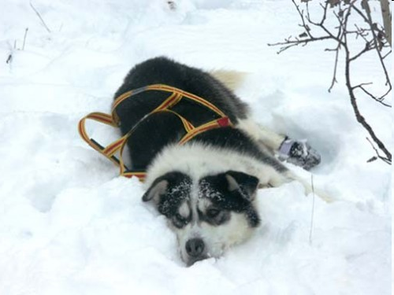
BREAK

Slide 45
Using SQLDeveloper
First, you must set up a new connection to a computer running a DBMS (see document)
cdmoracledb.cti.depaul.edu
use your CSTCIS username, with initial password cdm####### (7-digit Student ID)
To change password, ALTER USER username IDENTIFIED BY newpassword ; (…Execute)
Double-click to open an existing connection

Slide 46
Viewing Tables
Left window shows current Tables, click on + to expand list
Right-click on Tables and choose Refresh to see changes (can also Commit changes to disk)
Double-click on a table to open it in the center window
COLUMNS tab shows schema
DATA tab shows contents

Slide 47
Working with SQL Scripts
Create file scriptname.sql in Notepad
Be sure to use .sql extension
To add comments:
-- for a single-line comment
/* ... */ for a multi-line comment
Output full contents of table with SELECT * FROM TABLE_NAME ;

Slide 48
Running SQL Scripts
A script is sequence of SQL commands stored in a file
To run, type @FullPath\File.sql in center window, then click Run Script (F5)
@”C:\.....\Folder Name with a space\File.sql”
Any output will appear in bottom window (Results or Script Output)
Click on Save icon to save output window contents to a text file (Click Clear icon first)

Slide 49
Creating a Table
CREATE TABLE TABLE_NAME (Attribute1 DOMAIN_1, Attribute2 DOMAIN_2, ... AttributeN DOMAIN_N);
You can list as many attributes and domains as you want, separated by commas

Slide 50
Removing Tables
To remove a table: DROP TABLE TABLE_NAME ; (Should do this at the beginning of every script before creating tables to avoid conflicts with existing tables…)
There are also ways to remove or modify individual records within tables…

Slide 51
SQL Domains / Data Types
Numerical domains:
NUMBER: A general floating-point number
NUMBER(*, 0): A general integer
NUMBER(n): An n-digit integer
NUMBER(x, y): A fixed-precision number with x total digits, and y digits to the right of the decimal point

Slide 52
SQL Domains / Data Types
String domains:
CHAR(n): A fixed-length string of n characters
VARCHAR2(m) or VARCHAR(m): A variable-length string of up to m characters
Dates:
DATE: A date in dd-mon-yy format (dd = day, mon = month, yy = year)

Slide 53
Table Definition Example
CREATE TABLE Student (
sid NUMBER(7),
name VARCHAR2(16),
login VARCHAR2(32),
age NUMBER(3),
gpa NUMBER(3,2)
);
CREATE TABLE Enrolled (
sid NUMBER(7),
cid VARCHAR2(32),
grade CHAR(1)
);
Integer Range
Variable String Length
Fixed String Length

Slide 54
Defaults and Constraints
After attribute and domain, before comma:
Can add default value for the attribute with DEFAULT value
Can disallow NULL values with NOT NULL
Can impose general constraints with CHECK (condition)
e.g., to require that attribute is within a range, add CHECK (value1 <= Attribute AND Attribute <= value2)
Applied whenever a tuple is added/changed

Slide 55
Creating Primary/Foreign Keys
Set up primary and foreign keys using CONSTRAINT clauses within CREATE, after all attributes have been specified
CONSTRAINT PKName PRIMARY KEY (Att1, Att2, ...)
CONSTRAINT FKName FOREIGN KEY (Att1, Att2, …) REFERENCES TABLE_NAME(Att1, Att2, ...)
Separate all clauses with commas

Slide 56
Table Definition Example
CREATE TABLE Student (
sid NUMBER(7),
name VARCHAR2(16),
login VARCHAR2(32),
age NUMBER(3),
gpa NUMBER(3,2),
CONSTRAINT StudentPK
PRIMARY KEY (sid)
);
Primary Key

Slide 57
Table Definition Example
CREATE TABLE Enrolled (
sid NUMBER(7),
cid VARCHAR2(32),
grade CHAR(1),
CONSTRAINT EnrolledFK1
FOREIGN KEY (sid)
REFERENCES STUDENT(sid);
);
Foreign Key

Slide 58
ALTER TABLE
ALTER TABLE TABLE_NAME {ADD (Attribute DOMAIN)}
{DROP COLUMN Attribute CASCADE}
Allows modifications to an existing table schema

Slide 59
Handling Constraint Violations
Operations that violate domain constraints, entity integrity, or referential integrity are rejected by default
SQL can specify alternatives for foreign and primary keys ON UPDATE and ON DELETE
CASCADE, SET NULL, SET DEFAULT
(Oracle only supports ON DELETE, with either CASCADE or SET NULL…)

Slide 60
Populating a Table
To insert a record into a table:
INSERT INTO TABLE_NAME VALUES (value1, value2, value3, ... );
Values of attributes must be given in the same order as in the schema
Will generate an error if any constraints are violated (domain constraints, entity integrity, referential integrity, user-defined constraints)

Slide 61
Populating a Table (continued)
To insert a record that specifies only some of the attributes:
INSERT INTO TABLE_NAME(Attr1, Attr2,...) VALUES (value1, value2, ... );
Missing attributes will be filled in with NULL (unless default values are specified…)

Slide 62
Displaying Table Contents
SELECT * FROM TABLE_NAME ;
This will display the entire contents of the table TABLE_NAME (all rows and columns)
This is an example of a very simple query
Addition of a WHERE clause lets us display only a subset of the records

Slide 63
SQL Queries
General form of a query:
SELECT list of attributes to report FROM list of tables [WHERE tuple condition] [GROUP BY list of grouping attributes] [HAVING group condition] [ORDER BY list of ordering attributes] ;
Result is an ordered set of ordered tuples

Slide 64
SELECT FROM
SELECT list of attributes FROM list of tables
SELECT gives which attributes to include
give a single attribute, or a list (rename with AS)
* for all attributes
DISTINCT will only report distinct tuples
FROM gives the table(s) to get tuples from
for now, just a single table

Slide 65
WHERE
WHERE condition
Each tuple is tested against the condition, and only those that satisfy it are returned by the query
Condition expression can contain:
comparisons
expressions with wildcards (for strings)
boolean operations

Slide 66
UPDATE
UPDATE TABLE_NAME SET Attribute = value WHERE condition;
Sets Attribute to value in exactly those tuples that satisfy condition

Slide 67
DELETE
DELETE FROM TABLE_NAME WHERE condition;
Removes from the table exactly those tuples that satisfy condition

Slide 68
Comparisons
Put numerical or string value on each side, each comparison returns true or false
= is equal to
!= or <> is not equal to
> is greater than
>= is greater than or equal to
< is less than
<= is less than or equal to

Slide 69
Boolean Operators
Simple conditions can be combined into more complicated conditions
X AND Y is satisfied by a tuple if and only if both X and Y are satisfied by it
X OR Y is satisfied by a tuple if and only if at least one of X and Y is satisfied by it
NOT X is satisfied by a tuple if and only if X is not satisfied by it

Slide 70
ORDER BY
ORDER BY list of ordering attributes
Tuples returned by the query are sorted by the first attribute in the list
Ties are broken by the second attribute, then the third, et cetera
Tuples are sorted in ascending order unless we put DESC after an attribute

Slide 71
Aggregate Functions
Given an attribute, these functions will collect their results from the values of that attribute in the set of returned tuples:
COUNT: Number of tuples containing values
SUM: Sum of the values
AVG: Average of the values
MIN: Smallest of the values
MAX: Largest of the values

Slide 72
Lists
cCodes = ["CSC355", "CSC553"]
cCodes.append("CSC555")
cCodes.insert(2, "CSC453")
cCodes.extend(["CSC451", "CSC401"])
cCodes.sort()

Slide 73
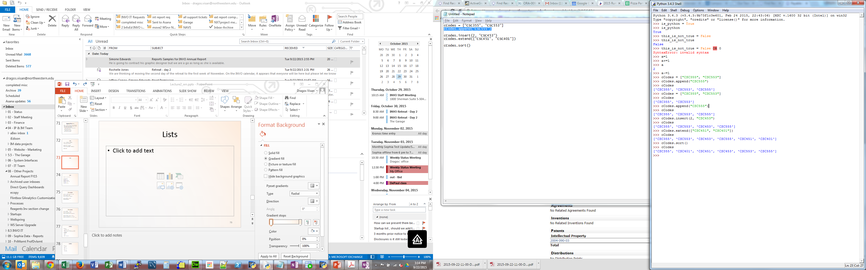
Lists

Slide 74
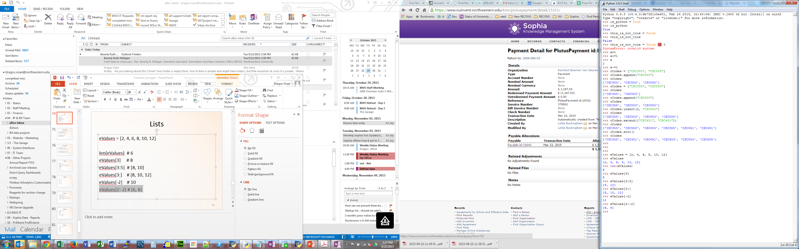
Lists
eValues = [2, 4, 6, 8, 10, 12]
len(eValues) # 6
eValues[3] # 8
eValues[3:5] # [8, 10]
eValues[3:] # [8, 10, 12]
eValues[-2] # 10
eValues[2:-2] # [6, 8]

Slide 75
Dictionaries
extensions = {111: 'Alex', 222: 'Jane'}
extensions[333] = 'Mike'
extensions['Default']='Operator'
extensions[222] = 'Jennifer'
extensions.pop(222)

Slide 76
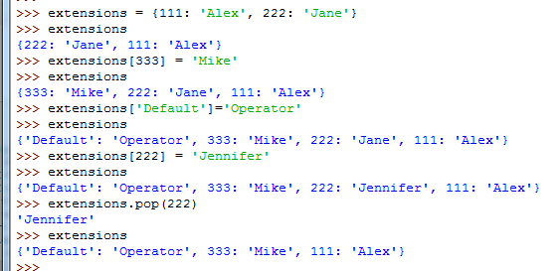
Dictionaries

Slide 77
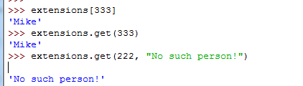
Dictionaries
extensions[333] # ‘Mike’
extensions.get(333) # ‘Mike’
extensions.get(222, "No such person!")

Slide 78
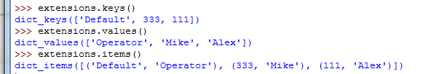
Dictionaries
extensions.keys() # [333, 222, 111] extensions.values() # ['Mike', 'Jane', 'Alex']
extensions.items() # [(333, 'Mike'), (222, 'Jane'), (111, 'Alex')]

Slide 79
Python
Booleans
is_python = True
this_is_not_true = False or 0 or “” or None
these_are_true = True and 1 and “any text”
Operators
a = 10
a+=1
a-=1
b = 10*(a+1) - 50

Slide 80
Python
Operators
c = a+b
d = c * 2
e = c * 2.0
f = c / 2
g = c % 3
h = c ** 2

Slide 81
Python
String manipulation
animals = “Cats “ + “Dogs “
animals += “Rabbits”
fruit = ‘, ‘.join([‘Apple’, ‘Banana’, ‘Orange’])
address = ‘%d %s, %s %s %d’ % (243, ‘S. Wabash’, ‘Chicago’, ‘IL’, 60604)

Slide 82
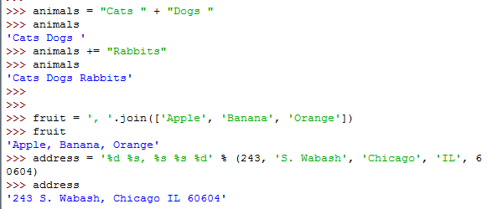
Python

Slide 83
Python
Logical comparison
a and b
a or b
not a
(a or not (b and c) or d)
1 == ‘1’ # False
1 == 1 # True

Slide 84
Python
Arithmetic comparison
a > b
a <= c
b < b
a == b
c == d
a < a+5

Slide 85
Python
Conditionals
grade = 82
If (grade >= 90):
if (grade==100):
print ‘A+’
else:
print ‘A’
else:
print “Not A”

Slide 86
Python
For loop
for x in range(100):
print “X = “, x
fruit = [‘Apple’, ‘Banana’, ‘Orange’]
fruit = ‘Apple, Banana, Orange’.split(‘, ‘)
for value in fruit:
print value

Slide 87
Python
states = {‘IL’ : ‘Illinois’, ‘ME’: ‘Maine’,
‘RI’: ‘Rhode Island’}
for key, value in states.items():
print ‘%s: %s’ % (key, value)
While loop:
x = 0
while x < 1000:
print “ X = “, x
x += 5

Slide 88
Python
def multiply(x, y):
return x*y
def printUpper(phrase = “No input”):
print phrase.upper()

Slide 89
Next Time:
SQL DDL with python
SQL Queries
SELECT
WHERE
Aggregates
(Assignment 1 posted tonight)

