Slide 1
The Career Choice Study
Cognition | Personality | Career
Example from some students at DePaul

Slide 2
Summary
DePaul Student Career Center advises students on career decisions. In order to better match students’ personalities and abilities with career choices, Chainsaw Juggling Club consultants are hired to investigate following questions:
Are Cognitive Abilities and Personality Traits good predictors of Career Choice?
What types of correlations are there amongst Cognitive Abilities, Personality Traits, and Career Choice?
Are there natural groupings within Career Choices?
Are there any unexpected correlations?

Slide 3
Dataset & Methods
Dataset
Source: Colorado University’s data analysis class
Already been cleaned and all variables are in numeric form
Four parts: demographic information, cognition, personality, and occupational interest
34 Variables
250 Cases
Methods
Canonical Correlation Analysis
Principal Component Analysis
Cluster Analysis
Linear Discriminant Analysis

Slide 4
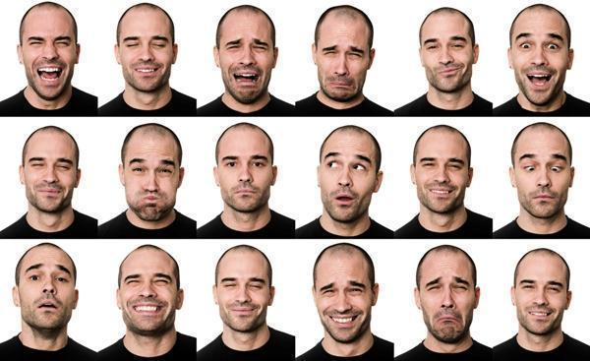
Personality
Social Dominance
Sociability
Stress Reaction
Worry Scale
Impulsion
Thrill-seeking

Slide 5

Cognition
Vocabulary Test
Reading Comprehension
Sentence Completion
Mathematics
Geometry
Analytical Reasoning

Slide 6

Career
Police
Fireman
Teacher
Artist
Lawyer
… (18 variables)

Slide 7
Canonical Correlation Analysis

Slide 8




Questions we may ask at the first glance of the dataset
Will personality traits impact career choice?
What about cognitive abilities?
What are important factors to become a lawyer / police / teacher?

Slide 9
Digging into the data & Design the models
Technically, What we want to know…
Canonical correlations: Personality & Career
Loadings: Certain personality variables may link with certain jobs
Model1: CCA model between personality and vocational interest
Canonical correlations: Cognition & Career
Loadings: Certain cognitive variables may link with certain jobs
Model2: CCA model between cognition and vocational interest

Slide 10
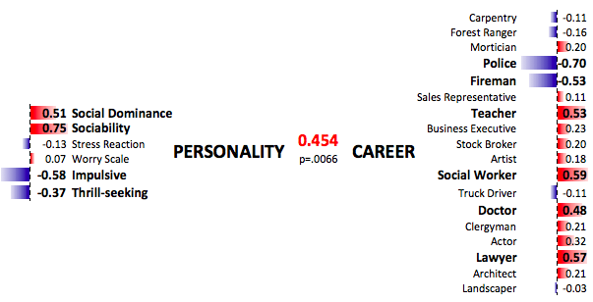
Model1 - CCA Model show significant canonical correlation between personality and career interest

Slide 11
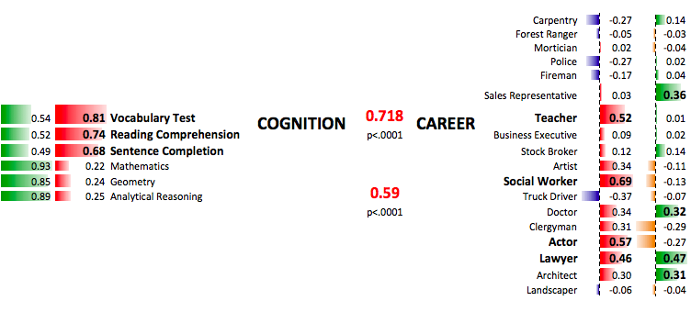
Model2 - CCA Model show significant canonical correlation between cognition and career interest

Slide 12
Key Findings & Answers to our initial questions
Will personality traits impact career choice?
Yes! Personality traits and career interests are significantly canonical correlated
What about cognitive abilities?
Yes! cognitive abilities and career interests are significantly canonical correlated
What are important factors to become a lawyer / police / teacher?
Social dominance, Sociability, all around cognitive abilities -> Lawyer
Impulsive, Thrill-seeking -> Policeman, Fireman
Verbal Reasoning Abilities, Sociability -> Teacher

