Slide 1


FDA solution
The solution works just like PCA then, but with the matrix
$$S_{X}=S_{W}^{−1}S_{B}$$
In particular, we get the solution
$$w^{∗}=S_{W}^{−1}({\overline{X}}_{1}−{\overline{X}}_{2})$$

Slide 2
Linear discrimination
Linear combination W⋅X > θ, with fixed W, defines a half-space.
W⋅X = 0 defines a hyperplane orthogonal to W, passing through 0
W⋅X > 0 is the half-space in the direction of W vector
W⋅X > θ is the half-space, shifted by θ in the direction of W vector.
Linear discrimination: separate different classes of data using hyperplanes, learn the best W parameters from data.
Frequently a single hyperplane is sufficient to separate data, especially in high-dimensional spaces!

Slide 3
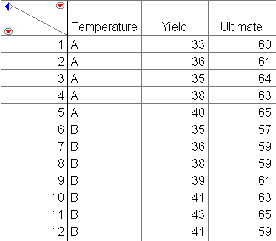
Real Data Example
Example: steel dataset (2 groups)
Two measurements of strength on samples of steel processed at two different temperatures
Temperatures -> groups
We will develop a linear discriminant function to classify the steel into the two groups based upon the two measurements.

Slide 4
Great deal of overlap if projected on X or Y axis or on first PC
Choose a better direction
Recover groups based on projection along that direction
This is the concept of a linear discriminant function.

Slide 5
X marks the centroids
Projection line will always be parallel to some line connecting the centroids
Exact direction of this line depends upon the calculation of w
Remember the solution shown is not unique, but the projection direction is unique.
Z
Temperature A
Temperature B

Slide 6
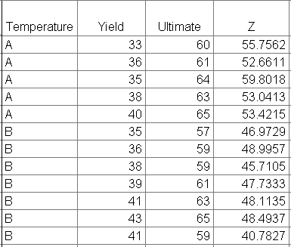
Example: Below is a data table showing the values of the discriminant function Z. On the Z scale we can clearly differentiate between the two Temperature groups.

Slide 7
Example: Below are the calculations for the coefficients of the discriminant functions for the two groups.

Slide 8
Linear discriminant functions (how to classify)
Linear discriminant function g_{W}(X) = W^{T}⋅X + W₀
Terminology: W is the weight vector, W₀ is the bias term.
IF g_{W}(X) Then Class ω₁, otherwise Class ω₂
W = [W₀, W₁ ... W_{d}] usually includes W₀, and X=[1,X₁, .. X_{d}]

Slide 9
Discriminant functions
Decision boundary for two classes
linear discriminant

Slide 10
LDA in SPSS

Slide 11
Cluster Analysis
What is Cluster Analysis?
Types of Data in Cluster Analysis
A Categorization of Major Clustering Methods
Partitioning Methods
K-means clustering
Hierarchical clustering

Slide 12
What is Cluster Analysis?
Cluster: a collection of data objects
Similar to one another within the same cluster
Dissimilar to the objects in other clusters
Cluster analysis
Grouping a set of data objects into clusters
Clustering is unsupervised classification: no predefined classes
Typical applications
As a stand-alone tool to get insight into data distribution
As a preprocessing step for other algorithms

Slide 13
General Applications of Clustering
Pattern Recognition
Image Processing
Economic Science (especially market research)
WWW
Document classification
Cluster Web log data to discover groups of similar access patterns
Marketing: Help marketers discover distinct groups in their customer bases, and then use this knowledge to develop targeted marketing programs

Slide 14
Examples of Clustering Applications
Land use: Identification of areas of similar land use in an earth observation database
Insurance: Identifying groups of motor insurance policy holders with a high average claim cost
City-planning: Identifying groups of houses according to their house type, value, and geographical location
Earth-quake studies: Observed earth quake epicenters should be clustered along continent faults

Slide 15
What Is Good Clustering?
A good clustering method will produce high quality clusters with
high intra-class similarity
low inter-class similarity
The quality of a clustering result depends on both the similarity measure used by the method and its implementation.
The quality of a clustering method is also measured by its ability to discover some or all of the hidden patterns.

Slide 16
Cluster Analysis
What is Cluster Analysis?
Types of Data in Cluster Analysis
A Categorization of Major Clustering Methods
Partitioning Methods
K-means clustering

Slide 17
Data Structures
Data matrix
Dissimilarity matrix

Slide 18
Measure the Quality of Clustering
Dissimilarity/Similarity metric: Similarity is expressed in terms of a distance function, which is typically metric: d(i, j)
There is a separate “quality” function that measures the “goodness” of a cluster.
The definitions of distance functions are usually very different for interval-scaled, boolean, categorical, ordinal and ratio variables.
Weights should be associated with different variables based on applications and data semantics.
It is hard to define “similar enough” or “good enough”
the answer is typically highly subjective.

Slide 19
Type of data in clustering analysis
Interval-scaled variables
Binary variables
Nominal, ordinal, and ratio variables
Variables of mixed types

Slide 20
Interval-valued variables
Standardize data
Calculate the mean absolute deviation:
where
Calculate the standardized measurement (z-score)
Using mean absolute deviation is more robust than using standard deviation

Slide 21
Similarity and Dissimilarity Between Objects
Distances are normally used to measure the similarity or dissimilarity between two data objects
Some popular ones include: Minkowski distance:
where i = (x_{i1}, x_{i2}, …, x_{ip}) and j = (x_{j1}, x_{j2}, …, x_{jp}) are two p-dimensional data objects, and q is a positive integer
If q = 1, d is Manhattan distance

Slide 22
Similarity and Dissimilarity Between Objects (Cont.)
If q = 2, d is Euclidean distance:
Properties
d(i,j) ≥ 0
d(i,i) = 0
d(i,j) = d(j,i)
d(i,j) ≤ d(i,k) + d(k,j)
Also, one can use weighted distance, parametric Pearson product moment correlation, or other dissimilarity measures

Slide 23

The cosine similarity measure
n-dimensional space
Similarity is calculated based on the angle between the vectors

Slide 24
Binary Variables
A contingency table for binary data
Simple matching coefficient (invariant, if the binary variable is symmetric):
Jaccard coefficient (noninvariant if the binary variable is asymmetric):
Object j
Object i

Slide 25
Dissimilarity between Binary Variables
Example
gender is a symmetric attribute
the remaining attributes are asymmetric binary
let the values Y and P be set to 1, and the value N be set to 0

Slide 26
Nominal Variables
A generalization of the binary variable in that it can take more than 2 states, e.g., red, yellow, blue, green
Method 1: Simple matching
m: # of matches, p: total # of variables
Method 2: use a large number of binary variables
creating a new binary variable for each of the M nominal states

Slide 27
Ordinal Variables
An ordinal variable can be discrete or continuous
Order is important, e.g., rank
Can be treated like interval-scaled
replace x_{if} by their rank
map the range of each variable onto [0, 1] by replacing i-th object in the f-th variable by
compute the dissimilarity using methods for interval-scaled variables

Slide 28
Ratio-Scaled Variables
Ratio-scaled variable: a positive measurement on a nonlinear scale, approximately at exponential scale, such as Ae^{Bt} or Ae^{-Bt}
Methods:
treat them like interval-scaled variables—not a good choice! (why?—the scale can be distorted)
apply logarithmic transformation
y_{if} = log(x_{if})
treat them as continuous ordinal data or treat their rank as interval-scaled

Slide 29
Variables of Mixed Types
A database may contain all the six types of variables
symmetric binary, asymmetric binary, nominal, ordinal, interval and ratio
One may use a weighted formula to combine their effects
f is binary or nominal:
d_{ij}^{(f)} = 0 if x_{if} = x_{jf} , or d_{ij}^{(f)} = 1 o.w.
f is interval-based: use the normalized distance
f is ordinal or ratio-scaled
compute ranks r_{if} and
and treat z_{if} as interval-scaled

Slide 30
Cluster Analysis
What is Cluster Analysis?
Types of Data in Cluster Analysis
A Categorization of Major Clustering Methods
Partitioning Methods
K-means clustering
Hierarchical Methods

Slide 31
Major Clustering Approaches
Partitioning algorithms: Construct various partitions and then evaluate them by some criterion
Hierarchy algorithms: Create a hierarchical decomposition of the set of data (or objects) using some criterion
Density-based: based on connectivity and density functions
Grid-based: based on a multiple-level granularity structure
Model-based: A model is hypothesized for each of the clusters and the idea is to find the best fit of that model to each other

Slide 32
Partitioning Algorithms: Basic Concept
Partitioning method: Construct a partition of a database D of n objects into a set of k clusters
Given a k, find a partition of k clusters that optimizes the chosen partitioning criterion
Global optimal: exhaustively enumerate all partitions
Heuristic methods: k-means and k-medoids algorithms
k-means (MacQueen’67): Each cluster is represented by the center of the cluster
k-medoids or PAM (Partition around medoids) (Kaufman & Rousseeuw’87): Each cluster is represented by one of the objects in the cluster

Slide 33


The sum of squared error is defined as
This criterion defines clusters by their mean vectors m_{i}
→ it minimizes the sum of the squared lengths of the error x - m_{i}.
The minimum variance partition minimizes J_{e}
Results:
Good when clusters form well separated compact clouds
Bad with large differences in the number of samples in different clusters.

Slide 34
Scatter criteria
Scatter matrices used in multiple discriminant analysis, i.e., the within-scatter matrix S_{W} and the between-scatter matrix S_{B}
S_{T} = S_{B} + S_{W}
Note:
S_{T} does not depend on partitioning
In contrast, S_{B} and S_{W} depend on partitioning
Two approaches:
minimize the within-cluster
maximize the between-cluster scatter

Slide 35
The trace (sum of diagonal elements) is the simplest scalar measure of the scatter matrix
proportional to the sum of the variances in the coordinate directions
This is the sum-of-squared-error criterion, J_{e}.

Slide 36
As tr[S_{T}] = tr[S_{W}] + tr[S_{B}] and tr[S_{T}] is independent from the partitioning, no new results can be derived by minimizing tr[S_{B}]
However, seeking to minimize the within-cluster criterion J_{e}=tr[S_{W}], is equivalent to maximise the between-cluster criterion
where m is the total mean vector:

Slide 37
Iterative optimization
Clustering ➔ discrete optimization problem
Finite data set → finite number of partitions
What is the cost of exhaustive search?
→c^{n}/c! For c clusters. Not a good idea
Typically iterative optimization used:
starting from a reasonable initial partition
Redistribute samples to minimize criterion function.
➔ guarantees local, not global, optimization.

Slide 38
consider an iterative procedure to minimize the sum-of-squared-error criterion J_{e}
where J_{i} is the effective error per cluster.
Moving sample from cluster D_{i} to D_{j}, changes the errors in the 2 clusters by:

Slide 39
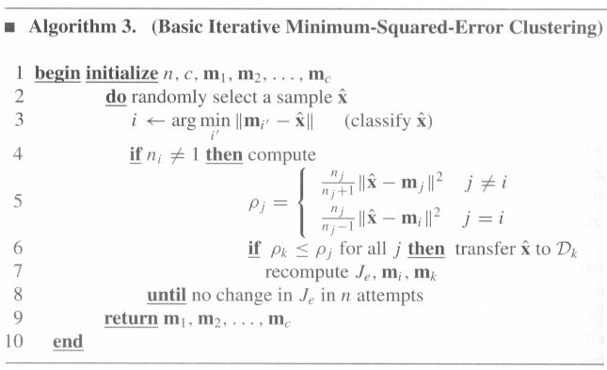
Hence, the transfer is advantegeous if the decrease in J_{i} is larger than the increase in J_{j}

Slide 40
Alg. 3 is sequential version of the k-means alg.
updates each time a sample is reclassified
k-means waits until n samples have been reclassified before updating
Alg 3 can get trapped in local minima
Depends on order of the samples
Basically, myopic approach
But it is online!

Slide 41
Starting point is always a problem
Approaches:
Random centers of clusters
Repetition with different random initialization
c-cluster starting point as the solution of the (c-1)-cluster problem plus the sample farthest from the nearer cluster center

Slide 42
Summary on the K-Means Method
Strength: Relatively efficient: O(tkn), where n is # objects, k is # clusters, and t is # iterations. Normally, k, t << n.
Comparing: PAM: O(k(n-k)² ), CLARA: O(ks² + k(n-k))
Comment: Often terminates at a local optimum. The global optimum may be found using techniques such as: deterministic annealing and genetic algorithms
Weakness
Applicable only when mean is defined, then what about categorical data?
Need to specify k, the number of clusters, in advance
Unable to handle noisy data and outliers
Not suitable to discover clusters with non-convex shapes

Slide 43
The K-Means Clustering Method
Given k, the k-means algorithm is implemented in four steps:
Partition objects into k nonempty subsets
Compute seed points as the centroids of the clusters of the current partition (the centroid is the center, i.e., mean point, of the cluster)
Assign each object to the cluster with the nearest seed point
Go back to Step 2, stop when there are no more new assignment

Slide 44
The K-Means Clustering Method
Example
10
10
9
9
8
8
7
7
6
6
5
5
4
Assign each objects to most similar center
Update the cluster means
4
3
3
2
2
1
1
0
0
0
1
2
3
4
5
6
7
8
9
10
0
1
2
3
4
5
6
7
8
9
10
reassign
K=2
Arbitrarily choose K object as initial cluster center
Update the cluster means

Slide 45
Demo
https://www.youtube.com/watch?v=BVFG7fd1H30

Slide 46
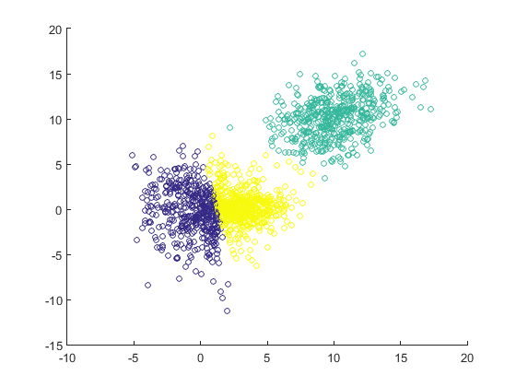
MATLAB Demo (kmeans)
>> D = [ mvnrnd([0 0] , [ 5 0 ; 0 10 ], 500) ;
mvnrnd([3 0] , [ 3 0 ; 0 1 ], 500) ;
mvnrnd([10 10], [5 2 ; 2 5], 500)];
>> scatter(D(:,1), D(:,2));
>>
>> [idx, C] = kmeans(D, 2);
>> scatter(D(:,1), D(:,2),
20, idx);
>>
>> [idx, C] = kmeans(D, 3);
>> scatter(D(:,1), D(:,2),
20, idx);

Slide 47
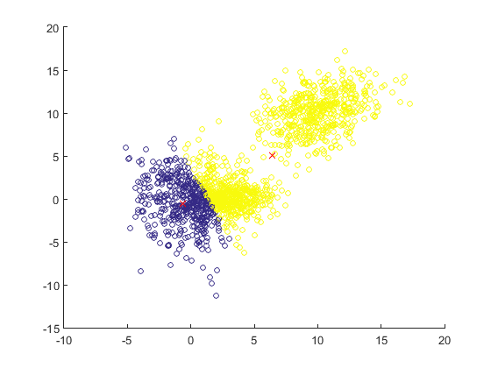
MATLAB Demo (kmeans steps)
>> figure; hold on;
>> scatter(D(:,1), D(:,2));
>> c1 = [-5 10]; c2 = [0 10];
>> plot(c1(1), c1(2), 'rx')
>> plot(c2(1), c2(2), 'rx')
>> c1_dists = arrayfun(@(i) norm(D(i,:) - c1), 1:size(D,1));
>> c2_dists = arrayfun(@(i) norm(D(i,:) - c2), 1:size(D,1));
>> c1_members = c1_dists <= c2_dists;
>> c2_members = ~c1_members;
>> idx = c1_members + 2*c2_members ;
>> figure; hold on;
>> scatter(D(:,1), D(:,2),
20, idx);
>> c1 = mean(D(c1_members,:));
>> c2 = mean(D(c2_members,:));
>> plot(c1(1), c1(2), 'rx')
>> plot(c2(1), c2(2), 'rx')
% repeat…
>> c1_dists = arrayfun(@(i) norm(D(i,:) - c1), 1:size(D,1));
>> c2_dists = arrayfun(@(i) norm(D(i,:) - c2), 1:size(D,1));
>> c1_members = c1_dists <= c2_dists;
>> c2_members = ~c1_members;
>> idx = c1_members + 2*c2_members ;
>> figure; hold on;
>> scatter(D(:,1), D(:,2), 20, idx);
>> c1 = mean(D(c1_members,:));
>> c2 = mean(D(c2_members,:));
>> plot(c1(1), c1(2), 'rx')
>> plot(c2(1), c2(2), 'rx')

Slide 48
Variations of the K-Means Method
A few variants of the k-means which differ in
Selection of the initial k means
Dissimilarity calculations
Strategies to calculate cluster means
Handling categorical data: k-modes (Huang’98)
Replacing means of clusters with modes
Using new dissimilarity measures to deal with categorical objects
Using a frequency-based method to update modes of clusters
A mixture of categorical and numerical data: k-prototype method

Slide 49
What is the problem of k-Means Method?
The k-means algorithm is sensitive to outliers !
Since an object with an extremely large value may substantially distort the distribution of the data.
K-Medoids: Instead of taking the mean value of the object in a cluster as a reference point, medoids can be used, which is the most centrally located object in a cluster.
10
10
9
9
8
8
7
7
6
6
5
5
4
4
3
3
2
2
1
1
0
0
1
2
3
4
5
6
7
8
9
10
0
0
1
2
3
4
5
6
7
8
9
10

Slide 50
The K-Medoids Clustering Method
Find representative objects, called medoids, in clusters
PAM (Partitioning Around Medoids, 1987)
starts from an initial set of medoids and iteratively replaces one of the medoids by one of the non-medoids if it improves the total distance of the resulting clustering
PAM works effectively for small data sets, but does not scale well for large data sets:O(k(n-k)² ) for each iteration
where n is # of data,k is # of clusters
CLARA (Kaufmann & Rousseeuw, 1990)
CLARANS (Ng & Han, 1994): Randomized sampling

Slide 51
Typical k-medoids algorithm (PAM)
Total Cost = 20
10
9
8
Arbitrary choose k object as initial medoids
Assign each remaining object to nearest medoids
7
6
5
4
3
2
1
0
0
1
2
3
4
5
6
7
8
9
10
K=2
Randomly select a nonmedoid object,O_{ramdom}
Do loop
Until no change
10
10
9
Compute total cost of swapping
9
Swapping O and O_{ramdom}
If quality is improved.
8
8
7
7
6
6
5
5
4
4
3
3
2
2
1
1
0
0
1
2
3
4
5
6
7
8
9
10
0
0
1
2
3
4
5
6
7
8
9
10

Slide 52
Check
Why cluster?
How do you choose the similarity / distance matric?
How do you define a good cluster?
How do you choose K?

Slide 53
Hierarchical Clustering
Many times, clusters are not disjoint, but a cluster may have subclusters, in turn having sub-subclusters, etc.
Consider a sequence of partitions of the n samples into c clusters
The first is a partition into n clusters, each one containing exactly one sample
The second is a partition into n-1 clusters, the third into n-2, and so on, until the n-th in which there is only one cluster containing all of the samples
At the level k in the sequence, c = n-k+1.

Slide 54
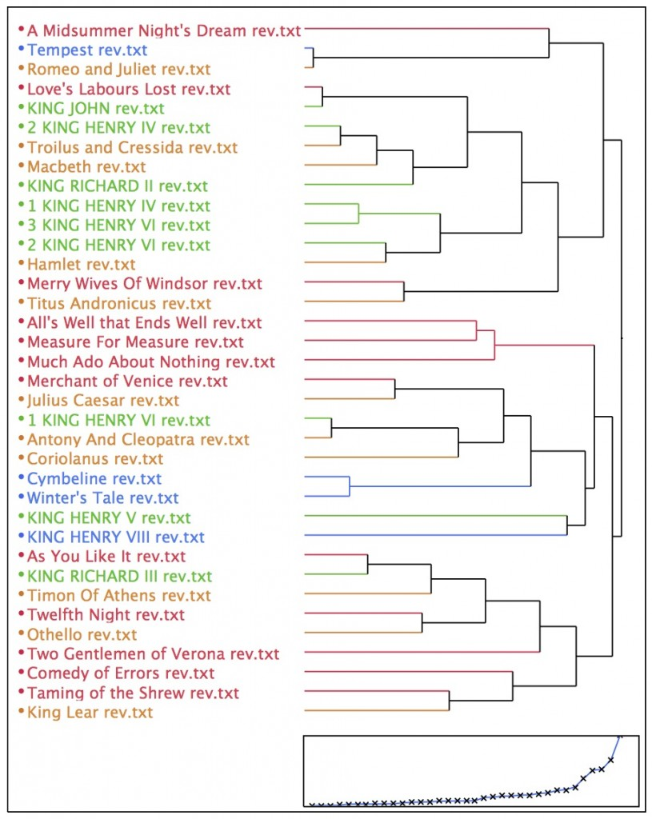
Given any two samples x and x’, they will be grouped together at some level, and if they are grouped a level k, they remain grouped for all higher levels
Hierarchical clustering ⇒ tree representation called dendrogram

Slide 55
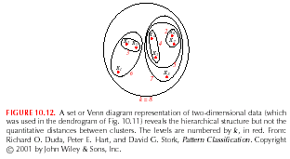
Are groupings natural or forced: check similarity values
Evenly distributed similarity → no justification for grouping
Another representation is based on set, e.g., on the Venn diagrams

Slide 56
Hierarchical clustering can be divided in agglomerative and divisive.
Agglomerative (bottom up, clumping): start with n singleton cluster and form the sequence by merging clusters
Divisive (top down, splitting): start with all of the samples in one cluster and form the sequence by successively splitting clusters

Slide 57
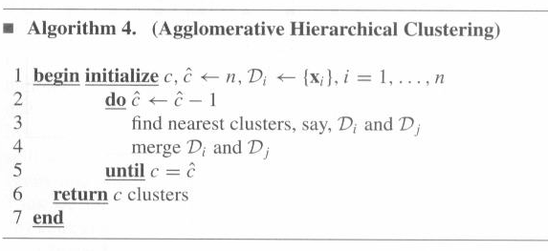
Agglomerative hierarchical clustering
The procedure terminates when the specified number of cluster has been obtained, and returns the cluster as sets of points, rather than the mean or a representative vector for each cluster

Slide 58
At any level, the distance between nearest clusters can provide the dissimilarity value for that level
To find the nearest clusters, one can use
which behave quite similar if the clusters are hyperspherical and well separated.
The computational complexity is O(cn²d²), n>>c

Slide 59
Nearest-neighbor algorithm (single linkage)
d_{min} is used
Viewed in graph terms, an edge is added to the nearest nonconnected components
Equivalent of Prim’s minimum spanning tree algorithm
Terminates when the distance between nearest clusters exceeds an arbitrary threshold

Slide 60
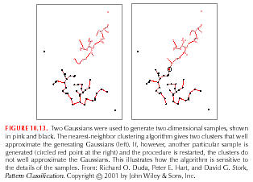
The use of d_{min} as a distance measure and the agglomerative clustering generate a minimal spanning tree
Chaining effect: defect of this distance measure

Slide 61
The farthest neighbor algorithm (complete linkage)
d_{max} is used
This method discourages the growth of elongated clusters
Encourages approximately equal diameters
In graph theoretic terms:
every cluster is a complete subgraph
the distance between two clusters is determined by the most distant nodes in the 2 clusters
terminates when the distance between nearest clusters exceeds an arbitrary threshold

Slide 62
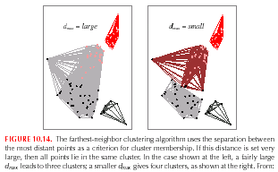
When two clusters are merged, the graph is changed by adding edges between every pair of nodes in the 2 clusters
All the procedures involving minima or maxima are sensitive to outliers. The use of d_{mean} or d_{avg} are natural compromises

Slide 63
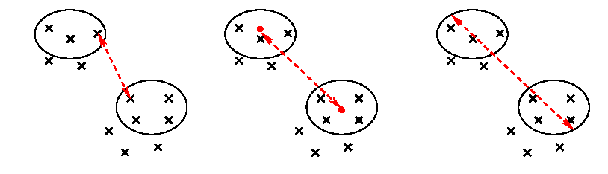
Hierarchical Clustering – distance between clusters
Single-linkage
Average-linkage
Complete-linkage

Slide 64
The problem of the number of clusters
How many clusters should there be?
For clustering by extremizing a criterion function
repeat the clustering with c=1, c=2, c=3, etc.
look for large changes in criterion function
Alternatively:
state a threshold for the creation of a new cluster
useful for on line cases
sensitive to order of presentation of data.
These approaches are similar to model selection procedures

Slide 65
Density-Based Clustering

Slide 66
Density-Based Clustering Methods
Clustering based on density (local cluster criterion), such as density-connected points
Major features:
Discover clusters of arbitrary shape
Handle noise
One scan
Need density parameters as termination condition
Several interesting studies:
DBSCAN: Ester, et al. (KDD’96)
DENCLUE: Hinneburg & D. Keim (KDD’98)
CLIQUE: Agrawal, et al. (SIGMOD’98)
OPTICS: Ankerst, et al (SIGMOD’99).

Slide 67
Density-Based Clustering: Background
Two parameters:
Eps: Maximum radius of the neighbourhood
MinPts: Minimum number of points in an Eps-neighbourhood of that point
N_{Eps}(p): {q belongs to D | dist(p,q) <= Eps}
Directly density-reachable: A point p is directly density-reachable from a point q wrt. Eps, MinPts if
1) p belongs to N_{Eps}(q)
2) core point condition:
|N_{Eps} (q)| >= MinPts
p
MinPts = 5
Eps = 1 cm
q

Slide 68
Density-Based Clustering: Background (II)
Density-reachable:
A point p is density-reachable from a point q wrt. Eps, MinPts if there is a chain of points p₁, …, p_{n}, p₁ = q, p_{n} = p such that p_{i+1} is directly density-reachable from p_{i}
Density-connected
A point p is density-connected to a point q wrt. Eps, MinPts if there is a point o such that both, p and q are density-reachable from o wrt. Eps and MinPts.
p
p₁
q
p
q
o

Slide 69
DBSCAN
DBSCAN: Density Based Spatial Clustering of Applications with Noise
Relies on a density-based notion of cluster: A cluster is defined as a maximal set of density-connected points
Discovers clusters of arbitrary shape in spatial databases with noise

Slide 70
DBSCAN’s Main Concepts
DBSCAN is a density-based algorithm.
Density = number of points within a specified radius r (Eps)
A point is a core point if it has more than a specified number of points (MinPts) within Eps
These are points that are at the interior of a cluster
A border point has fewer than MinPts within Eps, but is in the neighborhood of a core point
A noise point is any point that is not a core point or a border point.

Slide 71
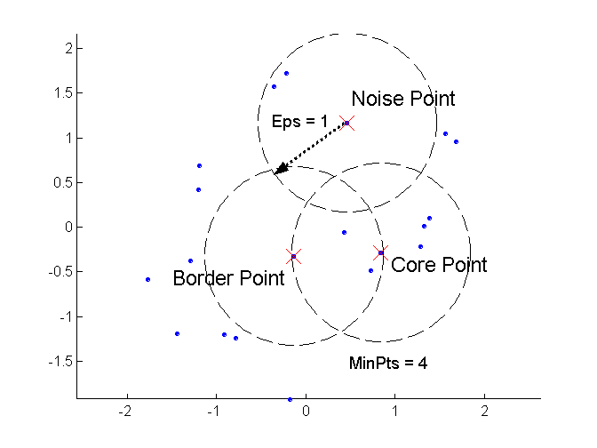
DBSCAN: Core, Border, and Noise Points

Slide 72
DBSCAN: The Algorithm
Arbitrary select a point p
Retrieve all points density-reachable from p wrt Eps and MinPts.
If p is a core point, a cluster is formed.
If p is a border point, no points are density-reachable from p and DBSCAN visits the next point of the database.
Continue the process until all of the points have been processed.

Slide 73
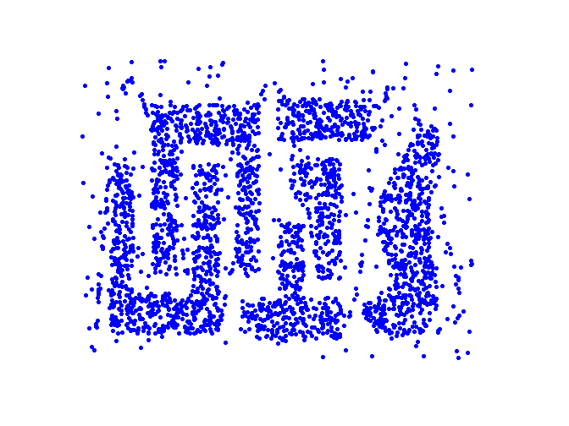
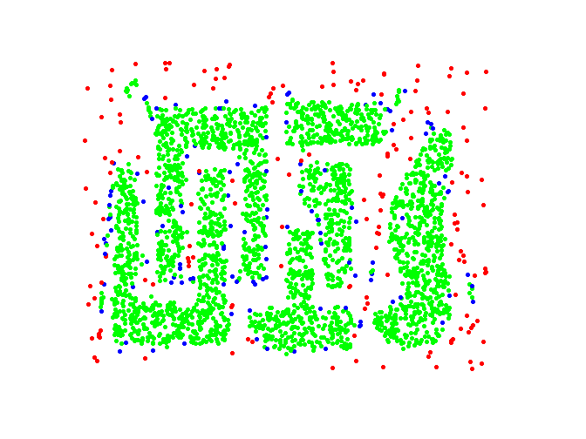
DBSCAN: Core, Border and Noise Points
Original Points
Point types: core, border and noise
Eps = 10, MinPts = 4

Slide 74
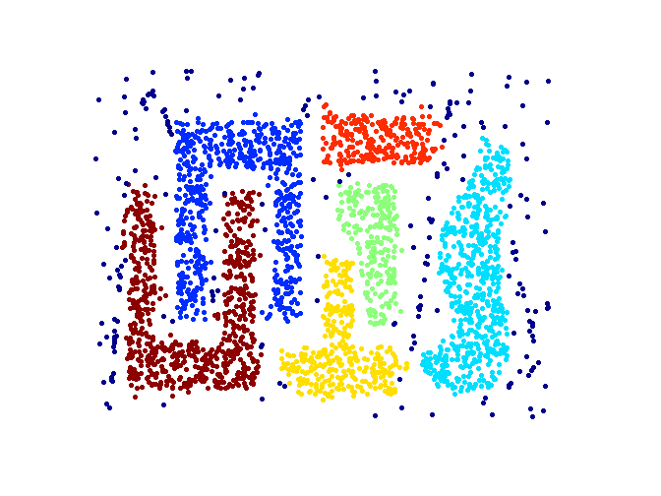
When DBSCAN Works Well
Original Points
Clusters
Resistant to Noise
Can handle clusters of different shapes and sizes

Slide 75
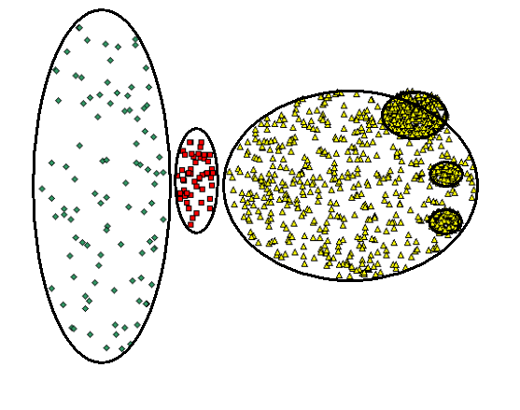
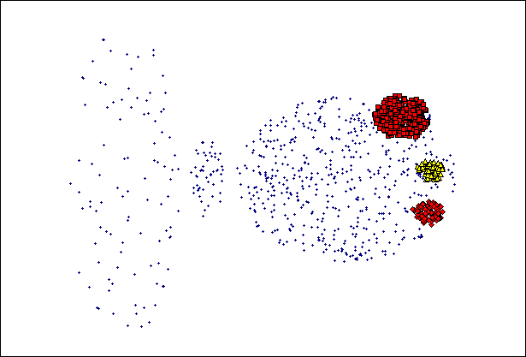
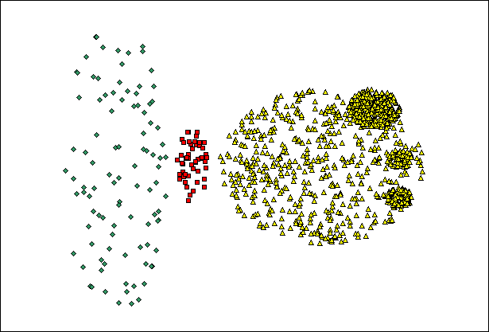
When DBSCAN Does NOT Work Well
(MinPts=4, Eps=9.75).
Original Points
Varying densities
High-dimensional data
(MinPts=4, Eps=9.92)

Slide 76
Complexity DBSCAN
Time Complexity: O(n²)—for each point it has to be determined if it is a core point, can be reduced to O(n*log(n)) in lower dimensional spaces by using efficient data structures (n is the number of objects to be clustered);
Space Complexity: O(n).

Slide 77
Summary DBSCAN
Good: can detect arbitrary shapes, not very sensitive to noise, supports outlier detection, complexity is kind of okay, beside K-means the second most used clustering algorithm.
Bad: does not work well in high-dimensional datasets, parameter selection is tricky, has problems of identifying clusters of varying densities, density estimation is kind of simplistic (→does not create a real density function, but rather a graph of density-connected points)

Slide 78
DENCLUE: using density functions
DENsity-based CLUstEring by Hinneburg & Keim (KDD’98)
Major features
Solid mathematical foundation
Good for data sets with large amounts of noise
Allows a compact mathematical description of arbitrarily shaped clusters in high-dimensional data sets
Significant faster than existing algorithm (faster than DBSCAN by a factor of up to 45)
But needs a large number of parameters

Slide 79
Denclue: Technical Essence
Uses grid cells but only keeps information about grid cells that do actually contain data points and manages these cells in a tree-based access structure.
Influence function: describes the impact of a data point within its neighborhood.
Overall density of the data space can be calculated as the sum of the influence function of all data points.
Clusters can be determined mathematically by identifying density attractors.
Density attractors are local maxima of the overall density function.

Slide 80
Gradient: The steepness of a slope
Example: f= Influence function is the Gaussian function of y on x; f^{D} is the density function

Slide 81
Example: Density Computation
D={x1,x2,x3,x4}
f^{D}_{Gaussian}(x)= influence(x,x1) + influence(x,x2) + influence(x,x3)
+ influence(x4)=0.04+0.06+0.08+0.6=0.78
x1
0.04
x3
y
0.08
x2
x4
0.06
x
0.6
Remark: the density value of y would be larger than the one for x

Slide 82
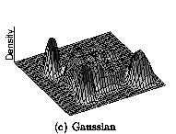
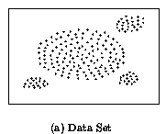
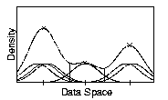
Density Attractor
Density attractor is the local maximal of over all density function
A cluster = a density attractor x* + { data points density-attracted by x* }

Slide 83
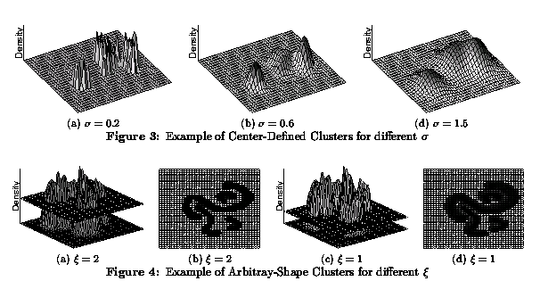
Center-Defined and Arbitrary

Slide 84
Model-Based Clustering Methods
Attempt to optimize the fit between the data and some mathematical model
Statistical and AI approach
COBWEB (Fisher’87)
A popular a simple method of incremental conceptual learning
Creates a hierarchical clustering in the form of a classification tree
Each node refers to a concept and contains a probabilistic description of that concept

Slide 85
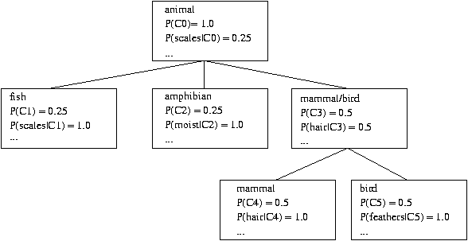
COBWEB Clustering Method
A classification tree

Slide 86
More on Statistical-Based Clustering
Limitations of COBWEB
The assumption that the attributes are independent of each other is often too strong because correlation may exist
Not suitable for clustering large database data – skewed tree and expensive probability distributions
CLASSIT
an extension of COBWEB for incremental clustering of continuous data
suffers similar problems as COBWEB
AutoClass (Cheeseman and Stutz, 1996)
Uses Bayesian statistical analysis to estimate the number of clusters
Popular in industry

Slide 87
Other Model-Based Clustering Methods
Neural network approaches
Represent each cluster as an exemplar, acting as a “prototype” of the cluster
New objects are distributed to the cluster whose exemplar is the most similar according to some distance measure
Competitive learning (self-organizing feature maps)
Involves a hierarchical architecture of several units (neurons)
Neurons compete in a “winner-takes-all” fashion for the object currently being presented

Slide 88
Self-Organizing Feature Map (SOM)
SOMs, also called topological ordered maps, or Kohonen Self-Organizing Feature Map (KSOMs)
It maps all the points in a high-dimensional source space into a 2 to 3-d target space, such that, the distance and proximity relationship (i.e., topology) are preserved as much as possible
A constrained version of k-means clustering: cluster centers tend to lie in a low-dimensional manifold in the feature space
Clustering is performed by having several units competing for the current object
The unit whose weight vector is closest to the current object wins
The winner and its neighbors learn by having their weights adjusted
SOMs are believed to resemble processing that can occur in the brain
Useful for visualizing high-dimensional data in 2- or 3-D space

Slide 89
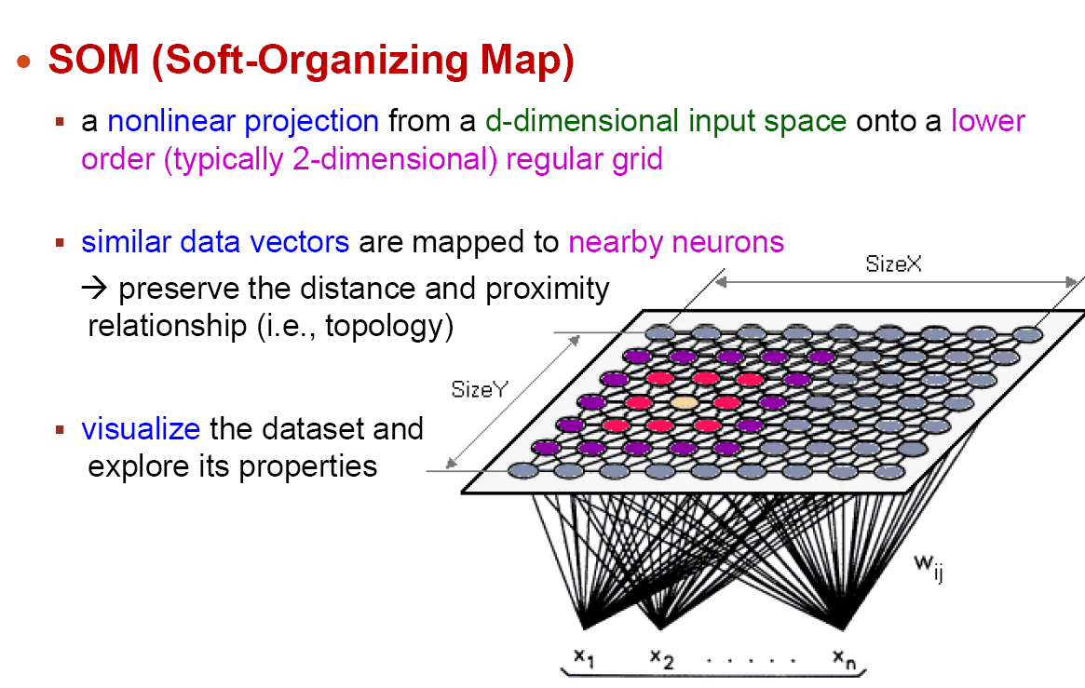
Self-Organizing Feature Map (SOM)

Slide 90
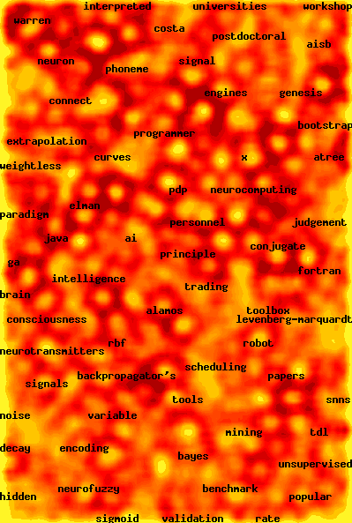
Web Document Clustering Using SOM
The result of SOM clustering of 12088 Web articles
The picture on the right: drilling down on the keyword “mining”
Based on websom.hut.fi Web page

Slide 91
Fuzzy Set and Fuzzy Cluster
Clustering methods discussed so far
Every data object is assigned to exactly one cluster
Some applications may need for fuzzy or soft cluster assignment
Ex. An e-game could belong to both entertainment and software
Methods: fuzzy clusters and probabilistic model-based clusters
Fuzzy cluster: A fuzzy set S: F_{S} : X → [0, 1] (value between 0 and 1)
Example: Popularity of cameras is defined as a fuzzy mapping
Then, A(0.05), B(1), C(0.86), D(0.27)
91

Slide 92
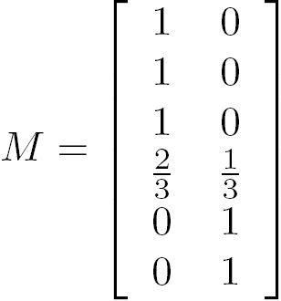


Fuzzy (Soft) Clustering
Example: Let cluster features be
C₁ :“digital camera” and “lens”
C₂: “computer“
Fuzzy clustering
k fuzzy clusters C₁, …,C_{k} ,represented as a partition matrix M = [w_{ij}]
P1: for each object o_{i} and cluster C_{j}, 0 ≤ w_{ij} ≤ 1 (fuzzy set)
P2: for each object o_{i}, , equal participation in the clustering
P3: for each cluster C_{j} , ensures there is no empty cluster
Let c₁, …, c_{k} as the center of the k clusters
For an object o_{i}, sum of the squared error:
For a cluster C_{i}, SSE:
Measure how well a clustering fits the data:
92

Slide 93
Probabilistic Model-Based Clustering
Cluster analysis is to find hidden categories.
A hidden category (i.e., probabilistic cluster) is a distribution over the data space, which can be mathematically represented using a probability density function (or distribution function).
Ex. 2 categories for digital cameras sold
consumer line vs. professional line
density functions f₁, f₂ for C₁, C₂
obtained by probabilistic clustering
A mixture model assumes that a set of observed objects is a mixture of instances from multiple probabilistic clusters, and conceptually each observed object is generated independently
Our task: infer a set of k probabilistic clusters that is mostly likely to generate D using the above data generation process
93

Slide 94
Model-Based Clustering
A set C of k probabilistic clusters C₁, …,C_{k} with probability density functions f₁, …, f_{k}, respectively, and their probabilities ω₁, …, ω_{k}.
Probability of an object o generated by cluster C_{j} is
Probability of o generated by the set of cluster C is
Since objects are assumed to be generated independently, for a data set D = {o₁, …, o_{n}}, we have,
Task: Find a set C of k probabilistic clusters s.t. P(D|C) is maximized
However, maximizing P(D|C) is often intractable since the probability density function of a cluster can take an arbitrarily complicated form
To make it computationally feasible (as a compromise), assume the probability density functions being some parameterized distributions
94
Notes:
94

Slide 95
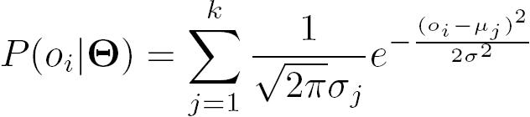
Univariate Gaussian Mixture Model
O = {o₁, …, o_{n}} (n observed objects), Θ = {θ₁, …, θ_{k}} (parameters of the k distributions), and P_{j}(o_{i}| θ_{j}) is the probability that o_{i} is generated from the j-th distribution using parameter θ_{j}, we have
Univariate Gaussian mixture model
Assume the probability density function of each cluster follows a 1-d Gaussian distribution. Suppose that there are k clusters.
The probability density function of each cluster are centered at μ_{j} with standard deviation σ_{j}, θ_{j}, = (μ_{j}, σ_{j}), we have
95
Notes:
95

Slide 96
The EM (Expectation Maximization) Algorithm
The k-means algorithm has two steps at each iteration:
Expectation Step (E-step): Given the current cluster centers, each object is assigned to the cluster whose center is closest to the object: An object is expected to belong to the closest cluster
Maximization Step (M-step): Given the cluster assignment, for each cluster, the algorithm adjusts the center so that the sum of distance from the objects assigned to this cluster and the new center is minimized
The (EM) algorithm: A framework to approach maximum likelihood or maximum a posteriori estimates of parameters in statistical models.
E-step assigns objects to clusters according to the current fuzzy clustering or parameters of probabilistic clusters
M-step finds the new clustering or parameters that maximize the sum of squared error (SSE) or the expected likelihood
96

Slide 97
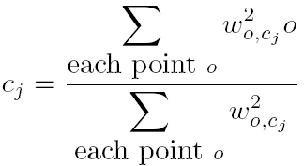
Fuzzy Clustering Using the EM Algorithm
Initially, let c₁ = a and c₂ = b
1st E-step: assign o to c₁, w =
1st M-step: recalculate the centroids according to the partition matrix, minimizing the sum of squared error (SSE)
Iteratively calculate this until the cluster centers converge or the change is small enough

Slide 98
Univariate Gaussian Mixture Model
O = {o₁, …, o_{n}} (n observed objects), Θ = {θ₁, …, θ_{k}} (parameters of the k distributions), and P_{j}(o_{i}| θ_{j}) is the probability that o_{i} is generated from the j-th distribution using parameter θ_{j}, we have
Univariate Gaussian mixture model
Assume the probability density function of each cluster follows a 1-d Gaussian distribution. Suppose that there are k clusters.
The probability density function of each cluster are centered at μ_{j} with standard deviation σ_{j}, θ_{j}, = (μ_{j}, σ_{j}), we have
98
Notes:
98

Slide 99
Computing Mixture Models with EM
Given n objects O = {o₁, …, o_{n}}, we want to mine a set of parameters Θ = {θ₁, …, θ_{k}} s.t.,P(O|Θ) is maximized, where θ_{j} = (μ_{j}, σ_{j}) are the mean and standard deviation of the j-th univariate Gaussian distribution
We initially assign random values to parameters θ_{j}, then iteratively conduct the E- and M- steps until converge or sufficiently small change
At the E-step, for each object o_{i}, calculate the probability that o_{i} belongs to each distribution,
At the M-step, adjust the parameters θ_{j} = (μ_{j}, σ_{j}) so that the expected likelihood P(O|Θ) is maximized
99
Notes:
99

Slide 100
Advantages and Disadvantages of Mixture Models
Strength
Mixture models are more general than partitioning and fuzzy clustering
Clusters can be characterized by a small number of parameters
The results may satisfy the statistical assumptions of the generative models
Weakness
Converge to local optimal (overcome: run multi-times w. random initialization)
Computationally expensive if the number of distributions is large, or the data set contains very few observed data points
Need large data sets
Hard to estimate the number of clusters
100

Slide 101
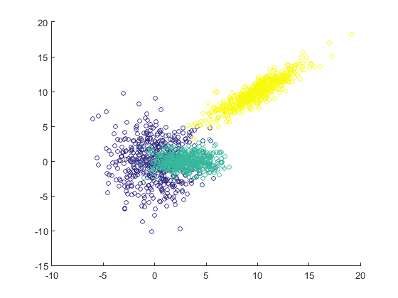
MATLAB Demo (EM Clustering)
% Starting with previous data
>> gmmodel = fitgmdist(D,3);
>> idx_em = gmmodel.cluster(D);
>> scatter(D(:,1), D(:,2), 20, idx_em);
>> idx_em = cluster(gmmodel, D);
>> scatter(D(:,1), D(:,2), 20, idx_em);
>> D = [ mvnrnd([0 0] , [ 5 0 ; 0 10 ],
500) ;
mvnrnd([3 0] , [ 3 0 ; 0 1 ],
500) ;
mvnrnd([10 10],[5 4 ; 4 4 ],
500)];
>> figure
>> scatter(D(:,1), D(:,2));
>> gmmodel = fitgmdist(D,3);
>> idx_em = gmmodel.cluster(D);
>> scatter(D(:,1), D(:,2),
20, idx_em);
>> figure
>> labels = [ ones(500,1) ;
2*ones(500,1) ;
3*ones(500,1) ] ;
>> scatter(D(:,1), D(:,2),
20, labels);
>> figure
>> [idx, C] = kmeans(D, 3);
>> scatter(D(:,1), D(:,2), 20, idx);

Slide 102
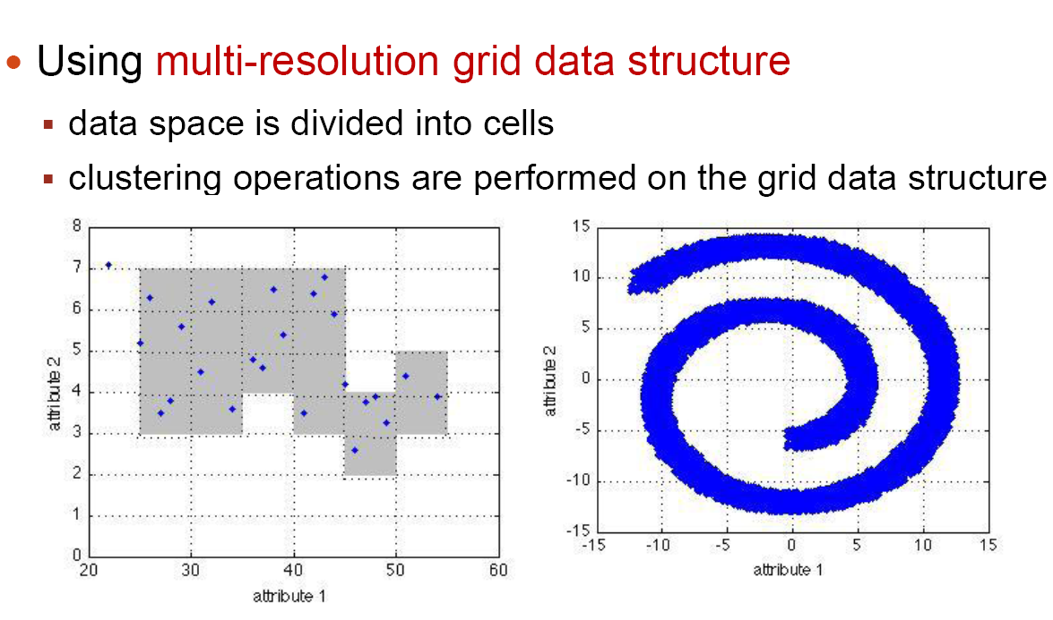
Grid-Based Clustering Method

Slide 103
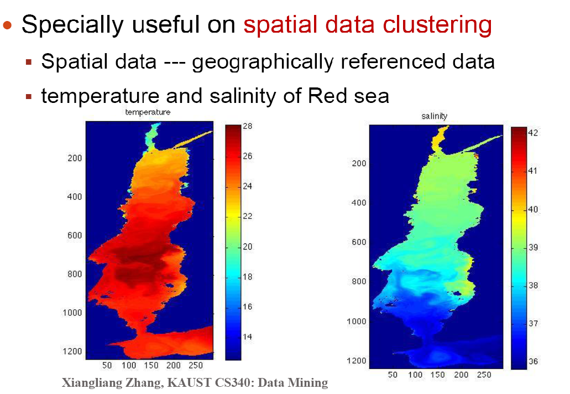
Grid-Based Clustering Method

Slide 104
Grid-Based Clustering Method
Using multi-resolution grid data structure
Several interesting methods
STING (a STatistical INformation Grid approach) by Wang, Yang and Muntz (1997)
WaveCluster by Sheikholeslami, Chatterjee, and Zhang (VLDB’98)
A multi-resolution clustering approach using wavelet method
CLIQUE: Agrawal, et al. (SIGMOD’98)

Slide 105
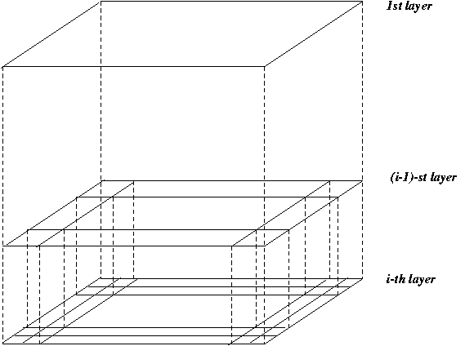
STING
Wang, Yang and Muntz (VLDB’97)
The spatial area is divided into rectangular cells
There are several levels of cells corresponding to different levels of resolution

Slide 106
STING (2)
Each cell at a high level is partitioned into a number of smaller cells in the next lower level
Statistical info of each cell is calculated and stored beforehand and is used to answer queries
Parameters of higher level cells can be easily calculated from parameters of lower level cell
count, mean, s, min, max
type of distribution—normal, uniform, etc.
Use a top-down approach to answer spatial data queries
Start from a pre-selected layer—typically with a small number of cells
For each cell in the current level compute the confidence interval

Slide 107
STING (3)
Remove the irrelevant cells from further consideration
When finish examining the current layer, proceed to the next lower level
Repeat this process until the bottom layer is reached
Advantages:
Query-independent, easy to parallelize, incremental update
O(K), where K is the number of grid cells at the lowest level
Disadvantages:
All the cluster boundaries are either horizontal or vertical, and no diagonal boundary is detected

Slide 108
CLIQUE (Clustering In QUEst)
Agrawal, Gehrke, Gunopulos, Raghavan (SIGMOD’98).
Automatically identifying subspaces of a high dimensional data space that allow better clustering than original space
CLIQUE can be considered as both density-based and grid-based
It partitions each dimension into the same number of equal length interval
It partitions an m-dimensional data space into non-overlapping rectangular units
A unit is dense if the fraction of total data points contained in the unit exceeds the input model parameter
A cluster is a maximal set of connected dense units within a subspace

Slide 109
CLIQUE: The Major Steps
Partition the data space and find the number of points that lie inside each cell of the partition.
Identify the subspaces that contain clusters using the Apriori principle
Identify clusters:
Determine dense units in all subspaces of interests
Determine connected dense units in all subspaces of interests.
Generate minimal description for the clusters
Determine maximal regions that cover a cluster of connected dense units for each cluster
Determination of minimal cover for each cluster

Slide 110
Salary (10,000)
Vacation(week)
7
7
6
6
5
5
4
4
3
3
2
2
1
1
0
age
0
age
20
30
40
50
60
20
30
40
50
60
τ = 3
Vacation
Salary
30
50
age

Slide 111
Strength and Weakness of CLIQUE
Strength
It automatically finds subspaces of the highest dimensionality such that high density clusters exist in those subspaces
It is insensitive to the order of records in input and does not presume some canonical data distribution
It scales linearly with the size of input and has good scalability as the number of dimensions in the data increases
Weakness
The accuracy of the clustering result may be degraded at the expense of simplicity of the method

Slide 112
Clustering High-Dimensional Data
Clustering high-dimensional data (How high is high-D in clustering?)
Many applications: text documents, DNA micro-array data
Major challenges:
Many irrelevant dimensions may mask clusters
Distance measure becomes meaningless—due to equi-distance
Clusters may exist only in some subspaces
Methods
Subspace-clustering: Search for clusters existing in subspaces of the given high dimensional data space
CLIQUE, ProClus, and bi-clustering approaches
Dimensionality reduction approaches: Construct a much lower dimensional space and search for clusters there (may construct new dimensions by combining some dimensions in the original data)
Dimensionality reduction methods and spectral clustering
112
Notes:
112

Slide 113
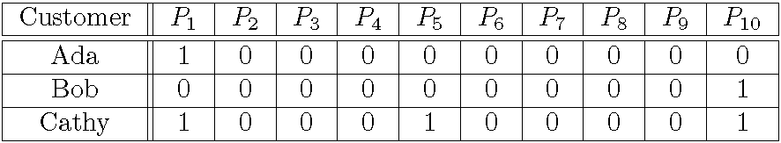
Traditional Distance Measures May Not Be Effective on High-D Data
Traditional distance measure could be dominated by noises in many dimensions
Ex. Which pairs of customers are more similar?
By Euclidean distance, we get,
despite Ada and Cathy look more similar
Clustering should consider changing dimensions (features)
Feature transformation: effective if most dimensions are relevant (PCA & SVD useful when features are highly correlated/redundant)
Feature selection: useful to find a subspace where the data have nice clusters

Slide 114
Why Constraint-Based Cluster Analysis?
Need user feedback: Users know their applications the best
Less parameters but more user-desired constraints, e.g., an ATM allocation problem: obstacle & desired clusters
114
Notes:
114

Slide 115
Categorization of Constraints
Constraints on instances: specifies how a pair or a set of instances should be grouped in the cluster analysis
Must-link vs. cannot link constraints
must-link(x, y): x and y should be grouped into one cluster
Constraints can be defined using variables, e.g.,
cannot-link(x, y) if dist(x, y) > d
Constraints on clusters: specifies a requirement on the clusters
E.g., specify the min # of objects in a cluster, the max diameter of a cluster, the shape of a cluster (e.g., a convex), # of clusters (e.g., k)
Constraints on similarity measurements: specifies a requirement that the similarity calculation must respect
E.g., driving on roads, obstacles (e.g., rivers, lakes)
Issues: Hard vs. soft constraints; conflicting or redundant constraints
115
Notes:
115

Slide 116
Constraint-Based Clustering Methods (I): Handling Hard Constraints
Handling hard constraints: Strictly respect the constraints in cluster assignments
Example: The COP-k-means algorithm
Generate super-instances for must-link constraints
Compute the transitive closure of the must-link constraints
To represent such a subset, replace all those objects in the subset by the mean.
The super-instance also carries a weight, which is the number of objects it represents
Conduct modified k-means clustering to respect cannot-link constraints
Modify the center-assignment process in k-means to a nearest feasible center assignment
An object is assigned to the nearest center so that the assignment respects all cannot-link constraints
116
Notes:
116

Slide 117
Constraint-Based Clustering Methods (II): Handling Soft Constraints
Treated as an optimization problem: When a clustering violates a soft constraint, a penalty is imposed on the clustering
Overall objective: Optimizing the clustering quality, and minimizing the constraint violation penalty
Ex. CVQE (Constrained Vector Quantization Error) algorithm: Conduct k-means clustering while enforcing constraint violation penalties
Objective function: Sum of distance used in k-means, adjusted by the constraint violation penalties
Penalty of a must-link violation
If objects x and y must-be-linked but they are assigned to two different centers, c₁ and c₂, dist(c₁, c₂) is added to the objective function as the penalty
Penalty of a cannot-link violation
If objects x and y cannot-be-linked but they are assigned to a common center c, dist(c, c′), between c and c′ is added to the objective function as the penalty, where c′ is the closest cluster to c that can accommodate x or y
117

Slide 118
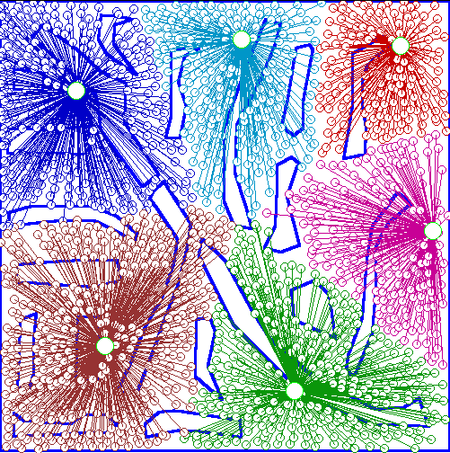
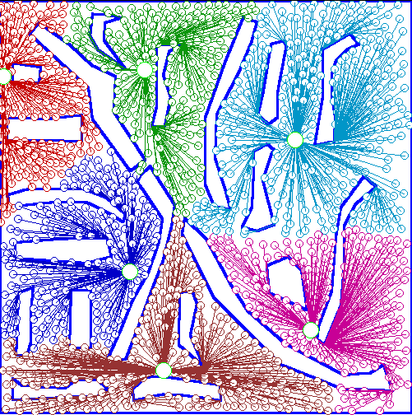
An Example: Clustering With Obstacle Objects
Not Taking obstacles into account
Taking obstacles into account
118
Notes:
118

