Slide 1
CSC423 Data Analysis and Regression
T-TESTS and CONFIDENCE INTERVALS
By Hand … Using SAS … Using R…
Instructor: Bill Qualls
Email: bill_qualls@hotmail.com

Slide 2
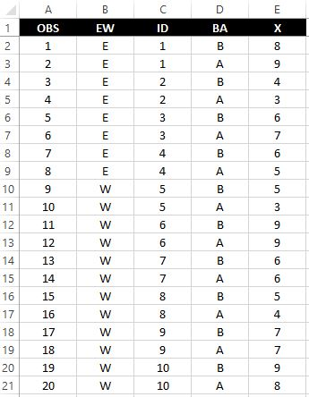
Dataset

Slide 3
Tests of Hypotheses -- Eight Steps
1. State the hypothesis
2. Identify the test statistic to be used
3. Determine the alpha to be used
4. Identify the critical value(s) / rejection region
5. Draw the sample
6. Calculate the observed value of the test statistic
7. State the conclusion
8. Find the p-value.
Note: hypothesis = singular, hypotheses = plural.

Slide 4

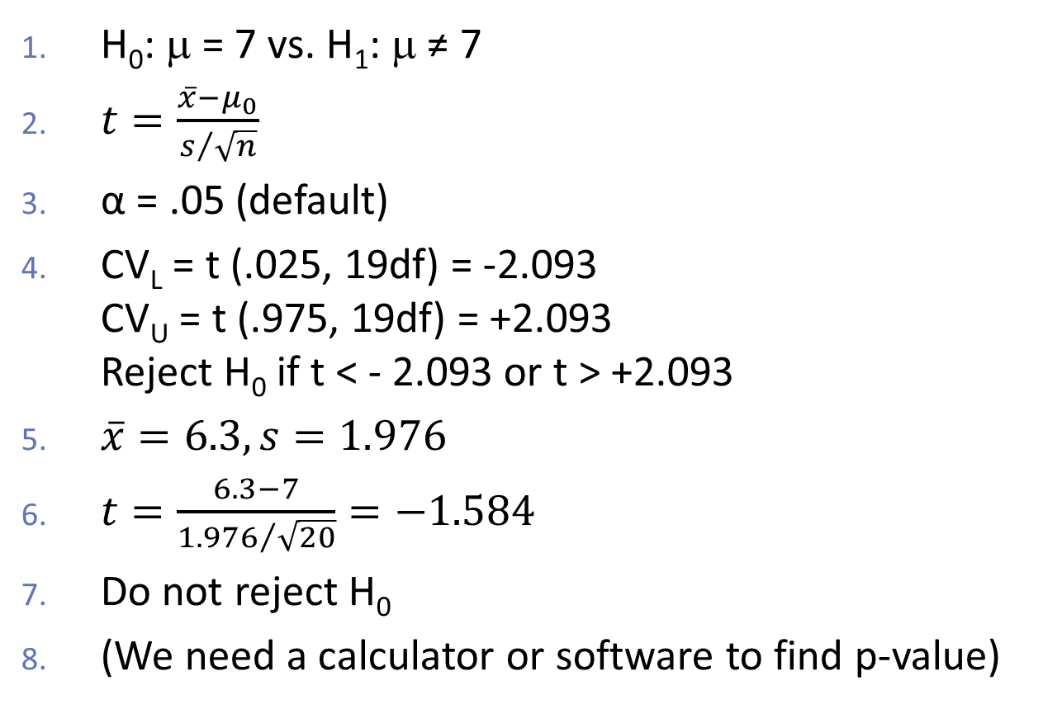
Test #1 by hand
H₀: μ = 7 vs. H₁: μ ≠ 7
$t=\frac{\overline{x}−μ_{0}}{s/{\sqrt{n}}}$
α = .05 (default)
CV_{L} = t (.025, 19df) = -2.093 CV_{U} = t (.975, 19df) = +2.093 Reject H₀ if t < - 2.093 or t > +2.093
$\overline{x}=6.3, s=1.976$
$t=\frac{6.3−7}{{1.976}/{\sqrt{20}}}=−1.584$
Do not reject H₀
(We need a calculator or software to find p-value)

Slide 5

Confidence Interval #1 by hand
$$μ=\overline{x}±t\frac{s}{\sqrt{n}}$$
$=6.3±2.093\frac{1.976}{\sqrt{20}}$
$=6.3±2.093×.4418$
$=6.3±.925$
$=\left\lceil 5.375, 7.225\right\rceil$

Slide 6
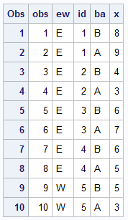
Test #1 using SAS
libname perm 'full/path/to/data/folder';
proc print data=perm.ttests (obs=10);
run;

Slide 7
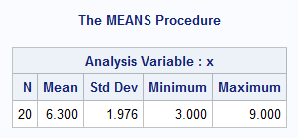
Test #1 using SAS
proc means data=perm.ttests maxdec=3;
var x;
run;

Slide 8
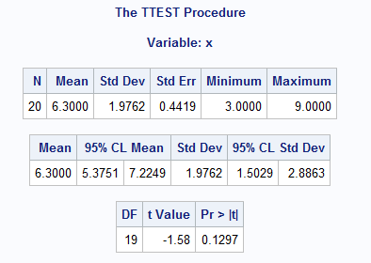
Test #1 using SAS
proc ttest data=perm.ttests
h0=7 alpha=.05 plots=none;
var x;
run;

Slide 9
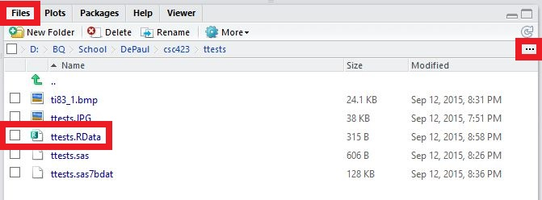
Test #1 using R
Using R Studio…
Select Files tab
Click on ellipses
Navigate to data folder
Select file ttests.Rdata

Slide 10
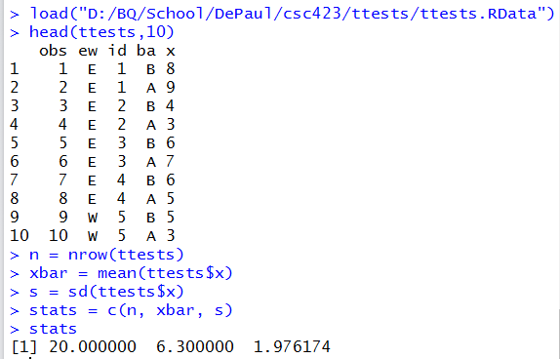
Test #1 using R

Slide 11
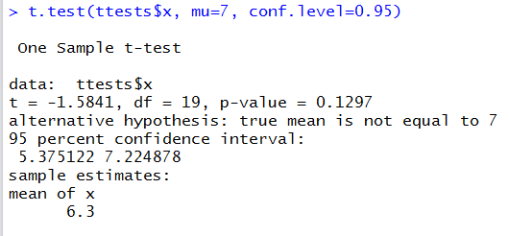
Test #1 using R

Slide 12
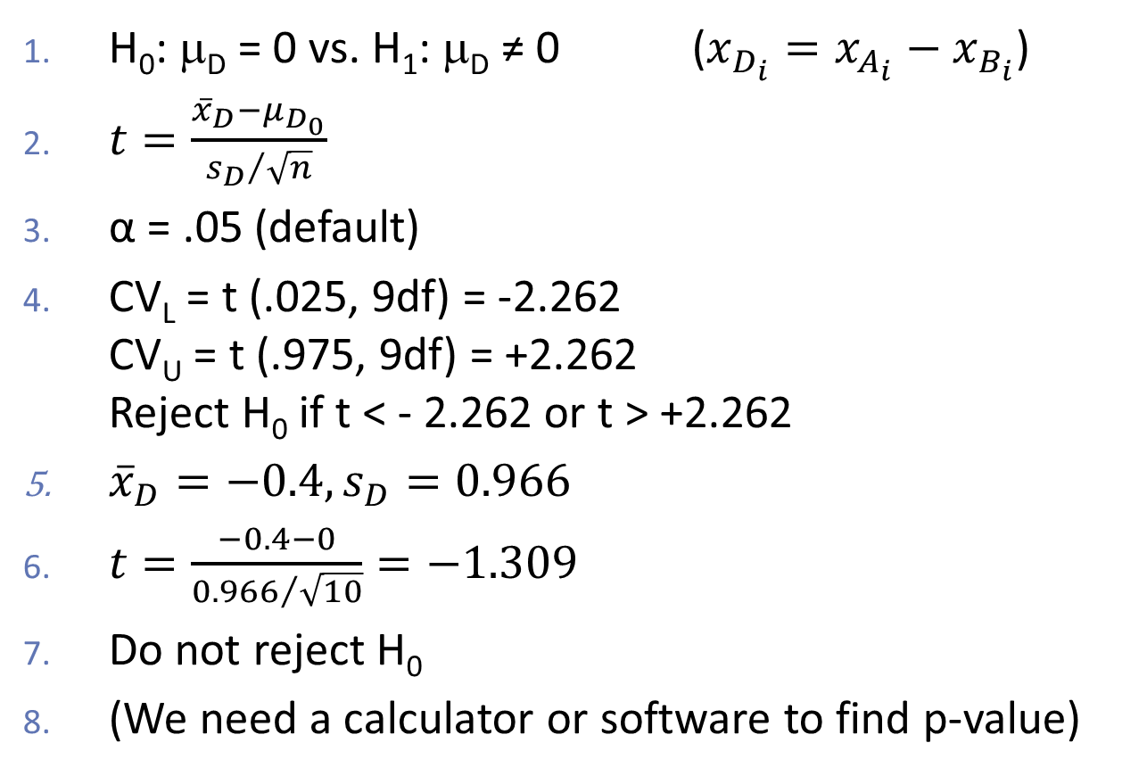
Test #2 by hand
D = {-1, 1, -1, -2, 0, 0, -1, 0, -1}
H₀: μ_{D} = 0 vs. H₁: μ_{D} ≠ 0 ($x_{D_{i}}=x_{A_{i}}−x_{B_{i}}$)
$t=\frac{{\overline{x}}_{D}−μ_{D_{0}}}{{s_{D}}/{\sqrt{n}}}$
α = .05 (default)
CV_{L} = t (.025, 9df) = -2.262 CV_{U} = t (.975, 9df) = +2.262 Reject H₀ if t < - 2.262 or t > +2.262
${\overline{x}}_{D}=−0.4, s_{D}=0.966$
$t=\frac{−0.4−0}{{0.966}/{\sqrt{10}}}=−1.309$
Do not reject H₀
(We need a calculator or software to find p-value)

Slide 13

Confidence Interval #2 by hand
$$μ={\overline{x}}_{D}±t\frac{s_{D}}{\sqrt{n}}$$
$=−0.4±2.262\frac{0.966 }{\sqrt{10}}$
$=−0.4±2.262×.3055$
$=−0.4±.691$
$=\left\lceil −1.091, 0.291\right\rceil$

Slide 14
Test #2 using SAS
data work.before;
set perm.ttests;
if ba = "B" then do;
before = x;
output;
end;
run;
data work.after;
set perm.ttests;
if ba = "A" then do;
after = x;
output;
end;
run;

Slide 15
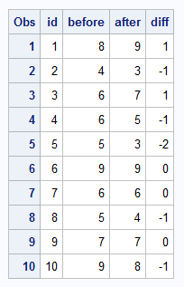
Test #2 using SAS
data work.merged (keep = id before after diff);
merge work.before work.after;
by id;
diff = after - before;
run;
proc print data=work.merged;
run;

Slide 16
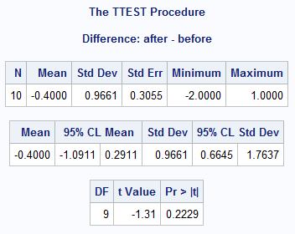
Test #2 using SAS
proc ttest data=work.merged h0=0
alpha=0.05 plots=none;
paired after * before;
run;

Slide 17
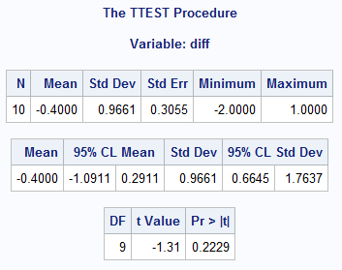
Test #2 using SAS
proc ttest data=work.merged h0=0
alpha=0.05 plots=none;
var diff;
run;

Slide 18
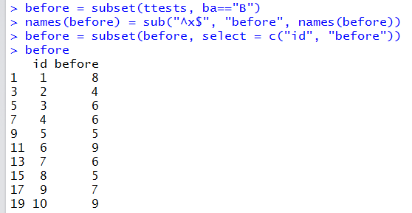
Test #2 using R

Slide 19
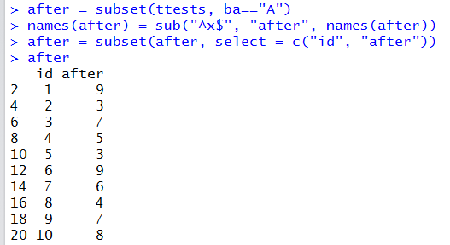
Test #2 using R

Slide 20
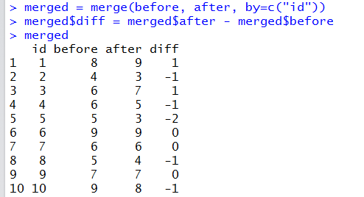
Test #2 using R

Slide 21
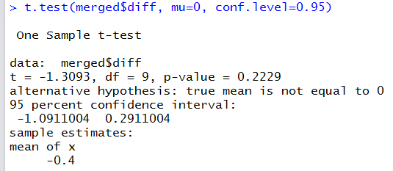
Test #2 using R

Slide 22
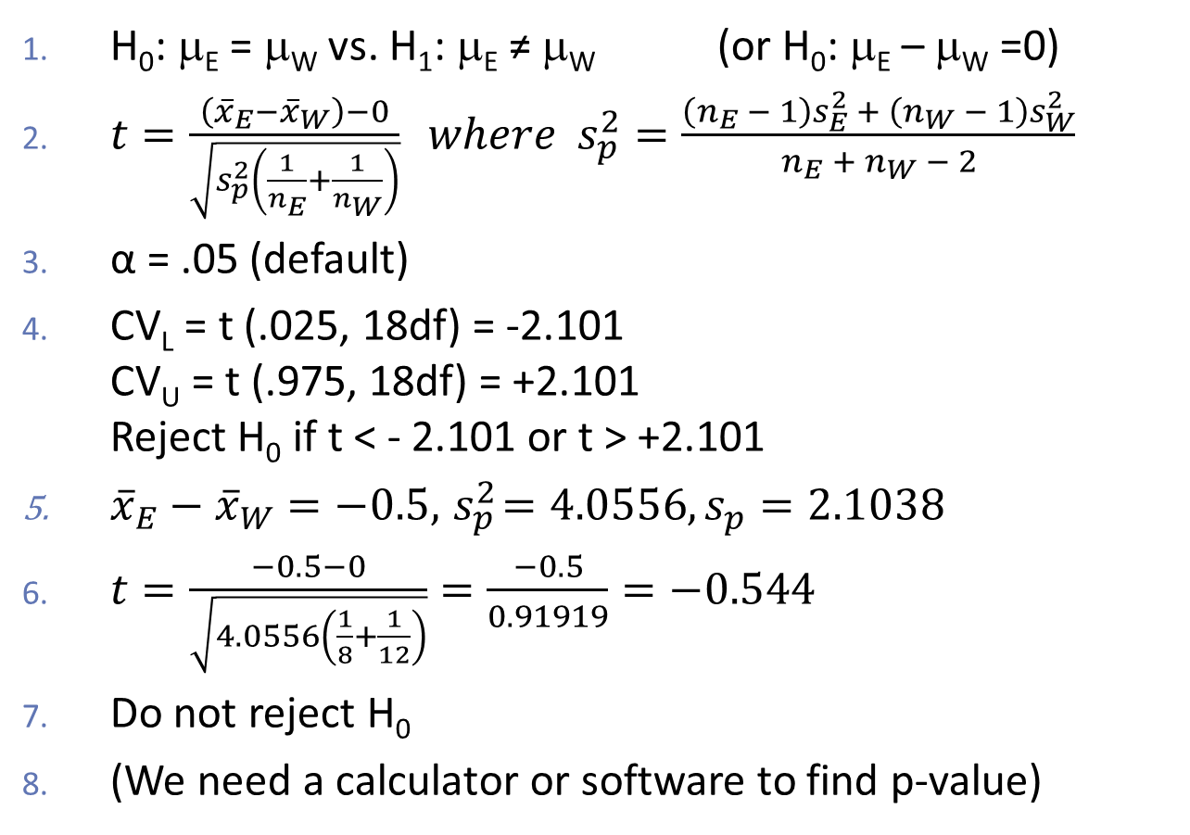
Test #3 by hand
This is not paired data!
H₀: μ_{E} = μ_{W} vs. H₁: μ_{E} ≠ μ_{W} (or H₀: μ_{E} – μ_{W} =0)
$t=\frac{\left({\overline{x}}_{E}−{\overline{x}}_{W}\right)−0}{\sqrt{s_{p}^{2}\left(\frac{1}{n_{E}}+\frac{1}{n_{W}}\right)}} where { s}_{p}^{2}=\frac{\left(n_{E} − 1\right)s_{E}^{2} + \left(n_{W} − 1\right)s_{W}^{2}}{n_{E} +{ n}_{W} − 2}$
α = .05 (default)
CV_{L} = t (.025, 18df) = -2.101 CV_{U} = t (.975, 18df) = +2.101 Reject H₀ if t < - 2.101 or t > +2.101
${\overline{x}}_{E}−{\overline{x}}_{W}=−0.5,{ s}_{p}^{2}=4.0556, s_{p}=2.1038$
$t=\frac{−0.5−0}{\sqrt{4.0556\left(\frac{1}{8}+\frac{1}{12}\right)}}=\frac{−0.5}{0.91919}=−0.544$
Do not reject H₀
(We need a calculator or software to find p-value)

Slide 23
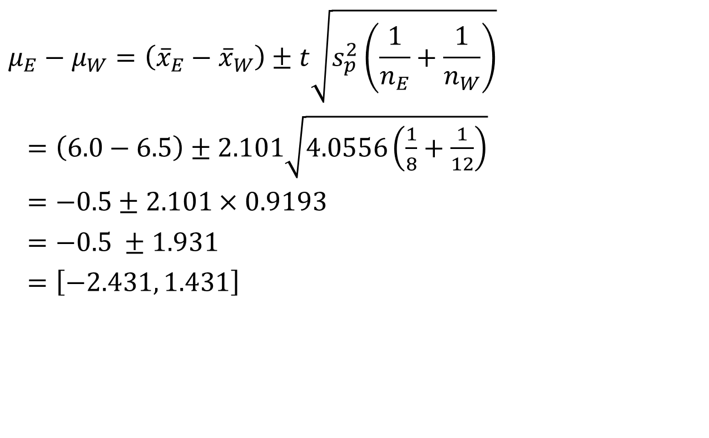
Confidence Interval #3 by hand
$$μ_{E}−μ_{W}=\left({\overline{x}}_{E}−{\overline{x}}_{W}\right)±t\sqrt{s_{p}^{2}\left(\frac{1}{n_{E}}+\frac{1}{n_{W}}\right)}$$
$=\left(6.0−6.5\right)±2.101\sqrt{4.0556\left(\frac{1}{8}+\frac{1}{12}\right)}$
$=−0.5±2.101×0.9193$
$=−0.5 ±1.931$
$=\left[−2.431, 1.431\right]$

Slide 24
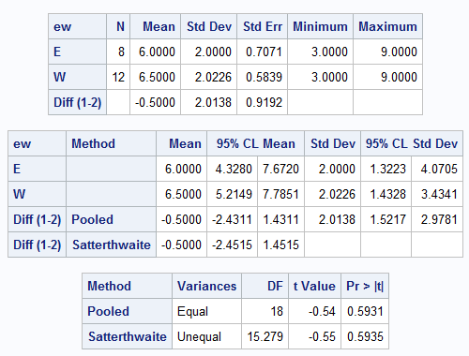
Test #3 using SAS
proc ttest data=perm.ttests h0=0
alpha=0.05 plots=none;
class ew;
var x;
run;

Slide 25
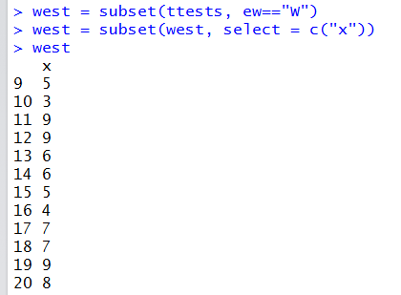
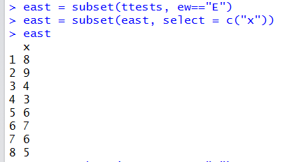
Test #3 using R

Slide 26
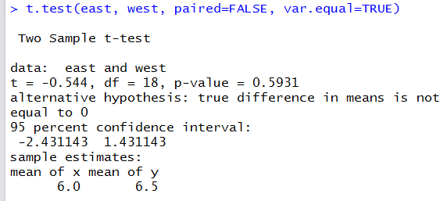
Test #3 using R

