Slide 1
Association Rule Discovery
Bamshad Mobasher
DePaul University

Slide 2

Market Basket Analysis
Goal of MBA is to find associations (affinities) among groups of items occurring in a transactional database
has roots in analysis of point-of-sale data, as in supermarkets
but, has found applications in many other areas
Association Rule Discovery
most common type of MBA technique
Find all rules that associate the presence of one set of items with that of another set of items.
Example: 98% of people who purchase tires and auto accessories also get automotive services done
We are interested in rules that are
non-trivial (possibly unexpected)
actionable
easily explainable

Slide 3
Format of Association Rules
Typical Rule form:
Body ==> Head
Body and Head can be represented as sets of items (in transaction data) or as conjunction of predicates (in relational data)
Support and Confidence
Usually reported along with the rules
Metrics that indicate the strength of the item associations
Examples:
{diaper, milk} ==> {beer} [support: 0.5%, confidence: 78%]
buys(x, "bread") /\ buys(x, “eggs") ==> buys(x, "milk") [sup: 0.6%, conf: 65%]
major(x, "CS") /\ takes(x, "DB") ==> grade(x, "A") [1%, 75%]
age(X,30-45) /\ income(X, 50K-75K) ==> owns(X, SUV)
age=“30-45”, income=“50K-75K” ==> car=“SUV”

Slide 4
Association Rules – Basic Concepts
Let D be database of transactions
e.g.:
Let I be the set of items that appear in the database, e.g., I={A,B,C,D,E,F}
Each transaction t is a subset of I
A rule is an implication among itemsets X and Y, of the form by X → Y, where X⊂I, Y⊂I, and X∩Y=∅
e.g.: {B,C} ◊ {A} is a rule
Transaction ID | Items
1000 | A, B, C
2000 | A, B
3000 | A, D
4000 | B, E, F
Notes:
4

Slide 5
Association Rules – Basic Concepts
Itemset
A set of one or more items
E.g.: {Milk, Bread, Diaper}
k-itemset
An itemset that contains k items
Support count (σ)‏
Frequency of occurrence of an itemset (number of transactions it appears)
E.g. σ({Milk, Bread,Diaper}) = 2
Support
Fraction of the transactions in which an itemset appears
E.g. s({Milk, Bread, Diaper}) = 2/5
Frequent Itemset
An itemset whose support is greater than or equal to a minsup threshold
Notes:
5

Slide 6
Association Rules – Basic Concepts
Association Rule
X → Y, where X and Y are non-overlapping itemsets
{Milk, Diaper} → {Beer}
Rule Evaluation Metrics
Support (s)‏
Fraction of transactions that contain both X and Y
i.e., support of the itemset X ∪ Y
Confidence (c)‏
Measures how often items in Y appear in transactions that contain X
Example:
Notes:
6

Slide 7
Association Rules – Basic Concepts
Customer
buys both
Another interpretation of support and confidence for X → Y
support, s, probability that a transaction contains {X ∪ Y} or Pr(X /\ Y)
confidence, c, conditional probability
that a transaction having X also contains Y or Pr(Y | X)
Customer
buys diaper
Customer
buys beer
Note: confidence(X → Y) = support(X ∪ Y) / support(X)
TID | Items
100 | A,B,C
200 | A,C
300 | A,D
400 | B,E,F
Let minimum support = 50%, and minimum confidence = 50%:
A → C (50%, 66.6%)‏ C → A (50%, 100%)‏
Notes:
7

Slide 8
Support and Confidence - Example
Itemset {A, C} has a support of 2/5 = 40%
Rule {A} ==> {C} has confidence of 50%
Rule {C} ==> {A} has confidence of 100%
Support for {A, C, E} ?
Support for {A, D, F} ?
Confidence for {A, D} ==> {F} ?
Confidence for {A} ==> {D, F} ?

Slide 9
Lift (Improvement)
High confidence rules are not necessarily useful
What if confidence of {A, B} → {C} is less than Pr({C})?
Lift gives the predictive power of a rule compared to random chance:
$$lift\left(X→Y\right)= \frac{\operatorname{Pr}\left(Y | X\right)}{\operatorname{Pr}\left(Y\right)}=\frac{confidence\left(X→Y\right)}{support\left(Y\right)}= \frac{support(X∪Y)}{support\left(X\right).support(Y)}$$
Itemset {A} has a support of 4/5
Rule {C} ==> {A} has confidence of 2/2
Lift = 5/4 = 1.25
Itemset {A} has a support of 4/5
Rule {B} ==> {A} has confidence of 1/2
Lift = 5/8 = 0.625

Slide 10
Steps in Association Rule Discovery
Find the frequent itemsets
(item sets are the sets of items that have minimum support)
Use the frequent itemsets to generate association rules
Brute Force Algorithm:
List all possible itemsets and compute their support
Generate all rules from frequent itemset
Prune rules that fail the minconf threshold
Would this work?!

Slide 11
How many itemsets are there?
Given n items, there are 2^{n} possible itemsets
Notes:
11

Slide 12
Solution: The Apriroi Principle
Support is “downward closed”
If an itemset is frequent (has enough support), then all of its subsets must also be frequent
if {AB} is a frequent itemset, both {A} and {B} are frequent itemsets
This is due to the anti-monotone property of support
Corollary: if an itemset doesn’t satisfy minimum support, none of its supersets will either
this is essential for pruning search space)
Notes:
12

Slide 13
The Apriori Principle
Found to be Infrequent
Pruned supersets

Slide 14
Support-Based Pruning
Items (1-itemsets)‏
Pairs (2-itemsets)‏
(No need to generate candidates involving Coke or Eggs)‏
minsup = 3/5
Triplets (3-itemsets)‏

Slide 15
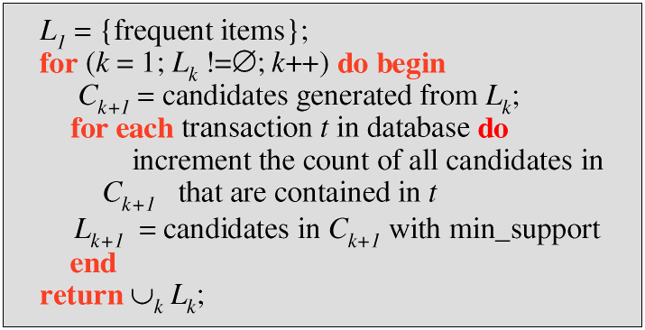
Apriori Algorithm
C_{k} : Candidate itemset of size k
L_{k} : Frequent itemset of size k
Join Step: C_{k} is generated by joining L_{k-1}with itself
Prune Step: Any (k-1)-itemset that is not frequent cannot be a subset of a frequent k-itemset

Slide 16
Example of Generating Candidates
L₃={abc, abd, acd, ace, bcd}
Self-joining: L₃*L₃
abcd from abc and abd
acde from acd and ace
Pruning:
acde is removed because ade is not in L₃
C₄ = {abcd}
{a,c,d}
{a,c,e}
{a,c,d,e}
acd
ace
ade
cde

Slide 17
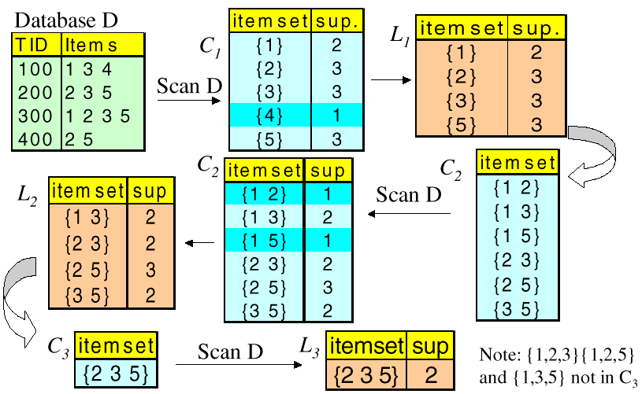
Apriori Algorithm - An Example
Assume minimum support = 2

Slide 18
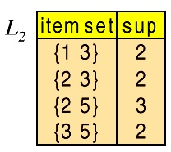

Apriori Algorithm - An Example
The final “frequent” item sets are those remaining in L2 and L3.
However, {2,3}, {2,5}, and {3,5} are all contained in the larger item set {2, 3, 5}. Thus, the final group of item sets reported by Apriori are {1,3} and {2,3,5}. These are the only item sets from which we will generate association rules.

Slide 19
Generating Association Rules from Frequent Itemsets
Only strong association rules are generated
Frequent itemsets satisfy minimum support threshold
Strong rules are those that satisfy minimum confidence threshold
confidence(A → B) = Pr(B | A) =
For each frequent itemset, f, generate all non-empty subsets of f
For every non-empty subset s of f do
if support(f)/support(s) ≥ min_confidence then
output rule s ==> (f-s)
end

Slide 20
Generating Association Rules (Example Continued)
Item sets: {1,3} and {2,3,5}
Recall that confidence of a rule LHS → RHS is Support of itemset (i.e. LHS ∪ RHS) divided by support of LHS.
Candidate rules for {1,3} |  | Candidate rules for {2,3,5}
Rule | Conf. | Rule | Conf. | Rule | Conf.
{1}→{3} | 2/2 = 1.0 | {2,3}→{5} | 2/2 = 1.00 | {2}→{5} | 3/3 = 1.00
{3}→{1} | 2/3 = 0.67 | {2,5}→{3} | 2/3 = 0.67 | {2}→{3} | 2/3 = 0.67
 |  | {3,5}→{2} | 2/2 = 1.00 | {3}→{2} | 2/3 = 0.67
 |  | {2}→{3,5} | 2/3 = 0.67 | {3}→{5} | 2/3 = 0.67
 |  | {3}→{2,5} | 2/3 = 0.67 | {5}→{2} | 3/3 = 1.00
 |  | {5}→{2,3} | 2/3 = 0.67 | {5}→{3} | 2/3 = 0.67
Assuming a min. confidence of 75%, the final set of rules reported by
Apriori are: {1}→{3}, {3,5}→{2}, {5}→{2} and {2}→{5}

Slide 21
Frequent Patterns Without Candidate Generation
Bottlenecks of the Apriori approach
Breadth-first (i.e., level-wise) search
Candidate generation and test (Often generates a huge number of candidates)
The FPGrowth Approach (J. Han, J. Pei, Y. Yin, 2000)
Depth-first search; avoids explicit candidate generation
Basic Idea: Grow long patterns from short ones using locally frequent items only
“abc” is a frequent pattern; get all transactions having “abc”
“d” is a local frequent item in DB|abc → abcd is a frequent pattern
Approach:
Use a compressed representation of the database using an FP-tree
Once an FP-tree has been constructed, it uses a recursive divide-and-conquer approach to mine the frequent itemsets

Slide 22
FP-Growth: Constructing FP-tree from a Transaction Database
TID Items bought (ordered) frequent items
100 {f, a, c, d, g, i, m, p} {f, c, a, m, p}
200 {a, b, c, f, l, m, o} {f, c, a, b, m}
300 {b, f, h, j, o, w} {f, b}
400 {b, c, k, s, p} {c, b, p}
500 {a, f, c, e, l, p, m, n} {f, c, a, m, p}
min_support = 3
{}
Header Table
Item frequency head
f 4
c 4
a 3
b 3
m 3
p 3
Scan DB once, find frequent 1-itemset (single item pattern)
Sort frequent items in frequency descending order, f-list
Scan DB again, construct FP-tree
f:4
c:1
c:3
b:1
b:1
a:3
p:1
m:2
b:1
F-list = f-c-a-b-m-p
p:2
m:1

Slide 23
Example: FP-Tree Construction
null
After reading TID=1:
A:1
B:1
After reading TID=2:
null
A:1
B:1
B:1
C:1
D:1

Slide 24
Example: FP-Tree Construction
After reading TID=3:
null
A:2
B:1
B:1
C:1
C:1
D:1
D:1
E:1

Slide 25
Example: FP-Tree Construction
Transaction Database
null
A:7
B:3
B:5
C:3
C:1
D:1
Header table
D:1
C:3
E:1
D:1
E:1
D:1
E:1
D:1
Pointers are used to assist frequent itemset generation

Slide 26
FP-growth
Build conditional pattern base for E: P = {(A:1,C:1,D:1), (A:1,D:1), (B:1,C:1)}
Recursively apply FP-growth on P
null
A:7
B:3
B:5
C:3
C:1
D:1
C:3
D:1
D:1
E:1
D:1
E:1
E:1
D:1

Slide 27
FP-growth
Conditional tree for E:
Conditional Pattern base for E: P = {(A:1,C:1,D:1,E:1), (A:1,D:1,E:1), (B:1,C:1,E:1)}
Count for E is 3: {E} is frequent itemset
Recursively apply FP-growth on P
null
A:2
B:1
C:1
C:1
D:1
D:1
E:1
E:1
E:1

Slide 28
FP-growth
Conditional tree for D within conditional tree for E:
Conditional pattern base for D within conditional base for E: P = {(A:1,C:1,D:1), (A:1,D:1)}
Count for D is 2: {D,E} is frequent itemset
Recursively apply FP-growth on P
null
A:2
C:1
D:1
D:1

Slide 29
FP-growth
Conditional tree for C within D within E:
Conditional pattern base for C within D within E: P = {(A:1,C:1)}
Count for C is 1: {C,D,E} is NOT frequent itemset
null
A:1
C:1

Slide 30
FP-growth
Conditional tree for A within D within E:
Count for A is 2: {A,D,E} is frequent itemset
Next step:
Construct conditional tree C within conditional tree E
Continue until exploring conditional tree for A (which has only node A)
null
A:2

Slide 31
The FP-Growth Mining Method Summary
Idea: Frequent pattern growth
Recursively grow frequent patterns by pattern and database partition
Method
For each frequent item, construct its conditional pattern-base, and then its conditional FP-tree
Repeat the process on each newly created conditional FP-tree
Until the resulting FP-tree is empty, or it contains only one path—single path will generate all the combinations of its sub-paths, each of which is a frequent pattern

Slide 32
Extensions: Multiple-Level Association Rules
Items often form a hierarchy
Items at the lower level are expected to have lower support
Rules regarding itemsets at appropriate levels could be quite useful
Transaction database can be encoded based on dimensions and levels
Food
Milk
Bread
Skim
2%
Wheat
White

Slide 33
Mining Multi-Level Associations
A top_down, progressive deepening approach
First find high-level strong rules:
milk → bread [20%, 60%]
Then find their lower-level “weaker” rules:
2% milk → wheat bread [6%, 50%]
When one threshold set for all levels; if support too high then it is possible to miss meaningful associations at low level; if support too low then possible generation of uninteresting rules
different minimum support thresholds across multi-levels lead to different algorithms (e.g., decrease min-support at lower levels)
Variations at mining multiple-level association rules
Level-crossed association rules:
milk → wonder wheat bread
Association rules with multiple, alternative hierarchies:
2% milk → wonder bread

Slide 34
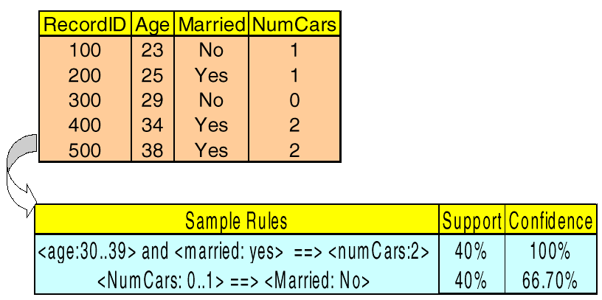
Extensions: Quantitative Association Rules
Handling quantitative rules may requires discretization of numerical attributes

Slide 35
Associations in Text / Web Mining
Document Associations
Find (content-based) associations among documents in a collection
Documents correspond to items and words correspond to transactions
Frequent itemsets are groups of docs in which many words occur in common
Term Associations
Find associations among words based on their occurrences in documents
similar to above, but invert the table (terms as items, and docs as transactions)

Slide 36
Associations in Web Usage Mining
Association Rules in Web Transactions
discover affinities among sets of Web page references across user sessions
Examples
60% of clients who accessed /products/, also accessed /products/software/webminer.htm
30% of clients who accessed /special-offer.html, placed an online order in /products/software/
Actual Example from IBM official Olympics Site:
{Badminton, Diving} ==> {Table Tennis} [conf = 69.7%, sup = 0.35%]
Applications
Use rules to serve dynamic, customized contents to users
prefetch files that are most likely to be accessed
determine the best way to structure the Web site (site optimization)
targeted electronic advertising and increasing cross sales

Slide 37
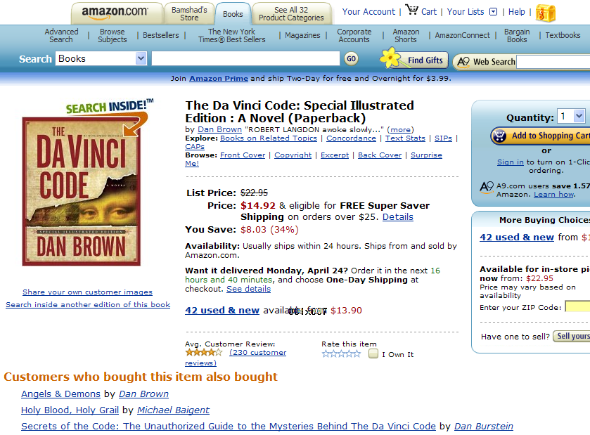
Associations in Recommender Systems

Slide 38
Sequential Patterns Extending Frequent Itemsets
Sequential patterns add an extra dimension to frequent itemsets and association rules - time.
Items can appear before, after, or at the same time as each other.
General form: “x% of the time, when A appears in a transaction, B appears within z transactions.”
note that other items may appear between A and B, so sequential patterns do not necessarily imply consecutive appearances of items (in terms of time)
Examples
Renting “Star Wars”, then “Empire Strikes Back”, then “Return of the Jedi” in that order
Collection of ordered events within an interval
Most sequential pattern discovery algorithms are based on extensions of the Apriori algorithm for discovering itemsets
Navigational Patterns
they can be viewed as a special form of sequential patterns which capture navigational patterns among users of a site
in this case a session is a consecutive sequence of pageview references for a user over a specified period of time

Slide 39
Mining Sequences - Example
Customer-sequence
Sequential patterns with support > 0.25 {(C), (H)} {(C), (DG)}

Slide 40
Sequential Pattern Mining: Cases and Parameters
Duration of a time sequence T
Sequential pattern mining can then be confined to the data within a specified duration
Ex. Subsequence corresponding to the year of 1999
Ex. Partitioned sequences, such as every year, or every week after stock crashes, or every two weeks before and after a volcano eruption
Event folding window w
If w = T, time-insensitive frequent patterns are found
If w = 0 (no event sequence folding), sequential patterns are found where each event occurs at a distinct time instant
If 0 < w < T, sequences occurring within the same period w are folded in the analysis

Slide 41
Sequential Pattern Mining: Cases and Parameters
Time interval, int, between events in the discovered pattern
int = 0: no interval gap is allowed, i.e., only strictly consecutive sequences are found
Ex. “Find frequent patterns occurring in consecutive weeks”
min_int ≤ int ≤ max_int: find patterns that are separated by at least min_int but at most max_int
Ex. “If a person rents movie A, it is likely she will rent movie B within 30 days” (int ≤ 30)
int = c ≠ 0: find patterns carrying an exact interval
Ex. “Every time when Dow Jones drops more than 5%, what will happen exactly two days later?” (int = 2)

