Slide 1
Classification Techniques: Bayesian Classification
Bamshad Mobasher
DePaul University

Slide 2
Classification: 3 Step Process
1. Model construction (Learning):
Each record (instance, example) is assumed to belong to a predefined class, as determined by one of the attributes
This attribute is called the target attribute
The values of the target attribute are the class labels
The set of all instances used for learning the model is called training set
2. Model Evaluation (Accuracy):
Estimate accuracy rate of the model based on a test set
The known labels of test instances are compared with the predicts class from model
Test set is independent of training set otherwise over-fitting will occur
3. Model Use (Classification):
The model is used to classify unseen instances (i.e., to predict the class labels for new unclassified instances)
Predict the value of an actual attribute

Slide 3
Classification Methods
Decision Tree Induction
Bayesian Classification
K-Nearest Neighbor
Neural Networks
Support Vector Machines
Association-Based Classification
Genetic Algorithms
Many More ….
Also Ensemble Methods

Slide 4
Bayesian Learning
Bayes’s theorem plays a critical role in probabilistic learning and classification
Uses prior probability of each class given no information about an item
Classification produces a posterior probability distribution over the possible classes given a description of an item
The models are incremental in the sense that each training example can incrementally increase or decrease the probability that a hypothesis is correct. Prior knowledge can be combined with observed data
Given a data instance X with an unknown class label, H is the hypothesis that X belongs to a specific class C
The conditional probability of hypothesis H given observation X, Pr(H|X), follows the Bayes’s theorem:
Practical difficulty: requires initial knowledge of many probabilities

Slide 5
Basic Concepts In Probability I
P(A | B) is the probability of A given B
Assumes that B is all and only information known.
Defined by:
Bayes’s Rule: Direct corollary of above definition
Often written in terms of hypothesis and evidence:
A
B

Slide 6
Basic Concepts In Probability II
A and B are independent iff:
Therefore, if A and B are independent:
These two constraints are logically equivalent

Slide 7
Bayesian Classification
Let set of classes be {c₁, c₂,…c_{n}}
Let E be description of an instance (e.g., vector representation)
Determine class of E by computing for each class c_{i}
P(E) can be determined since classes are complete and disjoint:

Slide 8
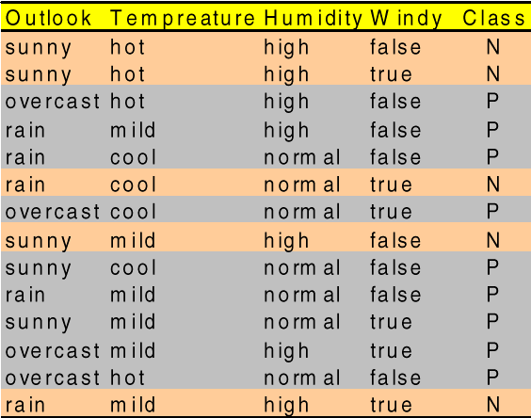
Bayesian Categorization (cont.)
Need to know:
Priors: P(c_{i}) and Conditionals: P(E | c_{i})
P(c_{i}) are easily estimated from data.
If n_{i} of the examples in D are in c_{i},then P(c_{i}) = n_{i} / |D|
Assume instance is a conjunction of binary features/attributes:

Slide 9
Naïve Bayesian Classification
Problem: Too many possible combinations (exponential in m) to estimate all P(E | c_{i})
If we assume features/attributes of an instance are independent given the class (c_{i}) (conditionally independent)
Therefore, we then only need to know P(e_{j} | c_{i}) for each feature and category

Slide 10
Estimating Probabilities
Normally, probabilities are estimated based on observed frequencies in the training data.
If D contains n_{i} examples in class c_{i}, and n_{ij} of these n_{i} examples contains feature/attribute e_{j}, then:
If the feature is continuous-valued, P(e_{j}|c_{i}) is usually computed based on Gaussian distribution with a mean μ and standard deviation σ
and P(e_{j}|c_{i}) is

Slide 11
Smoothing
Estimating probabilities from small training sets is error-prone:
If due only to chance, a rare feature, e_{k}, is always false in the training data, ∀c_{i} :P(e_{k} | c_{i}) = 0.
If e_{k} then occurs in a test example, E, the result is that ∀c_{i}: P(E | c_{i}) = 0 and ∀c_{i}: P(c_{i} | E) = 0
To account for estimation from small samples, probability estimates are adjusted or smoothed
Laplace smoothing using an m-estimate assumes that each feature is given a prior probability, p, that is assumed to have been previously observed in a “virtual” sample of size m.
For binary features, p is simply assumed to be 0.5.

Slide 12
Naïve Bayesian Classifier - Example
Here, we have two classes C1=“yes” (Positive) and C2=“no” (Negative)
Pr(“yes”) = instances with “yes” / all instances = 9/14
If a new instance X had outlook=“sunny”, then Pr(outlook=“sunny” | “yes”) = 2/9
(since there are 9 instances with “yes” (or P) of which 2 have outlook=“sunny”)
Similarly, for humidity=“high”, Pr(humidity=“high” | “no”) = 4/5
And so on.

Slide 13
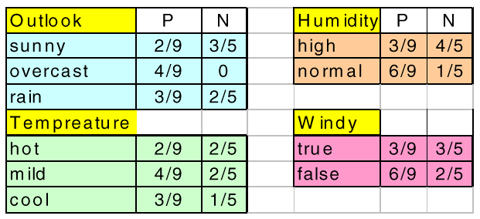
Naïve Bayes (Example Continued)
Now, given the training set, we can compute all the probabilities
Suppose we have new instance X = <sunny, mild, high, true>. How should it be classified?
Similarly:
X = < sunny , mild , high , true >
Pr(X | “no”) = 3/5 . 2/5 . 4/5 . 3/5
Pr(X | “yes”) = (2/9 . 4/9 . 3/9 . 3/9)

Slide 14
Naïve Bayes (Example Continued)
To find out to which class X belongs we need to maximize: Pr(X | C_{i}).Pr(C_{i}), for each class C_{i} (here “yes” and “no”)
To convert these to probabilities, we can normalize by dividing each by the sum of the two:
Pr(“no” | X) = 0.04 / (0.04 + 0.007) = 0.85
Pr(“yes” | X) = 0.007 / (0.04 + 0.007) = 0.15
Therefore the new instance X will be classified as “no”.
X = <sunny, mild, high, true>
Pr(X | “no”).Pr(“no”) = (3/5 . 2/5 . 4/5 . 3/5) . 5/14 = 0.04
Pr(X | “yes”).Pr(“yes”) = (2/9 . 4/9 . 3/9 . 3/9) . 9/14 = 0.007

Slide 15
Text Naïve Bayes – Spam Example
Training
Data
P(no) = 0.4
P(yes) = 0.6
New email x containing t1, t4, t5 ➔ x = <1, 0, 0, 1, 1>
Should it be classified as spam = “yes” or spam = “no”?
Need to find P(yes | x) and P(no | x) …

Slide 16
Text Naïve Bayes - Example
New email x containing t1, t4, t5
x = <1, 0, 0, 1, 1>
P(no) = 0.4
P(yes) = 0.6
P(yes | x) = [4/6 * (1-4/6) * (1-3/6) * 3/6 * 2/6] * P(yes) / P(x)
= [0.67 * 0.33 * 0.5 * 0.5 * 0.33] * 0.6 / P(x) = 0.11 / P(x)
P(no | x) = [1/4 * (1-2/4) * (1-2/4) * 3/4 * 2/4] * P(no) / P(x)
= [0.25 * 0.5 * 0.5 * 0.75 * 0.5] * 0.4 / P(x) = 0.019 / P(x)
To get actual probabilities need to normalize: note that P(yes | x) + P(no | x) must be 1
0.11 / P(x) + 0.019 / P(x) = 1 ➔ P(x) = 0.11 + 0.019 = 0.129
So: P(yes | x) = 0.11 / 0.129 = 0.853
P(no | x) = 0.019 / 0.129 = 0.147

Slide 17
Classification Techniques: Bayesian Classification
Bamshad Mobasher
DePaul University

